Slide 1
Getting to Simple
Deploying IoT at scale
Pilgrim Beart FIET
Founder
1248
AlertMe
Splashpower antenova activeRF

Slide 2

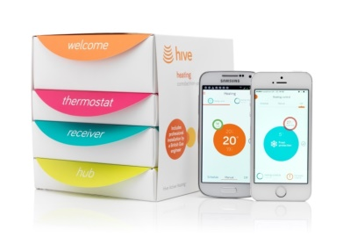
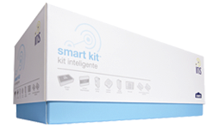
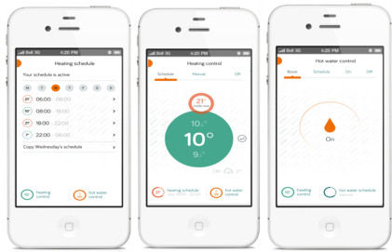
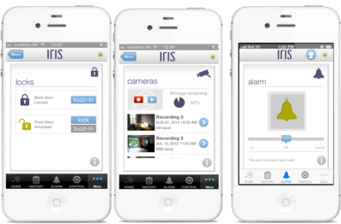
Background
Energy Controls
‘Hive’
Home Automation
‘Iris’

Slide 3
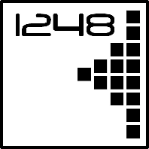
What is IoT?
@1248_io

Slide 4
IoT Architecture/Terminology
Clients
(UI and other services)
Cloud services
(Storage, Analytics)
UX
Gateways
(gets devices onto the Internet)
Devices
(sensors & actuators
in the real world)

Slide 5
Lessons
from the school of hard knocks

Slide 6
For every one way that IoT works…
@1248_io
there are 100 ways it can not work

Slide 7
Real world is a messy place
Making it work simply is - in fact - “the work”
Consider every way that every part can (will) fail
  How must it & other parts respond?
  e.g. Link failure - Buffering? Syncing?
Design Process as well as Product
  e.g. Hive repeater story
  Determines whether you can scale cost-effectively

Slide 8
First impressions
Users don’t follow instructions
  Must cope with any sequence
Onboarding: security and usability
Pairing
  Temporary UIs
  “Duh” interactions e.g. via NFC
  Pre-pairing (pro’s & con’s)

Slide 9
State
In the face of
  Latency
  Unreliable connections
e.g. Smartplug switch UI
  400ms response
  E.g. on smartphone, show local state or remote state?
  Need indicators for “in progress” & “unknown”
Plan for missing data (e.g. buttons & charts)
Historical state:
    Immutability good for scaling.
    Data can show-up late.
    When do we say data is irrevocably missed?
Round-tripping unit conversions (F->C->F)

Slide 10
Where does the “App” run?
Latency, reliability, consistency
  e.g. IHD, Phone, Web
Scalability (local/cloud)
“Fog”?
Client(s)
Cloud
Gateway(s)
Device(s)

Slide 11
Less eyeballs
In e.g. home, interact with home (not device)
Avoid modal interfaces
Often, no screen at all
User intervention as a last resort
  Actionable error messages
  No beeping!
  99.99% aren’t Rain Man (flash sequences etc.)
  >4% of your audience can’t read LEDs colors
…behind the scenes too
  Beware Ops & CS costs (automate mgmt.)

Slide 12
Mindset for IoT design
Start with “User Journey”, not tech
  But design for tech limitations (e.g. batteries)
  Like Architect/Engineer relationship for buildings
Design is often more than just a UX
  It can be a business model revolution too - “servitisation”
Focus UX on Benefits:
  Declarative UI (what you wish to be true)
    Leave machines to work out how & report how well they have achieved it
  e.g. if primary reason someone bought your heating system is to save money, then talk about money, not degrees or kWh
CI/CD:
  Take advantage of measurability of IoT products, to evolve & co-create
Still an early market
  Don’t re-invent the wheel
  Aim for 5 years’ time when there’s an open ecosystem of co-operating vendors at each layer

Slide 13
Getting to Simple
Deploying IoT at scale
Pilgrim Beart FIET
Founder
1248
AlertMe
Splashpower antenova activeRF

