Slide 1
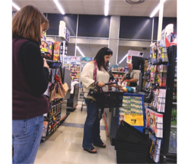
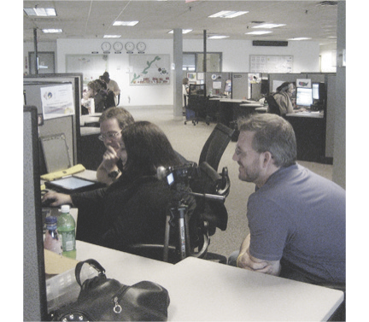
THE USER EXPERIENCE OF PREDICTIVE ANALYTICS IN THE (CONSUMER) INTERNET OF THINGS
BEHAVIOR
Mike Kuniavsky
O’Reilly Experience Design for the IoT
May 20, 2015
© 2015 PARC
Notes:
Good evening. Thanks for having me here. Today I want to give you a bit of my perspective on user experience design for predictive analytics for the internet of things. Most broadly I want to look at the design challenges of systems that anticipate users’ needs based on models of past situations which they use to predict the near future and act on it. I feel this is a fundamentally new challenge for designers that goes beyond traditional UX design practices such as interaction design and information architecture. This talk is broadly divided into two parts: an overview of why I think this is particularly important as the Internet of Things becomes more about services than devices, how people’s relationships to devices and companies’ relationships to value change as a result of this model, and some thoughts on the issues around predictive analytics and behavior, and finally some approaches to addressing these issues.
A couple of caveats up front:
- I’m not planning to review UX design as a whole. I’m planning to just drill down into this one issue that’s been interesting me for the last couple of years.
- Although this talk is about “predictive analytics,” it’s really about BEHAVIOR, which is what the analytics enable
- The talk is focused on the consumer internet of things because although predictive behavior is an important part of the Industrial Internet of Things, it’s REALLY key to the consumer IoT.
- This is a rapidly changing environment, and every time I revise this presentation there have been a lot of changes, so apologies in advance if it doesn’t match your perspective.
- Finally, I want to point out that few if any of the issues I raise are new. Though the term “internet of things” is hot right now, the ideas have been developed for more than 20 years and there’s lots of great thinking out there. Just search for “ubiquitous computing,” “ambient intelligence,” and “pervasive computing.”

Slide 2
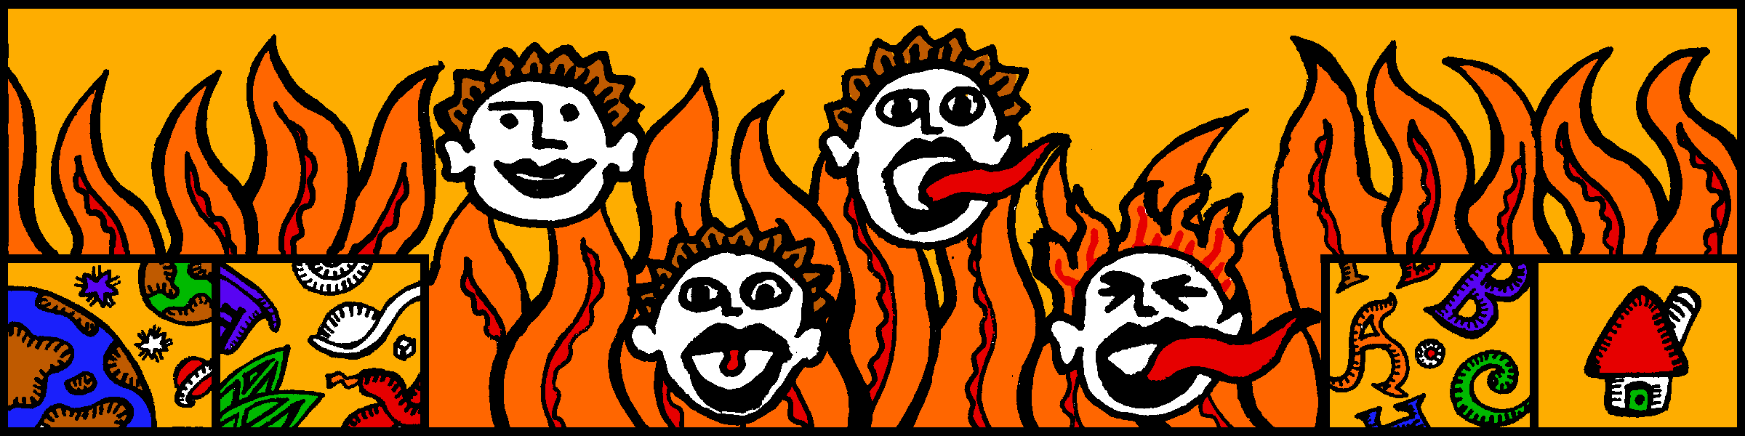
Notes:
Let me begin by telling you a bit about my background. I’m a user experience designer. I was one of the first professional Web designers. This is the navigation for a hot sauce shopping site I designed in the spring of 1994.

Slide 3
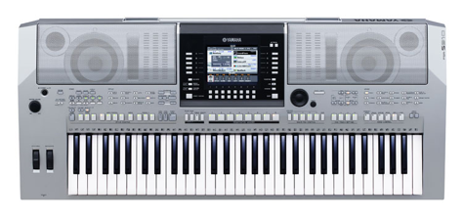
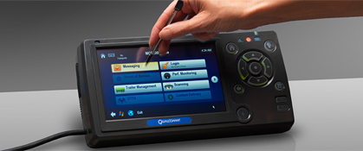
Notes:
I’ve also worked on the user experience design of a lot of consumer electronics products from companies you’ve probably heard of.

Slide 4
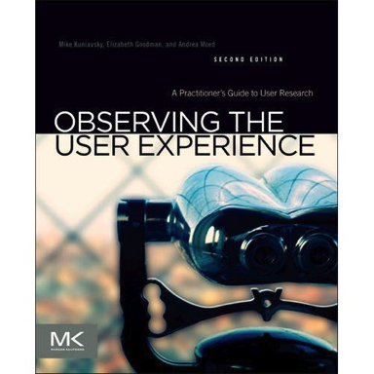
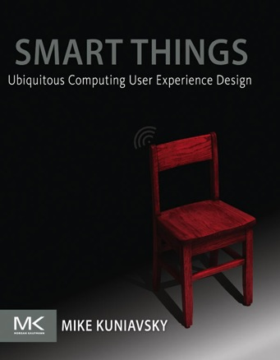
Notes:
I wrote a couple of books based on my experience as a designer. One is a cookbook of user research methods, and the second describes what I think are some of the core concerns when designing networked computational devices.

Slide 5

Notes:
I also started a couple of companies. The first, Adaptive Path, was primarily focused on the web, and with the second one, ThingM, I got deep into developing hardware.

Slide 6
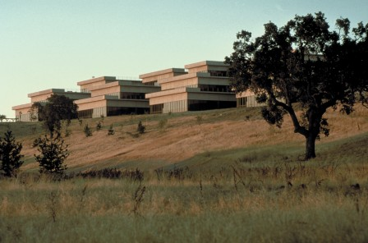
Notes:
Today I work for PARC, the famous research lab, as a principal in its Innovation Services group. We help companies reduce the risk of adopting novel technologies using a mix of ethnographic research, user experience design and innovation strategy. We do everything from coaching teams inside companies to developing novel products.

Slide 7
SERVICE AVATARS: THE MODEL FOR B2C IOT
Notes:
I want start by focusing on two aspects: how consumers’ relationships to devices change, how companies value chains change from selling physical products to delivering services for which a product is only one means through which the service is accessed.

Slide 8


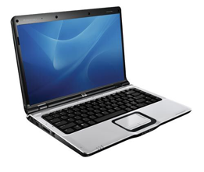
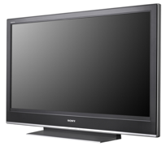
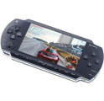








Notes:
The core of this change is a shift from generic devices and software to specialized devices and software. When computing was expensive, you had general purpose devices and general purpose software that had deal with almost every situation. This necessitated design compromises that resulted in devices and software that could do almost everything, but did none of it well.
Now that processing is cheap thanks to Moore’s Law, you can have a combination of 10, 20, or 30 computing devices and apps for the price of that one device, and you can acquire new functionality as needed. This means that every device and software package can have a narrower purpose.
Adobe brush
Haiku deck

Slide 9
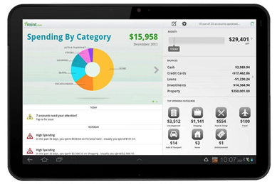
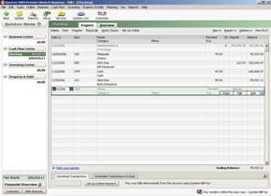
Notes:
The second trend is that much of the value of computing is now remote. Today, most people understand that the experience you see on one device is often a part of something that’s distributed throughout the world. There’s no longer a need to pack everything into a single piece of software, and there’s no expectation that everything will be there.
Foursquare as a whole doesn’t live on your phone in any meaningful way, and people know that.

Slide 10

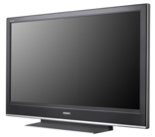
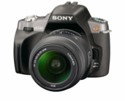

TERMINALS
APPLIANCES
Notes:
If we chart these two tends, two broad classes of digital products emerge.
If we follow the local to remote axis, we find general-purpose devices that do roughly the same set of things, and differ primarily in size. They exist to provide access to online services, in a form factor that’s appropriate to the context in which they’re used.
I call these devices terminals.
If we follow the general to specific axis, we see a shift is to more narrow-function devices that are designed to do a small set of things with specialized hardware. A parking meter can take quarters, which your phone can’t do, and a digital SLR has a giant lens on it, which you probably don’t want on your phone. These devices differ in their specialized hardware. I call these devices appliances.

Slide 11
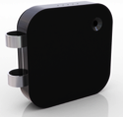

Laptop
AVATARS
Notes:
The most interesting thing, however, to me is that these shifts are part of an even larger transition, one where devices are simultaneously specific AND deeply tied to online services. In this model, the service provides the majority of the value, and can be represented either as a dedicated appliance, an app running on a terminal, or anything in between.
I call these devices service avatars. And this is where much of the Internet of Things currently lies, at least for consumer products.

Slide 12
SERVICE
AVATARS
Notes:
As value shifts to services, the devices, software applications and websites used to access it—its avatars—become secondary. A camera becomes a really good appliance for taking photos for Flickr, while a TV becomes a nice Flickr display that you don’t have to log into every time, and a phone becomes a convenient way to take your Flickr pictures on the road.
Hardware becomes simultaneously more specialized and devalued as users see “through” each device to the service it represents. The hardware exists to get better value out of the service.

Slide 13

Notes:
Amazon really gets this. Here’s a telling older ad from Amazon for the Kindle. It’s saying “Look, use whatever device you want. We don’t care, as long you stay loyal to our service. You can buy our specialized devices, but you don’t have to.”

Slide 14
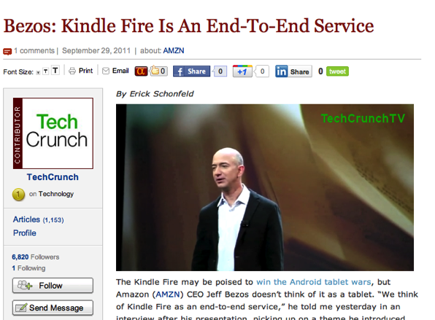
Notes:
When Fire was released 3 years ago, Jeff Bezos even called it a service.

Slide 15
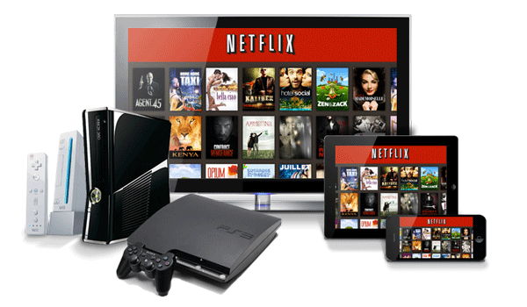
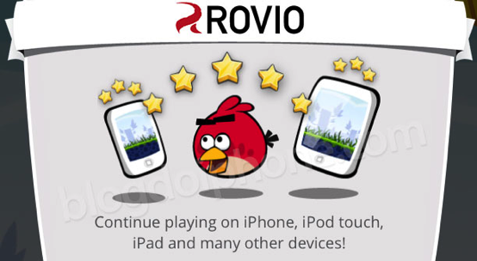
Notes:
NetFlix is another good media example. It feels natural to pause a movie on one device and continue it on another because from your perspective there’s only ONE Netflix. Dropbox creates this for files, Evernote for notes, and Angry Birds for score synchronization. The service is where your attention is, the device is there to give you access to the service, but other than a convenient form factor, the hardware is largely disposable.

Slide 16
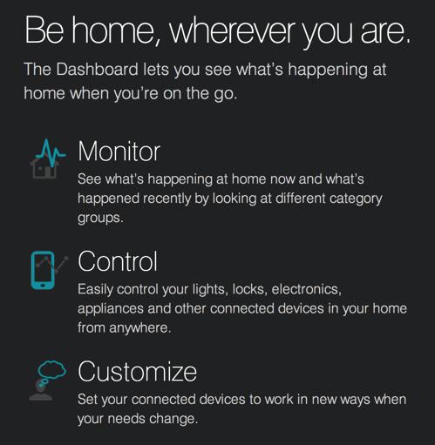
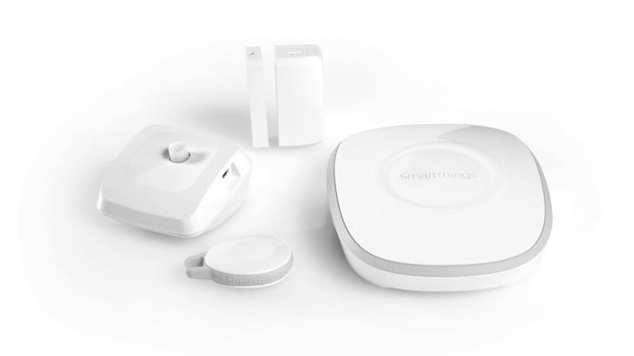
Notes:
Most large-scale IoT products are service avatars. They use specialized sensors and actuators to support a service, but have little value—or don’t work at all—without the supporting service. Smart Things, which was acquired by Samsung last year, clearly states its service offering right up front on their site. The first thing they say about their product line is not what the functionality is, but what effect their service will achieve for their customers. Their hardware products’ functionality, how they will technically satisfy the service promise, is almost an afterthought.

Slide 17
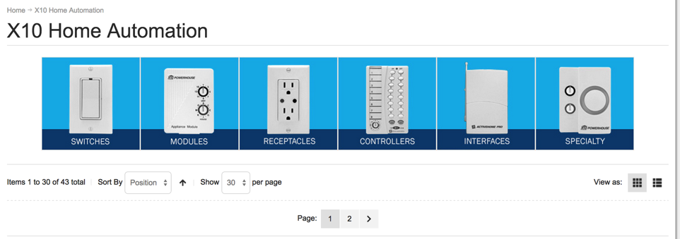
Notes:
Compare that to X10, their spiritual predecessor that’s been in the business for more than 20 years. All that X10 tells is you is what the devices are, not what the service will accomplish for you. I don’t even know if there IS a service. Why should I care that they have “modules”? I shouldn’t, and I don’t.

Slide 18
B2C IOT SERVICES
Notes:
So what do these services offer?

Slide 19
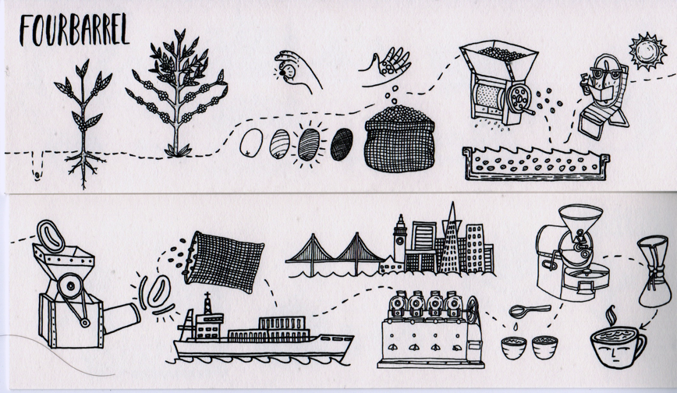
Notes:
Let me actually back up and talk about what they don’t offer, or don’t successfully offer, which is simple connectivity. Simply providing telemetry from physical devices to the Net—such as the logistics chain of my local coffee roaster in San Francisco—IS a successful B2B business, and this is the heart of the Industrial Internet of Things, but I don’t think it’s particularly successful for consumers.

Slide 20
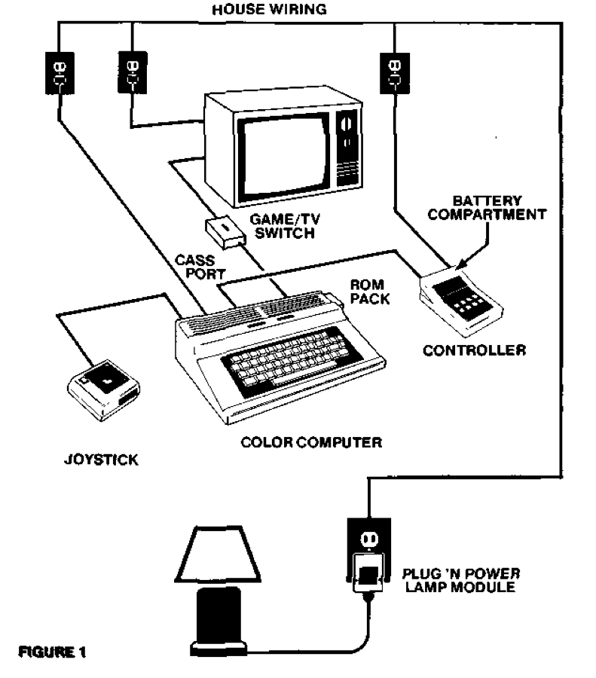
Notes:
Simple connectivity helps when you’re trying to maximize the efficiency of a fixed process, but that’s not a problem that most people have. We’ve been able to simply connect various devices to a computer since a Tandy Color Computers could lights off and on over X10 in 1983. That wasn’t very useful then, and it’s not very useful now. If you replace the Tandy with an iPhone and the lamp with a washing machine…

Slide 21
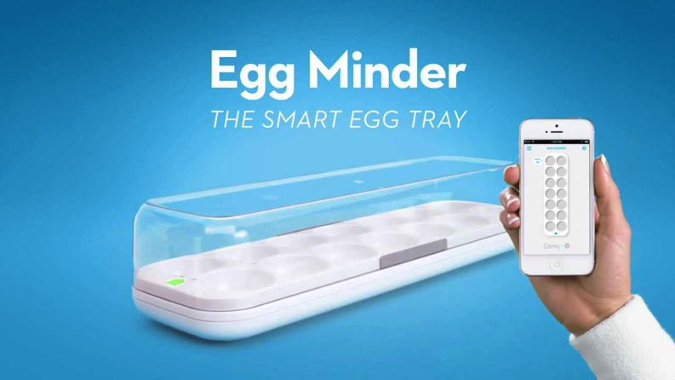
Notes:
…or an egg carton, you still have the same problem, and it’s a user experience problem.
The UX problem is that end users have to connect all the dots and coordinate between a wide variety of devices, and to interpret the meaning of all of these sensors. Unlike a business, very few people have the skills and motivation to do that. Thus, instead of things that reduce cognitive load, that overhead each of us has managing our daily lives, these products increase it without compensating with additional value. That’s what distinguishes a gadget from a tool, and gadgets are, by definition, optional and marginal.

Slide 22
PREDICTIVE BEHAVIOR, ENABLED BY MACHINE LEARNING, IS THE KEY TO THE BUSINESS MODELS OF MOST B2C IOT PRODUCTS
Notes:
I think real consumer value connected services offer is their ability to make sense of the world on people’s behalf, using data they collect, to reduce people’s cognitive load, rather than increasing it. Humans are good pattern matchers, but we’re not built to collect and make sense of huge amounts of data. Computers are great at it. They can making statistical models and then try to maximizes the probability of a desired outcome. A person programming a device can only express what they’re familiar with, or try to create an abstraction based on their past experience. That can be considerable, but a model learned from the outcome of thousands of situations across many people and long periods of time can compensate for much wider variety of situations in a more nuanced way than an individual’s perspective will ever be able to.

Slide 23
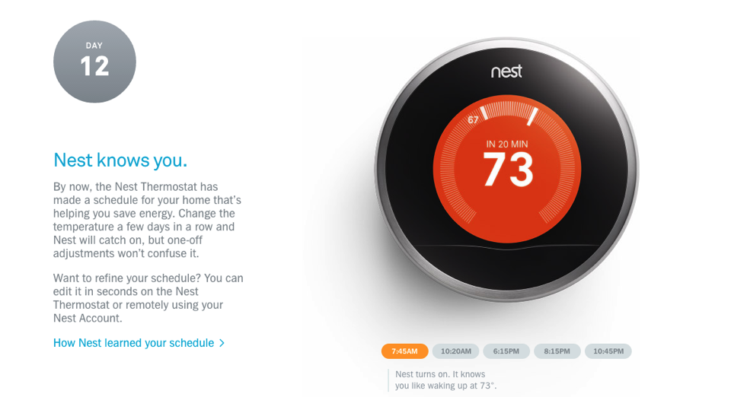
Notes:
Prediction is at the heart of the value proposition many of the most compelling IoT products offering, starting with the Nest. The Nest says that it knows you. How does it know you? It predicts what you’re going to want based on your past behavior.

Slide 24
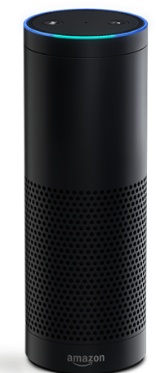
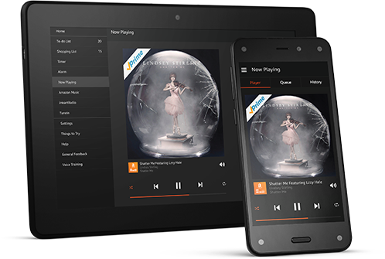
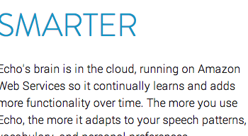
Notes:
Amazon’s Echo speaker says it’s continually learning. How is that? Predictive analytics, predictive machine learning.

Slide 25
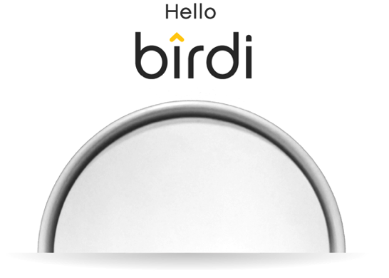
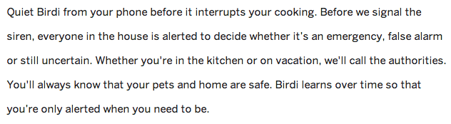
Notes:
The Birdi smart smoke alarm says it will learn over time, which is again the same thing.

Slide 26
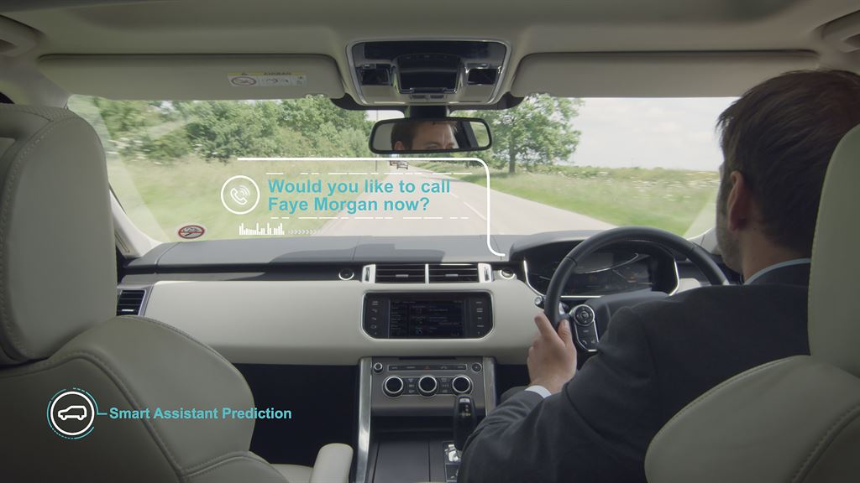

Notes:
Jaguar comes right out with it. They even obliquely reference the 40 years of artificial intelligence research that powers predictive analytics by calling their car not just learning, but learning AND intelligent.

Slide 27
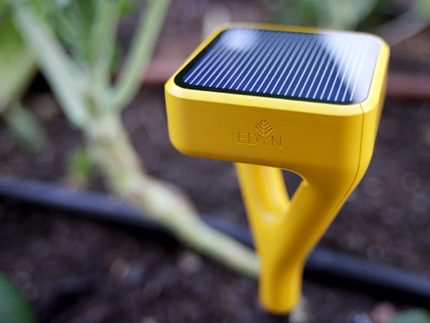
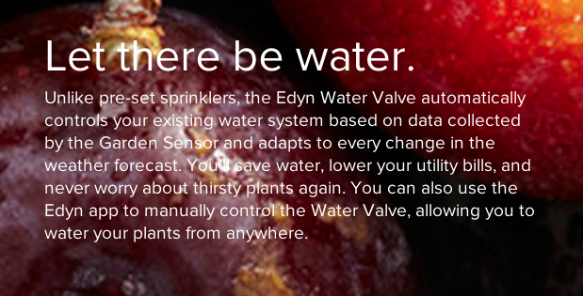
Notes:
The Edyn plant watering system adapts to every change. What is that adaptation? Predictive analytics.

Slide 28
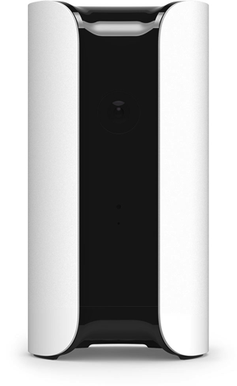
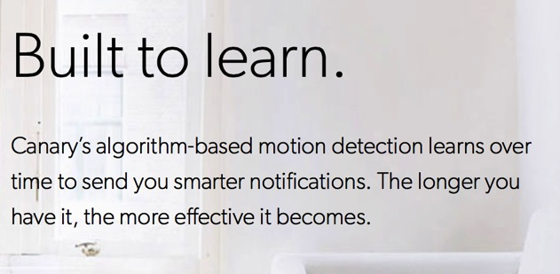
Notes:
Canary, a home security service.

Slide 29
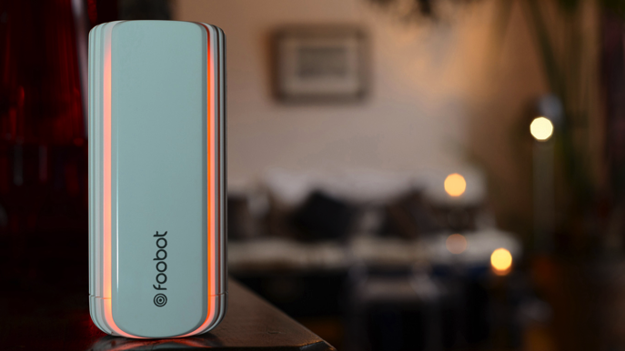
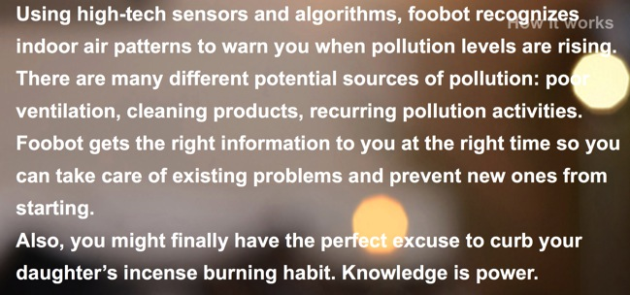
Notes:
Here’s foobot, an air quality service.

Slide 30
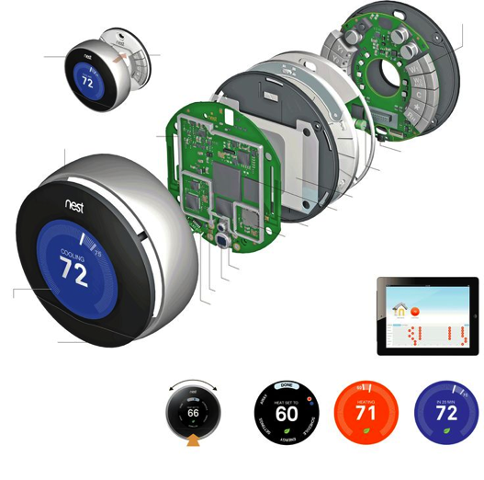
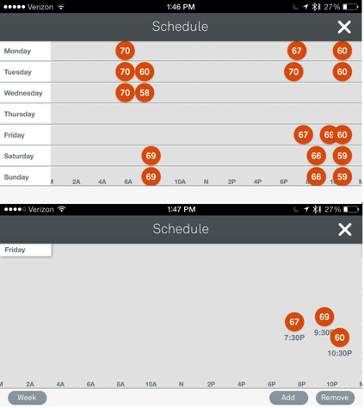
Notes:
Let’s look at a specific example of how this works. The Nest starts by recording readings from its onboard sensors and its users’ behavior, to which it probably adds the weather, the time, the day of the week, and secret sauce data (the spot price of energy? How many people are in the house right now? How neighbors have set their Nests?). The Nest service in the cloud then builds a model of how people prefer heating and air conditioning to work, subtly adjusted for every household. Then the Nest acts on its users’ behalf. It creates a schedule that changes the temperature, but it doesn’t just play back past behavior or preset preferences. Instead, it acts on what it believes users would have wanted if they knew more than just “I’m hot” or “I’m cold”. That predictive behavior is the magic that makes these relatively simple systems much more valuable to consumers than just sensor networks connected to the net.
Machine learning predictive systems have existed in preventative maintenance and financial services for decades. However, those systems were only for experts. What’s new is that the technology to do this has gotten very cheap so new machine learning products now enter our everyday lives on an almost daily basis. That means that their design is now a user experience problem.

Slide 31
ISSUES WITH THE UX OF PREDICTIVE ANALYTICS
Notes:
Predictive behavior creates a pretty seductive world of espresso machines that start brewing as you’re thinking it’s a good time for coffee, and reorder your favorite blend; office lights that dim when it’s sunny, power is cheap and you’re not doing anything that needs them; and food truck caravans that show up just as the crowd in the park is getting hungry. The problem is that although the value proposition is of a better user experience, it’s unspecific in the details. Exactly how will our experience of the world, our ability to use all the collected data, become more efficient and more pleasurable?
Now I’d like to offer some initial thoughts on user experience design for predictive analytics for the internet of things. We’re still early in our understanding of design for predictive devices, so right now the problems are worse than solutions and I want to start by articulating the issues I’ve observed in our work.

Slide 32
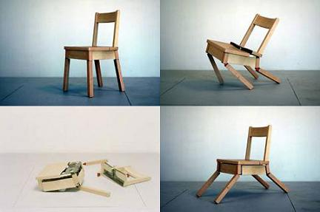
ISSUE 1: EXPECTATIONS OF AUTONOMOUS BEHAVIOR
Notes:
We’ve never had mechanical things that make significant decisions on their own, the first major issue is around expectations. As devices adapt their behavior, how will they communicate that they’re doing so? Do we treat them like animals? Do we stick a sign on them that says “adapting”, like the light on a video camera says “recording”? Should my chair vibrate when adjusting to my posture? How will users, or just passers-by, know which things adapt and which merely behave? I could end up sitting uncomfortable for a long time, waiting for my chair to change, before realizing it doesn’t adapt on its own or sitting in the dark waiting for the smart lights to realize it’s now productivity time. How should smart devices set the expectation that they may behave differently in what appears to people as an identical set of circumstances?
People are already prone to project more intelligence on devices than those devices actually have, so a couple of accurate predictions may imply a much more accurate model than actually exists. Roboticists talk about an “uncanny valley” where robots exhibit just enough human-like behavior to initially fool us, but become creepy when they’re revealed to be anything but human. Predictive IoT may be homesteading that valley without us knowing we live there.
Chair by Raffaello D'Andrea, Matt Donovan and Max Dean.

Slide 33
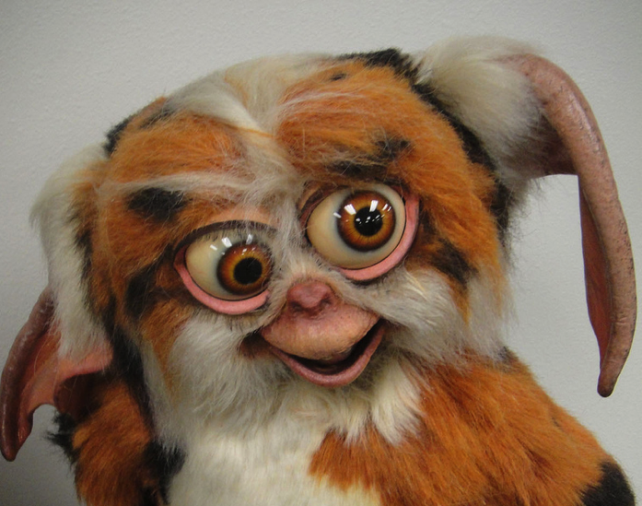
ISSUE 2: UNCERTAINTY
Notes:
The irony in predictive systems is that they’re pretty unpredictable, at least at first. Most predictive models are fairly inaccurate when they’re new. Because they’re statistical, they need lots of data, and a large variety of data to be accurate, and initially they don’t have that data, so they won’t be accurate. 60%-70% accuracy is typical for a first pass, but even 90% accuracy isn’t enough for a predictive system to feel right, since if it’s making decisions all the time, it’s going to be making mistakes all the time, too. This creates a significant amount of uncertainty for people who supposed to benefit from these systems when the systems don’t behave. It’s fine if your house is a couple of degrees cooler than you’d like, but what about a motorized wheelchair that refuses to a drinking fountain next to a door because it’s been trained to go through doors and it can’t tell that’s not what you mean in this one instance? A couple such instances can shatter the confidence in a system that’s mostly right because it creates doubt when it’s supposed to remove cognitive burden and that doubt is enough to turn a UX that’s right most of the time into one that’s anxiety inducing all the time, and when that happens, you’ve more than likely lost your customer.
And sooner than we think, such inaccurate predictive behavior isn’t going to be an isolated incident. Soon we’re going to have 100 connected devices simultaneously acting on predictions about us. If each is 99% accurate, then one is always wrong. So the problem is: How can you design a user experience to make a device still functional, still valuable, still fun, even when it’s spewing junk behavior?
Photo CC BY 2.0 photo 2011 Pop Culture Geek taken by Doug Kline: https://www.flickr.com/photos/popculturegeek/6300931073/

Slide 34
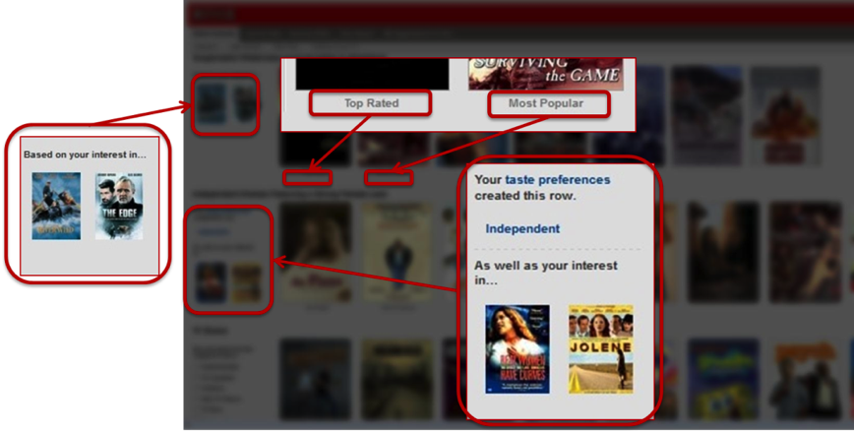
ISSUE 3: CONTROL
Notes:
The last issue comes as a result of the previous one: control. How can we maintain some level of control over these devices, when their behavior is by definition statistical and unpredictable?
On the one hand you can mangle your device’s predictive behavior by giving it too much data. When I visited Nest once they told me that none of the Nests in their office worked well because they’re constantly fiddling with them. In machine learning this is called overtraining. The other hand, if I have no direct way to control it other than through my own behavior, how do I adjust it? Amazon and Netflix’s recommendation systems, which is a kind of predictive analytics system, give you some context about why they recommended something, but what do I do when my only interface is a garden hose?

Slide 35
FOUR PATTERNS FOR ADDRESSING PREDICTIVE UX ISSUES
Notes:
Here are 4 patterns I’ve observed in developing predictive systems that I think map to the IoT. For most of these I’m going to be using examples from Nest and recommender systems like Amazon’s, Google’s and Netflix’s which have been using similar predictive technologies for years and have addressed some of these issues.

Slide 36
PATTERN 0: HAVE A USER STORY FOR EVERY STAGE OF PREDICTION
Acquire
Behave
Extract
Train
Classify
Model
Notes:
My first pattern isn’t really a pattern, but a general approach. To design these systems you need to have a user model for every stage of the machine learning and prediction process. There needs to be a story to tell about each step, even if it’s a step that seems like it would invisible to customers. Starting with acquisition: how will you incentivize people o add data to the system at all? Why should I upload my car’s dashcam video to your traffic prediction system EVERY DAY? Next, how will you communicate you’re extracting features? I like the way that Google speech to text shows you partial phrases as you’re speaking into it, and how it corrects itself. That small bit of feedback tells people it’s pulling information out and it trains users how to meet the algorithm halfway to get the results you want. How do machine-generated classifications compare to people’s organization of the same phenomena? How is a context model presented to end users and developers? How will you get people to train it and tell you when the model is wrong? Does the final behavior actually match their experience? Machine learning algorithms used to be strictly behind-the-scenes, but in the IoT they are actors in our lives, so as designers it’s our responsibility to understand the situations where the algorithms and the devices they control interact with people’s lives, especially since there’s a deep symbiotic relationship between the data that comprises the models, the behavior those models induce and the people who are the intended beneficiaries.

Slide 37
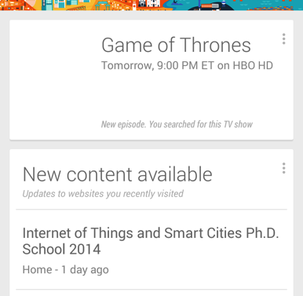
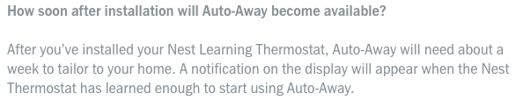
PATTERN 1: SET BEHAVIOR EXPECTATIONS
Notes:
Now to the actual UX patterns. Our current expectation for digital systems is that they’ll behave consistently and the reasons for their behavior will be clear. Neither of these is true for the user experience of predictive systems, which don’t necessarily behave identically in what appear to be similar circumstances, whose behavior changes over time, and where the reasons for the behavior may not be obvious. If we undermine people’s confidence in a system by violating their expectations, they’re likely to be disappointed and stop using it.
When we’re dealing with a human or an animal, these kinds of behaviors are expected and tolerated, but that’s not the case with computers, so the first thing a UX needs to do is to set people’s expectations appropriately. It needs to explain the nature of the device, to describe it is trying to predict, that it’s trying to adapt, that it’s going to sometimes be wrong, to explain how it’s learning, and how long it’ll take before it crosses over from creating more trouble than benefit.
Recommender systems, such as Google Now, describe why a certain kind of content was selected, and that sets the expectation that in the future the system will recommend other things based on other kinds of content you’ve requested. Nest’s FAQ kind of buries the information, but it does explain that you shouldn’t expect your thermostat to make a model of when you’re home or not until it’s been operating for a week or so.

Slide 38
Notes:
About ten years ago Timo Arnall and his students tried to address a similar set of questions around interactions with RFID-enabled devices by creating an iconography system that communicated to potential users that these devices had functionality that was invisible from the outside. Perhaps we need something like this for behavior created by predictive analytics?

Slide 39
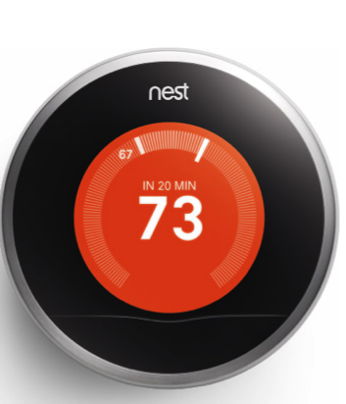
PATTERN 2: EXPLAIN WHEN A STATE HAS CHANGED OR IS GOING TO CHANGE
Notes:
Predictive behavior, as opposed to is all about time, about sequences of activities. Many predictive UX issues around expectations and uncertainty have time as their basis: what were you expecting to happen and why. If it didn’t happen, why? If something else happened, or it happened at an unexpected time, why did that happen?
Knowing that a device has acted on your behalf, and that it’s going to act—and HOW it’s going to act—in the future is important to giving people a model of how it’s working, setting their expectations, reducing the uncertainty. Nest, for example, has a calendar of its expected behavior, and it shows that it’s acting on your behalf to change the temperature, and when you can expect that temperature will be reached.

Slide 40
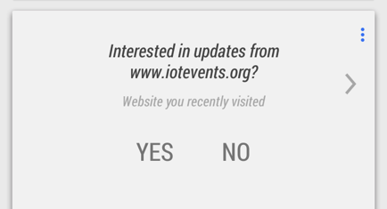
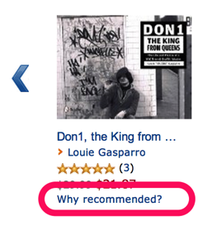
PATTERN 3: CREATE CLEAR WAYS FOR PEOPLE TO ADJUST THE PREDICTIVE BEHAVIOR
Notes:
Remember the Wall Street Journal story about a guy (Basil Iwanyk) realized his TiVo thought he was gay because of the shows he recorded (he wasn’t)? That’s funny, but the second part is frustrating: he tried to correct it the only way he could think of, by watching war movies, and his TiVo then decided he was a Nazi (which he also wasn’t). You have to give people a clear way to teach the system and tell it when its model is wrong. Statistical systems, by definition, don’t have simple rules that can be changed. There aren’t obvious handles to turn or dials to adjust, because everything is probabilistic. If the model is made from data collected by several devices, which device should I interact with to get it to change its behavior? Google Now asks whether I want more information from a site I visited, Amazon shows a explanation of why it gave me a suggestion. Mapping this to the consumer IoT means way more explanation than we’re currently getting, which is either that a thing has happened, or it hasn’t.

Slide 41
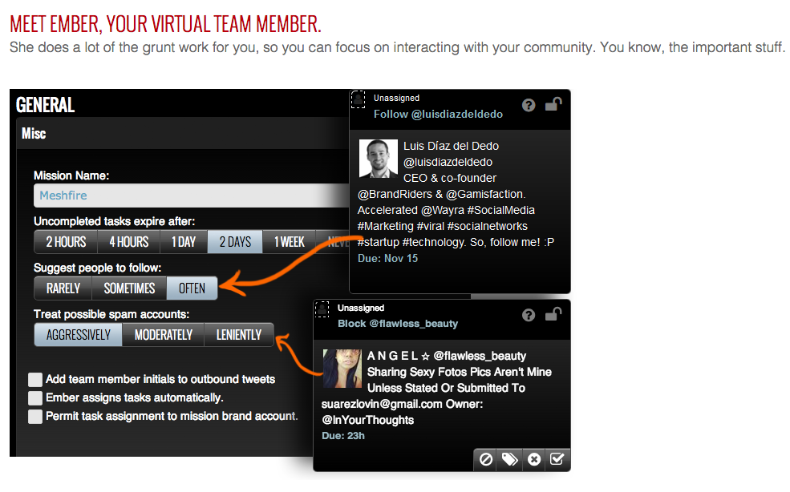
PATTERN 4: SUPPORT PEOPLE, DON’T REPLACE THEM
Notes:
Finally, don’t automate. These system’s shouldn’t try to replace people, but to support them, to augment and extent their capabilities, not to replace them.
One of my favorite current examples of this kind of system is from Meshfire, which is a social media management tool that has a machine learning assistant. Its machine learning assistant, called Ember, doesn’t try to replace the social media manager. Instead it manages the media manager’s todo list. It adds things that it thinks are going to be interesting, deletes old things, and reprioritizes the manager’s list based on what it thinks is important. I think this is a good model for how such systems can add value to a person’s experience without creating a situation where random, unexplained behaviors confuse people, frustrate them and make them feel powerless. Ember is an augmentation to the social media manager, it helps that person focus on what’s important so that they can be smarter about their decisions. It doesn’t try to be smarter than they are. How can our devices HELP us, rather than trying to replace us?

Slide 42
ANTIPATTERN: DON’T MAKE PEOPLE DO ALL THE TRAINING, THEY WON’T
1:11
1:26
1:36
1:47
1:59
2:25
2:38
2:57
…
Notes:
Finally, an antipattern: making people do all of the training, asking them to identify whether a behavior is appropriate or not, should be done selectively and infrequently. Yes, it will really help your supervised model’s accuracy to have people identify the correct positives from the false positives, but unless you’re paying these people, it’s incredibly annoying to have customers do it all the time. Last Friday one consumer IoT product with a machine learning system I’m playing with asked me to classify its output at 1:11PM, then again at 1:26, and again at 1:47 and again and again. I think it was on roughly ten-minute sensing cycle, and at every cycle it tried to make a decision, and asked me to verify it. I’m sure it’s still doing it, but I turned off all notifications from it, and now I’m considering turning it off entirely. People will sometimes willingly act as sensors and actuators for your system, but because they are not machines, they will not do it all the time and you’re just going to have to find a better way to train your model.

Slide 43
IT’S NOT ABOUT THE THINGS
Notes:
Finally, for me the IoT is not about the things, but the experience created by the services for which the things are avatars.

Slide 44
The wheel is an extension of the foot.
The book is an extension of the eye.
Clothing is an extension of the skin.
Electric circuitry is an extension of the central nervous system.
— Marshall McLuhan,
The Medium is the Massage, 1967
Notes:
Ultimately we are using these tools to extend our capabilities, to use the digital world as an extension of our minds. To do that well we have to respect that as interesting and powerful as these technologies are, they are still in their infancy, and our job as entrepreneurs, developers and designers will be to create systems, services, that help people, rather than adding extra work in the name of simplistic automation. What we want to create is a symbiotic relationship where we, and our predictive systems, work together to create a world that provides the most value, for the least cost, for the most people, for the longest time.

Slide 45
Thank you! Mike Kuniavsky
mikek@parc.com @mikekuniavsky
Notes:
Thank you.

