Slide 1




Diving Into Web Components
Cory House
@housecor
.com
Notes:
https://www.polleverywhere.com/multiple_choice_polls/2CGVnAvf9rYI0v3

Slide 2


Happy place

Slide 3
POLL
Notes:
https://www.polleverywhere.com/multiple_choice_polls/2CGVnAvf9rYI0v3
Ask for a travel tip - tell story of my parents flying with me to England for the first time.

Slide 4

Web Developers Have Problems
Notes:
Today’s web developers have some big problems. And that’s why I’m really excited to bring you this course on HTML5 web components. I believe web components are going to radically improve the way you write applications. So what sorts of problems am I talking about? Well, let’s walk through 6 specific problems that web developers face today.

Slide 5
5 Problems
No native templates
Undescriptive markup
No style and DOM encapsulation
No bundling
No component standard
Notes:
1. Today’s components don’t have descriptive markup. They’re typically composed of mostly divs and spans.
2. There’s no standard, so each time you decide to choose a component library, you have to learn how the authors have chosen to structure their vision of reusable components.
3. Since there’s no way to encapsulate the styling for a given component, they suffer from style conflicts requiring complex and verbose style sheets and class structures
4. There’s no native standard for defining client-side templates, so each library defines their own approach. And we, as developers, resort to various proprietary approaches.
5. Finally, there’s no native way to bundle the HTML, JavaScript and CSS that’s necessary to build a component together into a single unit that we can include on the page with a single line of markup.
So that’s it, 5 specific problems facing web developers today. And of course you see the punch line coming.

Slide 6










We Need a Standard. Bad.
Notes:
Problem 6 really summarizes up all of the other problems. The bottom line is we have no standard for creating web components with HTML5, JavaScript and CSS today.
Each of these libraries offer their own approach to creating HTML based web components. And the differences are obvious because if you want to use more than one of these at the same time, you’ll find it’s a struggle because they solve problems in such different ways. Each offers it’s own API, and utilizes a proprietary approach to publishing and configuring components.
So when we change venders, we must learn each new library’s conventions.
There’s a wide variety of abstraction levels above as well, ranging from the simplicity of jQuery plugins all the way up to heavy opinionated components like ExtJS.
Many of these libraries utilize large complex stylesheets with highly specific selectors to avoid conflicting with other markup on your page.

Slide 7

Notes:
Other industries have solved this problem of reusable components. Car manufacturers don't buy raw diodes, capacitors, etc. They buy radios, and navigation systems, much larger and more powerful components.
BMW, like all car manufacturers, reuses components between cars. The blinker stalk, push button start, door handles, stereo, Steering wheel buttons, seatbelt assemblies, and airbag systems. What if all vehicles started with a clean slate and simply used raw plastic or metal? Cars would cost far more money because it would take far more work if the manufacturers truly had to design and build each model completely from scratch. The interior is made up of components. And often, those components are composed of multiple smaller components. Suppliers deliver high level components like stereos and navigation systems.
As the automotive industry grows, they continue to use larger components. In fact, many of today’s vehicles even utilize the same engines, transmissions, and platforms. And this phenomena isn’t unique to the automotive industry. Component size and complexity grows as industries mature. Industries grow by utilizing ever more powerful abstractions.
In the same way, we used to build our apps from the ground up with plain html, JavaScript and css. Then people started using jQuery plugins, and components like jQueryUI, KendoUI, or ExtJS. However, The current state of components in web development lacks a strong, formal standard. Reuse across manufacturers requires standards.
This is why it feels awkward and wasteful when we want to utilize components from multiple companies. We have to learn the ad-hoc way each manufacturer designed their components.

Slide 8






A Path to Standard Components
1995
2008
2011
Today
2006
Notes:
Consider a brief history of web development and the increasing levels of abstraction are pretty clear. We’re certainly headed down the right path, albeit very slowly. In 1995 Brenden Eich created JavaScript. For years it was a real struggle because browsers were so inconsistent and JavaScript was largely misunderstood or ignored in these early phases.
Fast forward a decade and John Resig created jQuery. jQuery finally made working with the DOM much less painful by providing abstractions over the native APIs. This single library radically changed the trajectory of JavaScript’s future by providing people higher level components, in this case in the form of simple, terse functions, to interact with the DOM.
And it was upon this foundation of success that jQueryUI was created, offering a library of higher level reusable components including tabs, accordians, dialogs, and many other components that we were previously often building ourselves. The jQuery Plugin community began to thrive offering many developers the chance to simply add an extra JavaScript file to their page to enjoy richer components. Competitors like ExtJS also arrived on the scene about this time, offering developers richer, and higher level controls than we’d seen previously.
By 2011, there were many mature component options like KendoUI and Bootstrap. Bootstrap helped popularize the idea of componentized CSS. And KendoUI began offering powerful grids for paginating, sorting, and filtering data, and schedulers for easily creating interactive calendars.
Around this same time Angular was released, offering a proprietary way to define components that it calls directives. More recently other proprietary component options have popped up like Ember components and Knockout components.
And today, we can finally begin enjoying the power of native HTML5 web components. HTML5 web components are a powerful standards based solution that should help radically improve the power and reusability of these existing solutions, and empower us to build our own.
As you can see, the theme is that over time the components that we use just keep growing in power and moving higher up the abstraction layer. We started out using plain JavaScript, moved to jQuery which was basically a friendlier abstraction over much of the JavaScript we were struggling to write. Then we moved on to ever higher level components to solve problems. However, despite the greatness of all these technologies, the current component solutions all struggle with the six aforementioned fundamental problems.

Slide 9
Templates
Custom Elements
Imports
Shadow DOM
Inert, reusable markup
Define our own Elements
Encapsulated Markup & Styling
Bundle HTML, JS, & CSS
Notes:
Web components are are built using a combination of these 4 new technologies.
Templates,
Custom Elements,
the Shadow DOM,
and HTML5 imports.
These are the 4 core technologies that we’ll explore throughout this course.
Templates allow us to define inert, reusable markup using web standards. We’ll discuss templates in Module 2.
Custom Elements give us the power to extend HTML by defining our own elements. We’ll explore custom elements in Module 3.
The Shadow DOM provides encapsulation of our markup and styling. The shadow DOM is a huge topic so it’s split up into three separate modules. Module 4 covers Shadow DOM fundamentals, Module 5 covers Shadow DOM insertion points and events, and module 6 discusses new CSS styling techniques related to the shadow DOM.
And finally HTML5 imports support bundling HTML, JS, and CSS files together into a single, simple, and reusable package so we can easily deliver the web components that we create. We’ll cover Imports in Module 7.
These four new technologies work together to create HTML5 web components and will be the focus of this course.

Slide 10
Templates
@housecor
Notes:
https://www.polleverywhere.com/multiple_choice_polls/2CGVnAvf9rYI0v3

Slide 11





You Already Use Templates
HAML
Razor
Django
Jade
?
Notes:
I’m sure you already understand what templates are. They’re a way to define a preset format for reuse. And all sorts of server-side technologies offer a template-like solution. HAML is a popular templating solution used by Ruby and PHP developers. If you’re in ASP.NET MVC, then the Razor view engine is a popular templating option. Python developers are likely familiar with Django, and Node developers often use Jade. The point is, there’s a huge number of server-side solutions for templating. But what if you decide to render the UI on the client instead?
These days it’s becoming increasingly common to render the UI on the client. And up until now, the web has offered no standardized support for defining templates that are parsed on the browser.

Slide 12
Where Do We Put This On the Client?
Simple template of a table row:
<tr>
<td class="first-name"></td>
<td class="last-name"></td>
<td class="address"></td>
<td class="phone"></td>
</tr>
Notes:
Nearly every app has sections that need to be repeated on the page. Imagine I want to define a table row in my HTML for use on the client as a template. With client-side templating we can avoid sending down a lot of duplicate markup from the server and instead utilize some simple JSON to populate a template on the client. Just think if this was rendered on the server. All this duplicate markup is sent down for every row in the table. It’s redundant.
But the question is, where would I store this table row on the client? Until HTML5 templates there has been no standard way to define a template on the client. But that hasn’t stopped us from coming up with creating solutions.

Slide 13
Common Template Approaches
1. HTML in Script Tags
2. Hidden DOM elements
+ Nothing inside runs or renders
- XSS risk from using .innerHTML
<script type="text/custom-name-here">
+ Easy to clone – just DOM elements
- Everything inside still runs.
- May throw 404’s, <script> runs, etc.
<div style="display: none;">Template here</div>
Notes:
Today we use a variety of techniques to hack in templates.
1. One of the most popular methods involves stuffing markup with script tags with a custom type attribute. For example, the popular templating library handlebars (http://handlebarsjs.com/) stuffs templates within a script tag with a type of text/x-handlebars-template (short vid of handlerbars site here).
Another popular library is KendoUI, an HTML5 widget library from Telerik. For templates, it uses a script tag with a type of text/x-kendo-template. Show http://demos.telerik.com/kendo-ui/templates/index
This approach is popular because nothing inside runs or renders because the value of type attribute isn’t recognized by the browser. However, this approach often leads to using .innerHTML for copying the template which can lead to cross site scripting vulnerabilities. Remember, cross site scripting is all about an attacker being able to run their own JavaScript on your page.
2. Another popular approach is to stuff templates into hidden DOM elements, either set to display:none; via CSS or thrown off the visible portion of the screen with extreme margin settings. The advantage of this approach over the first is it’s easy and safe to clone since it’s just plain ‘ol DOM elements. We don’t have to use hacky approaches like innerHTML to clone the contents. However, this benefit also leads to an important downside. Everything inside is still immediately parsed and run. This means empty image src attributes will throw 404 errors, and any script inside will immediately run.
So neither of these hacks are ideal. What we need is a solution that allows us to define a template using plain HTML, JavaScript, and CSS. And we need the benefits of both of these approaches. We need the contents of a template to be inert until cloned, but also easy to clone since it’s native HTML, JS and CSS.

Slide 14
The Solution?
<template>
Notes:
And the solution is the template tag. With templates you can finally safely declare a chunk of markup that you don’t want the browser to render or manipulate. It’s merely there for reference. As a template. So the template tag lets you declare chunks of HTML that won’t affect the display of your page in any way. So what’s the power of the templates? They can be cloned for use anywhere on your page.

Slide 15
Characteristics of <template>
Inert – Does nothing
Won’t load assets until cloned and inserted
Can’t be traversed
Can be placed in:
<template>
<p></p>
</template>
document.querySelector('template p'); //returns null
<head>
<body>
<frameset>
Notes:
All markup in the template tag is inert. It doesn’t render. Any script inside doesn’t run. The markup inside is totally inert until cloned and utilized on the page. We’ll get to how to do that shortly. By the way, this includes *any* content you put inside a template tag. An empty img tag won’t throw a 404. Script won’t run. Video won’t play, etc. None of the assets defined in template tag will be run by the browser in any way until the template is cloned for use in a particular spot. Let’s check out an example.
http://plnkr.co/edit/pI5VA9hBn6R5i9IQejvd?p=preview
You can’t use JS to select any child nodes in a template. And CSS selectors won’t effect anything in a template tag either. Let’s jump back to the example. Just note how $(‘p’) only returns the body text in the example Plunk. It’s as though the content in the template tag is not there at all. Thus, you can only access the template tag itself, and thus all markup within the template. This means if you think you’ll want to clone just a piece of the template, you should create two separate templates instead.
The template tag is so inert, that it can’t be traversed like other DOM elements. So for example, if you define a simple template with nothing but a paragraph tag inside, you won’t be able to select the p tag within the template. Instead, as we’ll see in a moment, you have to use the content property of the template to access the elements inside.
Templates can be placed in multiple locations on the page including the head, body, or within a frameset. It can even be a child of table or select.

Slide 16
Demo
Defining and Cloning Templates
Notes:
Let’s check out our first code example for the course. Throughout this course I’m going to use Plunker for demonstrating the power of web components. Plunker is a handy way to rapidly prototype on the web. If you’re familiar with JSFiddle or Codepen, Plunker is a direct competitor.
With Plunker, the current file is displayed in this middle pane. The left pane allows us to navigate between different files in this Plunk. And the right hand pane displays a live preview of our work.
So as I type in this center pane, you can instantly see the results of my work rendered on the right. I’ll make the Plunks I create for demonstrations throughout this course public so you can try them out yourself. Just download the powerpoint and check the speaker notes to get the URL for each demo.
With that introduction out of the way, let’s check out an example of the template tag in action. http://plnkr.co/edit/pI5VA9hBn6R5i9IQejvd?p=preview
Create template tag
Add <p> to tag
Create script below that grabs template.
Note that using querySelector to get P gets you nowhere
Note that you have to use template.content to traverse the template, unlike other DOM elements like
Note that adding a script with an alert to the template doesn’t fire
Note that adding am <img> with an empty src to a template doesn’t show a broken image or throw a 404 error.
Clone the template
Show how toggling the deep param of importNode to false causes none of the contents of the template tag to be cloned. So to clone templates, be sure to set the deep parameter to true.
http://plnkr.co/edit/zYNiE3WfB6weRjHsLfW6?p=preview

Slide 17
Demonstration
Injecting Data Into Templates
Notes:
Let’s take a look at an example of injecting dynamic data into a template when cloning:
http://plnkr.co/edit/Y4SpzhlvGmYwlwoorbLJ?p=preview
Create template with placeholders for a verb and a number
Create button to copy template
Create var to store number of copies
Create copyTemplate function
Now this a very primitive example. And note that some people suggest putting a js- prefix on any classes utilized by javascript to avoid accidentally breaking js when changing CSS classes for design purposes. (good ref: http://intuio.at/en/blog/dont-use-data-attributes-to-find-html-elements-with-js/)
Or, could use data attributes, but slightly slower: document.querySelectorAll('[data-mydata]');
This version strips spans so that only text remains without the IDs: http://plnkr.co/edit/gjtrWTNObIcEn56F2wB1?p=preview
Note: Avoid using IDs since they must be unique, unless of course you:
remove the IDs before appendings
Replace the placeholder with the result as I do above.
TODO: Fork above using curly brace syntax instead.
Note:
1. I’m using textContent instead of innerHTML since I’m just setting text. The value I’m setting in this case doesn’t need to be interpreted as HTML.
Also, keep in mind that I’m just displaying one approach to using templates. You’ll likely find other approaches used such as double curly brace syntax (also known as the mustache syntax). That approach used by Polymer for instance and would feel familiar if you’ve worked in Angular or with Mustache templates as well. But this simple example shows the power of using the DOM API you already know to programmatically inject data into templates.

Slide 18
Summary
We’ve been getting by with hacks for HTML templates
<template> gives us a standard
All content inside does nothing until activated via cloning
No native data interpolation/logic, but hey, it’s just DOM! ☺
Notes:
In this module we reviewed how we have been lacking a native way to declare templates all of these year. So we’ve resorted to various approaches like tossing HTML in script tags or stuffing it in hidden DOM elements. And while these approaches certainly work, they’re non-standard and thus come with their own set of issues including styling, cloning, security depending on the approach you select.
Templates give us a clear and standardized way to store HTML, CSS, and JavaScript in inert templates that we can clone and activate on demand. We can even declare elements that would throw an error if they existed in the actual DOM. And the elements inside are hidden from selectors to help avoid accidental styling and manipulation.
The content inside does absolutely nothing until we clone it. So even empty video tags or anchors without hyper-references are valid and will not throw 404s since the template’s content is totally inert until cloned and inserted on the page.
Finally, the template tag is quite simple, and doesn’t provide any native support for data interpolation or logic. But it’s easy to replace values since the elements inside the template tag aren’t strings like other approaches to client side templates. They’re real DOM elements, so you can easily and safely reference placeholder DOM elements with your desired values. Or, if you want to easily populate a template with data like you can do today via popular frameworks like AngularJS, you can utilize a library like Polymer which adds support for interpolation to templates. In the future you’re likely to see many client side frameworks utilize templates behind the scenes to store inert markup in a safe and standard place. That should be a common story in the future. As web component support becomes more common, popular client side frameworks will increasingly become layers on top of web components that augment the standard with additional power.

Slide 19
Custom Elements
@housecor

Slide 20
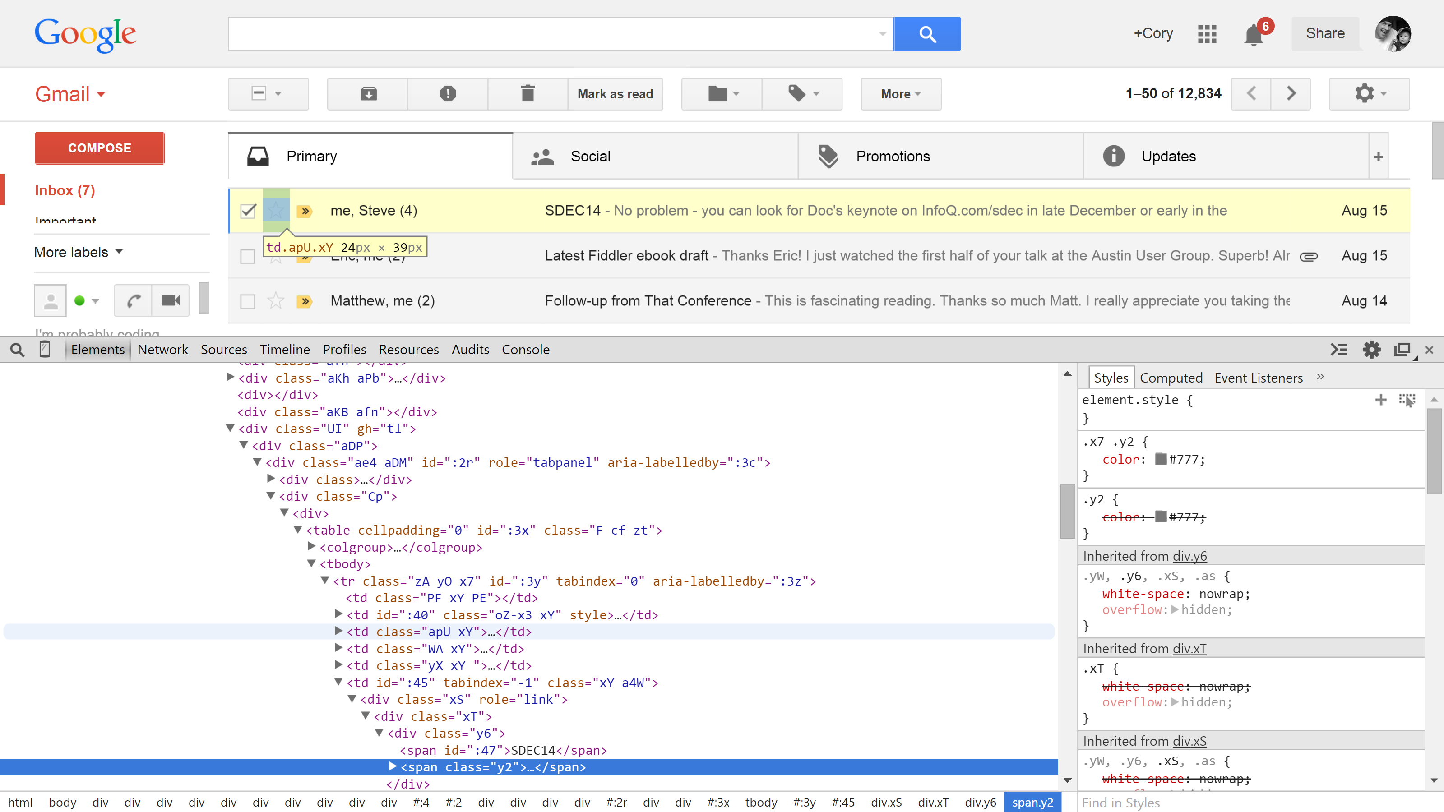
Problem: Undescriptive Markup
Notes:
The first problem is, most of our markup isn’t descriptive. It’s highly generic. Just look at the source of Gmail. Note the divs nested more than a dozen layers deep! Using the developer tools, it’s really obvious when you look at the layers of nesting. HTML, Body, then div, div, div, div, div, div, div. I could go on. But Div soup is a problem. Divs mean nothing. All they say is “this element is a block”.
And Gmail isn’t alone with having a sea of divs in it’s markup.

Slide 21
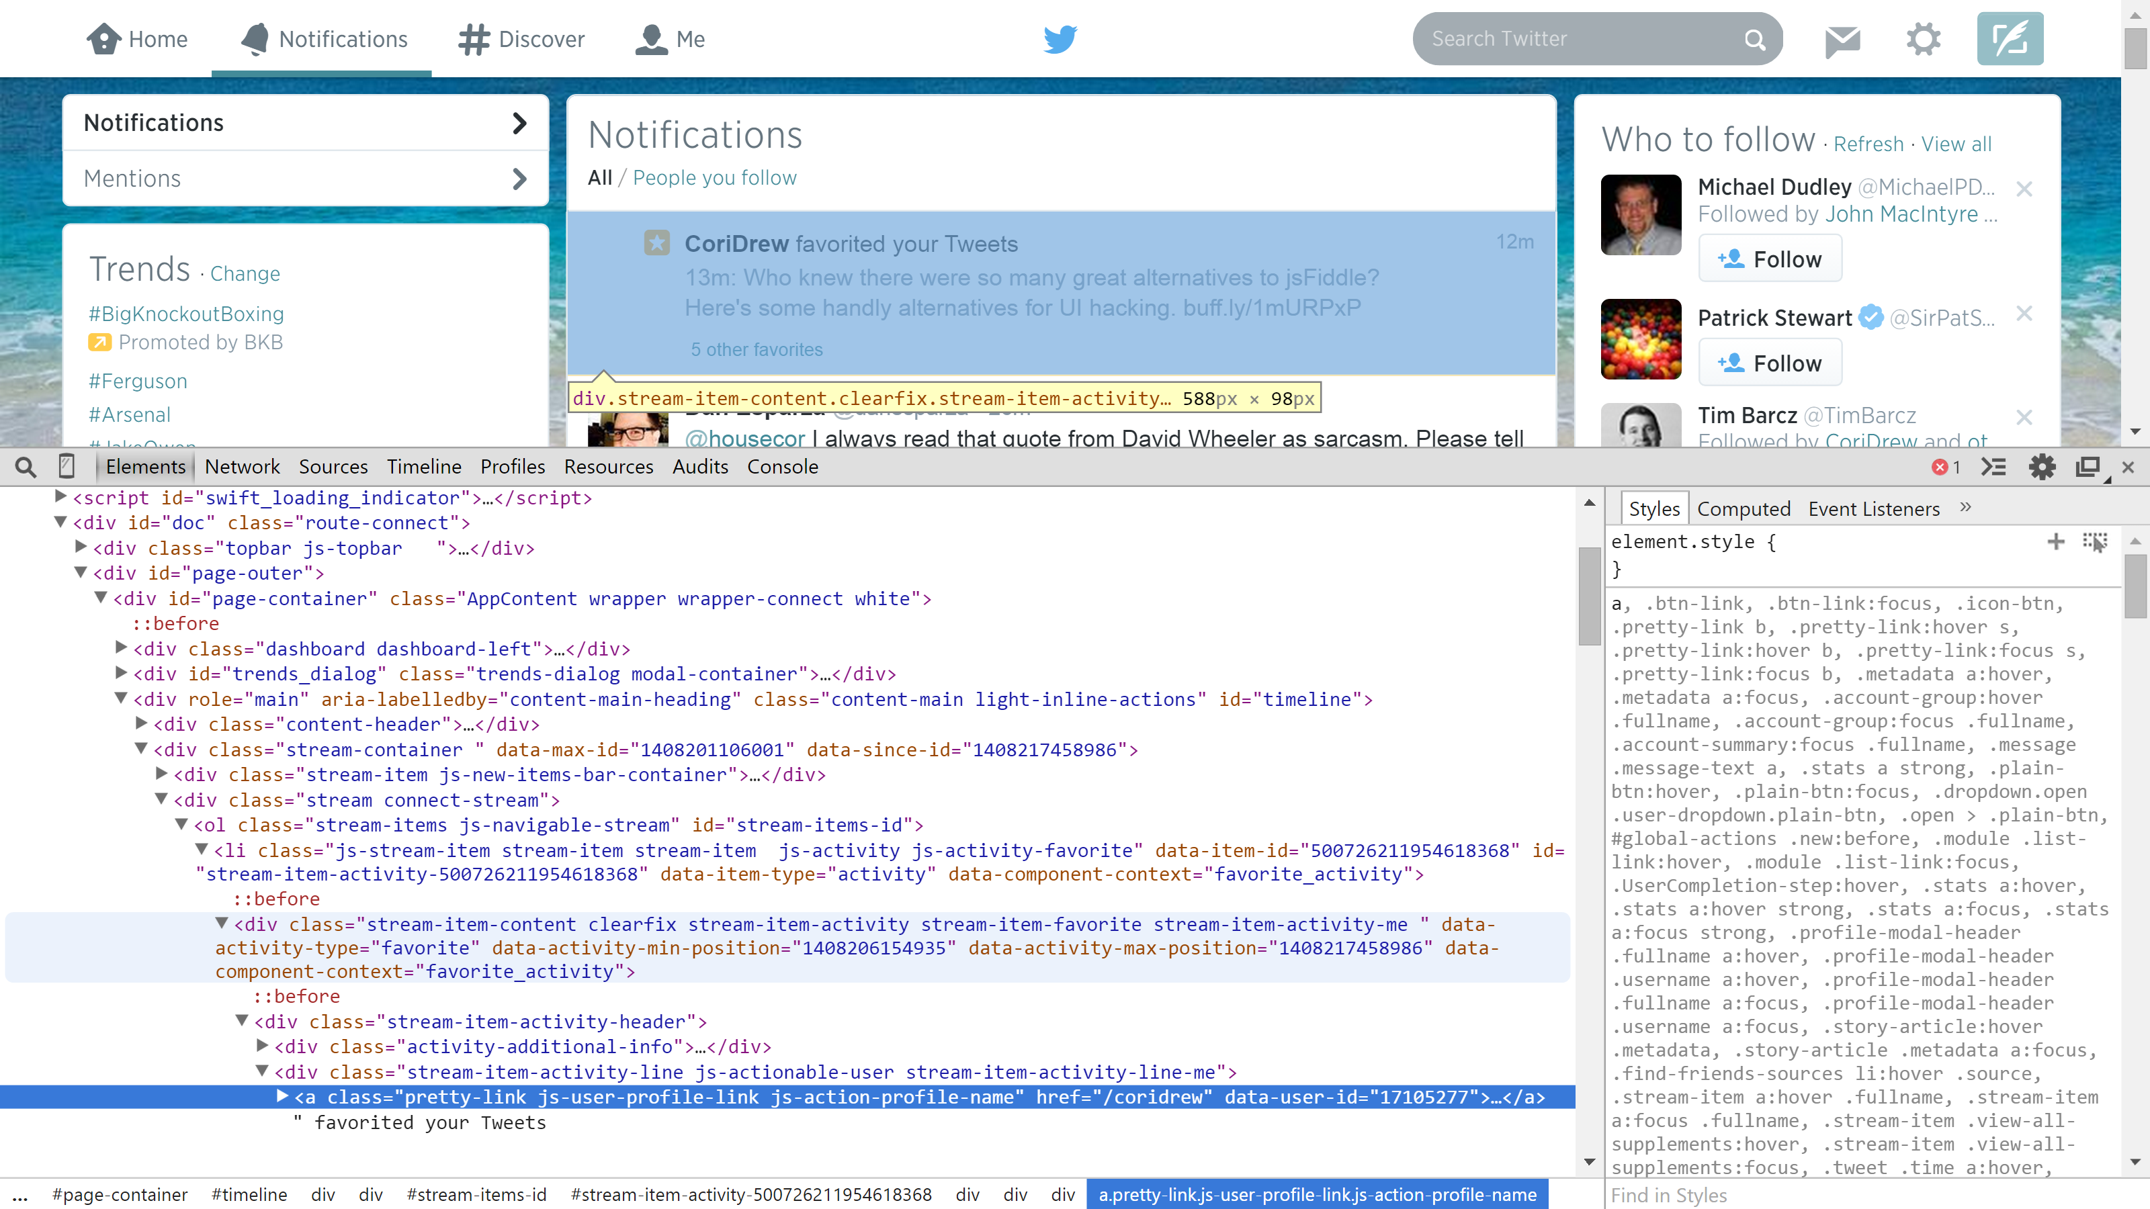
Notes:
Twitter is the same story. As you can see, there are div at least 9 layers of divs in the markup for twitter. Wouldn’t it be nice if the markup were more descriptive and less generic?

Slide 22
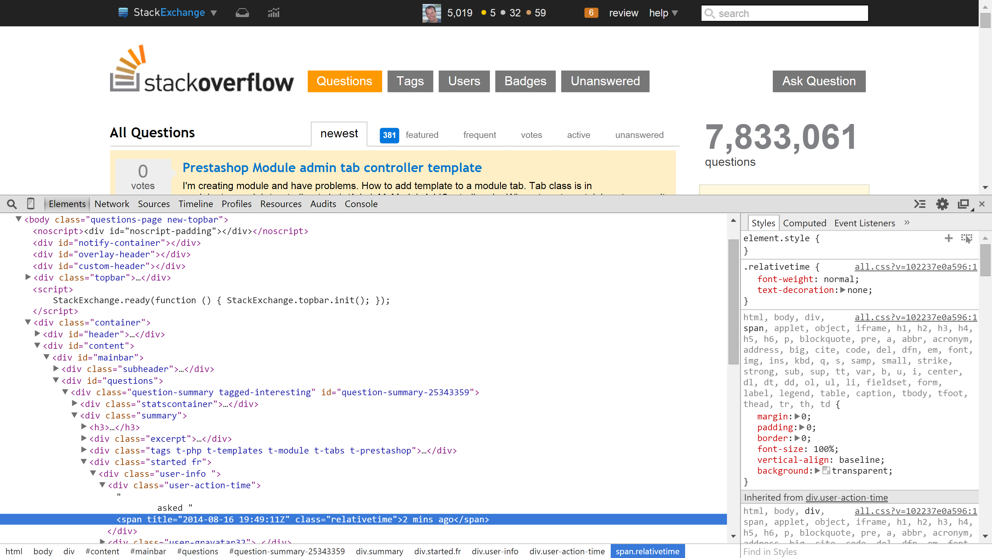
Notes:
One last example. Check out StackOverflow. Again, it’s div soup. But, note that StackOverflow has done a great job of at least providing useful ID and class names on different elements. This certainly helps the maintenance programmer navigate the markup, but it’s still composed of deeply nested DIVs at least 9 layers deep in this example.
You’ve likely heard about the importance of the sematic web over the years. Semantics is the study of meaning in language. And the semantic web is important because it helps convey the meaning of the your content. The generic div tag conveys no meaning about what lies inside.

Slide 23


Slide 24

That’s Smurf’dup.
Notes:
Everything is a smurf. Show smurf vid. We grossly overuse the word div.
Car manufacturers don't buy diodes, capacitors, etc. They buy, radios, ECUs, a larger component.
Components in the real word:
Transmission, headlight, radio.
What if all vehicles simply used the plastic or metal "tag"? The interior is made up of massive amounts of plastic. But those bigger pieces create the door assembly, dashboard, and armrest. Suppliers deliver high level components.

Slide 25
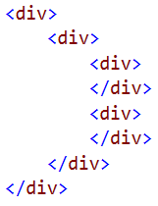
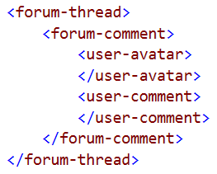
Which Would You Rather Debug?

Slide 26
Problem: Undescriptive Markup
<div>
My do list<br/>
1. Take out trash<br/>
2. Walk the dog<br/>
3. Brush my teeth<br/>
</div>
<h1>My do list</h1>
<ol>
<li>Take out trash</li>
<li>Walk the dog</li>
<li>Brush my teeth</li>
</ol>
Descriptive markup:
Conveys additional information
Improves SEO
Enhances accessibility
Speeds development
Aids Maintenance
Generic
Notes:
So for instance, while you could put a numbered list of items in a span or a div, using an ordered list is preferable since it conveys more meaning. It says “this is a numbered list of items”. The <ol> tag is designed for displaying ordered lists.
Consider some attributes of great markup.
1. First, great markup conveys additional information about your content. The h2 tag says “hey, this is a new section that’s about my to do list. It has intrinsic meaning.
2. Semantic markup aids search engine optimization. For example, search engines pay special attention to headings since they provide a succinct high level overview of the content below.
3. Descriptive markup is also important for accessibility. Proper semantic markup assists screen readers. For instance, screen readers understand that the markup on the right is an ordered list and convey that information to the user.
4. Descriptive markup speeds development by reducing the amount of markup and styling you have to write to achieve the desired look and feel.
5. And perhaps most importantly, it helps maintenance programmers work with our markup because it makes the markup easier to read and navigate. It’s easier to find what you’re looking for when pieces of markup are placed within well named structures. Divs and spans tell us nothing about what is inside.

Slide 27
Custom Elements
Define your own HTML elements. Name must have a dash (-).
Extend existing elements
Extend <button> with <button is=“uber-button”>
Valid | Invalid
<my-component> | <mycomponent>
<pluralsight-tab> | <tab_bar>
<cory-contact-form> | <billingForm>
Notes:
Custom elements provide two new core functionalities:
First, you can define your own rich HTML elements. These elements can be named whatever you like, but note, the name must have a dash. This tells the browser that it’s a custom element and is important because it triggers certain behaviors, particularly for styling. So my-component, tab-bar, and billing-form are valid component names. Mycomponent, tab_bar, and billingForm are not. These custom elements can provide rich custom functionality and be pretty much any size. You can create a simple custom element that provides a simple reusable UI element, or deliver an entire application via a single custom element. Some suggest thinking of the first dash in the name as a namespace. (http://webcomponents.org/articles/how-should-i-name-my-element/). This helps avoid naming collisions.
Second, custom elements can extend the existing HTML elements you already know and love. But you can radically improve their power, and again give them any creative name you like such as <uber-button>, <company-textbox>, or <massive-submit>
Now let’s check out the API for creating custom elements.

Slide 28
Registering Elements
Register the new element via registerElement
Append to DOM via appendChild
var slickTabs = document.registerElement('slick-tabs);
document.body.appendChild(new slickTabs());
var superTextarea = document.registerElement('super-textarea', {
prototype: Object.create(HTMLTextAreaElement.prototype),
});
document.body.appendChild(new superTextarea());
Notes:
Note that any IDE with good intellisense support for JavaScript like WebStorm or Visual Studio will help you locate the proper prototype for extending native HTML elements. Just type HTML and you’ll see a long list of common elements to choose from.

Slide 29
Four Ways To Instantiate
Markup
new Operator
createElement
innerHTML
<pluralsight-comment />
var comment = new PluralsightComment();
var comment = document.createElement('pluralsight-comment');
el.innerHTML = '<pluralsight-comment />';
Notes:
These methods should look familiar to any web developer, because instantiating a custom element looks just like instantiating any other element. For these examples, assume I’ve created a pluralsight-comment custom element that makes it easy for us to add a comment form to any page on the Pluralsight website.
The most obvious way is to simply create a tag in the markup. So just like any other HTML element, placing this in markup would create an instance of our custom element.
Another method is to create a prototype for the component and utilize the new operator to instantiate it. Of course, this line doesn’t add the new custom element to the DOM, so you’d need to append it to the DOM on a separate line.
Or you can use the create element method to instantiate the element. Simply pass the desired tag as a parameter. Again, like the previous example, this doesn’t append the element to the DOM, so you’d do that separately.
Finally, and the least attractive of the three, you could utilize the innerHTML method to add your custom element to the page. Of course before this you’d need to have configured the component.
Let’s quickly check out an example of each of these approaches.
http://plnkr.co/edit/1yYsTPbBHewH6vav7xvv?p=preview

Slide 30
Lifecycle Callback Methods
Name | Called when…
createdCallback | Instance is created
attachedCallback | Instance inserted into DOM
detachedCallback | Instance is removed from DOM
attributeChangedCallback(attributeName, oldValue, newValue) | Attributes are added, removed, or updated.
Notes:
There are 4 lifecycle callback methods. These methods provide hooks that allow injecting behavior, performing cleanup, or initializing the element at the appropriate point in the lifecycle. All of these are optional, so don’t feel obligated to define these unless you have a specific reason.
The 4 in action: http://plnkr.co/edit/o4B0d9WHb0PqYckCEyYy?p=preview
//TODO: Why do I have to set the property value rather than just setting the function directly?
Alternative less terse format to the Plunk above:
http://plnkr.co/edit/o4B0d9WHb0PqYckCEyYy?p=preview

Slide 31
Demo
Instantiating Custom Elements
Notes:
Let’s check out an example of each of these approaches to instantiating custom elements.
http://plnkr.co/edit/1yYsTPbBHewH6vav7xvv?p=preview

Slide 32
What Level of Abstraction?
Any.
Low Level or Entire App!
Notes:
So before we dive in, let’s consider what level of abstraction makes sense when creating web components. My short answer? Any! Low level to entire app! Yes, you could encapsulate an entire application into a web component. And that component would of course be composed of many smaller components.

Slide 33
What Level of Abstraction?
<author-page>
<course-list>
<author-info>
<course-item>
<star-rating>
Any.
Low Level or Entire App!
Notes:
So imagine you created a billing system application.
You could create a component that encapsulates the entire application if you like. Since it’s a billing application, perhaps you’d decide to prefix all your custom element names with the word bill. So you could call the component that delivers the application bill-app. And that component would compose together more granular components that handle smaller pieces of the app
like a header and a body
And that header might be composed of a navigation bar and an avatar of the currently logged in user. You get the idea. Now you certainly aren’t obligated to make your entire app into a single component. You might simply find web components useful for creating very small reusable components like search inputs, tabbed navigation, or other small reusable pieces of interface. There’s no right answer here, but think carefully about the level of abstraction that is useful for your project.

Slide 34

<author-page author="cory-house"></author-page>
<pluralsight-course
title="Clean Code"
author="Cory House"
level="intermediate"
length="3h 10m"
rating="4.7">
</pluralsight-course>
Notes:
When you start thinking about the web as a nested set of components, it starts to really change the way you write your markup and compose your pages.
Here’s an author page. Oh, it just happens to be mine! Niiiiice. Okay, so what components do we see here? Well, there’s a header across the top. And that header is really helping integrate two separate sites, Pluralsight and Digital Tutors, so this could be an <integration-header> element.
Jumping down here to the list of courses, each of these could be a <pluralsight-course-listing> component. And that component might have attributes like course name, author, course level, date, and rating. Of course some of these components are complicated and would warrant their own component. You can imagine the <Pluralsight-star-rating> component could be composed within a Pluralsight-course-listing component.
And this entire page could be wrapped up as an <author-page author=“cory-house”> component. You could just set the attribute on the component and it would make the call to retrieve the information you need. It’s not required, but just an example of how high level you could go if desired. Since you can compose components within components, deep nesting is a practical option to consider.

Slide 35
Summary
Today’s markup is highly generic
Custom Elements let us create our own HTML elements
Instantiate just like regular elements
Use the Lifecycle callback methods
Choose a level of abstraction – single component to full app
Notes:
In this module we were reminded that today’s markup is highly generic. Many popular web apps today are a div soup. Their markup is chock full of generic divs and spans.
But custom element finally give us the power to create rich, reusable, and highly descriptive markup by defining our own HTML elements.
We walked through the lifecycle callback methods that give us the power to build the component and attach behaviors at different points in the elements creation, changes, and destruction. These methods are critical for assuring that your web components operate like native HTML elements.
And finally, we discussed a variety of approaches to namespacing your elements to avoid conflicts with other authors and help convey the intended audience and reusability for your components.

Slide 36
Shadow DOM
@housecor

Slide 37


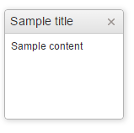
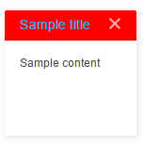


Problem: No Style and DOM Encapsulation
Avoiding style conflicts requires highly specific CSS selectors
Use of !important to force styles
No guarantee another style won’t conflict
We envision this
But may end up with this
Notes:
Do you ever plan take family pictures, and have this vision of well behaved children in proper coordinating outfits? As developers we have the same dreams of creating clean, professional looking components with a polished style. It looks crisp. Everything flows. But then you pull in the giant centralized app stylesheet and, ah! What happened?! That's not at all what I envisioned! When everyone is free to do their own thing, style clashes are a real risk.
So problem #2 is styling conflicts.
Today’s HTML5 components struggle with avoiding CSS conflicts.
We envision cohesive styles like this,
but if we’re not really careful, we end up with this. Other people’s styles end up ruining our vision!
And because there’s no way to encapsulate styles for a given component, there’s no way to assure that other styles on the page won’t accidentally break the styling of any components we use or write ourselves.
So we’re forced bloat our CSS and markup with very specific selectors or even resort to the use hacks like !important to assure our styles our applied as expected.
The bottom line is, we have no guarantee that other styles won’t accidentally conflict with ours, so we have to extremely specific when writing reusable components. This adds unfortunate bloat to our markup and stylesheets.

Slide 38
Light DOM
Shadow DOM

Slide 39
Shadow DOM Hacks
Shadow DOM encapsulates markup, & styling
Today’s ways to get similar behavior:
<iframe>
<canvas>
Notes:
Today, iframes are commonly used today to assure separate scope and styling. Examples include Google's map and YouTube videos.
However, iframes are designed to embed another *full document* within the current HTML document. This means accessing values in a given DOM element in an iframe from the parent document is a hassle by design. The DOM elements are in a completely separate context, so you need to traverse the iframe’s DOM to access the values you’re looking for. Contrast this with web components which offer an elegant way to expose a clean API for accessing the values of custom elements.
Imagine creating a page using a set of 5 iframes that each contain one component. Each component would need a separate URL to host the iframe’s content. The resulting markup would be littered with iframe tags, yielding markup with low semantic meaning that is also clunky to read and manage. In contrast, web components support declaring rich semantic tags for each component. These tags operate as first class citizens in HTML. This aids the reader (in other words, the maintenance developer).
In summary, while both iframes and the shadow DOM provide encapsulation, only the shadow DOM was designed for use with web components and thus avoids the excessive separation, setup overhead, and clunky markup that occurs with iframes.
Plunkr to showcase the difference in progress: http://plnkr.co/edit/D46MxuuaRxJ1a9JMwLAP?p=preview
----------------
The Canvas tag allows you to create rich interactions via a rich vector based API. However, items rendered within the <canvas> tag are hindered by low accessibility, search engine optimization issues, and an inability to easily compose these elements together. Using canvas would also mean you can’t extend and leverage any existing HTML inputs. You’d have to create your own versions in canvas from the ground up. In short, canvas is a powerful drawing tool, but was never designed with creating reusable components for web applications in mind.

Slide 40
Shadow DOM is Already Used Today?!
<input type="range">
<video controls width="250"></video>
<input type="date" />
Notes:
Shadow DOM is already used today. See http://plnkr.co/edit/tFbskmOhscOaBNqGYCck?p=preview
Note the multiple shadow roots. One for the entire video. Slider is a nested shadow root (so another reusable component),

Slide 41
Demo
Shadow DOM in Native HTML Elements
Notes:
Let’s jump over to Plunker to check out some native examples of native HTML elements that utilize Shadow DOM.
http://plnkr.co/edit/tFbskmOhscOaBNqGYCck?p=preview
Create video, input type range, and input type date controls.
Show how each has shadow DOM
Note that the video control uses multiple shadow roots.
Note the multiple shadow roots. One for the entire video. Slider is a nested shadow root (so another reusable component)
The date input is particularly interesting. You can see that behind the scenes it’s really just a number of different spans. And as we change values in the input, the values in the shadow DOM are changed as well. You can even see that IDs are defined for the elements within the shadow DOM

Slide 42
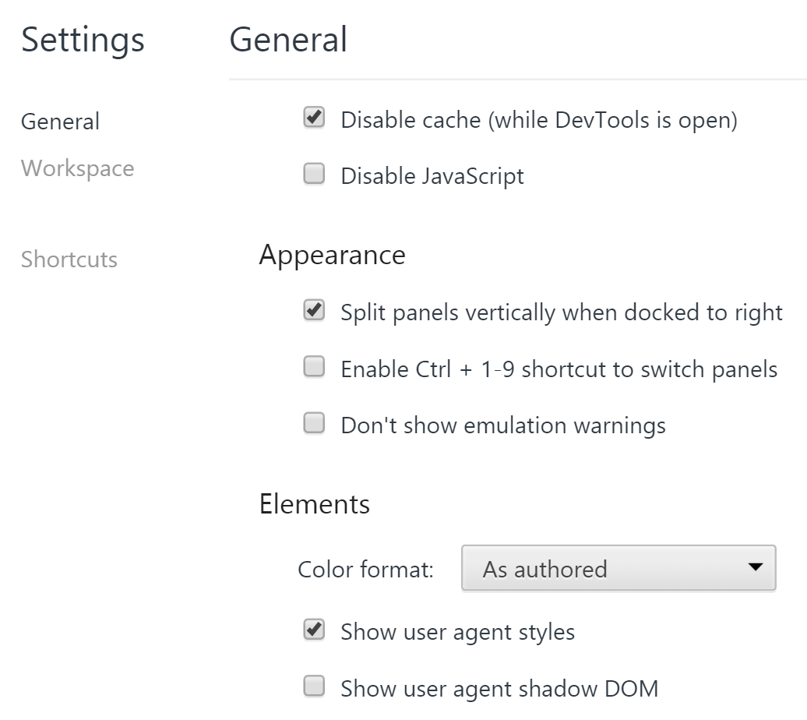
Show me the magic
Notes:
You can view the Shadow DOM in Chrome

Slide 43
Create Shadow DOM
Select shadow host
Create a shadow root
Add elements
  innerHTML
  appendChild
Notes:
Creating Shadow DOM is a simple 3 step process.
First, Select a shadow host. This is the element in the light DOM that will wrap the shadow root. Remember the video tag we just reviewed as an example.
Second, Create a shadow root
And finally, you add elements to the shadow DOM using the same methods you use today. The approaches for appending elements to the shadow DOM should look familiar to you, because they’re the same methods you use to append elements to the light DOM. InnerHTML accepts a string of markup and appends it to the DOM. And appendChild appends an element to a given parent.

Slide 44
Demo
Creating Shadow DOM
Notes:
Alright, enough talking concepts, let’s jump into Plunker and create our own Shadow DOM
http://plnkr.co/edit/zkVpE3nghgCZkTEPkiUl?p=preview
Alright, so as I just mentioned, creating shadow DOM is a simple 3 step process:
Select shadow host
Create a shadow root
Add elements to the shadow root
So,
Create shadow host
Create shadow root
Add elements to the shadow root
Enhance by defining a template and using appendChild instead.
Add a style in the light DOM and note how the h1 we created isn’t changed. Create an h1 in the light DOM and note how it’s styled.
Note how when I run a simple selector: console.log(document.querySelector('h1')); I get null because it’s with the shadow root and thus isn’t traversed by standard selectors. (we’ll get into how to traverse the shadow DOM later in this module.)

Slide 45
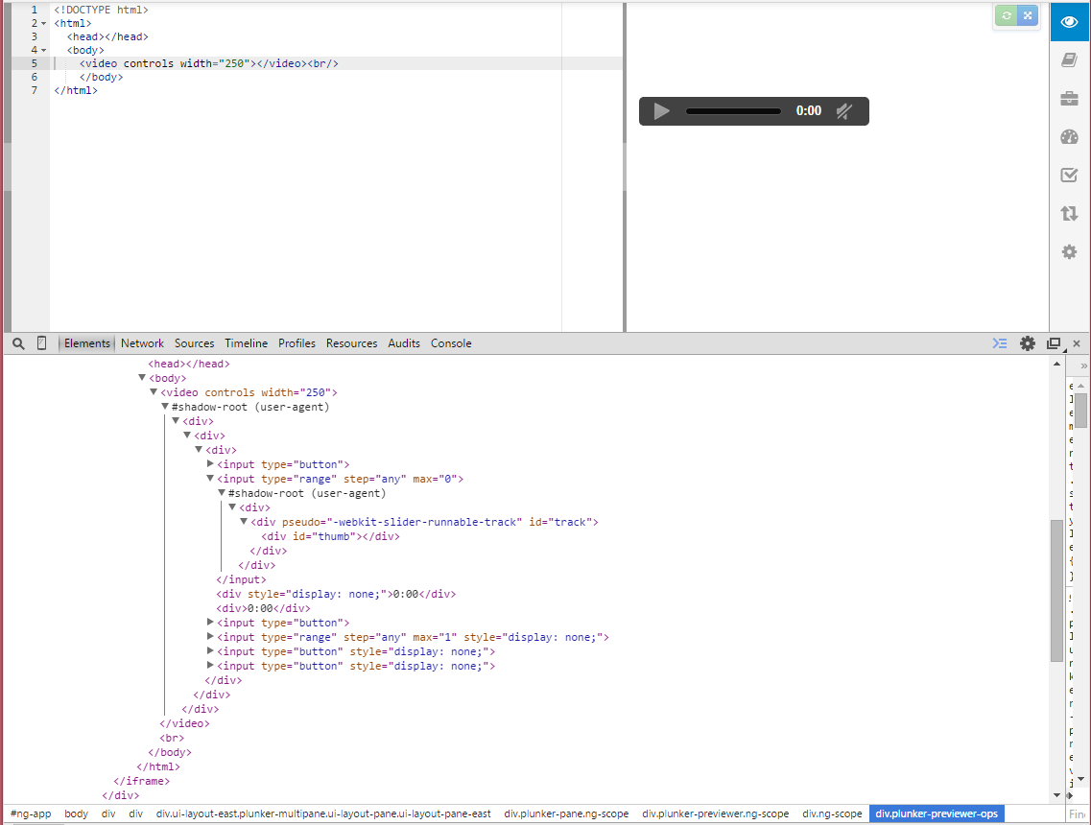

Shadow Host
Shadow Root
Shadow Root and Shadow Boundary
Shadow Tree / DOM Subtree
Notes:
We’ve introduced a lot of new terms related to the Shadow DOM in the last few slides, so let’s step back to the video tag code we reviewed earlier and consider how all these terms apply together.
First, you can see the shadow root is clearly labeled in Chrome’s browser tools. Chrome makes it really easy to see the encapsulated DOM elements that sit within this Shadow Root.
The shadow root is the root node of a shadow tree. The shadow root encapsulates a DOM subtree. As you can see, this is the DOM subtree that being encapsulated by this shadow root. I say encapsulated because this is a chunk of DOM elements that are hidden from traversal and styling via traditional means. You’ve already seen the power of this encapsulation because you likely didn’t even know that there was all this interesting markup being created behind the scenes when you use the video tag. All of this markup within the shadow root is shadow DOM. You can also see a nested shadow tree here. (highlight range). Here, the input of range
This Shadow Tree, also known as a DOM subtree is a node tree. This shadow tree is encapsulated because the shadow Root creates a shadow boundary around the DOM subtree. The shadow boundary is merely a concept. It’s simply a term to describe the encapsulation provided by the shadow DOM. But as you can see, the shadow-root is the shadow boundary so I’m just labeling them together. Because of the shadow boundary, styles defined in this DOM subtree won’t apply to DOM elements in the Light DOM. And the corollary, is true too, styles in the light DOM won’t pierce the shadow boundary and effect items in the shadow DOM. Now, be forewarned, this is generally true, but as you’ll see in the next module on styling, there are some ways to deliberately pierce the shadow boundary in both directions. In other words, with some new CSS selectors and DOM methods, there are some deliberate ways for the light and shadow DOM to interact. So the shadow DOM isn’t a fortress. It’s encapsulated and has a clear API that helps avoid accidental traversal and manipulation of the DOM subtree. Also, take note that you can nest shadow roots. So one DOM Subtree can end up hosting another DOM subtree. This can be useful when the markup for an element is complex since each separate DOM subtree has its own shadow boundary. This is useful because it means styles and CSS selectors won’t impact other DOM subtrees. You can see that the native video tag uses a nested shadow root to hold the range element. This composition of multiple components is a powerful concept. Remember, the range input is another HTML element that utilizes shadow DOM to encapsulate complex markup. So the video tag is especially powerful because it not only uses the shadow DOM to encapsulate its markup. It encapsulates other complex elements that utilize their own shadow DOM. And since the shadow boundary protects the markup inside of each shadow root, the DOM elements can interact in this case via a clean API that is defined by the developer.
Finally, this is the shadow host. The shadow host is the element in the light DOM that is hosts one or more node trees. In this case, the shadow host is the video tag. (insert party music here) I find the shadow host term quite intuitive. It’s just like the host of a party. You invite people into your home and these people are encapsulated from the outside world. Your house provides a boundary for the party. You, the shadow host, are a very important element. Because, without you, the shadow host, own the container for the exciting shadow DOM party!
See http://w3c.github.io/webcomponents/spec/shadow/ section 2.2 for the W3C spec

Slide 46

Shadow DOM Styling Selectors
:host – Style shadow host
:host-context – Style light from shadow
::content –Style content in <content> tags
::shadow – Style shadow from light (1 layer deep)
/deep/ - Style shadow from light (infinite depth)
:unresolved – Style unresolved custom elements
Notes:
Note: Older specs included the hat and cat selectors (^ and ^^, respectively), but these were replaced by ::shadow and /deep/ (http://robdodson.me/blog/2013/11/15/the-cat-and-the-hat-css-selectors/) – They were last discussed at http://lists.w3.org/Archives/Public/www-style/2013Nov/0313.html
Also, the ::part pseudo selector was also removed, and is now handled by ::shadow and /deep/.
Handy cheat sheet: http://robdodson.me/blog/2014/04/10/shadow-dom-css-cheat-sheet/
Host Example at http://plnkr.co/edit/9uR0oMeRpKfxuGpMyCkB?p=preview
Content example at http://plnkr.co/edit/qFbyg3RWV6H9VPNHL4V0?p=preview
Shadow at http://plnkr.co/edit/76o72GmgTLaUJY8IhvL8?p=preview

Slide 47
Summary
Light DOM vs Shadow DOM – Finally encapsulation for DOM and styles!
Many new terms:
JavaScript is not encapsulated
Shadow Root
Shadow Boundary
Shadow Host
DOM Subtrees
CSS Selectors
Notes:
In this module we learned about the power of the Shadow DOM. We contrasted it with the light DOM and learned that the light DOM is the DOM you’re already familiar with that we’ve been using for years.
The Shadow DOM is a new mechanism that provides encapsulation for our DOM elements and styles. In the next module we’ll discuss various new CSS selectors for styling the Shadow DOM, distributed nodes, and shadow hosts.
And along the way we learned a boat load of new terms including:
Shadow Root – which is the root node of a shadow tree
Shadow Boundary –
Shadow Host – which is the element that hosts one or more node trees
DOM subtrees – which are the pieces of encapsulated DOM that sit within the shadow root
And, don’t be confused, JavaScript is not encapsulated in the shadow DOM. So if you want encapsulation, you need to use the same techniques you’d use elsewhere in JavaScript to encapsulate your code such using the popular Immediately Invoked Function Expression pattern, also known as an IIFE.
In the next module we’ll explore how to make your components much more powerful and flexible by defining insertion points in your shadow DOM.
I’m Cory House with Bitnative Consulting.

Slide 48
Imports
@housecor

Slide 49



Packaging Matters
Notes:
Imports help solve the delivery problem for web components. See, when you create a web component, you're potentially giving a gift to your team, your company, or perhaps the world. Others can use your component so they don’t have to start from scratch.
You can think of imports as the packaging that you create for the gift of web components. See, if I give my son a present in a nice package, with everything grouped together and wrapped with a bow, he’ll be excited. See, there’s no denying the excitement on that face.
But what if he walks in on his birthday and I try to give him his gift as a bunch of separate pieces lying on the floor? Well, that may not go so well. He’ll be confused at first about what he’s seeing, and he’ll likely be less than impressed with the gift.
See, how you package and deliver things for others to use really does matter. It effects their initial experience. If I give you a gift and its pieces are scattered about on the floor, you're likely to be unimpressed and confused. But if I hand it to you in a flashy consolidated package, then it's exciting, it’s easier to understand, and it's simple for you to get started. That's exactly what HTML5 imports do. They bundle up all the pieces of your web components into a handy package that you can start using with a single line of code!

Slide 50
Problem: No Native Bundling
Consider a component using bootstrap…
What if we could simply say:
<script src ="jquery.min.js"></script>
<script src ="bootstrap.min.js"></script>
<link rel="stylesheet" href="fonts.css">
<link rel="stylesheet" href="bootstrap.min.css" />
<script src="script.js"></script>
<link rel="stylesheet" href="style.css" />
<import rel="import" href="myBootstrapComponent.html" />
Notes:
What if you want to bundle some CSS, JS, and HTML together?
And sure, these hacks do work, but we still have a bigger problem. We’ve seen how to leverage the shadow DOM to encapsulate our styles, how to define templates that can be reused, but how do we bundle all of this up into a reusable component? That’s where HTML5 imports come in. Just consider Bootstrap. Building a web component that utilizes bootstrap requires at least 2 JavaScript files since jQuery and bootstrap are separate JS files. And you may end up with even more js files if you pull in certain optional features in Bootstrap. Two separate CSS files are also involved. With imports we can simply bundle these dependencies together within a single html import.

Slide 51
Bundle Up
HTML
JS
CSS
Notes:
HTML imports aren’t limited to merely importing HTML. You can bundle up and import JS, CSS and anything else that an HTML file can contain. It’s quite handy. Just one line pulls in everything you need for a given component.

Slide 52
Demo
Imports
Notes:
Okay, enough talk. Let’s check out an example of HTML imports in action.
For this demo were going to create a component that lists the cars in my dream garage.
Note that a friendly practice in imports is to register the custom element so all the consumer has to do is slap the new tag on the page and it’ll just magically work. Let the import do all the dirty work!
Create dream-garage.html.
Add list of 3 cars
Populate index.html with link tag
Add getCarListFromImport function and call
Comment out link tag and generate dynamically.
Start of demo: http://plnkr.co/edit/Pgh5d1pJdCbaUkkXtCXc?p=preview
Completed phase 1 of demo: http://plnkr.co/edit/jtryIfHnR9EoOBUUg1B4?p=preview
Full Demo (with moves to Shadow DOM and template included, and various experiments as well): http://plnkr.co/edit/hT6rJqmfMlyx6TDotatD?p=preview
Simple comment form example: http://plnkr.co/edit/y8SYWOQs2aGZGpPvfuXv?p=preview

Slide 53
Other Uses for Imports
Themes
Component Library
App Sections
An entire app!
Even change markup and behavior within themes
Bundle related components together
Bundle resources used in specific portions of your app
Just an import and a single custom element…
Notes:
Since HTML5 imports simply bundle up HTML, JavaScript, and/or CSS, there's all sorts of other interesting use cases you can consider. With imports you can wrap up all sorts of things:
Other usages - You can wrap up all sorts of things!
Bundle up:
1. Themes - Imagine if you could change a single import and radically change the theme of your app. Yes, you can do this with separate CSS stylesheets today, but using imports could give you even greater power to change markup and even behaviors for different themes by importing different markup and JavaScript for different themes.
2. Library of components - Maybe your app uses a set of components on multiple pages. Imagine you're a developer on the Pluralsight website. You might find that there are certain core components that you find useful on multiple pages like an author avatar, star rating, or feedback form. All of these core widgets could be included and registered as custom elements by a single import if desired. Closely related to this, you could use an import to pull in JavaScript files that define various functions that are used by the calling page.
3. Sections of your app - If you find that sections of your application require certain common elements, you can bundle those dependencies into a single import. This concept isn't all that different from master pages in web forms or templates in mvc. Imports can be used to create a centralized mechanism for bundling the list of dependencies for a given section of a site.
4. Finally, you could even consider using imports to deliver an entire app! We discussed custom elements in a previous module, and you could use a single import file that contains multiple sub-imports to completely bootstrap an application from merely two lines of markup. One line for the import, and another for the custom element that instantiates the application. Now whether you find going to this extreme logical and helpful is another discussion altogether, but the point is, the power is there. So use it wisely.

Slide 54
Summary
Store inert HTML
Imports bundle up and deliver your components
Programmatically access import contents
Avoid third party dependencies
Notes:
In this module we saw how HTML5 Imports are the fourth and final key to creating reusable web components.
Just like the template tag, any HTML in an HTML5 import is inert initially.
Imports are an elegant way to bundle up all of your web components dependencies into a convenient package that people can reference via a single simple line of markup.
And you can programmatically access import content using the import property on the imports link tag
We discussed various approaches to avoid third party library conflicts. It’s preferable to avoid third party library dependencies if possible, but strive to require the latest version of the library if you do in order to keep the component relevant and help decrease the chance of conflicts with other components.
Consider publishing your web component as a Bower to handle your third party library dependencies. Bower makes it really easy to download front-end related assets like web components and their dependencies.
And if you’re building components for internal use, strive to agree on a standard for handling third party components so developers don’t have to struggle with conflicts and duplicate requests.
And congratulations! With this key 4th technology in place, you now have all the tools necessary to build your own web components!
So in the next module we’ll see how the four core web component technologies: Templates, Shadow DOM, Custom elements, and Imports work together by building a useful web component from scratch.
I’m Cory House with Bitnative Consulting.

Slide 55
Native Alternatives
@housecor

Slide 56
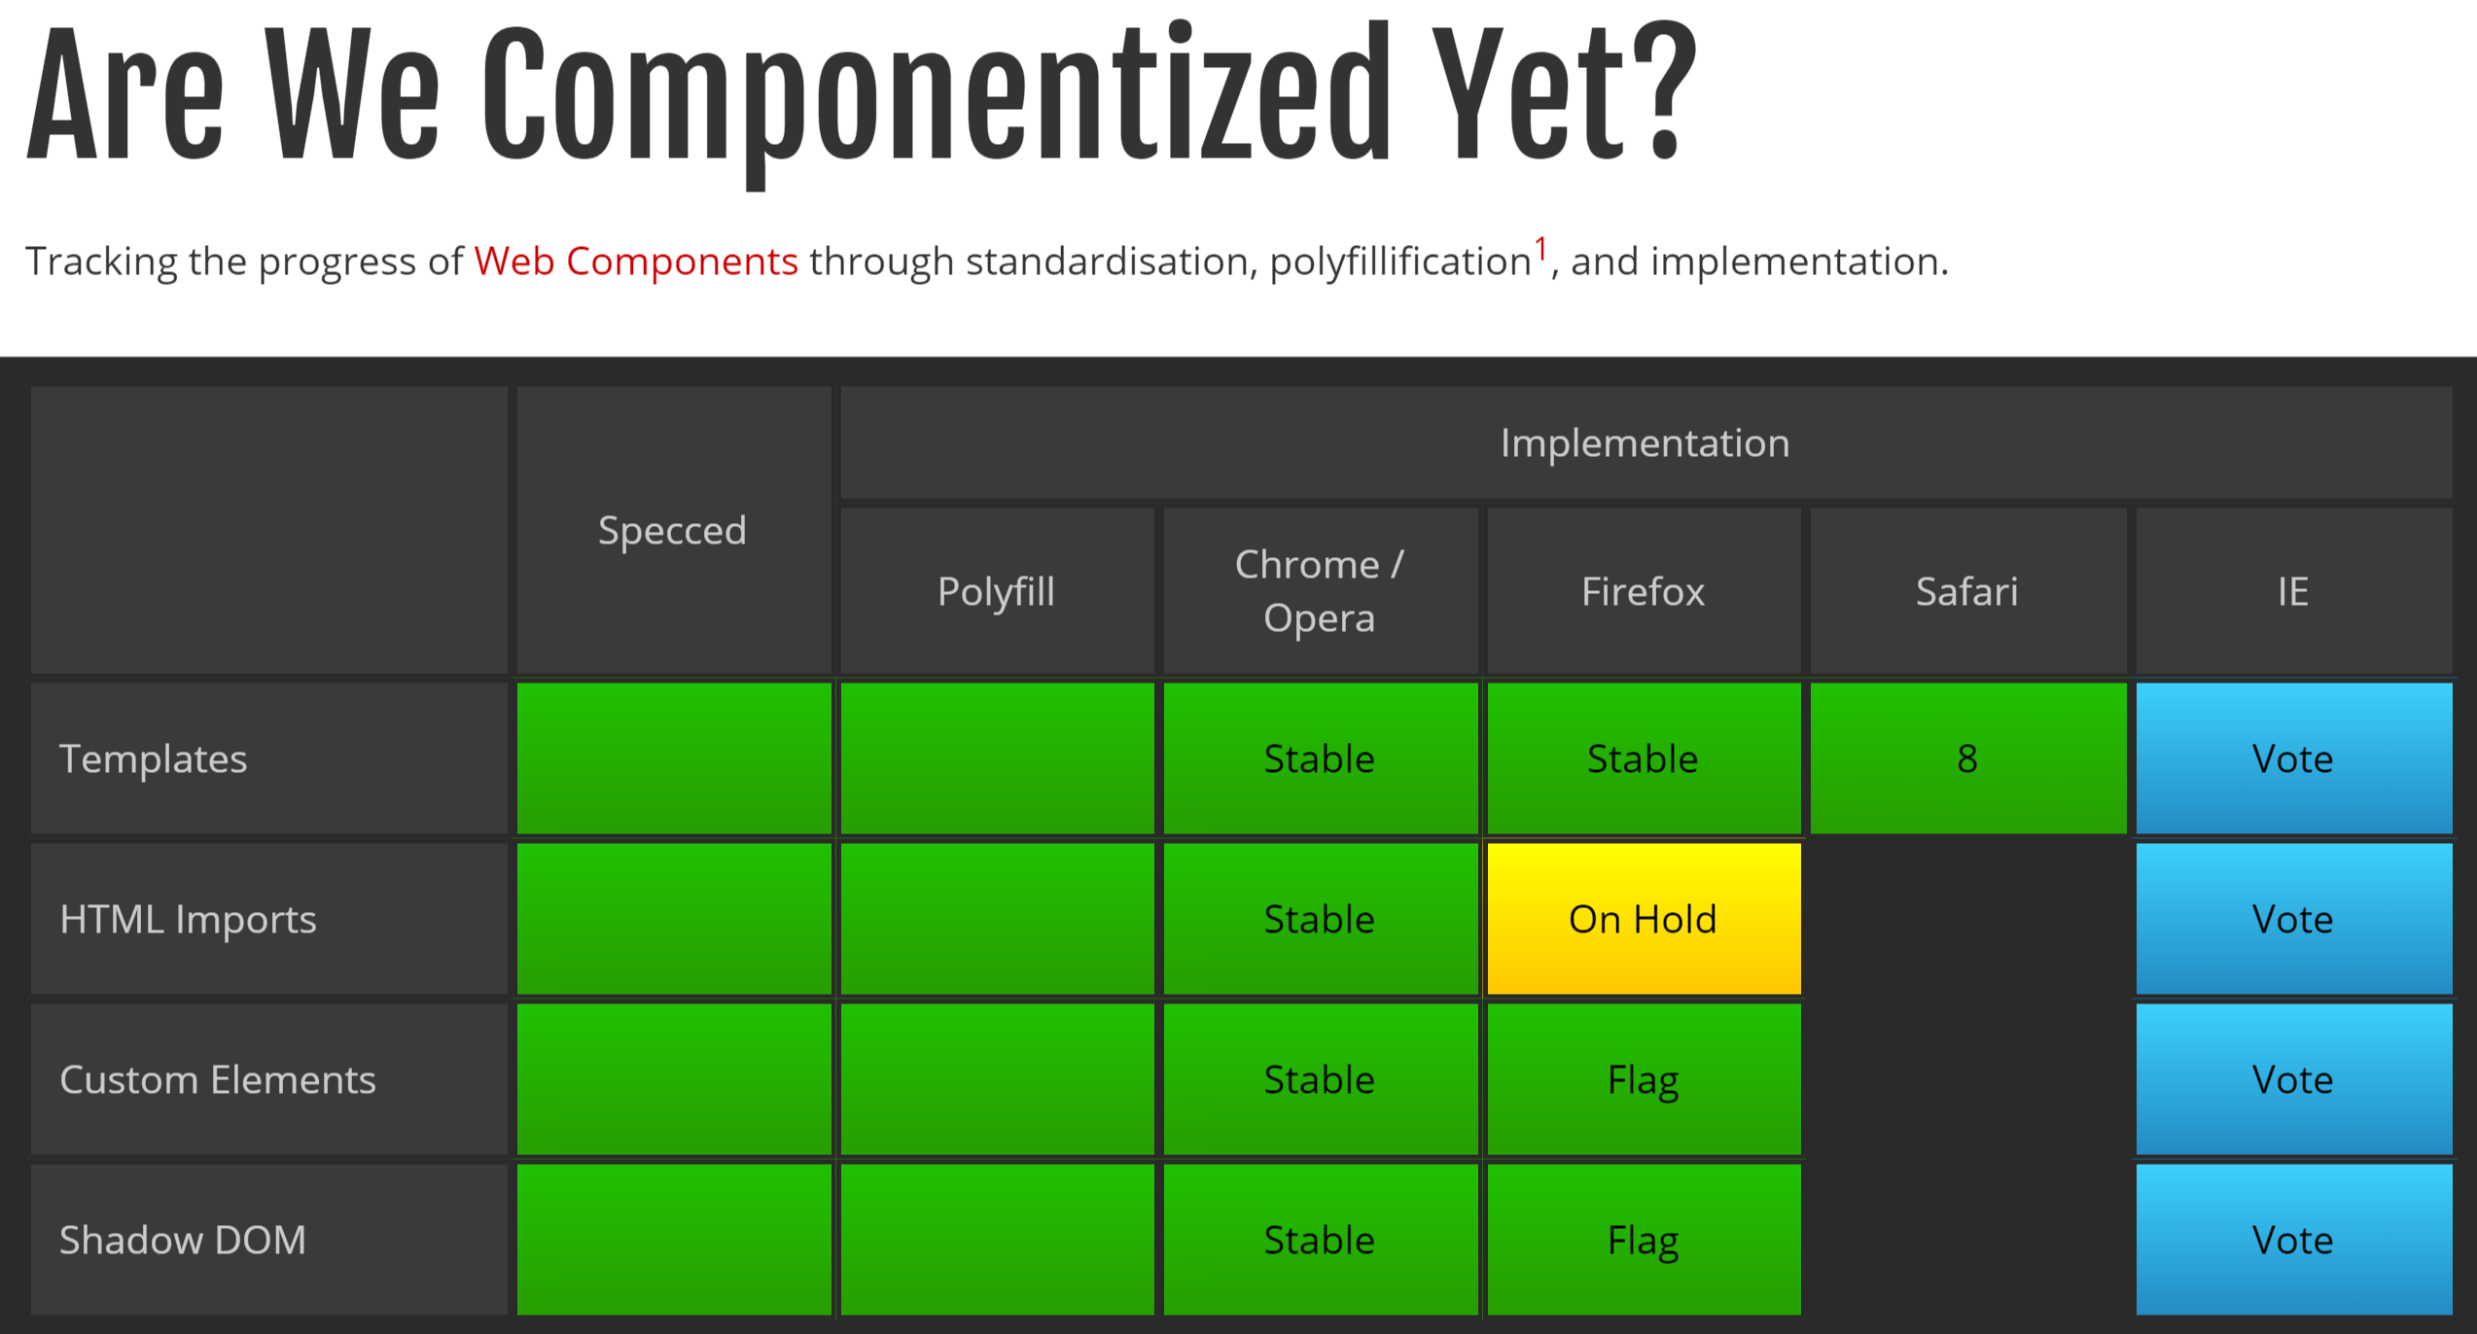
http://jonrimmer.github.io/are-we-componentized-yet/
Notes:
To keep track of the latest status of web components support, check out Jon Rimmer’s website at this URL: http://jonrimmer.github.io/are-we-componentized-yet/. As you can see, at the time of this recording all of the 4 core pillars of web components are fully specified and supported, supported natively in both Chrome and Opera, and Polyfilled for use in all modern browsers using JavaScript frameworks like Polymer.
Also, please don’t be discouraged about the current state of browser support because in later modules we’ll walk through various alternatives to native web components like Polymer components, Angular directives, and Knockout components. So while the native support in all browser hasn’t quite arrived yet, many of the principles we’re going to learn can be enjoyed in all modern browsers today through these libraries and frameworks.
And learning these foundational web component technologies should help you be successful even if you decide to use a framework like Polymer or Angular today. I’ll use an analogy to help explain why.

Slide 57
Want Cross-Browser Components Today?
Webcomponents.js
Notes:
If you’re able to write applications that only support modern browsers with native web component support, then you can enjoy the power of native HTML5 web components today. However, if you’re building cross-browser web applications, then you can utilize a polyfill library to add web component support to older browsers.
webcomponents.js is a polyfill library for native HTML5 web components. A polyfill library seeks to add support for new features to older browsers, typically using primarily JavaScript. The webcomponents.js library polyfills the core features of HTML5 web components including Custom Elements, HTML Imports, and the Shadow DOM. So once you add this library to the page, your native web components can also run in modern browsers that don't yet have native support for web components.
Webcomponents.js was formerly called platform.js and was used as the core of the Polymer and x-tag projects. But it’s now called webcomponents.js and maintained in a separate GitHub repository. This helps clarify that webcomponents.js is a polyfill library that anyone can use, even if you’re not using Polymer or X-tag. That said, if you choose to use webcomponents.js, you’re likely to be interested in using Polymer or X-tag along with it.
Polymer is a project by Google that is a developer preview at the time of this recording. Polymer is library built on top of Web Components and adds a number of handy features on top of the specification. Both X-tag and Polymer utilize the webcomponents.js polyfill. X-tag is a library maintained by Mozilla. For more information on these projects, check out Polymer-project.org and x-tags.org.
See https://github.com/webcomponents/webcomponentsjs to download the polyfill.

Slide 58

Heard of Polymer?

Slide 59


Why Learn Native Web Components First?
Learn this
Before you learn this
Foundation
Abstraction over foundation
Notes:
Remember a few years ago when jQuery had become so popular that new developers were learning jQuery instead of learning JavaScript first? It became more common to hear people ask if you knew jQuery than to hear them ask if you knew JavaScript. That was a problem. And it’s a problem because just like in school, it’s important to learn the foundation before learning the abstraction. Not understanding the abstraction means you’re stuck when the abstraction leaks.
What do I mean by leaks? An abstraction leaks when it expects the user to understand the underlying technology which is being abstracted. So for example, jQuery would sometimes leak and require someone to understand the underlying quirks in JavaScript or cross-browser issues. When these issues occur, it’s important to understand the foundation so that you can address the issue and move on.
JavaScript is the foundation.
jQuery is an abstraction over that foundation. So it’s important to learn the foundation first.

Slide 60

Learn this
Before you learn this
Foundation
Abstraction over foundation
Notes:
In the same way, Web Components are the foundation. They’re the native technology that we’ll be using natively for many years to come, long after polyfills like Polymer are no longer needed. So despite the fact that not all browsers have added full support of web components, it’s important to learn the foundation of web components *trigger animation here* before you try learning an abstraction over web components like Polymer.
Polymer is a library that polyfills web components to work in all modern browsers today. In the future browsers should offer full support for web components. So we won’t need abstractions like Polymer, or alternatives like Angular directives and Knockout components.
Regardless, the foundation you’ll receive on web components in the next 5 modules will help make you successful in any of these alternative technologies today. In fact, in the near future, you’re likely to find that today’s popular frameworks like Angular will become a layer over the web components standard.

Slide 61
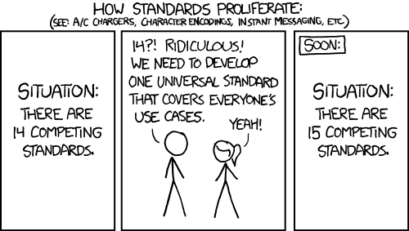


The Risk
Notes:
If you’re able to write applications that only support modern browsers with native web component support, then you can enjoy the power of native HTML5 web components today. However, if you’re building cross-browser web applications, then you can utilize a polyfill library to add web component support to older browsers.
webcomponents.js is a polyfill library for native HTML5 web components. A polyfill library seeks to add support for new features to older browsers, typically using primarily JavaScript. The webcomponents.js library polyfills the core features of HTML5 web components including Custom Elements, HTML Imports, and the Shadow DOM. So once you add this library to the page, your native web components can also run in modern browsers that don't yet have native support for web components.
Webcomponents.js was formerly called platform.js and was used as the core of the Polymer and x-tag projects. But it’s now called webcomponents.js and maintained in a separate GitHub repository. This helps clarify that webcomponents.js is a polyfill library that anyone can use, even if you’re not using Polymer or X-tag. That said, if you choose to use webcomponents.js, you’re likely to be interested in using Polymer or X-tag along with it.
Polymer is a project by Google that is a developer preview at the time of this recording. Polymer is library built on top of Web Components and adds a number of handy features on top of the specification. Both X-tag and Polymer utilize the webcomponents.js polyfill. X-tag is a library maintained by Mozilla. For more information on these projects, check out Polymer-project.org and x-tags.org.
See https://github.com/webcomponents/webcomponentsjs to download the polyfill.

Slide 62
Native Alternatives
Angular Directives
React Components
Ember Components
Knockout Components
Notes:
If you’re able to write applications that only support modern browsers with native web component support, then you can enjoy the power of native HTML5 web components today. And as we just saw, you can consider using the webcomponents.js polyfill library to add web components support to modern browsers. However, if you’re building cross-browser web applications that support older browsers, then you’ll want to consider some alternatives to HTML5 web components.
Likely the most popular way to build non-standard web components at the time of this recording is Angular. Angular offers an alternative to native web components called directives.
But Knockout
And Ember both offer a proprietary component solution as well.
To clarify, these three are NOT polyfills for native HTML5 web components. In fact, they look nothing like These are libraries and frameworks that perform a variety of other services, but they do happen to offer alternatives to native web components as well. And while they seek to honor the web components spec where possible, these are not pure polyfills like Polymer and x-tag. So they don’t seek to follow the web components spec to the same degree. Instead, their primary goal is to provide a proprietary and opinionated alternative to native web components that works well with users of their framework. So, throughout the rest of this module, I’m going to refer to these three as non-standard component frameworks because they don’t currently seek to polyfill the web components standard. Also, I recognize that Knockout is generally considered a library, not a framework, but I’m going to lump all these under the label of non-standard frameworks for brevity.
As time goes on, the popularity and approach of these frameworks may change and new frameworks may be added to this list, but I mention these because if you’re already working in one of these three frameworks, you’re likely to enjoy their solution for components. And as browser support matures, you’re likely to find these libraries increasingly mimic the web components specification you’ve just learned.
So how do you choose between these options? Well much of the decision hinges upon your browser requirements.

Slide 63
What’s Your Browser Requirements?
IE 6+
Chrome/Opera
IE 9+
IE 10+
Native Web Components
Webcomponents.js
Polymer or X-Tag
Angular Directives
Knockout or Ember Components
Notes:
Perhaps you’re one of the unlucky many who have to support very old versions of IE. Sorry, you have my condolences. If you have to support all the way back to IE6, then of course, native HTML5 web components aren’t an option. But two practical alternatives to consider are Knockout or Ember components. I’m personally quite familiar with Knockout components and they provide an elegant and simple way to begin enjoying custom elements today. We’ll talk about what you gain and lose by choosing this approach in a moment.
If you only need to support IE9 and up, then Angular directives are a popular option. The API is quite different than what we’ve discussed here, but Angular is currently quite popular and future versions are Angular are likely migrate toward becoming more of a layer over the top of native web components.
If you need to support IE10 and up, you can create native web components using the techniques we’ve discussed throughout this course if you utilize the webcomponents.js polyfill. This polyfill adds web component support to evergreen browsers, in other words, the latest versions of popular browsers. And if you do so, you can also consider using Polymer or X-tag along with the polyfill. Polymer, for instance, adds a variety of nice enhancements along the way such as declarative custom elements, data-binding, and support for linking to external stylesheets within templates.
And finally, if you’re building web apps solely for use in a specific modern browser that already offers full support for web components like Chrome, you can enjoy the full power of native web components today, with no polyfill library needed. Likely the most common use case here is developers building web-based internal applications. In addition, many hybrid mobile apps can start considering using native HTML5 web components as browser support in the mobile space moves very quickly. If that describes your use case, then you can seriously consider the merits of only supporting specific modern browsers, so that you can leverage the power of native web components today. At the time of publishing this course, only Chrome and Opera offer full native support, but browsers are regularly adding support for new features, so be sure to check webcomponents.org for the latest information on cross-browser support.
Let’s step back and consider what you gain and lose with using a non-standard framework.

Slide 64




Feature Matrix
Shadow DOM | ☹ | ☹
Imports | ☺ | 😐
Templates | ☺ | ☺
Custom Elements | ☺ | ☺
Notes:
Let’s consider what you gain and lose by choosing to use a polyfill style frameworks like Polymer or X-tag, or a non-standard component framework today.
Shadow DOM: Polymer and X-tag utilize the webcomponents.js polyfill library which polyfills the shadow DOM. But be forewarned, polyfilling the Shadow DOM is a lot of work and comes with some of quirks. Non-standard frameworks like Knockout, Angular, and Ember don’t attempt to provide something similar to the Shadow DOM. So, if you choose to use one of these libraries for your components, be sure style your component carefully to avoid your component styles impacting the hosting page and vice versa.
Imports: Again, Polymer and X-tag utilize the webcomponent.js polyfill library to add support for HTML5 imports to modern browser that don’t yet have this support natively. Non-standard frameworks like Angular, Knockout and Ember don’t utilize or polyfill HTML5 imports, but they do each have their own unique ways of bundling dependencies together for their components. So while this doesn’t exactly get a smiley face, bundling and importing necessary dependencies for components in these libraries isn’t a problem. It’s just solved in a very different way than native HTML5 imports.
Templates: By leveraging the webcomponents.js polyfill, Polymer and X-tag support using the templates tag, even in browsers that don’t fully support native web components yet. Polymer even augments the standard by supporting for declarative data binding within template tags. Non-standard frameworks like Angular, Knockout and Ember all offer their own form of templating. Now given, none of them utilize the template tag, but their templating systems are quite powerful. Again, this is where the philosophies of the polyfill libraries on the left diverge from the non-standard component frameworks on the right. Polymer and X-tag seek add nice features for working with native HTML5 templates, while the options on the right use a proprietary solution that doesn’t look like native HTML5 templates.
Custom Elements: Finally, this is where the great news occurs. Custom elements support is available in any of these options. Though the API for doing so is quite different when using the non-standard options on the right, you can indeed create custom elements with the any of these frameworks and enjoy declarative and descriptive markup as a result.

Slide 65
Let’s Wrap Up
@housecor

Slide 66

The Dawn of the Democratic Web
Communities will rally around components
Github will measure interest
Popular components will drive future HTML elements
Notes:
In summary, I believe Web Components will democratically grow the web from the bottom up. We’re moving control over the future of the web from a small group of people who work within standards bodies like the W3C and the web hypertext application technology working group, and empowering every developer to create ever more powerful components for building the web. Web components get around the bottleneck of waiting for standards organizations by giving web developers the power to introduce rich new declarative elements.
We’re going to see communities rally around components and major existing component vendors like Telerik and ComponentOne(?) are likely to release web component based versions of their existing components.
In this new world Git stars and downloads will measure interest in specific components. and likely be considered by the standards bodies for determining which components should be considered for becoming native HTML elements in future versions of the HTML specification.
Standards bodies will consider the interest in existing web components when considering which new elements should be added to future HTML specifications. Thus, future web browsers are likely to provide native alternatives to popular components. Web components will create a rich feedback loop where standards bodies regularly consider which of the most popular web components should become native elements. This should produce a bright future where web application developers enjoy ever more powerful solutions with less boilerplace configuration and complexity.
In the long run, may even improve SEO as search engines treat content in different tags differently.
Finally, in the future you’ll likely find that your favorite client-side frameworks like Angular and Knockout are basically a layer on top of web components. In fact, as you’ll learn later both Angular and Knockout offer component like solutions that deliver some of the functionality of full-fledged native web components that we’re exploring in this course.

Slide 67

There’s much more to be said...

Slide 68
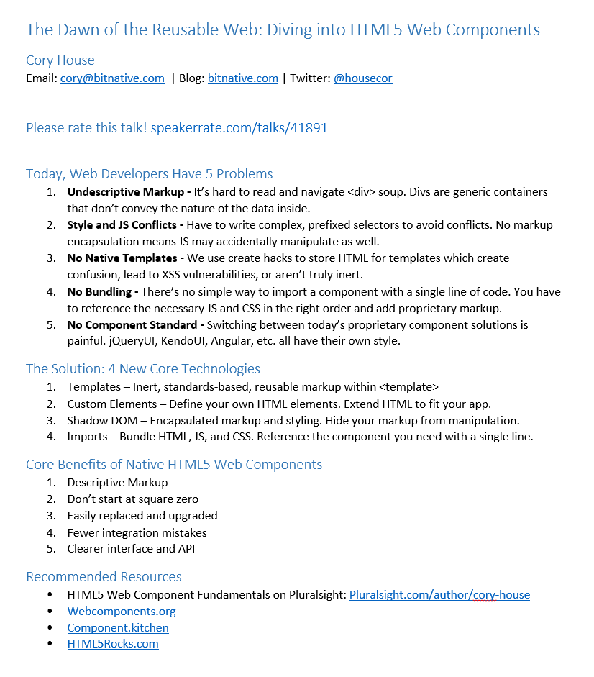
bitnative.com/handouts

Slide 69
Componentize the Web!
bitnative.com/handouts
Cory House
@housecor
.com
Notes:
https://www.polleverywhere.com/multiple_choice_polls/2CGVnAvf9rYI0v3

