Slide 1
Unleash and Empower
Your Engineers
Jeff Harrell
@juxtajeff

Slide 2
“Talk less about code and more about craft”
– Me
Notes:
Spoken to a dozen companies about our transformation, but largely those discussions had less to do with node and more to do with how we practiced our craft
A few things you can do to start empowering your teams

Slide 3
Break down the monoliths
Glass houses where you’re
encouraged to throw stones
Notes:
Monoliths don't allow people to try new things.
You play to the lowest common denominator.

Slide 4
paypal.com/cgi-bin/webscr
Checkout
Send Money
Mobile
Invoicing
Servicing
History
Sign Up
Wallet
…
Monolith = Days of testing and 6 week pushes
ZERO freedom to engineer

Slide 5
Checkout
Sign Up
Login
Pay
Help
Mini-monolith = Less regression and 2 week pushes
Some freedom

Slide 6
App Framework
grunt
dust
lusca
less
kraken
enrouten
requirejs
confit
meddleware
Modularized: Individual tests and swappable
Freedom to choose
Notes:
Modularity is key to getting developers to explore new things.

Slide 7
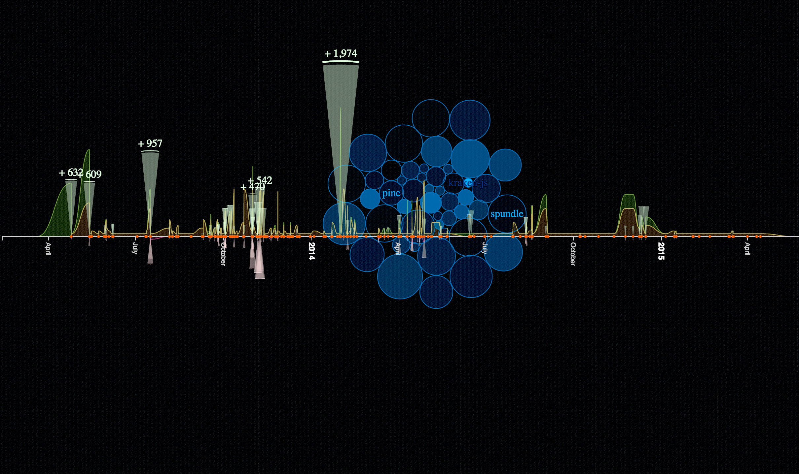
require('open-source');

Slide 8

November 22, 2013

Slide 9
Two years later
The culture has taken off
PayPal now has 200+ public repos
App/test frameworks, servers, and tools
From JavaScript and Python to Java and Go
Doesn't this look like the beginning of Star Wars

Slide 10
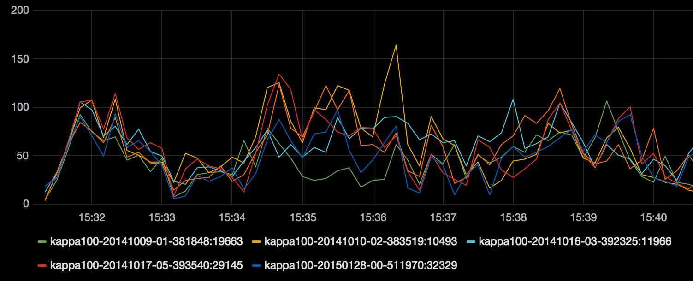
Inner sourcing
github, npm, bower, viewable code, PRs, oh my!

Slide 11
1,000 modules in internal npm

Slide 12
Serving 2mm requests a day

Slide 13
Play to your strengths
Let teams evaluate and choose their tools
They're the ones using them after all

Slide 14
“Controlled chaos”
Don't prematurely optimize
Allow time to organically find the right solve

Slide 15
67 node apps in production
Notes:
These developers have started to build beyond what we originally intended
Some examples…

Slide 16
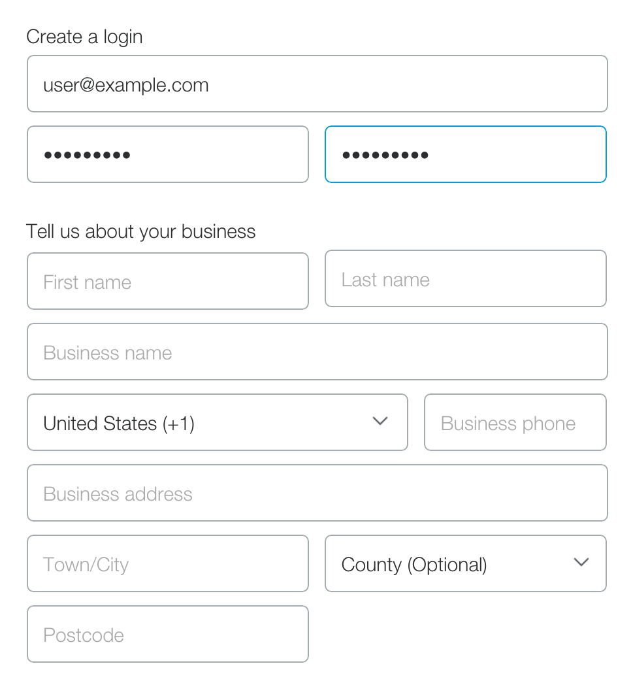
Sign up
Originally in Dust
180+ countries
Compliance changes
JSON driven
POC in Angular
Rebuilt in React

Slide 17
“We were coding ourselves into a corner with our old tech. We evaluated React, Ember, Angular and rolling our own framework. After a few iterations the team agreed React was the clear winner. Now there's so much energy behind it!”
– Mark Stuart

Slide 18
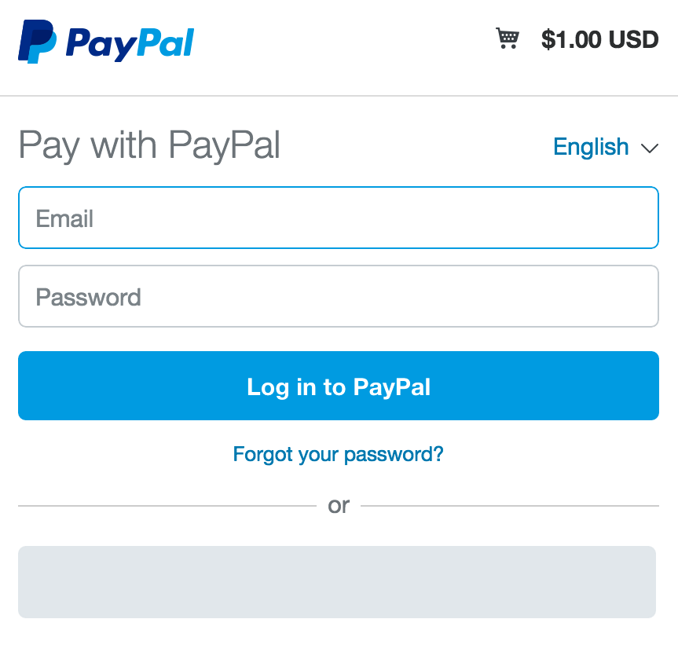
Checkout
Originally in Dust
Lots of $$ through this
Parallel teams working
Split into micro apps
Rebuilt in Angular

Slide 19
People can be the
hardest part
Notes:
So tooling lays the foundation, but…
Some tools chosen for you; others are developer preference
Far left or far right of the equation

Slide 20
“Choices complicate things. I want a single solution!”
– You Know Who You Are

Slide 21
People can also be the easiest part
Notes:
So tooling lays the foundation, but…
Some tools chosen for you; others are developer preference
Far left or far right of the equation

Slide 22
“It’s awesome to have the freedom to experiment with technologies – we were able to rapidly build prototypes with two different frameworks and managed to foresee potential bottlenecks and problems right from the start.”
– Sachin Hegde

Slide 23
Questions?
@juxtajeff

