Slide 1

Web Components in
Enterprise Applications
Ben Donohue, VP Engineering at MediaMath
April 2015

Slide 2
@bndo

Slide 3

B2B
Notes:
So how many of you are working on web applications that other companies pay them to use?
Great so you too are building an enterprise app, and you’re probably here wondering if you can take advantage of Web Components to do it.
overview of MediaMath and our platform, TerminalOne

Slide 4

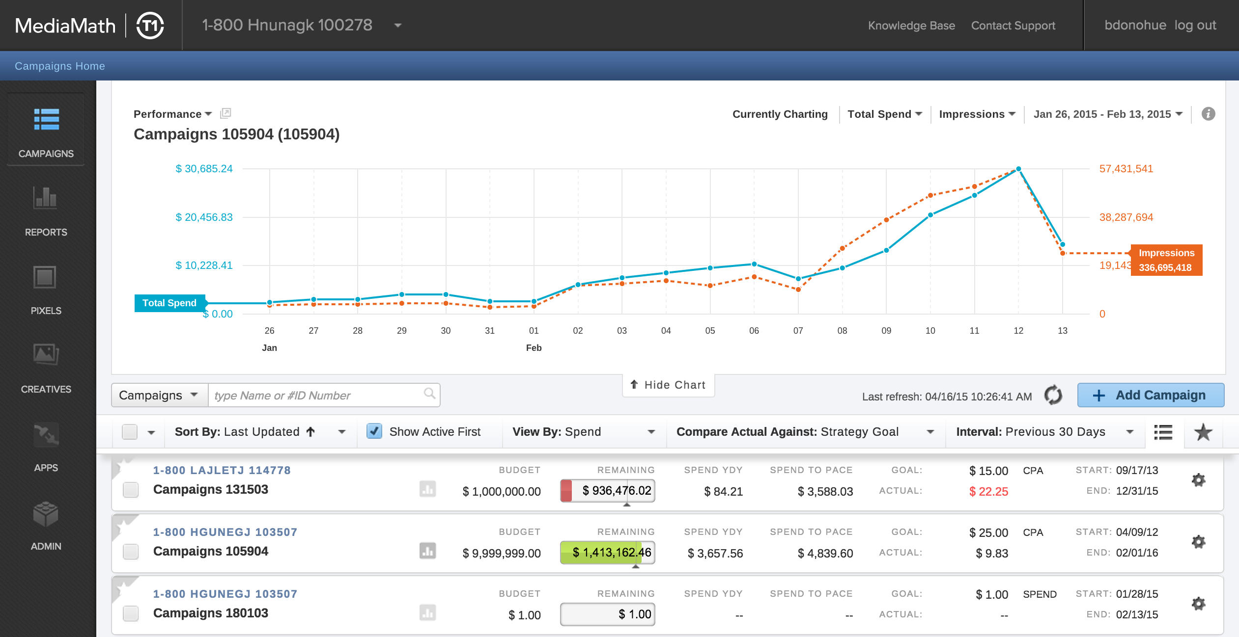

Slide 5

THE PROBLEM
Notes:
After 2+ years of rapid feature development, the team started getting weary of building on this house of cards.
Changes in one section caused problems in another. There was redundant code. There were “special snowflake” styles created.
The QA team had to do a multi-day regression test of the entire app before any release. We were getting slower.
Now, I don’t think this is unique to our team, I’ve seen it before as apps mature. In fact I suspect most of us have worked on web applications that we’ve wanted to burn to the ground and start from scratch. The bigger it becomes the harder it is to maintain, and the harder it is to start over.

Slide 6

THE SOLUTION
Notes:
A few of our developers first became exposed to Web Components at Fluent 2 years ago in 2013
If you’re not too familiar with Web Components yet and missed the great talks earlier this week
webcomponents.org and the 101 webcast that Martin Naumann did on oreilly.com earlier this month.

Slide 7
Web Components enable
Stability
Consistency
Velocity
Notes:
not only benefit our internal engineering team, but also our partners who want to build applications on our technology. We’d be able to give them fully tested UI and Data components that enabled direct access into our platform.

Slide 8
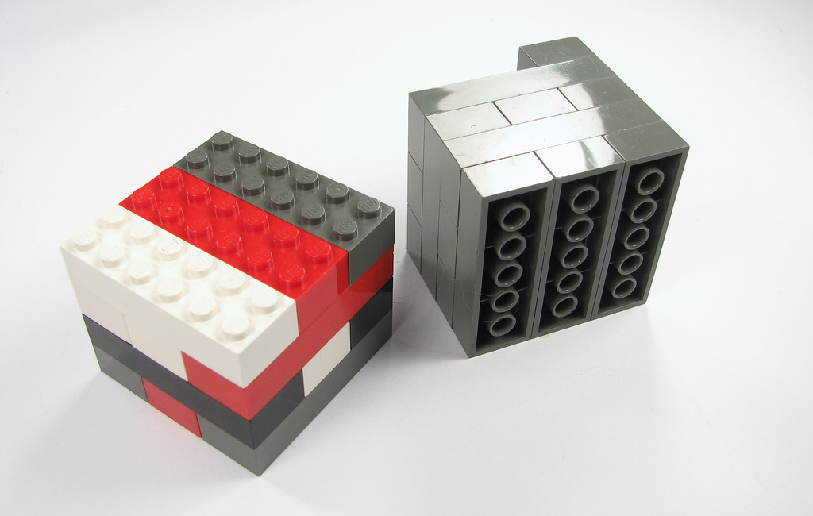
Stability
Encapsulation
Reusability
https://www.flickr.com/photos/oskay/
Notes:
By building smaller components first, we’d be able to test things along the way and be confident in their performance when used to build larger, more complex ones.

Slide 9

Consistency
http://giphy.com/gifs/variety-consistency-1bcZDwpb8gdZC
Notes:
Consistency was also something we were eager to regain. We have a distributed team with different Product Managers, different roadmaps… all building features for the same application.
It was really difficult to consistently deliver like this guy

Slide 10
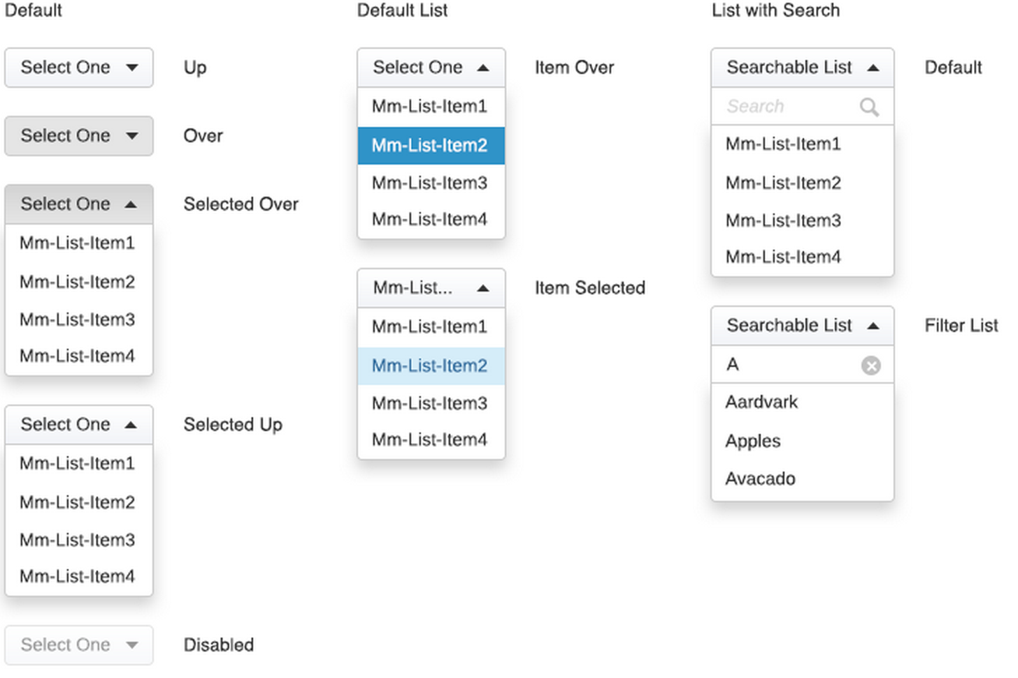
Consistency
<mm-dropdown>
Notes:
Moving to a component-based design allowed us to build a style guide with some teeth.

Slide 11
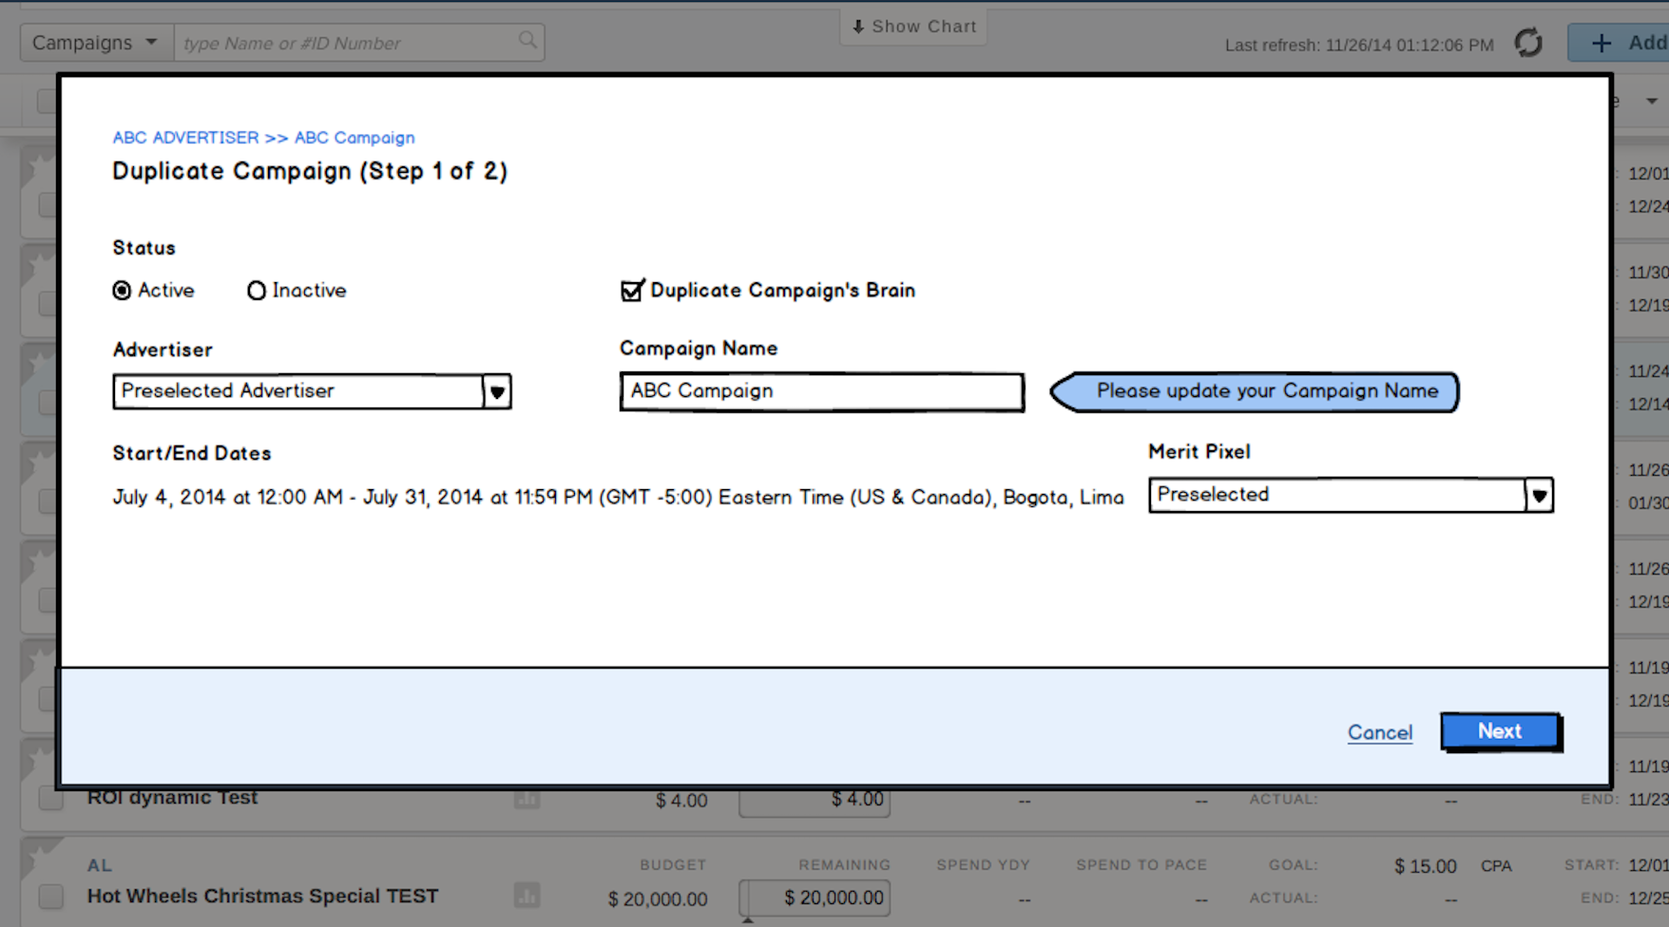
Velocity
<mm-dropdown>
Notes:
We could conduct short design reviews with just wireframes.
It’s not use A dropdown here…
it’s use the MM-DROPDOWN

Slide 12

Velocity
“
At the risk of a faux pas, I'm going to use the @here tag to congratulate/thank the Framework team. William rewrote our segment list rendering using <mm-grid> in about a day (mindblown)
”
Notes:
Developer workflow
Implementing a new grid like this used to take at least a week.

Slide 13

REALITY CHECK
Notes:
probably heard about the browser compatibility challenges here, which is why most talks or blog posts you’ll see or read always have audience questions or comments about whether or not you can use Web Components in Prod.

Slide 14
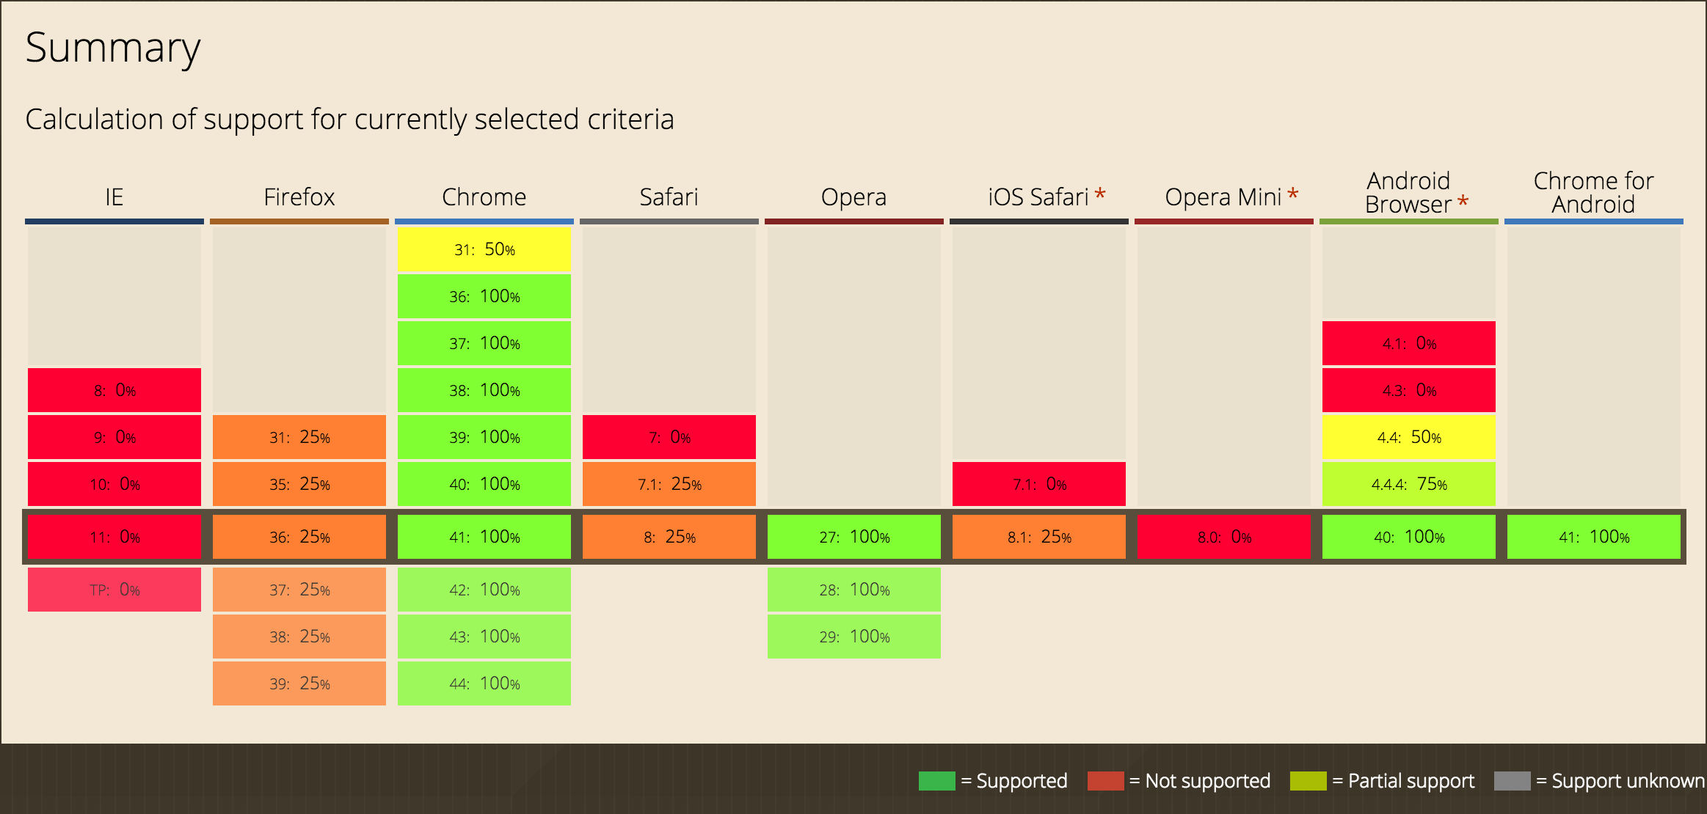
http://caniuse.com/#search=components
http://caniuse.com/#search=components
Notes:
Here’s the state of native support for Web Components in browsers today.
Firefox has flat-out punted adding support for HTML Imports until ES6 Import is sorted out.

Slide 15

Enter Polyfills
https://github.com/webcomponents/webcomponentsjs
Notes:
The Polymer team built a set of polyfills called platform.js >> webcomponents.js
These polyfills provide a shim layer that translates the Web Components API into something that Browsers without Native support can understand.

Slide 16
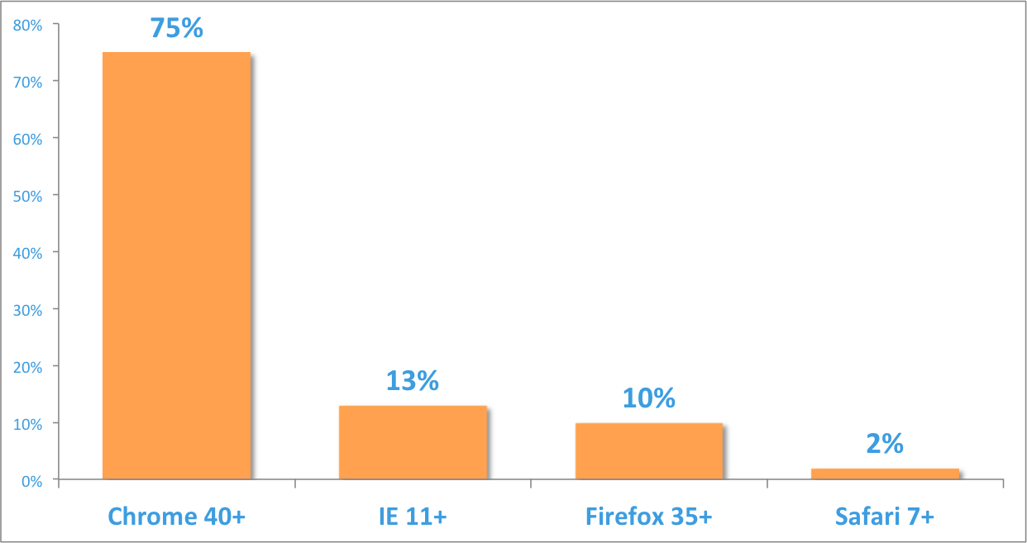
Our users are relatively homogenous
Desktop only!
Notes:
do you know who your users are?
As you can see, 75% of our users are using Chrome which has had native support for Web Components since July 2014.

Slide 17
Notes:
And since September of 2014, it’s been built with Web Components

Slide 18

It’s Happening!
Notes:
work to do to migrate the whole application, but everything new is getting the Web Component treatment.
beauties of Web Components, total interoperability with your existing HTML, Javascript, and CSS.

Slide 19
Users w/o Native WC Browsers
Totally Fine!
Notes:
The other 25% are TOTALLY fine using our application thanks to the webcomponents.js polyfills.
NO bug reports related to Web Components in production… but

Slide 20
We do disclaim…
if (nonmodern) {
obj.warning = 'T1 performs best in a browser that supports Web Components. We recommend using Chrome for optimal experience.';
}
Notes:
… as an application with users around the world, we didn’t want to rely on the polyfills to handle all of the Browser/OS combos
before launch…
Saw performance issues in FF on pages with large DOMs.
date range selected… a huge amount of data could be returned = 10s of thousands of DOM nodes.
Script Timeouts traverse
added a User Agent check to light the path a bit. We also reached out to the Polymer team to let them know and made a suggestion based on our research

Slide 21
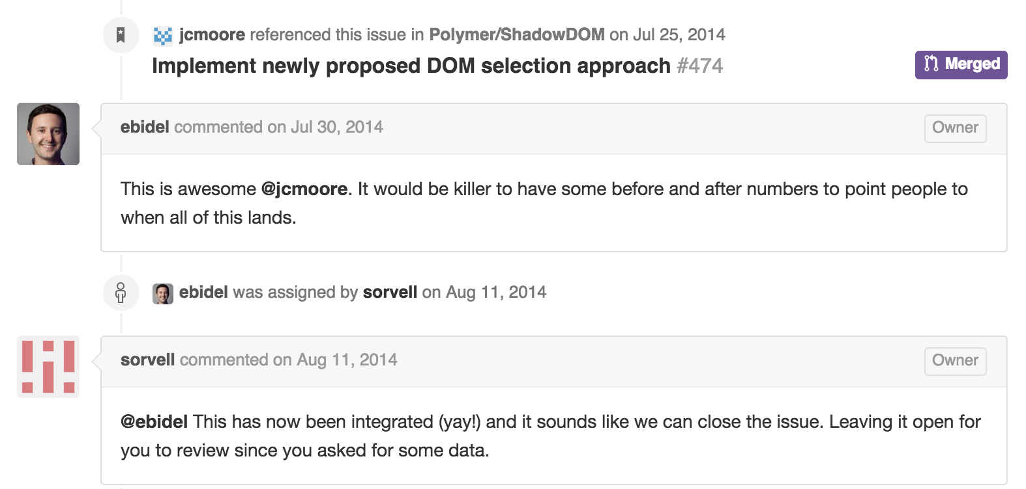
Working with Polymer
document.querySelectorAll sluggish on Firefox (v30) for large DOM
https://github.com/Polymer/polymer/issues/629
Notes:
Which turned into an accepted pull request on the Polymer project.
Things were getting real
Most recently we spotted an issue in Chrome 41 with host: attribute selectors NOT consistently being applied on web components. We reported that issue to the chromium team on Mar 12th, it was fixed within 4 days, and went out in Chrome 42 on April 13. Awesome!

Slide 22
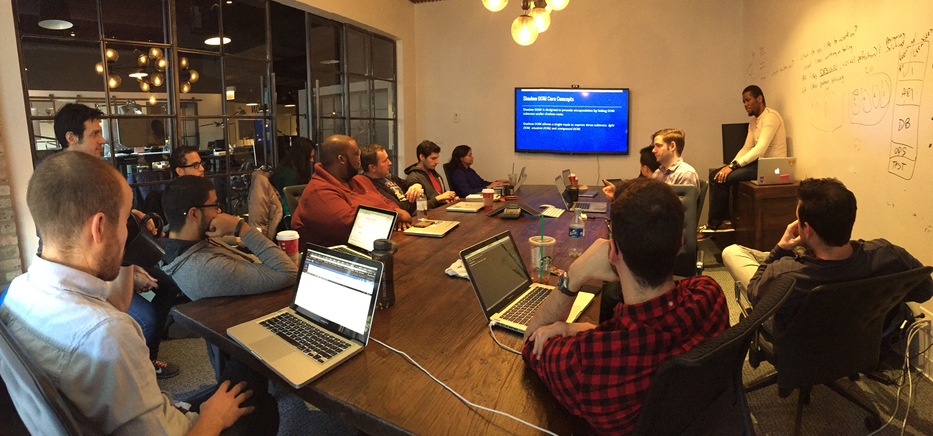
Developer Happiness
Notes:
Here’s our entire frontend team in November at our office in Chicago during a two-day Web Components workshop.
We used this time to share experiences, build knowledge and get the whole team comfortable with our WCs.
From the start, we’ve approached our web component library as something we’ve wanted to open-source, so we treated the first year-and-a-half of it’s existence as an internal open source project.

Slide 23

https://mediamath.github.io/strand/
Notes:
After months of production use in our main T1 app and in other internal applications, we’re open-sourcing our full-featured Web Component Library
It builds on all of the amazing work from the Polymer Project and the entire Web Components community.
<< QUICK DEMO >>

Slide 24
WebComponents.org http://webcomponents.org
WC 101 webcast http://www.oreilly.com/pub/e/3342
Polymer Project https://www.polymer-project.org
Strand Lib https://mediamath.github.io/strand
Google Components https://googlewebcomponents.github.io
Sid Lee Dashboard http://dashboard.sidlee.com
Polymer-Ready Chrome Extensionhttps://github.com/beaufortfrancois/polymer-ready-chrome-extension
Notes:
Here’s some links of things I glossed over today that I’ll post later along with the whole deck

Slide 25


Thanks!
@bndo
mediamath.github.io/strand

