Slide 1
The Power of Combining Documents, Semantic Triples, and Values with Enterprise NoSQL
Dave Cassel
March 18, 2015

Slide 2
The Power of Combining Documents, Semantic Triples, and Values with Enterprise NoSQL
In recent years, NoSQL databases have called attention to some of the limitations of relational databases. An RDBMS is great if you know what your data will look like, it fits well into rows and columns, and isn't likely to change. NoSQL databases have given us new approaches for storing, searching, and retrieving data, with new families like document store, graph databases, key-value stores, and triple stores. Each of these is optimized for different types of data.
Storing data differently changes how applications are built on top of the database. In this session, we'll investigate the implications of using document stores and triple stores on application development, then see what happens when these two types can be combined. Shifting from the relational model to using documents and triples impacts applications throughout the stack, not just in the database tier. This allows faster application development, the intelligence of semantics, and easier integration of multiple data sources, without having to compromise the features you expect from your database.

Slide 3
Agenda
Why Should I Care?
Document Stores
Semantic Triple Stores
What Do I Mean By Values?
Combining

Slide 4

Agenda
Why Should I Care?
Document Stores
Semantic Triple Stores
What Do I Mean By Values?
Combining
http://knowyourmeme.com/memes/honey-badger

Slide 5

Notes:
Summary:
To celebrate the 40th anniversary of Saturday Night Live, NBC hosted a 3-hour special with over 23 Million viewers, and also launched the SNL app so that fans could watch any of the thousands of SNL sketches from the past four decades. The SNL App is the first enterprise-class mobile app to use semantics. It uses a semantics data model that gives fans the ability to search for and explore content quickly and easily, and also includes a recommendation engine that adapts to fans tastes over time. The app was launched in the cloud, and leveraged MarkLogic’s elasticity to scale up to meet spikes in demand at the time of the show, and back down during periods of lower use.
Background
Who doesn’t love Saturday Night Live? SNL, as we have come to know it, is an American past-time that has been delivering laughs since it first aired back in 1975. For four decades, SNL hasn’t really changed from its recipe for comedy, always bringing on an A-list guest host and throwing him or her into sketches with the ensemble players, which have included such heavy hitters as Will Ferrell, Jimmy Fallon, Tina Fey, Jane Curtin, Chevy Chase, Bill Murray and Mike Myers. The show even helped launch the careers of comedy legends, including Eddie Murphy and Bill Murray, and more recent stars such as Tuna Fey. Some sketches on the show have been made into hit films, such as The Blues Brothers in 1980 and Wayne's World in 1992.
SNL is produced by NBC, the oldest major broadcast network in the United States. It is part of NBC Universal, operating under the parent company, Comcast. In 2013, NBC Universal had revenues of over $26 Billion.

Slide 6



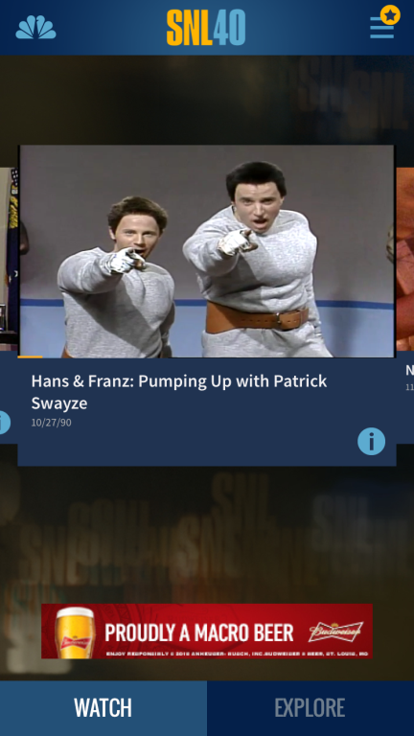
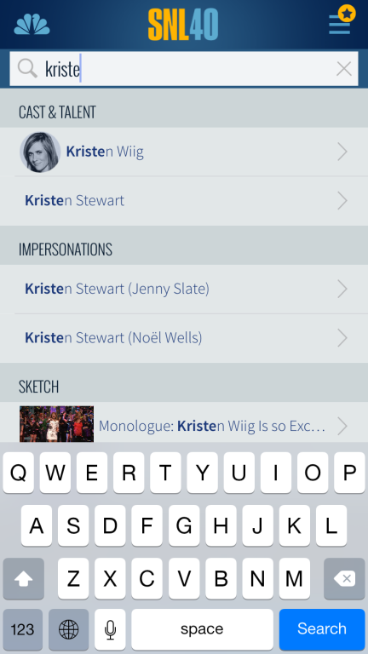
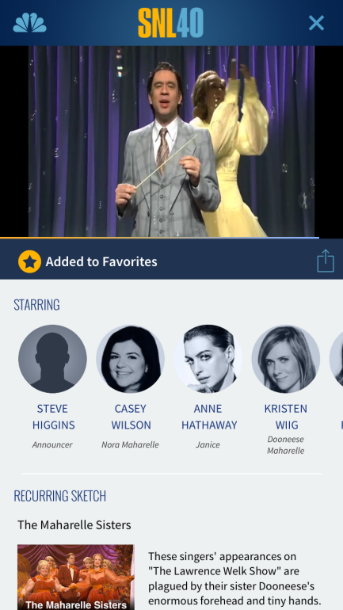
The SNL App
Notes:
Problems They Faced
SNL was planning a huge reunion bash to celebrate its 40 years. The three-hour special would air on February 15th, 2015, with plans to include a huge cast of current and former stars, including a surprise visit from Eddie Murphy. But, this 40th anniversary of SNL wasn’t just a television broadcast—it needed to be a full cross-channel experience for SNL fans.
So, in addition to planning the big 40th anniversary show, NBC also planned to launch an SNL mobile app that fans could download and watch thousands of sketches from the past 40 years. They had a relatively short timeline to develop the app, but also knew that the app would have to perform well under immense traffic that would spike around the time of the show. In addition, they wanted to design the app with an optimal user experience that would allow fans to find and watch content they wanted extremely quickly.
Solution Using MarkLogic
NBC chose MarkLogic as the database to power the SNL app because it was the ideal feature-rich platform with a flexible data model to develop the app quickly, and the elasticity to manage spikes in user traffic. MarkLogic semantics also gave developers the ability to build a content recommendation engine into the app, allowing the app to adapt to the tastes of each individual user as they use the app.

Slide 7

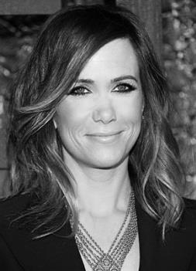
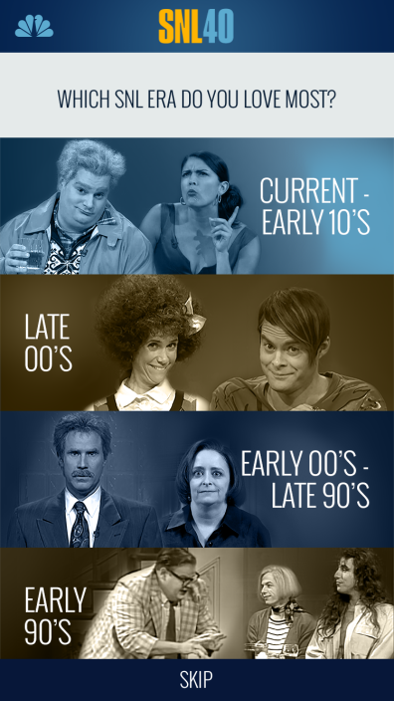

Semantics-driven search
Includes
Acted in
Segment
The Lawrence Welk Show
Talent Kristen Wiig
Era
Aired on
Played
Acted in
Date
10/4/08
Part of
Character
Maharelle Sister
Episode 4
Anne Hathaway and Killers
Part of
Season 34
Notes:
Data stored as a combination of XML and RDF. Allows for very flexible queries, as well as improving performance over a pure triple store.
What characters did this actor play during season 34?

Slide 8



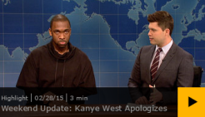


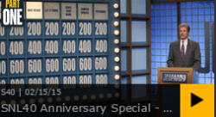





Intelligent recommendation engine
Notes:
Getting Smarter As You Go The app leverages MarkLogic’s integrated search and query engine to make sure fans can quickly find the content they want. But, it goes a step further. It also includes a personalization and recommendation engine responds to what you’re watching and how you watch. The more you watch and interact, the more you discover clips that fit your tastes.
How does this work? Again, it starts with semantics. When a user first downloads the app and logs on, they are asked to authenticate using Facebook and then they are asked, “Which SNL era do you love most?” Because the app uses semantics to tie each segment to an era, it can easily delivery a package of videos that the user can watch or swipe through. The app logs each one of those interactions and then changes future recommendations based on the user’s interactions. Semantics is also used to quickly filter out videos that the user has already viewed from its recommendations.
Semantics is what gives fans the ability to truly explore content rather than just watch content. There are in fact two modes in the app—“watch” and “explore”. Traditionally, an app may provide a listing of content that you can scroll through and pick what you want to watch. Sophisticated apps like Netlix have improved on this model by providing a listing along with a model for predicting what content you might like and listing that as well. But, even with Netflix, you still won’t be able to navigate across the relationships in the data. For example, you would still need to visit IMDB or another source in order to find out what other movies an actor was in.
With the SNL app, fans can pull up a video, see and click on the actors and characters and related tags on that video, and even see photos of what the actor looked like in that era. It’s semantics that allows fans to do this—to explore content in new ways that weren’t possible before. Rather than dictating a linear user experience in which they generally know what they are looking for, semantics opens up to discovery, to allow fans to more easily find content they didn’t even know existed.

Slide 9

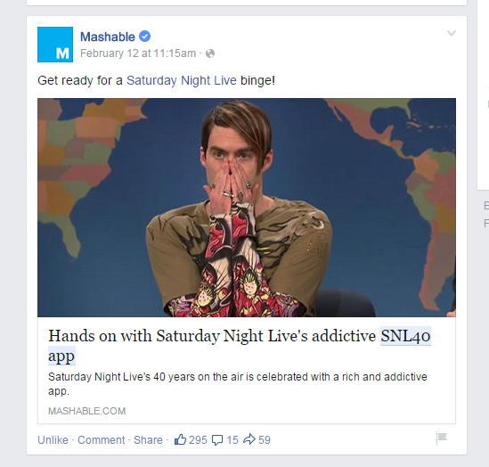
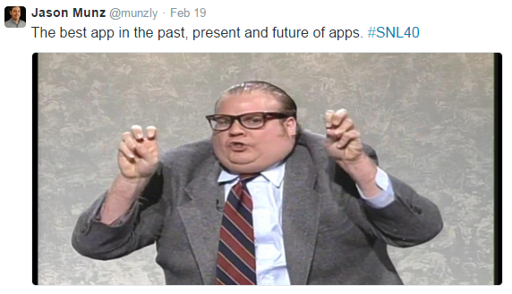
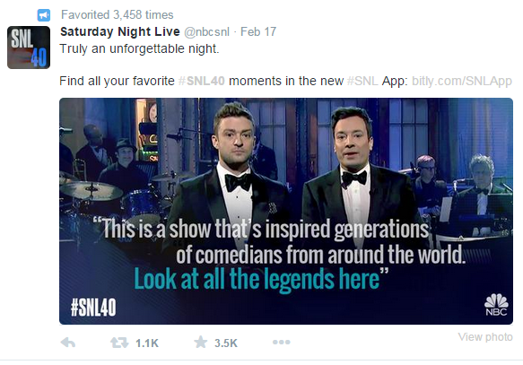







Great Content + Great UX =
Notes:
Results
While we cannot share specific numbers about the app, we can confidently say that the SNL app was a huge success. The SNL 40th Anniversary show brought in 23.1 Million viewers—the most viewers for any NBC primetime entertainment in over 10 years. We can assume that the same success was found with the app, which fans love:

Slide 10
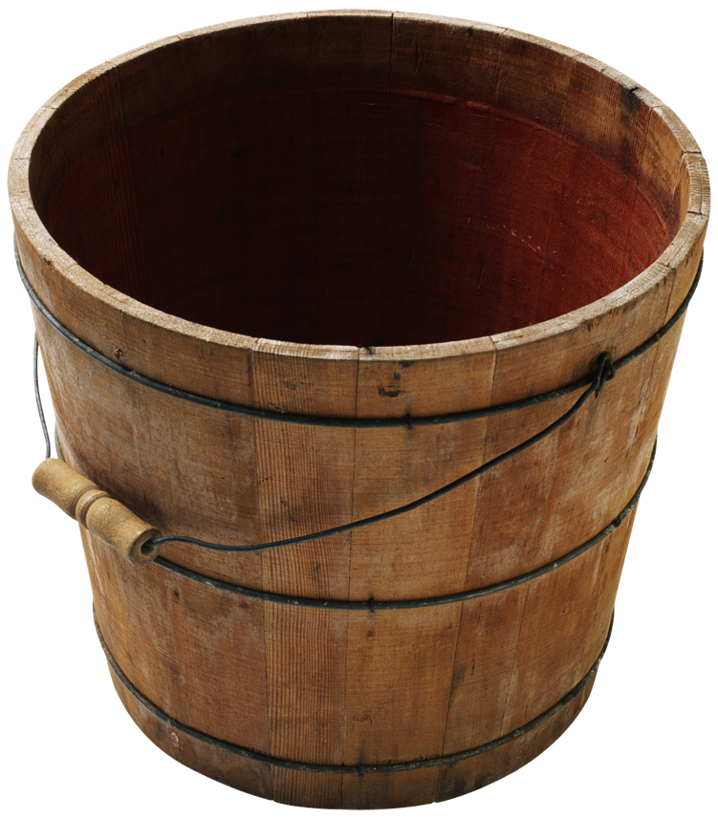
Agenda
Why Should I Care?
Document Stores
Semantic Triple Stores
What Do I Mean By Values?
Combining

Slide 11
NoSQL Document Store
Level Set
A) I regularly work with Document Stores
B) I have read about or have basic understanding of Document Stores
C) Is that in Copley Place?
Notes:
"not only sql"

Slide 12
Relational
Isn't
RDBMS
Good Enough?
Notes:
RDBMS have been around for 30 years. Aren't they good enough? Let's take a look at some relational thinking to remind ourselves of some weak points.

Slide 13
Let’s Begin…
Name | Full-time employee | Car type | Start date
Paul Smith | Y |  | May 1, 2011
Alex Carey | Y | Porsche | Oct 1, 2012
Susan Franklin | Y | Hummer | June 1, 2009
name flltme car_tp start
{
{
{
{
We have to make these decisions early
Notes:
Our assignment is to create an application to manage data on our employees. So lets do what everyone does and lay out what types of data we want to manage and see what actual data we have that can fit into this (click)
<click>
To make this into a schema we need to name the columns – you can’t have fancy full names. This means that we not only have the schema but we also have a data dictionary that explains how we went about creating it – you can’t understand just the schema. Sometime abbreviations make things hard to understand. Sometimes a name is ambiguous, like “start” – I know what that means now, but what about six months from now?
<click>
Then we need to think about types. Name and car type are strings. We don’t know how wide they’ll need to be, so we’ll go with variable width. What about full-time employee status? Could be a string like “Yes” or “Y” or “y”. Or if my database supports it, I could use boolean to avoid that problem. I wonder if we’ll need to record any other situations, like “casual employees”. Actually, maybe I should just make “employee status”. Well, I’ve already got it set and I don’t have a requirement for that right now.
How about the dates? I can use my database’s date format. Of course, that means I’ll need to parse dates right now and get them standardize. I wonder if that field will even get used?
You know Diane, the problem here isn’t about how tricky these decisions are – some are easy, some are hard. The problem is that I need to make them now, before loading data, before starting the app.
<click>
But that’s really it –now we have a schema!
Job done right? Well no – it turns out our business owner wanted to store more about the employees – things like addresses – what do we do?

Slide 14
New requirements… new schema
name | flltme | car_id | start
Paul Smith | Y |  | 2011-05-01
Alex Carey | Y | 123 | 2012-10-10
Susan Franklin | Y | 456 | 2009-06-01
house_road | city | state | zip
885 9th St. | Mount Prospect | IL | 60056
2761 Sycamore Ln | Rolla | MO | 65401
421 Durham Ct. | Chesterfield | VA | 23832
Other changes:
"casual" employees?
non-US addresses?
split out first & last names?
Deployment: can't just change to car_id
Notes:
One thing we can count on: requirements will change. Up there with death & taxes.
Let's suppose we need to add address information, and that we need to track more information about employees' cars, like license plates. Adding the address info isn't too bad – we alter the table and we can start filling in data. What about the car? We've gone from a string to a foreign key. How do we deploy that? The application expects to find a string, so we can't just update the table. But we can't update the app until the table is changed. We could declare some downtime while we roll out changes to both. Or we could add the car_id, roll out the updated app, and then remove the car_tp. Ugh.
Other changes will be similarly tricky. What about these other changes? UK addresses look different from US ones – I need a schema that will represent both, or maybe two different tables? People have done this, of course, so it's not impossible – it's just a pain.

Slide 15

Now let’s store something else
Notes:
Now we started off with a simple example like addresses – how do they work with some real and complex examples?
Lets take a book . . . this is something that fits better in MS Word than in Excel.

Slide 16
A book document looks like this…
Book
Info
Title = “I Love Penguins”
Author = “S. Lion”
Section
Chapter
Page
Paragraph = “I love penguins because…”
Page
Paragraph = “On the subject of food…”
Chapter
Page
Section
Chapter
Chapter
Chapter
Paragraph
Paragraph
title | author | Section
I love Penguins | S. Lion
How should I store a bibliography?
Is a Forward different from a Chapter?
What about an index?
What if a book has multiple authors?
Notes:
And so how do we model it?
Some metadata in fields. Links for sections, link from there for chapters, and so on.

Slide 17
What if we store the book like this …
Book
Info
Title = “I Love Penguins”
Author = “S. Lion”
Section
Chapter
Page
Paragraph = “I love penguins because…”
Page
Paragraph = “On the subject of food…”
Chapter
Page
Section
Chapter
Chapter
Chapter
Paragraph
Paragraph
Notes:
Well what if we could store information in a format that actually captures its complexity? What if a book or any complex data could be stored with its repeating components, its text and its data all in tact?

Slide 18
… and add a little structure
<Book>
<Info>
<Title>I Love Penguins</Title>
<Author>Paul</Author>
<Section>
<Chapter>
<Page>
<Paragraph>I love penguins because…</Paragraph>
<Page>
<Paragraph>Blah blah</Paragraph>
<Chapter>
<Page>
<Section>
<Chapter>
<Chapter>
<Chapter>
<Paragraph>
<Paragraph>
Notes:
If we add a little structure – this is the XML version – it could also be JSON – and this is actually what you store for data with a document NoSQL database.
The structure of the data actually defines the schema – you don’t need to know up front what will be there and how many sections there are
And all of it is accessible and queriable –we not only store this format but universally index it so you can access every data element

Slide 19
NoSQL Works for Relational
Document Store
Supports any-structured data via hierarchical data model
Stores compressed trees
Employees
Trade Cashflows
Full-time
Start Date
Address
Party Identifier
Payment Date
Name
Net Payment
First
Last
Apt
Party Reference
Trade ID
Payment Amount
Road
Post Code
Payer Party
City
Receiver Party
Notes:
And its really for any data – you can go from books to contracts and pretty soon you are storing trades like the example on the right
Or we can look at our original example and store employees
Data is modeled closer to the way it is actually used making it simple
Possible discussion;
What data is the not good for? Static, set data that doesn’t change or get added to. This is almost nothing these days
Does it have to be a hierarchy? No – but often ‘flat’ data we see – which are usually rows in a database – are actually representing more complex data and so we often try to get to the source

Slide 20




MarkLogic and All Data Types
<SAR>
Unstructured full-text
<title>
<description>
Suspicious vehicle…
<triple>
<type>
<location>
A blue van…
<object>
<date>
<triple>
<predicate>
ABC 123
2012-11-12Z
<threat>
<lat>
<long>
<subject>
37.497075
<subject>
value
-122.363319
IRIID
<predicate>
IRIID
observation/surveillance
<type>
<object>
Semantic
(RDF) Triples
<category>
Geospatial
isa
Values
suspicious activity
suspicious vehicle
license-plate
Notes:
And we can really use it for all types of data because we have strong data types in MarkLogic with
Text as a first class citizen – we have developed the full range of search to let you access text
Data types – dates, numeric values of all types for data queries
Geo – to let you accurately plot and query location with precision
Semantics – to manage relationships
----- Meeting Notes (3/9/15 17:42) -----
drop marklogic

Slide 21
Denormalizing
Book
id
title
author
pub_date
chapter
Notes:
Going back to our relational model, we've already decided that we would need more than one table to represent a book.

Slide 22
Denormalizing
Book
id
title
author
pub_date
Chapter
id
book_id
chap_title
Paragraph
id
chapter_id
text
BookAuthor
book_id
author_id
Author
id
first
last
…
Notes:
Here's a simple, but reasonable schema that we could start with.

Slide 23
Denormalizing
<Book>
<Info>
<Title>I Love Penguins</Title>
<Author>Paul</Author>
<Publisher>Bob's Books</Publisher>
<Section>
<Chapter>
<Page>
<Paragraph>I love penguins because…</Paragraph>
<Page>
<Paragraph>Blah blah</Paragraph>
<Chapter>
<Page>
<Section>
<Chapter>
<Chapter>
<Chapter>
<Paragraph>
<Paragraph>
<Publisher>
<name>Bob's Books</name>
<office>
<street>123 Main St.</street>
<city>Somewhere</city>
<state>PA</state>
</office>
</Publisher>
Notes:
Normalization comes in degrees, and we can do the same with denormalizing. The more we denormalize, the more we can get back without doing joins.
Let's look at the implications of this.

Slide 24
Expansion
Scale Up
Notes:
Now suppose that we got so much book data that we outgrew our original server. The easiest thing to do is get a bigger server. Easier, but this can get expensive and does have some practical upper limits that you'll hit pretty quickly. This is the scale up strategy.

Slide 25
Expansion
Scale Out
Notes:
Another approach is that when you outgrow your first server, you add more servers. This is scaling out.

Slide 26
Sharding
Book
id
title
author
pub_date
Chapter
id
book_id
chap_title
Paragraph
id
chapter_id
text
BookAuthor
book_id
author_id
Author
id
first
last
…
Notes:
Scaling out is economical, but tricky with relational data. How will we split the data across our servers? By table? More likely by trying to group some related rows from each table onto the same server, to minimize cross-server joins. This gets really tricky, and you'll probably still need cross-server joins pretty frequently.

Slide 27
Sharding
Employees
Full-time
Start Date
Name
Address
?
First
Last
Road
Post Code
Apt
City
Employees
Full-time
Start Date
Name
Address
First
Last
Road
Post Code
Apt
City
Notes:
With document stores, a document and its index values reside together on a server. That means each server has all the information needed to answer a query, at least with respect to the docs it has. No joins!
Suppose we're searching for books, but want to present some info about publishers with the book data. The search is fast (no joins), then we just do one page's worth of lookups for publishers. Still fast.

Slide 28
Document Modeling
Notes:
I've talked a lot about flexibility and getting started quickly on an application. Let's clarify – that doesn't mean you don't think about data modeling (a common criticism). It means we can quickly load and get started, then easily modify our data structure. We can do that as many times as we need to.

Slide 29

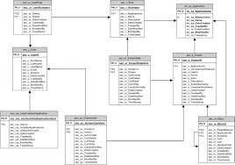
Beauty of Document Stores
No tables
Ingest as is
Index Everything!
Elastic
Notes:
1- relational requires up front design work, takes longer to start working on the application
2- document store allows loading first. only transform what needs to be transformed
3- XML, JSON, text, binary, etc, all in one database
3- can use the document structure: bonus points for finding a term in title or abstract (show example)
4- Free of Complex Joins: Generally-designed so joins aren’t necessary or recommended

Slide 30

Agenda
Why Should I Care?
Document Stores
Semantic Triple Stores
What Do I Mean By Values?
Combining

Slide 31

Semantic Triple Store
Level Set
A) I SPARQL
B) I know the concepts
C) the most exciting play in baseball…

Slide 32
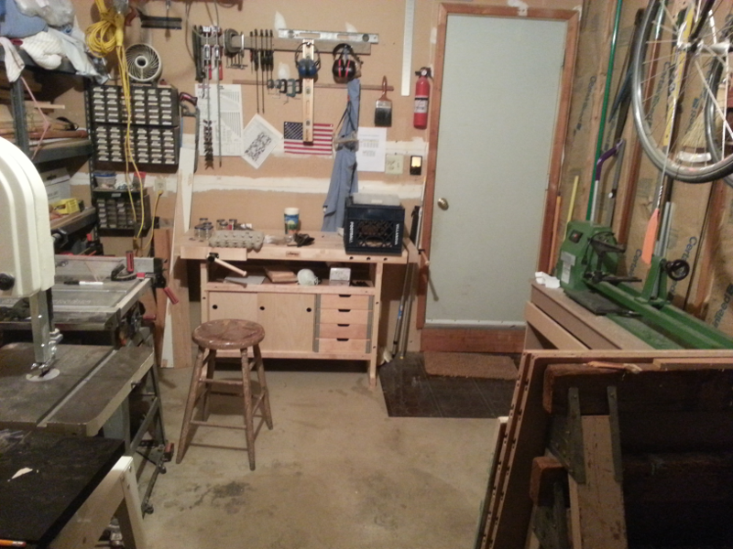


Semantics Is: A New Way to Organize Data
Subject Predicate Object
Notes:
lathe isA power-tool
lathe spins wood
earphones protect ears
earphones protect-from sound
doesn't have to be a verb, just a relationship
hamster subspecies teddy-bear
water-heaters powered-by electricity
Dave is-not-as-good-as-he-thinks-he-is-at electrical-work
Key take away: represent with subject – predicate – object

Slide 33
Semantics Is: A New Way to Organize Data
RDF
Triples
Data is stored in Triples, expressed as: Subject : Predicate : Object
John Smith : livesIn : London
London : isIn : England
Query with SPARQL, gives us simple lookup .. and more!
Find people who live in (a place that's in) England
"John Smith"
"London"
"England"
livesIn
isIn
livesIn
Notes:
Semantics is a new way of organizing and searching information
(click) Data are modeled as triples (as RDF Triples): the combination of a subject, predicate, object make up a triple, or fact (sometimes called an assertion).
For example, “John Smith lives in London” is a fact (click)
“London is in England” is another fact. Each of those facts can modeled as a triple.
(click) Any human would look at those two facts and immediately know that John Smith lives in England
With inference rules, MarkLogic Semantics can achieve the same result, by inferring that John Smith lives in England.
Even though we never explicitly say that John Smith lives in England, we can ask MarkLogic "who lives in England" and get back "John Smith".

Slide 34
FACTS
DOCUMENTS
DOMAIN
WORLD AT LARGE
Notes:
Where do triples come from?
Semantics adds context to your application.
That context comes in the form of facts:
Facts from your documents
Facts from the domain you’re in, and
Facts from the world at large
Let's take a closer look at each of those.

Slide 35
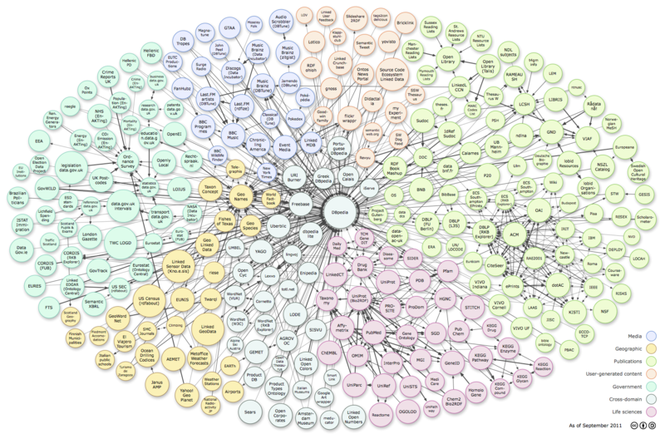
Facts from the World at Large
Linked Open Data
Facts that are freely available
In a form that’s easily consumed
DBpedia (wikipedia as structured information)
Einstein was born in Germany
Ireland’s currency is the Euro
GeoNames
Dover is the capital of Delaware
Dover has these lat/long coordinates
“Linking Open Data cloud diagram, by Richard Cyganiak and Anja Jentzsch. http://lod-cloud.net/”
Notes:
There are a large and growing number of Linked Open Data sets available and more are coming every day
These data sets are in a form that makes them easily consumed. That’s really important and we’ll describe what that form looks like in a minute
Examples
dbpedia (wikipedia as triples)
Einstein was born in Germany
Ireland's currency is the Euro
GeoNames:
Dover is the capital of Delaware
Dover has these lat/long coords
Others:
CIA World Fact Book
Data.gov, data.gov.uk
Legislation
Where the money goes
World Bank Linked Data
Patents.data.gov, reference.data.gov,
BBC Programmes, BBC Music, BBC Wildlife

Slide 36
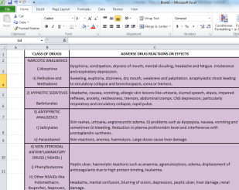
Facts from your domain
Proprietary Semantic Facts
(Facts and Taxonomies in your organization or industry)
Like Open Data, but domain specific
Might be proprietary within a company
Or shared across an industry
Includes data and ontologies
Some Examples
A bank's proprietary reference data
A pharmaceutical company's drug ontology
An industry-wide ontology such as FIBO
Notes:
Sometimes called Linked Closed Data.

Slide 37
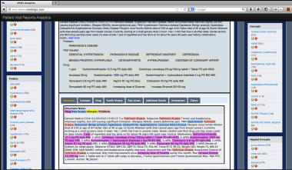
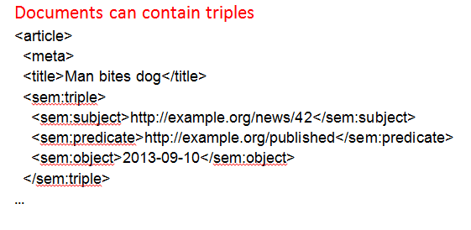
Facts from Documents
Document metadata
Ex: Categories, author, publish date, source
Facts in free-flowing text
Entities: this document mentions the person Richard Nixon, the product Advil, the company IBM
Events: this document says that Nixon went to China, John Smith met Jane Doe, Barclays acquired Lehman Brothers
Found automatically or provided at authoring time
Notes:
There are a couple of ways you can extract facts from documents:
Document metadata is a natural fit for the RDF data model – author, published date, version, and so on
NLP vendors will extract entities (people, products, companies, and so on) from free-flowing text. And they are getting better at extracting events from free-flowing text, represented as triples.
Note: when we talk about documents, we may mean text-based documents such as news articles or research reports; or we may mean highly structured data objects such as bank trades.

Slide 38
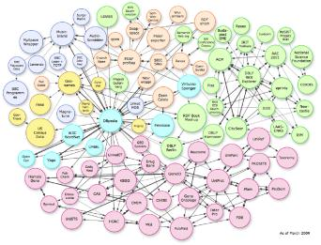

The World of Triples
Linked Open Data
(Free semantic facts available to anyone)
Facts in Documents
(Part of metadata or added with authoring tools)
Semantic World
Document World
Proprietary Semantic Facts
(Facts and Taxonomies in your organization)
Facts from Free-Flowing Text
(Derived from semantic enrichment)
Notes:
All these facts come together in MarkLogic – along with documents and data.

Slide 39
Relationships
Triples can model several kinds of relationships:
Relationships between resources
customer123 is the same as cus_id_456
Relationships between values
"John Smith" is the same as "John Smythe"
Relationships between classes
"Henley" is a sub class of "Shirt"
Relationships between a predicate and its subject or object
The object of "lives in" is a place
Relationships between entities and documents
"Merrill Lynch" was mentioned in reportABC (which mentioned "rogue trader")

Slide 40


Relationships
Relationships make it easy to:
infer facts
integrate data sources
customer123
is-the-same-as
cus_id_456
reconcile data
"John Smith"
link entities and documents
report1.xml
mentions
"John Smythe"

Slide 41
SPARQL
W3C Standard query language for RDF
query
select (count(distinct ?s) as ?count)
where {
?s <http://dbpedia.org/ontology/birthPlace> http://dbpedia.org/resource/Ukraine
}
discovery
describe ?person
where {﻿?person <http://xmlns.com/foaf/0.1/givenName> "\"Weird Al\""@e }
transitive
SELECT ?member
WHERE { ?member :hasParent* :Joe . }

Slide 42
SPARQL
inference
﻿PREFIX ex: http://example.com/
rule "bornInCountry" CONSTRUCT {
?person <http://dbpedia.org/ontology/birthPlace> ?place2
}
{
?person <http://dbpedia.org/ontology/birthPlace> ?place1 .
?place1 <http://dbpedia.org/ontology/country> ?place2
}
update
INSERT DATA {
<http://dbpedia.org/resource/Odessa>
<http://dbpedia.org/ontology/country>
http://dbpedia.org/resource/Ukraine
}

Slide 43



Agenda
Why Should I Care?
Document Stores
Semantic Triple Stores
What Do I Mean By Values?
Combining

Slide 44
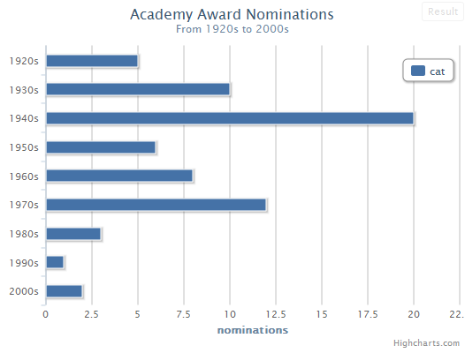
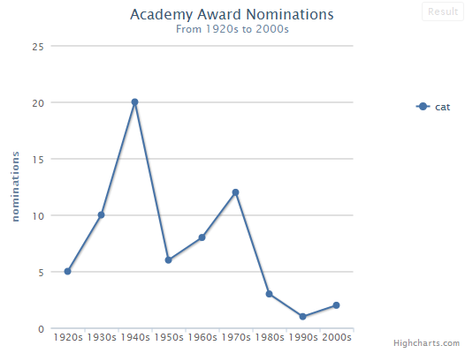
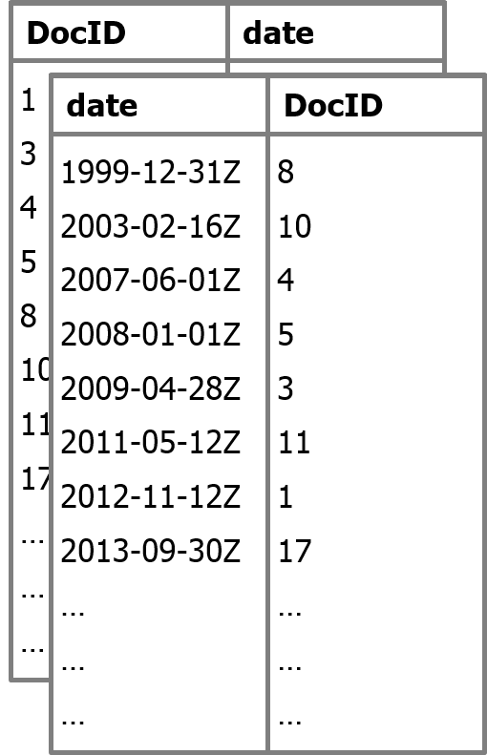
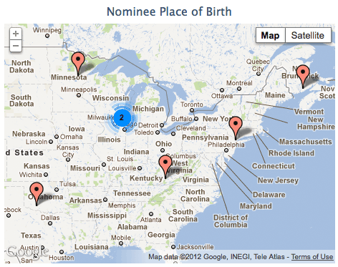
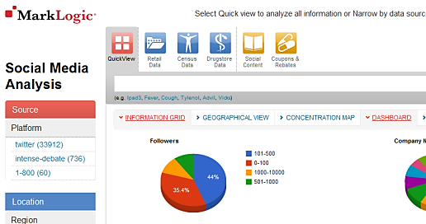
Real-Time Analytics
Range indexes can be used for
Faceted search
Aggregation and visualization
Range indexes map document IDs to values, and vice-versa in a compact in-memory representation.
Range indexes work like a built-in in-memory column store

Slide 45

Real-Time Analytics
Covariance
Range indexes can be used for
Faceted search
Aggregation and visualization
Analytics…
Variance
Linear
Model
Median
Mode
Correlation
Standard
Deviation
Percentile
Percent-rank
Rank
…and dozens more

Slide 46
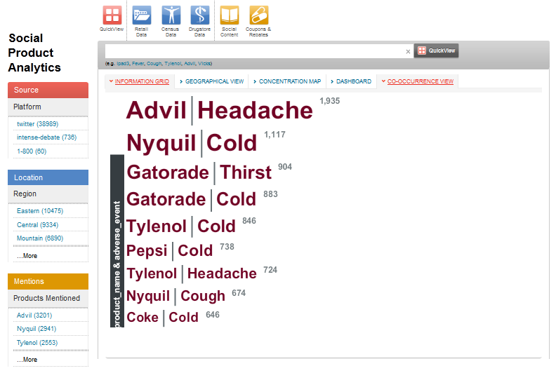
Real-Time Analytics
Range indexes can be used for
Faceted search
Aggregation and visualization
Analytics…
…including custom user-defined functions
Co-occurrence
Supports n-way
co-occurrence

Slide 47

Agenda
Why Should I Care?
Document Stores
Semantic Triple Stores
What Do I Mean By Values?
Combining

Slide 48
Triples and Documents
Documents can contain triples <article> <meta> <title>Man bites dog</title> <sem:triple> <sem:subject>http://example.org/news/42</sem:subject> <sem:predicate>http://example.org/published</sem:predicate> <sem:object>2013-09-10</sem:object> </sem:triple> …
Notes:
Triples can be embedded in documents – again, these could be text-based documents such as journal articles or they could be data objects such as trades.

Slide 49
Triples and Documents
Triples are persisted in documents <sem:triple> <sem:subject>http://example.org/news/Nixon</sem:subject> <sem:predicate>http://example.org/wentTo</sem:predicate> <sem:object>China</sem:object> </sem:triple>
…
Notes:
Triples are persisted as documents to enable feature such as backup/restore, database replication, and failover.
Queries against triples don't read these documents – they only read the index.

Slide 50
Triples and Documents
Documents can contain triples <article> <meta> <title>Man bites dog</title> <sem:triple> <sem:subject>http://example.org/news/42</sem:subject> <sem:predicate>http://example.org/published</sem:predicate> <sem:object>2013-09-10</sem:object> </sem:triple> …
Triples are persisted in documents <sem:triple> <sem:subject>http://example.org/news/Nixon</sem:subject> <sem:predicate>http://example.org/wentTo</sem:predicate> <sem:object>China</sem:object> </sem:triple>
…
Notes:
This is how you can mix data models – documents and triples, XML/JSON and RDF.
And you can mix languages too, to do combination queries.

Slide 51
Triples and Documents
Documents can contain triples <article> <meta> <title>Man bites dog</title> <sem:triple> <sem:subject>http://example.org/news/42</sem:subject> <sem:predicate>http://example.org/published</sem:predicate> <sem:object>2013-09-10</sem:object> </sem:triple> …
Triples can be annotated in documents <source>AP Newswire</source> <sem:triple date="1972-02-21" confidence="100"> <sem:subject>http://example.org/news/Nixon</sem:subject> <sem:predicate>http://example.org/wentTo</sem:predicate> <sem:object>China</sem:object> </sem:triple>
…
Notes:
And just as triples can be embedded in documents, so triples can be annotated in XML.
This is very useful when addressing hard RDF problems such as reification and provenance.

Slide 52
Triple Selection
?
Notes:
We have a bunch of triples in our triple store. Now a query gets run. In most triple stores, that query needs to run against all the triples in the store.
By combining documents and triples, we have the ability to run a combined query – this allows us to run the SPARQL query against a subset of all the triples, giving a performance benefit.

Slide 53
import module namespace sem = "http://marklogic.com/semantics"
at "/MarkLogic/semantics.xqy";
sem:sparql('
SELECT ?country
WHERE {
<http://example.org/news/Nixon> <http://example.org/wentTo> ?country
}
',
(),
(),
cts:and-query( (
cts:path-range-query( "//sem:triple/@confidence", ">", 80) ,
cts:path-range-query( "//sem:triple/@date", "<", xs:date("1974-01-01")),
cts:or-query( (
cts:element-value-query( xs:QName("source"), "AP Newswire" ),
cts:element-value-query( xs:QName("source"), "BBC" )
) )
) )
)
Which countries did Nixon visit?
.. before 1974?
.. only show me answers where I have at least 80% confidence
.. and the source is AP Newswire OR BBC
Notes:
This is what a combination query looks like.
It's actually very simple – there's a standard SPARQL query (in red) and a cts query (that's the MarkLogic API for search) added as a constraint.

Slide 54
Document Selection
?
Notes:
As with triple selection, combination queries can help us with document selection. We can use a SPARQL query to identify documents that match concepts.

Slide 55
Simpler Architecture
Notes:
When docs and triples are stored separately, it's necessary to send a request to the triple store, then use that as part of the doc store query.

Slide 56
Simpler Architecture
Notes:
By combining the two, queries happen faster. Integration between middle-tier and database is simpler (one connection point instead of two).
Another benefit: transactional consistency.

Slide 57


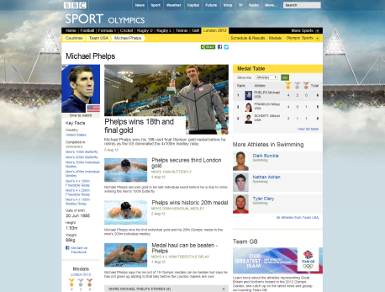



Limited Flexibility
MySQL
Static Publishing
Millions of Viewers
X
Millions of Viewers
Different Devices Streaming Updates
X
X
Limited Scalability
Notes:
To achieve their goals, the BBC chose to redevelop its infrastructure on MarkLogic. They were able to store their data as XML and RDF, and setup a process they called dynamic semantic publishing that published content to millions of viewers on different devices in real-time.
They MarkLogic for a few reasons:
its ability to act as a fast and scalable database (50K queries per day, 30–40 updates per second at peak)
Ability to store XML and drive content mgmt using applications services
It’s ability to integrate well with the triple store that drove their dynamic semantics publishing.
Whiteboard Build-out Script:
BBC is struggling to manage BBC website with limited editorial staff. The BBC website is composed of 2000+ micro sites, with many different
technologies and approaches. With budget and staff cuts they cannot meet the growing needs of today’s customer expectation.
Sports Refresh : 700+ team pages for football
2012 Olympics: 10000+ athletes, 200+ teams, 400+ disciplines, 10s of venues
The whiteboard shows an antiquated static publishing model. Static HTML templates are used and content is transformed into them and then published to different output channels.
Emphasize static workflow and add additional delivery channels to whiteboard. It is not scalable:
2.1. Not easy to rebrand/redesign
Has limited dynamic content aggregation capabilities
Requires redpublishing of static files when changes are made
Has high quality control requirements
Each delivery output channel multiplies these issues

Slide 58
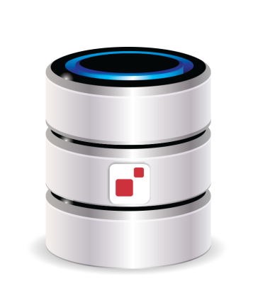


Speed and scale
XML
Dynamic Semantic Publishing
Millions of Viewers
RDF
Different Devices
Streaming Updates
Automated
publishing
Notes:
Whiteboard Build-out Script:
Simplified version of DSP (Dynamic Semantic Publishing) architecture. Points of note:
Content Creation includes the advanced semantic tagging editorial application CPS.
Move to SOA architecture to provide data services to different applications
MarkLogic is not the triple store.
This can also be described as a data driven architecture with MarkLogic at the heart storing stories as unstructured data and sports stats as structured data.
The diagram does not demonstrate the live/live DC configuration with XA d this should be talked through.
This represents a “possible future” where MarkLogic is the combined unstructured, structured and triple store. Discuss:
How the BBC has helped drive MarkLogic’s Semantics roadmap
How the API would be made much thinner by such a step
How this would drive a lower TCO with regard to license (OWLIM), infrastructure, development & testing.

Slide 59
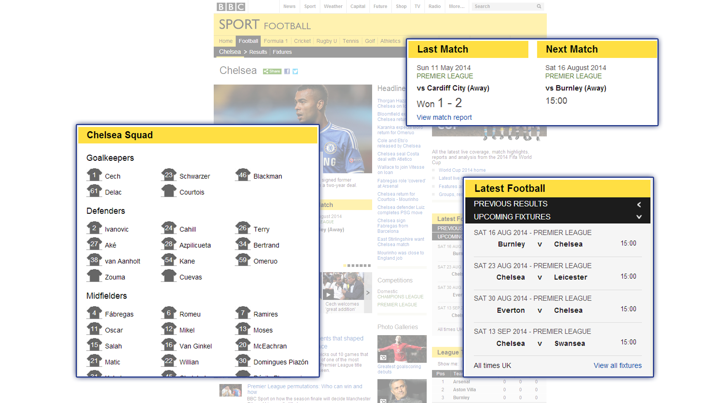
Dynamic Semantic Publishing
Semantic Inference
Diego Costa plays for Chelsea
Chelsea is in the Premier league
Diego plays in the Premier league
Notes:
This slide is important because it shows where MarkLogic is heading with the BBC. It is already planned (as of July 2014) for the BBC to move to using MarkLogic as its RDF Triple Store instead of Ontotext.
The graphic on this slide shows a screenshot of what the BBC Sports site looked like during the 2012 Olympics.
It shows “content objects”, or chunks of content, that are published based on the metadata. For example, the Web page on Chelsea would be automatically populated with data about the team, upcoming matches, players, other related scores, and recent news—all using semantics. This is made possible by using RDF. The data is updated in one place and then can be populated within these content chunks as needed.
This blog post from the BBC provides a lot of details regarding the implementation of DSP:
http://www.bbc.co.uk/blogs/legacy/bbcinternet/2012/04/sports_dynamic_semantic.html
From the blog post:
“DSP enables the publication of automated metadata and content state driven web pages that require minimal journalist management, as they automatically aggregate and render links to relevant stories and assets. The published metadata describes the BBC Sport content at a fairly low-level of granularity, enabling rich content relationships and semantic navigation. Querying the published metadata enables the creation of dynamic page aggregations such for teams and athelets. Published sports stats and navigation are mapped to the ontology and allows dynamic publication of statistics and navigation against automated indices.
The BBC is evolving its publishing architecture towards a model which will allow all content objects and aggregation to be served and rendered on a dynamic request-by-request basis to support rich navigation, state changes such as event or time and, potentially, personalisation; with the information architecture and page layout reacting to underlying semantics and meta model.”
Even in 2012, the number automated pages managed by the DSP architecture was 10,000+

Slide 60

35 M+ global browsers
25k+ transactions per second
10k+ pages updated in real-time
1 single platform for publishing

Slide 61
Use Semantics when you want to …
Normalize and link across lots of different sources of data
Model and query relationships between entities and/or documents
Use facts to give you context
Infer and discover new facts from existing facts + rules
Use MarkLogic Semantics when you want …
Enterprise features such as scalability and security
A view of all your information – documents, triples, data

Slide 62

Enterprise NoSQL: Powerful, Agile & Trusted
POWERFUL
AGILE
TRUSTED
Native JSON
Store
Native XML Store
Scalable and Elastic
Cloud Ready (AWS)
Performance at scale
LDAP and Kerberos
Security
Native RDF Triple Store
Geospatial Support
Hadoop and HDFS
REST API
Security Certifications
Monitoring and Management
Full-text Search
SQL Support
Multi-OS Support
Configuration Management
24/7
Engineering
Support
Flexible Indexes
Bitemporal
Real-time Alerting
Schema Agnostic
Samplestack
ACID Transactions
Flexible Replication
Semantic Inference
Tiered Storage
MarkLogic Content Pump
XA Transactions
Customizable Backup
Customizable Failover
Server-side JavaScript
Fully Transactional
Ad-hoc Queries
Index Across Data Types
Point-in-time Recovery
Atomic Forests

Slide 63
Values
Documents
Triples
Flexible, Powerful
Dave.Cassel@marklogic.com
@dmcassel
http://developer.marklogic.com
Office Hours
March 19, 12:15-1:15
Hynes Ballroom A (Lunch)

Slide 64
Backup

Slide 65
Relational Store vs. Document/Data/Triple Store Overview
Relational Structure | NoSQL Structure
Schema and Data | Semantic triples can represent schema or data, document elements and values can do same
Tables (an instance of a row is part of a single table) | Collection (an instance of a document can be part of one or more collections) or tuples stored as semantic triples
Records are not entities and cannot be created independent of a table | Documents are independent entities. Can easily be created and populated “on the fly”
Tables are difficult to create and populate “on the fly” | Collections can easily be created and populated “on the fly”
Foreign Key relationships | Semantic triples, which can be created on the fly
Tuples | Semantic triples or element values
Schema | Semantic triples or document elements

Slide 66
SPARQL: A Powerful Query Language
Relational | Explanation | Semantics | Explanation
Rigid schema hard coded into queries | Queries can only be created within the context of the defined schema | SPARQL provides flexibility by allowing queries against triples | SPARQL queries are not confined to a schema meaning that new data and relationships can be queried as they are ingested
Difficult to query ad hoc relationships | Querying ad-hoc relationships is either not possible due to schema restrictions or inefficient due to lack of indexes on linked columns | Query ad hoc relationships easily and “on the fly” Special-purpose triples index | All data and relationships are represented as triples providing a simple but powerful model on which to query new relationships and new data.
Friend of a friend queries are difficult | Querying repeating or hierarchical relationships to an arbitrary depth is difficult without potentially re-modeling data | Friend of a friend queries are easy to perform | SPARQL 1.1 (supported by MarkLogic) features property paths (see slide 20)

Slide 67
Built-in Deductive Reasoning: Gain insight with inferencing
Relational | Explanation | Semantics | Explanation
SQL doesn’t support inferencing | Unable to create relationship aliases. Materializing new, “inferred” data would require schema changes | Create direct relationships from indirect relationships | X related to Y, Y related to Z. Inference: X related to Z - then query X to Z relationship directly
 |  | simpler queries, more efficient developer productivity | from above, it’s easier to construct query mapping X to Z than X to Y to Z

