Slide 1
Apache Hadoop 2.0
Migration from 1.0 to 2.0
Vinod Kumar Vavilapalli
Hortonworks Inc
vinodkv [at] apache.org
@tshooter

Slide 2
Hello!
6.5 Hadoop-years old
Previously at Yahoo!, @Hortonworks now.
Last thing at School – a two node Tomcat cluster. Three months later, first thing at job, brought down a 800 node cluster ;)
Two hats
  Hortonworks: Hadoop MapReduce and YARN
  Apache: Apache Hadoop YARN lead. Apache Hadoop PMC, Apache Member
Worked/working on
  YARN, Hadoop MapReduce, HadoopOnDemand, CapacityScheduler, Hadoop security
  Apache Ambari: Kickstarted the project and its first release
  Stinger: High performance data processing with Hadoop/Hive
Lots of random trouble shooting on clusters
99% + code in Apache, Hadoop ☺ ☹

Slide 3
Agenda
Apache Hadoop 2
Migration Guide for Administrators
Migration Guide for Users
Summary

Slide 4
Apache Hadoop 2
Next Generation Architecture

Slide 5
Hadoop 1 vs Hadoop 2
Single Use System
Batch Apps
Multi Purpose Platform
Batch, Interactive, Online, Streaming, …
HADOOP 1.0
HADOOP 2.0
MapReduce
(data processing)
Others
MapReduce
(cluster resource management
& data processing)
YARN
(cluster resource management)
HDFS
(redundant, reliable storage)
HDFS2
(redundant, highly-available & reliable storage)

Slide 6
Why Migrate?
2.0 > 2 * 1.0
  HDFS: Lots of ground-breaking features
  YARN: Next generation architecture
    Beyond MapReduce with Tez, Storm, Spark; in Hadoop!
    Did I mention Services like HBase, Accumulo on YARN with HoYA?
Return on Investment: 2x throughput on same hardware!

Slide 7
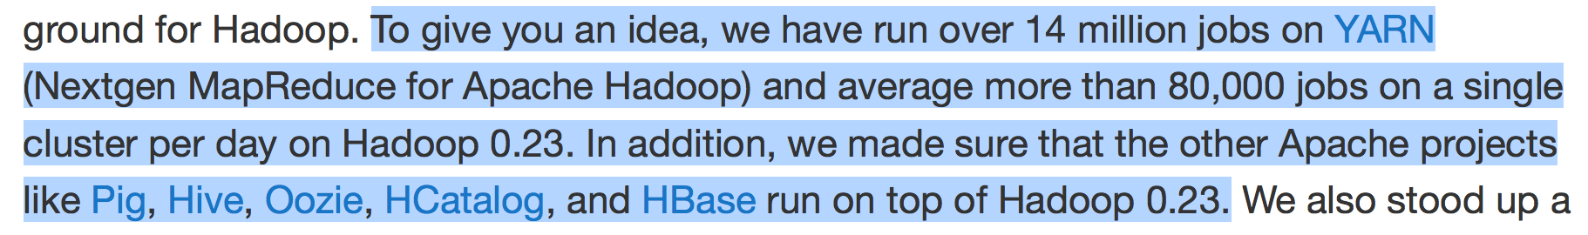
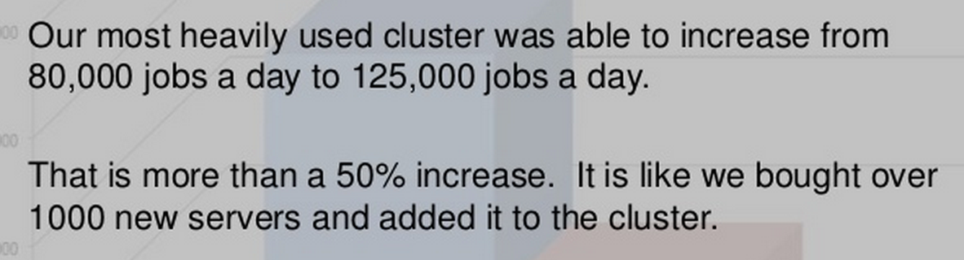
Yahoo!
On YARN (0.23.x)
Moving fast to 2.x
http://developer.yahoo.com/blogs/ydn/hadoop-yahoo-more-ever-54421.html

Slide 8
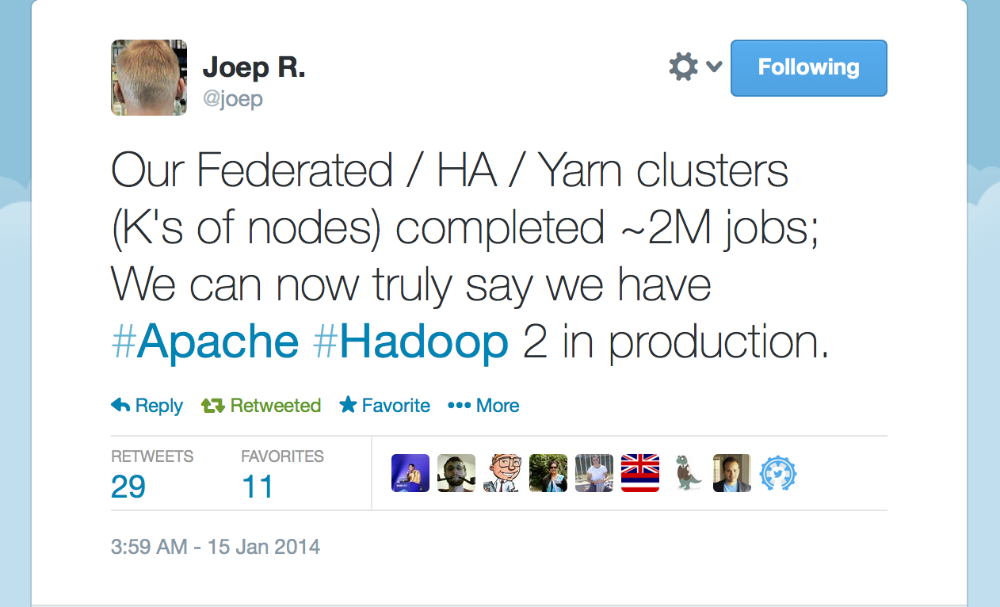
Twitter

Slide 9
HDFS
High Availability – NameNode HA
Scale further – Federation
Time-machine – HDFS Snapshots
NFSv3 access to data in HDFS

Slide 10
HDFS Contd.
Support for multiple storage tiers – Disk, Memory, SSD
Finer grained access – ACLs
Faster access to data – DataNode Caching
Operability – Rolling upgrades

Slide 11

YARN: Taking Hadoop Beyond Batch
Store ALL DATA in one place…
Interact with that data in MULTIPLE WAYS
with Predictable Performance and Quality of Service
Applications Run Natively in Hadoop
BATCH
(MapReduce)
INTERACTIVE
(Tez)
ONLINE
(HBase)
STREAMING
(Storm, S4,…)
GRAPH
(Giraph)
IN-MEMORY
(Spark)
HPC MPI
(OpenMPI)
OTHER
(Search)
(Weave…)
YARN (Cluster Resource Management)
HDFS2 (Redundant, Reliable Storage)

Slide 12
5 Key Benefits of YARN
5
Scale
New Programming Models & Services
Improved cluster utilization
Agility
Beyond Java

Slide 13
Any catch?
I could go on and on about the benefits, but what’s the catch?
Nothing major!
Major architectural changes
But the impact on user applications and APIs kept to a minimal
  Feature parity
  Administrators
  End-users

Slide 14
Administrators
Guide to migrating your clusters to Hadoop-2.x

Slide 15
New Environment
Hadoop Common, HDFS and MR are installable separately, but optional
Env
  HADOOP_HOME deprecated, but works
  The environment variables - HADOOP_COMMON_HOME, HADOOP_HDFS_HOME, HADOOP_MAPRED_HOME,
  HADOOP_YARN_HOME : New
Commands
  bin/hadoop works as usual but some sub-commands are deprecated
  Separate commands for mapred and hdfs
    hdfs fs -ls
    mapred job -kill <job_id>
  bin/yarn-daemon.sh etc for starting yarn daemons

Slide 16
Wire compatibility
Not RPC wire compatible with prior versions of Hadoop
Admins cannot mix and match versions
Clients must be updated to use the same version of Hadoop client library as the one installed on the cluster.

Slide 17
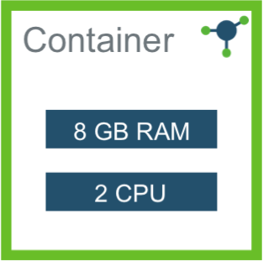
Capacity management
Slots -> Dynamic memory based Resources
Total memory on each node
  yarn.nodemanager.resource.memory-mb
Minimum and maximum sizes
  yarn.scheduler.minimum-allocation-mb
  yarn.scheduler.maximum-allocation-mb
MapReduce configs don’t change
  mapreduce.map.memory.mb
  mapreduce.map.java.opts

Slide 18
Cluster Schedulers
Concepts stay the same
  CapacityScheduler: Queues, User-limits
  FairScheduler: Pools
  Warning: Configuration names now have YARN-isms
Key enhancements
  Hierarchical Queues for fine-grained control
  Multi-resource scheduling (CPU, Memory etc.)
  Online administration (add queues, ACLs etc.)
  Support for long-lived services (HBase, Accumulo, Storm) (In progress)
  Node Labels for fine-grained administrative controls (Future)

Slide 19
Configuration
Watch those damn knobs!
Should work if you are using the previous configs in Common, HDFS and client side MapReduce configs
MapReduce server side is toast
  No migration
  Just use new configs
Past sins
  From 0.21.x
  Configuration names changed for better separation: client and server config names
  Cleaning up naming: mapred.job.queue.name → mapreduce.job.queuename
Old user-facing, job related configs work as before but deprecated
Configuration mappings exist

Slide 20
Installation/Upgrade
Fresh install
Upgrading from an existing version
Fresh Install
  Apache Ambari : Fully automated!
  Traditional manual install of RPMs/Tarballs
Upgrade
  Apache Ambari
    Semi automated
    Supplies scripts which take care of most things
  Manual upgrade

Slide 21
HDFS Pre-upgrade
Backup Configuration files
Stop users!
Run fsck and fix any errors
  hadoop fsck / -files -blocks -locations > /tmp/dfs-old-fsck-1.log
Capture the complete namespace
  hadoop dfs -lsr / > dfs-old-lsr-1.log
Create a list of DataNodes in the cluster
  hadoop dfsadmin -report > dfs-old-report-1.log
Save the namespace
  hadoop dfsadmin -safemode enter
  hadoop dfsadmin –saveNamespace
Back up NameNode meta-data
  dfs.name.dir/edits
  dfs.name.dir/image/fsimage
  dfs.name.dir/current/fsimage
  dfs.name.dir/current/VERSION
Finalize the state of the filesystem
  hadoop namenode –finalize
Other meta-data backup
  Hive Metastore, Hcat, Oozie
  mysqldump

Slide 22
HDFS Upgrade
Stop all services
Tarballs/RPMs

Slide 23
HDFS Post-upgrade
Process liveliness
Verify that all is well
  Namenode goes out of safe mode: hdfs dfsadmin -safemode wait
File-System health
Compare from before
  Node list
  Full Namespace
You can start HDFS without finalizing the upgrade. When you are ready to discard your backup, you can finalize the upgrade.
  hadoop dfsadmin -finalizeUpgrade

Slide 24
MapReduce upgrade
Ask users to stop their thing
Stop the MR sub-system
Replace everything ☺

Slide 25

HBase Upgrade
Tarballs/RPMs
HBase 0.95 removed support for Hfile V1
  Before the actual upgrade, check if there are HFiles in V1 format using HFileV1Detector
/usr/lib/hbase/bin/hbase upgrade –execute

Slide 26
Users
Guide to migrating your applications to Hadoop-2.x

Slide 27
Migrating the Hadoop Stack
MapReduce
MR Streaming
Pipes
Pig
Hive
Oozie

Slide 28
MapReduce Applications
Binary Compatibility of org.apache.hadoop.mapred APIs
  Full binary compatibility for vast majority of users and applications
  Nothing to do!
Use existing MR application jars of your existing application via bin/hadoop to submit them directly to YARN
  <property>
  <name>mapreduce.framework.name</name>
  <value>yarn</value>
  </property>

Slide 29
MapReduce Applications contd.
Source Compatibility of org.apache.hadoop.mapreduce API
  Minority of users
  Proved to be difficult to ensure full binary compatibility to the existing applications
Existing application using mapreduce APIs are source compatible
Can run on YARN with no changes, need recompilation only

Slide 30
MapReduce Applications contd.
MR Streaming applications
  work without any changes
Pipes applications
  will need recompilation

Slide 31
MapReduce Applications contd.
Examples
  Can run with minor tricks
Benchmarks
  To compare 1.x vs 2.x
Things to do
  Play with YARN
  Compare performance
http://hortonworks.com/blog/running-existing-applications-on-hadoop-2-yarn/

Slide 32
MapReduce feature parity
Setup, cleanup tasks are no longer separate tasks,
  And we dropped the optionality (which was a hack anyways).
JobHistory
  JobHistory file format changed to avro/json based.
  Rumen automatically recognizes the new format.
  Parsing history files yourselves? Need to move to new parsers.

Slide 33
User logs
Putting user-logs on DFS.
  AM logs too!
  While the job is running, logs are on the individual nodes
  After that on DFS
Provide pretty printers and parsers for various log files – syslog, stdout, stderr
User logs directory with quotas beyond their current user directories
Logs expire after a month by default and get GCed.

Slide 34
Application recovery
No more lost applications on the master restart!
  Applications do not lose previously completed work
    If AM crashes, RM will restart it from where it stopped
  Applications can (WIP) continue to run while RM is down
  No need to resubmit if RM restarts
Specifically for MR jobs
  Changes to semantics of OutputCommitter
  We fixed FileOutputCommitter, but if you have your own OutputCommitter, you need to care about application-recoverability

Slide 35
JARs
No single hadoop-core jar
Common, hdfs and mapred jars separated
Projects completely mavenized and YARN has separate jars for API, client and server code
  Good. You don’t link to server side code anymore
Some jars like avro, jackson etc are upgraded to their later versions
  If they have compatibility problems, you will have too
  You can override that behavior by putting your jars first in the Classpath

Slide 36
More features
Uber AM
  Run small jobs inside the AM itself
  No need for launching tasks.
  Is seamless – JobClient will automatically determine if this is a small job.
Speculative tasks
  Was not enabled by default in 1.x
  Much better in 2.x, supported
No JVM-Reuse: Feature dropped
Netty based zero-copy shuffle
MiniMRcluster →MiniMRYarnCluster

Slide 37
Web UI
Web UIs completely overhauled.
  Rave reviews ;)
  And some rotten tomatoes too
Functional improvements
  capability to sort tables by one or more columns
  filter rows incrementally in "real time".
Any user applications or tools that depends on Web UI and extract data using screen-scrapping will cease to function
  Web services!
AM web UI, History server UI, RM UI work together

Slide 38

Apache Pig
One of the two major data process applications in the Hadoop ecosystem
Existing Pig scripts that work with Pig 0.10.1 and beyond will work just fine on top of YARN !
Versions prior to pig-0.10.1 may not run directly on YARN
  Please accept my sincere condolences!

Slide 39

Apache Hive
Queries on Hive 0.10.0 and beyond will work without changes on top of YARN!
Hive 0.13 & beyond: Apache TEZ!!
  Interactive SQL queries at scale!
  Hive + Stinger: Petabyte Scale SQL, in Hadoop – Alan Gates & Owen O’Malley
    1.30pm Thu (2/13) at Ballroom F

Slide 40

Apache Oozie
Existing oozie workflows can start taking advantage of YARN in 0.23 and 2.x with Oozie 3.2.0 and above !

Slide 41


Cascading & Scalding
Cascading 2.5 - Just works, certified!
Scalding too!

Slide 42
Beyond upgrade
Where do I go from here?

Slide 43

YARN Eco-system
Applications Powered by YARN
Apache Giraph – Graph Processing
Apache Hama - BSP
Apache Hadoop MapReduce – Batch
Apache Tez – Batch/Interactive
Apache S4 – Stream Processing
Apache Samza – Stream Processing
Apache Storm – Stream Processing
Apache Spark – Iterative applications
Elastic Search – Scalable Search
Cloudera Llama – Impala on YARN
DataTorrent – Data Analysis
HOYA – HBase on YARN
There's an app for that...
YARN App Marketplace!
Frameworks Powered By YARN
Apache Twill
REEF by Microsoft
Spring support for Hadoop 2
Notes:
Graph processing – Giraph, Hama
Stream proessing – Smaza, Storm, Spark, DataTorrent
MapReduce
Tez – fast query execution
Weave/REEF – frameworks to help with writing applications
List of some of the applications which already support YARN, in some form.
Smaza, Storm, S4 and DataTorrent are streaming frameworks
Various types of graph processing frameworks – Giraph and Hama are graph processing systems
There’s some github projects – caching systems, on-demand web-server spin up
Wave and REEF are frameworks on top of YARN to make writing applications easier

Slide 44
Summary
Apache Hadoop 2 is, at least, twice as good!
  No, seriously!
Exciting journey with Hadoop for this decade…
  Hadoop is no longer just HDFS & MapReduce
Architecture for the future
  Centralized data and multi-variage applications
  Possibility of exciting new applications and types of workloads
Admins
  A bit of work
End-user
  Mostly should just work as is

Slide 45
YARN Book coming soon!

Slide 46

Thank you!
http://hortonworks.com/products/hortonworks-sandbox/
Download Sandbox: Experience Apache Hadoop
Both 2.x and 1.x Versions Available!
http://hortonworks.com/products/hortonworks-sandbox/
Questions?

