Slide 1
Apache Hadoop and the Emergence of the Enterprise Data Hub
Eli Collins, Chief Technologist

Slide 2
The Enterprise Data Warehouse
Archive
Operational Store
Reporting
Operational Store
Metadata
Mining
Facts & Dimensions
Flat Files
Staging
Summary
Analysis
Data Sources
EDW
Data marts

Slide 3
The Enterprise Data Hub
MR, Pig/Hive, SQL, Spark, SAS, R, Search, Graph..
Inexpensive storage
Flexible storage
Co-located compute
Multiple compute engines
DB dumps
logs
binary
images

Slide 4
So it’s Like a Data Warehouse?
..but can store more data, more kinds of data, and do more flexible analysis. It’s open source and runs on industry standard hardware so it’s more economical.

Slide 5


An Analogy

Slide 6

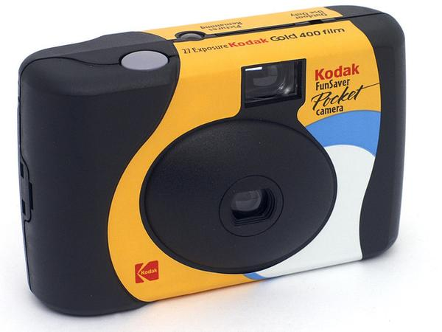
What changed?
The need?
Convenience? Cost?

Slide 7
Take and share good photos

Slide 8


Data Warehouse vs. Data Hub
Enterprise Data Warehouse
Enterprise Data Hub

Slide 9
An Operating System
APP
APP
APP
3rd PARTY APP
MGT
LIB
SCHEDULER
SERVICES
FILE SYSTEM

Slide 10
An Enterprise Data Hub
BATCH
PROCESSING
ANALYTIC
SQL
SEARCH
ENGINE
MACHINE
LEARNING
STREAM
PROCESSING
3RD PARTY
APPS
DATA
MANAGEMENT
WORKLOAD MANAGEMENT
STORAGE FOR ANY TYPE OF DATA
UNIFIED, ELASTIC, RESILIENT, SECURE
SYSTEM
MANAGEMENT
Filesystem
Online NoSQL

Slide 11
Data Warehousing with an EDH
Operational Store
3. Exploratory, Discovery,
Search, ML..
2. Reporting,
Mining,
Analysis
Reporting
Mining
Analysis
Operational Store
1. Stage, transform, archive
Flat Files
Data Sources
EDH
EDW

Slide 12
What about data warehousing on the enterprise data hub?

Slide 13


Slide 14
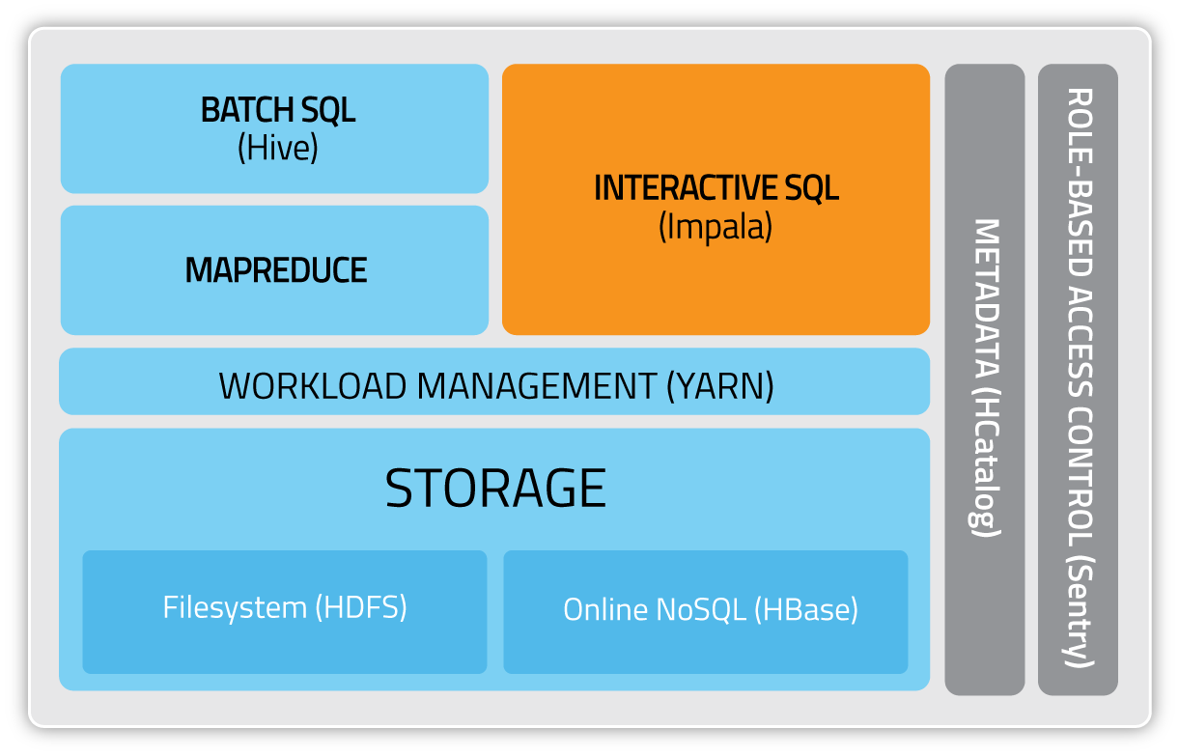
Data Warehousing in Cloudera’s EDH

Slide 15


