Slide 1
Big Data: Beyond Bare-Metal?
Mike Wendt
Feb. 12 2014

Slide 2

About Accenture Technology Labs
5 locations globally with 5 R&D groups

Slide 3

About Accenture Technology Labs
Silicon Valley
Accenture Technology Labs is the most forward looking R&D organization within Accenture
We build our innovation on top of partner technologies
Our flag ship location is in Silicon Valley and we love working with Valley companies and Startups

Slide 4

Big Data: Beyond Bare-Metal?
Growth of Data
Making Sense of It All
Harnessing Cloud Power
Testing Our Cloud Theory
Next Steps
Q&A Panel

Slide 5

Growth of Data
Data for mission-critical apps
doubles every 18 months
Explosion of Connected Devices
212 billion devices
expected in 2020

Slide 6

Stand Out From the Crowd
Be the 15%!
Through 2015, 85% of Fortune 500 companies will be
unable to exploit big data for competitive advantage
-Gartner
Source: “Big Data Business Benefits Are Hampered by 'Culture Clash',” Gartner, September 12, 2013.

Slide 7

Internet Giants’
Approach
Power
Intelligence
Scale

Slide 8

Making Sense of It All
Analytics on all data not just some data
Data Supply Chain mastery is the future
Harnessing the power of scalable platforms

Slide 9

Small but Mighty
Maximize Performance
with Your Budget
Leverage Built
Technologies
Focus on
Your Business

Slide 10

Harnessing
Cloud Power

Slide 11
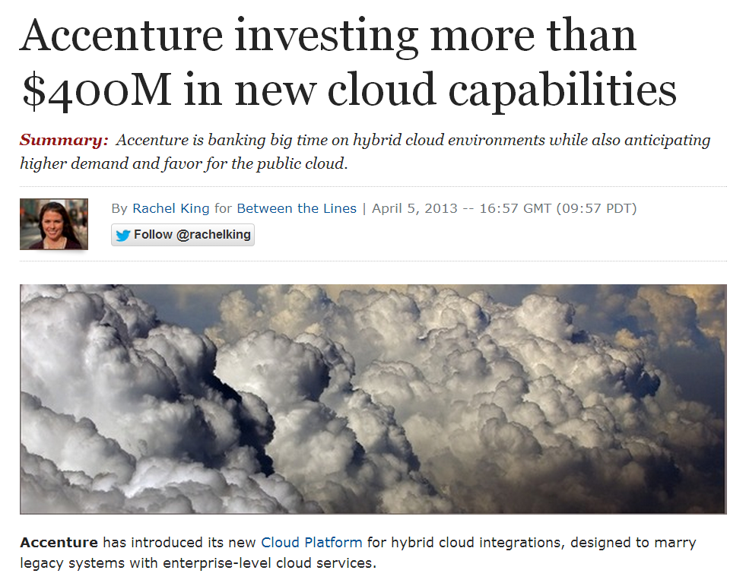
Power and
Scale for All
Source: http://www.zdnet.com/accenture-investing-more-than-400m-in-new-cloud-capabilities-7000013610/

Slide 12

Accenture
Cloud Platform
One Platform for
Multiple Vendors
Customize for
Client Needs
Unlimited Possibilities

Slide 13
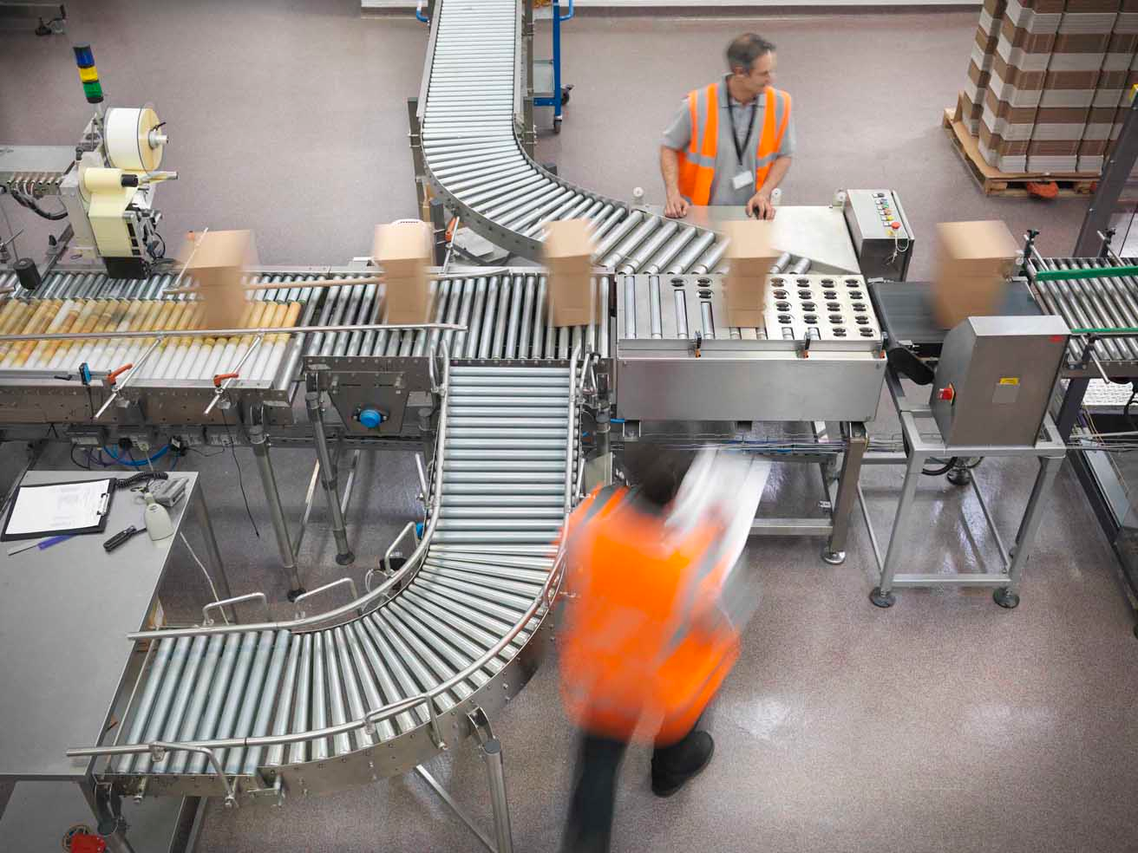
Industry
Examples
Online Retailers
Streaming Video
Service Providers

Slide 14

Testing Our
Cloud Theory

Slide 15

Why we chose Hadoop?
Industry standard platform with multiple applications
Proven results with our clients and in the field
Hadoop is resource intensive

Slide 16

Why we chose Google Cloud Platform?
New and different platform from our previous study
Different deployment option – Hadoop on the cloud
Test performance impacts of remote storage and data flow methods

Slide 17

Experiment Overview
Compare bare-metal and cloud-based Hadoop clusters
Matching both at a fixed TCO level
Examine price-performance ratio of each cluster

Slide 18

Price-performance
Ratio
Real-world benchmarks
Recommendation Engine
Sessionization
Document Clustering
Measure and compare
execution-time of each benchmark

Slide 19

Our Results
Cloud has a better price-performance ratio
Performance tuning options only in the cloud
Automated performance tuning tools
like Starfish (now Unravel) are necessary
Remote storage makes data more available

Slide 20

Next Steps

Slide 21
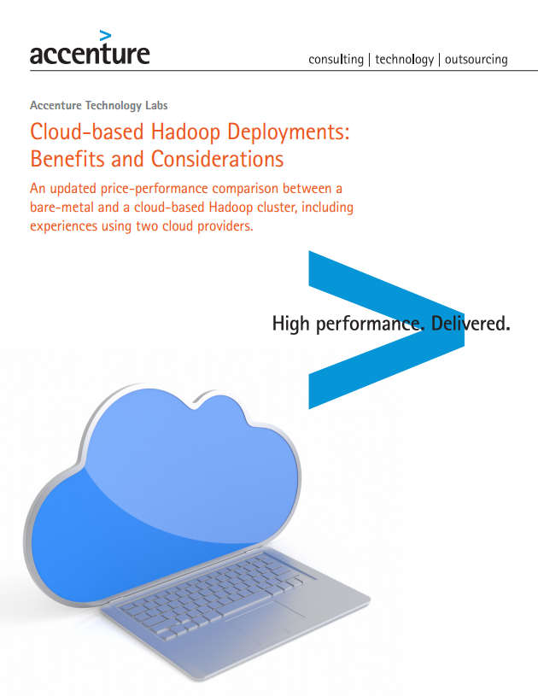
Read the Full Report j.mp/cloudhadoop

Slide 22

Questions to Ask
Does cloud work for us?
Which cloud provider works for us?
How can we move forward?
A. Partner with a cloud provider
B. Partner with a system integrator like Accenture
C. Build it yourself

Slide 23

Key
Considerations
Startups Live in the Cloud;
Corporations Are Moving There
Low-entry Barrier
Simplified Management and
Operations
On-demand Scalability

Slide 24

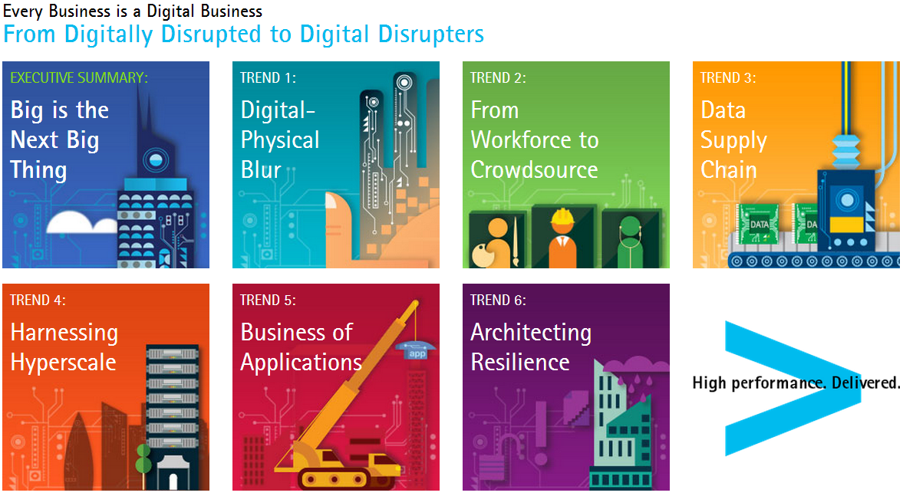
Accenture
Technology Vision 2014 j.mp/techvision2014
#techvision2014

Slide 25

Q&A Panel
Mike Wendt &
Nathan Shetterley
Accenture Technology Labs
Allan Naim
Global Product Lead for
Google Compute Engine

Slide 26

Thank You!
Mike Wendt
@mike_wendt
michael.e.wendt@accenture.com
Nathan Shetterley
nathan.shetterley@accenture.com
Allan Naim
anaim@google.com

