Slide 1

Big Data in Operations
Narendra Mulani, Accenture

Slide 2
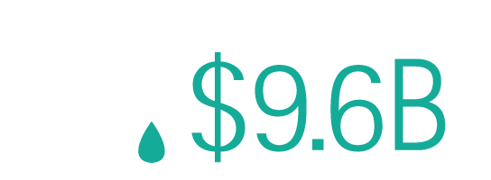

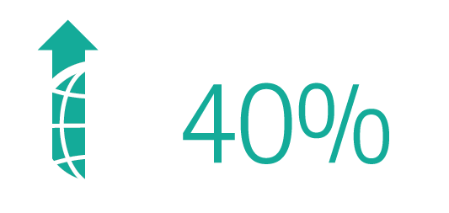
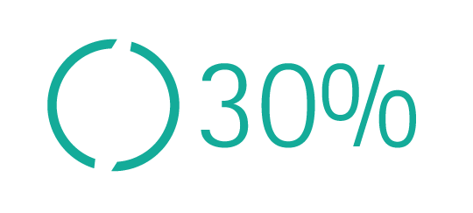
The Global Situation….
Increasing demand in the face of aging infrastructure, rising operational costs, capital funding constraints and tightening environmental and quality controls have created the perfect storm for water utilities.
Value for water leaked globally
Investment needed to replace aging infrastructure by 2033 in the US alone
The expected rise in demand for water globally by 2020
Rise in energy costs since 2004
Notes:
Companies are looking outside the sector to find ways of outperforming in the face of cost pressures, water shortages and aging infrastructure.
We are seeing an exponential rise in smart approaches that make the most of the installed base of technologies
These offer very good value for money because 90% of the investment has already been made and they offer localised solutions to specific problems
What others are doing

Slide 3
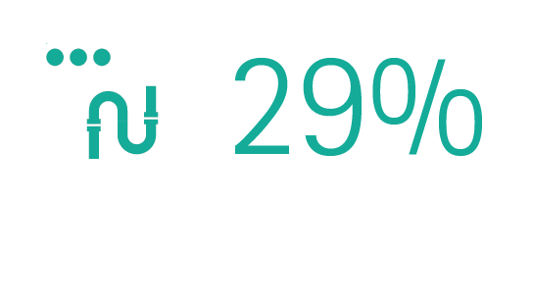
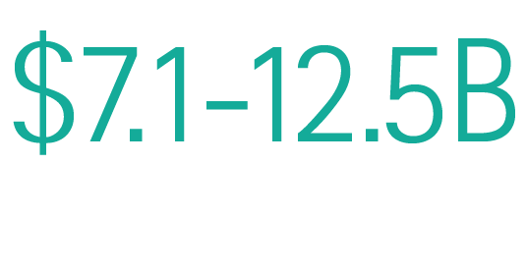
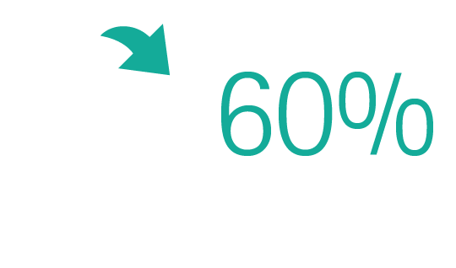
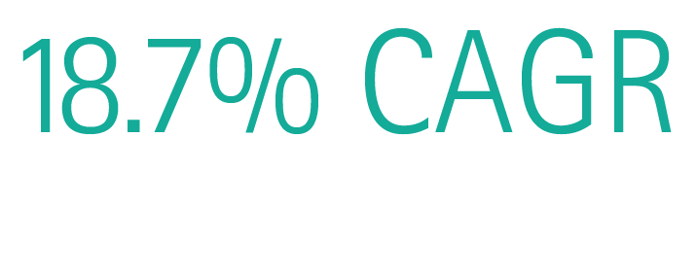
The Global Solution
There is a growing realization that technologically innovative ‘smart solutions’ are the most, and possibly, some experts believe, the only affordable way of delivering these priorities by exploiting what is available.
of the installed network will be
smart by 2020 (Frost and Sullivan)
Amount saved in utilities each year from smart solutions globally (Sensus 2012)
The investment in smart solutions is growing, and to reach $3.3B by 2016 (IDC)
of water company’s (B&V)
top goals are reducing leakage and network operating costs
Notes:
Companies are looking outside the sector to find ways of outperforming in the face of cost pressures, water shortages and aging infrastructure.
We are seeing an exponential rise in smart approaches that make the most of the installed base of technologies
These offer very good value for money because 90% of the investment has already been made and they offer localised solutions to specific problems
What others are doing

Slide 4







Smart Water Market Trends
Leading water utilities have already drawn up plans to invest in smart solutions in a big way over the next five to 10 years. However there is still a steep learning curve on how to deliver them.
Flagship programs of early adopters:
Smartwater4Europe – Leading trials in France, the Netherlands, Spain and U.K.
Integrated Remote Intelligence Service (IRIS)
Future Concept of Operations (FCO)
Real-Time Network Monitoring and Optimization
Real-Time System
Remote Monitoring and Control Center
Frontline Information Technology (FIT)
Notes:
Companies are looking outside the sector to find ways of outperforming in the face of cost pressures, water shortages and aging infrastructure.
We are seeing an exponential rise in smart approaches that make the most of the installed base of technologies
These offer very good value for money because 90% of the investment has already been made and they offer localised solutions to specific problems
What others are doing

Slide 5




The Four Big Tasks for a Water Company
Production
Distribution
Ensure Quality
Recycle & Renew
Produce Water
Manage leakage and pressure
Manage treatment plants
Deal with the sludge

Slide 6









Accenture’s Smart Monitoring Services
A suite of ready to deploy monitoring applications across the water value chain.
Production planning
Proactive customer contact
Plant performance monitoring
Water resources
Water treatment
Distribution
Sewers
Treatment
Sludge disposal
CUSTOMERS
Abstraction monitoring
Leakage and pressure management
Catchment flow control
Sludge management
Notes:
The capabilities on top are clearly transformational and quickly deployable
Yet most of the ingredients to deliver them already exist – instrumentation, data and models
There may be some work required to sort out the plumbing, but not a lot.
The key to success is understanding every detail of the behaviour you want to drive and designing intuitive solutions to make it happen.
Accenture is investing a million pounds just this year to build these solutions – show you some examples of what these look like

Slide 7





Smart Monitoring Logical Architecture
The analytics platform uses big data technologies hosted in the cloud to collate diverse types of data for easy access.
Accenture Smart Monitoring Analytics Platform
Accenture Smart Monitoring Apps
Real-time systems
Water Production Zone App
Historian
GIS
Interactive Visualization
ERP
Dashboards
Production Optimization App
Energy Mgmt.
CRM
Statistical Models
Water Networks Monitoring App
AMI
Data Discovery
EAM
Batch Services
Environment
Waste Networks Monitoring App
OMS
Data Store
Weather
Integration Services
Waste Treatment App
Security Services
Notes:
The capabilities on top are clearly transformational and quickly deployable
Yet most of the ingredients to deliver them already exist – instrumentation, data and models
There may be some work required to sort out the plumbing, but not a lot.
The key to success is understanding every detail of the behaviour you want to drive and designing intuitive solutions to make it happen.
Accenture is investing a million pounds just this year to build these solutions – show you some examples of what these look like

Slide 8





Key Success Factors for Smart Water
Developing a common strategic vision for Smart Water
Stakeholder alignment to fund and deliver innovative smart solutions
and share the benefits. For example:
  With Operations to develop and adopt new ways of working
  With Asset Management to prioritise needs for smart solutions
  With Capital Delivery to develop and implement intelligent solutions
  With IT to integrate business systems with operational systems
  With R&D to evaluate technologies, and develop new models and analytics
Implementing a new operating model
Supplier collaboration to integrate engineering and information
technology services

