Slide 1

MAKING DATA WORK
FOR EVERY NE
Quentin Clark
Corporate Vice President
Microsoft Corporation

Slide 2
1
,
,
,

Slide 3
1
,
,
,

Slide 4
,
,
,

Slide 6










































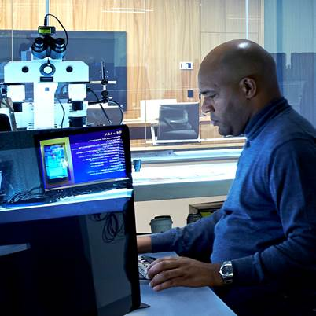









WHO ARE THEY?

Slide 7
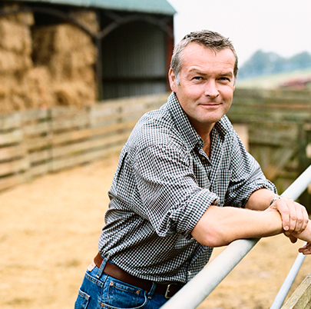

THE FARMER
A cloud-connected data platform and 300,000 sensors increase dairy production

Slide 8
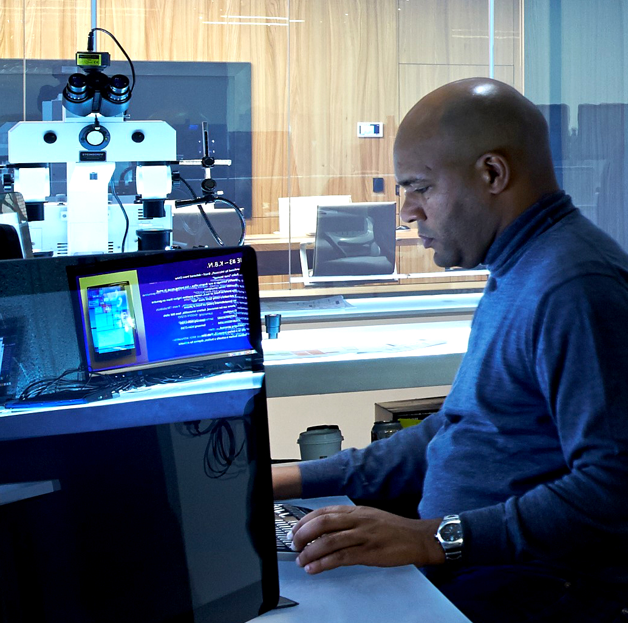

THE FARMER
A cloud-connected data platform and 300,000 sensors increase dairy production
THE CRIMINAL INVESTIGATOR
Visualization tools aid the takedown
of a $500M Citadel botnet

Slide 9
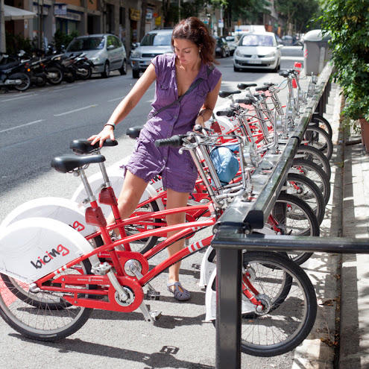

THE CITY PLANNER
Sensors, social media, and interactive tools deliver bikes to the right location at the right time
THE CRIMINAL INVESTIGATOR
Visualization tools aid the takedown
of a $500M Citadel botnet

Slide 10
THE CITY PLANNER
Sensors, social media, and interactive tools deliver bikes to the right location at the right time

Slide 11
WHAT DOES IT TAKE?

Slide 12
ACCESSIBLE DATA

Slide 13
ACCESSIBLE DATA
ENTERPRISE GRADE

Slide 14
ACCESSIBLE DATA
ENTERPRISE GRADE
IMMERSIVE EXPERIENCES

Slide 15
ACCESSIBLE DATA
ENTERPRISE GRADE
IMMERSIVE EXPERIENCES

Slide 16
THE ROAD TO A BILLION

Slide 17

© 2014 Microsoft Corporation. All rights reserved. Microsoft, Windows and other product names are or may be registered trademarks and/or trademarks in the U.S. and/or other countries.
The information herein is for informational purposes only and represents the current view of Microsoft Corporation as of the date of this presentation. Because Microsoft must respond to changing market conditions, it should not be interpreted to be a commitment on the part of Microsoft, and Microsoft cannot guarantee the accuracy of any information provided after the date of this presentation. MICROSOFT MAKES NO WARRANTIES, EXPRESS, IMPLIED OR STATUTORY, AS TO THE INFORMATION IN THIS PRESENTATION.

