Slide 1
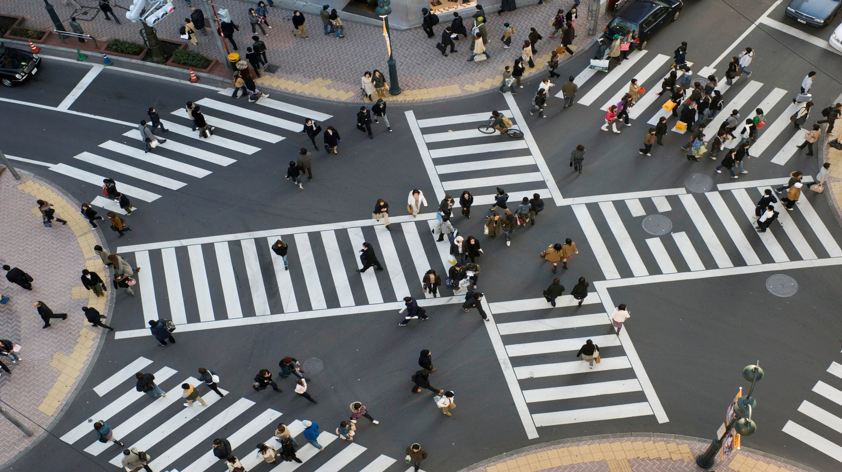

Collecting Massive Data via Crowdsourcing
John Schitka, SAP
Notes:
The theme of this gathering is “Making Data work” but before you can analyze it and make it work for you – you have to have the data. Otherwise there is nothing to mine, analyze or make work for you. The technology and skill exist to get to the making data work stage, to make decisions that create real value, to help you find the nuggets of relevant information that will have real impact. And you can take advantage of it. But first you have to have the data. And a connected world lets us bring crowds together effortlessly. And crowds are cool, for everything – including collecting data.

Slide 2
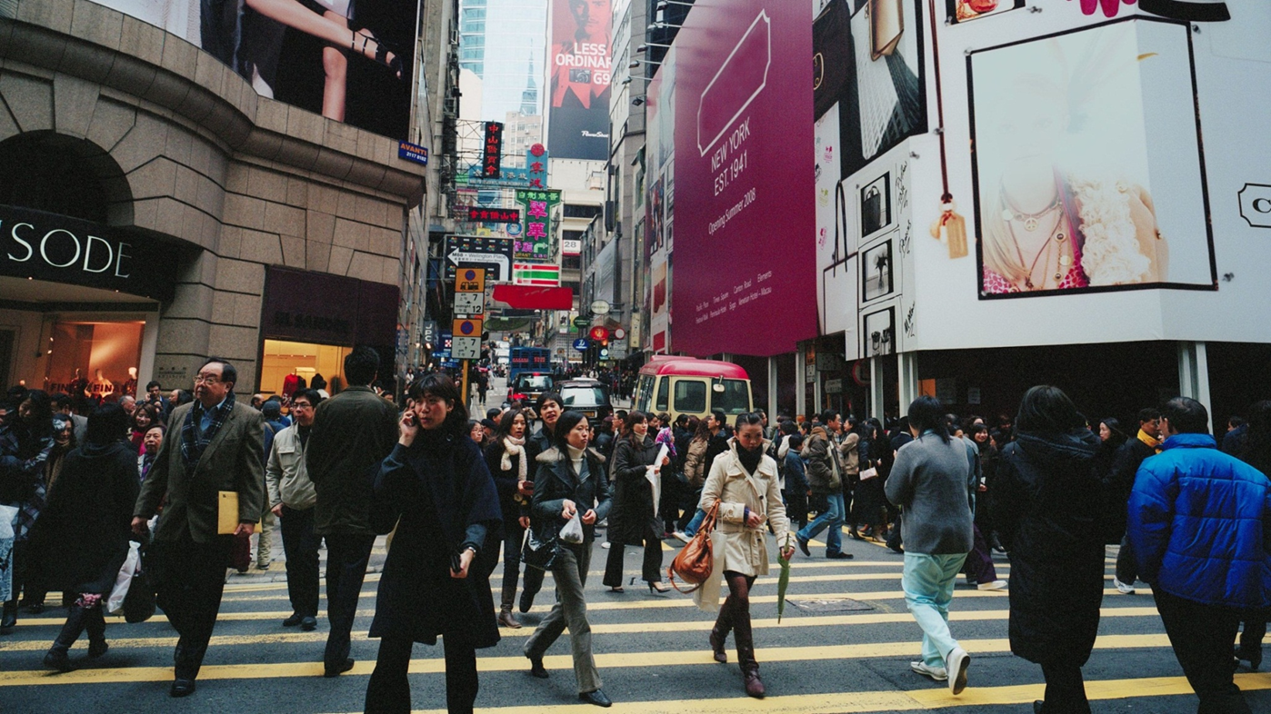
Data Analysis
Collaboration
Funding
Knowledge Sourcing
Solution Sourcing
Notes:
‘Crowdx’ projects have become commonplace in today’s world that is highly so connected - from developed to emerging economies - as a means of combining disparate resources and knowledge to do everything from raising funds for business and charity to collecting policy ideas and opinions, to finding solutions to problems - business and otherwise, to analyzing massive amounts of data. But what about gathering the data you need to analyze? That you need to have before you can embrace the theme ‘making data work’. Together there is a collective knowledge and synergy that is somehow far greater than the sum of the parts and it has and can help us in ways we never imagine. Not just to analyze data, to find innovative solutions, but to gather the relevant data that is needed.

Slide 3
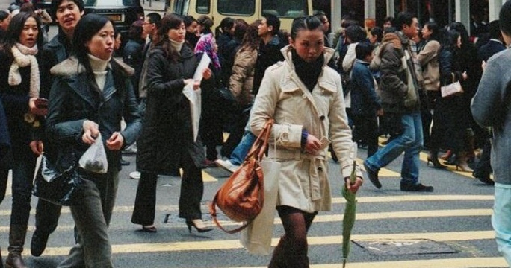
Crowdsource data in this connected world
Notes:
As I said before – crowds are cool. So why not use the connected, collected masses to provide the data you need – getting several hundred thousand willing eyes and ears can make rapid, light work of mass data collection. Crowdsourcing is not just about the collective intelligence or abilities.

Slide 4

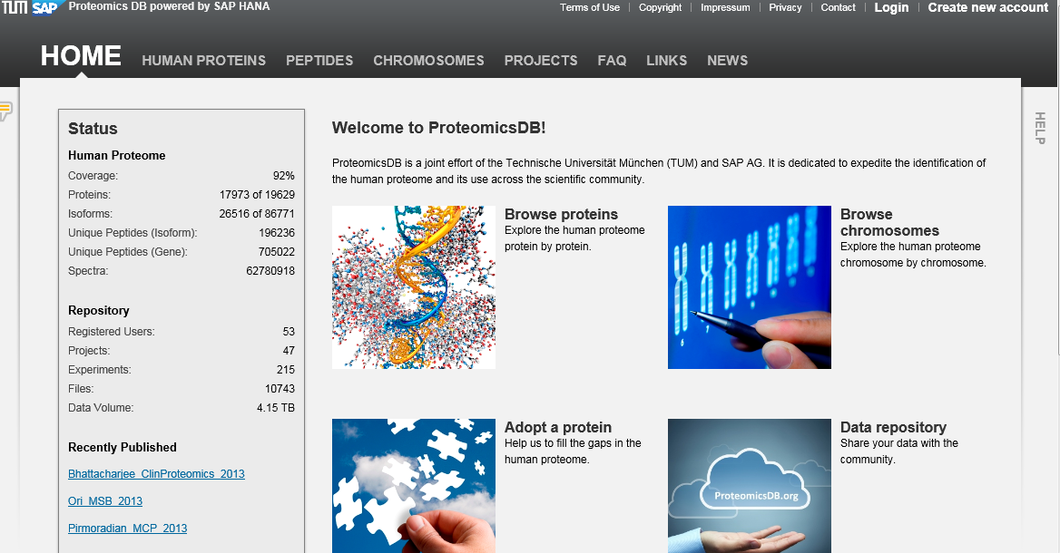
Notes:
You can harness the collective knowledge, efforts and collection abilities of a targeted group of people with collective skill set and knowledge base. The Technical University Munich (TUM) ProteomicsDB project is a great examples of collecting and gathering data via crowdsourcing - from within a given scientific community mind you - but none the less it relies on crowdsourcing to fill its burgeoning data store. The project stores protein and peptide identifications from mass spectrometry-based experiments and the data assembled provides identification of proteins mapping to over 18,000 human genes, currently representing 92% coverage of the human proteome. It currently contains more than 11,000 datasets from human cancer cell lines, tissues and body fluids, and enables real-time analysis of this highly dimensional data creating instant value by allowing testing of analytical hypothesis. The crowdsourced data stored and analyzed within ProteomicsDB can be used in basic and biomedical research for discovering therapeutic targets and developing new drugs as well as enhanced diagnosis methods and SAP is proud to be involved with driving the success of this project. But what about the rest of us … what about the masses, not just skilled, specialized communities?

Slide 5
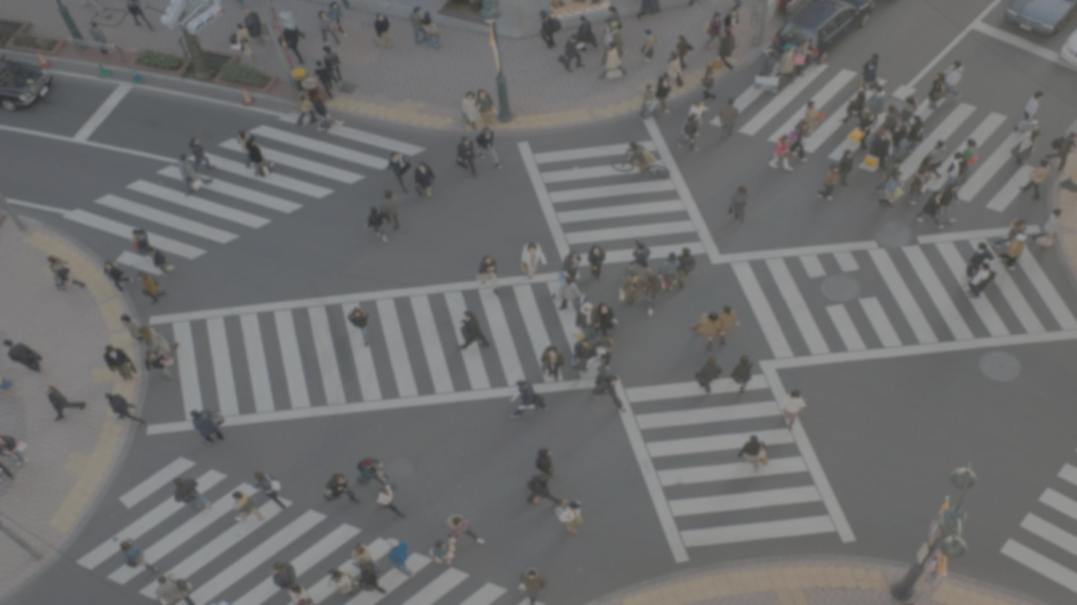
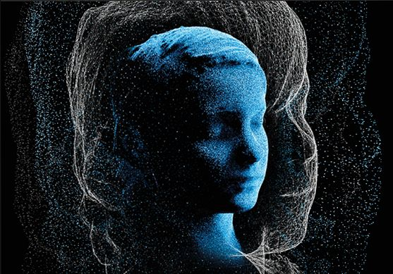
Learn,. Compare. Discover
The Human Face of Big Data is a globally crowdsourced media project focusing on humanity's new ability to collect, analyze, triangulate and visualize vast amounts of data in real-time
Notes:
You can even crowdsource information, data, for a book or project and distill what you have down to something presentable – and in the case of the Human Face of Big Data – something amazing. Rick Smolan – who has spoken previously at Strata - crowdsourced The Human Face of Big Data project which is a, book, website, app, and soon to be released video documentary, which SAP has proud to be associated with as one of the sponsors. In the area of this fascinating book dedicated to Crowdsourcing, co-creator Rick Smolan talks about how we began to use our interconnectedness to analyze existing data – from shared knowledge translating 2000 year old papyrus manuscripts – to providing distributed computing for SETI – and how we are now turning our collected connected conscious to collecting mass data. Our present highly interconnected world has offered a stage and place for ‘amateur’ or ‘citizen’ scientist such has never existed before. We can become the foot soldiers of science – providing more field presence that ever imagined. The Human Face project details some of projects that have begun crowdsorcing mass data – from accelerometers in computers and mobile devices to detect and warn of earthquakes (Quack Catcher) – to Safecast monitoring radiation levels around Japan. Want to known more go explore at the Human Face of Big Data project. – But this shows just the beginning of how we are beginning to use our mobile connectedness to truly crowdsource data. How about a mobile app?

Slide 6
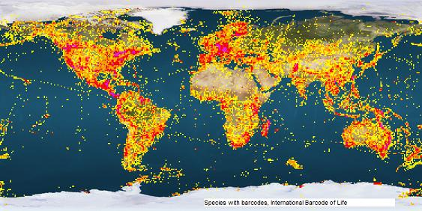
Notes:
There are a number of current projects leveraging the masses to gather data and one of the easiest ways to do this is with apps. Microsoft and Google are involved in and funding such projects. Mobile connected masses can use apps from those identifying bird calls on a mobile device so spottings can be more accurately recorded like iBirdPro to ‘Whale Spotter’ which used to provide data on Blue and Humpback whales in the Golden Gate area with the goal of decreasing collisions with commercial shipping traffic. There is also the Bar Code of Life project with which SAP announced its involvement back in October 2013. As the International Barcode of Life notes “Few taxonomists can reliably diagnose even 1,000 species, and that means that we will need up to 100,000 taxonomists simply to sustain the ability to recognize Earth’s 10 to 100 million species, once they have all been described. It is this stark reality that is driving a new approach to species recognition called DNA barcoding.” So how about a mobile app?

Slide 7
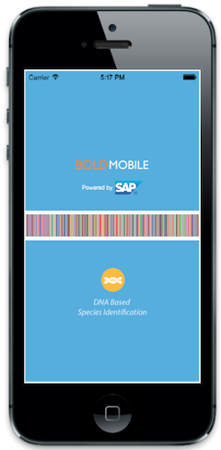
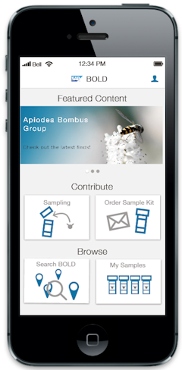
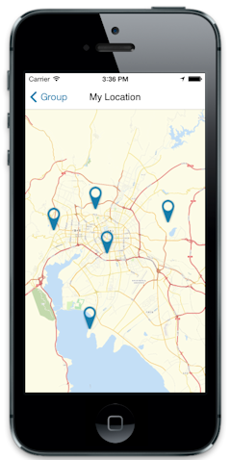
Notes:
Working through the Biodiversity of Life project at the University of Guelph, one of the consortiums form 25 courtiers around the globe that make up the International Bar Code of life SAP is applying data science and design thinking to creation of a mobile crowdsource app being developed to enable “citizen scientists” around the world to collect insect and plant DNA samples and related information. The goal is an application that anyone can use on a mobile device to collect a species sample, send it off for testing, and get the results back ... and to do this from anywhere on the globe. This application designed to crowd-source the collection of a massive data set, provides a rich source of information about our world – one that we want to analyze. The second part of this co-innovation project – making the data work - involves mining all of this data using SAP HANA and SAP's analytic tools. Through this we will gain insights into the genetic variation of species, their evolution, and their migrations resulting from climate change. A very early prototype was demonstrated at a show in China and more precise details and information will follow in the fall likely at Strata Hadoop World NYC. Hope to see you there.

Slide 8




Thank you
    Visit Booth 109
Contact information: John.Schitka@sap.com
@johnschika
www.sap.com/bigdata
facebook.com/sapanalytics
twitter.com/#!/@sapinmemory
Notes:
Next you are wondering about how to get the data you need in order to achieve the goal of making data work – crowdsourcing from the mobile connected masses – via an app perhaps - might be a viable option and there are companies like SAP with the skill, knowledge and ability willing to help. Come by and visit us at booth 109 – we’d love to say hi and share our Big Data story and strategy.

