Slide 1
Deploying a Data Sciences Team: The Promise and the Pitfalls
Simplify the business of life
Diane Chang, PhD
Senior Data Scientist
diane_chang@intuit.com

Slide 2
… or
Why I love embedding
I
embedding

Slide 3




Slide 4

You’ve hired them, now how do you deploy them?

Slide 5



Centralized team
Resident in the business
Embedded in business

Slide 6







Data
Science

Slide 7
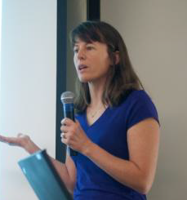
My Intuit experience
5 years as a data scientist
First 4 years in “centralized team” mode
Last year I was embedded for 10 months … and I loved it!

Slide 8

My concerns with centralization
Single point of contact
Few direct interactions
Single source for context
Feel less a part of the team

Slide 9
The first embedding experiment
Big Data for the Little Guy
First volunteer
4
+4
+4
+4
+4
+4
+4
+4
+4
+4
3 months
3 months
4 months
The result: A new business with data in its DNA!

Slide 10
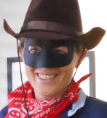
Being one of the team
Direct communications
No “geek speak”
Hallway conversations
Flash mob
Extra context -> better product
Plus:
Maintained connection with data science team

Slide 11
Why I love embedding
New data “believers”
Significant impact on a new product
Learned a lot
Made new friends
I
embedding

Slide 12

And what I learned…
It’s easy to get disconnected
Enter with an exit strategy
Demand can be overwhelming
Two homes can feel like no home

Slide 13

Hey product team - are you ready?
Well-defined problem with significant business value
Data is available
Committed bandwidth from team
Welcoming – have a buddy

Slide 14

Data scientist - do you have what it takes?
Open to change
Value learning
Easily develop personal relationships
Adaptable
Translate technical to business terms
∑ ≈ ∏

Slide 15
Since the first experiment…
We are growing the program
A dozen embedding rotations
We are still experimenting
Pods: a team not an individual
Can play a larger strategic role
Can offer a variety of skills

Slide 16
And me?
Doing a rotation back in the center
Improving tools and products that benefit many product teams
Increasing my skills and knowledge
I
embedding

Slide 17

Questions?
Contact me at:
diane_chang@intuit.com
Simplify the business of life

