Slide 1
Empowering Personalized Learning With Big Data
BRINGING DATA TO LIFE
RAMONA PIERSON
CEO AND CO-FOUNDER
02/12/2014

Slide 2
The fundamentals of personalized learning…

Slide 3
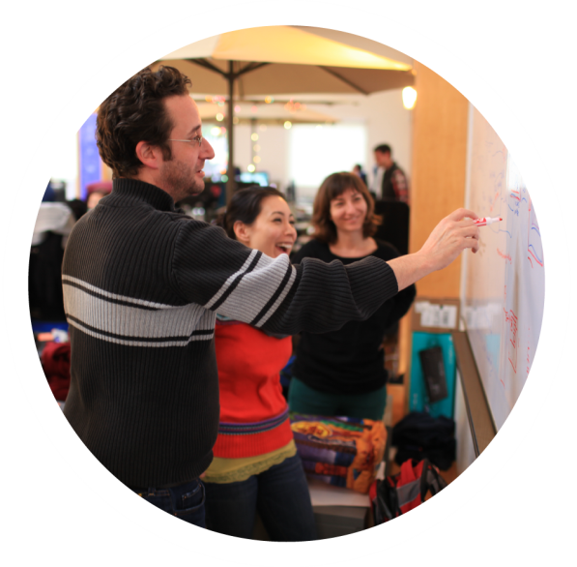
…begin with quality learning
Where mentors and experts can guide learners in a customized manner

Slide 4
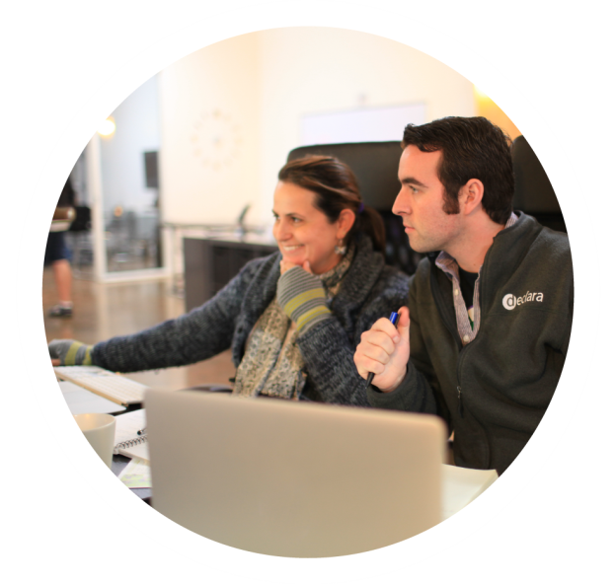
To prepare them for an ever changing global workforce

Slide 5

Dynamic Progressions can help Uncap Learning

Slide 6


With the Rise in Big Data

Slide 7

INTEGRATED LEARNING PLATFORM ESSENTIALS
THE CLOUD
As a repository for facts, rules, and cognitive models.

Slide 8

INTEGRATED LEARNING PLATFORM ESSENTIALS
THE APIs
To transfer those facts, rules, and cognitive models.

Slide 9

INTEGRATED LEARNING PLATFORM ESSENTIALS
THE ALGORITHMS
To customize the mode of learner engagement.

Slide 10

INTEGRATED LEARNING PLATFORM ESSENTIALS
THE APPLICATIONS
To create engaging, open-source learning content.

Slide 11







INTEGRATED LEARNING PLATFORM ESSENTIALS
into one platform
The Cloud
APIs
Algorithms
Applications
…across any device

Slide 12




Today learning does not only happen in schools but continues for a lifetime.

Slide 13
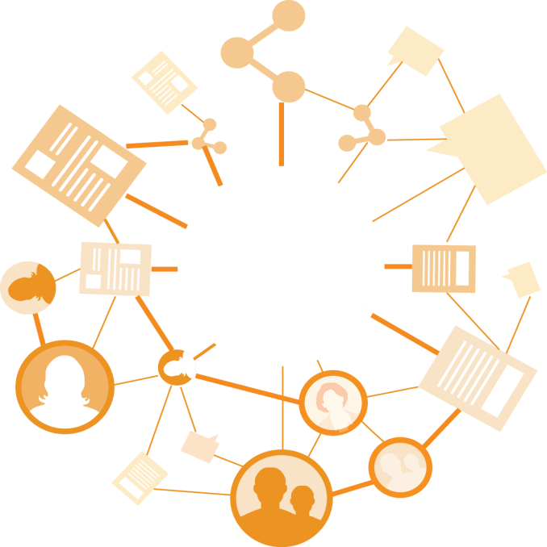
The global workforce constantly need to learn and re-learn their skills to advance their careers.

Slide 14
TODAY’S LEARNING
FORMAL LEARNING
INFORMAL LEARNING
Taught at universities, static learning
From human interaction, dynamic learning

Slide 15

DECLARA
Big data for personalized learning.

Slide 16
DECLARA PLATFORM
SHARE
Private/Public Collaboration
Intelligent Chat
Publishing
LEARN
Expert Graph
Badging
Mentor Management
ERP Data Ingestion
KPI/ROI Content Tagging
Predictive Analytics
IMPACT
Content Ingestion
Semantic Search
Personalized Recommendation
DISCOVER
MACHINE LEARNING – BIG DATA BACKEND – COGNITIVE GRAPH

Slide 17




DECLARA COGNITIVEGRAPH
LEARNS AS YOU LEARN
Social Platform
Search, search space and recommendations
Predictive Analytics

Slide 18
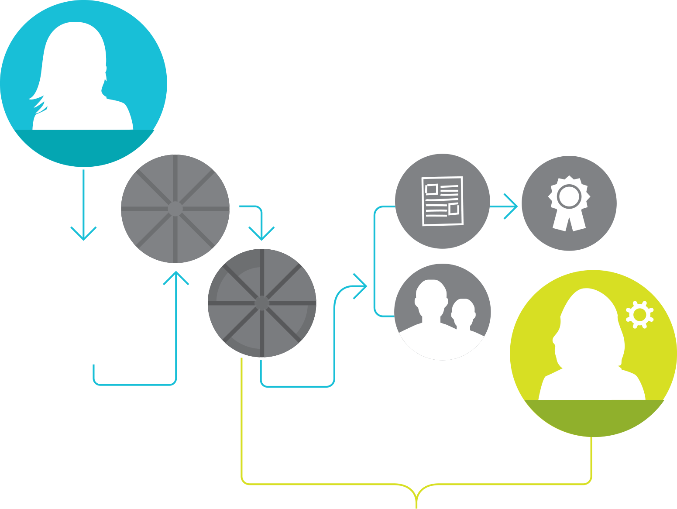

PERSONALIZED LEARNING PATH
The platform suggests that Susan connect with peers and experts, join groups and access pieces of content to help reach her goals.
The results are used to make a personalized work plan to meet her professional goals
Susan Smith
Employee
Registers in
Declara
Her goals are measured and acheivements are tracked to show improvement
Self Evaluation
Results
She completes an evaulation of:
Her abilities and competencies
Her undersanding of materials
Personal and professional experience
Administrator
The administrator can monitor progress

Slide 19
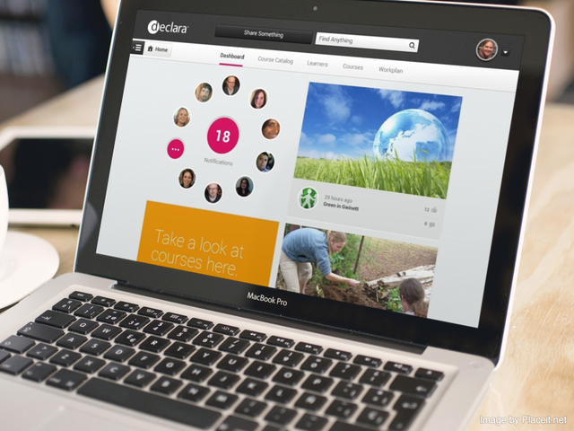
DISCOVERY

Slide 20
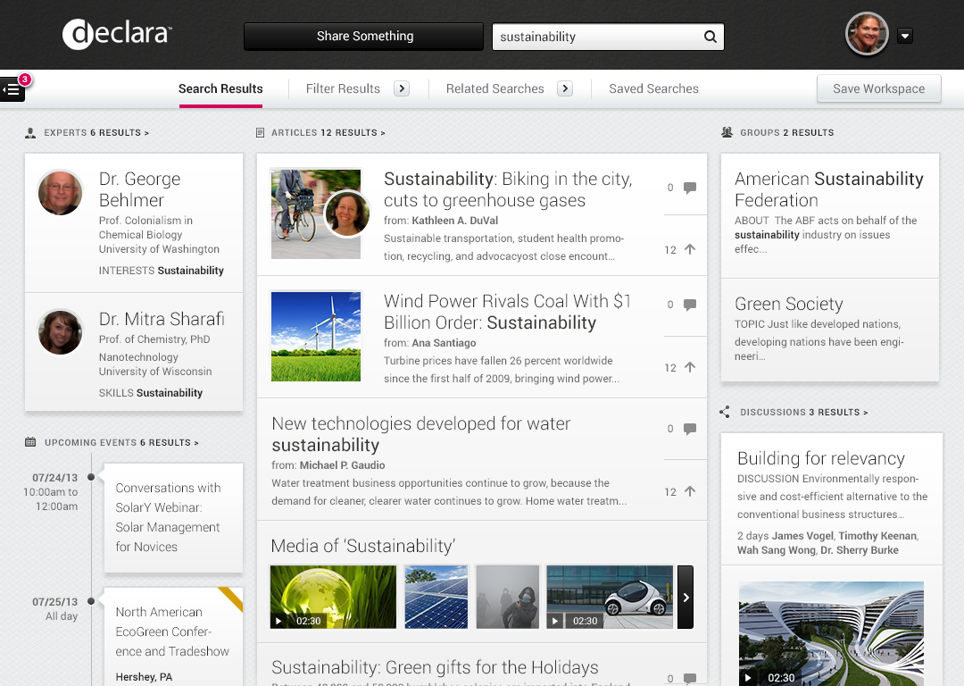
SEMANTIC SEARCH

Slide 21
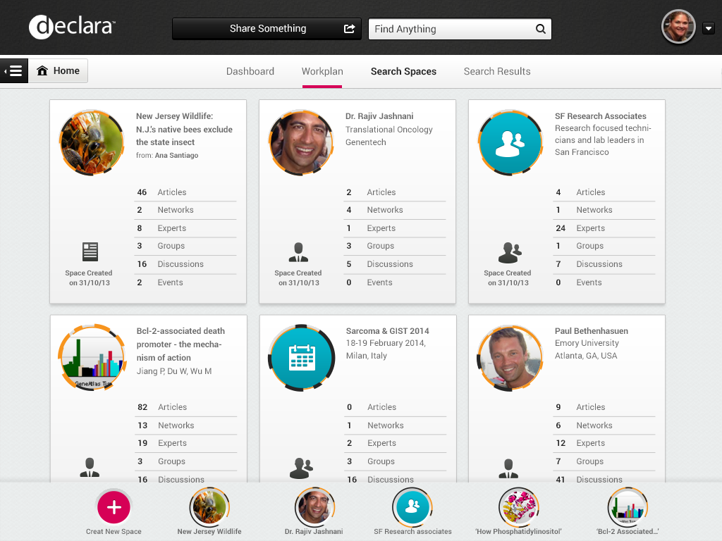
SEARCH SPACES

Slide 22
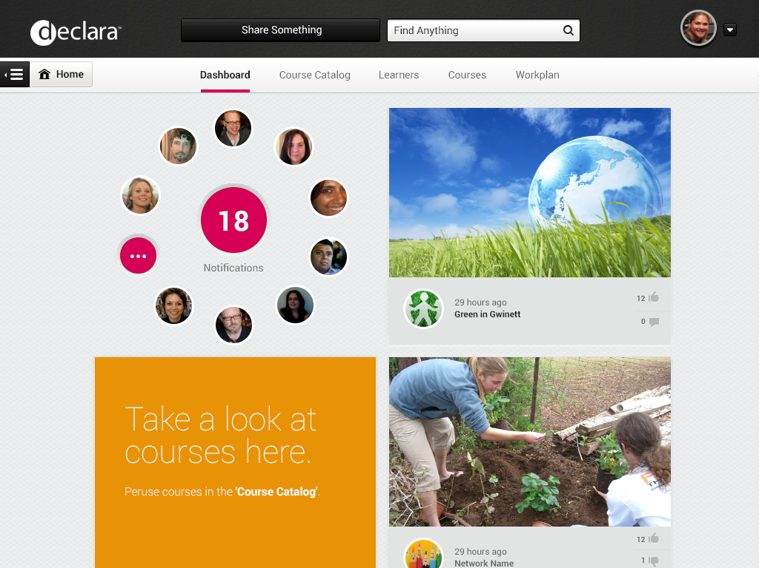
PERSONALIZED DASHBOARD

Slide 23
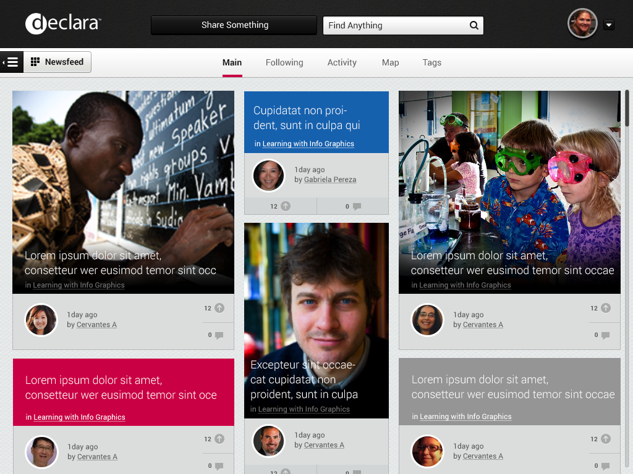
NETWORK NEWSFEED

Slide 24
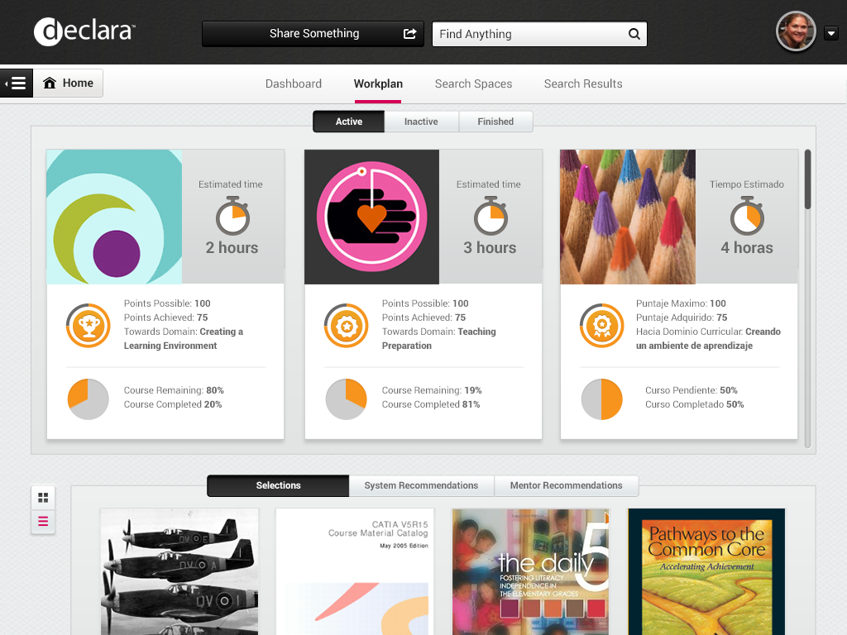
WORK PLANS

Slide 25
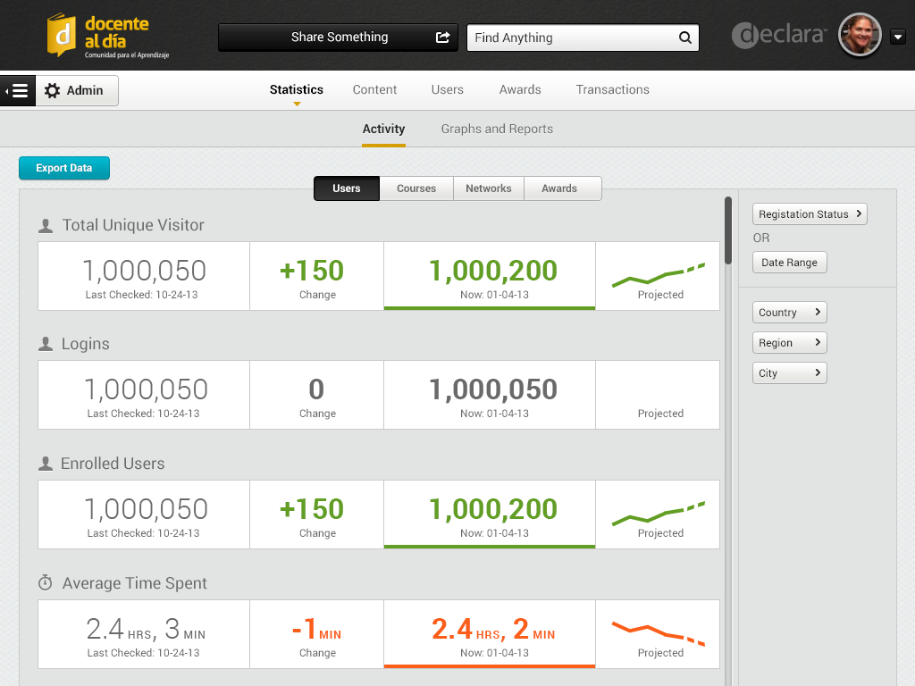
ANALYTICS DASHBOARD

Slide 26







EARLY TRACTION
Accelerate Innovation
Increase Efficiencies
Drive Large-scale Transformations

Slide 27
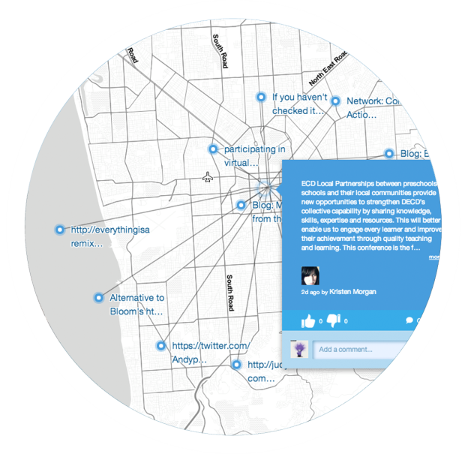
POWER OF BIG DATA
AUSTRALIA TEACHERS NETWORK
>280,000 teachers actively engaged
390 learning Networks created by teachers
468 collaboration boards created
100’s of thousands of files and comments shared

Slide 28
The End
BRINGING DATA TO LIFE
RAMONA PIERSON
CEO AND CO-FOUNDER
02/12/2014

