Slide 1
Getting a Handle on Hadoop and its Potential to Catalyze a New Information Architecture Model
Milan Vaclavik, Senior Director, Big Data John Martin, Chief Architect, Big Data

Slide 2
Agenda
Big data: what just happened?...
What’s likely to happen next
What it means for information architecture
Growth of data and its implications
The role for big data managed services

Slide 3
Big Data: What Just Happened?...
Market dynamics converging around Hadoop and NoSQL
Mission-critical needs to efficiently manage and analyze massive databases and streams
Inability of earlier technologies to address needs in a timely,cost-effective manner
Breakthrough price/performance and horizontal scaling with commodity hardware
A highly productive Apache open source community, using a flexible license agreement
Market leaders including Facebook, Twitter, Yahoo!, and others contributing huge amounts of code
Based on re-implementing Google innovations, in several domains
Several fast-moving commercial big data vendors
Cloud services offering revolutionary capability/cost equations

Slide 4
Impressive Results, Despite Constraints
Hadoop v1 is a brute-force solution in some respects
Data usually stored in triplicate
A fundamentally batch-oriented, append-only file system
Single point of failure risks (in many but not all distributions)
Limited security, governance, and disaster recovery features
Non-trivial complexity in MapReduce programming model
Somewhat alleviated by extensions such as Hive, for SQL-based access (generating MapReduce jobs)
Generally requires dedicated systems without virtualization and with ample local storage, for large-scale deployments
MapReduce has a dual role, as both resource negotiator and data processing framework, creating bottlenecks and constraints

Slide 5
A Similar Situation for First-Gen NoSQL
Much can be left as an exercise for developers, with some NoSQL systems, such as:
Security
Data integrity
Schemas
Transactions
Referential integrity
Query optimization
Disaster recovery
Other aspects of data governance

Slide 6
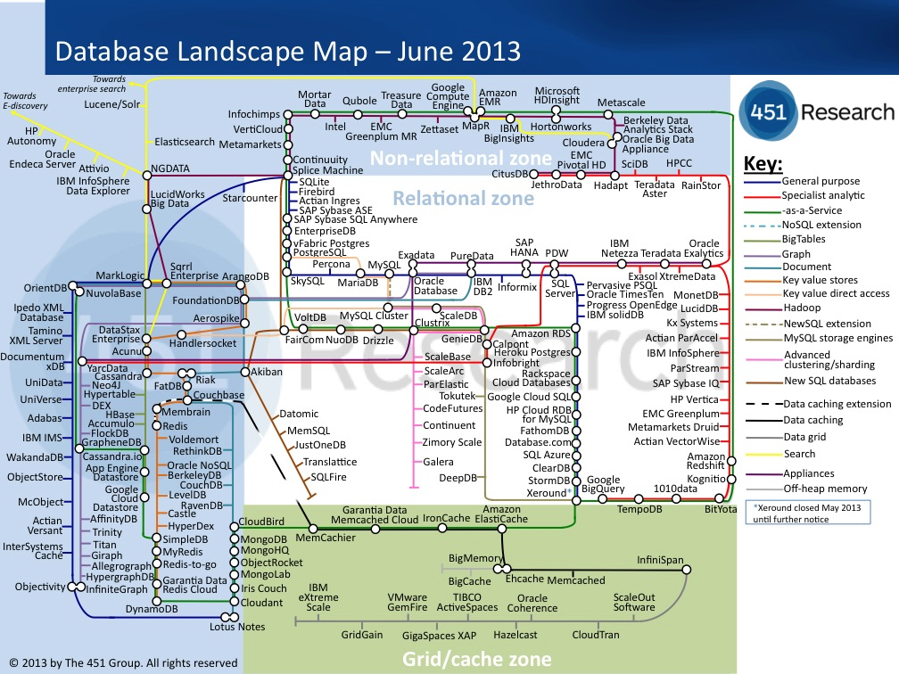
A Valiant 451 Research Map
Source: http://blogs.the451group.com/information_management/2013/06/10/updated-database-landscape-map-june-2013/

Slide 7
Agenda
Big data: what just happened?...
What’s likely to happen next
What it means for information architecture
Growth of data and its implications
The role for big data managed services

Slide 8
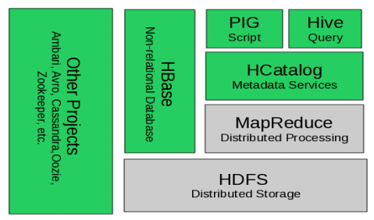
“Hadoop” is Transitioning from This…
Source: “Apache Hadoop YARN: Moving beyond MapReduce and Batch Processing with Apache Hadoop 2,” Murthy, Arun, Addison Wesley 2013

Slide 9
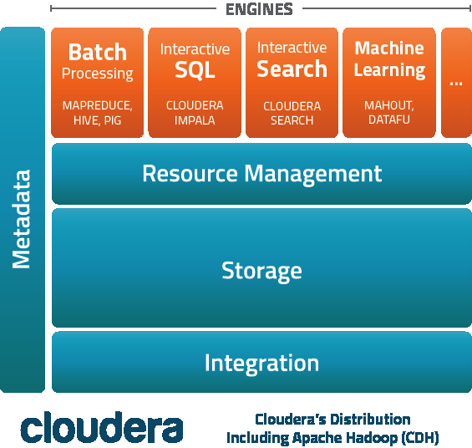
…To This
Source: http://www.cloudera.com/content/cloudera/en/products/cdh.html

Slide 10
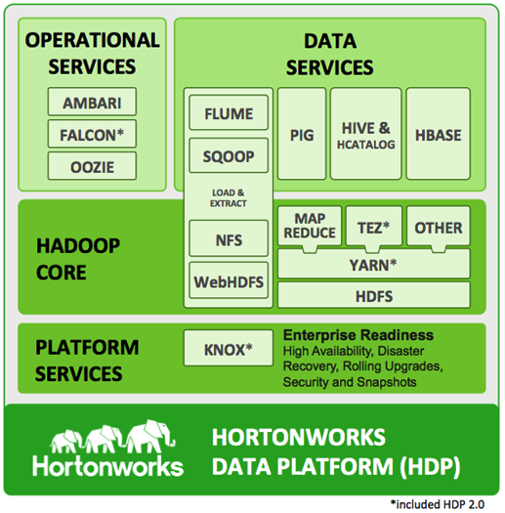
…And This
Source: http://hortonworks.com/products/hdp/

Slide 11
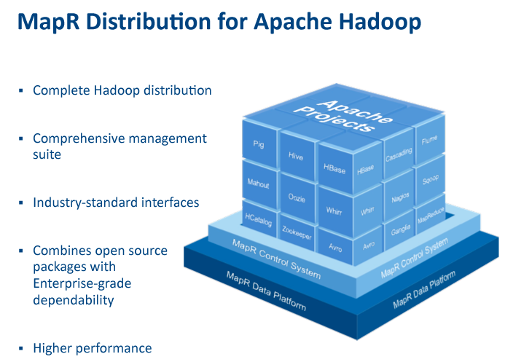
…And This
Source: http://www.mapr.com/products/product-tour#developers

Slide 12
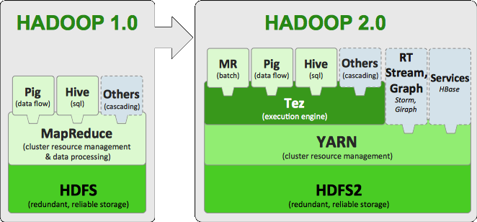
Another Hadoop v2 Perspective
Source: http://hortonworks.com/blog/apache-hadoop-2-is-ga/

Slide 13
Boundaries are Blurring
NoSQL Evolution
New Opportunities
for SQL?
Not Only
SQL
SQL

Slide 14
Boundaries are Blurring
Hadoop Platform
NoSQL
DBMS Dimensions
SQL support
Tables and transactions
Object storage subsystem (with HDFS API support)
Ability to manipulate data in HDFS-based subsystems
DBMSs extended with HDFS interoperability
Hybrid Hadoop/DBMS platforms
+
+

Slide 15
Interesting Apache Discussions Ahead
There are strongly-held differences of opinion in key domains such as SQL-on-Hadoop, e.g.,
Cloudera created and contributed Impala
EMC/Pivotal has HAWQ
Hortonworks is a Stinger contributor and backer
IBM created and offers Big SQL
MapR has bet on Apache Drill (based on Google Dremel)
Teradata/Aster has SQL-H
Vendors can support multiple approaches (e.g. Impala runs on MapR)
… but there is clearly room for many areas of Hadoop-related convergence and standardization

Slide 16
Agenda
Big data: what just happened?...
What’s likely to happen next
What it means for information architecture
Growth of data and its implications
The role for big data managed services

Slide 17
Revisiting the Separation of Concerns
Clearer distinctions
Application developers and analysts: conceptual level
E.g., fine to focus on Java or JavaScript and JSON, as long as doing so doesn’t mean compromising on effective use of underlying data management systems
Database designers and information architects: logical level
Application/data independence and logical/physical independence are more important than ever before
Database and system architects: physical level
Incredible innovation at the physical level, but conceptual and logical modeling concerns shouldn’t be unduly influenced by physical model considerations

Slide 18
Information Architecture Implications
Strategic opportunities
Consolidation: opportunity to have fewer moving parts
Expect rapid consolidation across
Extended relational DBMS
Hadoop platforms
NoSQL database systems
Distributed file systems
With analytics, developer frameworks, and management tools that work seamlessly across all of the above

Slide 19
Information Architecture Implications
Strategic opportunities
Big data can constructively serve as a catalyst for improving and integrating existing databases
Many enterprises have data management inconvenient truths that must be addressed to fully leverage big data opportunities
Focus on fundamentals; back to basics
As the technologies mature and converge, redoubled focus on effective modeling, query formulation, and analysis capabilities will be key to productive and agile data management
The next critical question for enterprises: how do you get there from here?...

Slide 20
Agenda
Big data: what just happened?...
What’s likely to happen next
What it means for information architecture
Growth of data and its implications
The role for big data managed services

Slide 21
Managed Services are Ideal for Big Data
“Storing all of your data on-premises need no longer be the default.”
Forrester Research, Inc.
“The Future of Customer Data Management”
March 6, 2013

Slide 22

The Growth of the Digital Universe is Accelerating
2020
40 ZB
~43% CAGR
2009
.8 ZB
2013
4.5 ZB
12%*
Of an enterprise’s data being used currently
Source: IDC Digital Universe Study 2013 *Forrester: Forrester Research Inc, Forrsights Business Intelligence Big Data Survey Q3 2012

Slide 23


SOCIAL MEDIA DATA
Financial Planning
VIDEO
IMAGES
FREE-FORM TEXT
LOG DATA
Customer Support
MACHINE/ SENSOR DATA
Sales
Distribution
Marketing
EMAILS / DOCUMENTS
GEOSPATIAL DATA
AUDIO
Supply Chain
TRANSACTIONS

Slide 24

A Basic Use Case is a Common
Starting Point
Break Down
Data Silos
Data Lake
Create Data
Archive
Analytics
Gain Business
Insights

Slide 25
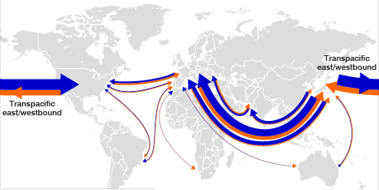
Data Lake Example In Action Large Retailer Optimizing its Supply Chain
Scenario: Evaluate on-time shipment delivery
25GB of Data: Container status events for previous 18 months
600K containers
30 events / container
Ocean, rail, truck data
Desired Outcomes:
Improved carrier, route selection
Fewer stock outages
Increased revenue

Slide 26
Three Variables Affect Hadoop Needs
Data Sources
Hadoop Environment Requirements
Use Cases
Data Retention

Slide 27
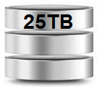

All Three Variables Can Ramp Quickly
Booking, invoice, price/performance analysis
Analysis by commodity type and port
Affect of weather, labor disputes
Use Cases
All operational data for shipments
External data (weather, news, LinkedIn)
Data Sources
Data Retention
5+ years for long term trend analysis
25GB

Slide 28


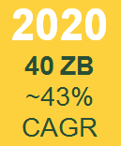
Scaling in-House is Challenging
Capital investment
Data center constraints
Skills shortage
Focus on low-level technology details vs. higher level objectives
“I need it next quarter”
eCommerce
Marketing
Data is Growing

Slide 29



Big Data Managed Services Improve Business Results
Increase agility by unlocking value from all data resources
v
Enable Innovation
Accelerate Results
Reduce Risk

Slide 30
Big Data Services Must be “Full Service”
Diverse range of use cases, data types
Standard services to reduce costs
Add-on products
Flexible commercial models
Enterprise data integration
Strategy and Business Case Consulting
Hadoop Management
Big Data Environment Planning and Implementation
Security
Analytics (Custom,OTS)
Hadoop
Infrastructure-as-a-Service
Network Services

Slide 31
Big Data is Moving to Managed Services
Hadoop v2 offers more, fewer moving parts needed
Big data is becoming much more accessible
Growth in data, use cases and retention periods will ALL accelerate
On premises resource needs may not be sustainable
Managed services are ideal for big data

Slide 32
Thanks!
Milan Vaclavik
Senior Director, Big Data
milan.vaclavik@centurylink.com
@mvaclavik
John Martin
Big Data Chief Architect
john.martin@centurylink.com

Slide 33
Who is CenturyLink Technology Solutions?
CenturyLink Technology Solutions is an enterprise-grade managed service provider delivering visionary cloud and IT solutions with proactive service, enabling organizations to gain a competitive advantage through IT.
Deep expertise in technical operations, client support, engineering and consulting
Infrastructure extends to 45 countries
More than 55 global data centers with over 2 million square feet of raised floor space
Ironclad security and compliance
Network services for the most demanding enterprise needs

