Slide 1
Hadoop in 5 Minutes or Less
John Schroeder, CEO & Co-founder
MapR Technologies
Notes:
I just have 5 minutes for this talk. Given the short time I thought I’d share with you some of the more interesting things you can do with Hadoop in 5 minutes or less…

Slide 2




Largest Biometric Database
4.73M
00:05
AUTHENTICATIONS
Notes:
In 1 minute you can perform 4.73 million concurrent authentications in the largest biometric database in the world
In India, there is no social security card. It’s difficult for the average citizen to set up a bank account, access benefit programs, and enjoy economic mobility. It’s difficult for the government as well with over a $1B of government aid classified as leakage, the result of fraud and corruption.
The Aadhaar program is poised to change all that by leveraging the unique IDs that all people are born with. The program aims to get fingerprints and retina scans for all 1.2 billion citizens. The scale of this project required an integrated in-Hadoop database that was capable of 200 millisecond response times while supporting millions of concurrent look-ups.

Slide 3

422.2K
00:04
GENETIC SEQUENCES
Notes:
You can use a second minute to change Healthcare. Doctors, particularly oncologists, are faced with an enormous amount of data regarding patient treatments, outcomes, and disease states. Hadoop is having an impact across the health care industry but for this minute we will focus on its use for developing better treatments. In one minute Hadoop can analyze more than 20,000 genes across hundreds of thousands of patients. The outcome of this analysis is to get a better understanding of genomic factors and integrate imaging and clinical analytics to better understand, predict, and impact survival. In any given minute our cluster is sequencing 422,000 genes per minute.

Slide 4

Advertising Automation Cloud
Sellers Cloud
Buyers
Cloud
63M
00:03
AD AUCTIONS
Notes:
In our third minute you could perform 63M ad auctions with the Rubicon Project. The company’s pioneering technology created a new model for the advertising industry – similar to what NASDAQ did for stock trading. Rubicon Project’s automated advertising platform is used by more than 500 of the world’s premium publishers to transact with over 100,000 ad brands globally.
63M might seem like a lot but that’s just the average not the peak performance of the Rubicon Project that perform 90B ad auctions each day -- providing the most extensive ad reach in the industry touching 96% of internet users in the US.
You might ask how do we know who has the largest ad reach. Well this was measured by comscore.

Slide 5

39M
EVENTS
Notes:
comScore uses Hadoop to analyze 1.7 trillion internet events a month (that’s an average of 39M a minute) as part of their industry leading analytics service that provides a continuous, real-time measurement of the myriad ways in which the Internet is used and the wide variety of activities that are occurring online

Slide 6

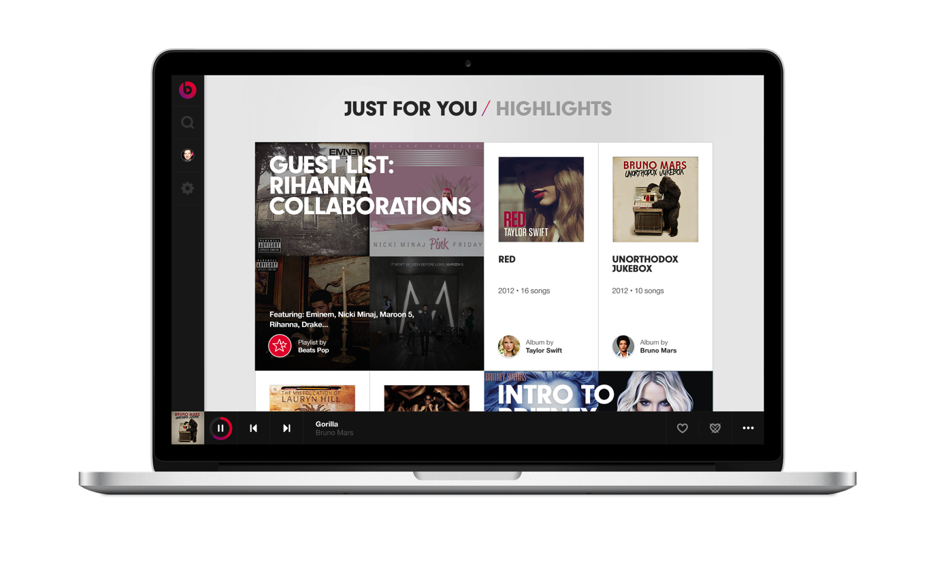
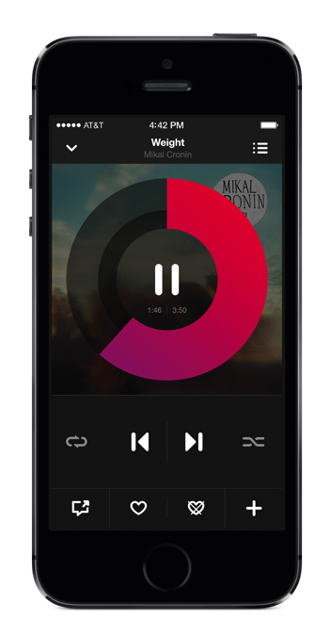
129K
00:02
RECCOMENDATIONS
Notes:
After just a few minutes of work here with Hadoop I could use a minute to relax – Beats headphones by Dr. Dre have swept the audio market. Beats has launched a new Beats Music service that is able to personalize music selections and select the perfect song in a minute from over 20 million songs. It joins a crowded space for online music, but now by using Hadoop Beats is able to provide a completely new personalized service from over 20 million songs in their library. In their very first day, they were processing 129,000 music interactions per minute. A number that is only growing.
11 Million events per day

Slide 7

Using Hadoop to Prevent Fraud
Notes:
I should also point out that when paying for Beats one of the largest credit card companies uses Hadoop to process petabytes of information to prevent fraud, personalize offers and drive efficiencies.

Slide 8

1.65TB
00:01
WITH 298 SERVERS
Notes:
The Minutesort benchmark is technology agnostic, until recently the record was held by Microsoft using custom software and dedicated high end hardware. Yahoo broke the record and sorted 1.6TB in one minute using 2200 servers.
This is not limited to just the originators of Hadoop…One of our customers over a weekend recently broke this record performing 1.65TB in one minute with 298 servers. This performance is key to their use of Hadoop as it is a critical part of their business operations.

Slide 9

1/7th the Hardware Footprint
Notes:
The Minutesort benchmark is technology agnostic, until recently the record was held by Microsoft using custom software and dedicated high end hardware. Yahoo broke the record and sorted 1.6TB in one minute using 2200 servers.
This is not limited to just the originators of Hadoop…One of our customers over a weekend recently broke this record performing 1.65TB in one minute with 298 servers. This performance is key to their use of Hadoop as it is a critical part of their business operations.

Slide 10

Sandbox
Come by our booth
It’ll only take a minute
Notes:
That’s all I have time for. I like to point out that today we announced the MapR Sandbox to make it easy to experience our world-record-breaking distribution. – Stop by our booth and pick up a free copy, it will only take a minute

