Slide 1
National Engineering
& Technical Operations
How Comcast Turns Big Data into Real-Time Operational Insights
Patrick Shumate
CDN Engineer
VSS CDN Engineering

Slide 2

Speakers
Patrick Shumate CDN Engineering @ Comcast
      Data nerd supporting Content Delivery
      Avid cyclist
      Home brewer
Brett Sheppard Big Data @ Splunk
      Data nerd supporting Big Data Enterprise Architectures
      Avid runner
      Home drinker

Slide 3
Agenda
Methods and Process (operating on data)
CDN Operations
Sochi Winter Olympic Games

Slide 4

Methods
Experimentation / Inquisition
Define KPI
Model Steady State
Predict Capacity
Effect without Causation
Notes:
When I say cost I mean back to the idea of “utils”. Not just money, but time, energy, good will, and the shine off an engineers battered soul.
Where is the data, what does it mean? Slice dice and review data. Model and predict. Test the past.
De-serialize the time series – look at the data without sequence “Which data has the most? What minute has the most errors week over week?
A lot of this exercise is not RT but without it how can RT data be understood.
Image (The burning of a 16th-century Dutch Anabaptist Anneken Hendriks, who was charged with heresy)

Slide 5
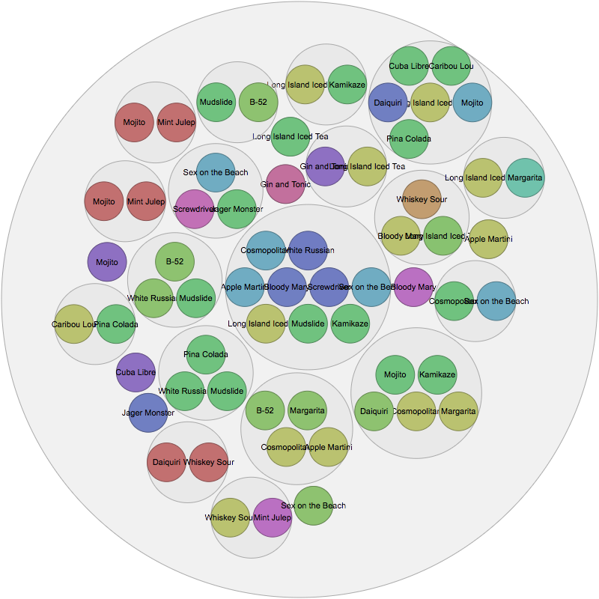
Procedures
Track
Alarm (real time)
Report (coffee time)
Visualize
Paper-cuts vs. Antennas
Notes:
Paper cuts represent the noise floor of events. 500 calls a day for some issue is the norm. That’s a paper cut
Antennas are the things that break though the noise and register as an event. Detect the Event, track and RCA the paper cut.

Slide 6
Comcast IPCDN Summary
Comcast Content Router
        Stateless
        DNS Round Robin
Rascal Health Monitoring
12 Monkeys Configuration Management
ATS Caches
Splunk Machine Data (Log) Collection and Analytics

Slide 7

The Comcast Content Router (CCR)
Tomcat Java application built in-house
Multiple VMs around the country in DNS Round Robin
Routes “by” DNS, HTTP 302, or REST
Can route based on:
  Regexp on URL host name (DNS and HTTP 302 redirect)
  Regexp on URL Path and headers (HTTP 302 redirect)
  Client location
    Coverage Zone File from network
    Geo IP lookup
  Edge cache health
  Edge cache load

Slide 8
Rascal
HTTP GETs vital stats from each cache every 5 seconds
  Modified stats_over_http plugin on caches exposes app & system stats
Determines and exposes state of caches to CRs
Can allow for real time monitoring / graphing of CDN
Can Expose 5 min avg/min/max to NE&TO Service Performance DB
Redundant by having 2 instances running independent of each other
  CRs pick one randomly
Notes:
Tomcat Java application built in-house. Applications must provide metrics for their own health. Before Rascal Cache health was though XMPP. That’s how the CCR knew if a cache was awake or not. With rascal it’s a HTTP API.

Slide 9
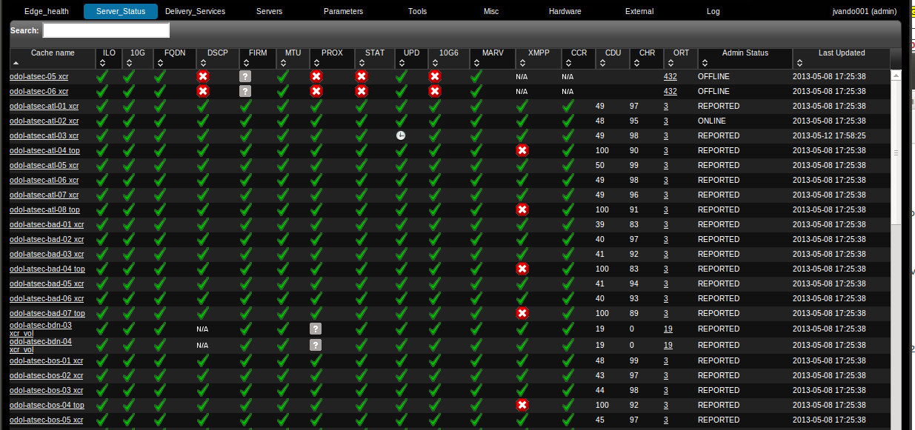
Configuration Management
Twelve Monkeys tool built in-house
Web based jQuery UI
Mojolicious Perl framework
MySQL database
REST interfaces
Integrated into standard Ops methods and best practices from day one
Monitoring from Health Protocol through Rascal server

Slide 10




The Caches - Software
Any HTTP 1.1 Compliant cache will work
We chose Apache Traffic Server (ATS)
  Top Level Apache project (NOT httpd!)
  Extremely scalable and proven
  Very good with our VOD load
  Efficient storage subsystem uses raw disks
  Extensible through plugin API
  Vibrant development community
  Added handful of plugins for specific use cases

Slide 11
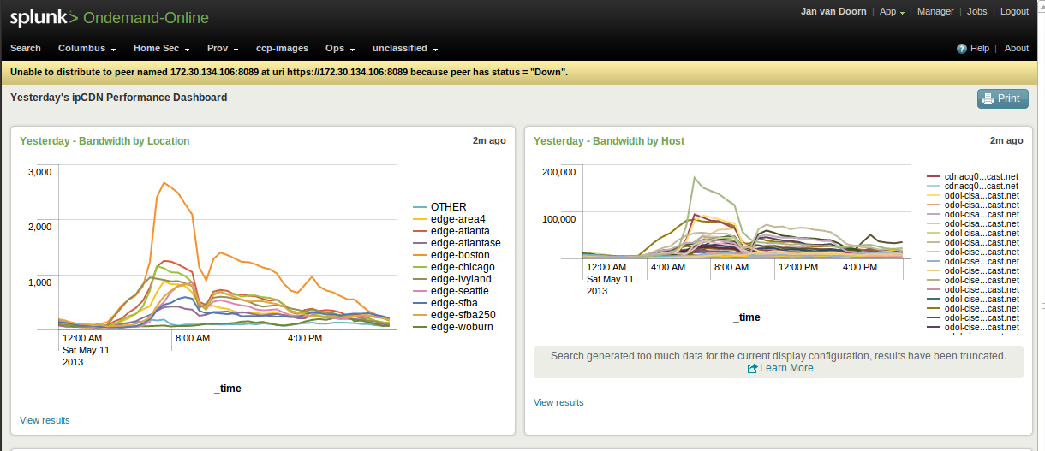
Machine Data Files and Reporting
Splunk>
The only commercial product we use
Well defined interfaces - No vendor lock-in possible
ipCDN usage metrics by delivery service

Slide 12
Demos
Notes:
How we use scripted inputs, logs, API to enrich the logs to bring many realtime sources into a single view.
Python to ETL into time series (SPDB) for enterprise dashboard ( Invite for splunk to blown up on Dashboards and such)

Slide 13
Splunk is a Different Approach for Raw Unstructured Big Data
Built by IT pros for IT pros
It’s all about the technical and business user from novice to guru
One code base
Laptop to datacenter, agent to server, native to virtual indexes
Open architecture
Files versus database, REST API, scriptable, SDKs
Flexible and extensible
Any data, any format, different views, built to be extended
Scales to big data
Not filtered, not “dumbed” down, not locked into a fixed schema
Transparent support
Public documentation, public roadmap, real engineers on IRC

Slide 14
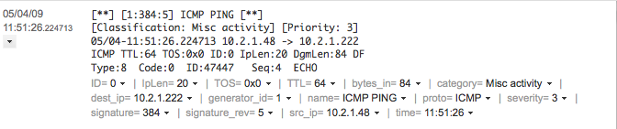
Inside Search-time Knowledge Extraction
Automatically discovered fields
And user-defined fields
... enable statistics and precise search on specific fields:
Notes:
Splunk automatically extracts a set of default fields for each event it indexes. You can "create" more "custom" fields by defining additional index-time and search-time field extractions. You can accomplish this manual field extraction through the use of search commands, the Interactive Field Extractor, and configuration files.

Slide 15

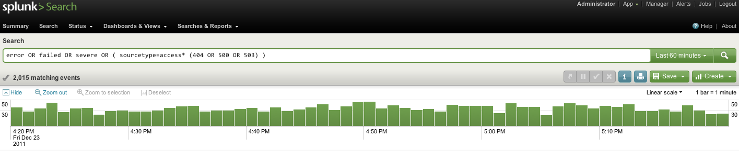




Real-time Analytics with Managed Forwarders
Data
Real-time Search Process
Monitor Input
Parsing Pipeline
Source, event typing
Character set normalization
Line breaking
Timestamp identification
Regex transforms
Real-time Buffer
TCP/UDP Input
Parsing Queue
Index Queue
Indexing Pipeline
Scripted Input
Splunk
Index
Raw data
Index Files
Notes:
Splunk Enterprise enables real-time analytics with managed forwarders for data ingest. For the most part, you can use monitor to add nearly all your data sources from files and directories. However, you might want to use upload to add one-time inputs, such as an archive of historical data. You can enable Splunk to accept an input on any TCP or UDP port. Splunk consumes any data sent on these ports. Use this method for syslog (default port is UDP 514), or set up netcat and bind to a port. TCP is the protocol underlying Splunk's data distribution and is the recommended method for sending data from any remote machine to your Splunk server. Splunk can index remote data from syslog-ng or any other application that transmits via TCP. However, there are times when you want to use scripts to feed data to Splunk for indexing, or prepare data from a non-standard source so Splunk can properly parse events and extract fields. You can use shell scripts, python scripts, Windows batch files, PowerShell, or any other utility that can format and stream the data that you want Splunk to index. You can stream the data to Splunk or write the data from a script to a file.
All data that comes into Splunk enters through the parsing pipeline as large chunks. During parsing, Splunk breaks these chunks into events which it hands off to the indexing pipeline, where final processing occurs. During both parsing and indexing, Splunk acts on the data, transforming it in various ways. Most of these processes are configurable, so you have the ability to adapt them to your needs.
To kick off a real-time search in Splunk Web, use the time range menu to select a preset Real-time time range window, such as 30 seconds or 1 minute. You can also specify a sliding time range window to apply to your real-time search. This defines a real-time buffer.
The Splunk Index is the repository for Splunk Enterprise data. Splunk Enterprise transforms incoming data into events, which it stores in indexes.

Slide 16
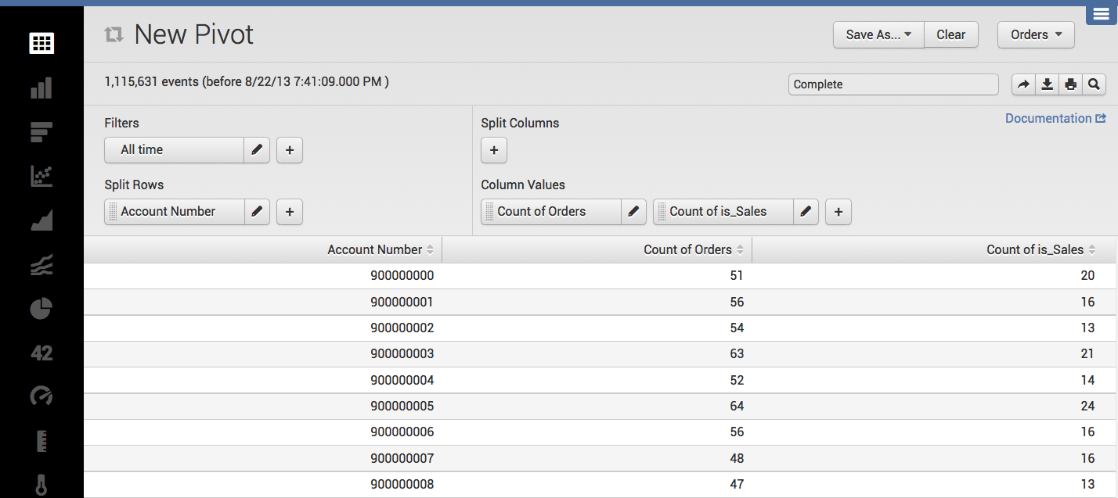
Data Models and Pivot
Describe how underlying data is represented and accessed
Drag-and-drop interface for non-specialists to analyze raw, unstructured data
Click to visualize any chart type; reports dynamically update when fields change
All chart types available in the chart toolbox
Save report
to share
Add constraints to filter out events
Time window
Select fields from
data model
Data models: hierarchical object view of underlying data
Notes:
Splunk software enables organizations to gain new insights from this data and a key focus for Splunk 6 is to empower a broader base of users in the organization with this insight – users that extend beyond core IT users.
The Pivot interface enables non-technical and technical users alike to quickly generate sophisticated charts, visualizations and dashboards using simple drag and drop. Users can access different chart types from the Splunk toolbox to easily visualize their data different ways.
Queries using the Pivot interface are powered by underlying data models, which are usually designed and implemented by users who understand the format and semantics of their indexed data, and who are familiar with the Splunk Search Processing Language (SPL).
Unlike traditional BI visualization tools focused on structured data analytics, the Pivot interface enables both non-technical and technical users to easily explore, manipulate and visualize raw, unstructured and polystructured data. It complements existing BI technologies by providing relevant business insights from a rapidly exploding new class of data.

Slide 17
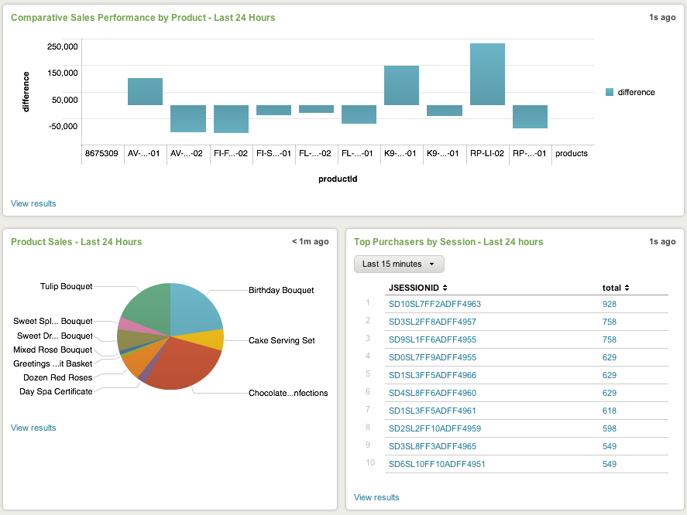
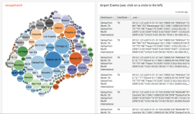
Integration Methods
Dashboards and Views
User Interface (UI) Extensibility
Simple XML, JavaScript, Django
REST API
iframe embed
Interactive dashboards and user workflows
Custom styling, behavior & visuals
Integrate charts, dashboards and query results into other applications
Workflows can trigger an action in an external system or use REST endpoints
ODBC driver to integrate with Tableau and other 3rd-party visualization software
Notes:
Dashboards and Views
Build interactive dashboards and user workflows with Simple XML, JavaScript and Django
Easily add custom styling, behavior and visualizations
One-click access to develop in the Splunk web framework
More Options for UI Extensibility
Integrate charts, dashboards, and query results into other applications
Create workflow actions that trigger an action in an external system
Alert creates a change request in a help-desk system
External / scripted lookups from a database or other system
Applications or interfaces developed on Splunk's REST API and SDKs
ODBC driver in beta to integrate with 3rd party visualization software such as Tableau, QlikTech and Tibco Spotfire.

Slide 18

Winter Olympic Games 2014 in Sochi
Sports! Wait how many time zones?
Events - on-demand
How quick can we get it “on menu”
How do we track, troubleshoot, and triage

Slide 19

A Good Day in Content
Notes:
The Normal day to day in Content delivery. Content flows between stages and down in to the languid pools of customer happiness. If a queue backs up it will clear in the 24 hours that it has before raising an alarm. 10000 item queues are not a deal.

Slide 20



What it Feels Like to Broadcast the Olympics
Credit: hotlightsandcoldsteel.com
Credit: Flickr User DVIDSHUB, via CC
Credit: defense.gov
Notes:
Sochi is not a carriages ride to market. It’s a frantic race to meet the businesses goals. No queues, no delays.

Slide 21
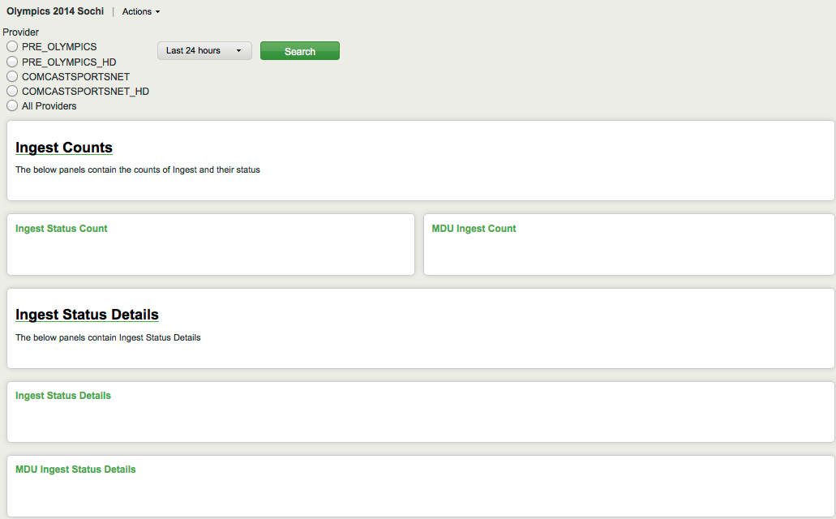
Ingesting Data from Sochi

Slide 22
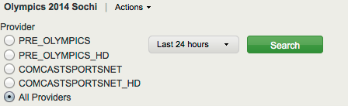
Working with Multiple Providers for Sports Programming

Slide 23
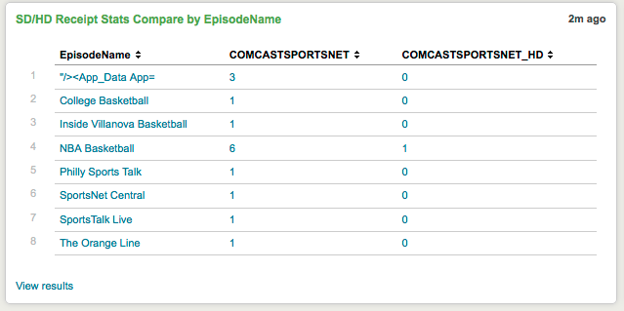
High-Definition and Standard-Definition Content Receipt Status

Slide 24
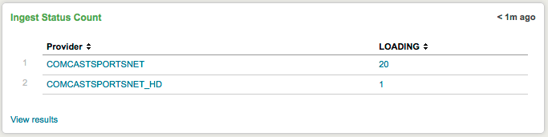
Ingest Tracking

Slide 25
Demos
Notes:
How we use scripted inputs, logs, API to enrich the logs to bring many realtime sources into a single view.
Python to ETL into time series (SPDB) for enterprise dashboard ( Invite for splunk to blown up on Dashboards and such)

Slide 26







The Nouns
Splunk Forwarders
Flume ( Kafka)
Hadoop / Hive
scripted inputs / outputs
ETL to time series > Charts > wikis = dashboards
API mining

Slide 27
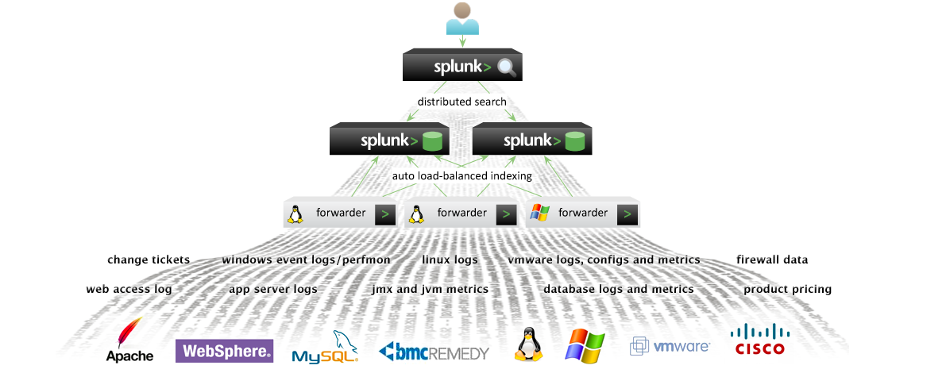
Turn Diverse Raw Unstructured Data into Operational Intelligence

Slide 28
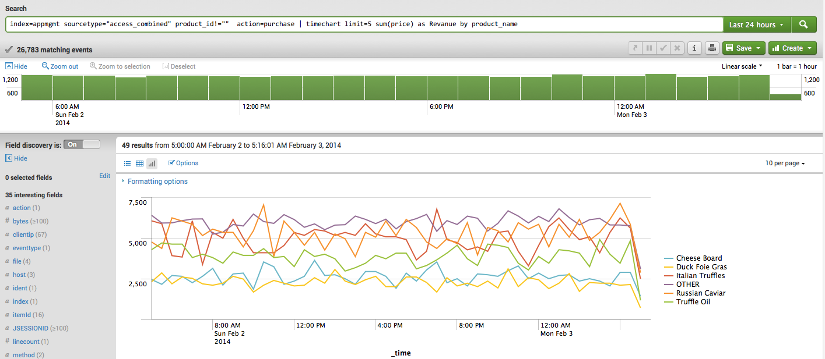
Search Commands and Graphing

Slide 29
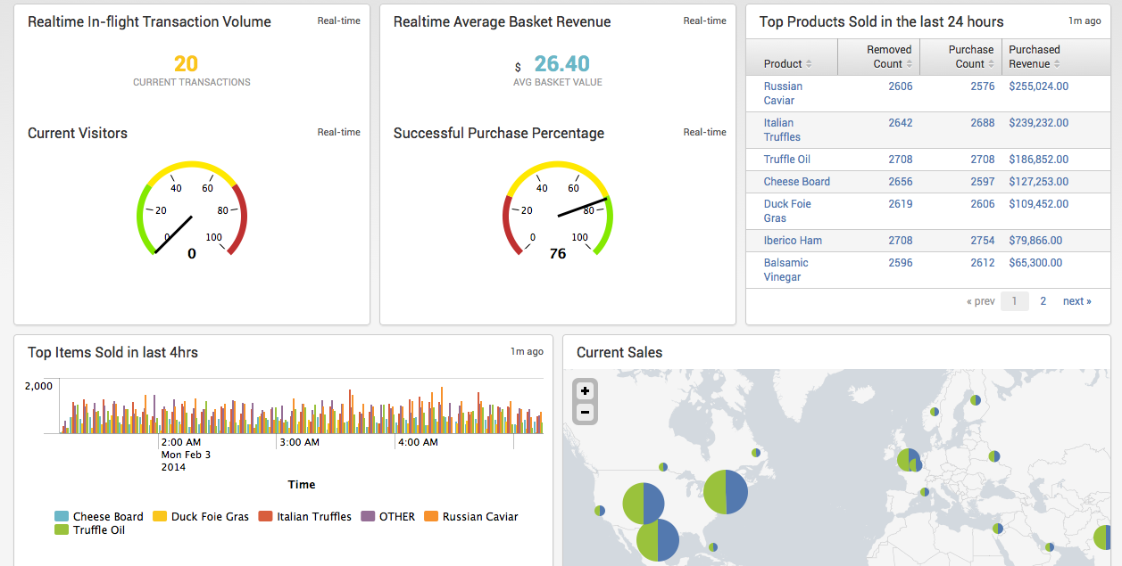
Operational Dashboards
29
How Comcast Turns Big Data Into Real-Time Operational Insights | Strata | February 2014

Slide 30
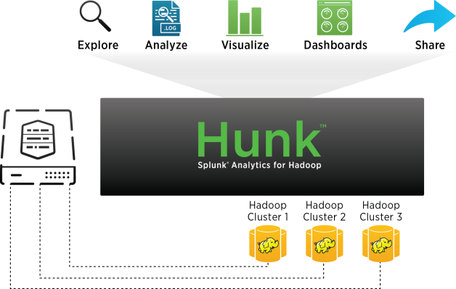
Be a Data Hunk

Slide 31
Hunk Mixed-Mode Search
Streaming
Reporting
Transfers first several blocks from HDFS to the Hunk Search Head for immediate processing
Pushes computation to the DataNodes and TaskTrackers for the complete search
Hunk starts the streaming and reporting modes concurrently
Streaming results show until the reporting results come in
Allows users to search interactively by pausing and refining queries
Notes:
Hunk starts the streaming and reporting modes concurrently. Streaming results show until the reporting results come in. Allows users to search interactively by pausing and refining queries.
This is a major, unique advantage of Hunk compared to alternative approaches such as Hive or SQL on Hadoop which require fixed schema in an effort to speed up searches, while Hunk retains the combination of schema on the fly with results preview.

Slide 32
Hunk Data Processing Pipeline
stdin
Raw data
(HDFS)
Custom processing
Indexing pipeline
Search pipeline
You can plug in
data preprocessors
e.g. Apache Avro or format readers
Event breaking
Timestamping
Event typing
Lookups
Tagging
Search processors
MapReduce/Java
splunkd/C++
Notes:
Before data is processed by Hunk you can plug in your own data preprocessor. The preprocessors have to be written in Java and can transform the data in some way before Hunk gets a chance to. Data preprocessors can vary in complexity from simple translators (say Avro to JSON) to as complex as doing image/video/document processing.
Hunk translates Avro to JSON. These translations happen on the fly and are not persisted.

Slide 33
Demos
Notes:
How we use scripted inputs, logs, API to enrich the logs to bring many realtime sources into a single view.
Python to ETL into time series (SPDB) for enterprise dashboard ( Invite for splunk to blown up on Dashboards and such)

Slide 34
Costs/ Benefit
MTTR
Automation
Reduction in skillset
Fewer admins
More SME
Notes:
Mean time to relief – how fast can you get the event to RSA and “fixed”
Automation – Detect and resolve events in realtime
More from Devin and Chris
I like d3, python, php, django. MapR makes a great product, Hadoop is a live saver. The mapR team is 10 people. The Analytics team is 8. So on. We are one and its disarmed self serve. As in I keep them hurting themselves.
Fewer admin see above
The teams self serve so its “train the trainer” and delegate roles and rights

Slide 35
National Engineering
& Technical Operations

