Slide 1



How Companies are Using Spark
And where the Edge in Big Data will be
Matei Zaharia
Notes:
Cost of 1 TB of disk

Slide 2
History
Decreasing storage costs have led to an explosion of big data
Commodity cluster software, like Hadoop, has made it 10-20x cheaper to store large datasets
Broadly available from multiple vendors

Slide 3
Implication
Big data storage is becoming commoditized, so how will organizations get an edge?
What matters now is what you can do with the data.

Slide 4
Two Factors
Speed: how quickly can you go from data to decisions?
Sophistication: can you run the best algorithms on the data?
These factors have usually required separate, non-commodity tools

Slide 5
Apache Spark
A compute engine for Hadoop data that is:
Fast: up to 100x faster than MapReduce
SQL performance
Response time (s)

Slide 6
Apache Spark
A compute engine for Hadoop data that is:
Fast: up to 100x faster than MapReduce
Sophisticated: can run today’s most advanced algorithms
Shark
SQL
Spark Streaming real-time
MLlib
machine learning
GraphX
graph
…
Apache Spark

Slide 7


Apache Spark
A compute engine for Hadoop data that is:
Fast: up to 100x faster than MapReduce
Sophisticated: can run today’s most advanced algorithms
Fully open source: one of most active projects in big data
Contributors in past year

Slide 8
Apache Spark
A compute engine for Hadoop data that is:
Fast: up to 100x faster than MapReduce
Sophisticated: can run today’s most advanced algorithms
Fully open source: one of most active projects in big data
Contributors in past year
Spark brings top-end data analysis to commodity Hadoop clusters

Slide 9
Spark Use Cases

Slide 10
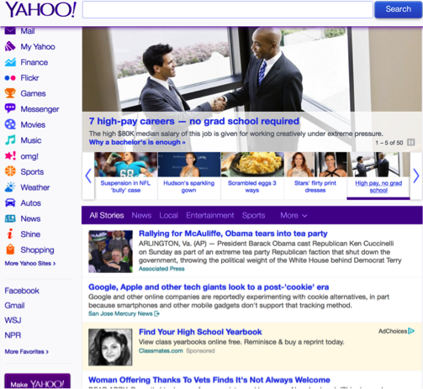
1. Yahoo! Personalization
Yahoo! properties are highly personalized to maximize relevance
Reaction must be fast, as stories, etc change in time
Best algorithms are highly sophisticated

Slide 11
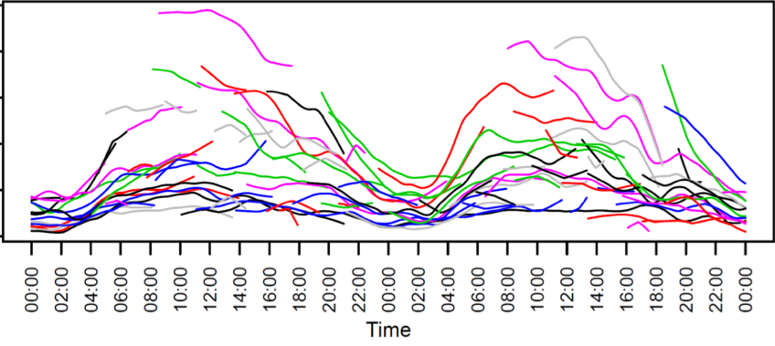
1. Yahoo! Personalization
Example challenge: relevance of news stories
Relevance models must be updated throughout the day
Notes:
Throughout the day

Slide 12

1. Yahoo! Personalization
Spark at Yahoo!
Runs in Hadoop YARN to use existing data & clusters
Result: pilot for stream ads
120 lines in Scala, compared to 15K in C++
30 min to run on 100 million samples
Hadoop: Batch Processing
Spark:
Iterative
Processing
…
YARN:
Resource Manager
Storage:
HDFS, HBase, etc
Major contributor on YARN support, scalability, operations

Slide 13
2. Yahoo! Ad Analytics
Yahoo! Ads wanted interactive BI on terabytes of data
Chose Shark (Hive on Spark) to provide this through standard Hive server API + Tableau
Result: interactive-speed queries on terabytes from Tableau
Large Hadoop Cluster
Hadoop MR (Pig, Hive, MR)
Spark
YARN
Historical DW (HDFS)
Major contributor on columnar compression, statistics, JDBC
Satellite Shark Cluster
Satellite Shark Cluster

Slide 14



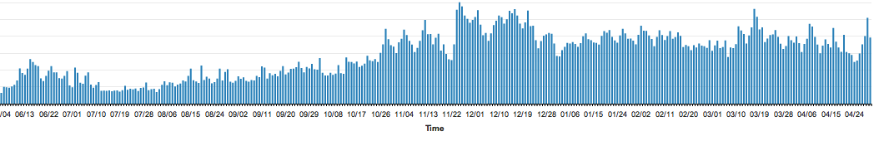

3. Conviva Real-Time Video Optimization
Conviva manages 4+ billion video streams per month
Dynamically selects sources to optimize quality
Time is critical: 1 second buffering = lost viewers

Slide 15



3. Conviva Real-Time Video Optimization
Using Spark Streaming, Conviva learns network conditions in real time
Results fed directly to video players to optimize streams
System running in production
Spark Node
Spark
Node
Spark Node
Spark Node
Spark Node
Storage Layer
Decision Maker
Decision Maker
Decision Maker

Slide 16
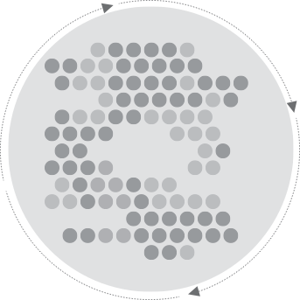
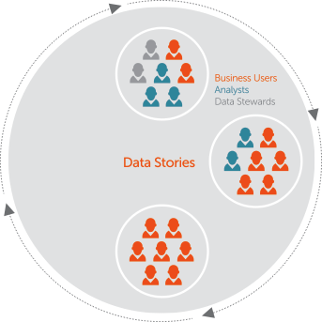
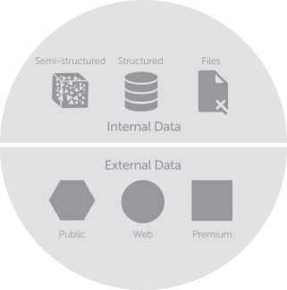

4. ClearStory Data: Multi-source, Fast-cycle Analysis
Same-day results from data updating at disparate sources
Dozens of disparate sources converged in seconds/minutes
Data Sources
ClearStory Platform
ClearStory Application
Harmonization
Data Inference & Profiling
In-Memory
Data Units
Visualization
Collaboration
clearstorydata.com

Slide 17
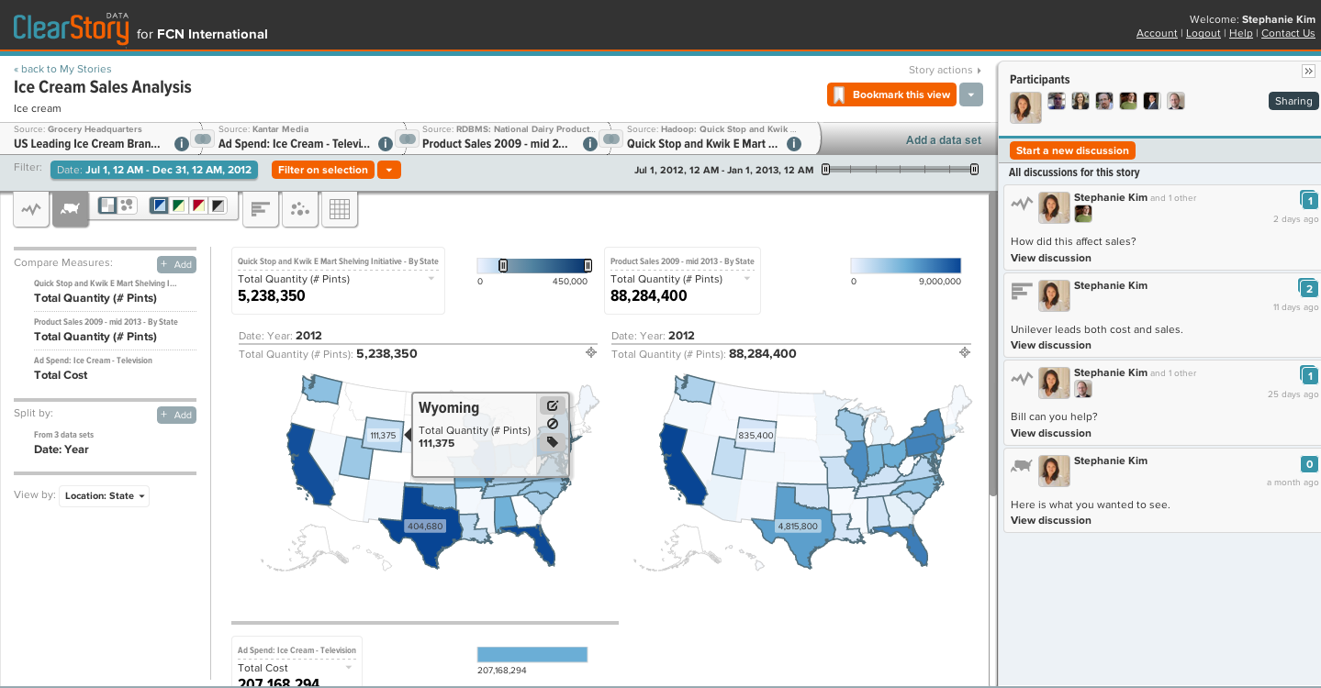
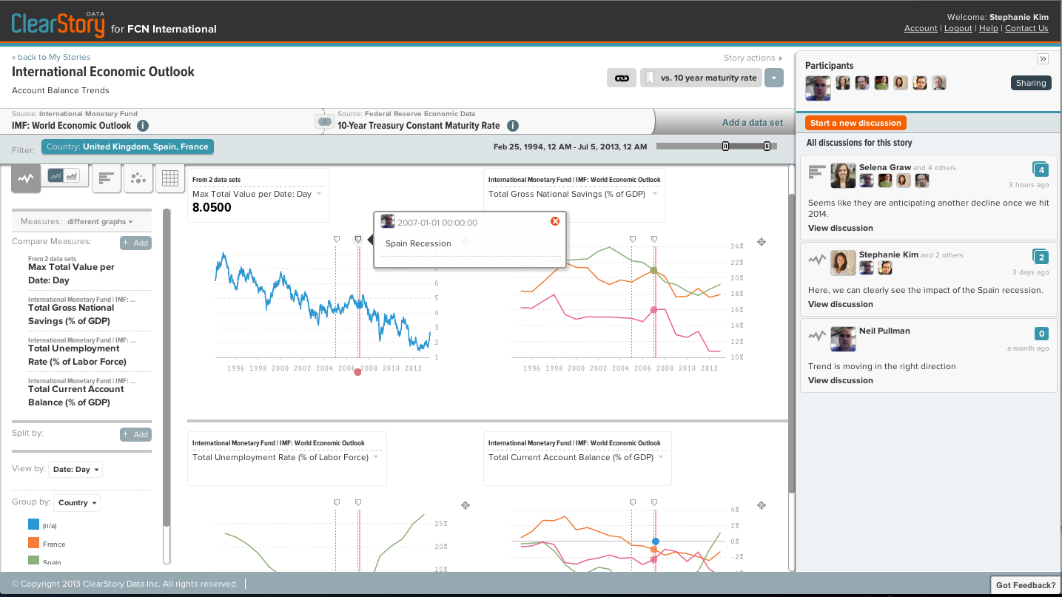

4. ClearStory Data: Multi-source, Fast-cycle Analysis

Slide 18

Get Started
Download and resources: spark.incubator.apache.org
Free video tutorials: spark-summit.org/2013
Commercial support:
+

Slide 19
Conclusion
Big data will be standard: everyone will have it
Organizations will gain an edge through speed of action and sophistication of analysis
Apache Spark brings these to Hadoop clusters

