Slide 1
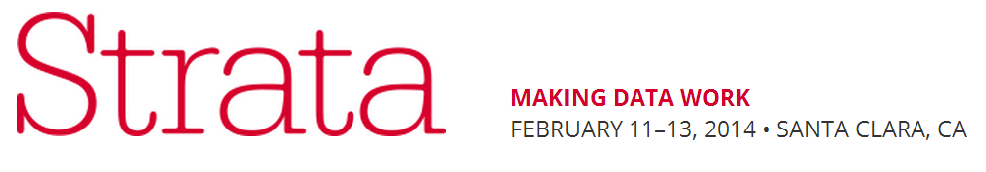
Leveraging Value from Open Data Through Collaboration
A Local Government Practitioner's Guide to Making It Happen
February 11, 2014
Peter Pirnejad
Development Services Director
City of Palo Alto
Notes:
Title Page
Calibri Font
No more than 3 lines
No smaller than 28 point font

Slide 2
MORE
Collaboration
Players
Informal
No. of Actors
Globalization
Organic Structure
Proximity-Less
Network
Governance
“Mass
Collaborative
Governance”
Peter Pirnejad (2014)
Contract
Cities
Public / Private
Partnerships
1950
1980
2010
Notes:
Title Page
Calibri Font
No more than 3 lines
No smaller than 28 point font

Slide 3
Agency Needs
Continuous
Collaboration
Improve and/or
Pivot
OPEN DATA
Stakeholder Interests
Notes:
Title Page
Calibri Font
No more than 3 lines
No smaller than 28 point font

Slide 4
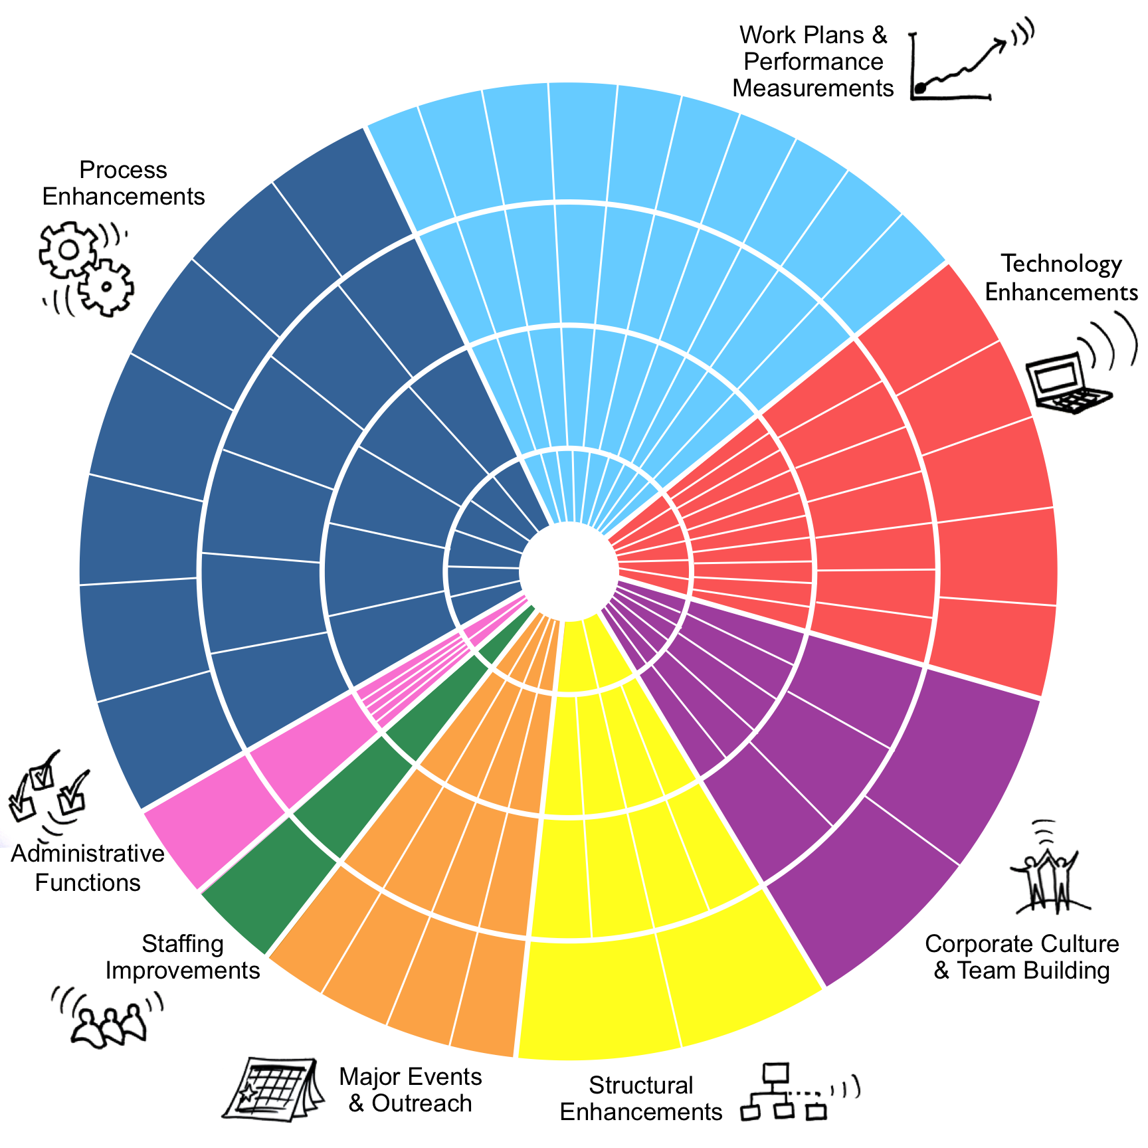

Slide 5
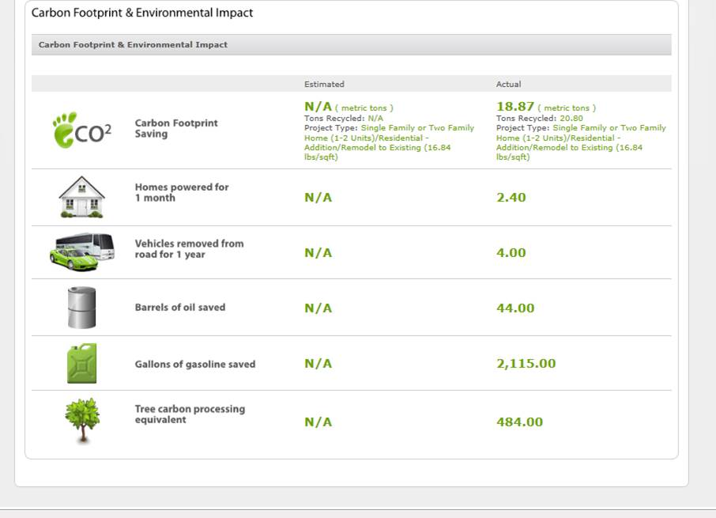

Slide 6
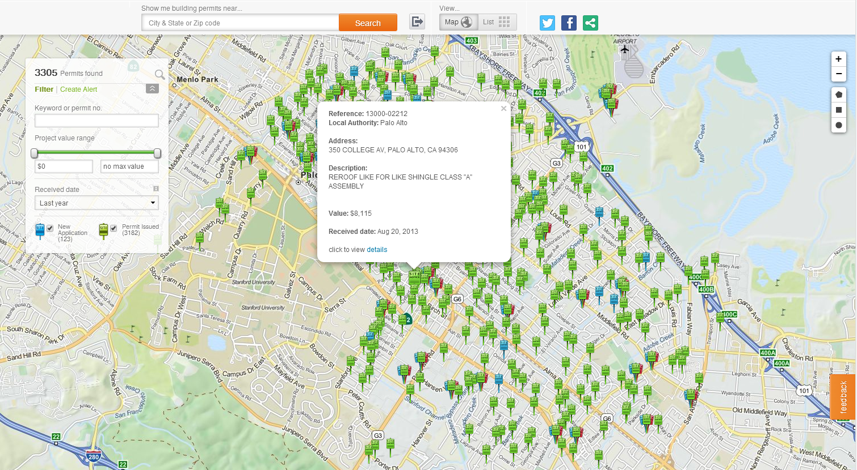

Slide 7
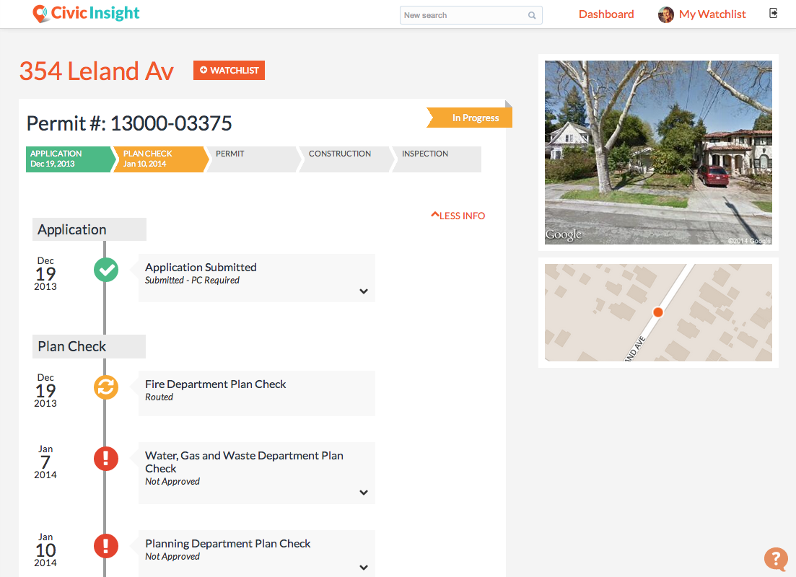

Slide 8
Peter Pirnejad
Development Services Department
City of Palo Alto
Peter.pirnejad@cityofpaloalto.org
Notes:
Title Page
Calibri Font
No more than 3 lines
No smaller than 28 point font

