Slide 1
OPEN DATA: IT’s NOT JUST FOR GOVernments Special Valentine’s Week Edition Jen van der Meer
STRATA SANTA CLARA 2014
MAKING DATA WORK | DATA DRIVEN BUSINESS DAY

Slide 2
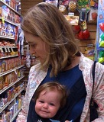







Jen van der Meer
@jenvandermeer

Slide 3
1
GOVs
OPEN DATA
BE MINE
@JENVANDERMEER

Slide 4
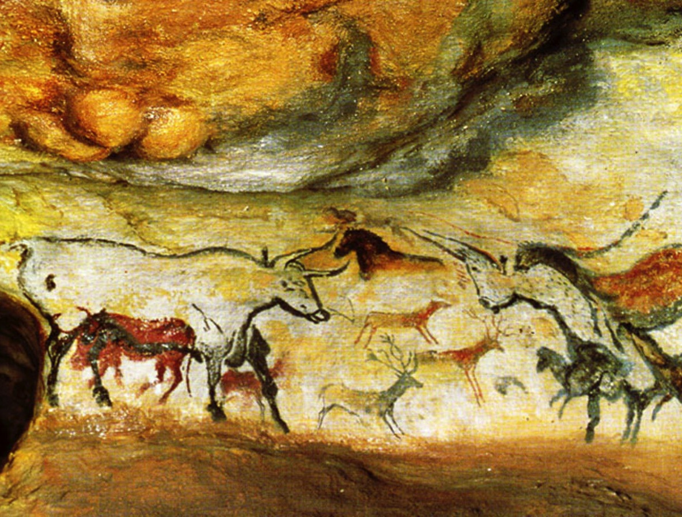
FIRST CAME THIS
Notes:
http://b.vimeocdn.com/ts/282/554/282554226_1280.jpg
Lascaux cave paintings in southwestern France depicted hunting scenes and, as some later analysts suggests, early attempts at star charts. Were they in some ways data for public consumption, or only private advantage, or were they simply a colourful expression of experience?

Slide 5

THEN THIS
Notes:
http://static.ddmcdn.com/gif/storymaker-cave-paintings-artists-1111160-514x268.jpg
Cueva de las Manos

Slide 6

THEN THIS
Notes:
http://i-cias.com/e.o/slides/cuneiform01.jpg
Sumerian writing was established in Mesopotamia around 3500BC, and, alongside Egyptian hieroglyphics in the same period, began to record all kinds of data from government taxes to schooling and religious rites.

Slide 7
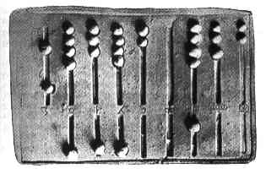
AND THIS

Slide 8
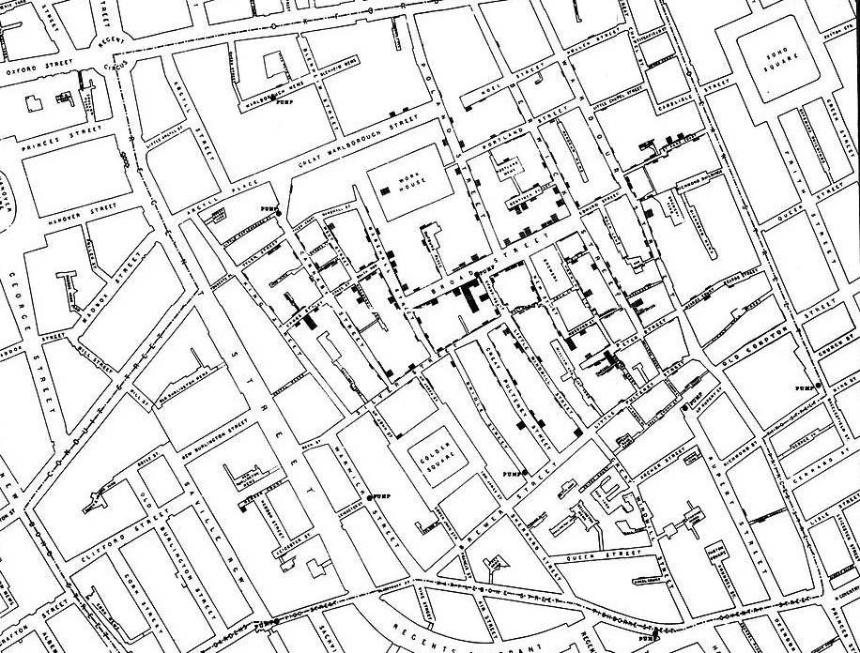
THEN THESE DOTS
Notes:
Dr. John Snow: 1854 Major event in the history of pubic health and georgraphy and a founding moment in epidemiology - used a dot map to illustrate the cluster of cholera cases around the pump. He used stats to illustrate the connection between the quality of the water source and cholera cases, showing that that Southwark and Vauxhall Waterworks Company was taking water from sewage-polluted sections ofthe Thames and delivering the water to homes, leading to an increased incidence of cholera.

Slide 9
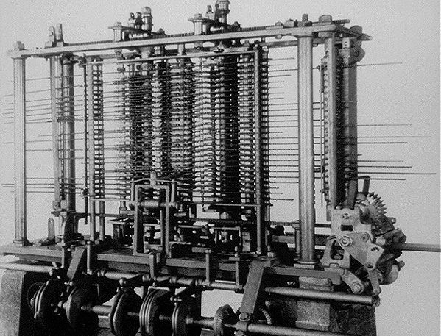
THEN THIS!
IT ISN’T STRATA UNTIL SOMEONE SHOWS YOU THE BABBAGE ENGINE
Notes:
https://www.msu.edu/course/lbs/126/lectures/images/babbage.jpg

Slide 10
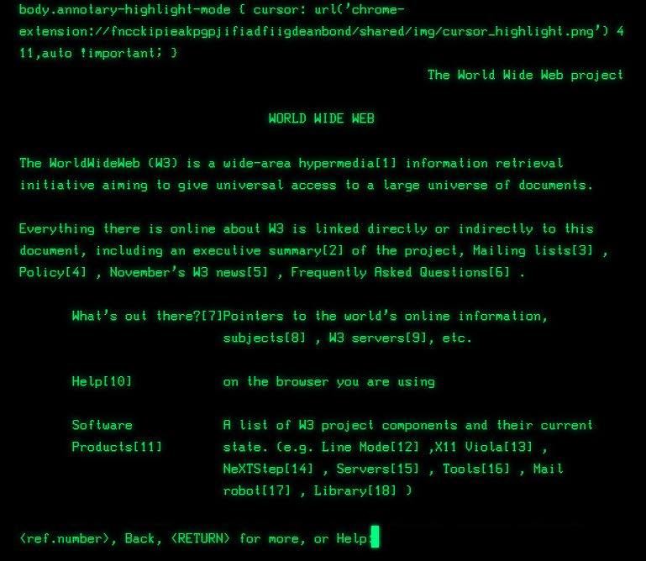
LATER, THIS:
Notes:
https://www.msu.edu/course/lbs/126/lectures/images/babbage.jpg

Slide 11
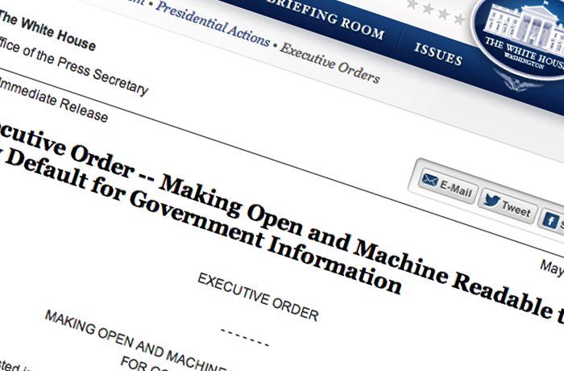
WHICH MADE THIS POSSIBLE

Slide 12
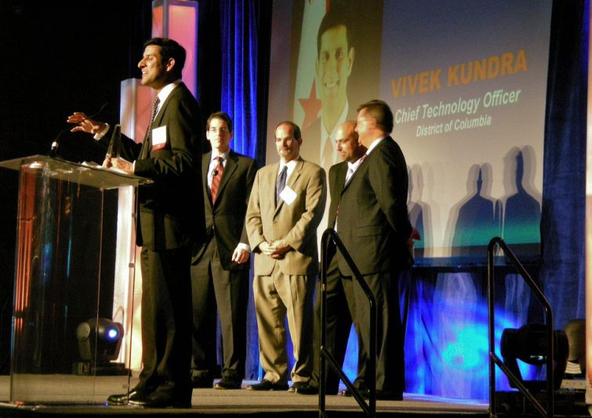
AND LET’S NOT FORGET WHAT A BIG DEAL THIS WAS
Notes:
http://observer.com/2009/06/vivek-kundra-at-pdf-help-us-build-the-future-of-federal-technology/

Slide 13
“Sunlight is said to be the best of disinfectants.”
President Barack Obama, quoting Louis Brandeis, on signing the Freedom of Information Act memo to make open and machine readable the default setting for government.
Notes:
Ensuring openness and transparency
Lowering the cost of government
Cybersecurity
Participatory democracy
Innovation[27]

Slide 14
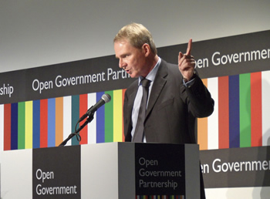
THEN, FIRST TO THE PARTY, NOW BACK AGAIN
Notes:
http://gov20radio.com/2012/10/launching-odi/
UK-based incubator and promoter of open-data businesses
Using open-source or open-data principles as building blocks for a business is not exactly a new idea; but as big data — and the ability to harness and use it — continues to grow in prominence, so will the need to ensure that data remains a resource for all and not become a proprietary commodity. Backing businesses that follow this principle is an essential part of that philosophy, the idea being that open data businesses will breed more open data businesses.

Slide 15
2
WE DO NOT
CLOSED DATA
@JENVANDERMEER

Slide 16
SUPPLY SIDE OF OPEN DATA
DEMAND SIDE OF OPEN DATA
And back again
Notes:
building the supply side; building capability and empowerment; developing a demand side
Calling for “a real forensic commitment to open data”, he explores new economic models needed around open data as well as the need to better understand where and knowing how the value is being generated.

Slide 17
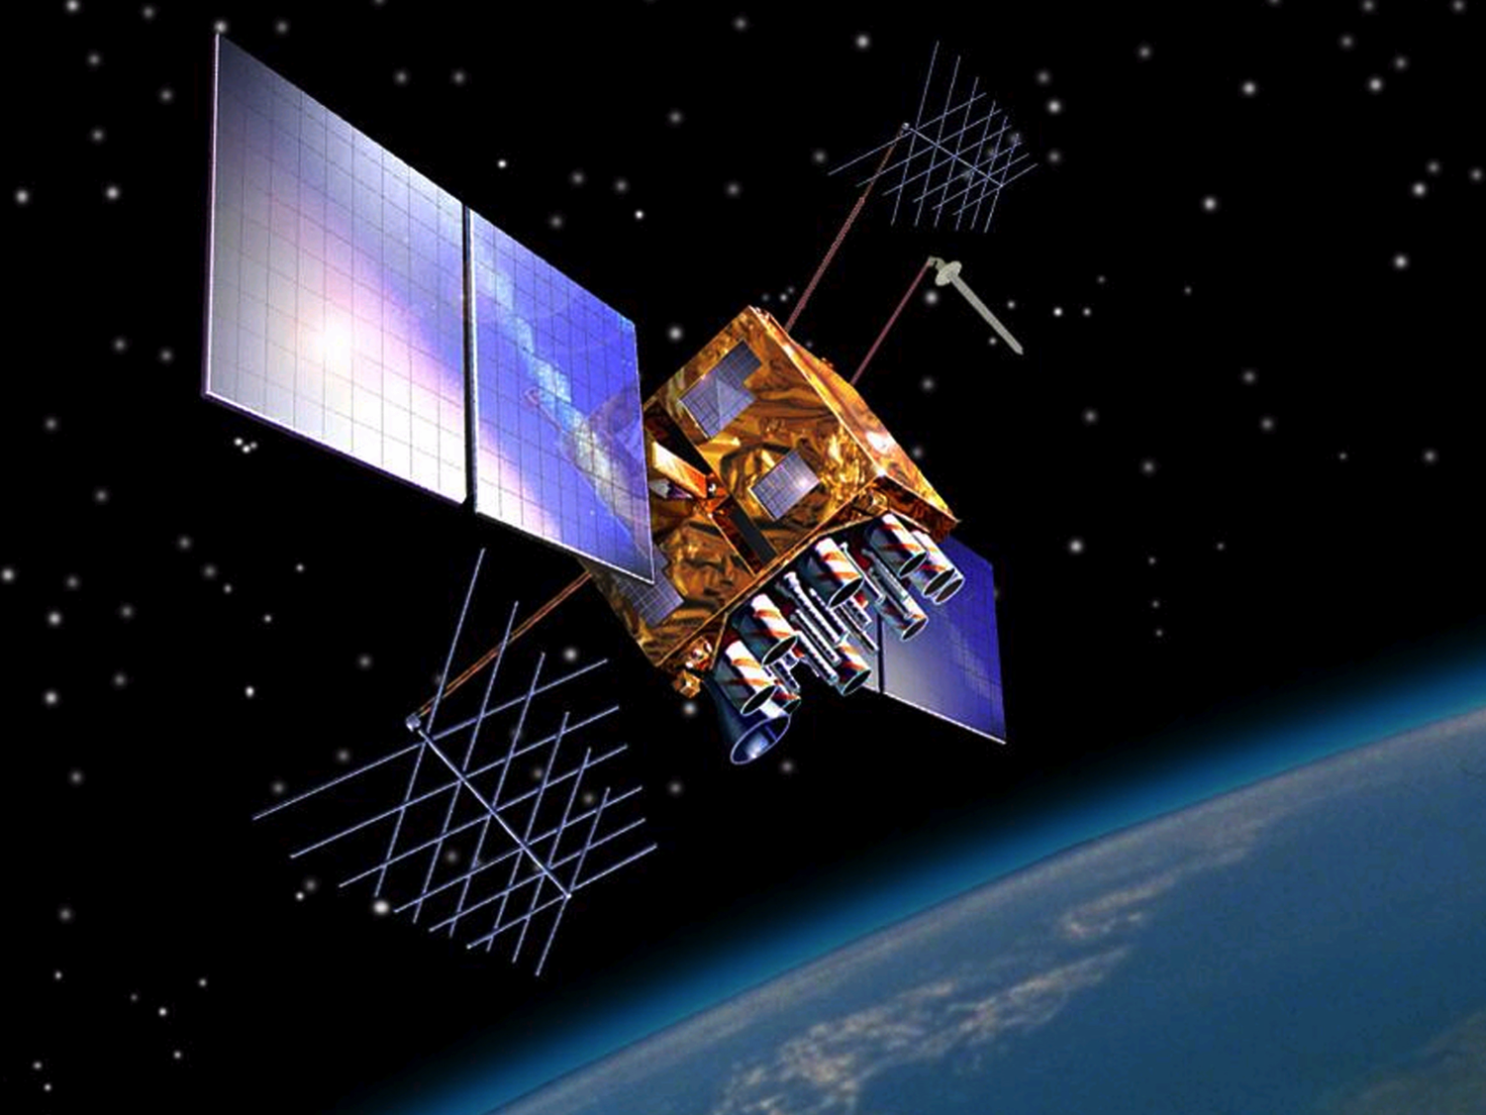
SUPPLY SIDE OF OPEN DATA: GPS
Notes:
Prior to the 1980s GPS data was mostly relegated to military and government organizations. It wasn't until 1983 and the release of GPS data to the public that consumer mapping technology really began to take shape.

Slide 18
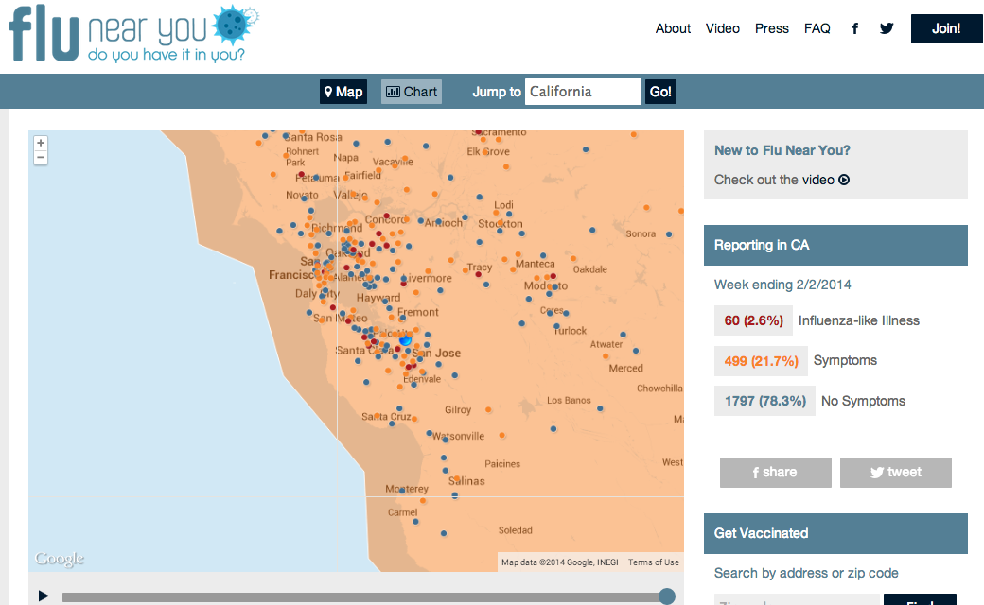
DEMAND SIDE: FLU
Notes:
Tracking the flu -- there's an app for that!
It's a crowd sourced system, driven by an expanding army of volunteers and their Internet devices.
"We want the public to volunteer this information as a global good, and then we're providing this data to help answer some of these questions of science, but also to help public health authorities," Smolinski explains.
Related Content
LINK: Flu Near You app
Each week, users receive an email that asks them to submit a flu report. With a push of a button they can report any symptoms or not. In exchange for providing their information, users can monitor flu activity in their area, and even receive customized alerts as new cases are being reported.
http://abclocal.go.com/kgo/story?id=9358784

Slide 19
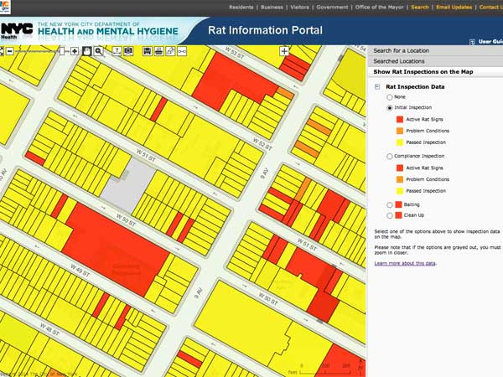
DEMAND SIDE: RATS
Notes:
http://www.itworld.com/big-data/401196/rats-open-data-tells-new-york-city-residents-where-vermin-are-and-aren-t
The Big Apple’s Rat Information Portal

Slide 20
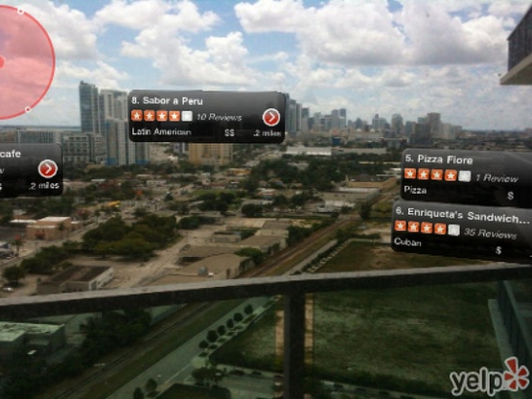
DEMAND SIDE: YELP
Notes:
FOODIES AND OPEN DATA ENTHUSIASTS REJOICE
http://www.codeforamerica.org/2013/01/17/foodies-and-open-data-enthusiasts-rejoice/

Slide 21
OPEN DATA HAS ECONOMIC, NOT JUST SOCIETAL BENEFITS
“Making data more “liquid” (open, widely available, and in sharable formats) has the potential to unlock large amounts of economic value, by improving the efficiency and effectiveness of existing processes; making possible new products, services and markets; and creating value for individual consumers and citizens.”
“An estimated $3 trillion in annual economic potential.”
McKinsey Global Institute Open Data 2013

Slide 22
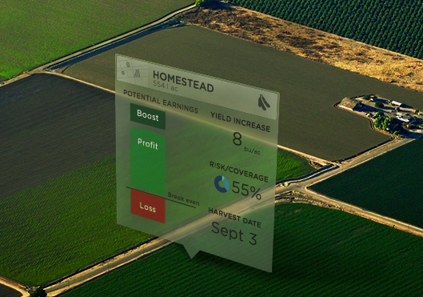
DEMAND SIDE OF OPEN DATA: INSURANCE
Notes:
The Climate Corporation is quite a remarkable example—they began as a company selling weather insurance but in order to do that well, they had to go so far into the data they now understand agriculture and can help improve the viability of farmed crops. Recently purchased by Monsanto for approx. 1$ Bn.

Slide 23
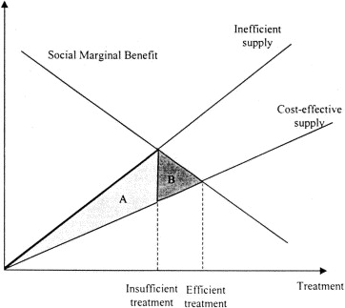
OPEN DATA IS A POSITIVE EXTERNALITY
CLOSED DATA IS A NEGATIVE EXTERNALITY
Notes:
A negative externality occurs when an individual or firm making a decision does not have to pay the full cost of the decision. If a good has a negative externality, then the cost to society is greater than the cost the customer is paying for it.
Since consumers make a decision based on where their marginal cost equals their marginal benefit, and since they don't take into account the cost of the negative externality, negative externalities result in market inefficiencies unless proper action is taken.
When a negative externality exists in an unregulated market, producers don't take responsibility for external costs that exist--these are passed on to society. Thus producers have lower marginal costs than they would otherwise have and the supply curve is effectively shifted down (to the right) of the supply curve that society faces. Because the supply curve is increased, more of the product is bought than the efficient amount--that is, too much of the product is produced and sold. Since marginal benefit is not equal to marginal cost, a deadweight welfare loss results.
WHAT IS THE THE VALUE OF UNDERLYING DATA IN A COMPLEX ADAPTIVE SYSTEM?

Slide 24
BUT CLOSED DATA IS SOMETHING TO GET MAD ABOUT
Slower science
Fewer medical breakthroughs
More money chasing programs that do not work, but we do not know it yet
Continued failure for all of us to understand the negative consequences that one actor incurs that we all pay
Notes:
Diversity of Interactions matter more than the size of the data.

Slide 25
ASK NOT WHAT OPEN DATA CAN DO FOR YOU

Slide 26
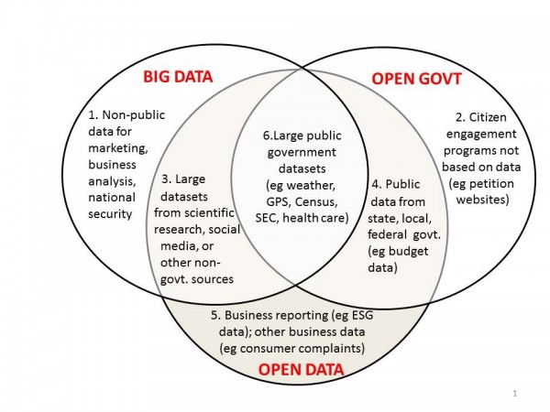
OPEN DATA: IT’S FOR BUSINESS TOO
Joel Gurin, NYUGovLab : Open Data Now
Notes:
http://www.opendatanow.com/about-joel-gurin/

Slide 27
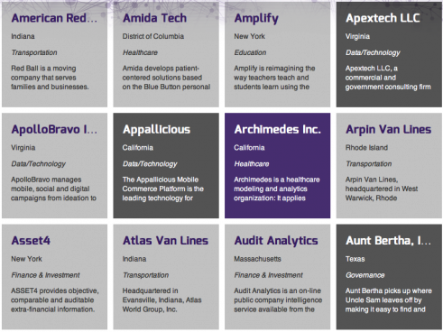
OPEN DATA 500
OPEN DATA 500 – NYUGOVLAB
Notes:
http://www.opendata500.com/

Slide 28
ASK WHAT YOU CAN DO FOR OPEN DATA

Slide 29
3
SHOW THE :
A CALL TO
PUBLIC SOURCE
@JENVANDERMEER

Slide 30
PUBLIC SOURCE: IT’S JUST BETTER
Accessible, Interoperable, Liquid
Closed
Open
Available
to some
Available
to some
Available to all
At cost
Maybe free
For free
Not sharable
Sometimes sharable
Unlimited use

Slide 31
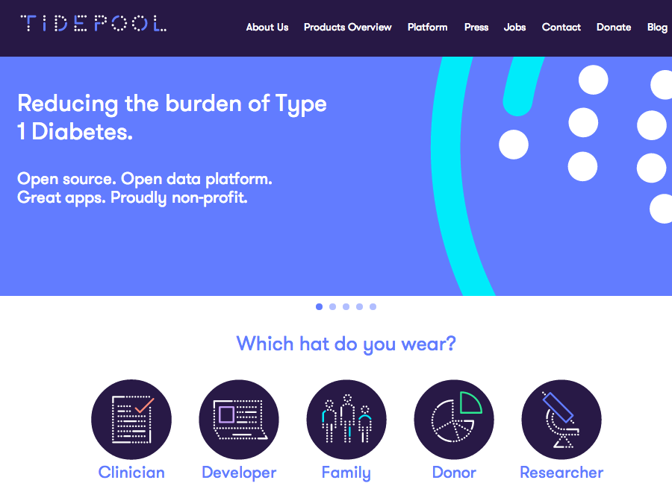
DOES IT HAVE TO BE .ORG?
Notes:
www.tidepool.org

Slide 32
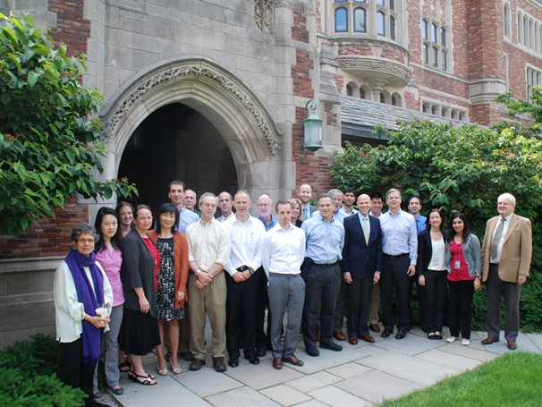
WILL .EDU BE THE KEEPER OF PRIVATE SECTOR OPEN DATA?
Yale University Open Data Access (YODA) Project: With J&J, Medtronic
Notes:
Yale University Open Data Access (YODA) Project
Center for Outcomes Research & Evaluation (CORE)
http://www.rsc.org/chemistryworld/2014/02/jj-trial-data-independent-hands
evertheless, Krumholz stresses that YODA’s advantage lies in its credibility as an independent body that will not impede access to data, but will ensure its responsible use. ‘People should follow a process, putting in proposals, getting feedback, having proposals posted online, having user identities, funding, conflicts of interest shown,’ he asserts. ‘We have to track the experience with this and what insights are produced.’
http://www.nytimes.com/2014/02/03/opinion/give-the-data-to-the-people.html?_r=3
In 2011, YODA struck a deal with Medtronic to release all the data on one of its products — a device that stimulates the production of bone. At the time, questions had been raised about the device’s safety, including whether it caused cancer, and about the conflicts of interests of some of the company’s researchers. Medtronic made the unusual decision to respond to the debate by releasing the device’s data for independent review. We commissioned and then published two independent reviews of the data, and now have made them globally available.
http://recode.net/2014/02/01/microsoft-adds-momentum-to-open-science/
Momentum continues to build behind the “open science movement,” propelling the debate over publication of scholarly works and the scientific process itself.
Last week, Microsoft Research announced it was adopting a policy that allows it to retain a license for research submitted to conferences or publishers in order to post it to a freely accessible online site as well.

Slide 33
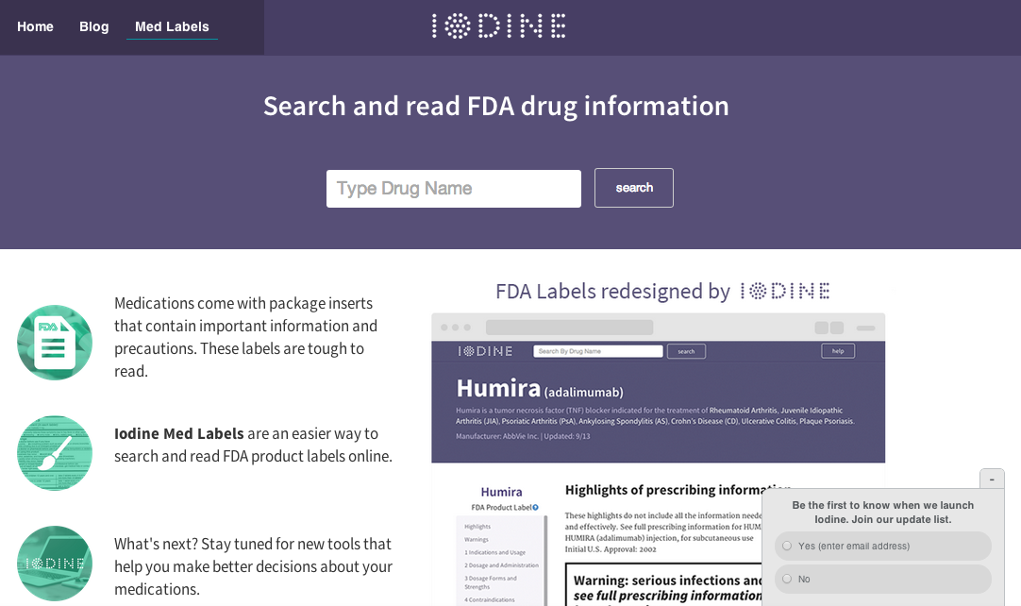
WILL THE NEW BREED OF OPEN STARTUPS SHOW THE WAY?
University Open Data Access (YODA) Project: With J&J, Medtronic, Microsoft
DISCLOSURE: Luminary Labs Ventures is an angel investor in Iodine
Notes:
Iodine combines large healthcare datasets with a user's individual needs and background to create a personalized resource for better understanding

Slide 34

WILL PUBLIC PRIVATE PARNTERSHIPS REIGN?
Drug Companies Join NIH in Study of Alzheimer's, Diabetes, Rheumatoid Arthritis, Lupus, taking a page from the Open Source Movement
Notes:
http://rack.1.mshcdn.com/media/ZgkyMDE0LzAyLzAyLzc2L1BTSnNzMy4xNDI4Mi5qcGcKcAl0aHVtYgk1NzV4MzIzIwplCWpwZw/7d821f93/d9f/PSJss3.jpg
http://online.wsj.com/news/articles/SB10001424052702303519404579353442155924498
Ten rivals join with NIH to search for new drugs
Under a five-year collaboration to be announced on Tuesday, the companies and the National Institutes of Health have agreed to share scientists, tissue and blood samples, and data. They aim to decipher the biology behind Alzheimer's, Type 2 diabetes, rheumatoid arthritis and lupus, and to thereby identify targets for new drugs.
Deciphering them "could not be done by any single organization. Even the NIH, with all of its might, doesn't have all of the solutions inside it. And no one company can do it."
The pact also marks a new stage in the industry's evolution toward openness. In recent years, companies have become more willing to share resources in research pacts with government and academic labs—and with one another—on specific diseases. Most pacts, however, give the participants any rights to findings, rather than making them open to anyone as the new NIH project does.
Taking a page from the "open-source" movement that has swept the software world, the group will share all findings with the public, for anyone to use freely to conduct their own experiments.

Slide 35
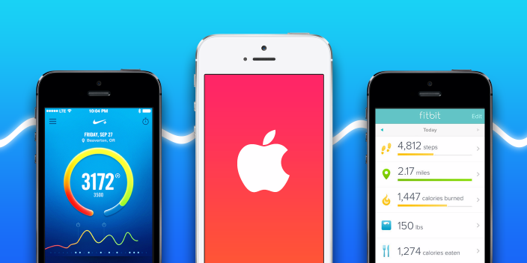
OR WILL APPLE SAVE US FROM OURSELVES?
WILL APPLE TEMPT US WITH PERSUASIVE BUT CLOSED DATAVIZ?
Drug Companies Join NIH in Study of Alzheimer's, Diabetes, Rheumatoid Arthritis, Lupus, taking a page from the Open Source Movement
Notes:
http://9to5mac.com/2014/01/31/iwatch-ios-8-apple-sets-out-to-redefine-mobile-health-fitness-tracking/
Besides fitness tracking, a marquee feature of “Healthbook” will be the ability to monitor a user’s vital signs.
The application will be able to track a person’s blood pressure, hydration levels, heart rate, and potentially several other blood-related data points, such as glucose levels, according to our sources.

Slide 36
“To to my mind, the big question is not what Healthbook will look like but whether Apple will make it easy to get our data out of it. If they do, this will be a massive game changer for the quantified self, health, and wellness markets.”
Fred Wilson, AVC.com
Notes:
http://www.avc.com/a_vc/2014/02/ios8-health-data-and-open-data.html

Slide 37
WHEN WE FINALLY HAVE OPEN DATA, WILL WE SEE EVERYTHING INTERCONNECTED?

Slide 38
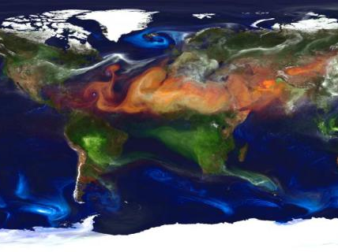
Notes:
http://www.fastcoexist.com/3025392/watch-60-years-of-climate-change-in-15-seconds

Slide 39
“He had shown her all the workings of his soul, mistaking this for love.”
= EM Forster, The Longest Journey

Slide 40
WHAT TO DO
1
Civically hack
2
Publicly source
3
Start an open data company HealthDataChallenges.com
@JENVANDERMEER | @LuminaryLabs | @HDChallenges

