Slide 1

Sensing Best Practices
Ben Waber

Slide 2
“You can’t manage what you can’t measure”
– Peter Drucker
Notes:
Motivation
Here’s how we measure it
Here’s how Deloitte is using it
Here’s all the stuff we can do

Slide 3
Largely unsolved for people

Slide 4

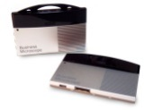
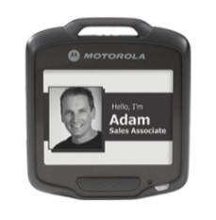

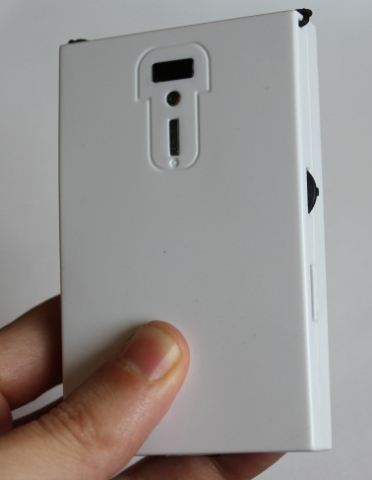


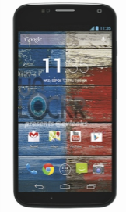
Approach
analytics

Slide 5
A Regular Day

Slide 6


Slide 7


Slide 8


Slide 9
Generating Data

Slide 10
Speaking Time

Slide 11
Turn Taking

Slide 12
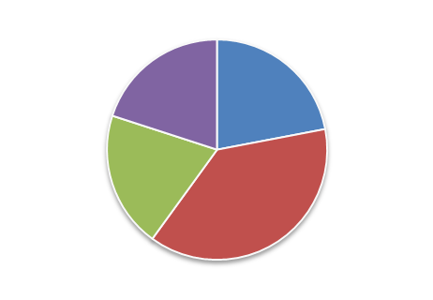
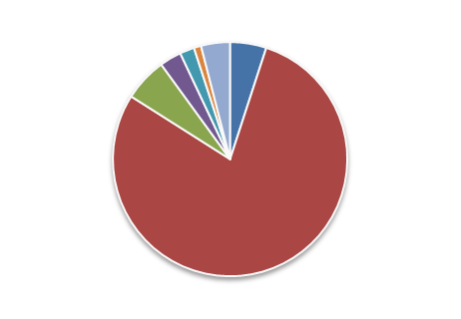
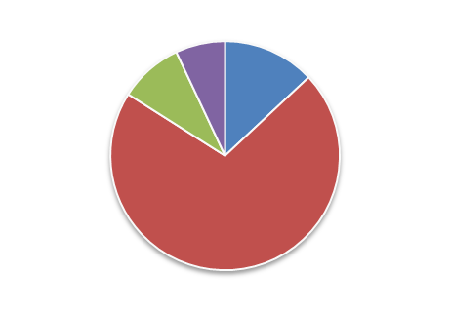
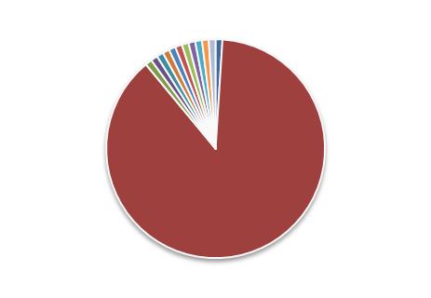
Interactivity
38%
79%
71%
88%

Slide 13
Posture
30◦

Slide 14

Energy Level
30◦
9 AM
10 AM
11 AM
12 PM
1 PM
2 PM

Slide 15

Digital Data
30◦
9 AM
10 AM
11 AM
12 PM
1 PM
2 PM

Slide 16
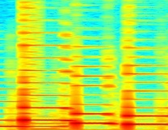

Tone of Voice

Slide 17
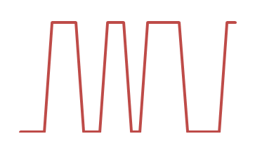

Speaking Speed

Slide 18
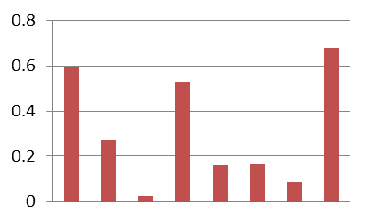
Volume

Slide 19
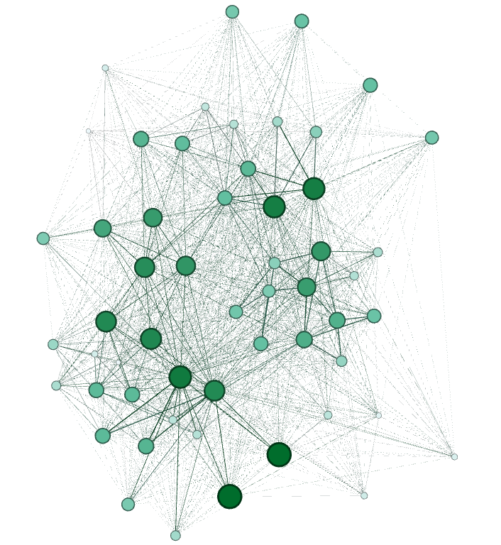
Organizations

Slide 20
Sociometric Badge
Microphone
Infra-Red (IR) Transceiver
Accelerometer
Bluetooth

Slide 21
A/B Test Everything

Slide 22


Slide 23


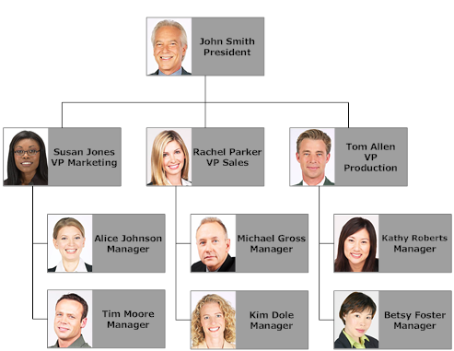

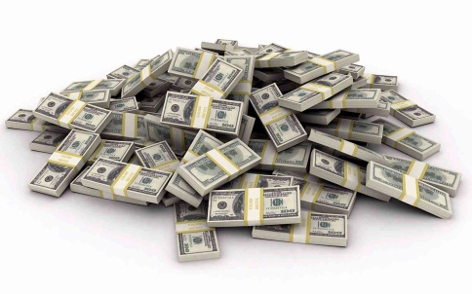
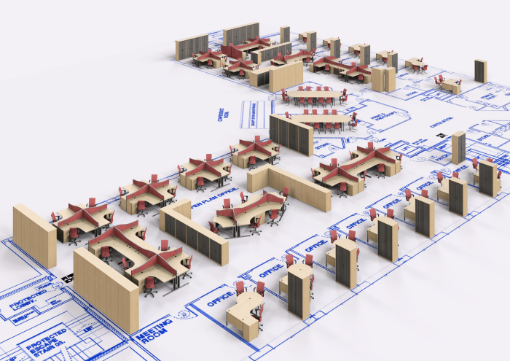

Slide 24
Case Study

Slide 25
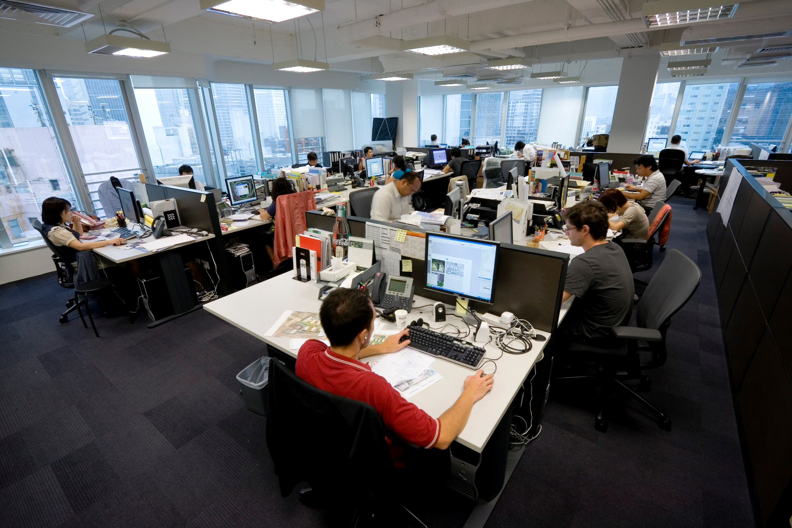

Slide 26
Energy
Notes:
Quantity represents the absolute difference in average energy level over all participants before and after the workspace redesign. The change in each time block was negative.
Energy has been related to health and creativity.

Slide 27
Engagement
Notes:
Data is the betweenness centrality of the f2f network before and after the redesign.
The employee network is less tightly-knit.

Slide 28
Exploration
Notes:
Percentage of participants with fixed location decreased from 90% (56) before to 57% (39) after redesign.
This result is for people who were assigned a desk in phase 1, but not in phase 2.

Slide 29
Perspectives

Slide 30
Remote Work

Slide 31


Slide 32
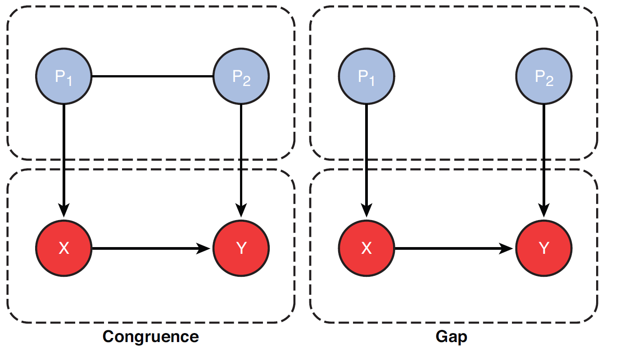
A Primer on Programming

Slide 33
Remote Work Effect

Slide 34
$150M/year

Slide 35
Gender @ Work

Slide 36
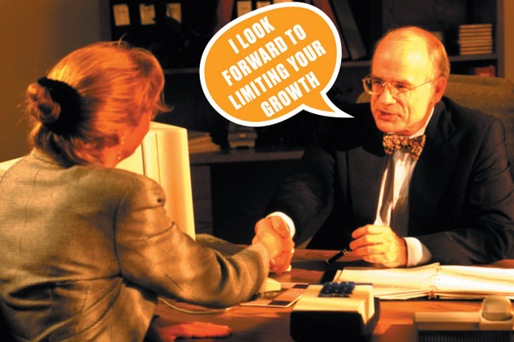
Photograph by Stock Connection Blue/Alamy

Slide 37
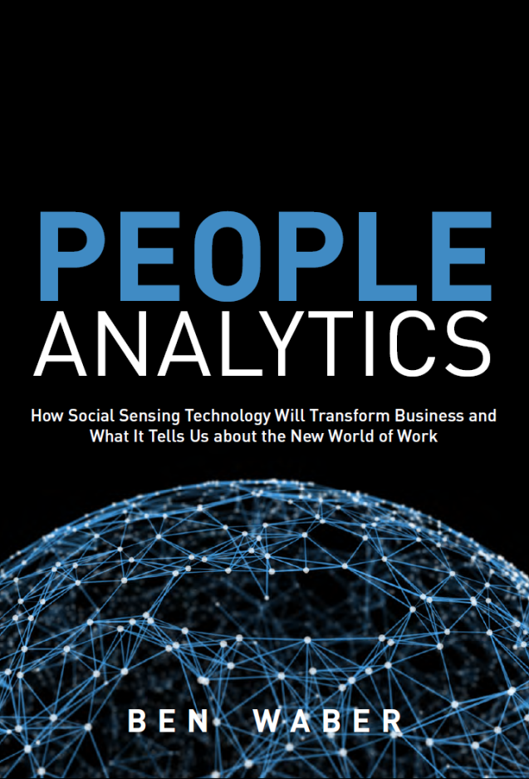
Questions?
ben@socio-metric.com

