Slide 1
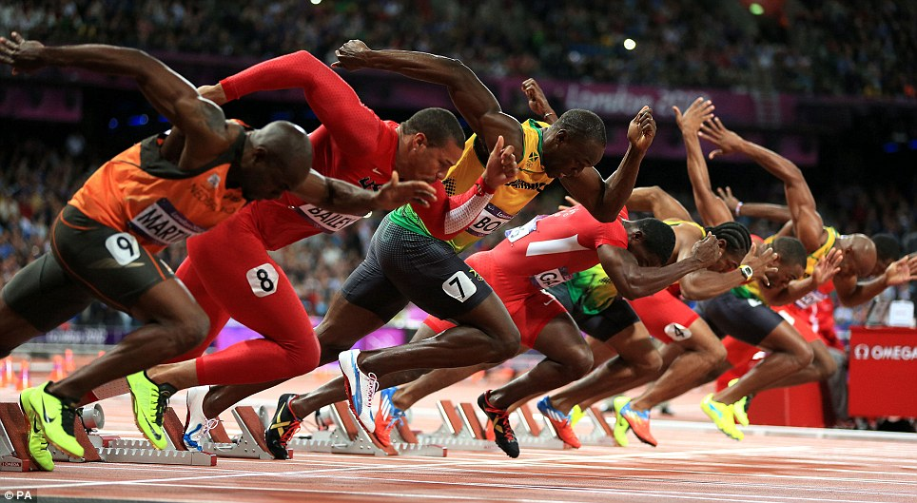

Notes:
Make sure to mention Neeru Jayanthi and butterfly goal-tending

Slide 2
0.5%

Slide 3
Average Weekly Practice Hours

Slide 4

Notes:
IN THE SPORT THEY EVENTUALLY BECOME ELITE IN.

Slide 5
Notes:
This is where you are now. (I want to talk to you about one of the things that is occurring over here, on the left) You have to find the activity that will spur you stay on this trajectory, not that one. You will have to get obsessed with something. Prior to now, it was easy to keep on track. There was an easy goal: Harvard. Or college, and your peers had somewhat similar goals. Other things were often handled for you. Someone else bought your toilet paper and did your laundry. Well, I have to tell, it’s going to get much harder very soon to stay focused. You’ll have many more opportunities, socially and academically. And that will be even more true four years from now when you graduate. So the trick will be to find something that is passionate enough to keep you on the red trajectory, not the blue trajectory, so that ultimately you can get to the place where identify the 0.5% in your field that makes a difference. I want to talk a bit about what I found to be passionate about, and to discuss in terms of my book. I didn’t go to Harvard. I probably wouldn’t have gotten in, if I had to guess, but I wrote a best seller, so by the rules of society I can tell you something or other. WHAT IS HAPPENING IN THOSE EARLY YEARS?? ARE THEY JUST LAZY? …while we think about that, I want to talk first a bit about practice, which allows you to do all sorts of amazing things, as I learned during the reporting of my book.

Slide 6
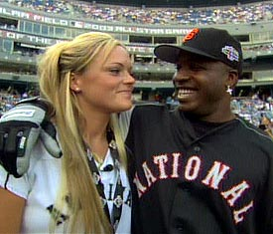
Notes:
I WANT TO TALK ABOUT THE IMPORTANCE OF PRACTICE

Slide 7
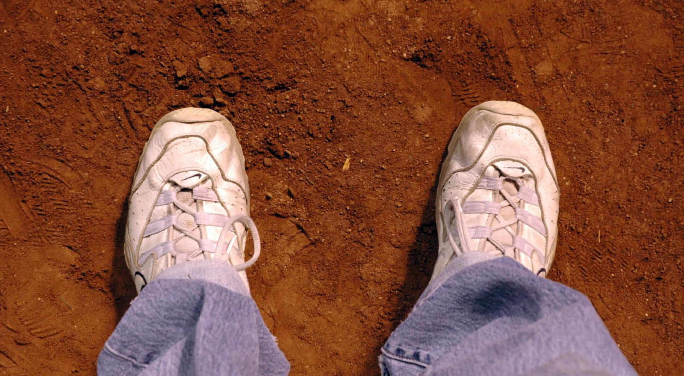
Notes:
Now explain why Barry couldn’t do this because he had only practiced in baseball. Why couldn’t he? It’s call the 10,000 hours rule. You need domain-specific practice.

Slide 8
The 10,000-hours Rule
Notes:
As if I believe it… it wasn’t actually that he had faster reflexes, Barry had learned perceputal cues, and something called chunking. Explain his chunking. We all chunk in things we’re expert every day. …I’m going to show you a slide with 20 words, and I want you to remember as many as you can. JUST BECAUSE YOU’RE A BIRD DOESN’T MEAN YOU’RE AN ORNITHOLOGIST. THEY ARE THE WORST EQUIPPED BECAUSE THEY’VE AUTOMATED THE SKILL. THIS WAS LIKE WHEN MICHAEL JORDAN TRIED TO BE A COACH, AND JUST KEPT TELLING PLAYERS THEY WERE DOING IT WRONG

Slide 9
BECAUSE GROUPS TWENTY PATTERNS MEANINGFUL ARE WORDS EASIER INTO CHUNK REMEMBER WORD SENTENCE FAMILIAR CAN TO YOU MUCH IN A.

Slide 11
TWENTY WORDS ARE MUCH EASIER TO REMEMBER IN A MEANINGFUL SENTENCE BECAUSE YOU CAN CHUNK FAMILIAR PATTERNS INTO GROUPS.

Slide 12
Notes:
We all learned the English language, because we all put in our 10,000 hours. So maybe we could all become Major League Baseball players if we put in our 10,000 hours. But the guy who supposedly invented the 10,000 hour rule doesn’t seem to think so. YOU”VE HEARD OF THE RULE, BUT RAISE YOUR HAND IF YOU’VE READ THE ACTUAL STUDY????

Slide 13
“THE DANGER OF DELEGATING EDUCATION TO JOURNALISTS”
11,053
25,000 and counting…
3,000
Notes:
Also, always read primary sources. I’M SURE IF YOU’VE READ ABOUT MEDICINE IN THE MAINSTREAM MEDIA, YOU CAN SYMPATHIZE!

Slide 14
The 10,000-hours-plus-or-minus-10,000-hours Rule
Notes:
So why aren’t we all Barry Bonds…well, here’s one reason

Slide 15
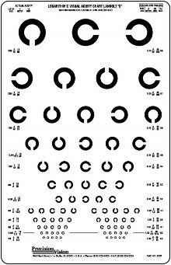
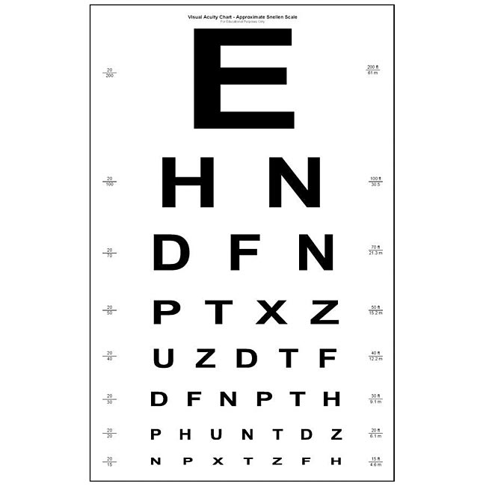
MLB Hitter Avg: 20/12 (several guys 20/8, approaching theoretical limit)
You: Not 20/12
See what I mean?
This talk is for MLB’ers.
Notes:
Maximum visual acuity is genetically determined, by the density of cones …and there are many other genetic gifts that are important to sports. Kids start self selecting out in Little League. And in a fantastic study in Belgium, picked women with varying degrees of depth perception.

Slide 16
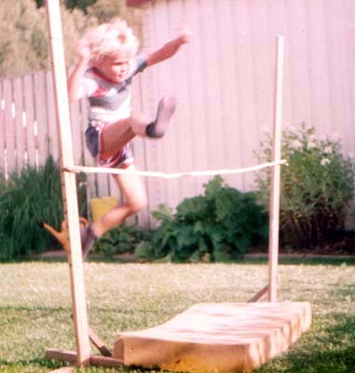
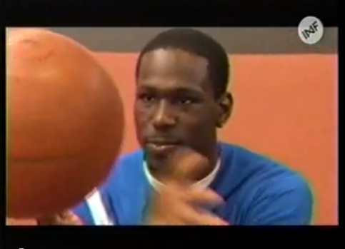
A Tale of Two High Jumpers
Notes:
Let me tell a little story that I tell in chapter two of my book that exemplifies the VARIABILITY AROUND THAT 10,000 HOURS I was just discussing.

Slide 17
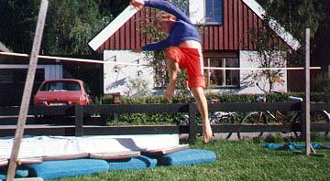
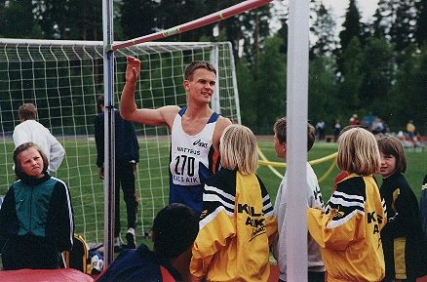
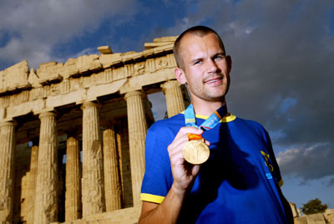
Stefan Holm, quintessential progression

Slide 18
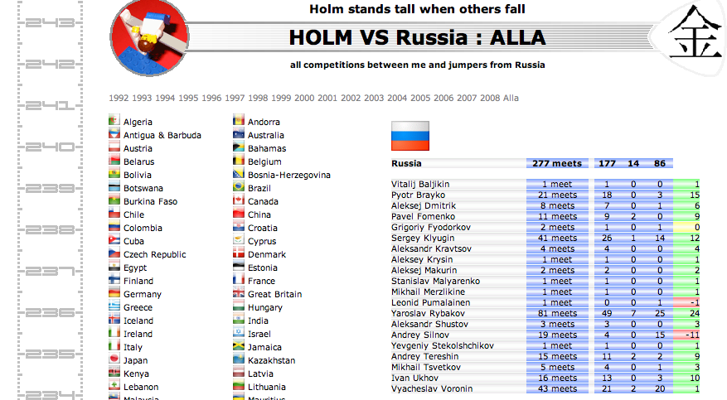
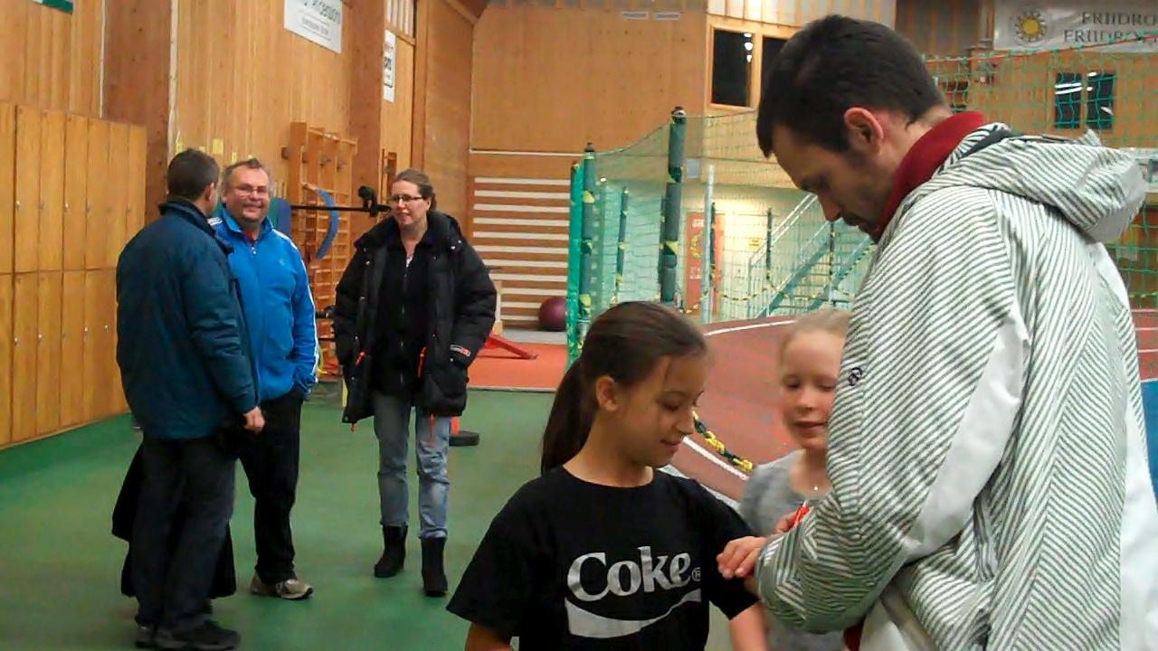
A Champion’s Obsession

Slide 19
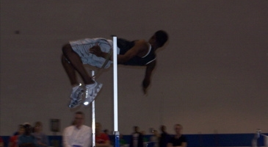
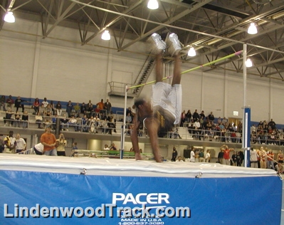
Donald’s first competition
Notes:
Stefan Holm’s father (Johnny Holm) called him “en javla pajas” …a buffoon. The reported suggested he teach him some form. “I doubt that is possible.” he appears to be right!
http://www.expressen.se/sport/friidrott/han-ar-en-javla-pajas/

Slide 20
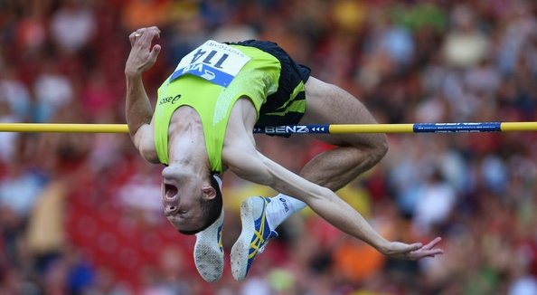
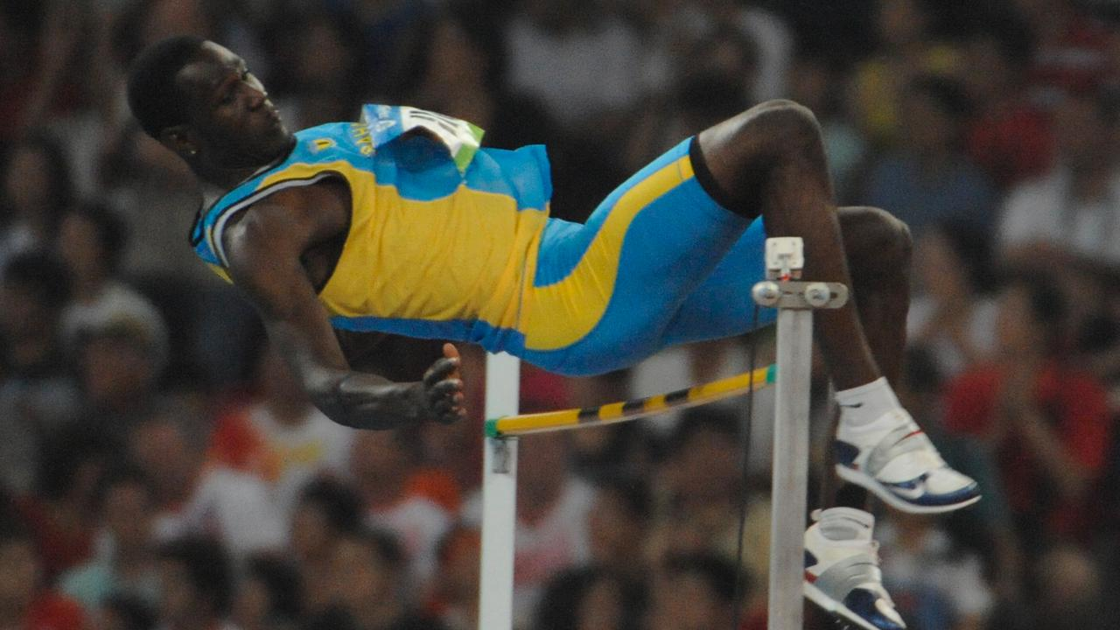
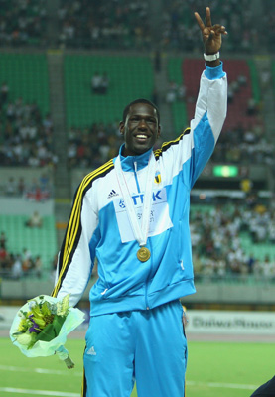
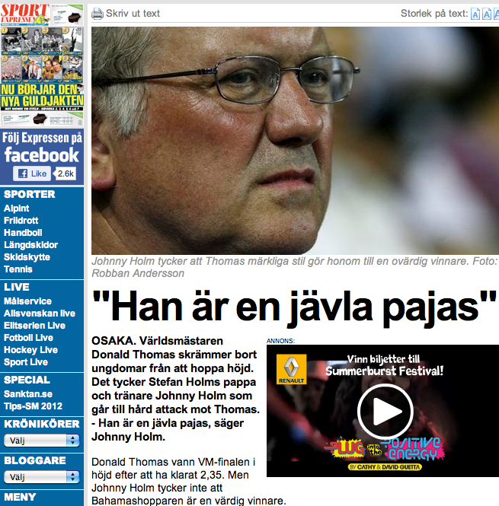
2007 World Championships
Notes:
DONALD, RIDING AN INVISIBLE DECK CHAIR THROUGH THE AIR. LIKE “OH HELLO, HOW DID I GET UP HERE??”

Slide 21
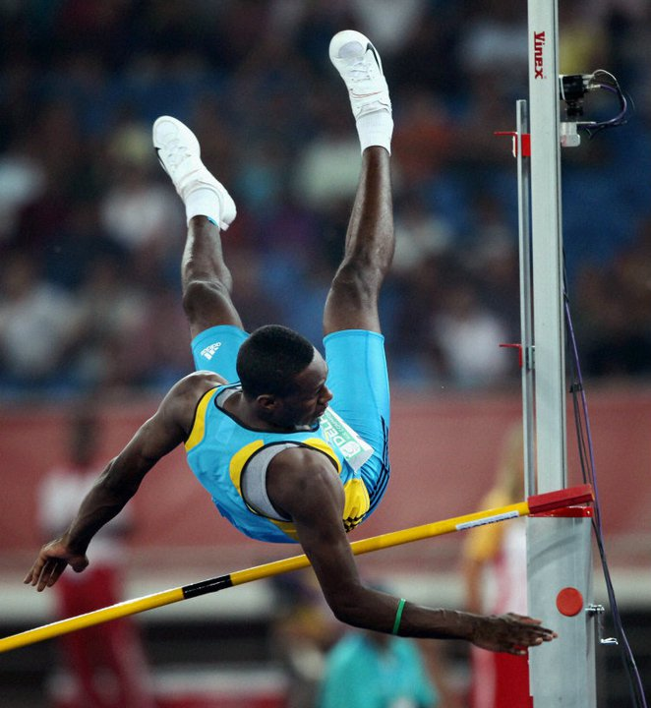
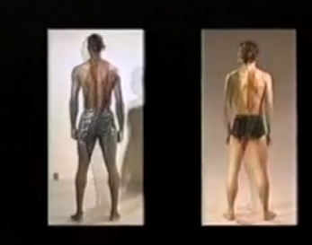
“I doubt it’s possible.” –Johnny Holm
“Kind of boring.” –Donald Thomas
Notes:
Johnny Holm says “doubt it’s possible” to teach Donald Thomas technique

Slide 22
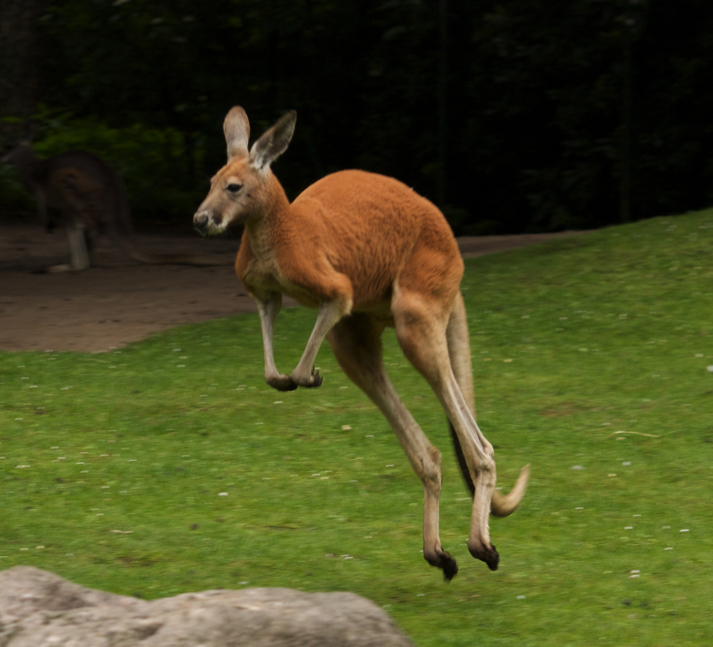
Hunter et. al (2011); MSSE.
Notes:
Also some empirical evidence that the length and flexibility (or stiffness) of the tendon have a significant impact on running economy. (R=0.69) …and COL5A1 gene correlates only with the running part of a traithlon. DONALD THOMAS WAS LUCK. BUT SYSTEMATIC TALENT SEARCH AND TRANSFER IN SMALL SPORTS WORKS.

Slide 23
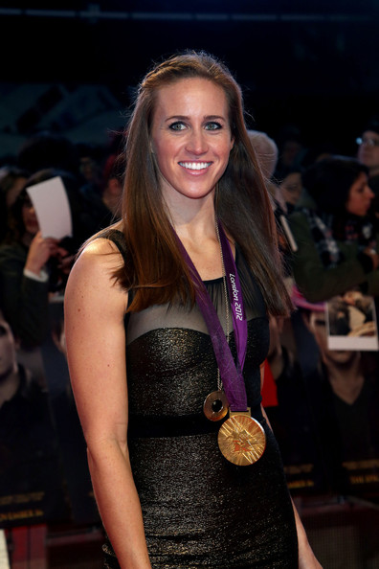
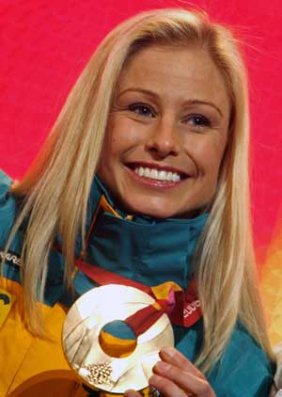
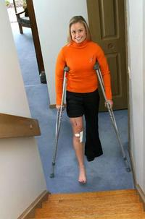
Niche Finding
HELEN GLOVER
“SPORTING GIANTS”
Sydney Games:
U.S.: 0.33 per million
AUS: 3.03 per million
Alisa Camplin
Talent Transfer
Notes:
Richard Jefferies, a British rugby player turned canoeist, nearly had a similar triumph in 2010. With just 40 meters left, the inexperienced Jeffries, in his first international season, was leading the 200-meter race at the world championships when he fell out of his canoe into the water.

Slide 24




Olympic medals at prior-to-home Games and home Games
41 13 63 47
58 16 100 65
Notes:
Greece didn’t invest in talent search. YOU HAVE TO TAKE AN EYE TOWARD TRIAL AND ERROR. These other three countries engaged in NICHE HUNTING.

Slide 25
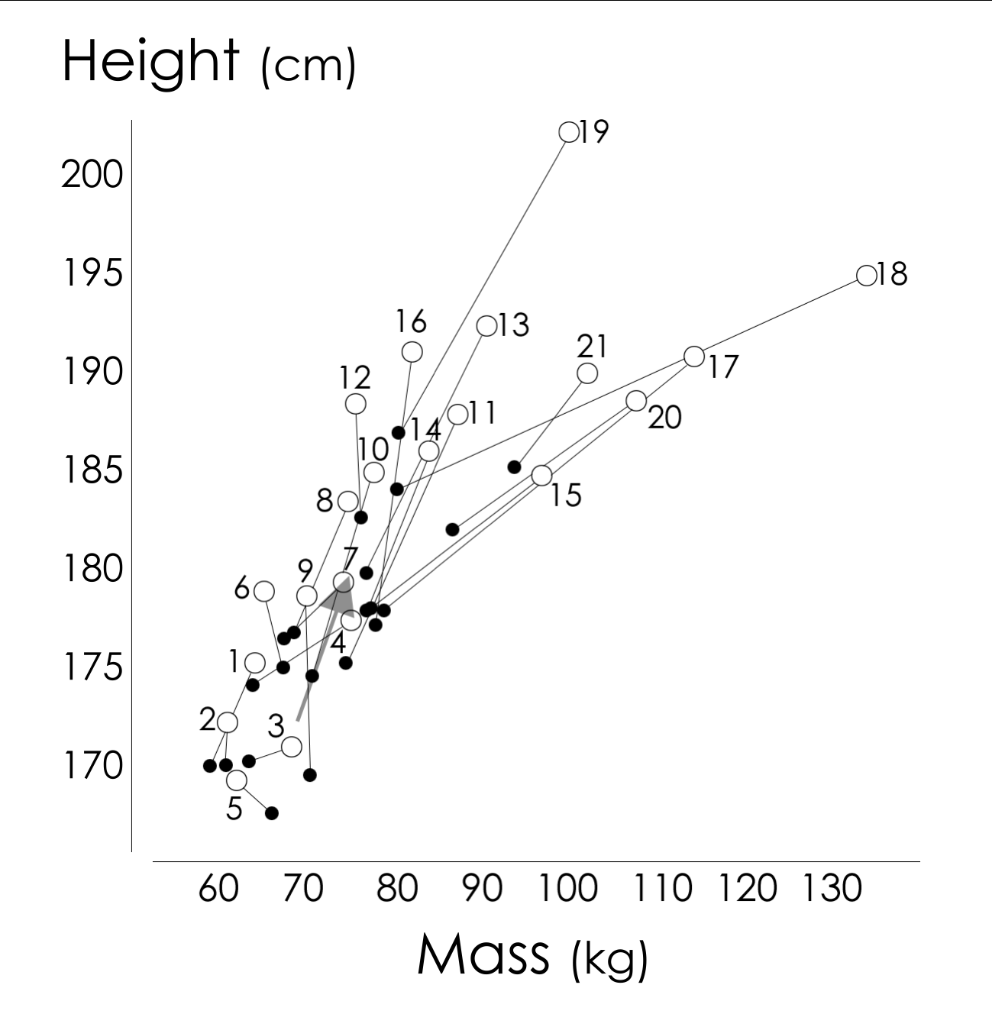
“Big Bang of Bodytypes” (Norton and Olds)
[1925-2000]
1 running-distance
2 running-marathon
3 diving
4 running-sprint
5 gymnastics
6 running-800-1500m
7 running-400m
8 long jump
9 cycling-road
10 swimming
11 waterpolo
12 high jump
13 rowing
14 Australian football
15 rugby union
16 volleyball
17 throwing (other than shot)
18 shot-put
19 basketball-NBA
20 football-NFL
21 boxing-heavyweight
Courtesy Tim Olds (University of South Australia); also appears in Maughan ed., The Olympic Textbook of Science in Sport (2009)
Notes:
FINDING THEIR NICHES. The more specialized we get, the more information there is as to what our best niche is. And this is one reason why athletes have gotten so much better in recent generations. They’re simply doing a better job of niche-finding. In 1925 the average elite shot putter and high jumper were the same height and weight. Today, the shot putter is 2.5 inches taller and 130 lbs heavier

Slide 26
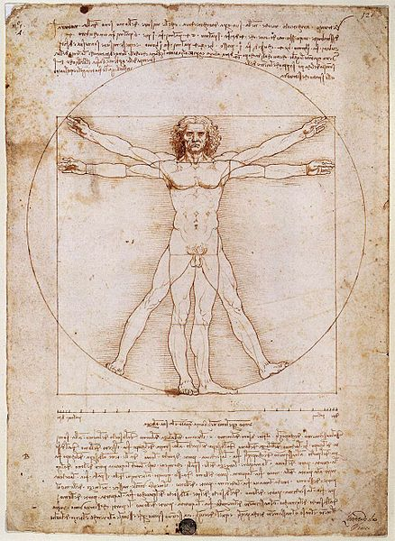

Slide 27
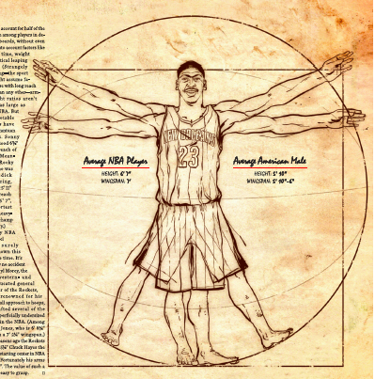
Notes:
Some are less obvious…gymnasts have shrunk, and waterpolo players have longer forearms.

Slide 28
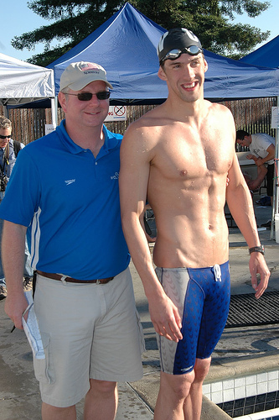
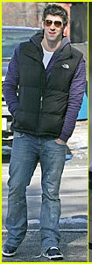
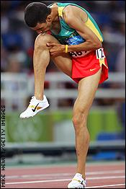
6’4”
5’9”
SAME SIZE PANTS!!

Slide 29
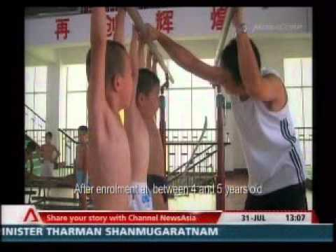
Notes:
I REALIZE THIS MAY SEEM JARRING TO WESTERNERS. THEN AGAIN, IT MIGHT ALSO BE CONSIDERED REALLY SMART NOT TO SIMPLY KEEP KIDS IN THE SPORT THEY STARTED FIRST BECAUSE THEY STARTED IT FIRST…BUT TO MOVE THEM.
Draconian? Saving those kids time and getting them a better experience? Depends on your perspective I suppose.

Slide 30
Being Best Right Away Isn’t Important
Notes:
Turns out that what is happening in these early years is the sampling period. Looking for best environment
NEERU JAYANTHI. NOT LESS TOTAL TIME IN SPORTS ….
And MUSIC. Let me give a personal example of sampling, and of not being best right away

Slide 31
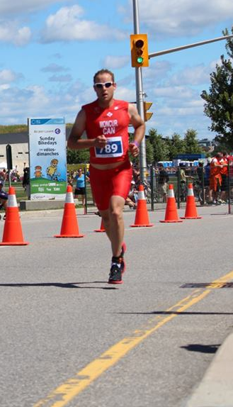
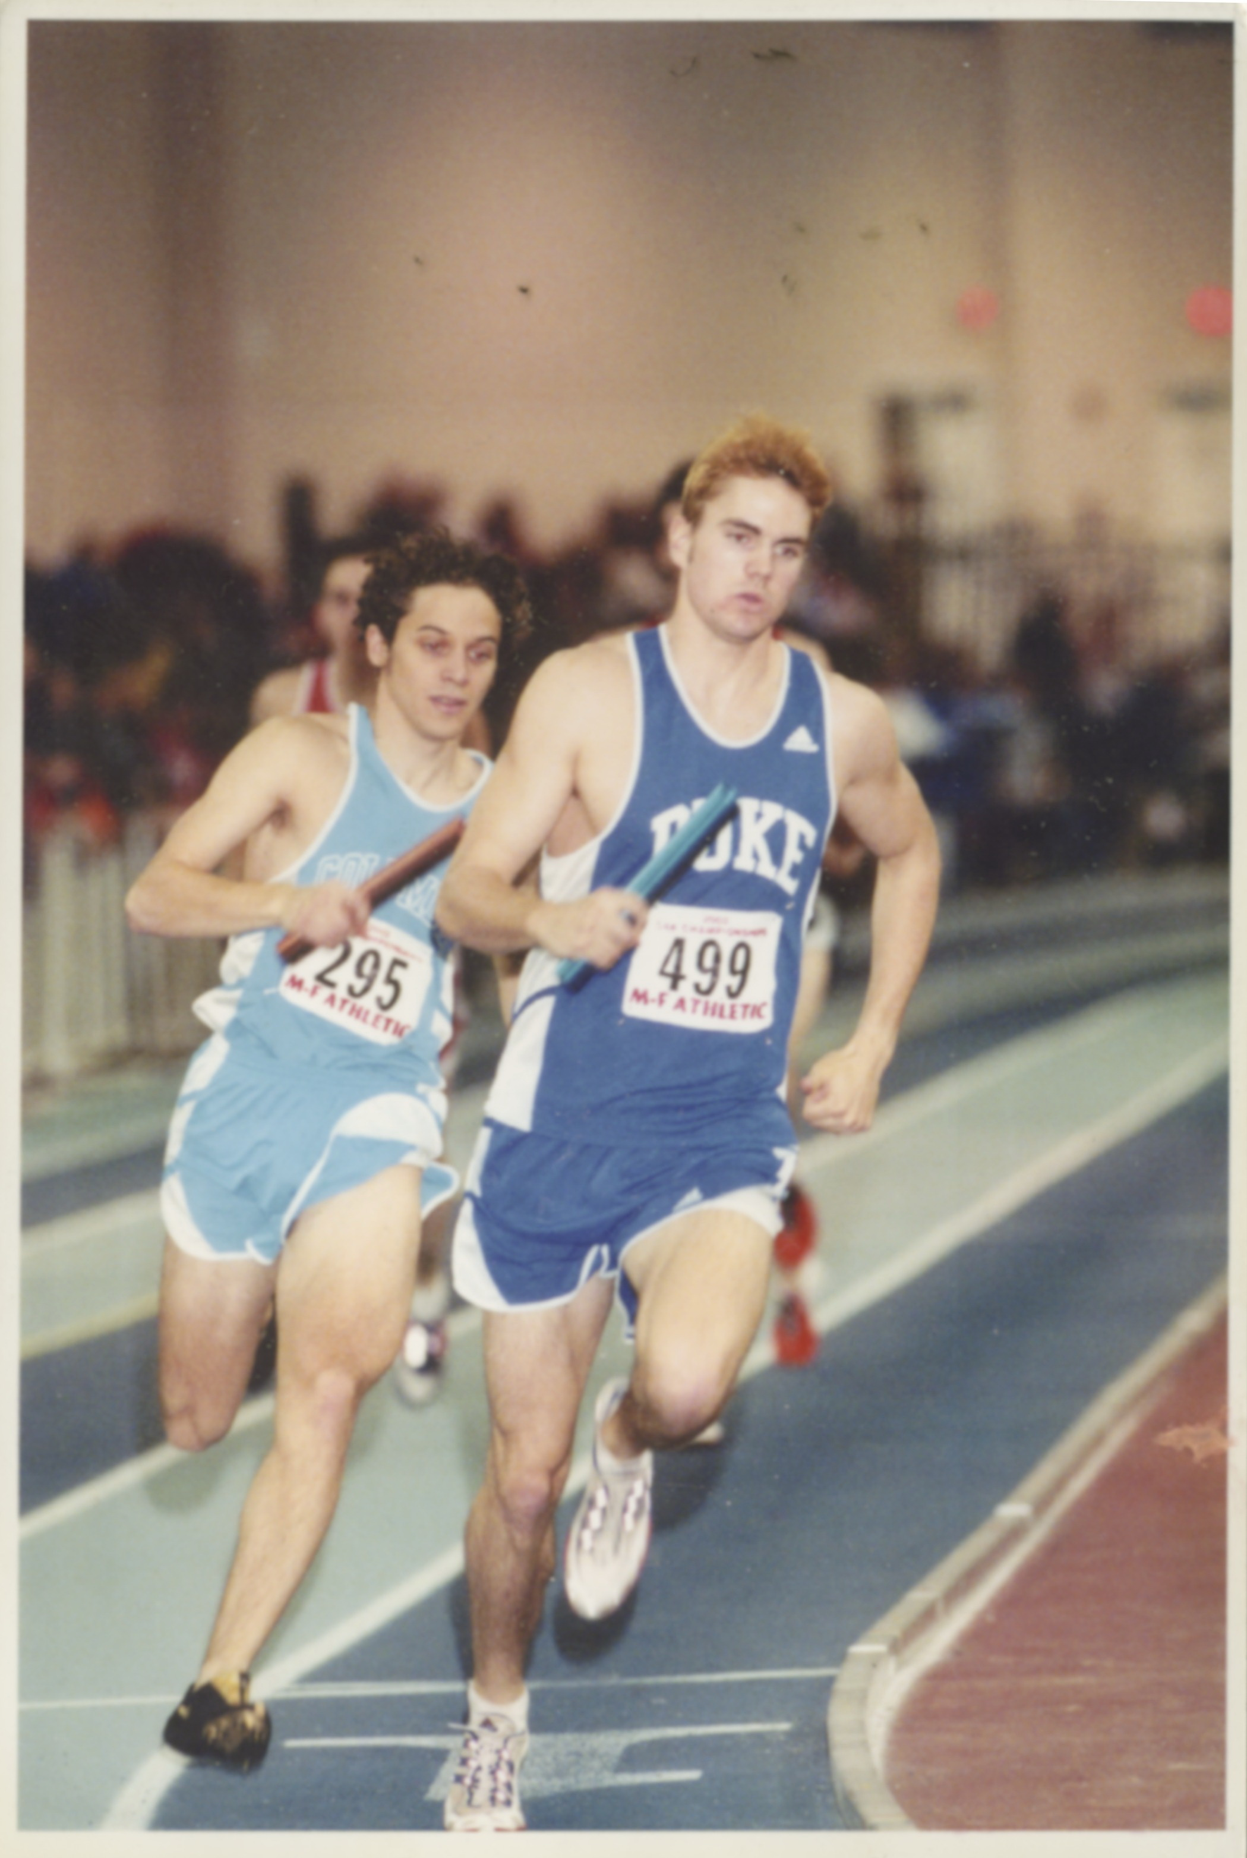
Notes:
I had a sampling period, which mean I WAS WAY BEHIND WHEN I GOT TO COLLEGE! So, if only practice matters, I would never catch up, right? …I wasn’t even thinking about body types, I just liked this sport psychologically. I had played football, basketball and baseball.

Slide 32
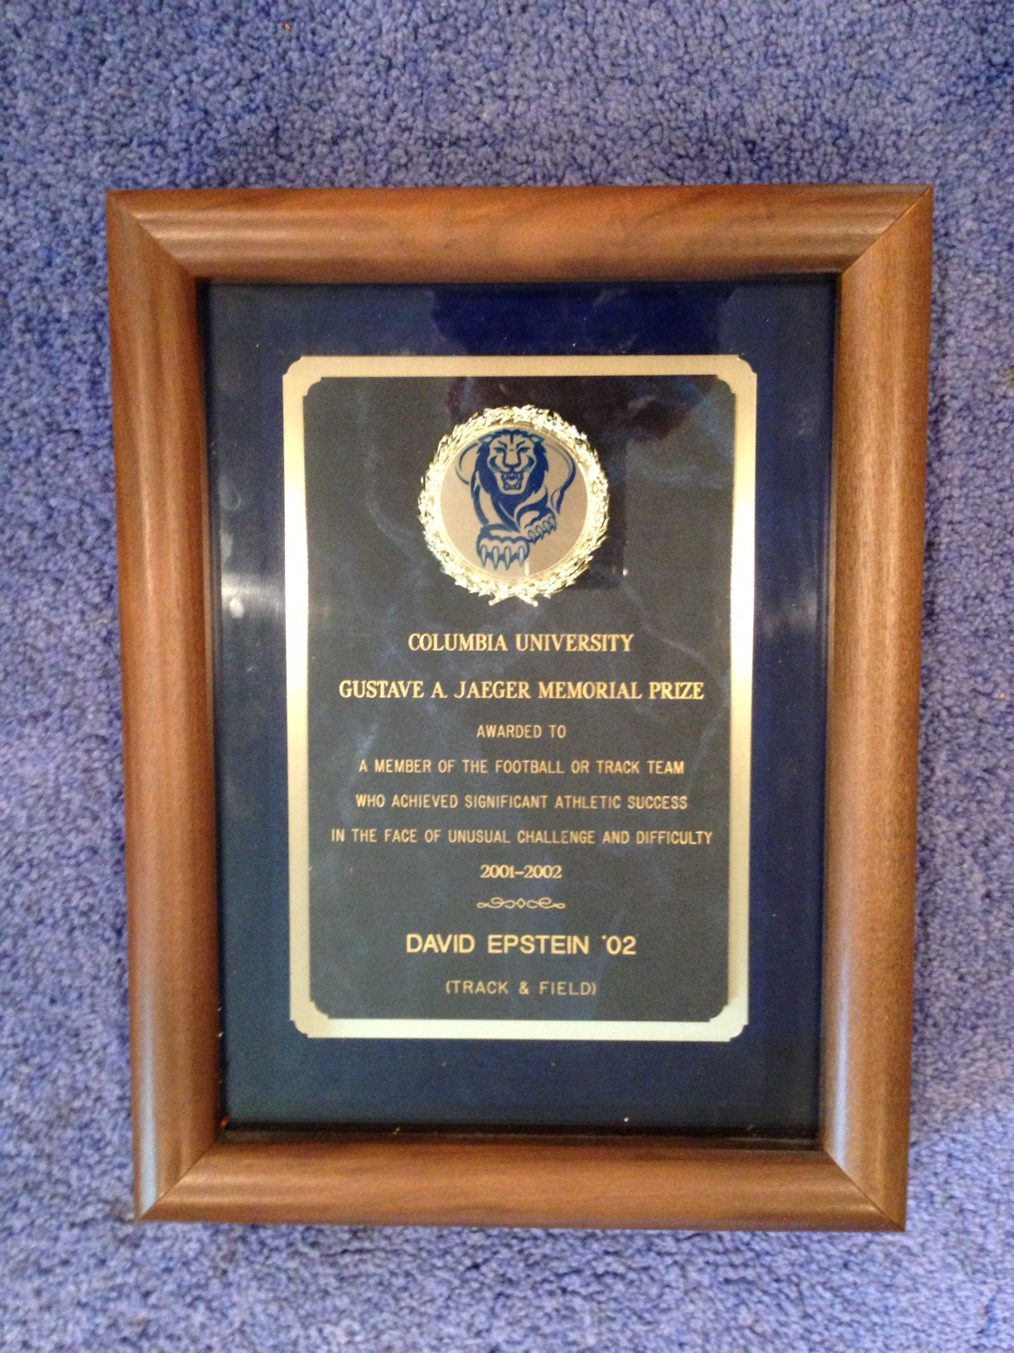
“…achieved significant athletic success in the face of unusual challenge and difficulty.”

Slide 33
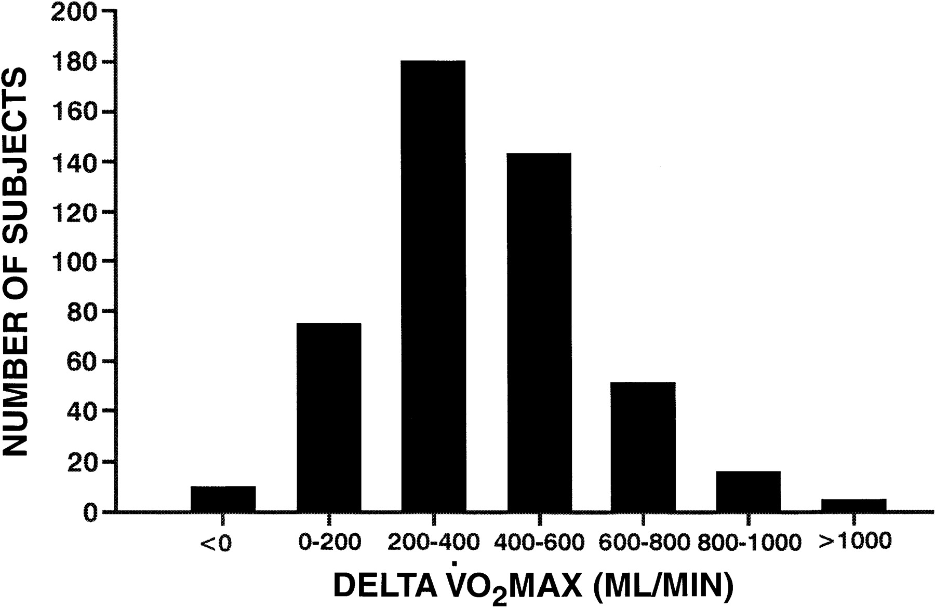

Distribution of the 481 subjects by classes of increase (delta) inV˙o 2 max from baseline levels.
Bouchard C et al. J Appl Physiol 1999;87:1003-1008
©1999 by American Physiological Society
Notes:
Distribution of the 481 subjects by classes of increase (delta) inV˙o 2 max from baseline levels. I’M JUST A DUMMY SO I STUCK WITH IT. AT THIS POINT, I DON’T SEE MUCH USE IN MOST GENE SCREENING. BUT I DO THINK THAT YOU CAN’T JUST EVALUATE PEOPLE FROM A TIME TRIAL. YOU WANT “RESPONDERS.” THE 10,000 HOURS THINKING IS A DISASTER TO FINDING TALENT. THANKFULLY, THEY HAVEN’T HEARD OF THE 10,000 HOUR RULE IN KENYA.

Slide 34
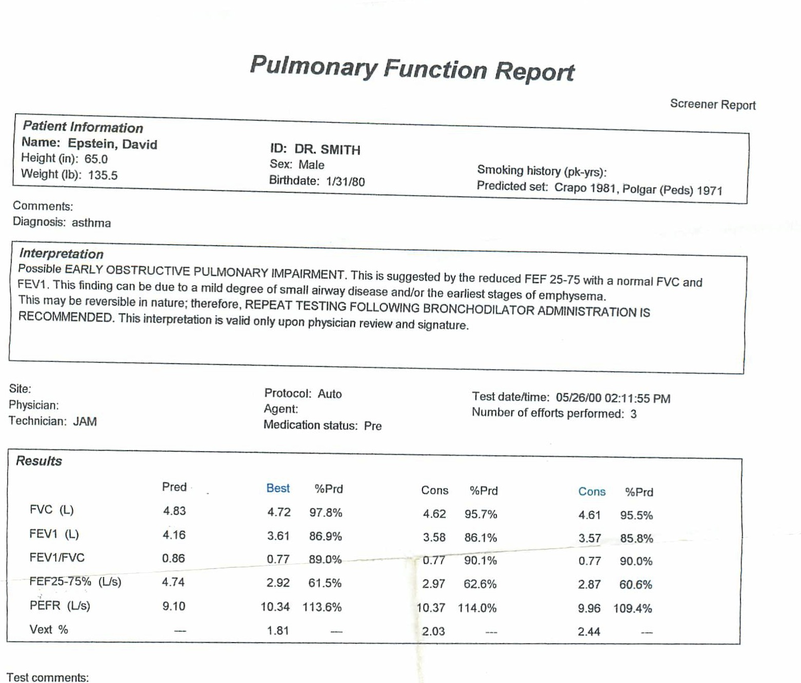
“EARLIEST STAGES OF EMPHYSEMA”
Notes:
Totally uncorrelated from baseline… and I ended up running at US track and field national championships in 2003, ok.

Slide 35
Notes:
ONLY ONCE YOU FIND THE RIGHT FIT SHOULD YOU LOOK FOR THE 0.5%
I think WALLY DIDN’T EMBRACE HIS SAMPLING PERIOD. DIDN’T FIND THE RIGHT ENVIRONMENT FOR HIMSELF, AND NOW IS DISCOURAGED [female character is Alice]
“people used to think it took 10,000 hours of practice to become an expert”
“but now people think the amount of practice you need depends on your genetic makeup”
“so you’d be good after a million or so hours”
“SEE WHY I DON’T BOTHER?” ….(well, actually, Wally is extremely good at gaming the system. I think he has talents, he just hasn’t found his niche)

Slide 36
0.5%
Notes:
You have to find the environment that caters to your strengths, and then you look for your 0.5%. Let me show you a great example of finding the 0.5%. FROM SPORTS

Slide 37
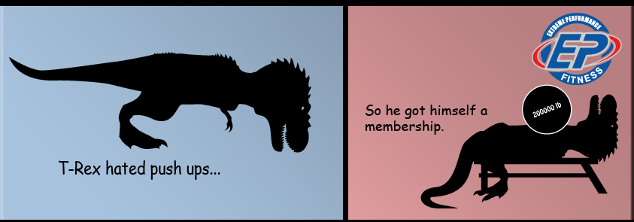
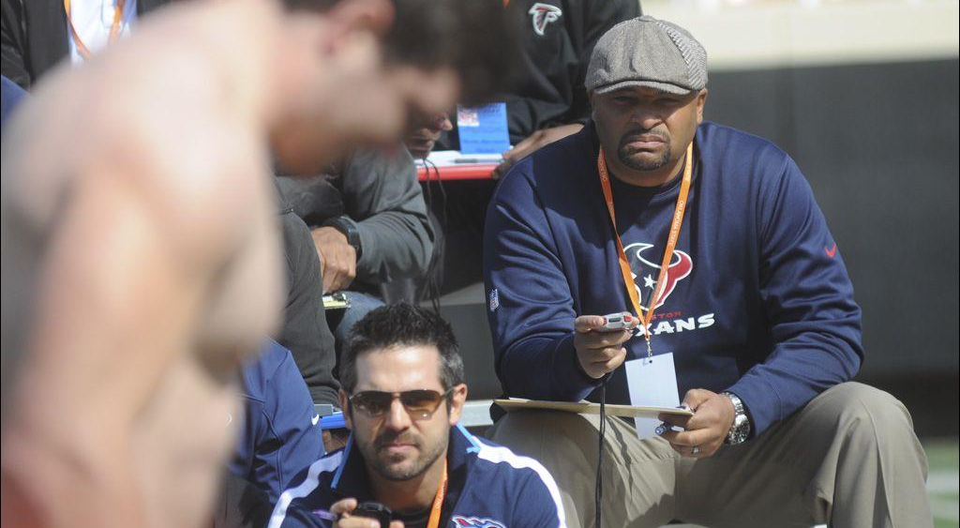
THIS IS THEATER. NOT SCIENCE.
Notes:
The wrong place to find the 0.5%

Slide 38
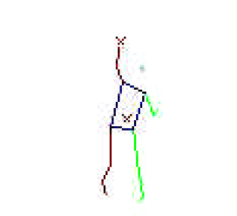
Biomechanics of shot put Brute strength, power and one degree of error
There are three factors that affect the length of the put:
1. Release velocity
V_{o}
What determined the final result of the 2007 Osaka World Championships in Athletics?
α
2. Release height
3. Release angle
Performance outcome

Slide 39
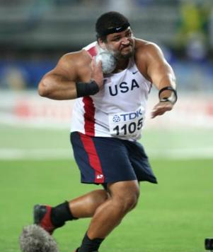


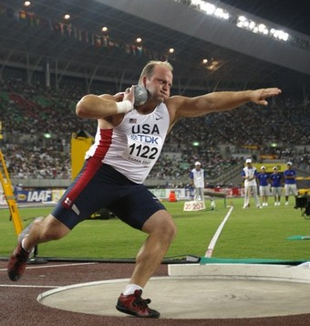
A result with hidden margins
Height
Velocity
Angle
✓
7’7”
14.27 m/s
33º
72’4”
✓
✓
7’9”
14.30 m/s
31.5º
70’11”
IF
α
DISTANCE
THEN
AND
31.5º
32.5º
70’11”
72’4.5”
Notes:
The Brits learned this and hired first ever BIOMECHANICS PhD as “horizontal jumps specialist” ONCE YOU FIND THAT NICHE, YOU INNOVATE!

Slide 40
“ICE NOVICE TO WINTER OLYMPIAN IN 14 MONTHS”
Notes:
THEY FIGURED OUT THAT 50% OF VARIANCE IN FINISH IS DETERMINED BY THE FIRST 10 FEET ..INSERT SKELETON PHOTO
In honor of winter olympics, there’s a woman competing this week named Michelle Steele

Slide 41
“Everyone has a different genotype. Therefore, for optimal development, everyone should have a different environment.”
-J.M. Tanner
Notes:
You’re going to begin to have much more control over your environment. And it will be up to you to find the right fit for your talents, the right fit for your passion, and then to find the 0.5%. I did this myself, I started in science, and realized what made me stood out was being a good writer. Then I switched to writing, and realized that what made me stand out was being science-minded about answering questions. I SAMPLED NOT ONLY IN MY ATHLETIC CAREER, BUT IN MY ACADEMIC AND PROFESSIONAL CAREER. 10,000 hours is causing us to move away from sampling and talent transfer

