Slide 1
Soylent Mean
Data Science
is Made of People
Kim Stedman @KimSted
Cameran Hetrick @CameranHetrick

Slide 2

Data Science is of the people, by the people, for the people
Notes:
As a society we're just getting used to big data
and we're also super excited about it. But when the wrapping is all the way off, this is how we'll see data: made of people.
We are talking about data anthropology, or what Cameran and I call "human factors in data adoption."
Yes, the dreaded human! Messy, error prone, imprecise humans.
We suffuse every part of big data.
Humans generate data,
which is used by and for humans to achieve human goals. Each step in the analysis process involves human interpretation, and all of the innate biases and errors we bring to everything we touch.
In data, our tools pose problems that are, for sure, hard.
The messy human problems of data are way harder.
For some reason we spend a lot of time talking about the former, and almost no time talking about the humans that use the tools to do the real work. The full data ecosystem is both, working in tandem.
Each part of that ecosystem can and does break down,
so if we want data to work, we need to analyze and solve both the physical and human parts together.
Optional, to parse down:
Combine your best algorithms and smartest data architecture, and what do you get? Without humans, you have an expensive, high tech brick. Humans generate data, which is used by and for humans to achieve human goals. If you want your data department to earn its keep by showing real value, you must build your social systems as meticulously as you build your pipeline.

Slide 3
Use data to discover truths that cause changes that improve the stuff we make.
The Goal of All This
Notes:
??? Do we want to talk her about the difference between recommender engines, vs like medical/environmental data exploration, vs data consumption as product research.
These goals are the same goals we’ve always had in the business.

Slide 4
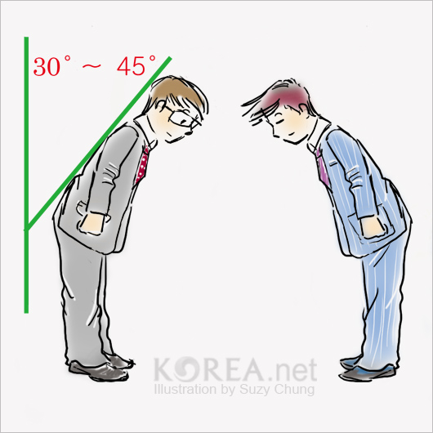

Notes:
There are two players in that game.
On the left hand, there’s the data scientists; on the right, the company who hires them.
We are each part of a broad organization that must operate in tandem to achieve our goal of having actionable insights that have a direct impact on the organization, making data science a financially sustainable aspect of a company.

Slide 5
The Three Futures
of Data
Notes:
We’re trying to highlight problems here – scope out the issues as a preface to how it’s actually an easy and intuitive fix.

Slide 6
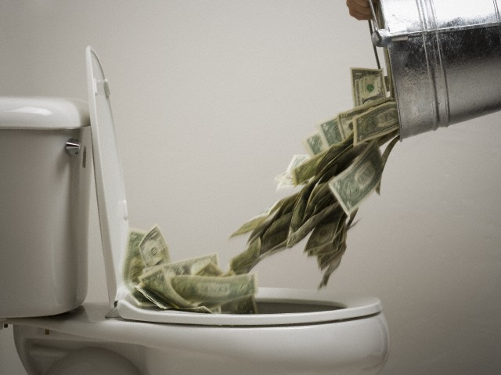
#1
Notes:
This is expensive
and it doesn’t do anything
Where “Expensive” = time as well as money
Replacing If they don’t get it, they aren’t going to fund it

Slide 7

Nope
Still
Don’t
Know
#2
Notes:
This is expensive
and it doesn’t do anything
Where “Expensive” = time as well as money
Replacing If they don’t get it, they aren’t going to fund it

Slide 8

#3
Notes:
This is expensive
and it doesn’t do anything
Where “Expensive” = time as well as money
Replacing If they don’t get it, they aren’t going to fund it

Slide 9

90%
Of the world’s data has been created in the last two years
Source: IBM
Notes:
Problem 3: BIG data is still so new

Slide 10
30%
of companies have invested in big data technology
8%
of companies have deployed big data solutions
Source: Gartner’s 2013 Big Data Survey
Notes:
Here is where we are. Early phases of development of a large and complex field. When our servers are fast enough, we still won’t be there yet. There are more ways and directions for this field to grow.

Slide 11
Diffusion of Innovation
WE ARE HERE
2.5%
13.5%
34%
34%
16%
Innovators
Early Adopters
Early Majority
Late Majority
Laggards
Notes:
Data science is a new social technology – not just physical technology, but a social technology, involving how to incorporate the potential power of large data stores into meaningful action.
Introduce diffusion of innovations – of the 100% of potential adopters. We are just at the beginning – we are the early adopters of this technology and we’re setting an example for everyone else. We, the people at this converence, are modeling behavior for every other company that will follow us.
As such we have a huge responsibility. We can crash this wave of adoption.
[K2] Address the audience.
You’re not typical. This conference is full of the intellectual elite.
We’re the different ones. We’re the cool kids. We’re the influencers. We’re the ones they’re trying to emulate.
So everything we model here, is setting the tone for the future of data.
- Everybody is trying to implement this right now. We’re talking about is data activism. Reaching out to the average person to make this a successfully adopted technology. We should’t increase the distance. EVANGELIZE AND EDUCATE.

Slide 12

Notes:
Big data is like teenage sex:
Everyone talks about it,
Nobody really knows how to do it,
Everyone thinks everyone else is doing it,
So everyone claims they are doing it...
Data science is described as a sexy job. And it is! It still is – the potential is great. But we all have the same problems. All of us! We’re all coming up against the same hurdles.
We’re competitors in this space, and we’re all incented to perform for each other. To act as though we’re getting a lot of value out of our systems. But the big secret is that nobody is yet.
We need to find ways to expose and communicate the complexities in the social implementation of data, so that we can model solving those problems for the world at large. Only thus, will data adoption be demonstrably worth the money, time, effort and learning curve.
“But how robust is his data pipeline?”
---- ?
Why? It’s not because data is an untested frontier. It’s that any research methodology involves a process of integration, as it creates a new systems feedback loop.
And that’s what data is. Data is not a technology. A research methodology.

Slide 13
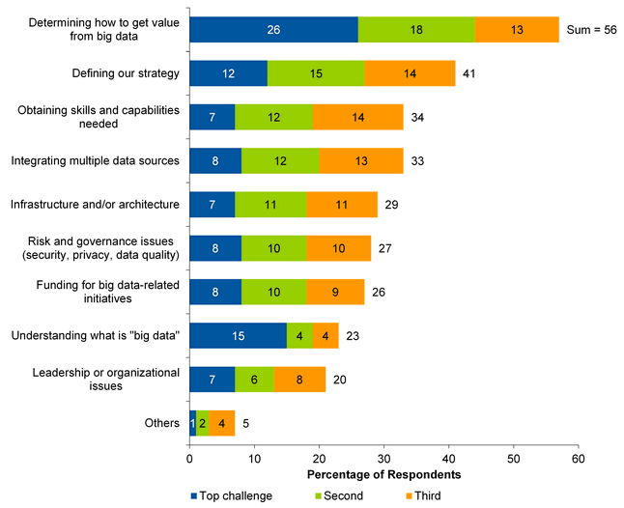
Top Challenges of Big Data
Source: Gartner’s 2013 Big Data Survey
Notes:
The human factors are what’s broken. I introduce the intrerviews I’ve been doing. Focus groups. What I hear.
K2 references other stuff from this general space.
Problem 2 Business people don’t know how to get value from big data
As an industry we have put huge investments in building the technology to process big data, and yet, people STILL don’t know how to use it

Slide 14
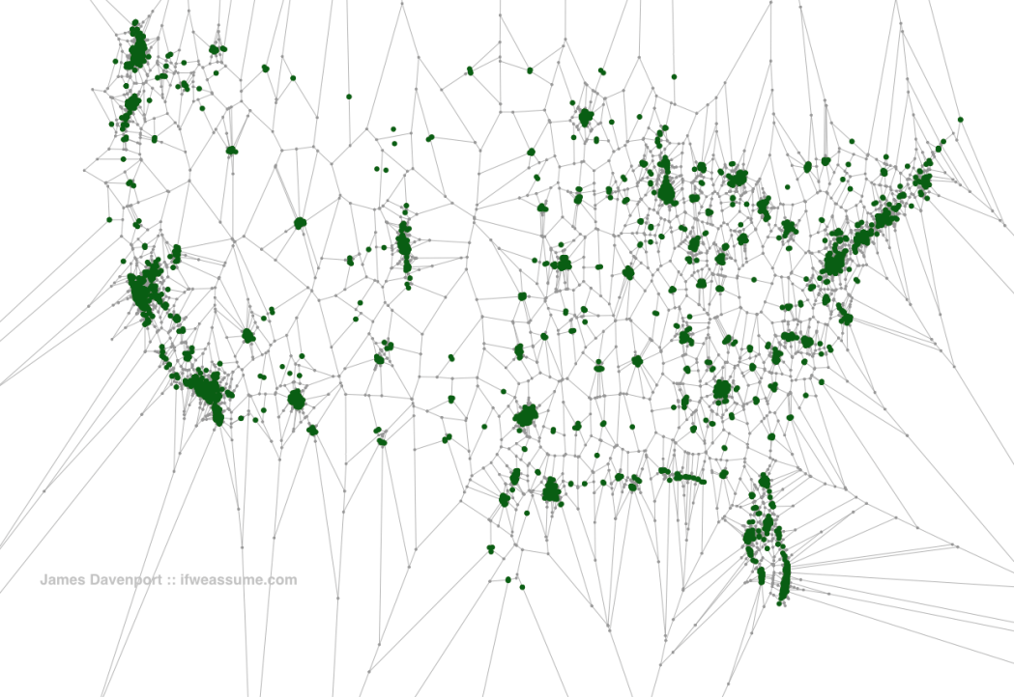
80% of USA lives within 20 miles of a Starbucks
Notes:
Problem 6: As an industry we talk about Data Science in a vacuum and there is little talk about why analysis are done or what people did with them, or even more importantly how to they help the company. We’re talking in a bubble and nobody gets it.
We are teaching the rest of the industry how to use these techniques – we’re on stage for the world right now. But we’re only showing them how to use the physical technologies. We’re not demonstrating how to do them to accomplish change.

Slide 15

That’
That’s Not
Data Science
That’s Just
DATA
Notes:
"That's not data SCIENCE. That's just DATA."
Science is the assertion of a testable hypothesis,
followed by a cycle of validation
In pursuit of usable theories.
***************
We’re fucking up this responsibility of setting an example – fucking up the responsibility of addressing the real problems that are making it hard to realize our data goals.
What we have to do now, is buffer the effects of the hype cycle crash by showing value
Take advantage of neighboring research disciplines which have been around for a while and learn from the past,
And take leadership to set an example of the huge wave of adopters who are about to follow us in.

Slide 16
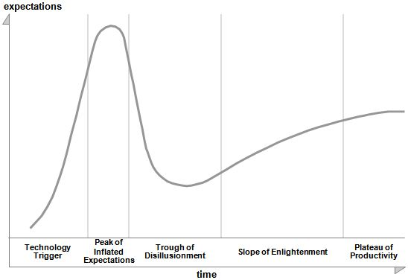
Gartner Hype Cycle: Big Data
2013
2012
2011
Notes:
Problem one – where we are as an industry. We are about to pay the price for the vast investment and the HYPE around data science

Slide 17
What’s Broken
Notes:
Here’s how we take in the lessons from the neighboring social technologies of research and analysis, so that we can achieve our goals.

Slide 18
What’s Broken
We’ve got 99 problems
and our tools ain’t one
Notes:
Here’s how we take in the lessons from the neighboring social technologies of research and analysis, so that we can achieve our goals.

Slide 19

Use data
We can’t find data scientists to hire
Nobody has the right training yet
To discover truths
There’s too much data & we don’t know where to start.
We can’t get the $$ for headcount or tools.
That cause change
Standalone data studies are rarely actionable.
Our KPIs make people act the opposite of what we wanted.
That improves the stuff we make
Our results take on horrible lives of their own
Notes:
The hype – the standalone studies are rarely actionable.
**** "Businesses are complex systems, so if you optimize one element, it rarely creates sustainable value." originally by Peter Drucker.

Slide 20
Use data
We can’t find data scientists to hire
Nobody has the right training yet
To discover truths
There’s too much data & we don’t know where to start.
We can’t get the $$ for headcount or tools.
That cause change
Standalone data studies are rarely actionable.
Our KPIs make people act the opposite of what we wanted.
That improves the stuff we make
Our results take on horrible lives of their own
Notes:
The hype – the standalone studies are rarely actionable.
**** "Businesses are complex systems, so if you optimize one element, it rarely creates sustainable value." originally by Peter Drucker.

Slide 21
Use data
We can’t find data scientists to hire
Nobody has the right training yet
To discover truths
There’s too much data & we don’t know where to start.
We can’t get the $$ for headcount or tools.
That cause change
Standalone data studies are rarely actionable.
Our KPIs make people act the opposite of what we wanted.
That improves the stuff we make
Our results take on horrible lives of their own
Notes:
The hype – the standalone studies are rarely actionable.
**** "Businesses are complex systems, so if you optimize one element, it rarely creates sustainable value." originally by Peter Drucker.

Slide 22
Use data
We can’t find data scientists to hire
Nobody has the right training yet
To discover truths
There’s too much data & we don’t know where to start.
We can’t get the $$ for headcount or tools.
That cause change
Standalone data studies are rarely actionable.
Our KPIs make people act the opposite of what we wanted.
That improves the stuff we make
Our results take on horrible lives of their own
Notes:
The hype – the standalone studies are rarely actionable.
**** "Businesses are complex systems, so if you optimize one element, it rarely creates sustainable value." originally by Peter Drucker.

Slide 23
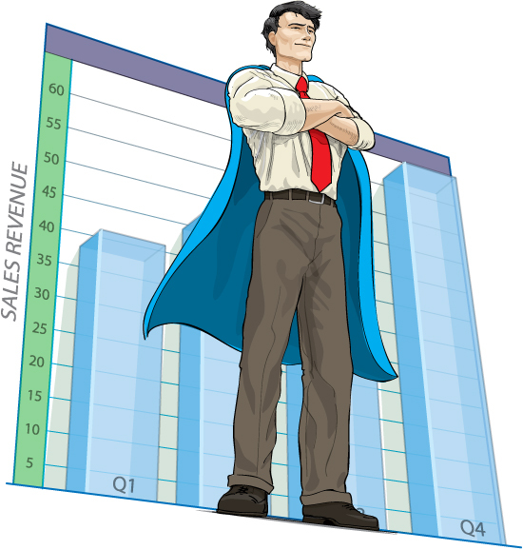
We are smrt.
We should solve
the things.
Notes:
Here’s how we take in the lessons from the neighboring social technologies of research and analysis, so that we can achieve our goals.
We’re going to give you tools for solving these problems within our organization,
Then put out a call to action for startups, consultancies, talks, and changes we want to help bring about in the industry at large.

Slide 24
Use data
We can’t find data scientists to hire
Nobody has the right training yet
Notes:
The hype – the standalone studies are rarely actionable.
**** "Businesses are complex systems, so if you optimize one element, it rarely creates sustainable value." originally by Peter Drucker.

Slide 25
Hacking Skills
Statistics / Mathematics
Good Luck
Business Knowledge
Notes:
JUST SOME THOUGHTS ON HOW TO CONVEY THIS
Problem 5

Slide 26
Hacking Skills
Statistics / Mathematics
Good Fucking Luck
Domain Expertise
Visualization
Notes:
Problem 5
[K2] HAHAHAHA…. This made me laugh out loud. Let’s keep it

Slide 27
Data Manipulation
Machine Learning
Statistics / Math
Big Data Software
Natural Curiosity
Data Warehousing
Human Computer Interaction
Business Strategy
Business Knowledge
Problem Solving
Data Leadership
Visualization Tools
Storytelling
Communication
Notes:
Still think I’m missing
Data Adv / Leadership

Slide 28
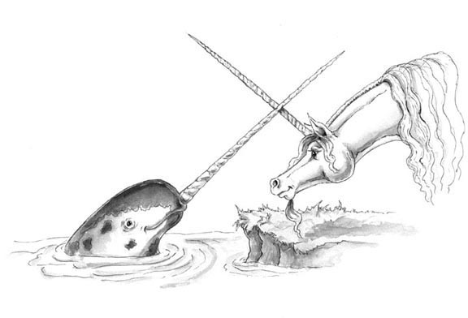
Notes:
Problem 5: People try to hire someone with all the skills and they don’t exist.

Slide 29

”Will you be my unicorn?”
no

Slide 30
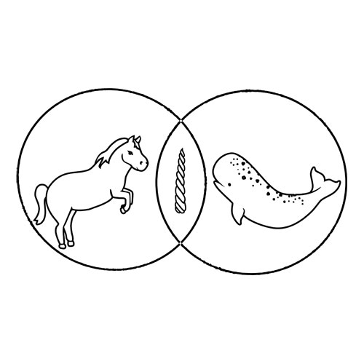
Notes:
[K2] The answer: CLUSTER THEM. This isn’t going to be a team full of people with identical roles. It’ll be a diverse team of people who play distinct, complimentary roles.
We’re talking about social design, which is an essential component of creating a useful team.
This is a short slide to deliver the gag, then we start talking about roles in data science.

Slide 31


Slide 32
Not every future data scientist
is a former computer scientist
or statistician
Notes:
{k2] The centrism of Pathologically false
Statisticians and computer scientists are well positioned to write the code
But are not well positioned to perform the or
May reference verbal training – programs that are out there.

Slide 33
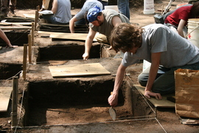
Notes:
Mention Genevieve Bell?
Maybe joke about digging into data
Earnest undergrads who will never actually get paying jobs. And there’s some validity to that. If you want people to dig into your data to understand human behavior, pick these guys.
{k2] The centrism of Pathologically false
Education: They won’t be any better able to solve the problems that we’re having, than we are right now.

Slide 34

We can’t find data scientists to hire
Notes:
The hype – the standalone studies are rarely actionable.
**** "Businesses are complex systems, so if you optimize one element, it rarely creates sustainable value." originally by Peter Drucker.

Slide 35
We can’t find data scientists to hire
Hire people from diverse backgrounds
into complimentary roles
within your data team.
Notes:
The hype – the standalone studies are rarely actionable.
**** "Businesses are complex systems, so if you optimize one element, it rarely creates sustainable value." originally by Peter Drucker.

Slide 36
“By 2018, the United States alone could face a shortage of 140,000 to 190,000 people with deep analytical skills as well as 1.5 million managers and analytics with the know-how to use the analysis of big data to make effective decisions”
McKinsey & Company: Big Data: The next frontier for competition
Notes:
Problem 5: Another Slide
McKinsey – Manyika 2011
[K2] – This is setup for grouping them to get them into hireable clusters. Which is in and of itself setup for putting them into *trainable* clusters.
but where are you going to get them, right? You have to hire trained people for your team. But they don’t exist!

Slide 37





Notes:
We’ve all heard the stats on the deficit of trained data scientists out there now, and projected for the future.
Even if you break down your team and job descriptions into achievable, interoperative roles, they’re all still going to need training.
There is literally only one way to get a trained data team soon.
You can hire no people, until the market produces a lot more trained people
You can hire untrained people and leave them untrained
You can hire untrained people with high potential and train them yourself.
We need organizations to provide training in analytics and hard skills directly to organizations. This is a brilliant startup. If you want to do it, I will help you.

Slide 38
Notes:
We’ve all heard the stats on the deficit of trained data scientists out there now, and projected for the future.
Even if you break down your team and job descriptions into achievable, interoperative roles, they’re all still going to need training.
There is literally only one way to get a trained data team soon.
You can hire no people, until the market produces a lot more trained people
You can hire untrained people and leave them untrained
You can hire untrained people with high potential and train them yourself.
We need organizations to provide training in analytics and hard skills directly to organizations. This is a brilliant startup. If you want to do it, I will help you.

Slide 39
Notes:
We’ve all heard the stats on the deficit of trained data scientists out there now, and projected for the future.
I can’t tell you how many companies I’ve talked to that would rather search for six months for a person, than take a person with potential and train them for three months.
Even if you break down your team and job descriptions into achievable, interoperative roles, they’re all still going to need training.
There is literally only one way to get a trained data team soon.
You can hire no people, until the market produces a lot more trained people
You can hire untrained people and leave them untrained
You can hire untrained people with high potential and train them yourself.
We need organizations to provide training in analytics and hard skills directly to organizations. This is a brilliant startup. If you want to do it, I will help you.

Slide 40

Analytic Rigor is a Thing
Notes:
TEACH PEOPLE THAT GET RESEARCH / DATA HOW TO USE THE TOOLS LOADS OF CLASSES FOR THAT
But train them in what?
First bullet: use “come back again” metaphor. Working with a woman who was a BRILLIANT programmer.
We spent days taking about it until I found out about it. Development time. How much wasted money, chasing a solution based on a spurious conclusion? It made my eyes bleed.
* Correlation is not causation

Slide 41

Why isn’t everyone talking about this book
Notes:
Liken intelligence analysis to
Even mention Palantir. Blowing people’s minds by implying that there will always beb humans involved in conducting analysis. You’re not just paying for buggy data tools, you’re also paying for buggy data people. They’re expensive too. So read the user’s manual!!
Free, on internet, CIA.
Slight coverage of what intelligence analysis is. The issues they face, and why they’re relevant.
Table of contents of the book.
Don’t just train the people doing the analysis. Train the people who will be consuming it. Everyone in the organization of tomorrow is going to be consuming data. They should all know how to do so without drawing unsubstantiated conclusions that lead to your product getting worse!
https://www.cia.gov/library/center-for-the-study-of-intelligence/csi-publications/books-and-monographs/psychology-of-intelligence-analysis/

Slide 42

Nobody has the right training yet
Notes:
The hype – the standalone studies are rarely actionable.
**** "Businesses are complex systems, so if you optimize one element, it rarely creates sustainable value." originally by Peter Drucker.

Slide 43
Nobody has the right training yet
So train people.
Train soft skills people in tech tools.
Train hard skills people in research methods and social analysis.
Train organizations in data use.
Notes:
The hype – the standalone studies are rarely actionable.
**** "Businesses are complex systems, so if you optimize one element, it rarely creates sustainable value." originally by Peter Drucker.

Slide 44

Use data
To discover truths
It’s too much data. We don’t know where to start.
We can’t get the $$ for headcount or tools.
That cause changes
Standalone data studies are rarely actionable.
Our KPIs incent people to act in useless ways.
Notes:
The hype – the standalone studies are rarely actionable.
**** "Businesses are complex systems, so if you optimize one element, it rarely creates sustainable value." originally by Peter Drucker.

Slide 45
Use data
To discover truths
It’s too much data. We don’t know where to start.
We can’t get the $$ for headcount or tools.
Notes:
The hype – the standalone studies are rarely actionable.
**** "Businesses are complex systems, so if you optimize one element, it rarely creates sustainable value." originally by Peter Drucker.

Slide 46

Notes:
Or “boiling the ocean”. I have been here. Hundreds of people. I have solved this problem. Here is what I learned.
“Not being reactive – instead, being the leader of the research & product insights effort.
Which means talking about prioritization, which means having priorities. This is how we get into goals (priorities) and questions (how to best pursue and satisfy the goals). Data is the third step:
We don’t have more business questions. We have more data to answer them.
The potential number of things you can look into is so much greater than it used to be, that prioritizing them is orders of magnitude more important.
Or create an infinitely expanding team of people you can’t find, who are expensive, and who waste their time on analysis that provides no business value.
If you're not prioritizing your requests, your assessment of needed headcount will be heavily skewed. Potential financial value out of each hire should be quantifiable, based on potential financial benefit over a year.

Slide 47

Notes:
First he identifies the goal of the factory. Don’t let the simple-ness of the statement trip you up here … The goal of the factory is to make money
And the goals of your company is to make money

Slide 48
Revenue
– Cost
____________________________
Profit
Notes:
So there are two ways to do this, right?
Increase revenue
Or decrease cost
While sometimes we do need to cost cut. Even if our costs are $0 we still make no money if our revenue is $0

Slide 49
REVENUE DRIVERS
1. Increase customers
Increase frequency
3. Sell more products
4. Increase price
Notes:
Increase the number of customers
Increase renewal rates / frequency of purchase
Sell more skews to customers
Increase the unit price
Types of software companies
E-commerce
2 sided market place
SaaS (B2B or B2C)
Mobile Apps
User- generated content
Media

Slide 50
Process
Translate each driver into a KPI
Understand what moves your KPIs
Teach your organization
Identify the focus
Notes:
Process
Translate each revenue driver into a metric
Identify the factors / metrics that impact each revenue driver at a high level
Teach your organization how to interpret each of these metrics and WHY they are important
Continue to track and partner with team to identify areas of opportunity

Slide 51
Identify opportunity
Form a hypothesis
Model the $$$
Worth it?
Notes:
Data is small bandwidth and it requires context. Low bandwidth social technology.
Once you have your hypothesis, you have to ask yourself what the best way is to answer that.

Slide 52
Goals → Hypothesis → Prioritize.
1. Potential Impact ($$$) →
2. Actionability →
3. Threshold for Action
Notes:
[K2] Can display these one at a time. There’s a narrative behind each one. This can take a few minutes. K2 can take this segment easy.
Don’t treat it like a data project. Treat it like a research project.
Threshhold for action is the first time we see a number
Ask yourself, is it repeatable.
Justify new headcount goes here.
K2 goes into something here about doing the diligence of how the data’s going to be used. Numerical threadhold for action, and whether folks have the *power* to act.
Start out with a scenario where you answer the toolbar question – what’s your threshold for action?
Talk here about assigning a possible numerical value to your research project, and then following up to see if you achieved impact or not.
Lastly, data isn’t magic. It’s a research tool.
If you want usable insight,
use ALL your tools. Quant AND qual.

Slide 53
Identify opportunity
Form a hypothesis
Model the $$$
Worth it?
Yes, Continue
No, Return
Notes:
Data is small bandwidth and it requires context. Low bandwidth social technology.
Once you have your hypothesis, you have to ask yourself what the best way is to answer that.

Slide 54
It’s too much data.
We don’t know where to start.
Notes:
The hype – the standalone studies are rarely actionable.
**** "Businesses are complex systems, so if you optimize one element, it rarely creates sustainable value." originally by Peter Drucker.

Slide 55
It’s too much data.
We don’t know where to start.
Have goals.
Start with the studies that will
have the biggest impact,
that you can actually act on.
Notes:
The hype – the standalone studies are rarely actionable.
**** "Businesses are complex systems, so if you optimize one element, it rarely creates sustainable value." originally by Peter Drucker.

Slide 56
We can’t get the $$ for headcount or tools.
Notes:
The hype – the standalone studies are rarely actionable.
You want headcount?
**** "Businesses are complex systems, so if you optimize one element, it rarely creates sustainable value." originally by Peter Drucker.

Slide 57
We can’t get the $$ for headcount or tools.
Track your value.
Data is about feedback loops.
We are not exempt.
Asses your team’s effectiveness
at meeting your goal.
Notes:
….. So you can improve on it.
You want headcount?
**** "Businesses are complex systems, so if you optimize one element, it rarely creates sustainable value." originally by Peter Drucker.

Slide 58
Use data
To discover truths
Notes:
The hype – the standalone studies are rarely actionable.
**** "Businesses are complex systems, so if you optimize one element, it rarely creates sustainable value." originally by Peter Drucker.

Slide 59
Use data
To discover truths
That cause changes
Our KPIs incent people to act in useless ways.
Standalone data studies are rarely actionable.
Notes:
The hype – the standalone studies are rarely actionable.
**** "Businesses are complex systems, so if you optimize one element, it rarely creates sustainable value." originally by Peter Drucker.

Slide 60
A
B
Notes:
Talk about numbers being good for some things and not other things. Great for trending.

Slide 61
A
B
Notes:
Talk about numbers being good for some things and not other things. Great for trending.

Slide 62

Numbers make people
act different
Notes:
Start with how you want them to behave.
Data people, it’s on us to turn those goals
into KPIS that do the right things.
KPIs aren’t numbers.
They’re powerful social devices.
Grassroots movements can start by changing just one KPI.
Think twice!

Slide 63
Our KPIs incent people to act in useless ways.
Notes:
The hype – the standalone studies are rarely actionable.
**** "Businesses are complex systems, so if you optimize one element, it rarely creates sustainable value." originally by Peter Drucker.

Slide 64
Our KPIs incent people to act in useless ways.
Start with how you want people to serve the business.
Then turn that into KPIs.
Where you want two groups to
act different from each other
give them different KPIs.
Notes:
The hype – the standalone studies are rarely actionable.
**** "Businesses are complex systems, so if you optimize one element, it rarely creates sustainable value." originally by Peter Drucker.

Slide 65
Identify opportunity
Form a hypothesis
Model the $$$
Worth it?
Yes, Continue
No, Return
Launch a test
Notes:
Data is small bandwidth and it requires context. Low bandwidth social technology.
Once you have your hypothesis, you have to ask yourself what the best way is to answer that.

Slide 66
Big data is a new phase
in an ongoing
research tradition
Notes:
The biggest pathology of big data, is that people think it is completely new.
The human race has always sought to answer questions with data.

Slide 67

Notes:
High bandwidth forms, low bandwidth forms.
I’ve done some of all of these. Each individual form is useless on its own, but very powerful when combined effectively. Mixed-Methods approach.
Observation in the form of ethnography or usability studies.
You might start with a survey to identify
THEN move on to data.
You might start with data to identify a trend – like poor retention – and then move on to interview research to find out why.

Slide 68
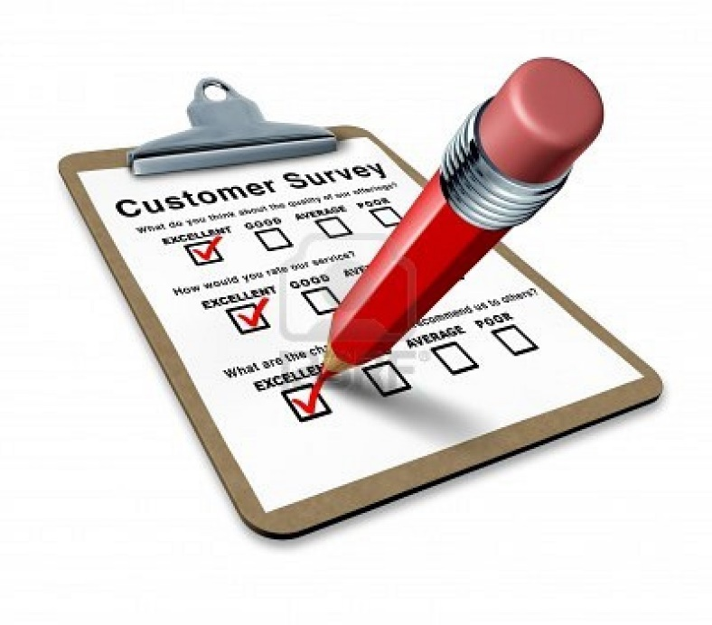
Notes:
High bandwidth forms, low bandwidth forms.
I’ve done some of all of these. Each individual form is useless on its own, but very powerful when combined effectively. Mixed-Methods approach.
Observation in the form of ethnography or usability studies.
You might start with a survey to identify
THEN move on to data.
You might start with data to identify a trend – like poor retention – and then move on to interview research to find out why.

Slide 69

Notes:
High bandwidth forms, low bandwidth forms.
I’ve done some of all of these. Each individual form is useless on its own, but very powerful when combined effectively. Mixed-Methods approach.
Observation in the form of ethnography or usability studies.
You might start with a survey to identify
THEN move on to data.
You might start with data to identify a trend – like poor retention – and then move on to interview research to find out why.

Slide 70

Notes:
High bandwidth forms, low bandwidth forms.
I’ve done some of all of these. Each individual form is useless on its own, but very powerful when combined effectively. Mixed-Methods approach.
Observation in the form of ethnography or usability studies.
You might start with a survey to identify
THEN move on to data.
You might start with data to identify a trend – like poor retention – and then move on to interview research to find out why.

Slide 71
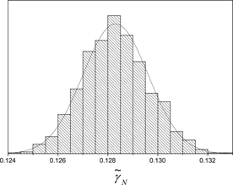
Notes:
Each on their own is not useful, but together, useful!
High bandwidth forms, low bandwidth forms.
I’ve done some of all of these. Each individual form is useless on its own, but very powerful when combined effectively. Mixed-Methods approach.
Observation in the form of ethnography or usability studies.
You might start with a survey to identify
THEN move on to data.
You might start with data to identify a trend – like poor retention – and then move on to interview research to find out why.

Slide 72
Form a hypothesis with a goal
Model ROI of the goal improvement
Does it meet the threshold?
Identify an area of opportunity
Yes, Continue
No, Return
Launch a test
Measure results
Did it meet the goal?
Yes, next improvement
No, iterate, reset or quit
Notes:
Data is small bandwidth and it requires context. Low bandwidth social technology.
Once you have your hypothesis, you have to ask yourself what the best way is to answer that.

Slide 73
Standalone data studies are rarely actionable.
Notes:
The hype – the standalone studies are rarely actionable.
**** "Businesses are complex systems, so if you optimize one element, it rarely creates sustainable value." originally by Peter Drucker.
Don’t start with data. Start with the goal: to learn the important stuff.

Slide 74
Standalone data studies are rarely actionable.
Conduct studies within a larger business process.
Translate hypothesis into data questions and use the right tool for the job.
Notes:
The hype – the standalone studies are rarely actionable.
**** "Businesses are complex systems, so if you optimize one element, it rarely creates sustainable value." originally by Peter Drucker.
Don’t start with data. Start with the goal: to learn the important stuff.

Slide 75
Use data
To discover truths
That cause changes
Notes:
The hype – the standalone studies are rarely actionable.
**** "Businesses are complex systems, so if you optimize one element, it rarely creates sustainable value." originally by Peter Drucker.

Slide 76
Use data
To discover truths
That cause changes
That improve the stuff we make.
Our results take on horrible lives of their own
Notes:
The hype – the standalone studies are rarely actionable.
**** "Businesses are complex systems, so if you optimize one element, it rarely creates sustainable value." originally by Peter Drucker.

Slide 77

Notes:
education and rumor management.
How much data do you give designers and PMs?
People are adding daily active users together and suddenly it’s on a board deck, and you’re like aaaaah it doesn’t work like that.
[K2] Each layer of analysis is done by a human being, who filters and modifies the model you are building of the problem.
The first layer of analysis (and opportunity for error) was done by the brain designing the tracking.
The second and third layers of analysis was done by the analyst when they asked the question & performed the analysis.
The fourth happens with each data consumer as they interpret and act on the information.
With everyone THEY tell, there is a fifth layer of analysis.

Slide 78
Expertise
Exposure
Notes:
Data teams serve the business, it is our job to make their job easier
Don’t overwhelm with data
Data requires more than just expertise, it requires an attention span.
Subjective interpretation is heavily colored by what you want to believe, especially if you're not trained in this.
So, only expose people to the raw data, in proportion to their expertise with data. If you give them something you think they could misinterpret, then stay in touch with them.
Speak here to the hub and spoke method.

Slide 79
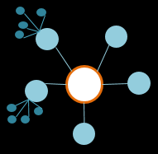
Data
Team
Notes:
Your back-end statistician / programmer geek does not go in this role.

Slide 80
Data
Person
Notes:
Your back-end statistician / programmer geek does not go in this role.

Slide 81

Data
Person
Notes:
Your back-end statistician / programmer geek does not go in this role.

Slide 82
Data
Person
Notes:
Your back-end statistician / programmer geek does not go in this role.

Slide 83
Our results take on horrible lives of their own
Notes:
The hype – the standalone studies are rarely actionable.
**** "Businesses are complex systems, so if you optimize one element, it rarely creates sustainable value." originally by Peter Drucker.

Slide 84
Our results take on horrible lives of their own
Stay involved.
A data team is not just
programmers & statisticians.
We are a change agency.
We must take responsibility for the
changes we drive.
Notes:
The hype – the standalone studies are rarely actionable.
**** "Businesses are complex systems, so if you optimize one element, it rarely creates sustainable value." originally by Peter Drucker.

Slide 85
Use data
To discover truths
That cause changes
That improve the stuff we make.
Notes:
The hype – the standalone studies are rarely actionable.
**** "Businesses are complex systems, so if you optimize one element, it rarely creates sustainable value." originally by Peter Drucker.

Slide 86
We can’t find data scientists to hire
Nobody has the right training yet
There’s too much data & we don’t know where to start.
We can’t get the $$ for headcount or tools.
Our KPIs make people act the opposite than we want.
Standalone data studies are rarely actionable.
7. Our results take on horrible lives of their own
Notes:
The hype – the standalone studies are rarely actionable.
**** "Businesses are complex systems, so if you optimize one element, it rarely creates sustainable value." originally by Peter Drucker.

Slide 87
Hire people with complimentary skill sets.
Train people at multiple levels.
Have goals. Use them to triage research.
Track your efficacy and your ROI.
Choose your KPIs by how you want people to act.
Use the right tool for the job. It’s not always quant.
7. Stay involved. Take responsibility for change.
Notes:
The hype – the standalone studies are rarely actionable.
**** "Businesses are complex systems, so if you optimize one element, it rarely creates sustainable value." originally by Peter Drucker.

Slide 88

Or
Notes:
We’re the frontrunners on this. It’s up to us to set an example, and do the outreach.
So, we share a vision.
And we share a fear. Is data a fad?
A fad is something that sounded great
but never provided real value.
Don’t worry about whether data’s a fad.
Because we all determine whether data’s a fad
by the way we use it.

Slide 89
But wait. There’s more.
Stedman.Kimberly@gmail.com
@KimSted
cameranhetrick@gmail.com
@cameranhetrick
Notes:
We’re going to be doing a lot more work on this frontier. If you want to join us, we’ll be glad to have you.

