Slide 1
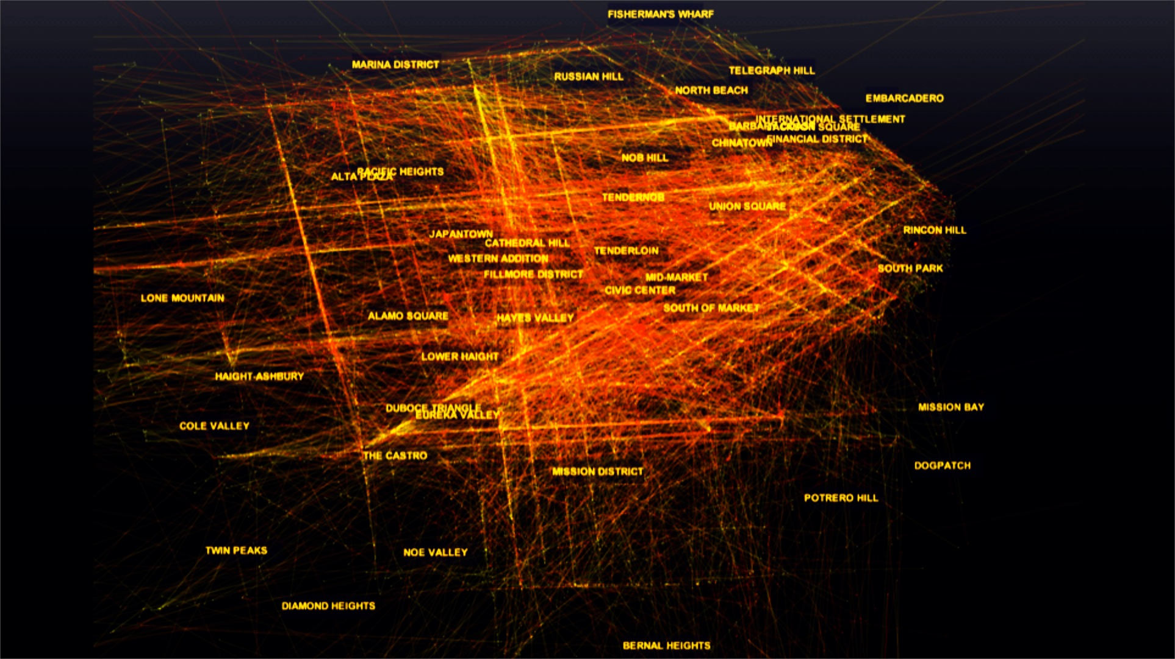
Scaling Charts with Design and GPUs
Superconductor
Leo Meyerovich (@LMeyerov) CEO of Graphistry.com | UC Berkeley

Slide 2
Visibility

Slide 3
Visibility through
design + speed

Slide 4
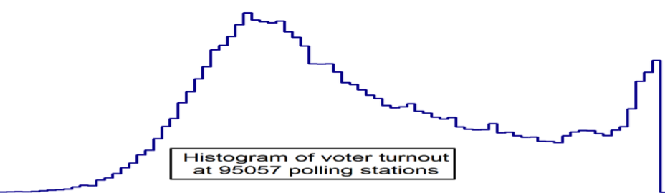
Histogram of Voter Turnout by Town
ballot box stuffing?
# Towns
Most towns had
~40% people vote
0% 25% 50% 75% 100%
Voter Turnout

Slide 5
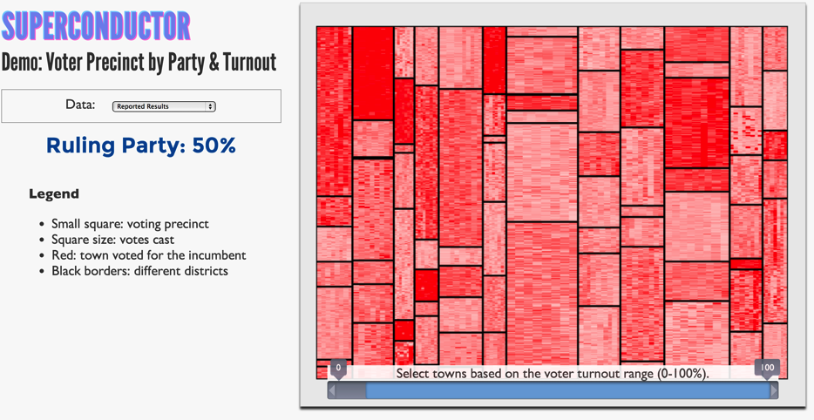

Slide 6

Tiny square shows town size (area) and vote (color)
Incumbent
Opposition

Slide 7
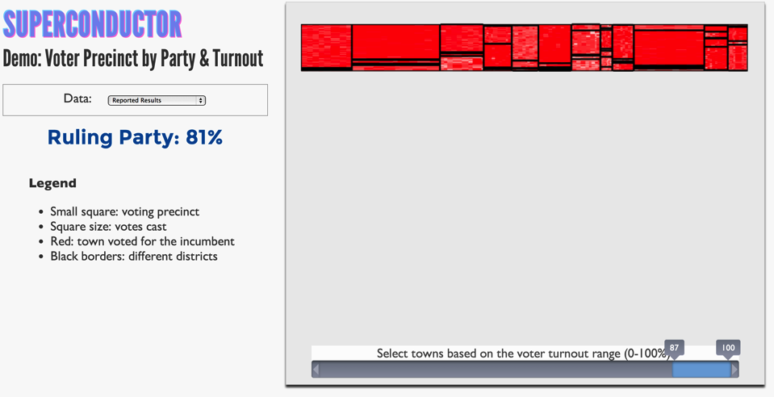
Filter for towns
w/ high turnout

Slide 8
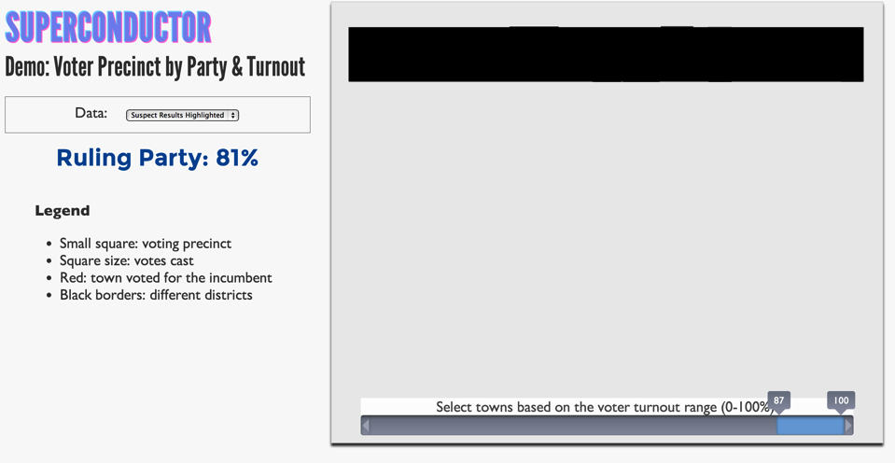
Tag suspicious with black

Slide 9
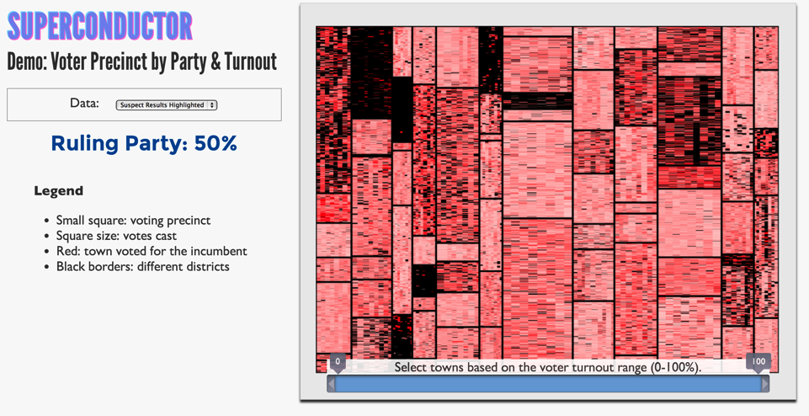

Slide 10
For visibility,
speed ∝ design

Slide 11
Problem: Plot 10+ Time Series Signals

Slide 12
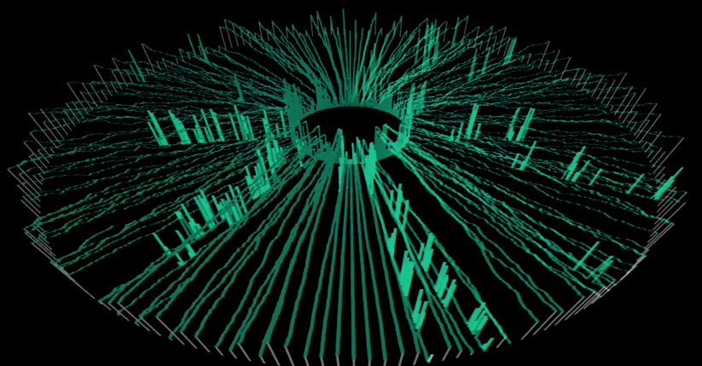
Design → 200 Time Series Signals
100 s
0 s
0 s

Slide 13
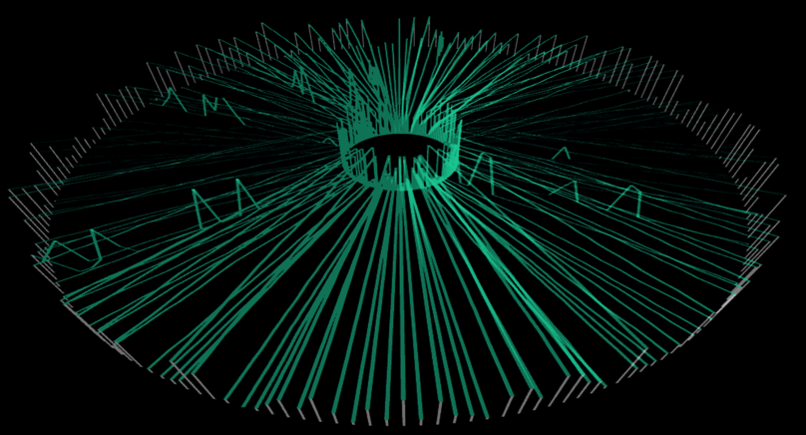
Speed → Pan/Zoom Interactions
38 s
37 s
37 s

Slide 14
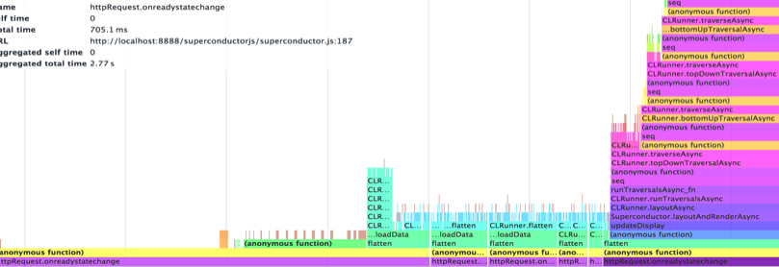
CPU Bottlenecks: naïve and offline
Render
real- time
is 30 ms
Layout
Transform
Parse
0ms
1600ms

Slide 15
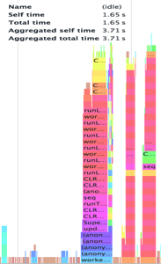
Optimize Binary Data, Multicore Layout, GPU Render
Render
Real-time interaction
Stream from server 12MB+/s
Layout
Prep
0ms
1600ms

Slide 16
Graphs: Placing Nodes and Edges

Slide 17
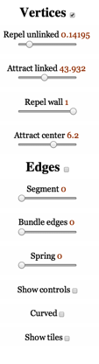


Direct Feedback on Settings

Slide 18

Uber: Trip Start to End

Slide 19
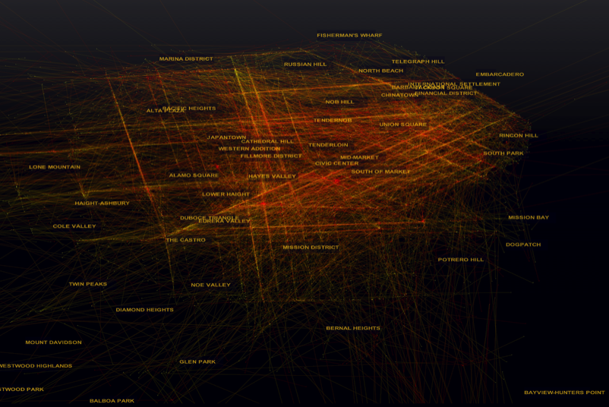
Direct Edge Placement: Overplotting

Slide 20
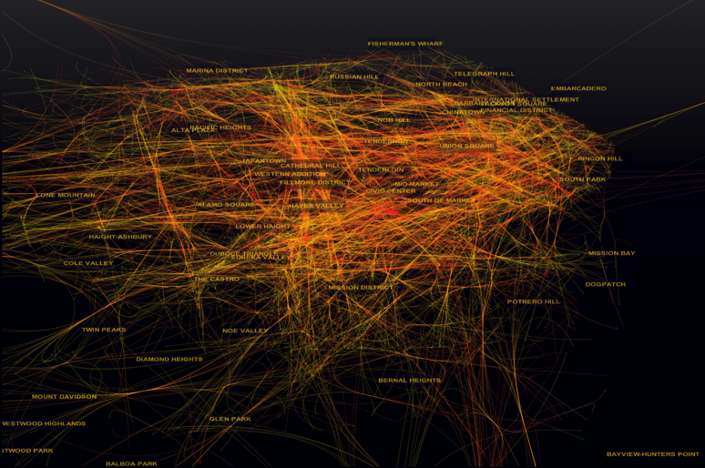
Speed → Design → Edge Bundling

Slide 21
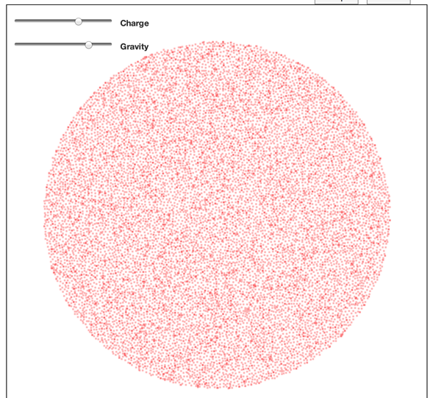

Slide 22

☑ web

Slide 23







Bare Metal in the Browser
Sequential
5 X
SIMD
4 lanes
Multicore
4+ cores
GPU
1024 lanes

Slide 24
Superconductor: Parallel JS Viz Engine
data viz
webpage
data
styling
widgets
Parser.js
Parser
HTML data
CSS styling
JS script
Selectors.CL
Selectors
JavaScript VM
GPU
Layout.CL
Layout
Compiler
Renderer.GL
Renderer
Pixels
SUPERCONDUCTOR.js
BROWSER

Slide 25
Layout as Parallel Tree Traversals
logical joins
…
x,y
w,h
logical spawns
w,h
w,h
Leaf
w,h
w,h
w,h
Parallelism in each traversal!
1. Works for all data sets
2. Compiler: CSS → Schedule

Slide 26
GPU Traversals: Flat & Level-Synchronous
y
x
Array per attribute
h
w
level 1
Nodes in arrays flat
parallel for loop
level synchronous
level n
Tree
Compiler handles transform of code & data
Notes:
Gloss over details of what is going on. Take away should be: this stuff is complicated, but don’t worry, compiler does it all for you.
[what is meant by ‘subtree’ here? And ‘including edges’? Get this slide clarified.]

Slide 27
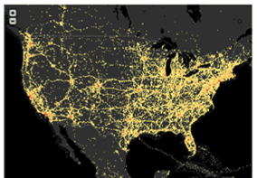

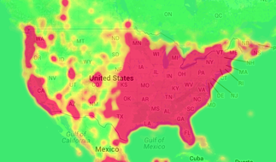
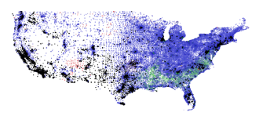
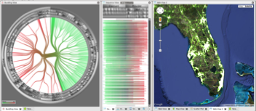
More Scalable Designs
Immens (Stanford)
Nanocubes (AT&T)
MapD (MIT)
Abstract Rendering (Continuum)
Synerscope

Slide 28
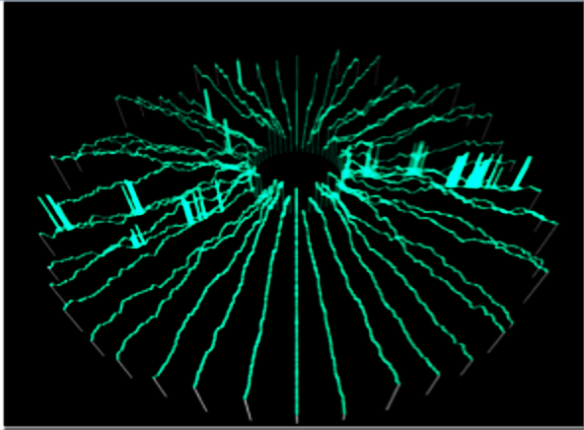
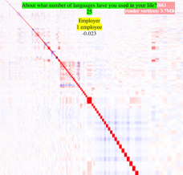
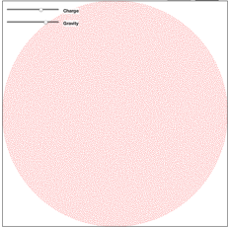
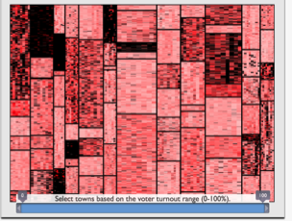
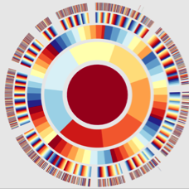


Slide 29
Achieve data visibility through hardware-accelerated designs
(and deploy on the web ☺ )

Slide 30
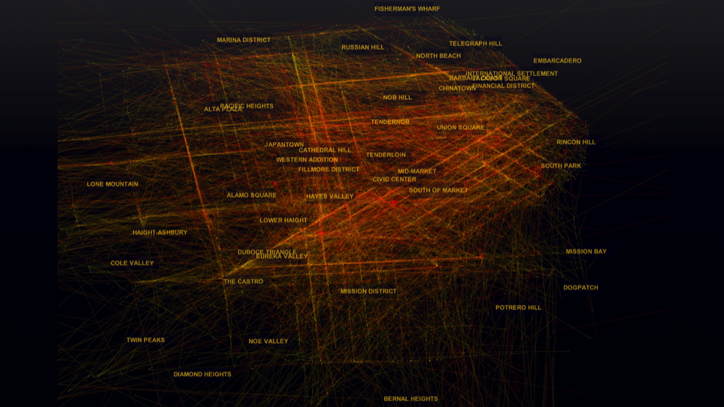
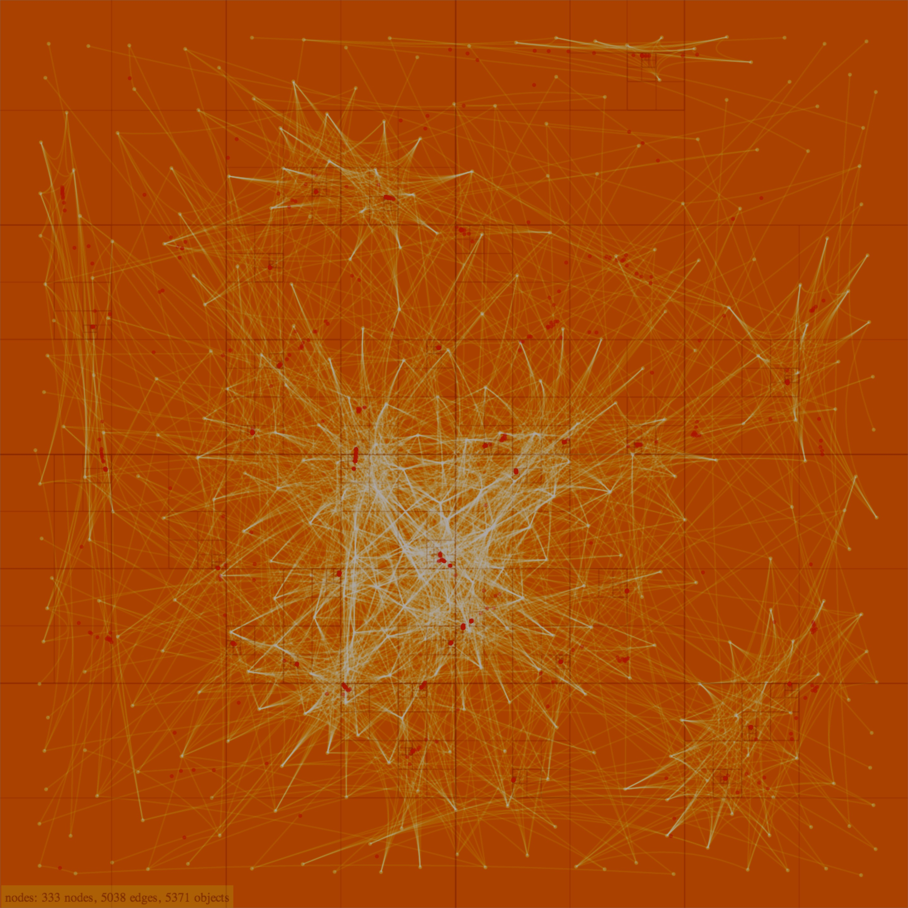
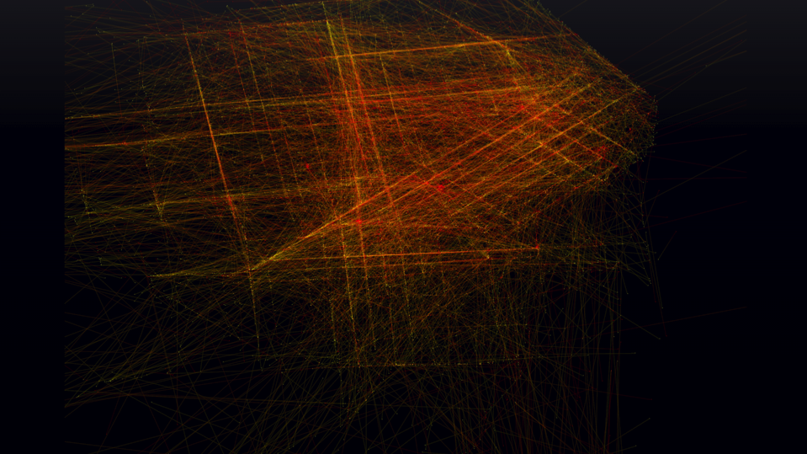
Visualize Magnitudes More Data in the Browser
Graphistry
Leo Meyerovich (@LMeyerov) CEO of Graphistry.com | UC Berkeley

Slide 31
Layout as Parallel Tree Traversals
logical joins
…
x,y
w,h
logical spawns
w,h
w,h
Leaf
w,h
w,h
w,h
Parallelism in each traversal!
1. Works for all data sets
2. Compiler: CSS → Schedule

Slide 32
GPU Traversals: Flat & Level-Synchronous
y
x
Array per attribute
h
w
level 1
Nodes in arrays flat
parallel for loop
level synchronous
level n
Tree
Compiler handles transform of code & data
Notes:
Gloss over details of what is going on. Take away should be: this stuff is complicated, but don’t worry, compiler does it all for you.
[what is meant by ‘subtree’ here? And ‘including edges’? Get this slide clarified.]

Slide 33

Today’s Supercomputer-in-a-Pocket
4-way SIMD
Phone
16-lane CPU
1024-lane GPU
core 1
L1d: 32KB
1
2
3
4
Challenge:
Parallelize Data Visualization
Prefetch Engine
L2: 1MB
256-way SIMT
RAM: 2GB
GPGPU core 1
2
3
4

Slide 34
Problem: Dynamic Memory Allocation on GPU?
rect(…); …
function circ (x,y,r) {
buffer = new Array(r * 10)
for (i = 0; i < r * 10; i++)
buffer[i] = cos(i)
}
line(…); …
oval(…)
circ(…)
dynamic allocation☹
square(…)
rect(…); …
1.0 0.8 0.5 0.2 0 0.2
Notes:
[MENTION THAT WE STAY ON GPU HERE. Rewrite to include this.]
‘malloc’ is what we want, but can’t have. Need solution.

Slide 35
Dynamic Allocation as SIMD Traversals
allocRect(…)→ 7
fillRect(…)
allocLine(…)→ 6
fillLine(…)
allocCirc(…)→ 4
fillCirc(…)
allocRect(…)→ 6
fillRect(…)
1.0 0.8 0.5 0.2 0 0.2
1.0 0.8 0.5 0.2
1.0 0.8 0.5 0.2 0 0.2
1. Prefix sum for needed space
3. Distribute offsets & compute
2. Allocate buffers
4. Give OpenGL buffer pointer

Slide 36
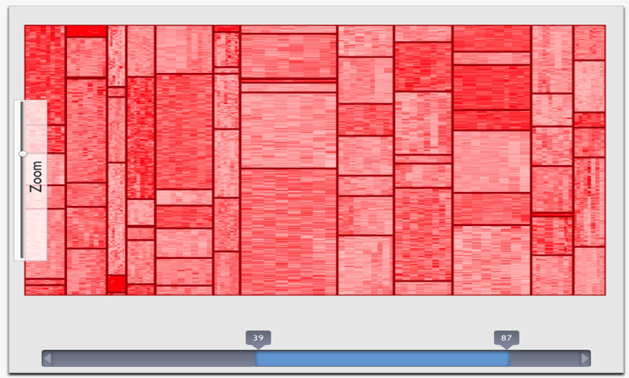
CPU vs. GPU for Election Treemap: 5 traversals over 100K nodes
COMBINED: 54X !
WebCL: 70X
WebCL: 30X

