Slide 1
The Insight Economy
Krista Schnell
February 11, 2014

Slide 2

Data
Marketplace

Slide 3

Insight
Economy

Slide 4


The value of insights…
and creativity

Slide 5

Insight as a differentiator
Volume
Analysis
Privacy
Value

Slide 6





Data Supply Chain:
Putting information
into circulation

Slide 7
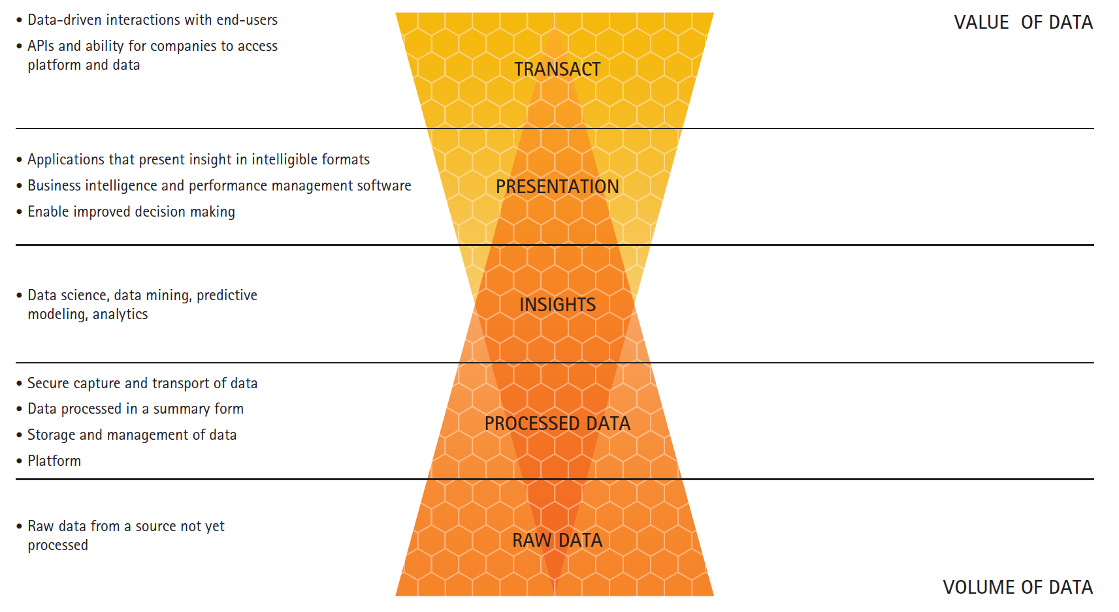
Data Value Continuum: From Raw Data to Insights

Slide 8


Slide 9

Data Monetization
Keep
Sell
Partner
Share

Slide 10

“Data Monetization in the Age of
Big Data”

Slide 11


Slide 12

krista.schnell@accenture.com
@kristaschnell
#techvision2014

