Slide 1

The Netflix Data Platform –
A Recipe for High Business Impact
Kurt Brown, Director, Data Platform

Slide 2
Agenda
Architecture
Cloud
OSS
Philosophy

Slide 3
Architecture

Slide 4
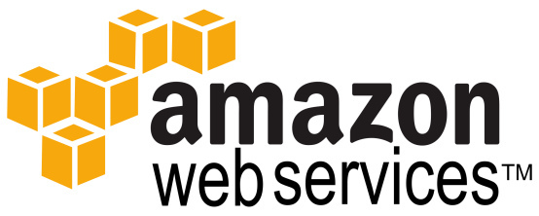


Slide 5
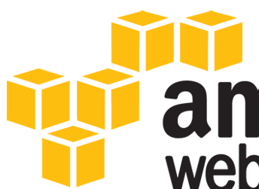
S3

Slide 6
S3
~5 PB

Slide 7


Slide 8
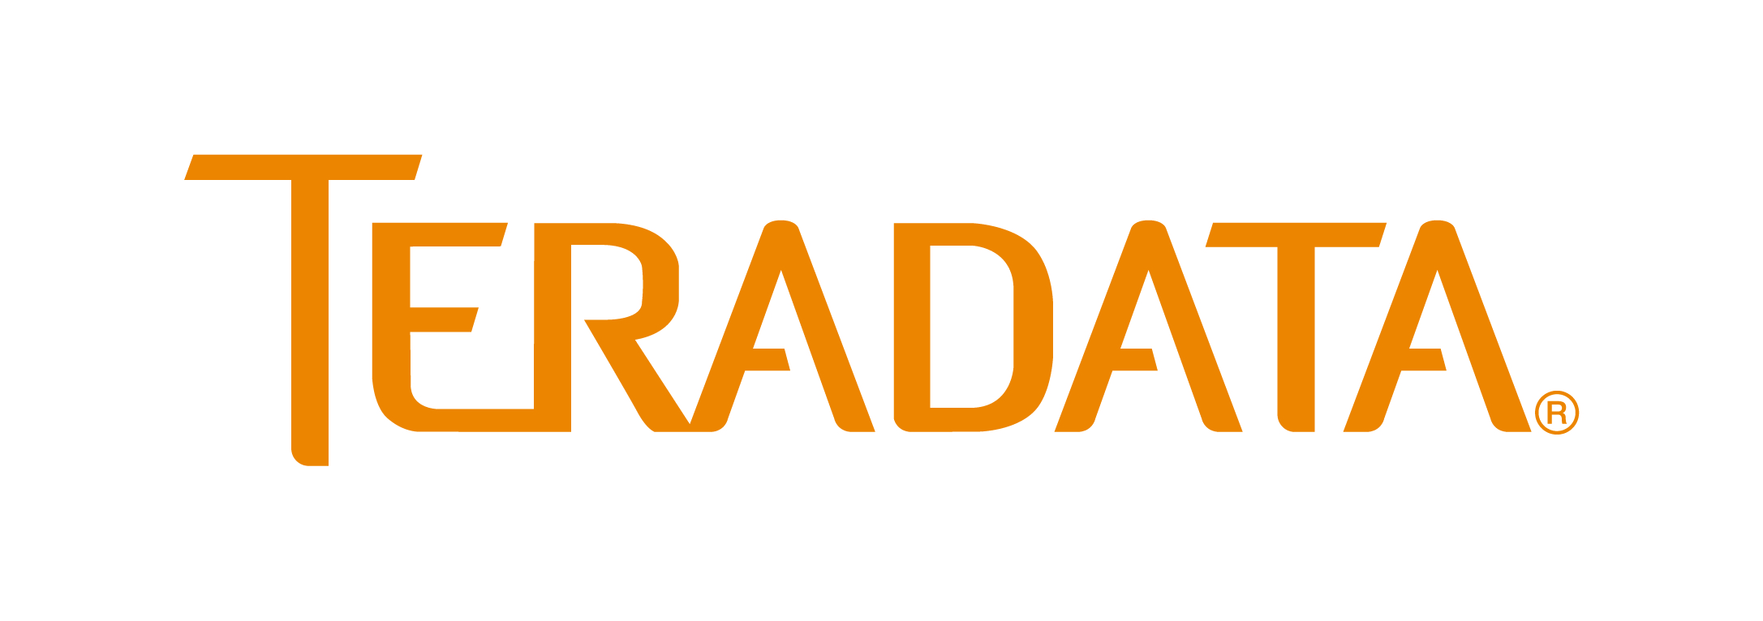

Slide 9


Slide 10
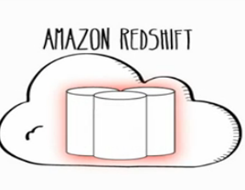
vs.

Slide 12
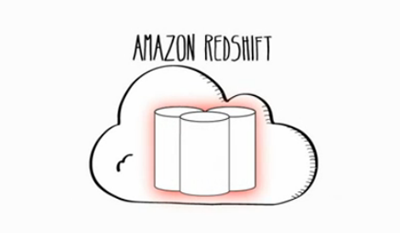

Slide 13


Slide 14


Slide 15


Slide 16


Slide 17


Slide 18


Slide 19



Slide 20


Sting

Slide 21

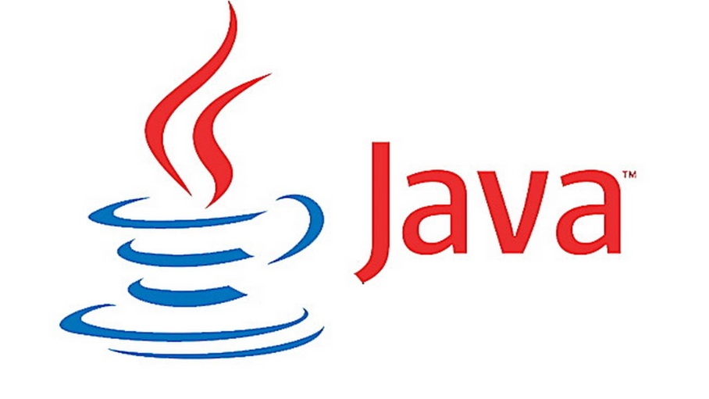



Slide 22











Data Platform
Sting
S3

Slide 23
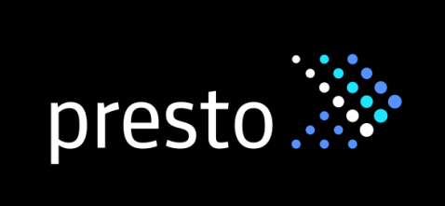





/ Shark
Tez

Slide 24

Data Platform
Sting
S3
Tez
Yarn
???
?

Slide 25
Cloud

Slide 26
Yes

Slide 27
OSS

Slide 29
Cost

Slide 30
Cost

Slide 31

Flexibility
Growth
Spikes
Self-service

Slide 32
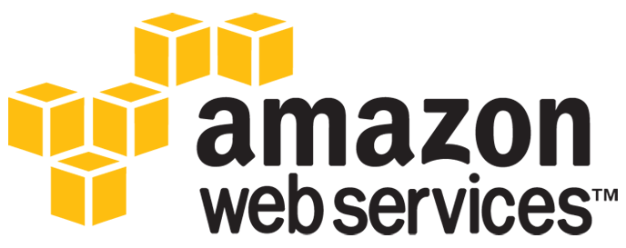
Services
SQS, EMR, S3,…
Available
Focus!

Slide 33

Redundancy / Global Presence
Multi-DC
International

Slide 34

Cloud Native
Build for failure
Swing systems
Excess capacity

Slide 35

Right for everyone?
Are you Google or Facebook?
Netflix
Undifferentiated
Opportunity Cost

Slide 36
Cost?

Slide 37
OSS

Slide 38


General OSS
Pooled goodness
Manage own destiny
Vendor relationships
Conflicting agendas

Slide 39
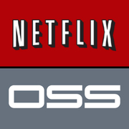
Netflix OSS
Meet Netflix needs
Shared direction
Recruiting & Retention
Code quality
Contributions

Slide 40





Data Platform OSS
Genie
Lipstick
Aegisthus
S3mper
Suro
Future: Inviso

Slide 41

Should you open source?
We’re all using it
You get value
Others would get value
Will invest some time

Slide 42
Philosophy

Slide 43
Netflix Expense Policy
“Act in Netflix’s Best Interest”

Slide 44

Development & Deployment Flow
Best
Practices
Clean-up
Components
Consultation
Tools
Automation

Slide 45

DBAs?

Slide 46

QA Team?

Slide 47

Testing

Slide 48

Accept things WILL break

Slide 49

Safety Nets

Slide 50
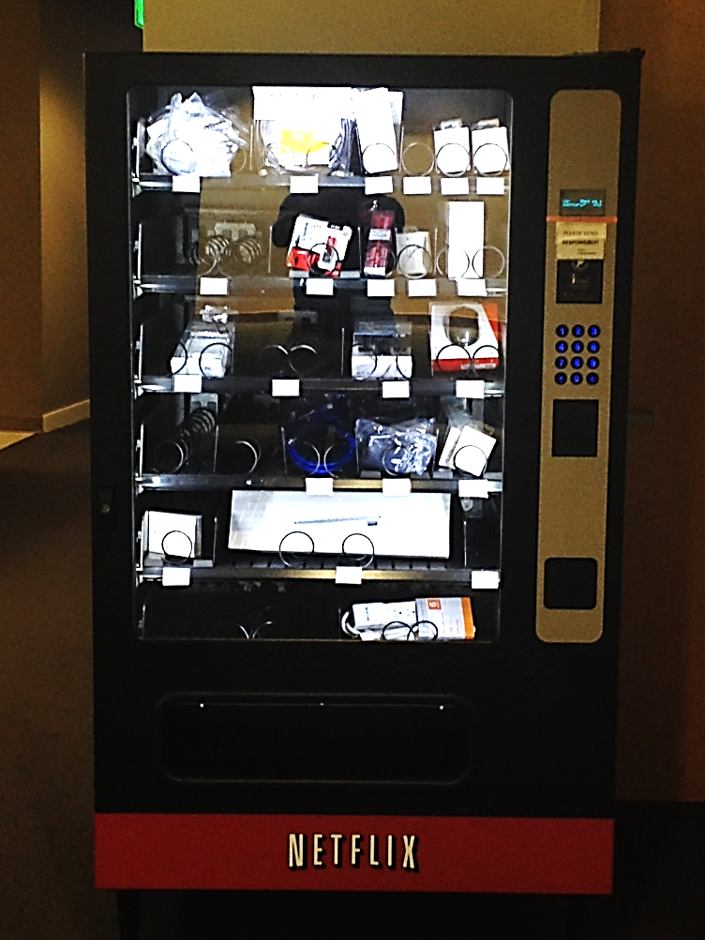
Give folks what they need

Slide 51

Eliminate Process
Status Reports
Tickets
Documentation

Slide 52

Tell vs. Ask

Slide 53

Does it really matter?

Slide 54
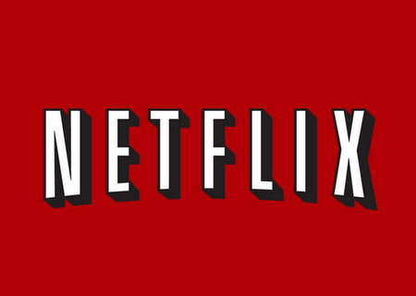
Questions?
kurtbrown@netflix.com
http://jobs.netflix.com

