Slide 1
How TripIt Uses Data to Organize Itineraries No Matter Where You Book
Edith Harbaugh
Director, Product
February 11, 2014

Slide 2
What is TripIt?
How TripIt uses data
How can you use your data

Slide 3

Edith Harbaugh, Director of Product Marketing TripIt (@tripit)
Customer Insights & Analytics
Founder of TripIt for Teams
10+ years consumer & enterprise startups
2 patents in portal sharing
BS Engineering, Harvey Mudd College

Slide 4
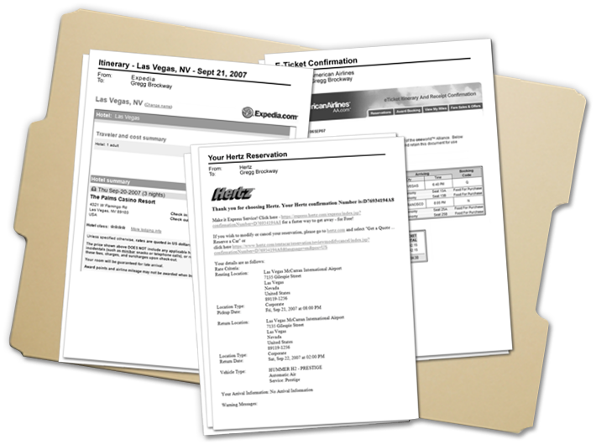
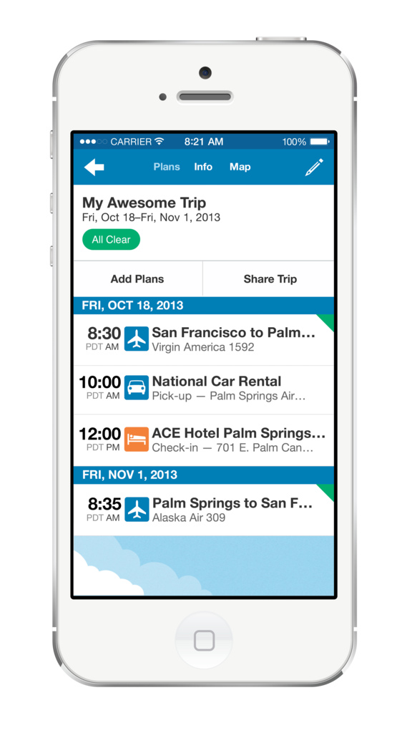
What is TripIt?
Most people travel like this…
…when they could travel like this!
Book anywhere – send your itinerary to plans@tripit.com, and our “elves” will make a beautiful, easy to read mobile itinerary

Slide 5
Why do people love TripIt?
If you travel/fly lots, there is no reason not to be using @tripit. Already plugging in honeymoon travel details
tripit is too cool, I know all of you that already use it know that, but I only just found out! that first time automagic joy is fab
Just finished booking travel for next few months. Looks like I'll be traveling in 13 of the next 15 weeks! Thank goodness for @Tripit
Wow, the @tripit app for iphone is actually useful and really easy to use. Colour me impressed.
Just booked my flight to Atlanta for TechEd... Simple email to TripIt and its all updated - love it
My new fav travel app is "tripit". I can't figure out how it does what it does, maybe magic, but it's really cool.
9 million + users, #1 iOS App for Travel

Slide 6
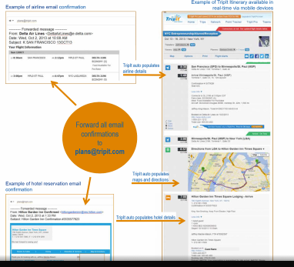
How does TripIt “DoIt”?
A template for every vendor email, which “reads” the relevant information, formats and stores it

Slide 7
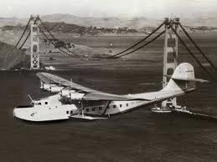
In the beginning, data was easy…
Top airlines, top hotel chains…

Slide 8

…as we grew, we could still eyeball logs…
“Wow, OpenTable & Eventbrite keep showing up in our logs – let’s add them!”

Slide 9
…then with 1 million monthly emails we were at an inflection point…
Vendors changing confirmations for holidays, promotions, and “just cause.”

Slide 10
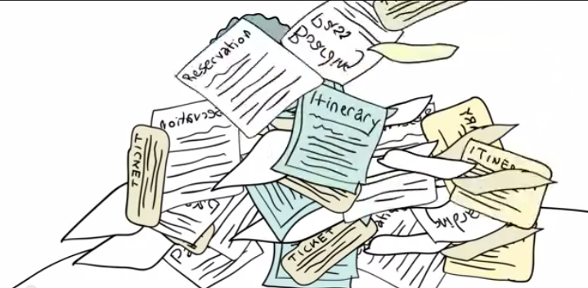
Time to get organized!
Data to the rescue!

Slide 11













What are our most common inbound itinerary emails?
Do we have coverage on most common vendors & templates?

Slide 12
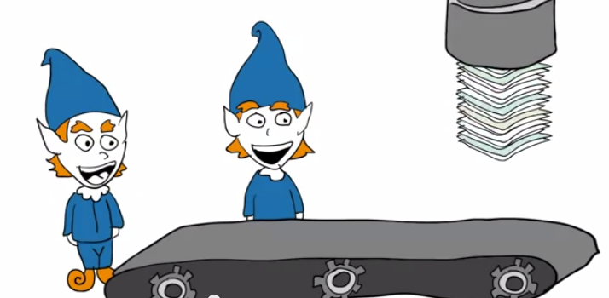
How are confirmation emails evolving?
Reporting to track vendors, formats, frequency

Slide 13

Today…TripIt supports 3,000+ vendors
Trains, planes, automobiles, events, concerts, everything our users need for a stress-free trip

Slide 14
How can you use your own data?
Focus on low hanging fruit
Use common sense with small datasets
Growing pains
Once enough data, build reports around most common needs
Critical mass
Use dataset as a “push” for customer requests

Slide 15
Questions?

