Slide 1
Behavior-driven Machine Translation at eBay
Asim Mathur, Irina Borisova amathur@ebay.com , irina@chegg.com

Slide 2
Outline
Intro
  Why is eBay Investing in Language Technology?
  Machine Translation Experience at eBay
  Key Data Challenges
Machine Translation Training Process
  Data Selection
  Evaluation
Measuring Language Performance at Scale

Slide 3
Why is eBay Investing in Language Technology

Slide 4



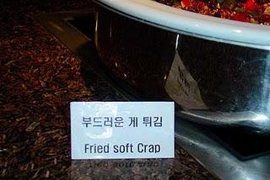
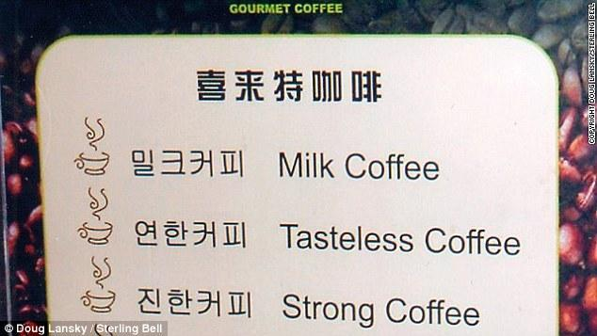
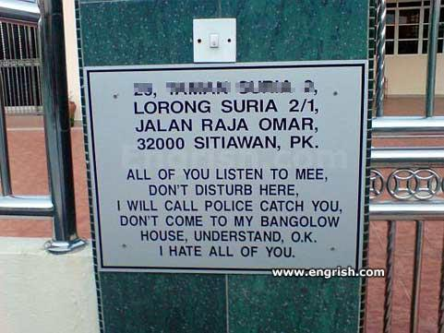

Slide 5
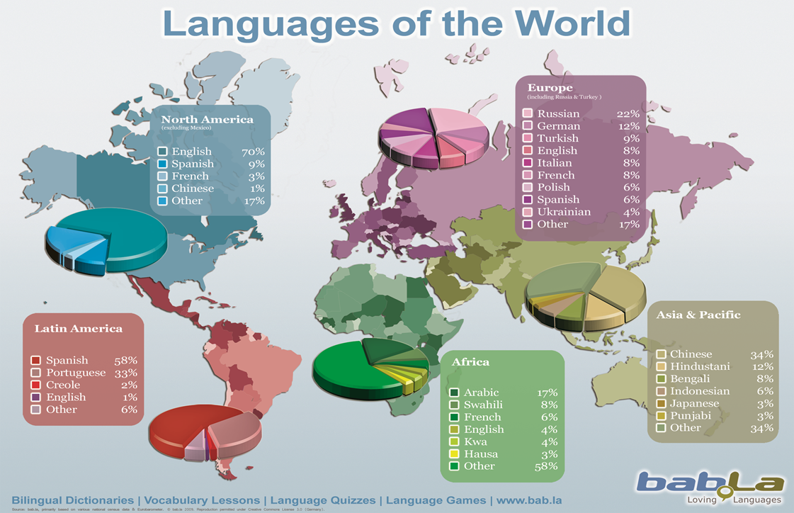
Notes:
This slide still comes empty

Slide 6
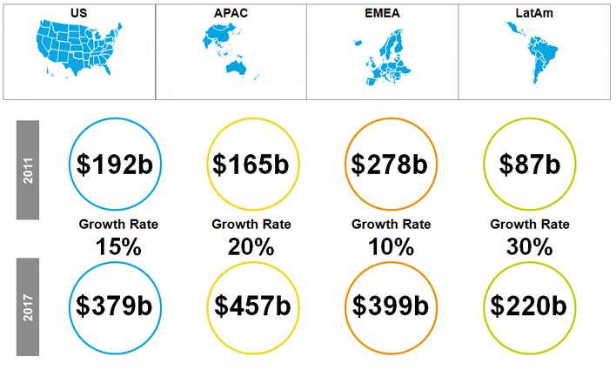
E-Commerce Growth by Region
Source: Forrester Research
Notes:
Maybe split into 2 slides or remove 1 graph

Slide 7
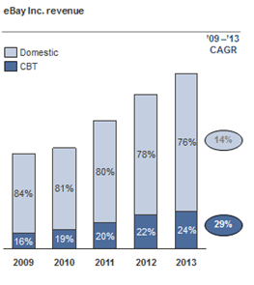
Why Is Machine Translation Important For eBay?
Cross-border trade is growing 2x as domestic!
It’s already big: almost 25% of Inc. business
61% of eBay GMV is international
Notes:
Changed “it” to machine translation in the header; changed CBT to cross-border trade

Slide 8
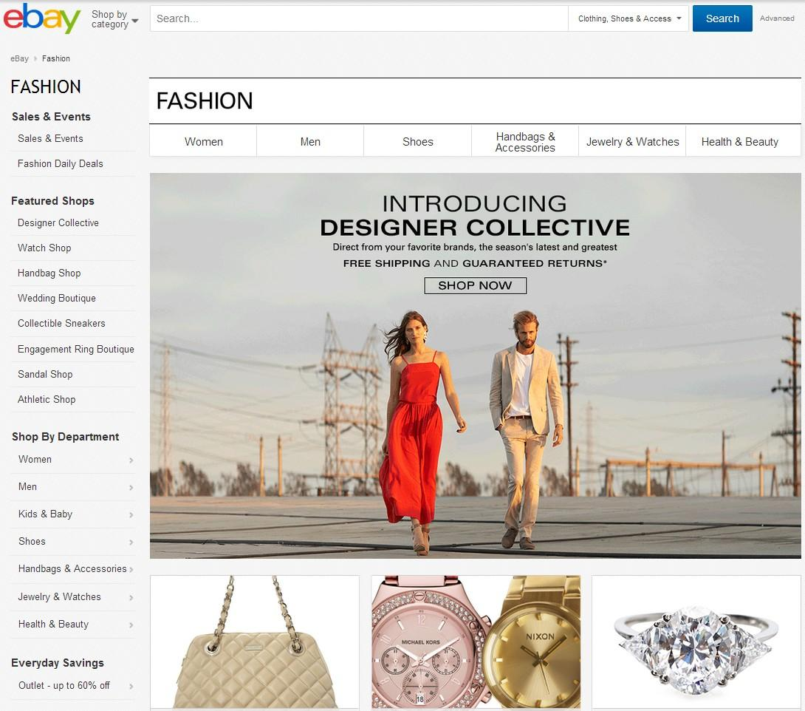
Static Content
…is translated by the localization team
Notes:
This is what most companies do with translation

Slide 9
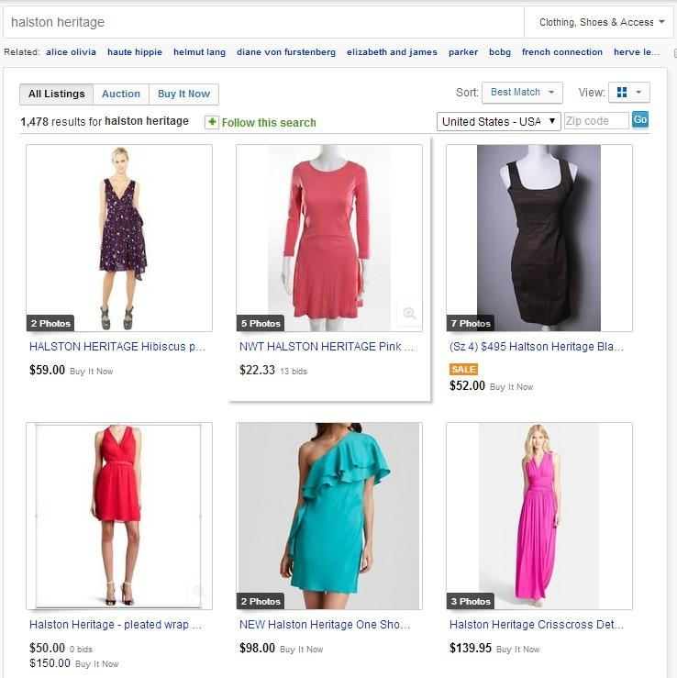
Dynamic Content
…requires machine translation
Inventory eligible for Russian market: 60M listings
Average # of characters per listing: 3,000
Sentence duplication: 50%
# of human translators: 1,000
It would take more than 5 years!
And this is for one language pair only!
Notes:
30% turn over of the inventory every month
Other content: messages, customer support

Slide 10



Solution: Statistical Machine Translation
Statistical machine translation started about 20 years ago and is now very competitive
Aims at teaching a machine how to translate from one language to another using examples of human translated documents
Training
Translation
MT engine
Source sentence
Data
Translated sentence
Model

Slide 11
Machine Translation Experience at eBay

Slide 12




Translation Flow
1. A user issues a query in the foreign language
Notes:
Challenge on the side?

Slide 13
Translation Flow
2. The engine translates the foreign query into English
lunettes de soleil homme
men’s sunglasses

Slide 14
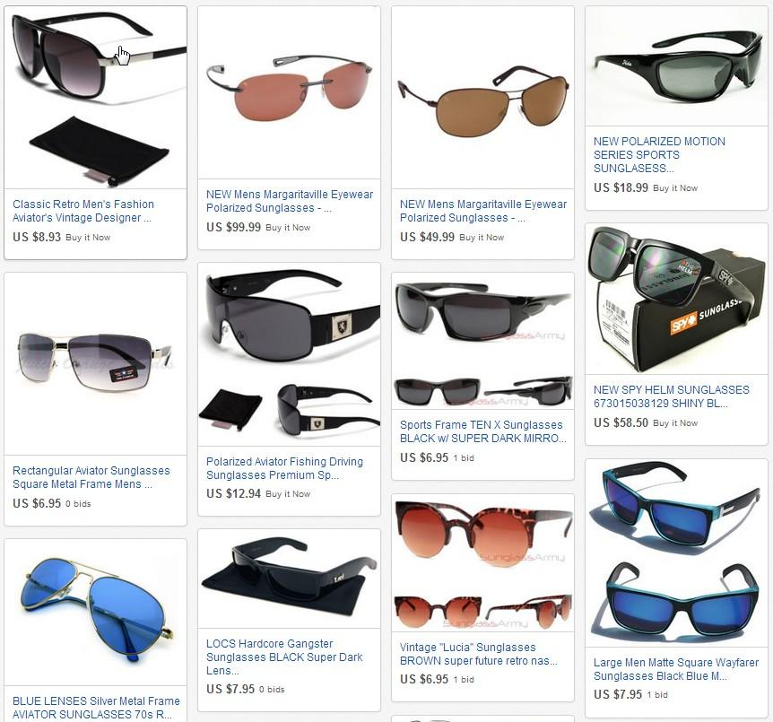

Translation Flow
3. The translated query is issued against the eBay English search engine to retrieve English inventory
men’s sunglasses

Slide 15

Translation Flow
4. The engine translates the English inventory into the foreign language

Slide 16
Translation Flow
5. The translated inventory is served to the user
Notes:
Transition to next?

Slide 17
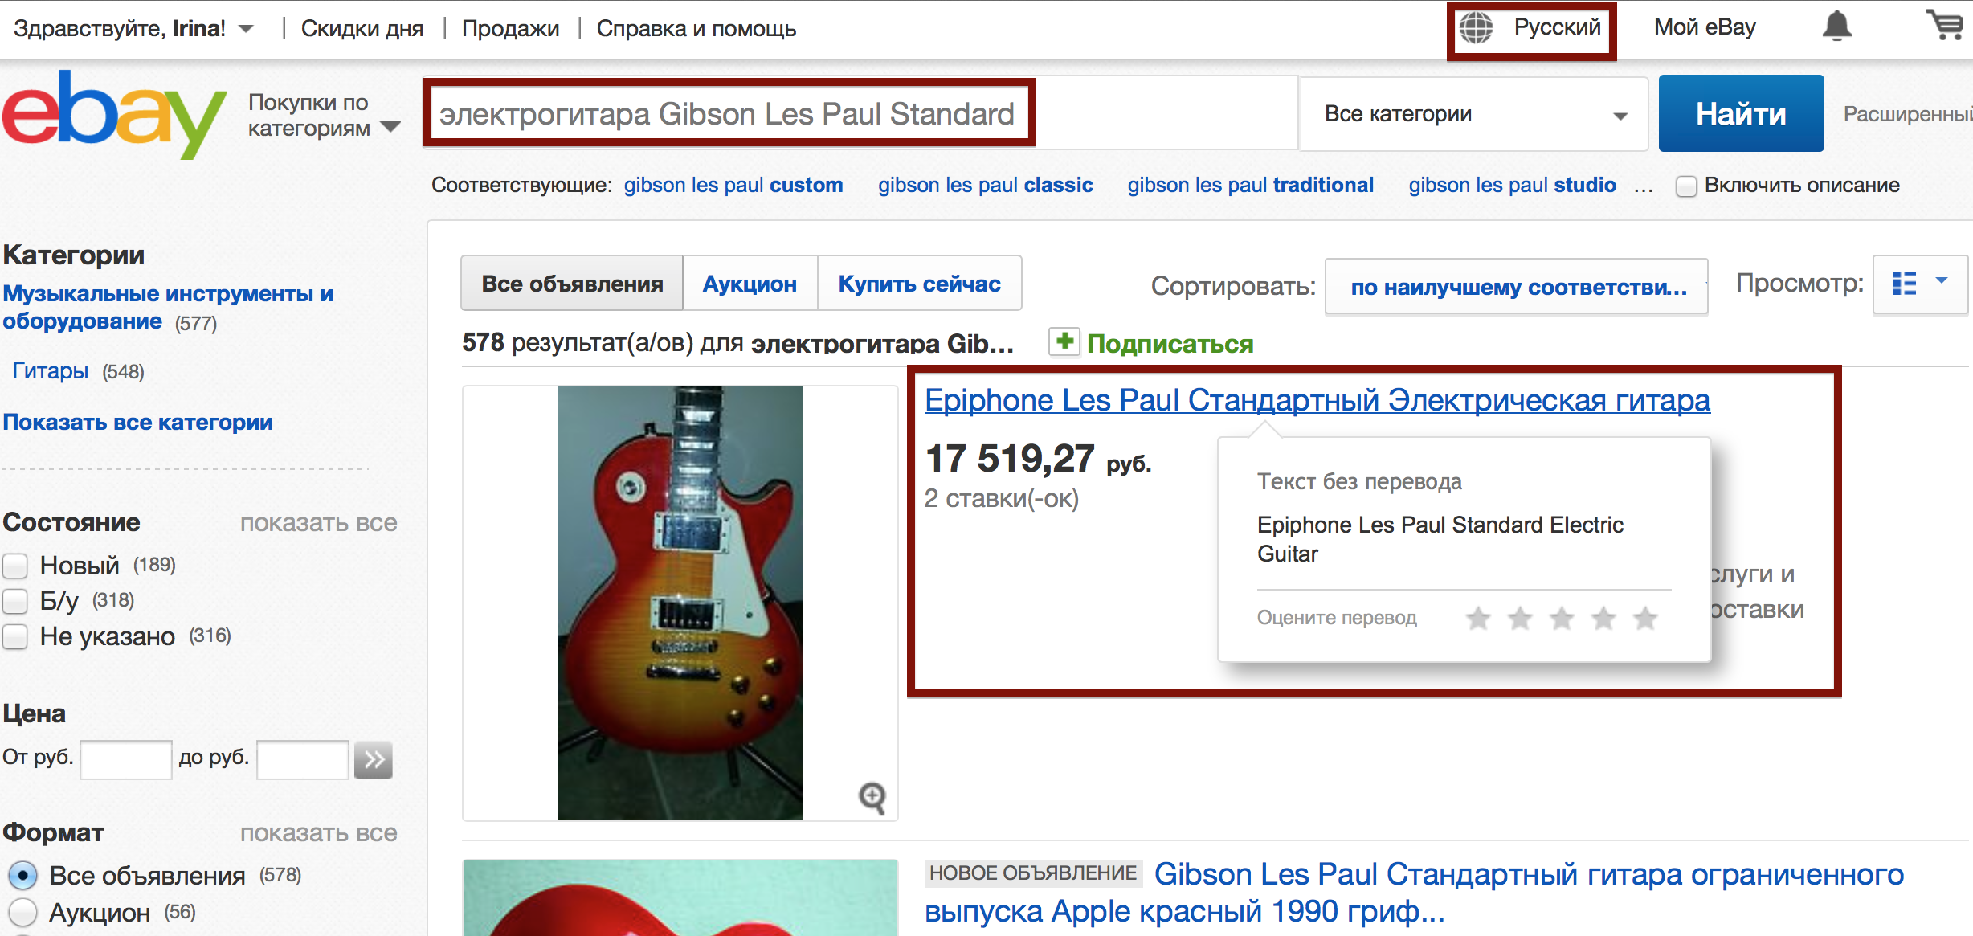
Machine Translation Experience at eBay

Slide 18
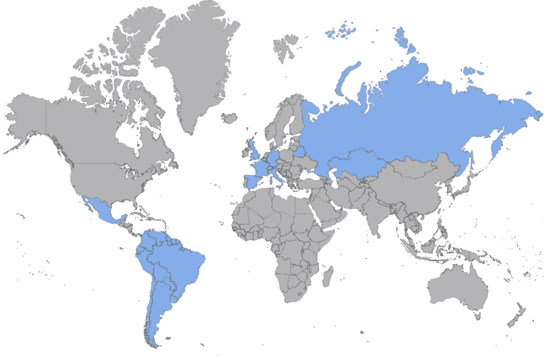
Types of MT at eBay:
Search query translation
Item title translation
Item Descriptions (Planned)
Member-to-Member communication (Planned)
Supported languages:
Operational Statistics:
Russian | German
Spanish | Italian
Portuguese (Brazil) | Hindi (Planned)
French | Chinese (Planned)
Avg. translation calls for - Queries: ~90 Million per day Item Titles: ~180 Million | Translation Latency - Queries: ~ 99%ile within 10 ms Item Titles: ~ 99%ile within 80 ms
Service Availability: ~99.95 %

Slide 19
Key Data Challenges

Slide 20
eBay Scale
A pair of shoes sells every 2 seconds
Headphones sold every 12 seconds
An car or truck sells every 5 minutes
Women’s accessories sell every 2.5 seconds
An iPad sells every 10 seconds
A boat sells every 35 minutes
A Woman’s dress sold every 2 seconds
A major appliance sold every 19 seconds
A Harley-Davidson sells every 38 minutes
A cell phone sold every 4 seconds

Slide 21
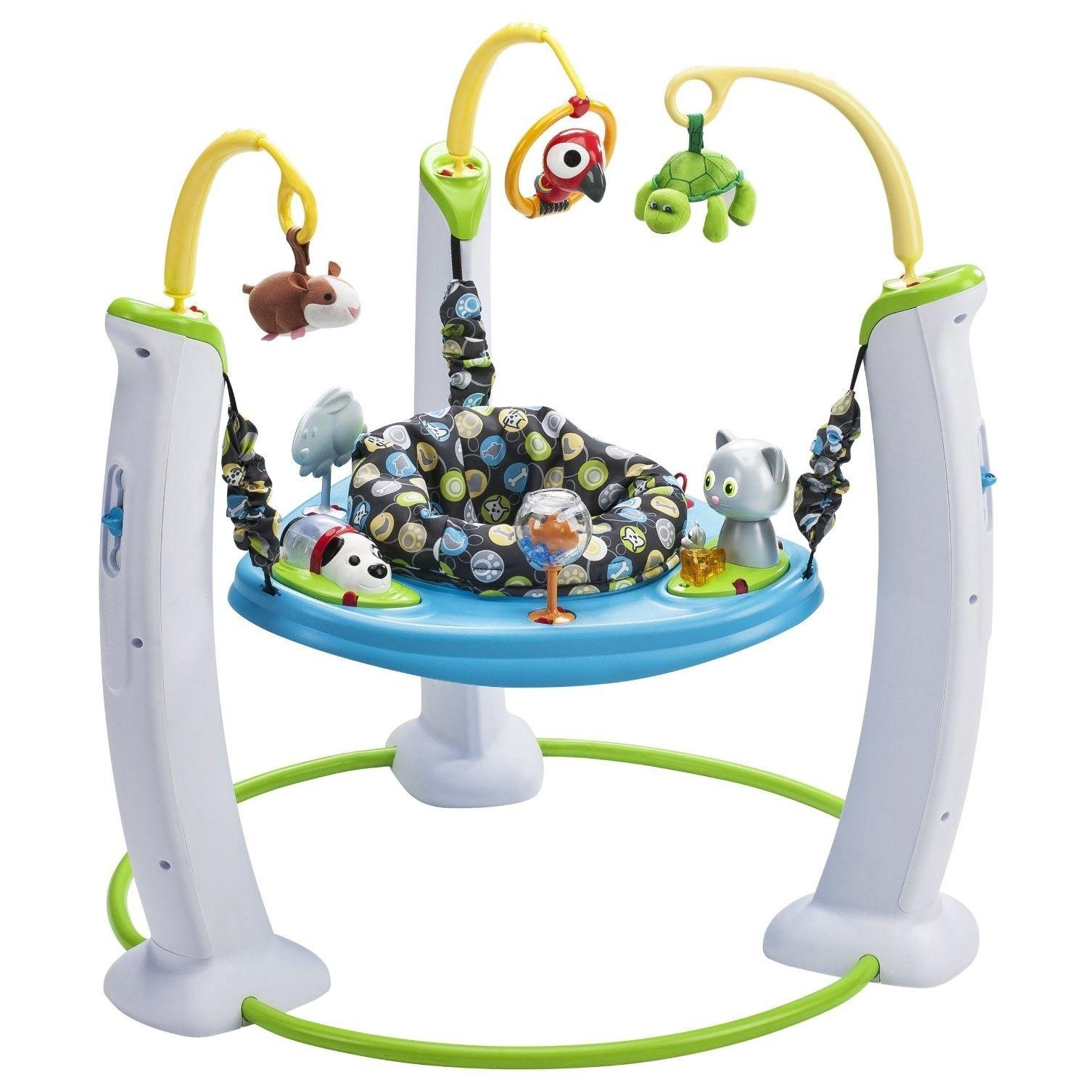
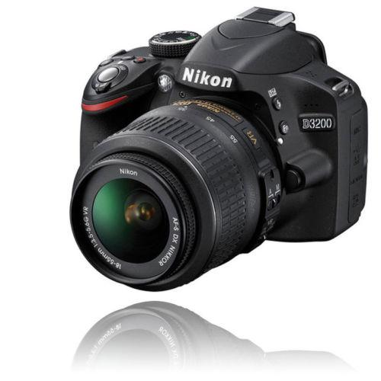
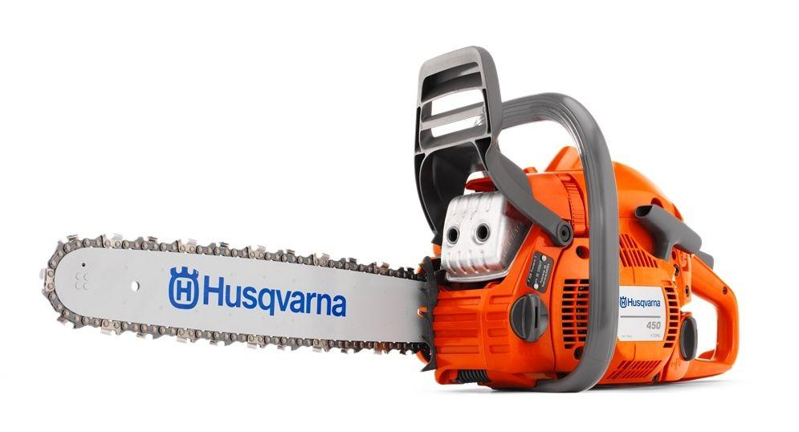

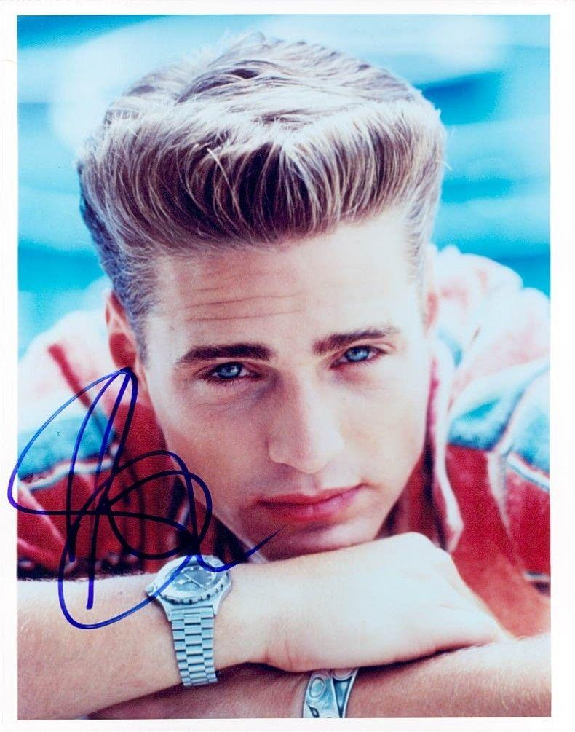
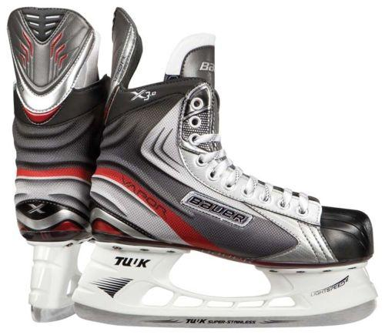
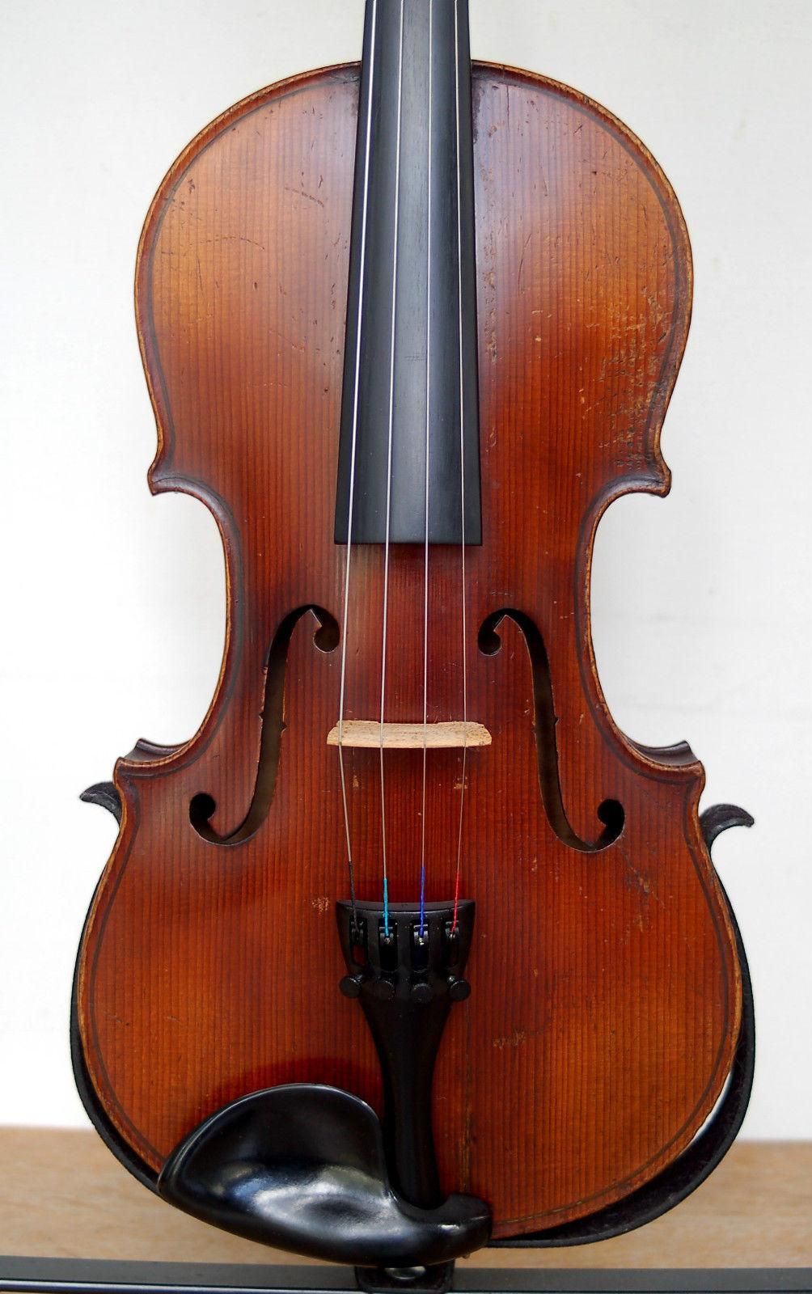
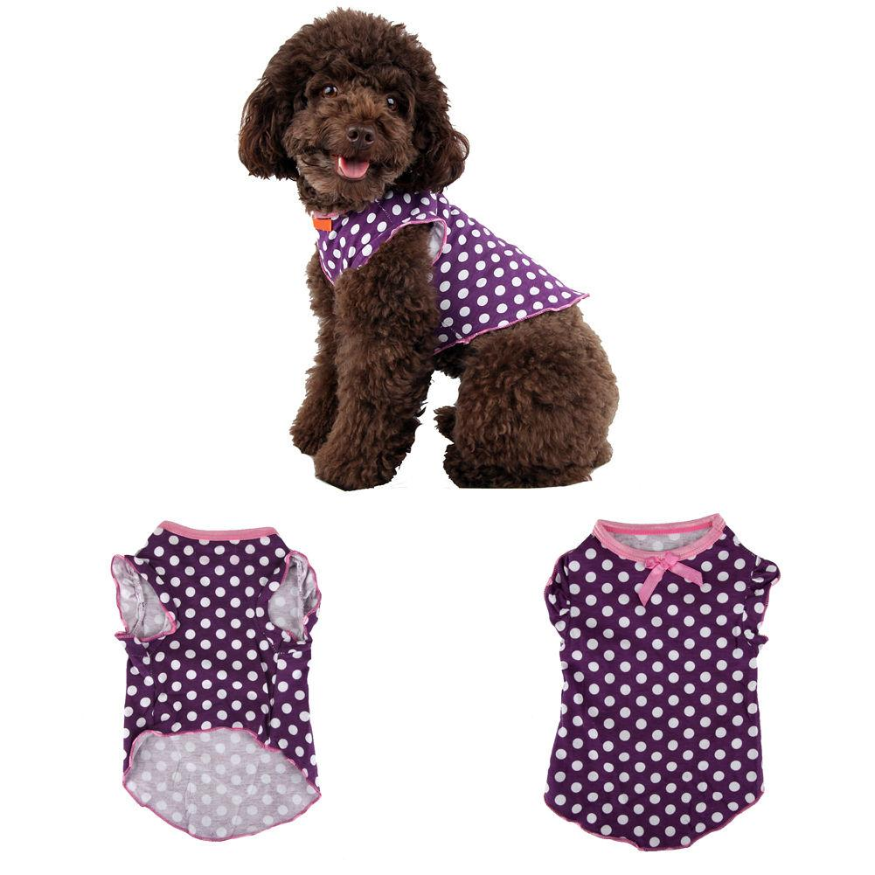


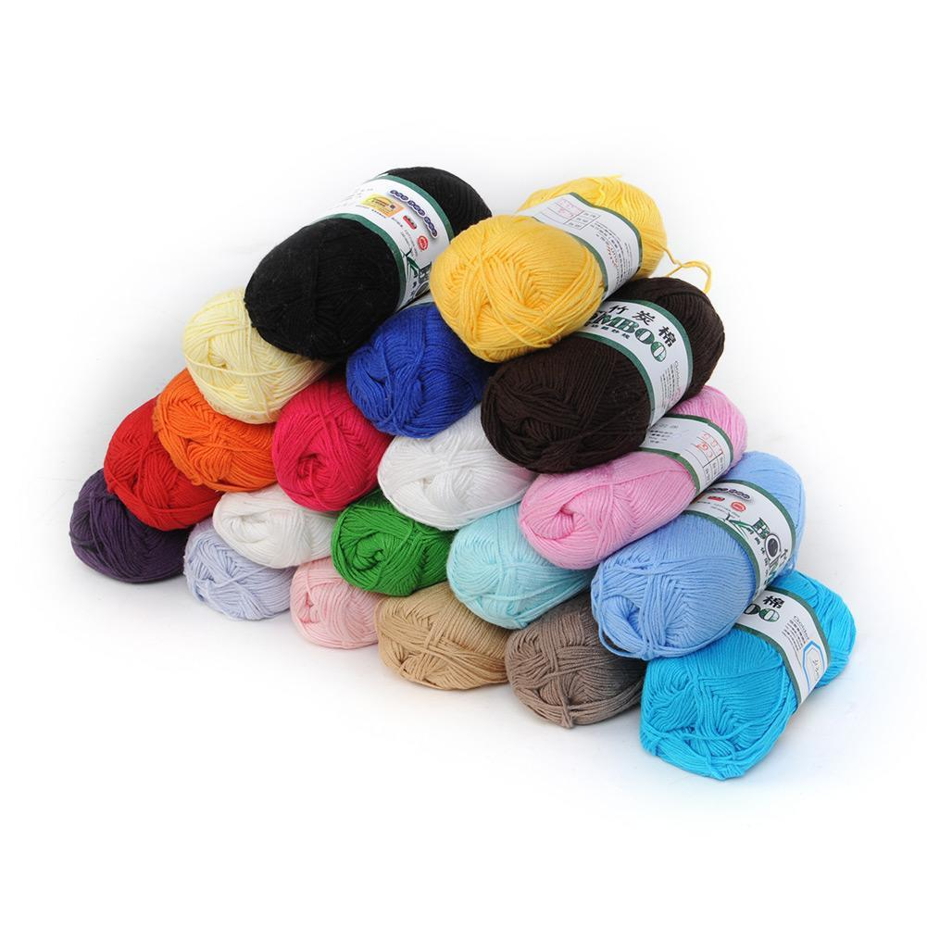
Very Diverse Data
A tiny sample from 15,000 categories. 800 million listings live at any given time.

Slide 22
A Wide Range of Inputs
The translation engine must accommodate a wide range of input like
  Foreign queries: require translation
  English queries: don’t try to translate!
  Ambiguous queries (no article): “figure” (English or French?), “time” (English or Portuguese?)
  Misspelled queries: e.g. 334 likely spelling variants of “Samsung” in 10M queries
  sansung samsug samsumg samung amsung samnsung smsung samsuns samaung sumsung smasung samsng samsing samusng sammlung ssamsung samdung samusung sasmung sasung samsugn samgung samsum samsuung samsubg samsnug samsunng samsunf ssmsung samsunh samasung samnsug damsung sampsung sanmsung samssung sammsung samsund saamsung aamsung samsyng samsungs samsong samsungg samsang samsungh samsunga sqmsung sambung hamsun sasmsung samsumng samsaung samsunv samsunsg samnung salmsung samsunt samnsun sammung asmsung samsjng samunsg samsungn samsunge salsung samyoung samusug samsui samsnung sampung samgun samesung samcung isamsung gamsung zamsung xsamsung samxung samsuny samsunfg samsuing sameung ùsamsung szmsung swmsung smausng samumg samsusng samsunug samsunb samsoung samsiung samsdung samiang asamsung sumsumg sumsong somsung smasun smamsung samzung samusun samsungù samsungo samsungf samsums samsujg samsuhg samsin samshng sampsun saksung saamsug rsamsung lsamsung eamsung xamsung …

Slide 23





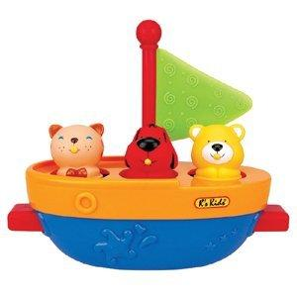
Brand Preservation
VS.

Slide 24
Machine Translation Training Process

Slide 25
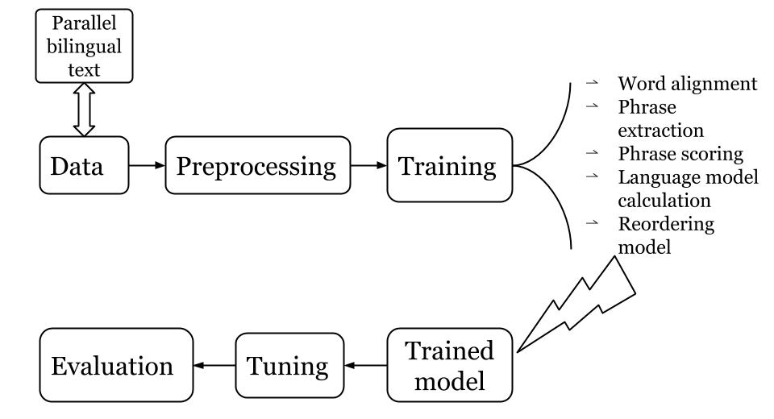
Machine Translation Training
Text.en-es
This is a line
Text.es-en
Esta es una línea

Slide 26
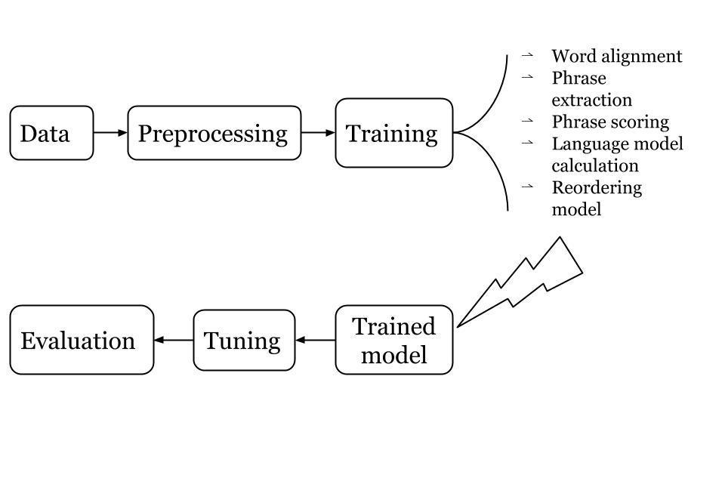
Machine Translation Training

Slide 27
Data Selection

Slide 28


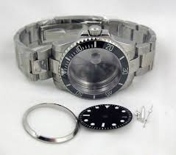
Why Choose Data
There are bilingual open source data sets available (legal, subtitles etc.), but language is diverse and ambiguous
case (for court) vs. case (for a cell phone) vs. case (for a watch)
Data genre is essential for domain specific machine translation
We need to get human translation of (some) eBay data and train on it

Slide 29
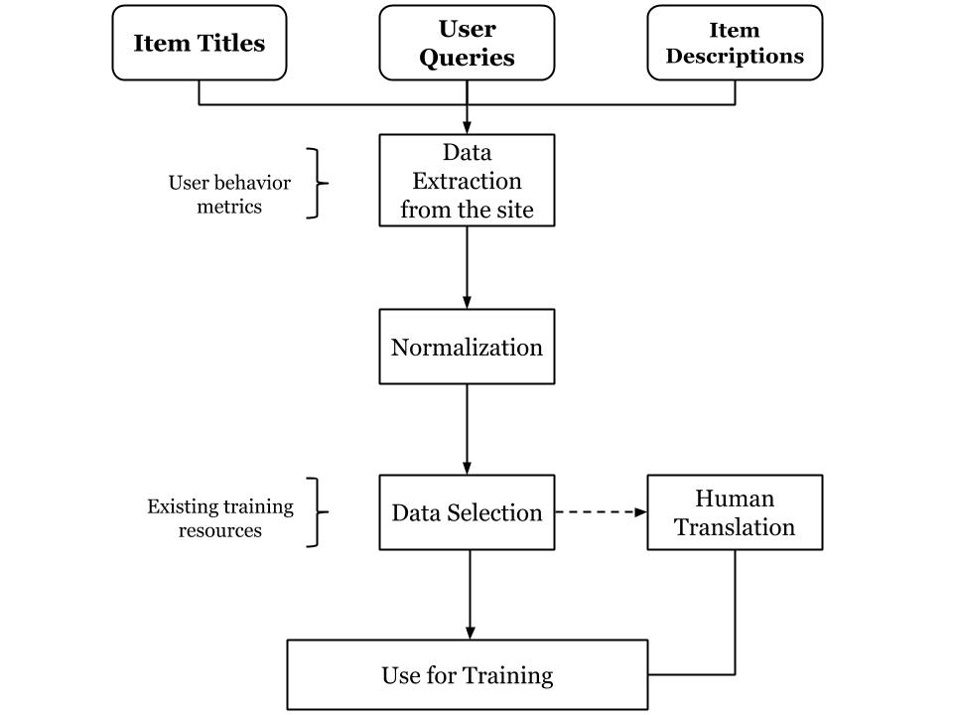
How to Choose Data
Notes:
Goal: select a relevant representative sample of eBay original data
Requirements:
Define relevance to represent customer interest
Maximize language coverage
Minimize redundancy
Optimize human translation costs

Slide 30
Data Extraction: Sample Relevant Data
Key buyer interest signals from clickstream logs:
  Queries: Search frequency
  Titles: Search page impressions
  Descriptions: Product page views
Rank by popularity to exclude tail & outliers
Sample proportionally by category weight
Notes:
For titles: the number of sampled titles is proportional to the number of Search Result Page Impressions in the category

Slide 31
Data Selection: Maximize Language Coverage
Ranking: Compare candidate data against existing training data
Parameters:
    Unknown words: selfie stick, x67df-25 …
    Phrase overlap: most similar or dissimilar data
    User popularity metric
Selection: Minimize redundancy across ranked segments
Send for human translation/post-editing

Slide 32
Evaluation

Slide 33
Pre-Launch Automatic Metrics: Traditional Approach
Traditional metrics compare machine translation output to human translation through phrase overlap (BLEU) and edit distance (WER, PER, TER)
BLEU: 70.71%
WER: 40%
TER: 20%
PER: 0%
Require human translation
Do not scale well and give only limited insights
IT source: | strumenti musicali usati chitarra classica
EN human translation: | used musical instruments classical guitar
EN machine translation: | musical instruments classical guitar used

Slide 34
Pre-Launch Automatic Metrics: eBay Extension
Minimize the % of unknown words across all categories
Minimize the % of falsely untranslated words
Maximize brand preservation
Expect lower null SRPs for machine translated vs. untranslated queries
Expect similar category distribution for machine translated queries and human translated queries
Follow SLAs and CPU requirements

Slide 35

Pre-launch Human Evaluation
Professional linguist judgment on machine translated output given original segment
Query translation:
  Acceptability
  Search result relevance
Title translation: measure translation adequacy for purchasing decision
  Rate translation on 1-5 continuous scale
  Emphasize product name translation and brand preservation
Seigneur des Anneaux | Acceptable? | Relevant
Master of the Rings | Yes | No
Lord of the Rings | Yes | Yes

Slide 36

Pre-Launch Human Evaluation: eBay Extension
On the web site users see title translations with images, not original titles
English titles are hard to understand
vs. Fisherman Hunter Equipment Fishing Travel Bag Pack
Tackle Storage Outdoor Gear
Title clarity evaluation based on item image, not English title

Slide 37
Post-Launch Linguistic Quality Assurance
Manual QA to check against seasonal queries/categories and translation appearance online
Example: detecting offensive translations
****
****

Slide 38

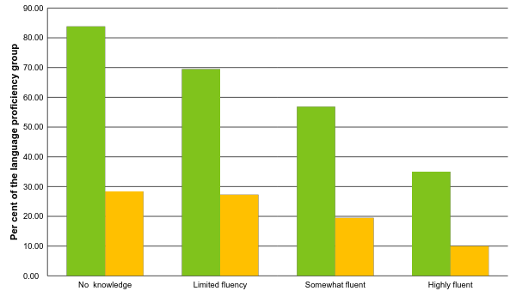
Post-launch Evaluation: User Surveys
Machine translated item titles improved my shopping experience on eBay
Translation is of high/highest quality

Slide 39

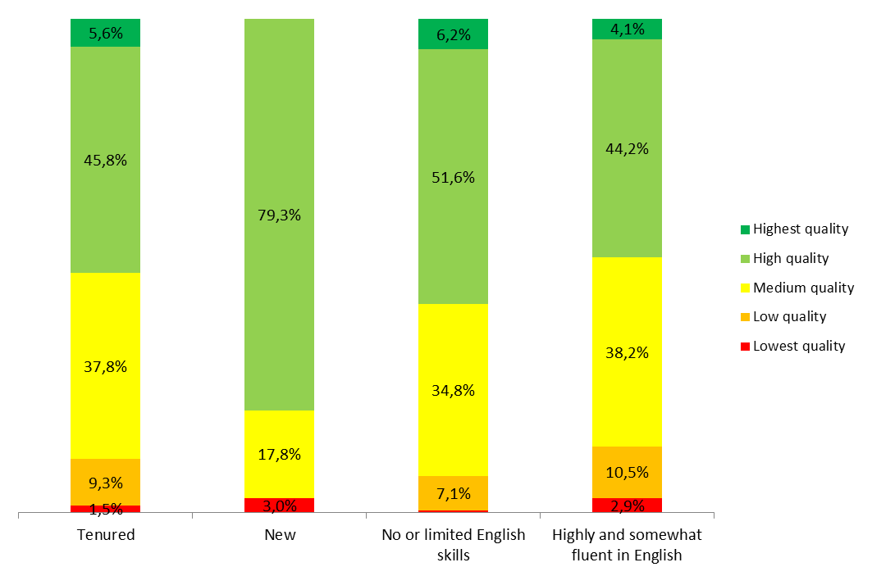
Post-launch Evaluation: User Surveys
Question: Please rate the quality of the machine translated item title
“It would be better if they weren't automated, but at any rate, they are sufficiently good.”
“It would be better if they weren't automated, but at any rate, they are sufficiently good.”

Slide 40
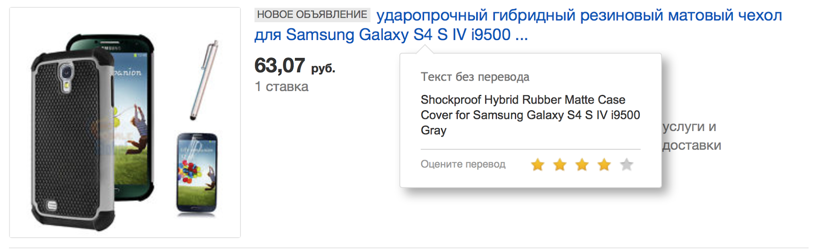
Crowdsourcing Human Evaluation: Explicit User Feedback
Item title translations are accompanied by hover window that includes original title and rating scale

Slide 41
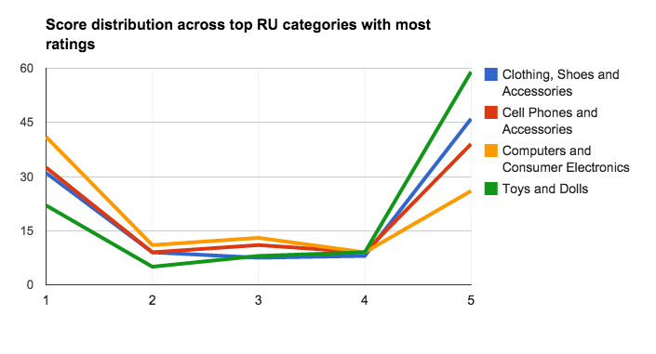
Crowdsourcing Human Evaluation: Explicit User Feedback
It does not have to be bad to be rated!
Cross-validation with professional human evaluation:
      high level of agreement for high-rated translations (4-5);
      low-rated translations are more likely to receive an average rating from a professional linguist
User ratings exhibit sensitivity to poorly expressed grammatical relations

Slide 42
Measuring Language Performance
at Scale

Slide 43
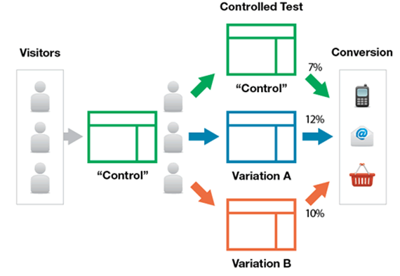
Machine Translation A / B Testing
Intuition vs Reality
Data driven
Reduce Risk
Critical for measuring feature performance
Assess financial impact & user engagement on site

Slide 44

Machine Translation A / B Testing
No Translation
Translation enabled
Launched multiple tests in 2014
Conducted deep dives of test data post wire-off
Focused on specific signals, by language and product category:
Site exits | Language abandonment | User engagement
Vocabulary loss | Untranslated/Unknown words | Search recall
Hover response | Conversion velocity | Revenue per Visit

Slide 45
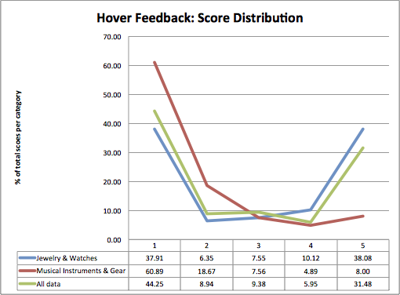
Title Translation A / B Test – Deep Dive
2 problematic categories: Specialty Services and Musical Instruments & Gear.
Automatic MT metrics below average: more unknown words.
Samples sent for human evaluation. Results < original release candidate set.
Hover feedback had lower scores ( < 3) in above 2 categories.
Increased opt-out behavior seen in treatment vs. control group
Notes:
Problems: statistically significant revenue & conversion velocity dips seen.
Automatic metrics below expected: OOV rates, vocabulary loss, & preserved tokens were much higher. Only partial brand preservation occurred.
% OOV: the number of tokens in a test set not present in the models training data given the number of source tokens in the test set.
% tokens preserved: the number of tokens from the source present in the translated titles given the number of source tokens.
% untranslated titles: the number of fully untranslated titles given the number of titles in the test set.
% of vocabulary loss: the difference between the tokens not present in the training data and not present in the phrase table divided by the total number of source tokens. The intuition behind this metrics is based on "vocabulary loss" observed when the words with very low frequency (largely hapax legomena, single-frequency words) tokens "do not make it" to the phrase table. This metric might be representative of the category specific lexicon (the higher it is, the more likely we are to observe single-frequency words in the category vocabulary).
– users changed preference manually on search pages to only see original English titles.

Slide 46
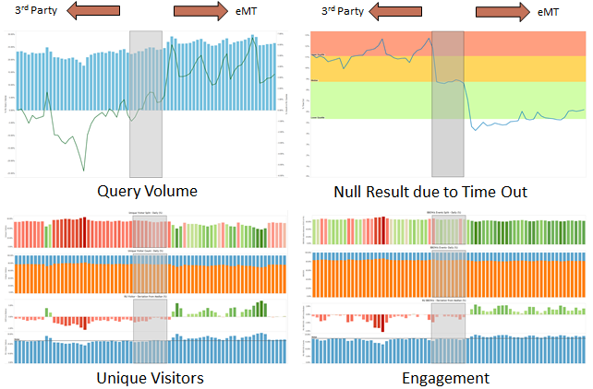
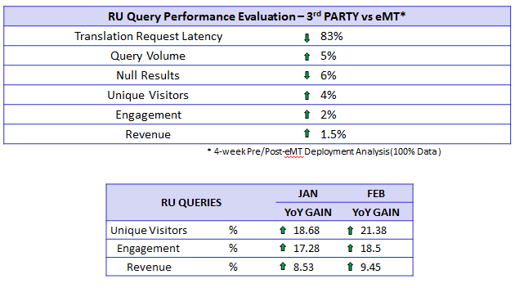
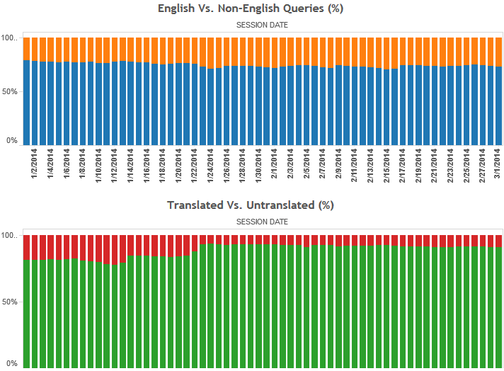
Product Health Monitoring
Daily jobs mine unstructured behavioral clickstream data. | Targeted attribution approach – analyze demand and supply data within search blocks.
Events processed/day ~ 7.5 Billion | Ability to react quickly and identify issues.
Size of data processed/day ~ 10 TB | Intuitive visualizations leveraged by PM and PD

Slide 47
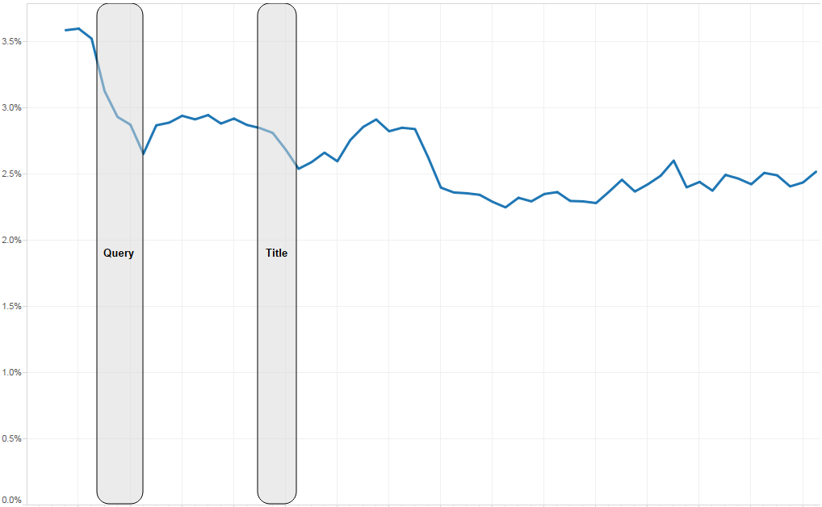
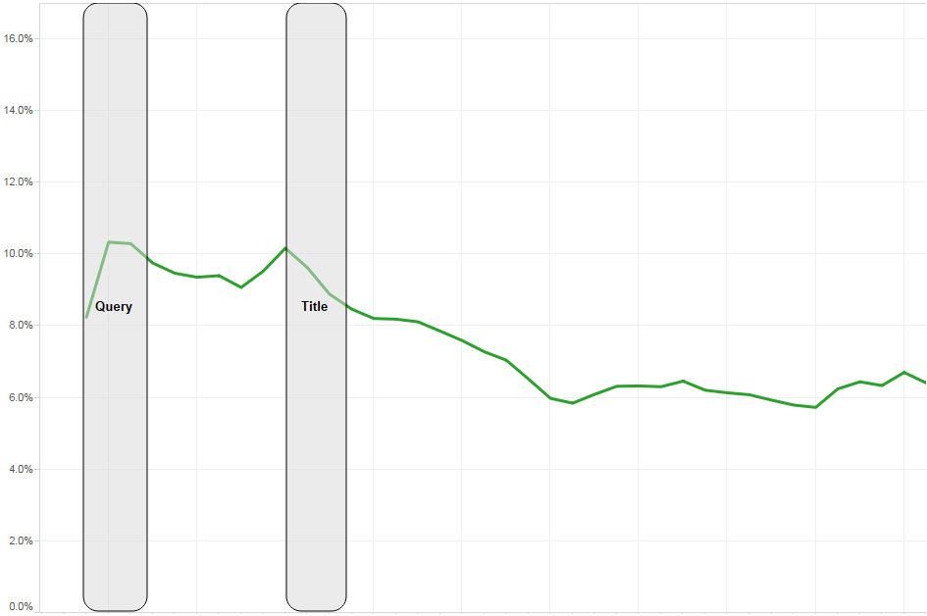
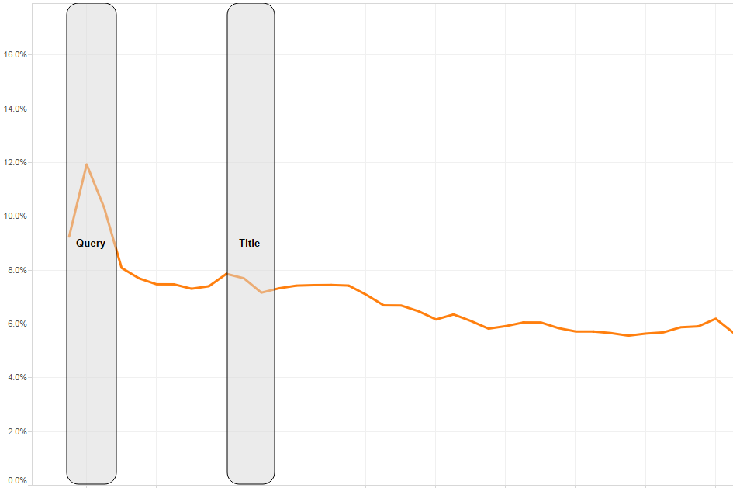
Product Health Monitoring
RU
BR
LATAM
Example KPI – Language Abandonment Rate
Identify visitors who switch searching from their native language to English.
Do not revert back to native language during subsequent search activity within given window.
Strong indicator of translation quality :
          poor translations null-to-low search recall poor search experience abandoning native language

Slide 48
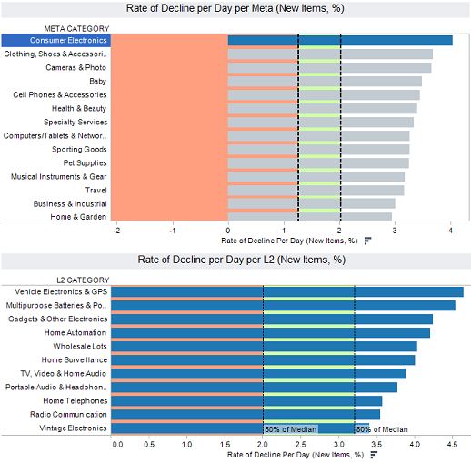
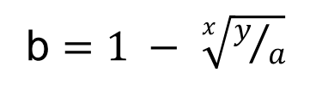
Translation Caching Strategy
b $=1 − \sqrt[x]{y/a}$
a: Initial pool of product listings
y: Final pool yet to be viewed
x: Time period
b: Percent decrease
1 – b: Decay factor
Improve latency by serving pre-cached translations
Leverage inventory and clickstream data to define caching strategy
Identify product categories where:
    Over time, more existing vs. new inventory seen
    Rate of Decay fastest

Slide 49













Technologies
Moses

Slide 50

Conclusion
Make your data work for your use case!
Analyze data in multiple ways!
Avoid analysis paralysis!

Slide 51
If you talk to a man in a language he understands, that goes to his head.
If you talk to him in his language, that goes to his heart
COMMERCE WITHOUT LANGUAGE BARRIERS
N. Mandela

