Slide 1

Bringing OLAP Fully Online Analyze Changing Datasets in MemSQL and Spark with Pinterest Demo
Eric Frenkiel, MemSQL CEO Rob Stepeck, Novus CTO Yu Yang, Pinterest Software Engineer
Feb 19, 2015 • San Jose, CA

Slide 2
What’s in store for this presentation
MemSQL: The real-time database for transactions and analytics
Case Study with Novus CTO, Rob Stepeck
New Developments in Spark
Advanced Analytics with Demo from Pinterest Sofware Engineer, Yu Yang

Slide 3
THE real-time database for Transactions and analytics
MemSQL Story

Slide 4
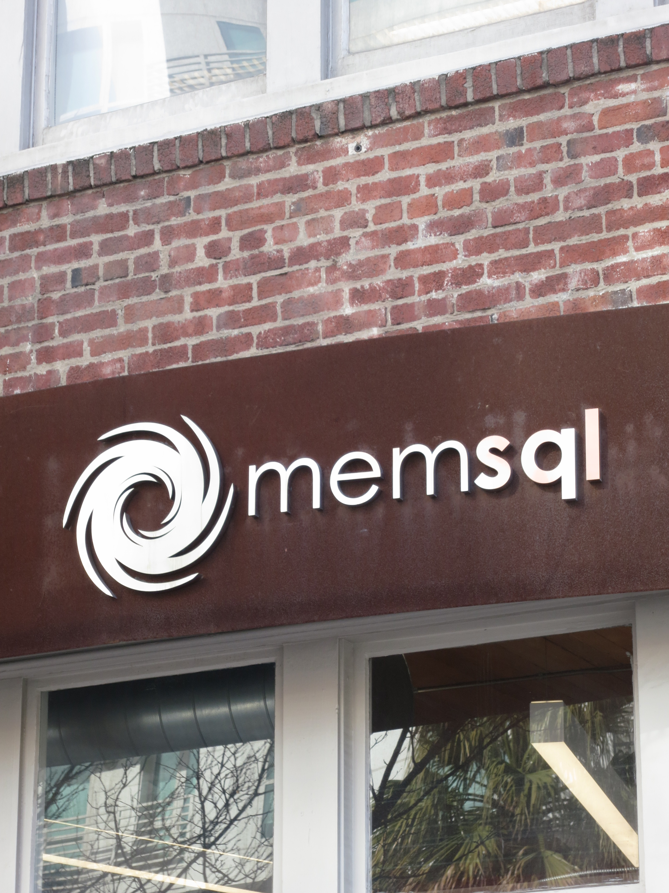
MemSQL Snapshot
Experienced Leadership
Microsoft, Facebook, Oracle, Fusion-io
Inspired by Enterprise architecture gap
A real-time database for transactions and analytics
In-memory, distributed, SQL
Broad customer adoption across verticals
Top tier investors

Slide 5

Four ways your DBMS is holding you back
ETL (Extract, Transform, Load)
Analytic Latency
Synchronization
Copies of data
Source: Gartner Hybrid/Transactional/Analytical Processing Will Foster Opportunities for Dramatic Business Innovation

Slide 6
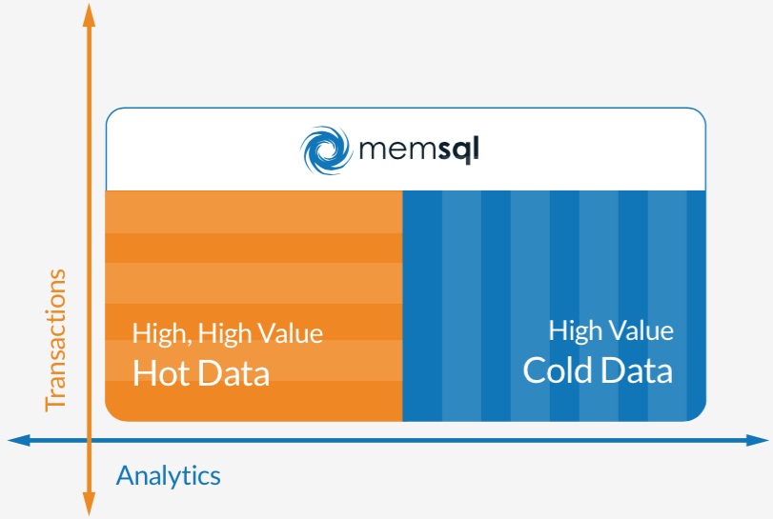
The Real-Time Database for Transactions and Analytics

Slide 7
HOW NOVUS enables investors to consistently maximize their performance potential USING MEMSQL
Novus Case Study

Slide 8


Quick Background on Novus
Rob Stepeck
Chief Technology Officer
Investment acumen, risk, insights and data management
$2 trillion in client assets
Used by 100 of the world’s top investment managers and investors
Founded in 2007 by group of investors, data scientists and engineers

Slide 9

Before MemSQL
Problem:
Write operations inefficient
Loading data was a 24 hour operation
Failures could significantly impact subsequent processes
Loading client data degraded system performance
Scaling was non-trivial
Prospect data integration trade-offs

Slide 10
MemSQL Implementation
Reduce Latency
Scale with Ease
SQL Support
Novus choose to use MemSQL based on the following data management requirements

Slide 11

After MemSQL
Results:
24 hour data cycle down to several hours
Scale is achieved by adding/removing clusters with ease
Learning curve is non existent
Eliminated data ‘hand-holding’ so team can focus on more important initiatives
Sales are more effective because they can use a customer’s actual data

Slide 12
Example: ‘Refresh a Client’
Raw Data
Backing Store
Convert to In-memory
Before MemSQL:
90 Min.
After MemSQL:
2 Min.

Slide 13
New developments in spark
MemSQL Spark Connector

Slide 14

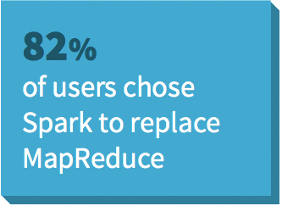
Interest in Spark
Recent survey of 2100 developers
82% of users choose Spark to replace MapReduce
78% of users need faster processing of larger datasets
Source: Typesafe, APACHE SPARK - Preparing for the Next Wave of Reactive Big Data

Slide 15
Spark Data Processing Framework
Intuitive, concise, and expressive operations needed for analytics
Spark
SQL
Spark
Streaming
Mllib
(machine learning)
GraphX
(graph)
Apache Spark

Slide 16

Enterprises Seek Simple Ways to Use Spark
Spark with operational data stores delivers new use cases
In-memory, distributed databases such as MemSQL fit well

Slide 17


Understanding MemSQL and Spark
Cluster-wide Parallelization | Bi-Directional

Slide 18
MemSQL and Spark Use Cases
Operationalize models built in Spark
Stream and event processing
Live dashboards and automated reports
Extend MemSQL analytics

Slide 19
Operationalize Models Built in Spark
Process in Spark, persist to MemSQL
Go to production and iterate faster
Data into Spark
Enterprise Consumption
Spark Cluster
MemSQL Cluster
Model Persistence
Model Creation

Slide 20
Stream and Event processing
Structure event data on the fly
Pass to MemSQL for persistent, queryable format
Real-time Streaming Data
Enterprise Consumption
Spark Cluster
MemSQL Cluster
Data Transformation
Persistent, Queryable Format

Slide 21
Extend MemSQL Analytics
The freshest data for analysis in Spark
Load from MemSQL to Spark and write results on return
Interactive Analytics,
Machine Learning
Applications,
Data Streams
Spark Cluster
MemSQL Replicated Cluster
MemSQL Cluster
Access to Live Production Data
Real-time Replica

Slide 22
Live Dashboards and Automated Reports
Serve live dashboards from MemSQL
Run custom reports on live data with Spark
Custom Reporting
Live Dashboards
Spark Cluster
MemSQL Cluster
Access to Live Production Data
SQL Transactions and Analytics

Slide 23
Real-Time analytics in practice
Pinterest Demo

Slide 24

Pinterest Demo
Yu Yang Software Engineer at Pinterest

Slide 25






Realtime Analytics at Pinterest
App
Kafka
Prototype
events
Spark
Insights
Singer
Secor

Slide 26
Why Spark
Pinterest has high traffic and an active community
Always looking for new ways to help users
Processing event data presents unique challenges
Spark is the leading processing framework for big data deployments
Spark Streaming is ideal for real-time data structuring

Slide 27





How It Works
All at sub-second speed

Slide 28
