Slide 1
A Marriage
made in silicon valley
Bill Loconzolo, Intuit
VP Data Engineering & Science
@bloconzolo #intuitdata
Laura Fennell, Intuit
SVP, Legal, Data, Compliance & Policy

Slide 2

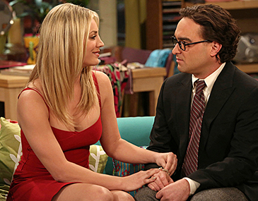

Other odd couples

Slide 3
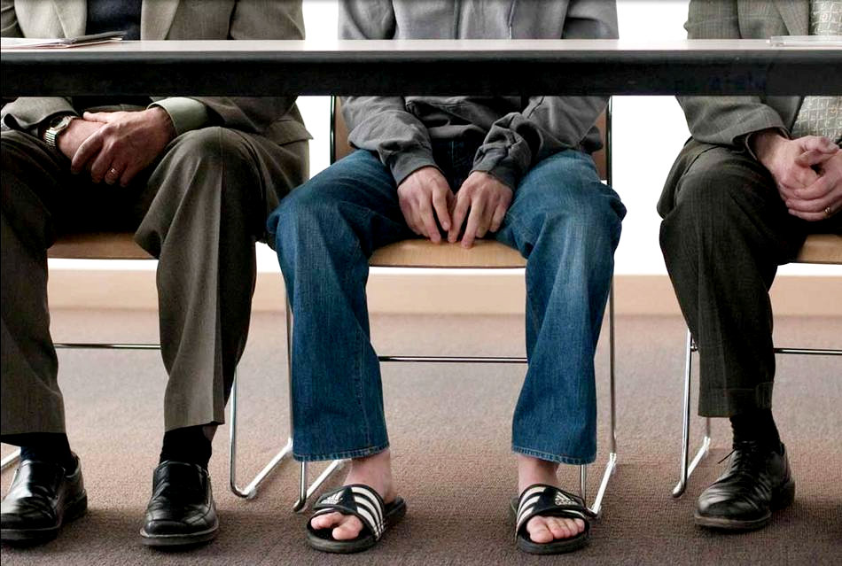

Innovators vs. regulators

Slide 4



Things that go well together

Slide 5


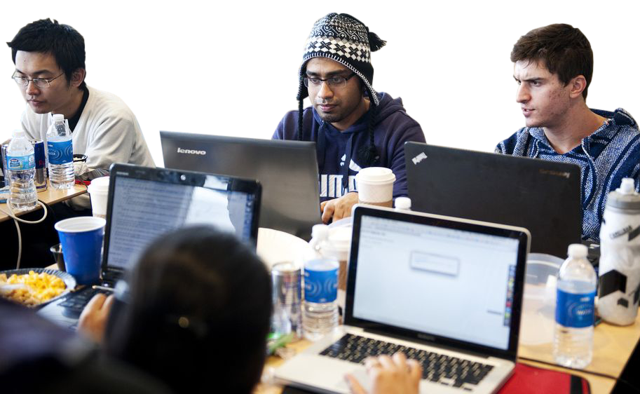
Legal
Data

Slide 6













The Intuit analytics cloud
Developers
Care
Product Managers
XD
Data Analysts
Scientists

Slide 7

Paint a picture.

Slide 8

Customer trust is everything to a company.
Customer trust is everything to a company.

Slide 9


Slide 10






50M+
6+
customers to handle
manage all of the data
petabytes of data
complex compliance
public and private cloud

Slide 11



Solving big, important problems.

Slide 12


Technology first, then legal
Technology & legal together

Slide 13

So how did we do this?

Slide 14

Shared outcome.

Slide 15

Shared accountability.

Slide 16

Empowered for execution.
Notes:
Green icson small team in circle
Laura
Bill example of PODS

Slide 17

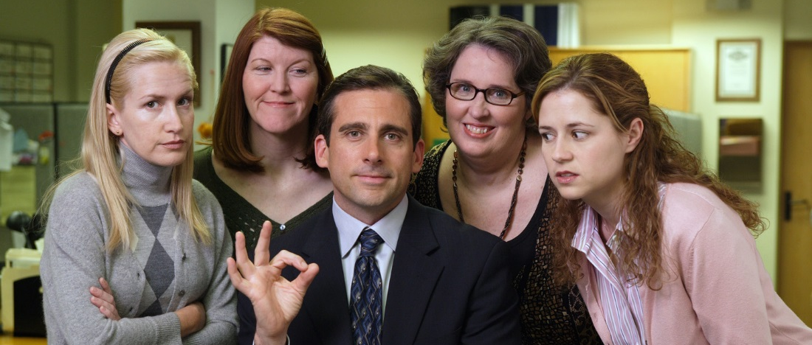
Healthy tension builds trust

Slide 18

Teach and repeat.
Notes:
Bill

Slide 19

Legal
Data

Slide 20





Shared outcome.
Shared accountability.
Empowered for execution.
Healthy tension builds trust.
Teach and repeat.
Notes:
Bill

