Slide 1
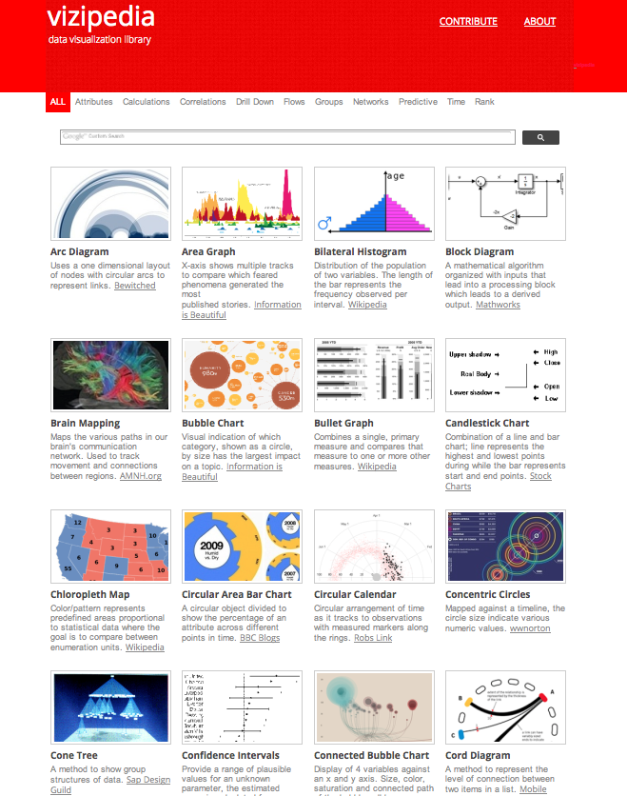
Data Visualizations Decoded
Tweet: juliargentinaG
October 01, 2014
October 01, 2014
October 01, 2014
October 01, 2014
Notes:
Concurrently, our world’s data sets continue to grow, and with it, our need to translate these data sets into meaningful communications. Our world’s visualization methods continue to grow as well. The visual mark can create a large range of visualizations, and as these visualization types grow, it becomes more important for the community to be well-informed and use visualizations accurately.

Slide 2
No definitions
No central repository
No use case driven approach

Slide 3
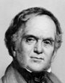
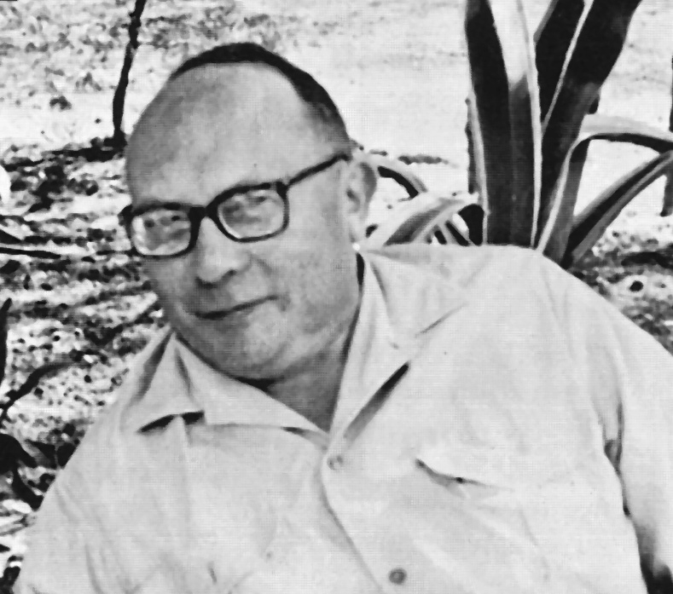





Visualization Taxonomies (220 years back)
A taxonomy of visualization techniques using the data state reference model
Rethinking Visualization: A High-level Taxonomy
Semiology of Graphics
The Structure of the Information Visualization Design Space
Domain, Data Type, Layout
Scientific, GIS, 2D, Multi-dimensional Plots, Information Landscapes, Trees, Network, Text, Web Visualization, Visualization Spreadsheets
Data Type, Layout
Diagrams, Networks, Maps
The Eyes Have It: A Task by Data Type Taxonomy for Information Visualization
Algorithm
Discrete or Continuous
Domain, Layout
Scientific, GIS, Multi-dimensional, Information Landscapes, Nodes & Links, Trees, Text Transforms
Syntactic Structures in Graphics
Data Type
1D,2D,3D, Temporal, Multi-dimensional, Tree, Network
Task
Overview, Zoom, Filter, Details, Relate, History, Extract
The Commercial & Political Atlas
Layout
Metric, topological, grouping, composite space
Layout
Line, Bar, Pie Chart
PLAYFAIR
BERTIN
SHNEIDERMAN
CARD
CHI
ENGELHARDT
TROY
1786
1967
1996
1997
2000
2003
2004

Slide 4




Visualization Taxonomies (and counting)
Visualization Software
Tableau
Infodesign
patterns
Qlik
Periodic Table for Management
Task
Quantities, Proportions, Flows, Hierarchies, Networks, Spatial, Navigation, Filtering, Arrangement, etc.
What Makes a Visualization Memorable
Solutions reflect:
Layout
Data type
Task
Technical Computing
Reviewing Data Visualization: an Analytical Taxonomical Study
Data Type Data, Information, Concept, Strategy, Metaphor, Compound
Data Type, Layout, Task
Area, Bar, Circle, Diagram, Distribution, Grid& Matrix, Line, Map, Point, Table, Text, Trees & Network
MATLAB
Layout, Task
Spatialization, Shape, Color, Prospective Interaction
Wolfram
Online Web Apps
ManyEyes
RODRIGUES
EPPLER
BEHRENS
BORKIN
Plotly
RAW
Frameworks
D3
2006
2007
2008
2013
Highcharts

Slide 5
Changing the Question
“I want to see the scatter plot view of this data.” with “I want to see what the correlations are with this data.”

Slide 6
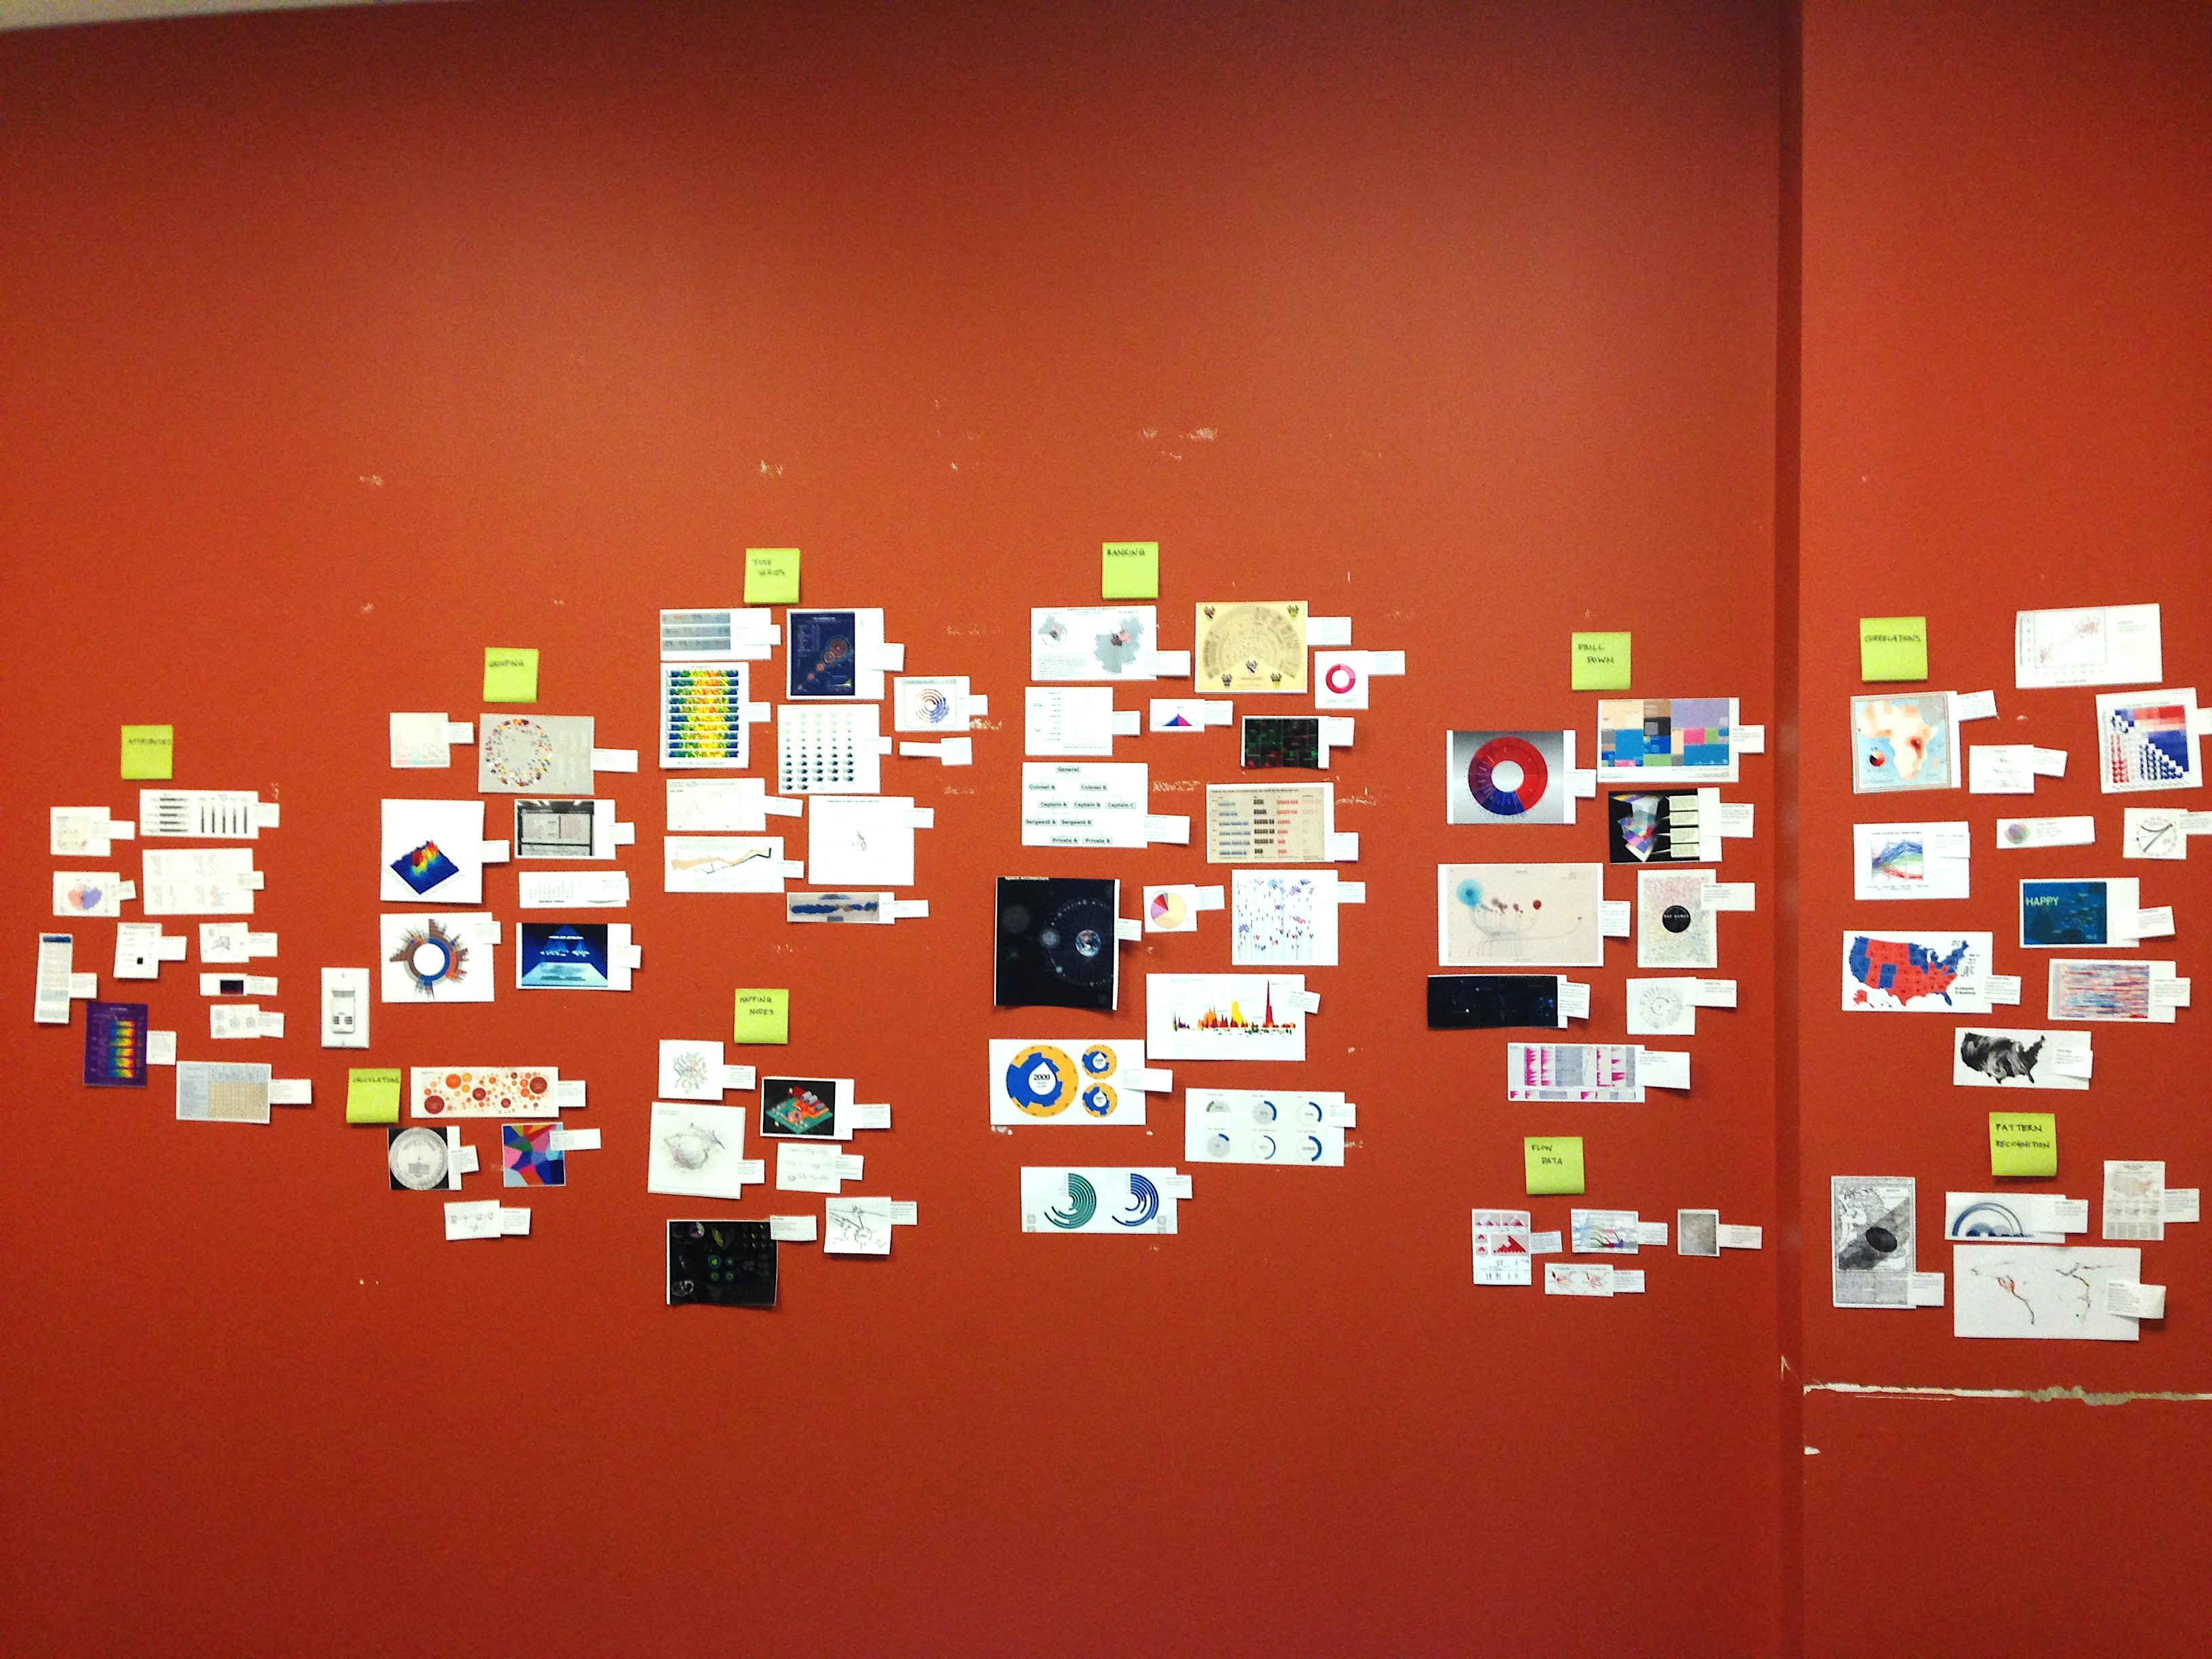
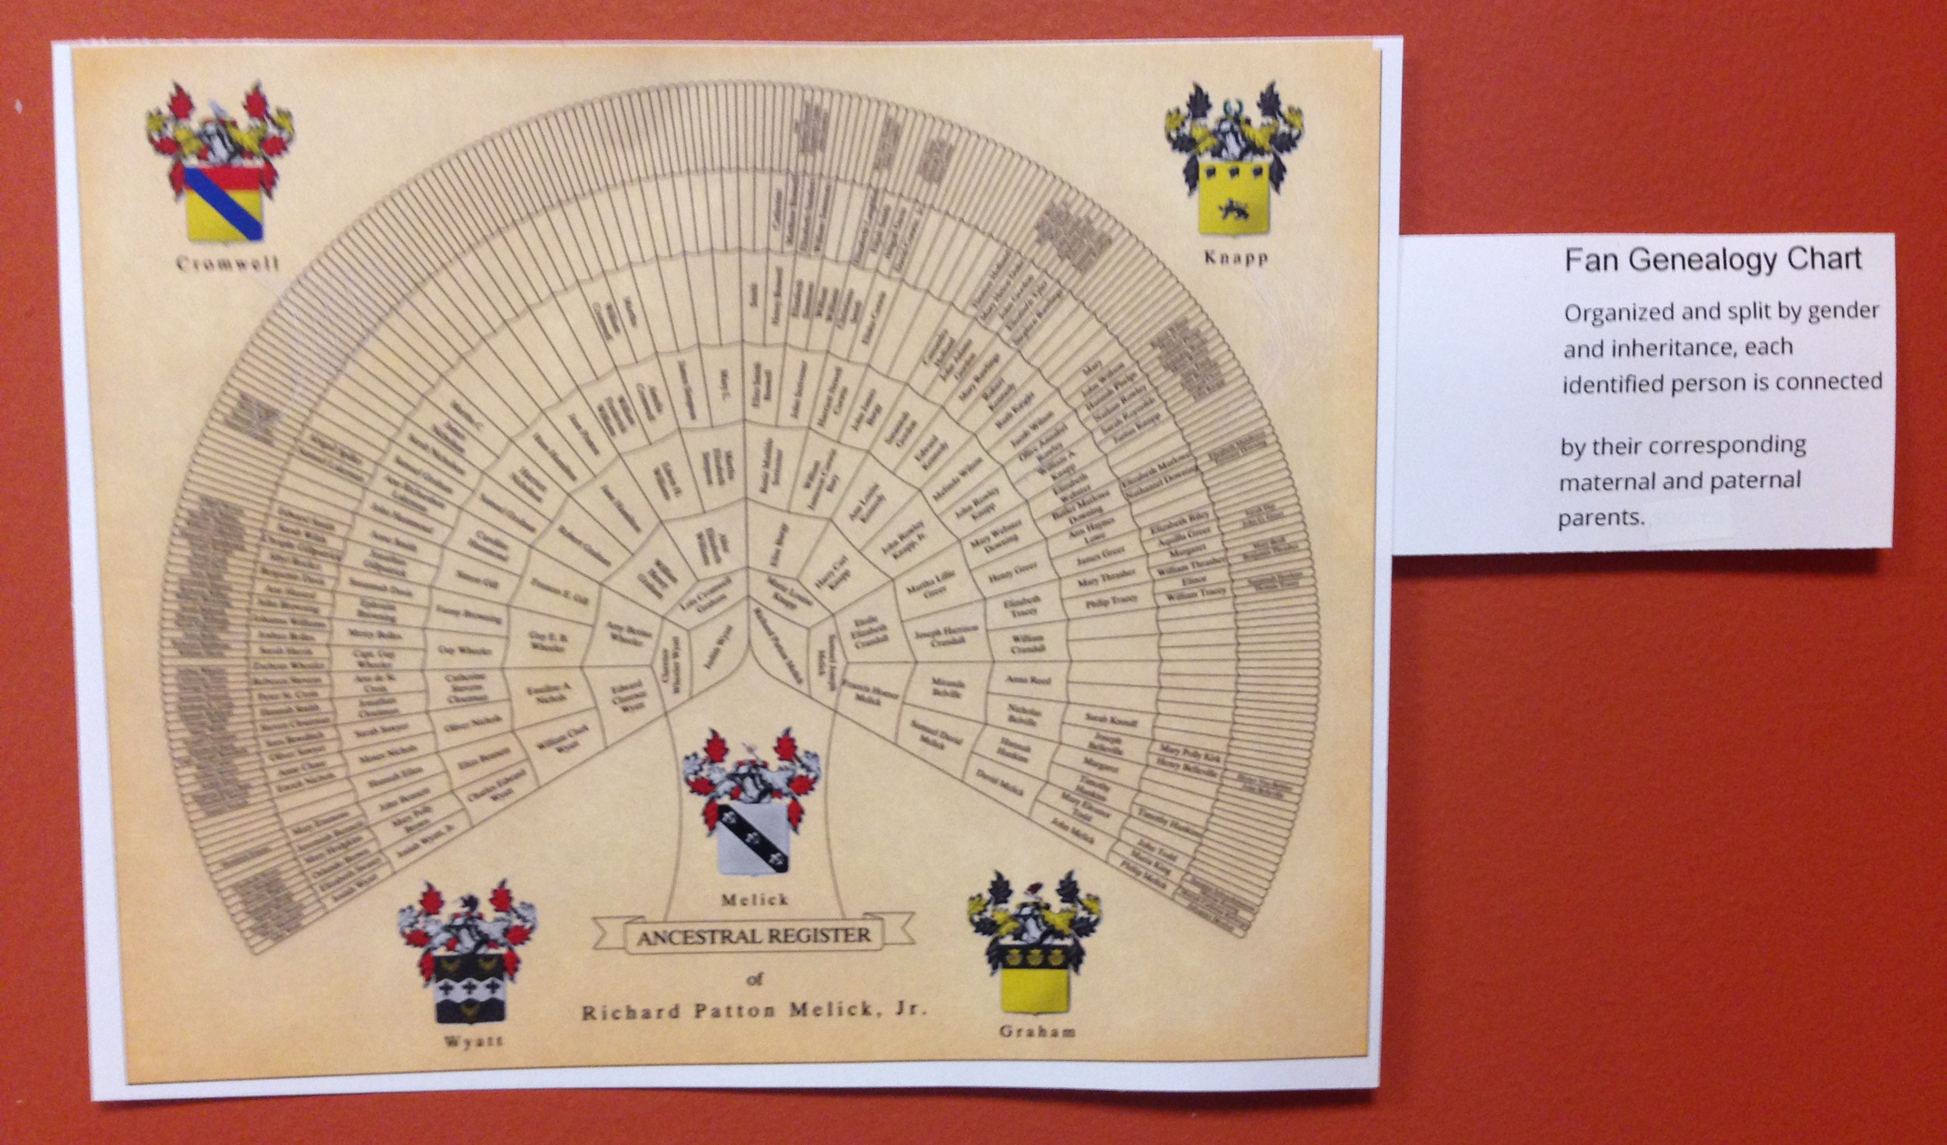
Collect & Organize

Slide 7
Collect & Organize & Discover
Time
Ranking
Correlations
Grouping
Drill Down
Attributes
Calculations
Flow
Networks
Predictive

Slide 8
Patterns of Use
Comparisons: Attributes, Time, Rank
Connections: Drill Down, Flow, Grouping, Networks
Conclusions: Calculations, Correlations, Predictive

Slide 9
Comparisons
Attributes, Time, Rank

Slide 10
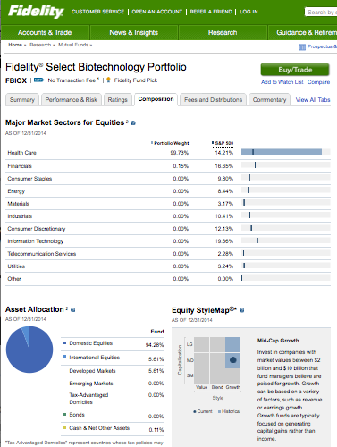
Defining the Question
“I want to see a pie chart to”….. “I want to see the attributes of this fund.”
SOURCE: https://fundresearch.fidelity.com/mutual-funds/composition/316390772
Notes:
Focus on the use case

Slide 11
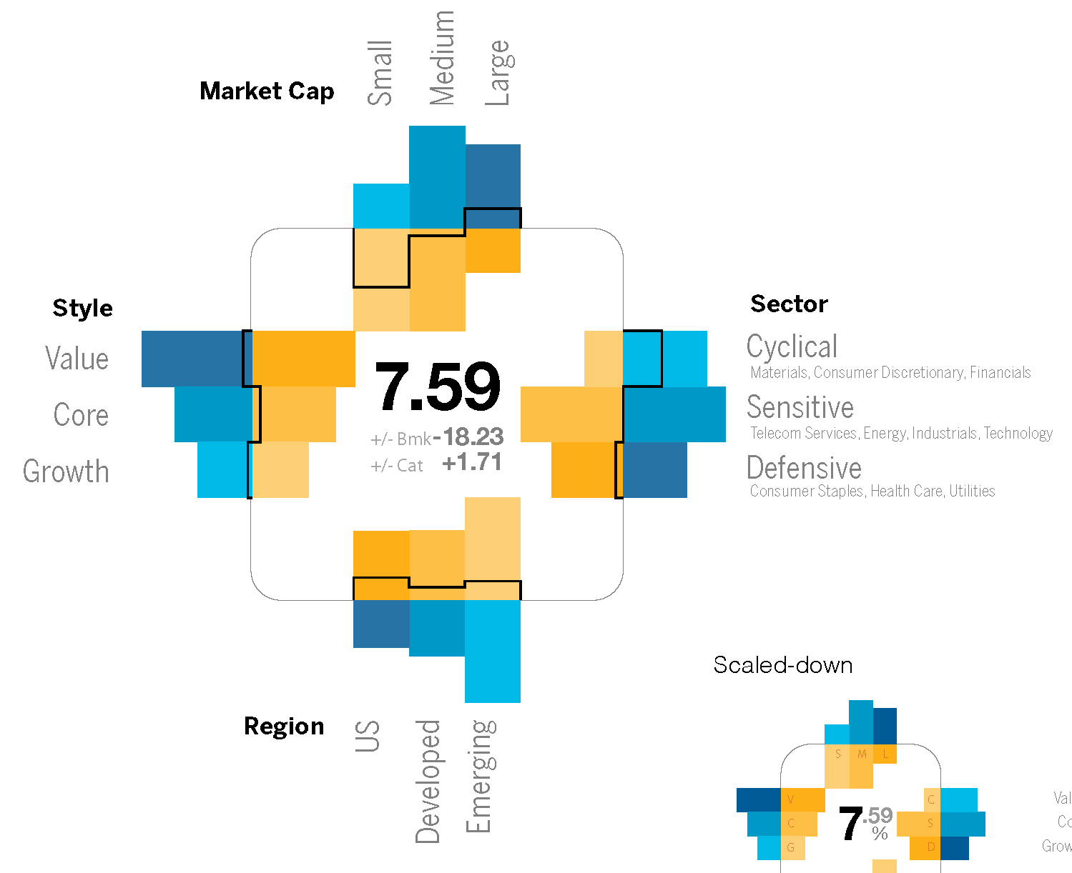
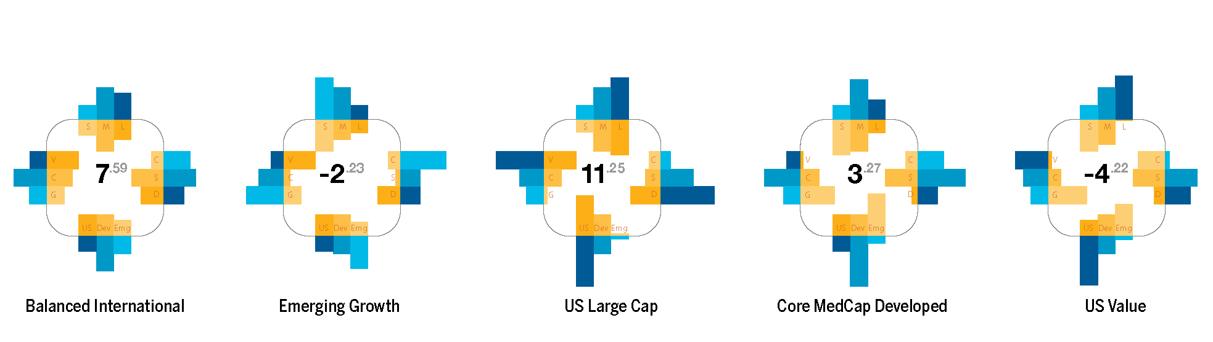
Attributes
Understanding the characteristics of an object
SOURCE:
Visualizing Financial Data
Rodriguez & Kaczmarek
Notes:
introduces the concept of producing fund level symbols as glyphs. The glyph answers basic questions; of how conservative is this fund? What are the fund’s characteristics and what are the performance results? As a symbol embedded with meaning, each bar mark within the glyph indicates long/short position, exposure, and net. To facilitate the process of interpreting the glyphs, the content has to be simplified to the level that will allow instant recognition of coded values without repeated dependence on legends or keys.

Slide 12
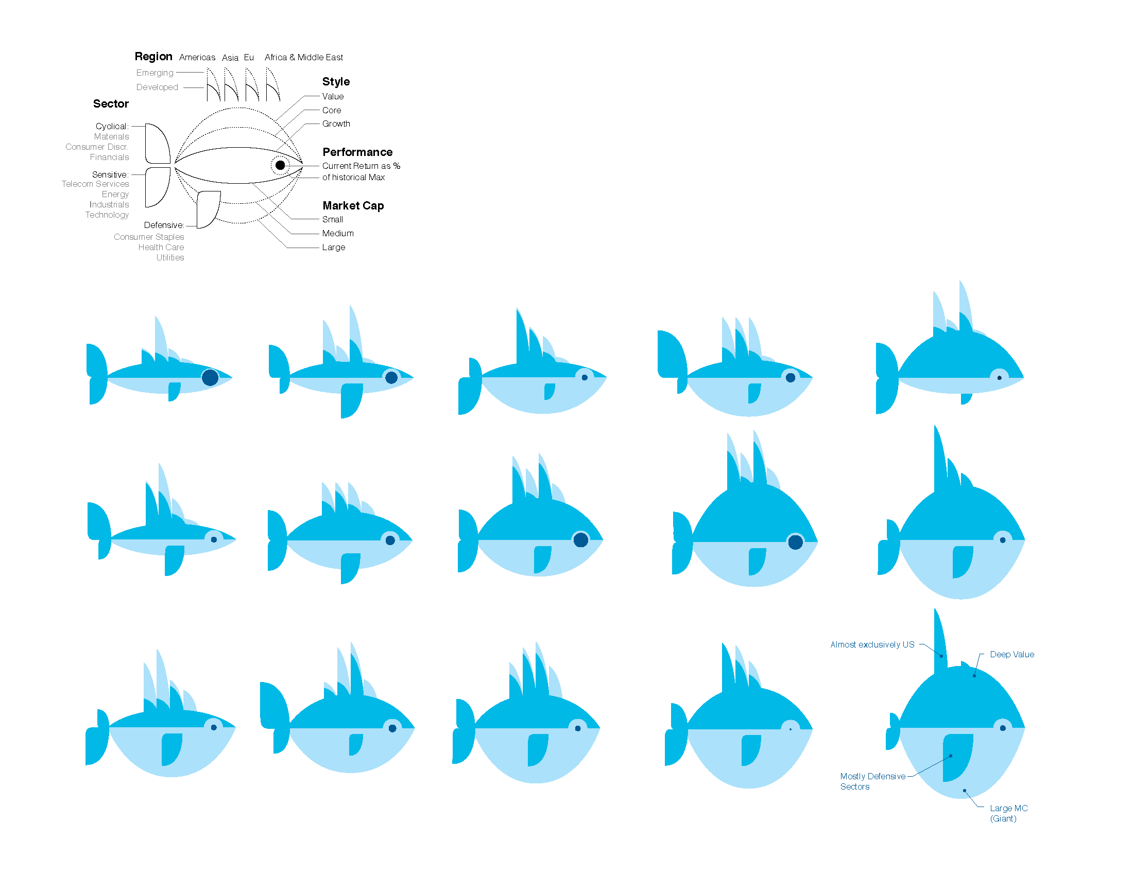
Attributes
Understanding the characteristics of an object
SOURCE:
Visualizing Financial Data
Rodriguez & Kaczmarek
Notes:
How many folks are familiar with Chernoff faces? Herman Chernoff is a statistian and presented multiple variables at once with facial features. The eyes represented one data set, nose another, etc. The overall idea is that we are very good at face recognition and why not leverage that into a display.
Similar in concept to Chernoff faces, the ‘Chernoff Fish’ maps multiple characteristics to a highly recognizable object, a fish. The schematic diagram, figure 9.11, shows the well-appointed characteristics of the fish as a logical link to a fund’s characteristics. As often the center of attention, the eyes show performance with the pupil representing the fund’s returns and the outline showing the top fund performance within the same category. The mass of the fish is depicted with market cap for the belly and style for the back. The fins are reserved to show exposure across various regions or sectors.

Slide 13
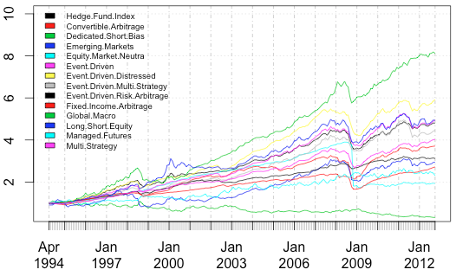
Defining the Question
“I want to see a line chart.” ….. “I need to see what has occurred.”
SOURCE: https://systematicedge.wordpress.com/2012/12/23/hedge-fund-performance/inception-equity/
Notes:
Each year, the inquisitive and competitive nature of the hedge fund industry publishes lists of top ranking hedge funds, fund managers performance, and even fund manager salaries. In a high stakes industry with large sums to invest, peers and investors alike want to know exactly how well a certain fund performed in comparison to others. outsiders and the media persistently wanting to break the binding mystic. Well-known publications like Bloomberg and Barrons grab the public’s attention in their annual reports that provide a ray of light into an otherwise opaque closed doors world. In this section we will take advantage of those publications in an effort to get a more comprehensive view of the industry.
The ray of light provided as annual data sets shows the results of a year’s worth of active investment moves on behalf of the investment team. Did the team’s day-to-day decisions work out? How well did their investment strategies do? How long can top performing strategies hold top ranking status? Does fund size play a role? Does firm size (assets under management) play a role? In this section we will explore these questions in a series of visual methods to show investment strategies rank, performance, fund size, and firm size across the post financial crisis period of 2008-2013. The full data set and source materials are included in the appendix (page xx).

Slide 14
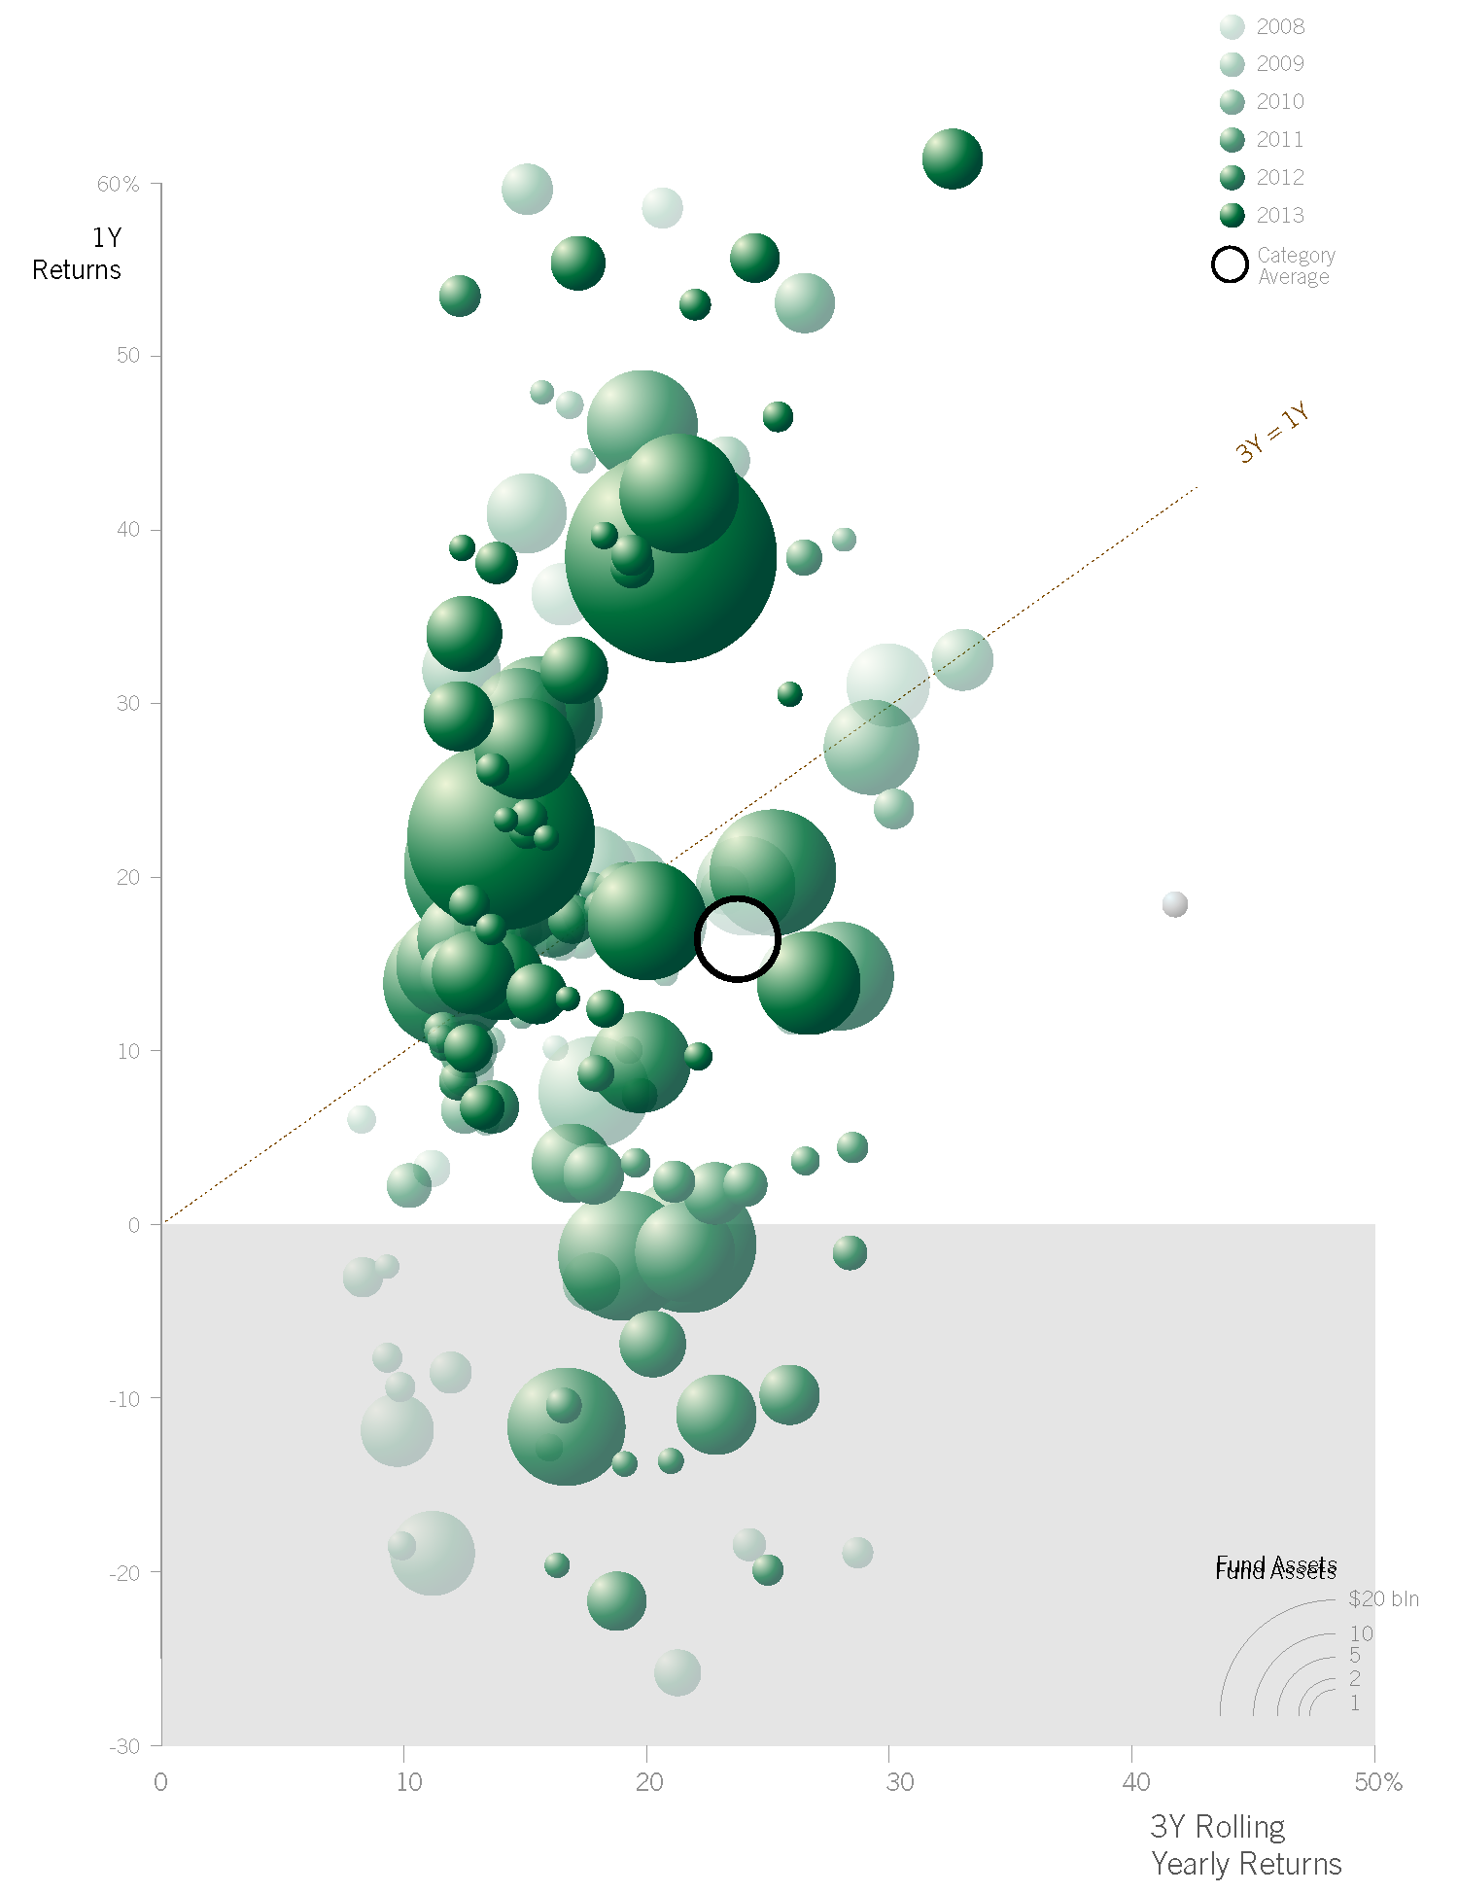
Time
Tracking events as they unfold over time
Fund Assets
SOURCE:
Visualizing Financial Data
Rodriguez & Kaczmarek
Notes:
The ‘Fund Bubbles – All Years One Strategy’ chart provides the reader with an expanded understanding of what comprises the Directional strategy average. All funds are present and represent the years with a slight fade out to the earlier years; the effect pushes the earlier years to the background while highlighting the most current years to the foreground. The quantity of funds, large fund assets, and cluster placements makes it a challenge to clearly see all the funds. This obstruction challenge is mitigated with the use of transparency to see through bubbles, three-dimensional sphere rendering to reinforce the layers, and rule-based layering of the bubbles to place the smallest fund on top. A clear negative returns marker of gray fill background emphasizes the underwater funds that still managed to make it into the top 100 funds. The overall effect of the ‘Fund Years – All Years Directional Strategy’ is a big picture view that shows where funds have bubbled over across the years; Where are the concentrations? What are the ranges?

Slide 15
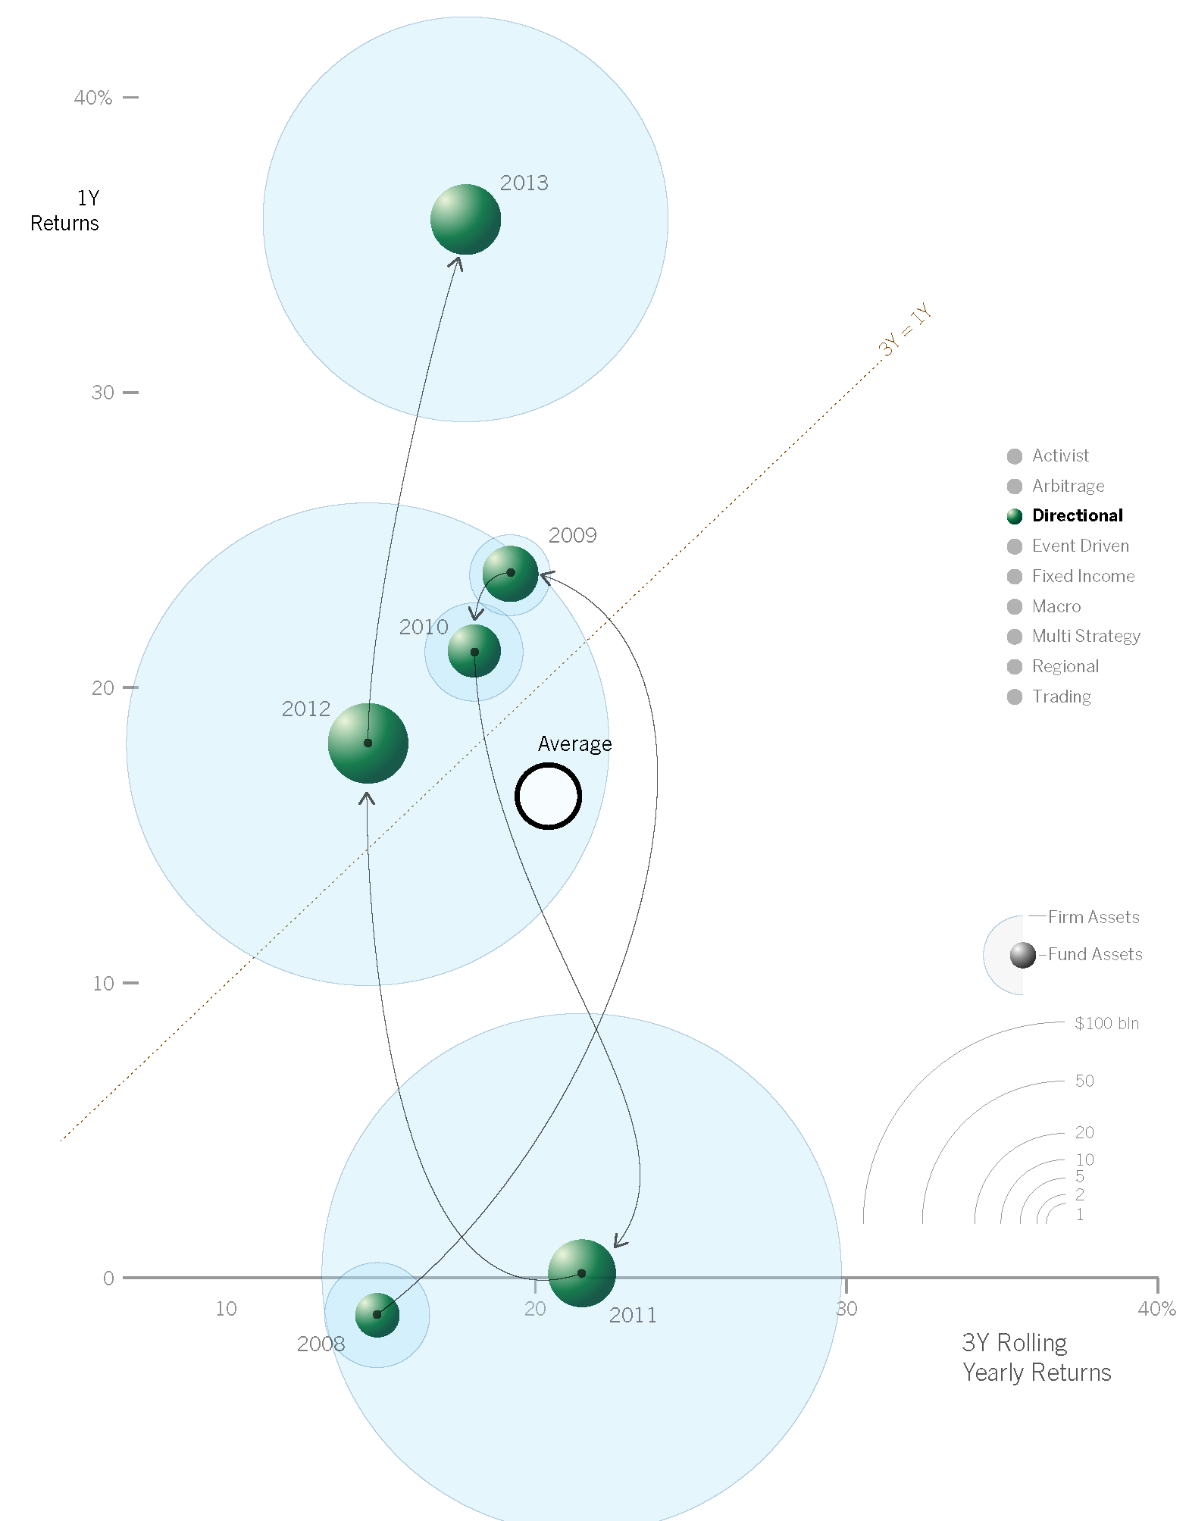
Time
Tracking events as they unfold over time
SOURCE:
Visualizing Financial Data
Rodriguez & Kaczmarek
Notes:
The ‘Temporal Path – Directional’ chart exposes the truth behind a similar average profile to the previous category of Arbitrage. Yet as is evident from the path model, the movement across the years is very different from the averages including some extreme ranges of negative returns in 2008 to mid-thirty percent returns in 2013. The variation in firm assets shows how after three years of modest size firms involvement in the latter years strategy gained popularity with very large firms.

Slide 16
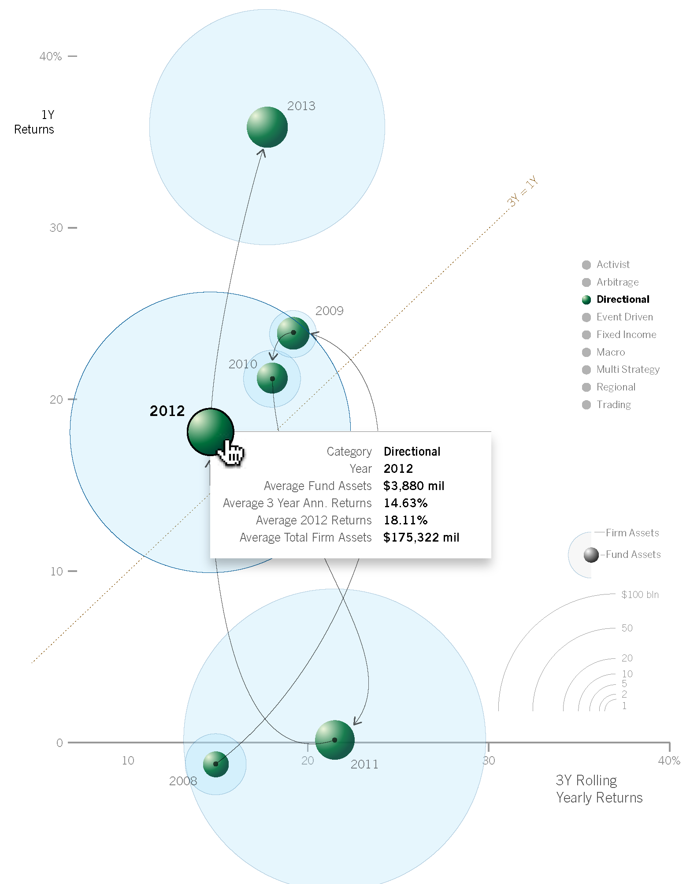
Time
Tracking events as they unfold over time
SOURCE:
Visualizing Financial Data
Rodriguez & Kaczmarek
Notes:
The ‘Temporal Path – Interactive Year Display’ is a method to show the category movement with minimal obstruction by layering precise numeric values on demand and as supporting evidence. Beyond the year detail shown in the display panel, the interaction allows the user to ask more questions regarding the funds present in each year.

Slide 17
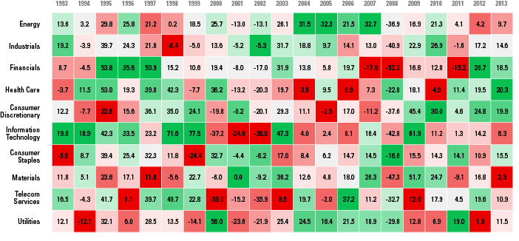
Defining the Question
“I want to see a heat map.”….. “I need to see who’s landed on top.”
SOURCE:
Visualizing Financial Data
Rodriguez & Kaczmarek
Notes:
uses tile rows to track each sector performance over time. Each column contains tiles ranging from red indicating the worst performing sector to green representing the best performing sector.

Slide 18
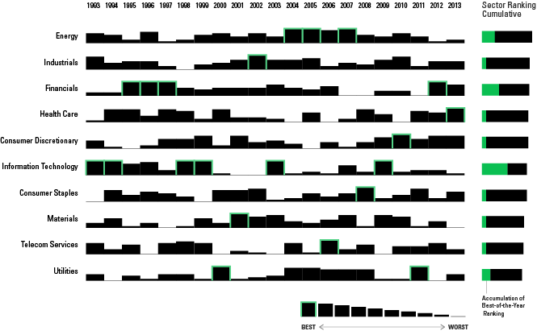
Rank
Establishing relationships of greater than, less than or equal to
SOURCE:
Visualizing Financial Data
Rodriguez & Kaczmarek
Notes:
the height of each sector bar represents the corresponding rank as shown in the legend. The bar for the top-ranked sector in each calendar year is outlined in green. To the right of the chart, the heading titled Sector Ranking Cumulative provides the reader with a broader contextual view of overall sector ranking.

Slide 19
Connections
Drill Down, Flows, Groups, Networks

Slide 20
Defining the Question
….. “I need to see both aggregates & details.”
SOURCE: CalPERS Annual Report 2013

Slide 21
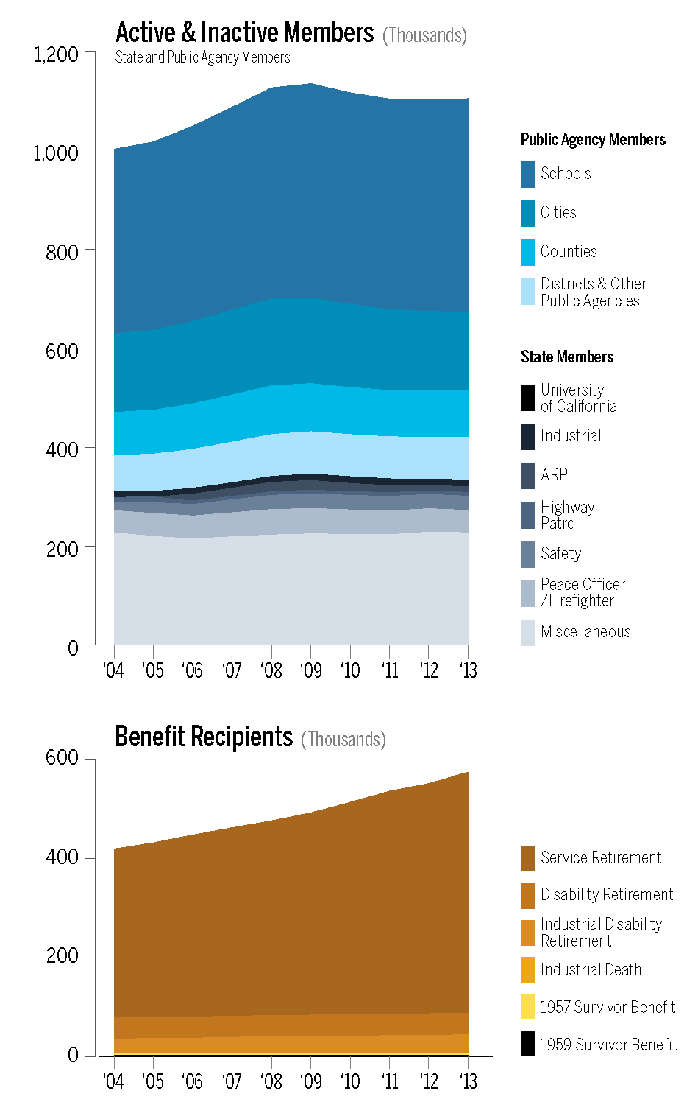
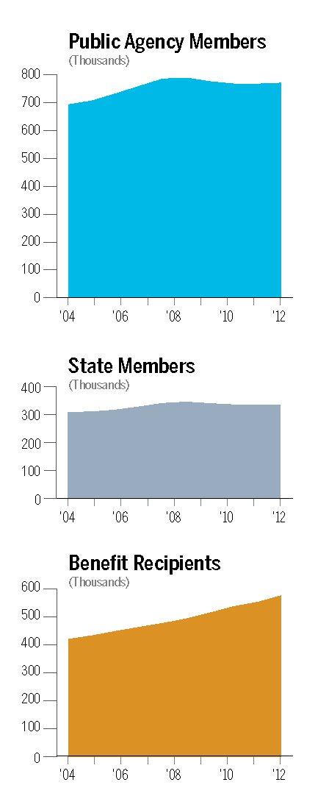
Drill Down
Shifting from summary to detail information
SOURCE:
Visualizing Financial Data
Rodriguez & Kaczmarek
Notes:
From one detail list to another detail list, both stack charts (figure 7.17 and 7.18) are a transfer of the table line items to chart legend line items. The roughly 1.7 members are represented in three color areas to distinguish and reinforce the three groups from the table data.
Figures 7.19 and 7.20 remove the details to clearly compare and show the change in volume across the member groups. The display change from stacking the groups (figure 7.19) to lining the groups (7.20) shifts our view from a one chart view to a multi-chart view. Figure 7.20 allows us to focus our attention on the curve lines across groups.
The chart profile visually shows us:
The make-up for each group with proportional representations of the data. This view inherently showcases the majority members.
The cumulative growth over the years with a direct indication of the change in volume.
The balance of those that are adding into the fund vs. those that are receiving from the fund.
There are other ways to shift to details….

Slide 22
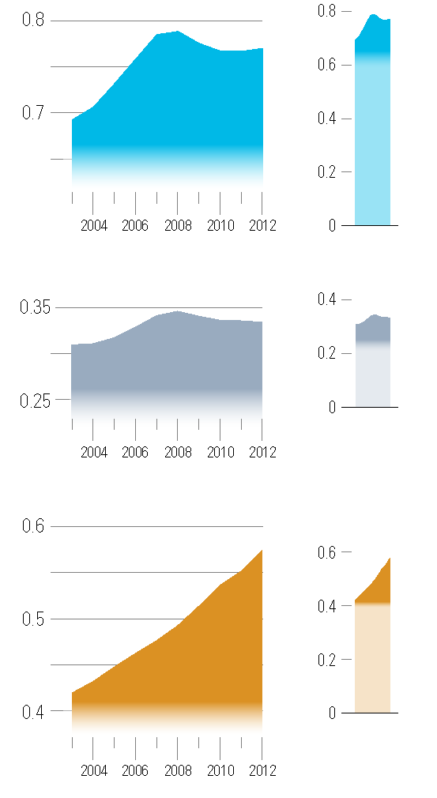
Drill Down
Shifting from summary to detail information
SOURCE:
Visualizing Financial Data
Rodriguez & Kaczmarek
Notes:
A close inspection of the line profile of the all members reveals more details to the changes over time. The zoom view is paired up with the full area chart view to disclose the full context of the chart. In figure 7.22, the reader can review the changes to member numbers with a more granular scale and still see the magnitude of size. As concentrated views, the zoom chart is able to highlight the changes. Similar to time-lapse photography that highlights movement and change of a seemingly motionless event, these concentrated views of the data do the same and bring forth changes.
A comparison across member groups uncovers the magnitude of change in member populations. Figure 7.23 uses the same technique of zooming into the y-axis to discover the significance in member changes. The zoom chart provides the type of resolution to help us detect small hiccups and bends in the benefit recipients upward climb. The power of the zoom chart is its ability to call attention and make the unnoticed noticed.

Slide 23
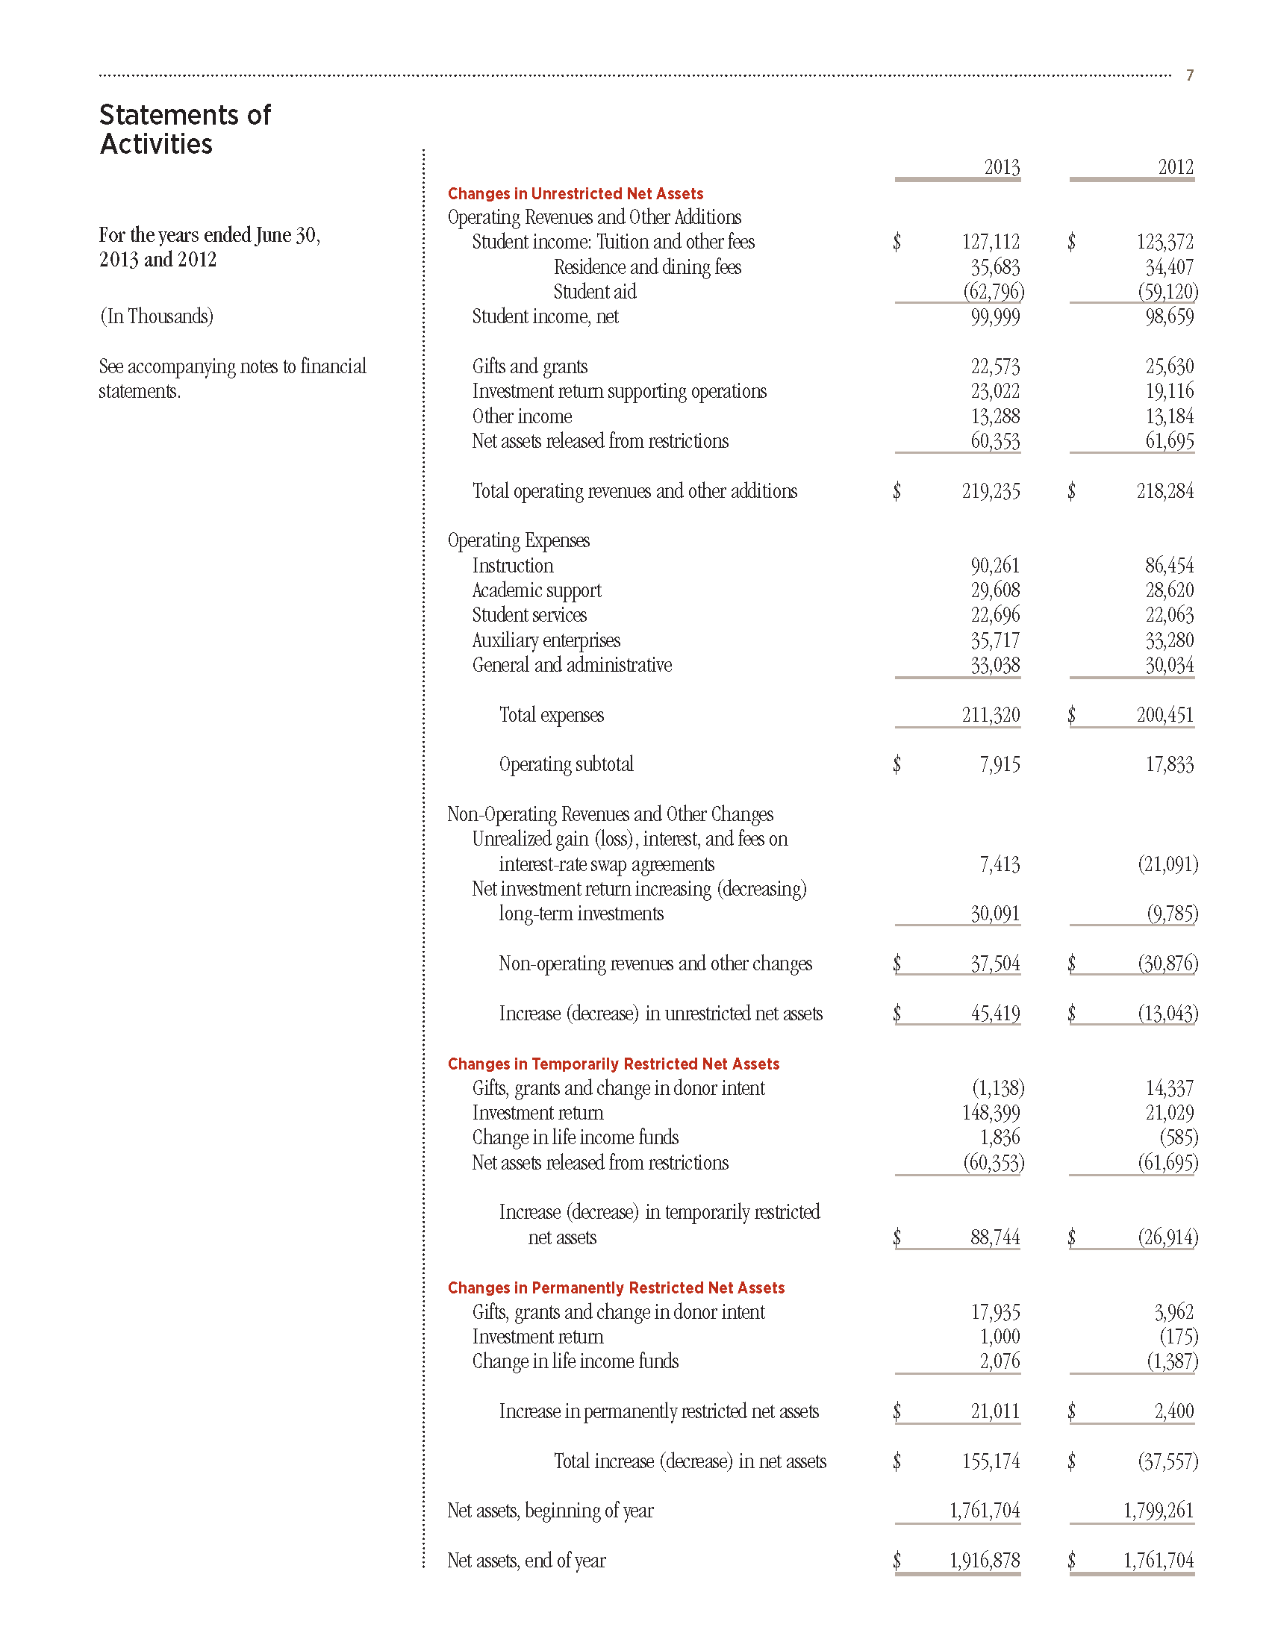
Defining the Question
….. “I need to see the influence and impact.”
SOURCE: Smith College Annual Report 2013

Slide 24
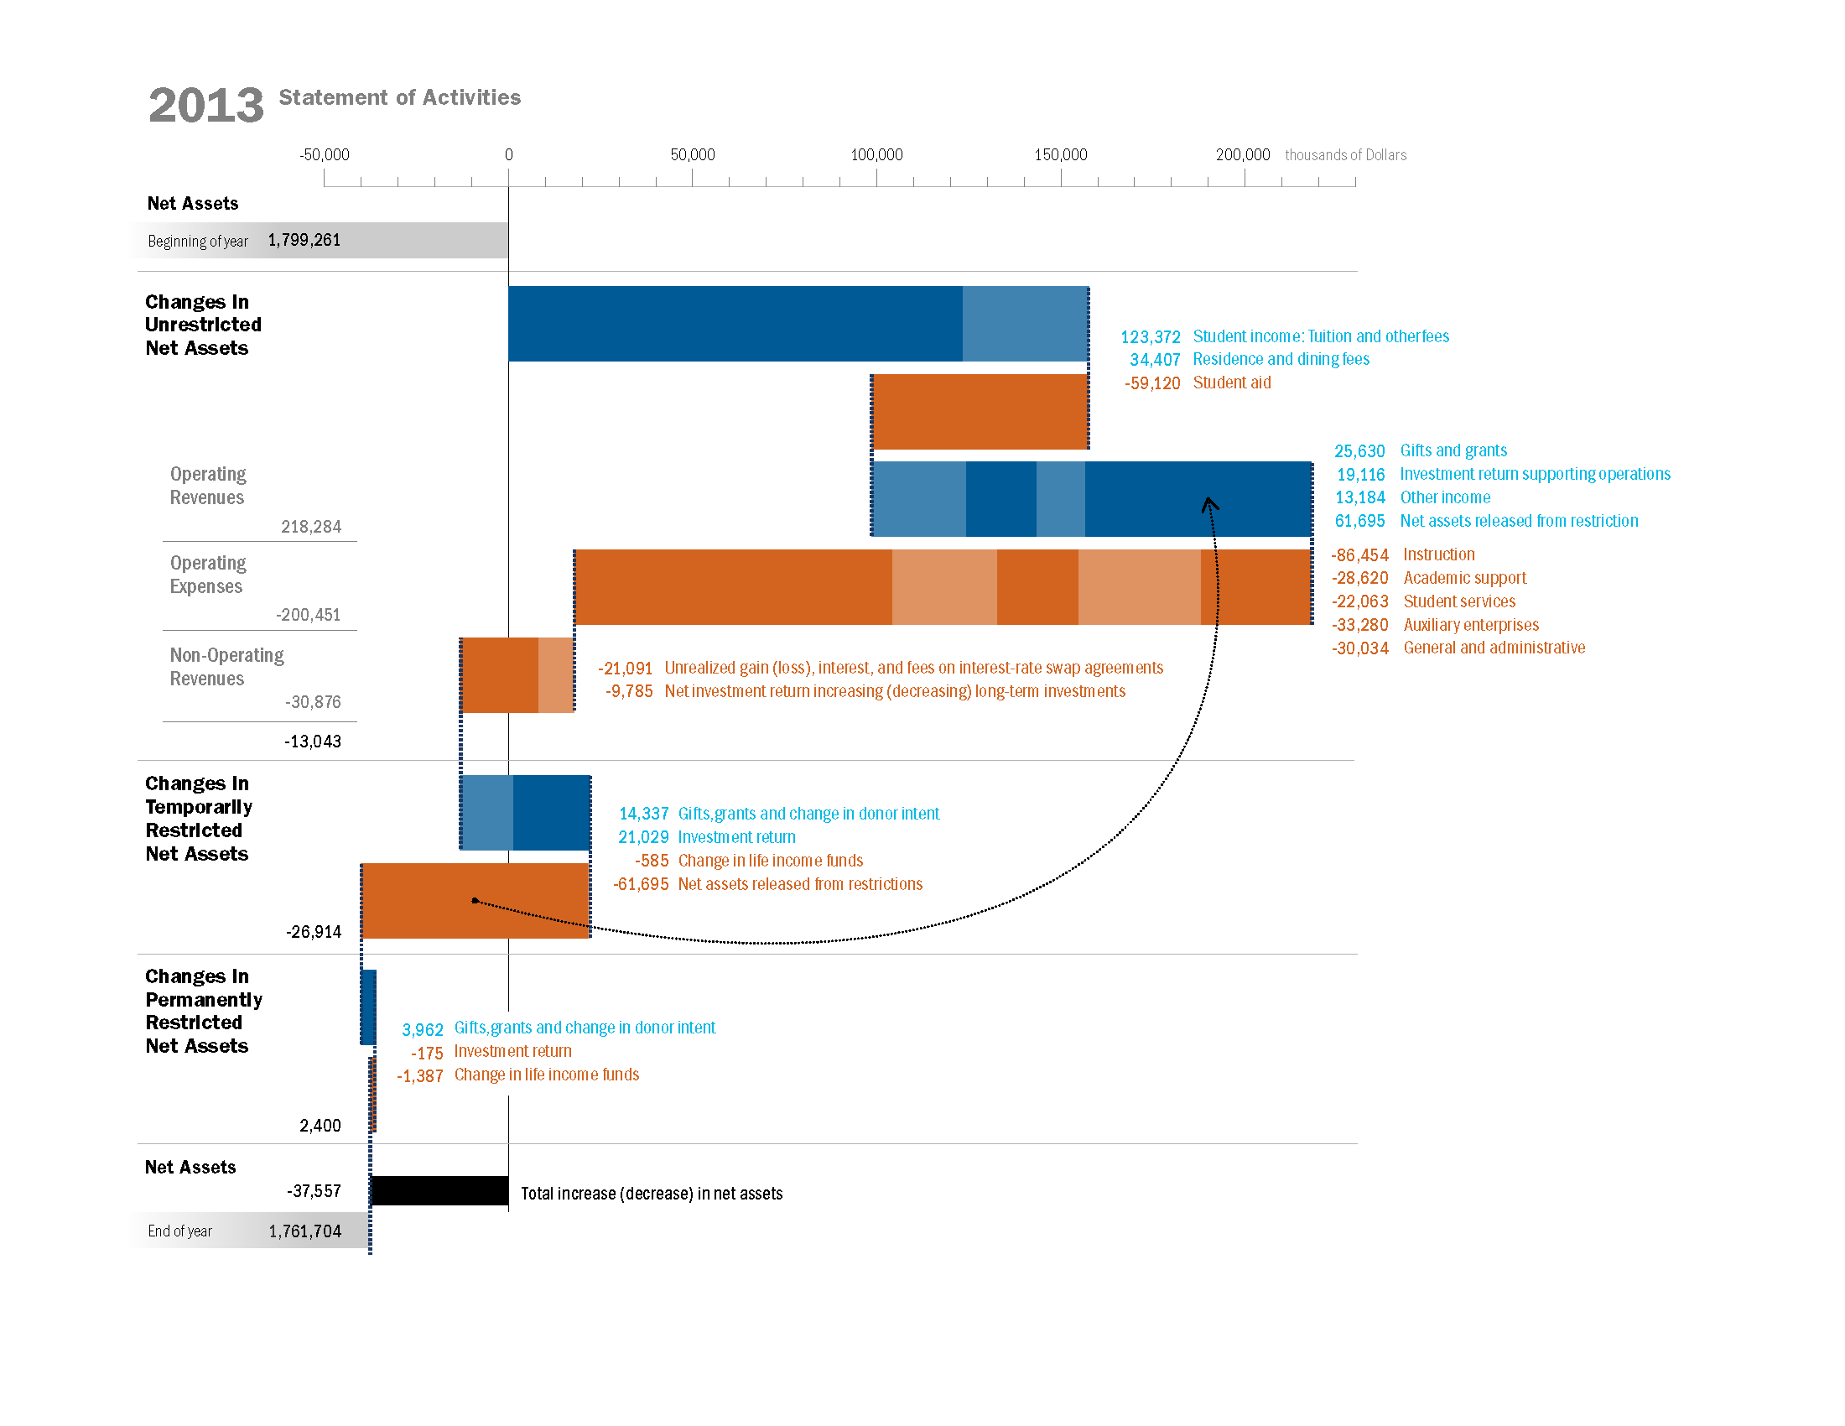
Flows
Transforming data from one stage to another
SOURCE:
Visualizing Financial Data
Rodriguez & Kaczmarek
Notes:
Results of top-level aggregates for unrestricted, temporarily restricted, and permanently restricted net assets.
Results of mid-level aggregates for operating revenues, operating expenses and non-operating revenues.
Grouped additions (blue bars) and subtractions (orange bars)
Individual line items within each group of additions or subtractions.

Slide 25
Defining the Question
….. “I need to see the major themes.”
Notes:
Analysis that finds themes in the data allow us to summarize and understand the data.

Slide 26
Groups
Creating categories from a data set
SOURCE:
Visualizing Financial Data
Rodriguez & Kaczmarek
Notes:
Rather than analyzing a sea of factors, ‘Factor Groupings’ creates categories of alpha factors for the portfolio manager to evaluate. This allows the portfolio manager to create more meaning from the heat map and see how categorical groupings either have consistent returns or inconsistent returns across all sectors. The dashboard display is flexible to also analyze each sector independently. For example, Information Technology’ intrinsic value of earning per share shows positive performance both at the category level and at the individual factor level. Equipped with categorized data, the portfolio manager is now able to more readily spot themes in the data.

Slide 27
Groups
Creating categories from a data set
SOURCE:
Visualizing Financial Data
Rodriguez & Kaczmarek
Notes:
Dashboard displays are often used to get an overall view of status and key performance indicators. In a relatively small amount of space dashboards are meant to bubble up the most salient information. As an interactive display, a dashboard can be flexible to progressively display either more or less details of the data. Both high level, mid-level and detail views provides rationale and disclosure of what is behind the numbers. How can we push this dashboard metaphor further? In the following examples, we will consider options that provide a dashboard view into the data across three levels of detail.

Slide 28
Defining the Question
….. “I need to see connections and links.”

Slide 29
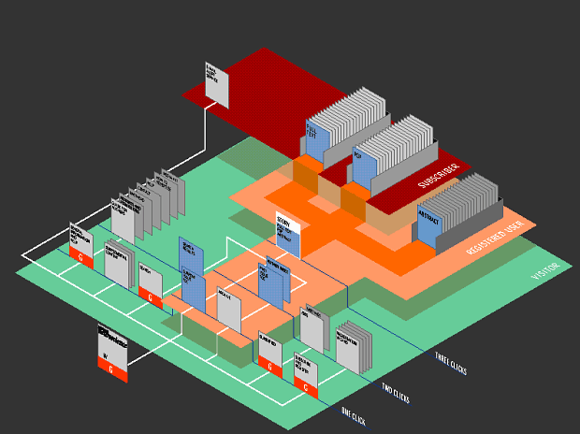
Networks
Connecting the dots between discrete locations
SOURCE: Mappa Mundi
Notes:
Dynamic Diagrams, Inc. has developed an innovative visual metaphor to represent Web site structure which they call the Z-Diagram. It is a 2.5d landscape view, with Web pages represented as small standing cards. The metaphor was originally conceived by Krzysztof Lenk, a designer and founding partner in the company, to display the structure of a multimedia encyclopaedia [2].
The Z-Diagram lays out the site on an isometric plain which has a constant scale across the space. Kahn says the Z-Diagram was influenced by the famous Turgot map of Paris from the 1730s [4] which employed the same geometric properties to provide legible views of the crowded Parisian streets. And he argues,
"This use of depth without vanishing point is the key. It is the point that is missed by many applications of 3D graphics for navigation. The distortions of vanishing point perspective are often counter to the principles of information design."

Slide 30
Conclusions
Calculations, Correlations, Predictive

Slide 31
Defining the Question
….. “I want to see the outcomes of this distance calculation.”
SOURCE: Wikipedia

Slide 32
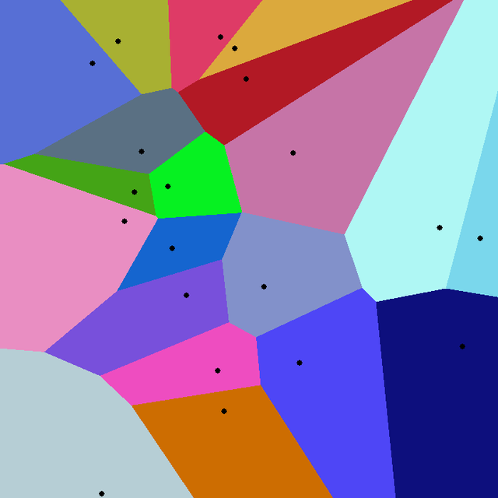
Calculations
Translating equations to be visually deciphered
SOURCE: Wikipedia

Slide 33
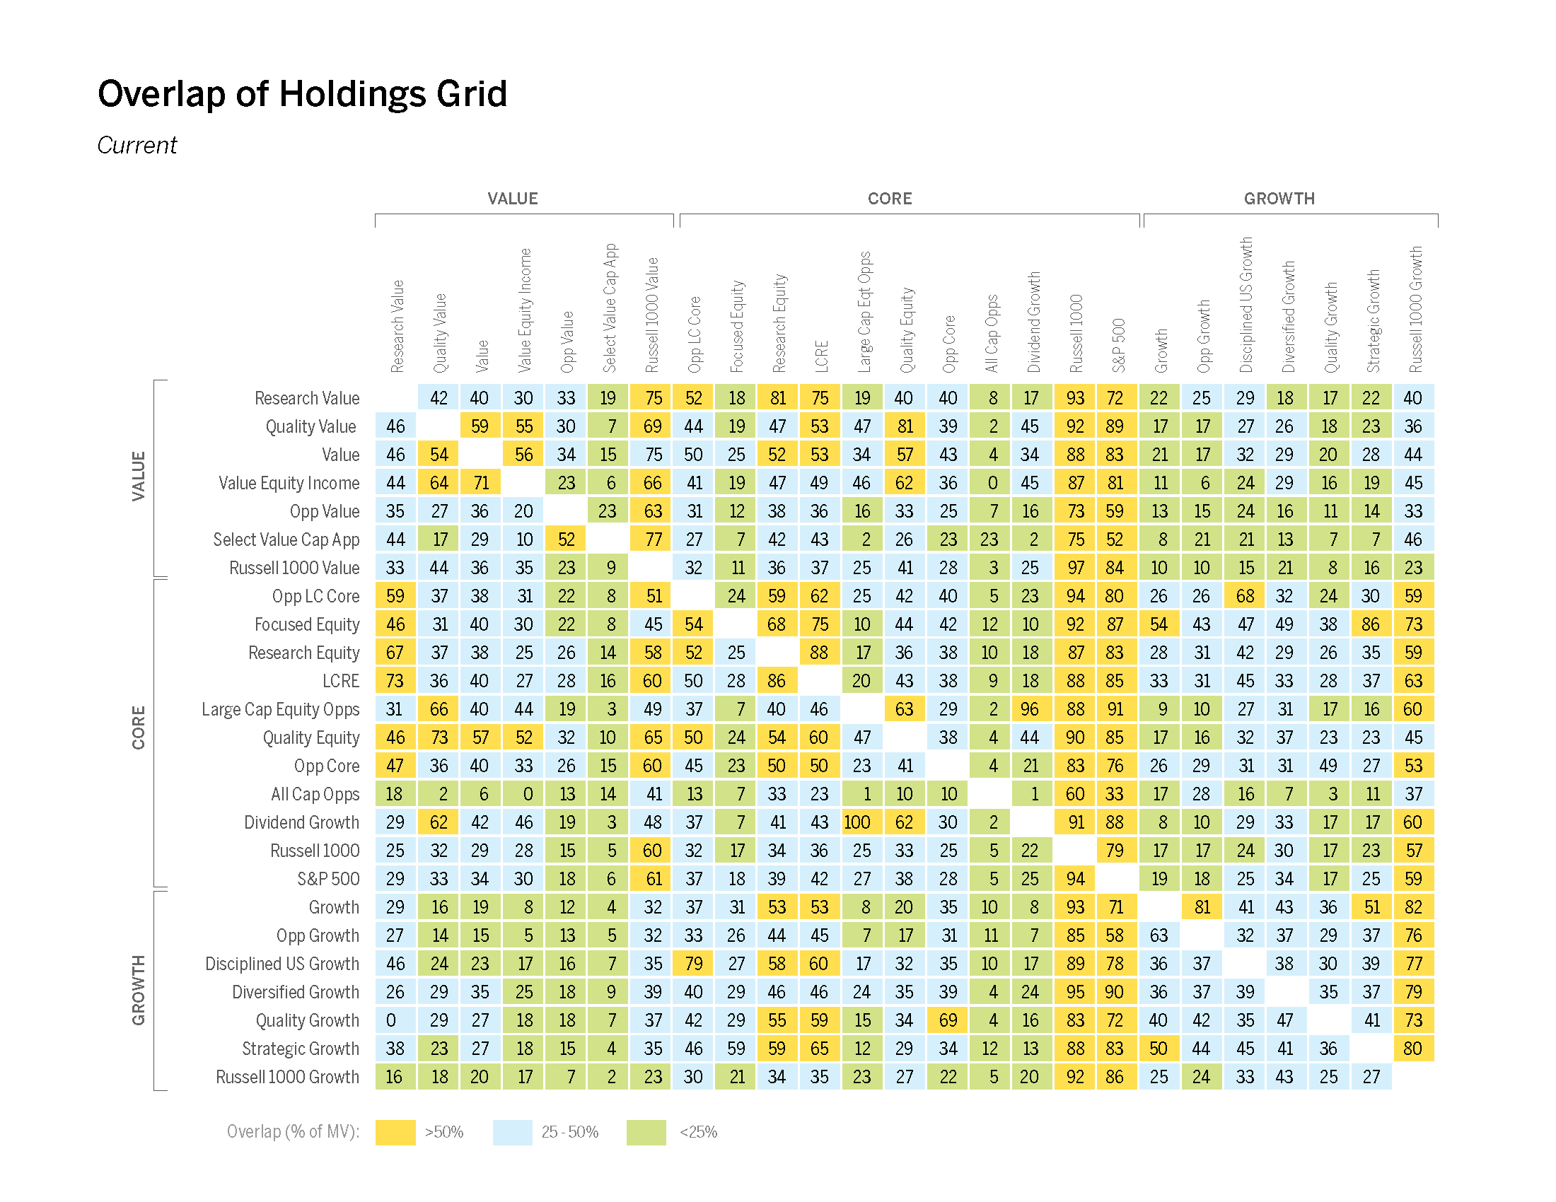
Defining the Question
….. “I need to see the level of correlation.”
SOURCE:
Visualizing Financial Data
Rodriguez & Kaczmarek
Notes:
A part of managing risk is largely defined by understanding exactly where investments are placed and sized and how this placement and size of the allocations map to exposure. Severe overlap of holdings among funds creates risk by having too much in a particular investment; it removes the efficiency gains of diversification and instead the portfolio manager is left to rely on select investments to do well in order for the full portfolio to do well. A part of managing risk is largely defined by understanding exactly where investments are placed and sized and how this placement and size of the allocations map to exposure. Severe overlap of holdings among funds creates risk by having too much in a particular investment; it removes the efficiency gains of diversification and instead the portfolio manager is left to rely on select investments to do well in order for the full portfolio to do well.

Slide 34
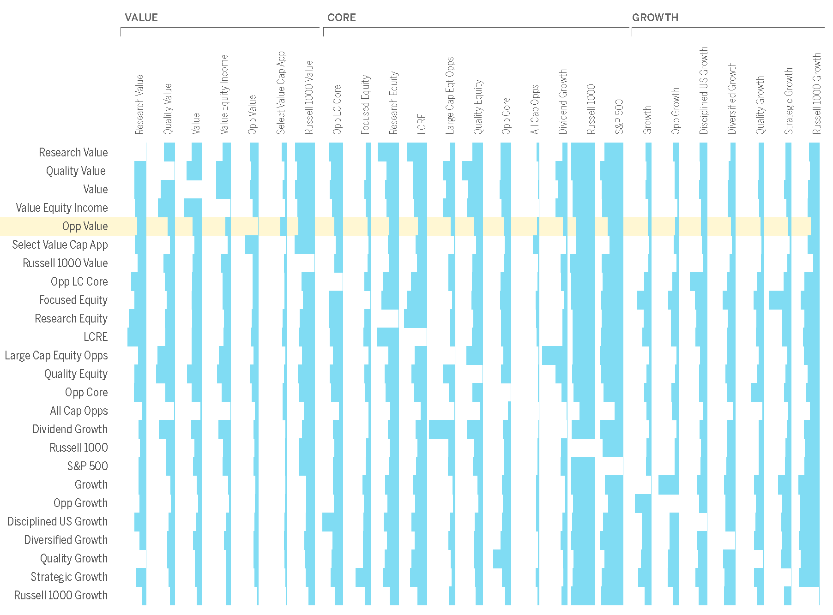
Correlations
Discovering congruency between data sets
SOURCE:
Visualizing Financial Data
Rodriguez & Kaczmarek
Notes:
However the tri-color system and numbers have been replaced with right aligned bar graphs that represent the market value percent overlap. The shear size of the bar illustrates the concentration of overlap. Alignment of the market value by the column header suggests a comparison that first starts with the column header. By providing focus on the column, the reader begins to read the chart from top to bottom and therefore deduces the order of operations to be the funds in column header A are xx% in row header B.

Slide 35
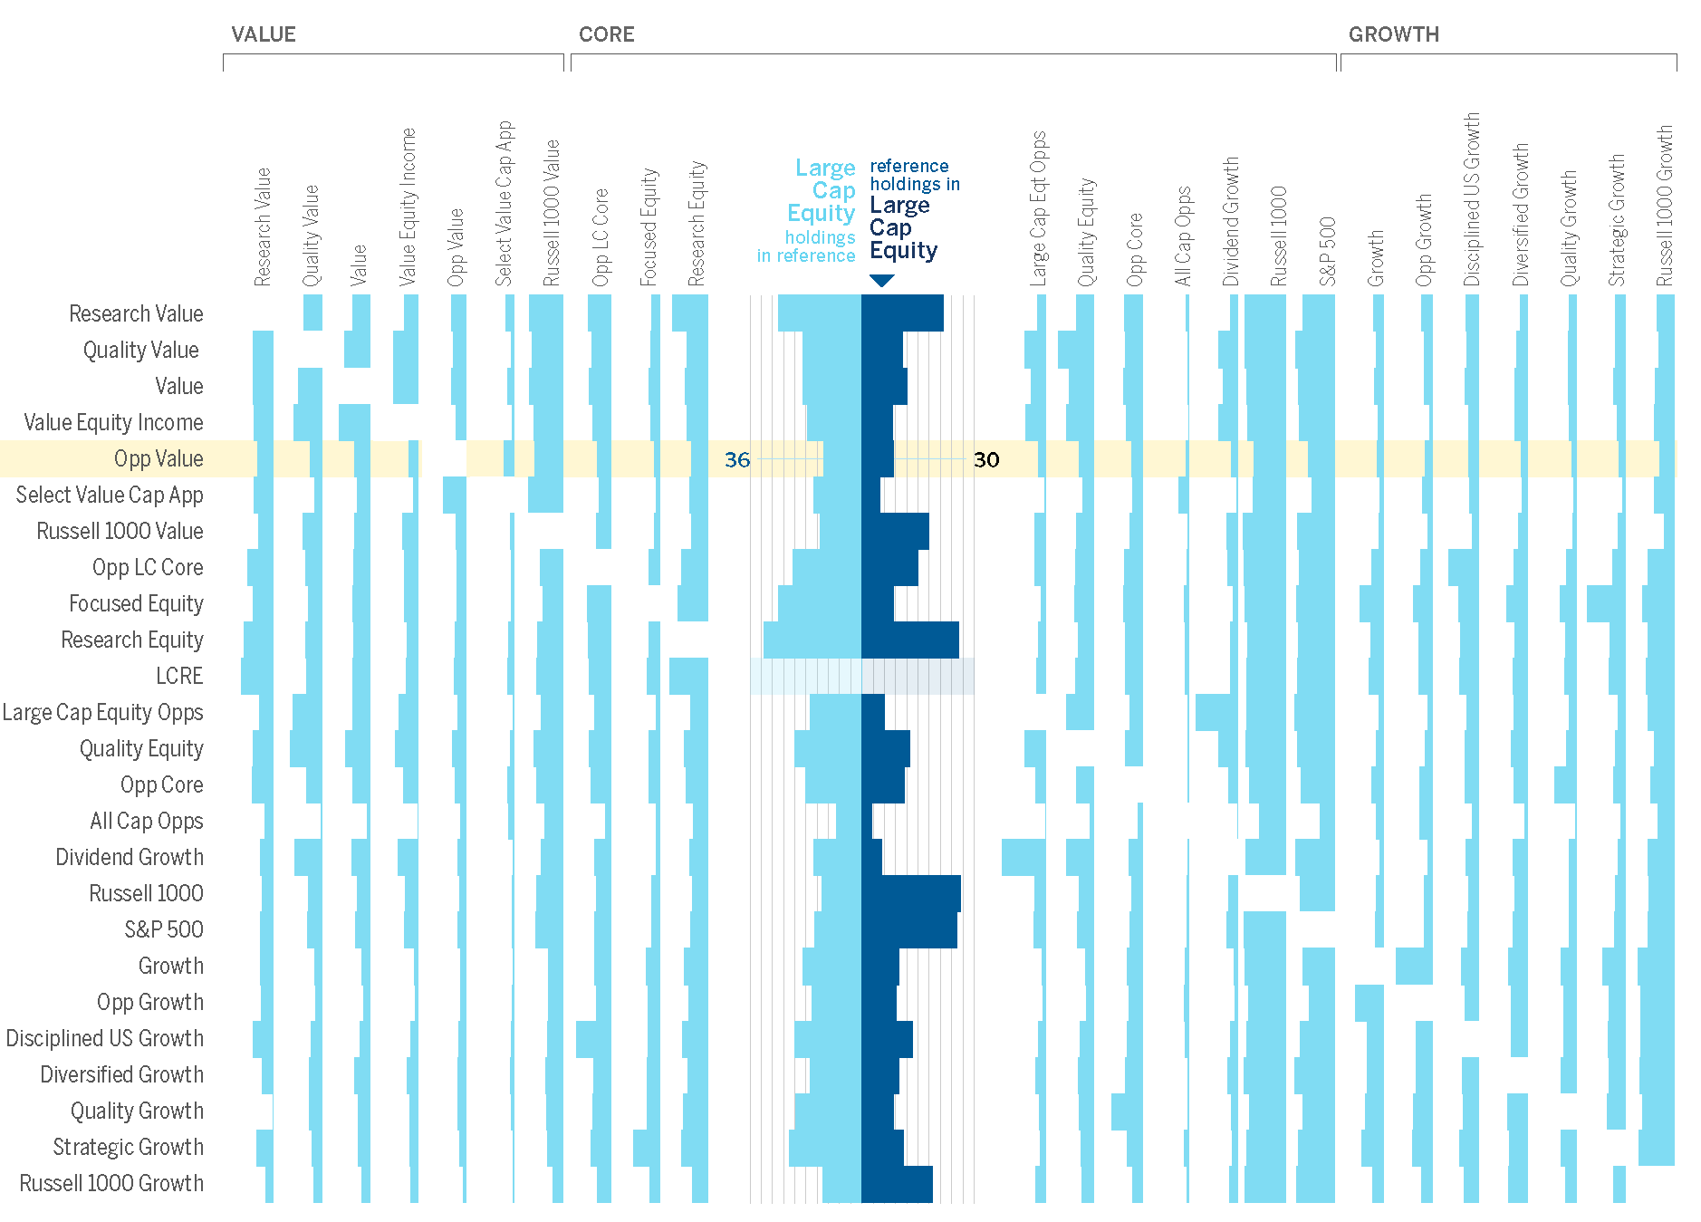
Correlations
Discovering congruency between data sets
SOURCE:
Visualizing Financial Data
Rodriguez & Kaczmarek
Notes:
The expanded view displayed in figure 6.33 shows the interaction of a user controlling the chart and actively selecting a column to open and review the contents. The title system for each open column labels the percentage holdings depicted as horizontal bars and listed as discrete numbers. As the column opens, the contents are revealed in a butterfly bar chart pattern. The column contents contain expanded bar graphs that provide more detail to the overlap between both funds. The technique of using the butterfly bar chart also includes light vertical lines for comparison as well as two toned colors to delineate each percentage overlap. Within this interactive tool the end user can elect to open multiple funds for further comparison.

Slide 36
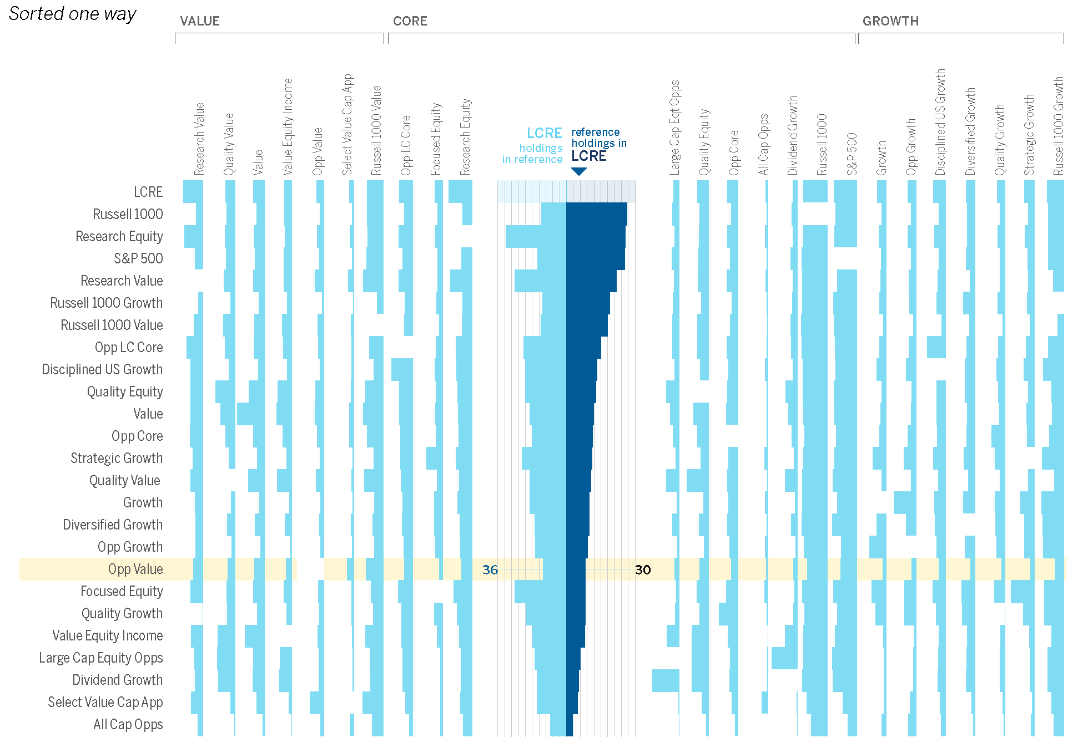
Correlations
Discovering congruency between data sets
SOURCE:
Visualizing Financial Data
Rodriguez & Kaczmarek
Notes:
The user can further organize the chart via sorting. The column headers at the top of the chart remain in the same order while the row headers shift to follow the user selected sort order.

Slide 37
Correlations
Discovering congruency between data sets
SOURCE:
Visualizing Financial Data
Rodriguez & Kaczmarek
Notes:
All Funds Sorted’ reorganizes the chart yet again. In this view, the end user has sorted all funds from left to right and top to bottom by percentage overlap. Both the columns and row headers are now reordered to reflect the new organization. Since the rows and columns are reordered, the group headings no longer apply and are now removed from the chart.

Slide 38
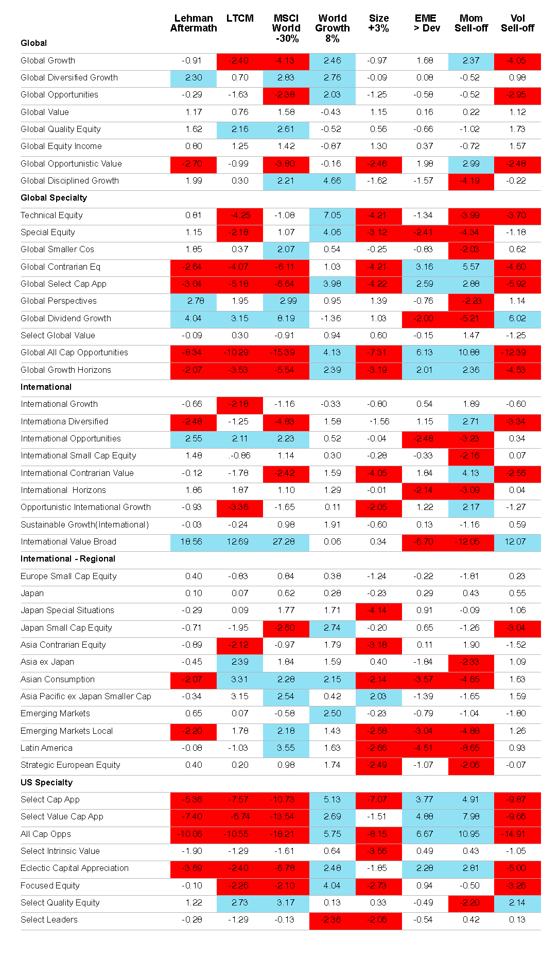
Defining the Question
….. “I need to foresee the possibilities.”
SOURCE:
Visualizing Financial Data
Rodriguez & Kaczmarek
Notes:
The ‘Stress Test Results’ chart provides the portfolio manager a full listing of how their own categorized group of funds would react to various scenarios. The scenarios represent significant impactful events like the Lehman Aftermath to the Long term capital management (LTCM), the private hedge fund failure of 1998. The column headers list each historical scenario while the row headers list each product. The numerical data entered into each cell represents expected excess returns one month post the event. The color cells represent two extreme data points; red for results that exceed negative two and blue that go beyond a positive two. The cells that are not colored maintain the middle ground range between negative two and two.

Slide 39
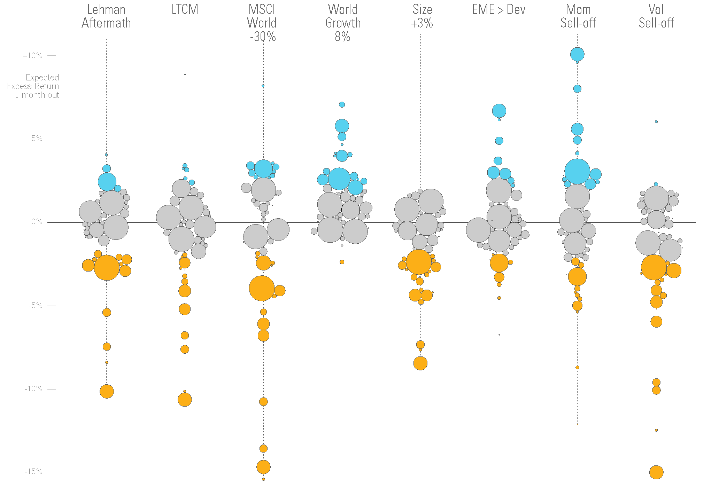
Predictive
Predicting outputs based on learned inputs
SOURCE:
Visualizing Financial Data
Rodriguez & Kaczmarek
Notes:
‘Stress Test Results: Weighted Bubble Distribution Layer’ is very similar to it’s predecessor figure 6.39 however, this version has included an additional data set of market value. The size of each circle represents the market value associated with each fund. The funds that hold the largest market value are shown as large bubbles while the funds with the smallest market value are shown as small bubbles and in some cases render as specs on the page.
Color is introduced to segment the results into three return categories. The categories are the same as the original chart ‘Stress Test Results Table’ figure 6.39. The funds that perform well, to the stress tests and show a positive 2% gain or greater, are colored in blue. The funds that perform in the middle and show a range between 2 and -2 are filled in gray. The negative performing funds that show returns at -2 or below are colored in orange.

Slide 40
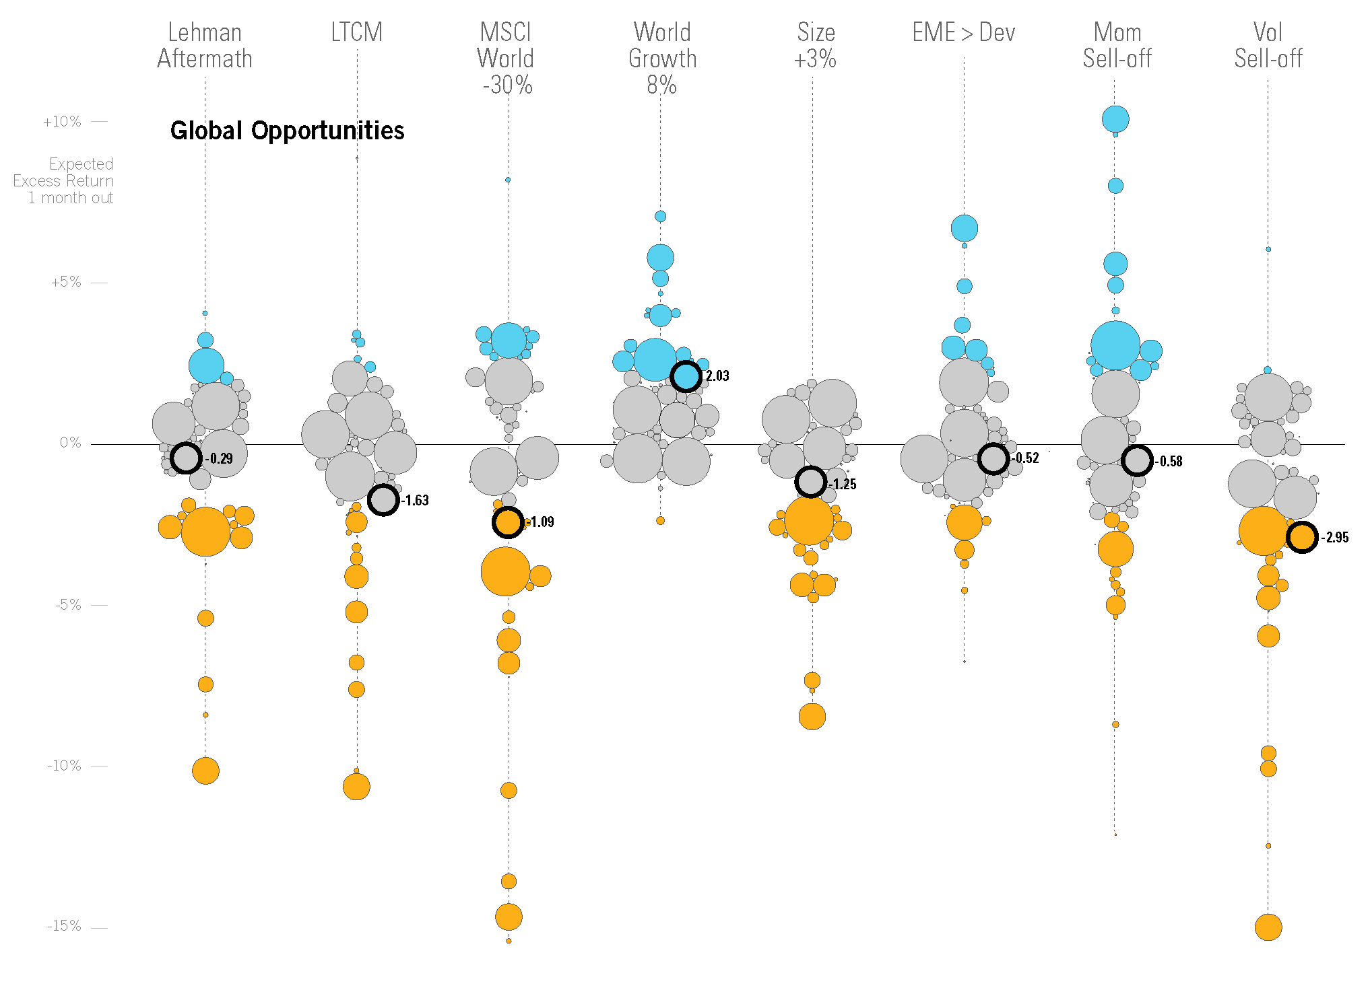
Predictive
Predicting outputs based on learned inputs
SOURCE:
Visualizing Financial Data
Rodriguez & Kaczmarek
Notes:
A fund identification version of the chart as shown in figure 6.43 provides the reader the ability to track a fund across the various stress tests. Designed as an interactive system, this chart provides the ability to select and identify each fund’s results upon the end user’s request. Once the end user selects a fund, the fund name is displayed and the return results are underscored with a bold circle alongside the numeric results. The fund identification method is an end user initiated request system.

Slide 41

Predictive
Predicting outputs based on learned inputs
SOURCE:
Visualizing Financial Data
Rodriguez & Kaczmarek

Slide 42
Collect & Organize & Discover
Time
Ranking
Correlations
Grouping
Drill Down
Attributes
Calculations
Flow
Networks
Predictive

Slide 43
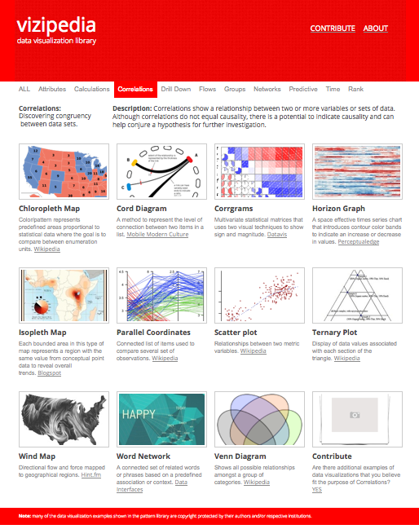
www.vizipedia.com
Browse
Reference
Contribute
Notes:
my pattern library is meant to show a single exemplary pattern of each type.

Slide 44
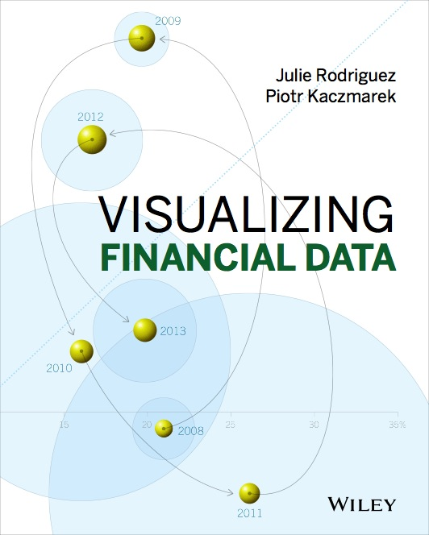
Thanks!
Tweet: juliargentinaG

Slide 45
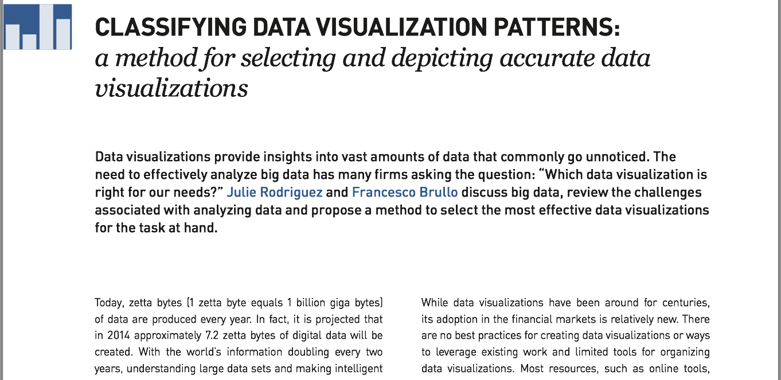
Publish
SOURCE: http://www.sapient.com/content/dam/sapient/sapientglobalmarkets/pdf/thought-leadership/crossings-fall2012.pdf

