Slide 1
Design Patterns For Real Time Streaming Analytics
Sheetal Dolas
Principal Architect, Hortonworks
19 Feb 2015

Slide 2
Who am I ?
Principal Architect @ Hortonworks
Most of the career has been in field, solving real life business problems
Last 5+ years in Big Data including Hadoop, Storm etc.
Co-developed Cisco OpenSOC ( http://opensoc.github.io )
sheetal@hortonworks.com
@sheetal_dolas

Slide 3
Agenda
Streaming Architectural Patterns - Overview
Design Patterns
What
Why
Illustrations
QA

Slide 4
Streaming Architectural Patterns
Notes:
As businesses are realizing the power Hadoop and large data analytics, many businesses are demanding large scale real time streaming data analytics. Apache Storm and Apache Spark are platforms that can process large amount of data in real time. However building applications on these platforms that can scale, reliably process data without any loss, satisfy functional needs and at the same time meet the strict latency requirements, takes lot of work to get it right.
After implementing multiple large real time data processing applications using these technologies in various business domains, we distilled commonly required solutions into generalized design patterns. These patterns are proven in the very large production deployments where they process millions of events per second, tens of billions of events per day and tens of terabytes of data per day.

Slide 5
Real Time Streaming Architecture
Source Systems
Data Collection
Messaging System
Real Time Processing
Storage
Access
Historic
Analytic Tools
Hive / HDFS
R / Python
Sources
Flume / Custom
Kafka
Storm
BI Tools
Syslog
Search
Agent A
Topic A
Topology A
Web Services
Machine Data
Elastic Search / Solr
Agent B
Topic B
Topology B
External
Streams
REST API
Low Latency NoSql
Web Apps
Other
Agent N
Topic N
Topology N
HBase
Alerting Systems

Slide 6
Lambda Architecture
Batch Layer
Serving Layer
All Data
Batch View
New Data
Pre-compute Views
Data Access
Batch View
Data Stream
Query
Speed Layer
Stream Processing
Real Time View
Notes:
All data is dispatched to both the batch layer and the speed layer
batch layer - (i) manage the master dataset and (ii) to pre-compute the batch views.
The serving layer indexes the batch views for low-latency, ad-hoc queries
The speed layer compensates for the high latency and deals with recent data only
incoming query can be answered by merging batch and real-time views

Slide 7
Kappa Architecture
Data Source
Stream Processing System
Serving DB
Data Access
Job Version n
Output table n
Data Stream
Query
Job Version n + 1
Output table n + 1
Notes:
Use Kafka or some other system that will let you retain the full log of the data you want to be able to reprocess and that allows for multiple subscribers. For example, if you want to reprocess up to 30 days of data, set your retention in Kafka to 30 days.
When you want to do the reprocessing, start a second instance of your stream processing job that starts processing from the beginning of the retained data, but direct this output data to a new output table.
When the second job has caught up, switch the application to read from the new table.
Stop the old version of the job, and delete the old output table.

Slide 8
Design Patterns

Slide 9
Design Pattern – What is it?
A General reusable solution to a commonly occurring problem within a given context in software design.
Reusable
Solution
Commonly Occurring
Problem
Contextual
Software Design
Notes:
Not a finished design that can be transformed directly into source or machine code.
It is a description or template for how to solve a problem
Patterns are formalized best practices

Slide 10
Design Patterns – Why ?
Streaming use cases have distinct characteristics
Unpredictable incoming data patterns
Correlating multiple streams
Out-of-sequence and late events
High scale and continuous streams pose new challenges
Peaks and valleys
Changing data characteristics over period of time
Maintain the latency and throughput SLAs

Slide 11
Streaming Patterns
Architectural Patterns
Real-time Streaming
Near-real-time Streaming
Lambda Architecture
Functional Patterns
Stream Joins
Top N (Trending)
Rolling Windows
Data Management Patterns
External Lookup
Responsive Shuffling
Out-of-Sequence Events
Stream Security Patterns
Kappa Architecture
Message Encryption
Authorized Access
Secure Cluster Authentication

Slide 12
Streaming Patterns – Being Discussed
Architectural Patterns
Real-time Streaming
Near-real-time Streaming
Lambda Architecture
Functional Patterns
Stream Joins
Top N (Trending)
Rolling Windows
Data Management Patterns
External Lookup
Responsive Shuffling
Out-of-Sequence Events
Stream Security Patterns
Kappa Architecture
Message encryption
Authorized Access
Secure Cluster Authentication

Slide 13
External Lookup
Dynamic, High Speed Enrichments With External Data Lookup

Slide 14
External Lookup - Description
Referencing frequently changing external system data for event enrichments, filters or validations
by minimizing the event processing latencies, system bottlenecks and maintaining high throughput.
Page 14

Slide 15
External Lookup - Challenges
Increased latency due to frequent external system calls
Insufficient memory to hold all reference data in memory
Scalability and performance issues with large data reference sets
Dynamic reference data needs frequent cache purge and refreshes
External systems can become a bottleneck
Page 15

Slide 16
External Lookup – Potential Options
 | Performance | Scalability | Fault Tolerance
Always Fetch
Cache Everything
Partition and Cache on the go

Slide 17
External Lookup - A Reference Use Case
Real Time Credit Card Fraud Identification and Alert
Credit card transaction data comes as stream (typically through Kafka)
External system holds information about the card holder’s recent location
Each credit card transaction is looked up against user’s current location
If the geographic distance between the credit card transaction location and user’s recent known location is significant, the credit card transaction is flagged as potential fraud
Page 17
Notes:
Credit card transaction data comes as stream (typically through Kafka)
An external system has information about the credit card holder’s recent location (collected from GPS on mobile device and/or from mobile towers)
Each credit card transaction is looked up against user’s current location
If the geographic distance between the credit card transaction location and user’s recent known location is significant (say 100 miles), the credit card transaction is flagged as potential fraud

Slide 18
External Lookup - Topology Overview
Source Stream
Storm
External Reference Data
Alerting System
Looks up user’s current location from external system and finds geo distance between transaction location and user location
User Location Information
Credit Card Transaction Spout
Partitioner Bolt
Fraud Analyzer Bolt
Locally caches the user location data. Cache validity is time bound
Fraud Alert Email
Partitions data based on area code of the mobile numbers
Page 18

Slide 19
External Lookup - Peek in the Bolts
Storm
Stream is partitioned based on area code
Local cache
(time sensitive)
(Use lightweight caching solution like Guava)
Fraud Analyzer Bolt
Instance 1
CA
NV
TX
Partitioner Bolt
Instance 1
Fraud Analyzer Bolt
Instance 2
NY
CT
MA
Partitioner Bolt
Instance 2
Partitioner Bolt
Instance n
Fraud Analyzer Bolt
Instance n
FL
NC
OH
Page 19

Slide 20
External Lookup - Benefits of the approach
Only required data is cached (on demand)
Each bolt caches only partition of reference data
Data is locally cached so trips to external system are reduced
Cache is time sensitive
On the go cache building handles failures elegantly
Page 20
Notes:
Only required data is cached (on demand)
Hence reduced cache size requirements
Each bolt caches only partition of reference data
No duplicate caching. Reduced cache size requirements
Can process more data with same RAM available
Data is locally cached so trips to external system are reduced
Reduced latency and increased system throughput
Reduced load on external system
Cache is time sensitive
Provides ability to refresh cache after certain intervals for dynamic reference data
On the go cache building handles failures elegantly
Cache gets auto built as the events are re processed and no additional handling needed
Also the data patterns are more predictable so you can also pre build cache on component start

Slide 21
External Lookup – Applicability
Stream processing depends on external data
External data is sufficiently large that could not be hold in memory of each task
External data keeps changing
External system has scalability limitations

Slide 22
Responsive Shuffling

Slide 23
Responsive Shuffling - Description
Automatically adjust shuffling for better performance and throughput during peaks and varying data skews in streams

Slide 24
Responsive Shuffling - Challenges
Incoming data stream is unpredictable and can be skewed
Skew can change from time to time
Managing latency and throughput with skews is difficult
Since streams are continuously flowing, restarting topology with new shuffling logic is practically not possible

Slide 25
Shuffling – Potential Options
 | Latency & Throughput | System Reliability | Uptime
Static Shuffle
Responsive Shuffle

Slide 26
External Lookup - A Reference Use Case
Optimized HBase Inserts
Event data is stored in HBase after storm processing
Group events such that a bolts can insert more events in HBase with less trips to region servers
Over period of time HBase regions can split/merge
Automatically adjust the event grouping as HBase region layout changes over period of time
Page 26

Slide 27
Example – HBase writes w/o responsive shuffling
App Bolt
Instance 1
(100 events)
HBase Bolt
Instance 1
(100 events)
Region Server
Instance 1
(100 events)
App Bolt
Instance 2
(100 events)
HBase Bolt
Instance 2
(100 events)
Region Server
Instance 2
(100 events)
App Bolt
Instance 3
(100 events)
HBase Bolt
Instance 3
(100 events)
Region Server
Instance 3
(100 events)
300 events sent
300 events sent
9 trips to region servers
300 events received

Slide 28
Responsive Shuffling - Design

Slide 29
Example – HBase writes with responsive shuffling
App Bolt
Instance 1
(100 events)
RS Aware Partitioner
HBase Bolt
Instance 1
(100 events)
Region Server
Instance 1
(100 events)
Partitioner automatically adapts to splitting/merging HBase regions
App Bolt
Instance 2
(100 events)
RS Aware Partitioner
HBase Bolt
Instance 2
(100 events)
Region Server
Instance 2
(100 events)
App Bolt
Instance 3
(100 events)
RS Aware Partitioner
HBase Bolt
Instance 3
(100 events)
Region Server
Instance 3
(100 events)
300 events sent
300 events sent
3 trips to region servers
300 events received

Slide 30
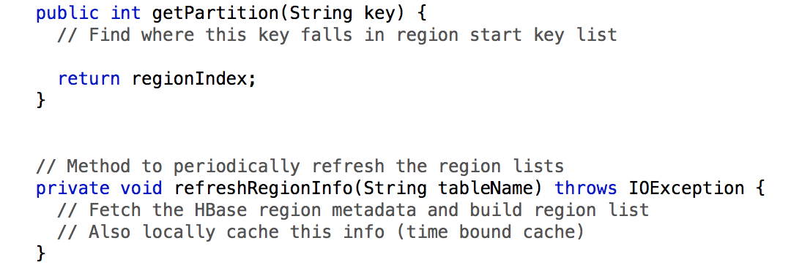
Responsive Shuffling – Sample Code
In App Bolt
In Topology
In RS Aware Partitioner

Slide 31
Responsive Shuffling - Benefits
Topology responds to changes in data patterns and adopts accordingly
Maintains high level of SLA and throughput adherence
Minimizes needs for maintenance & hence downtimes

Slide 32
Responsive Shuffling - Applicability
Change in shuffle pattern does not impact final outcome
Data stream has varying skews
Target/Reference system specifications change over period of time

Slide 33
Out-of-Sequence Events

Slide 34
Out-of-Sequence Events - Description
An out-of-sequence event is one that's received late, sufficiently late that you've already processed events that should have been processed after the out-of-sequence event was received.

Slide 35
Out-of-Sequence Events - Challenges
Hard to determine if all events in given window have been received
Need referencing of relevant data for late events
Builds more pressure on processing components
Increased latency and degraded overall system performance
Notes:
Out-of-sequence events can come very late and processing them would need referencing of relevant data
In streaming applications, it is hard to determine if all events in given window have been received
Out-of-sequence events can come very late that it can build more pressure on processing components as they need to wait longer as well as do additional processing for very old events
The complexity can increase latency of events processed and degrade overall system performance

Slide 36
Out-of-Sequence Events – Potential Options
 | Latency | Result Accuracy | Operational Ease
Drop
Wait
Fan Out

Slide 37
Out-of-Sequence Events - Processing
Monitors currently being processed events and identifying out-of-sequence events
Ordered events
Source Spout
Event Filter Bolt
Typical Processing Bolt
Out-of-Sequence events
Based on complexities in processing, this can be extended as different topology
Special Handling Bolt

Slide 38
Out-of-Sequence Events – Benefits
Separation of concerns
Maintain the the overall throughput and latency requirements
Independent scaling of components
Notes:
Separation of concerns – Separate the processing responsibilities between typical event processing and exceptional event processing
Typical processing components and Special handling components can be scaled independently (parallelism, memory needs, latency needs)

Slide 39
Out-of-Sequence Events - Applicability
When order of events matter
Processing out-of-sequence events needs special and complex logic
Stream has relatively low volume of out-of-sequence events
Notes:
When order of events matter - Input stream may have out-of-sequence events that need to be processed appropriately

Slide 40
Thank You!
sheetal@hortonworks.com
@sheetal_dolas

Slide 41
Appendix

Slide 42
Data Security in Kafka

Slide 43
Data Security in Kafka - Description
Ability to use Kafka as secure data transfer mechanism.
Apache Kafka is widely used messaging platform in streaming applications. Unfortunately Kafka does not have built in support for Authentication & Authorization (yet)

Slide 44
Data Security in Kafka - Flow
Source Systems
Data Collection
Messaging System
Real Time Processing
Sources
Custom Collector
Kafka
Storm
Syslog
Encrypting Producer
Encrypted Messages
Kafka Spout
Decrypting Bolt
App Bolt

Slide 45
Data Security in Kafka – Encryption Details
Data Collection
Messaging System
Real Time Processing
Event Producer
Kafka Topic
Storm Decrypting Bolt
Encrypt event(s) w/ AES
Encrypt AES key w/ RSA
Event
Event(s) Envelope
Decrypt AES key w/ RSA
Decrypt event(s) w/ AES
Event
Event(s) Envelope
Event(s) Envelope
Encrypted AES Key (w/ RSA)
Event(s) Envelope
Encrypted Event
(w/ AES)

Slide 46
Data Security in Kafka – Encryption Details
RSA public/private keys are generated ahead of time and securely shared with topology
AES key is randomly generated and periodically refreshed
Only user having appropriate RSA private key can read the data
One event or a batch of events can be encrypted together as per needs

Slide 47
Data Security in Kafka - Applicability
Multiple applications want to use Kafka as their source to the stream
Data is sensitive and can not be shared between applications
Other components in the pipeline are secured

Slide 48
Micro Batching

Slide 49
Micro Batching - Description
Micro-batching is a technique that allows a process or task to treat a stream as a sequence of small batches or chunks of data.
For incoming streams, the events can be packaged into small batches and delivered to a batch system for processing

Slide 50
Micro Batching - Challenges
Data delivery reliability
Unnecessary data duplication
Increased latency
Complexity in time-bound batching

Slide 51
Micro Batching - Design Options
Thread-based Model
Controller stream to trigger batch flush
Use of Tick Tuples

Slide 52
Tick Tuples
Tick tuples are system generated tuples that Storm can send to your bolt if you need to perform some actions at a fixed interval

Slide 53
Micro Batching - Benefits
Takes advantages of system characteristic by batching events together
Adheres to processing latency needs by ensuring that batches are executed by certain intervals
Prevents data loss by acknowledging events only after successful processing
Simple, elegant and easy to maintain code

Slide 54
Micro Batching - Applicability
Target systems are more efficient with bulk transactions
Processing group of events is more efficient than individual event
End to end event latency is not super sensitive

Slide 55
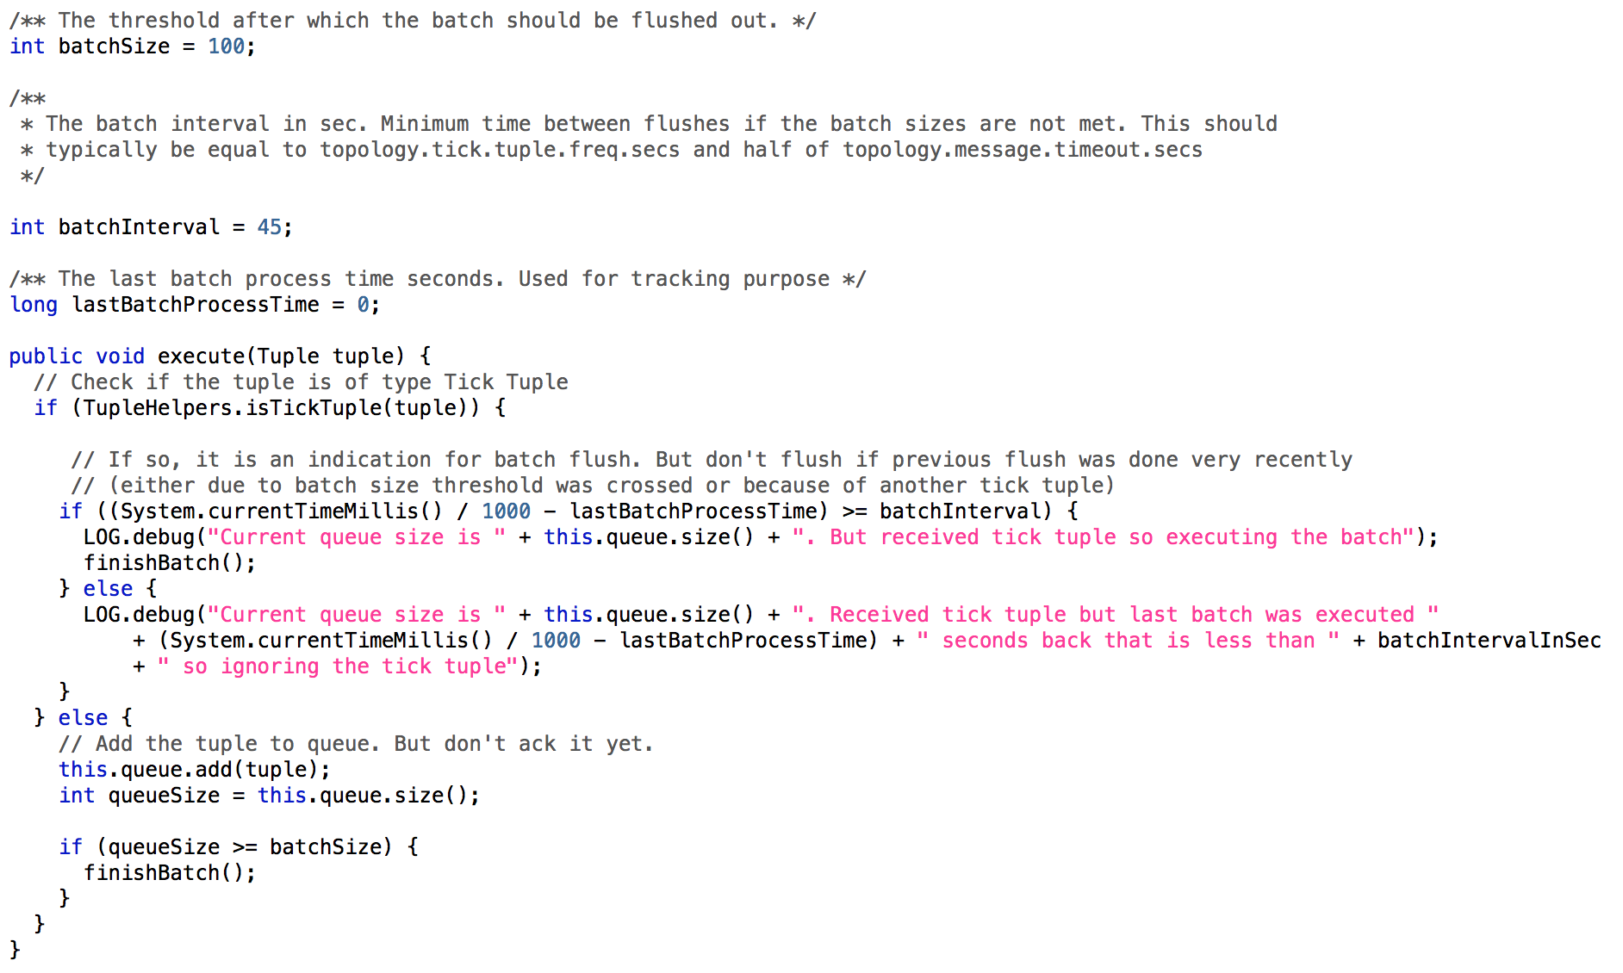
Micro Batching – Sample Code

Slide 56
Thank You!
sheetal@hortonworks.com
@sheetal_dolas

