Slide 1

Designing Data Products
Lutz Finger (@lutzfinger), Reza Rahman (@rezaur_reza)

Slide 2

Ingredients of Data Products
The algorithms?
The question?
Ask
The Why?
Measure
The need?
The Data?
The features?
Collaboration
Team
The right Skills?
All of them are necessary - None of them is sufficient!

Slide 3






ASK is the hardest Part
The question?
Ask
The Why?
The need?
Hack - Days & Incubator
Internal Process
External Competition
Close Collaboration between Business & Data Scientists
“All we do is Data” - Jeff Weiner

Slide 4
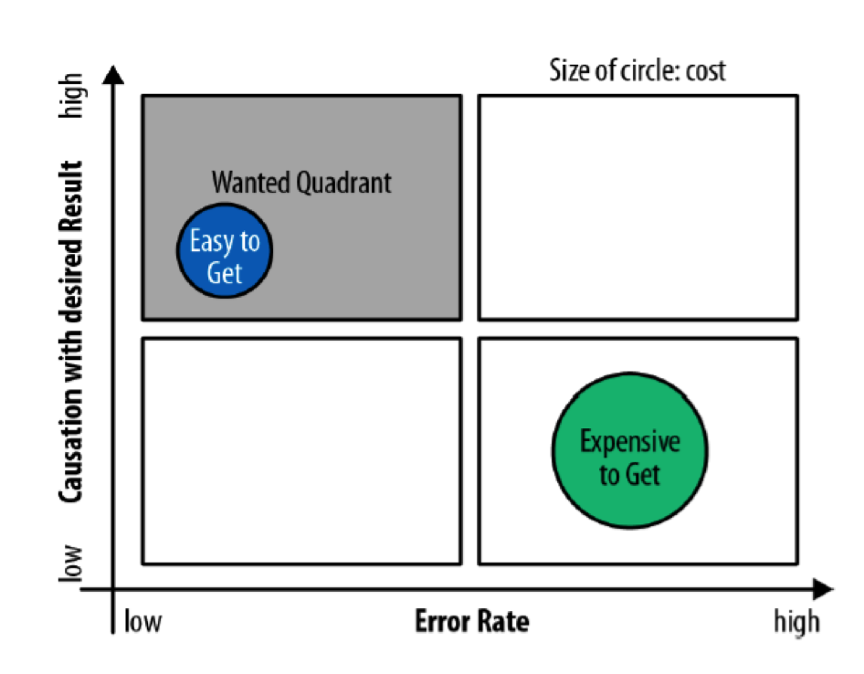
The Right Data
The Data?
Measure
The Algorithm?
Features of Data:
Causation
Noise Ratio
Cost
Privacy
The ‘right’ data set makes the difference. Not the amount. Not the algorithm.
chart: “Ask Measure Learn” by Lutz Finger and Soumitra Dutta

Slide 5
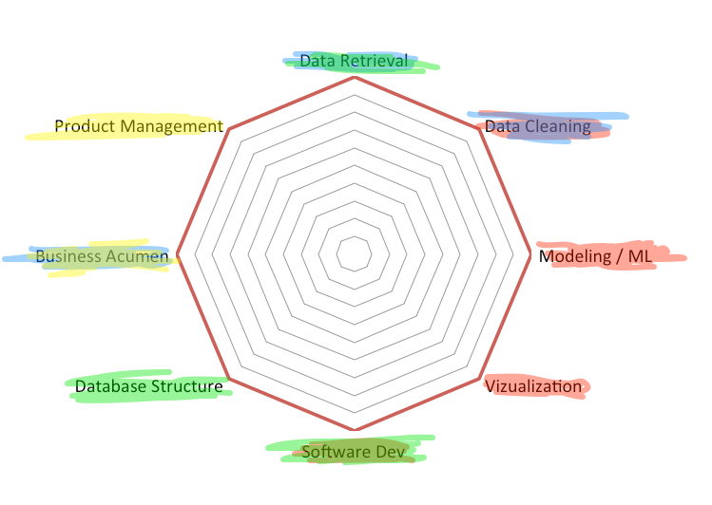
Team Culture
Collaboration
Team
The right Skills?
Data Scientist
BI Analyst
Engineer
Product Manager
Communication Skills
Domain Knowledge

Slide 6
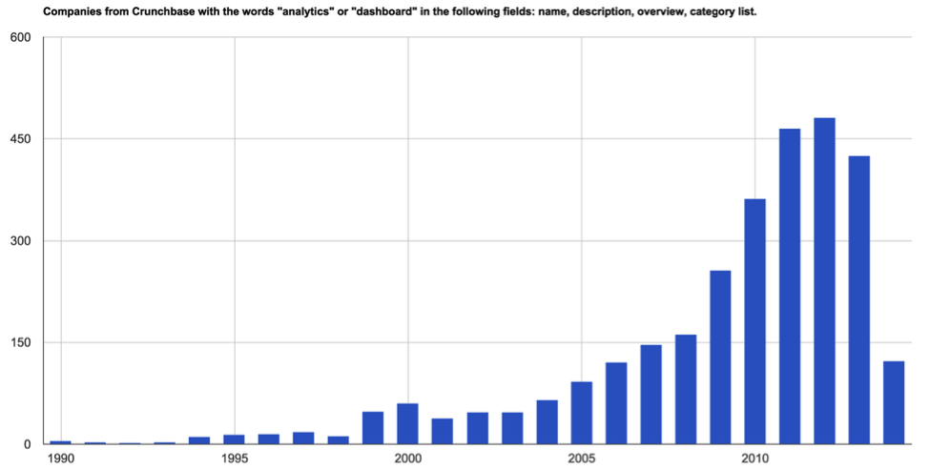
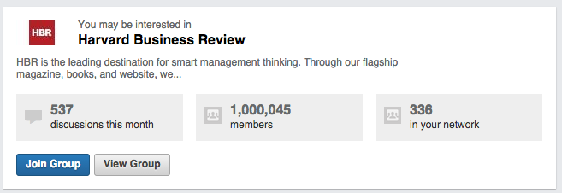
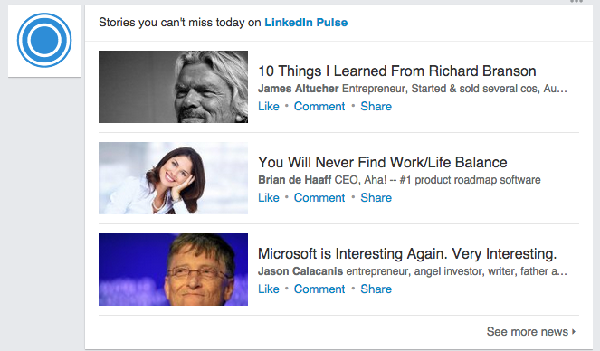
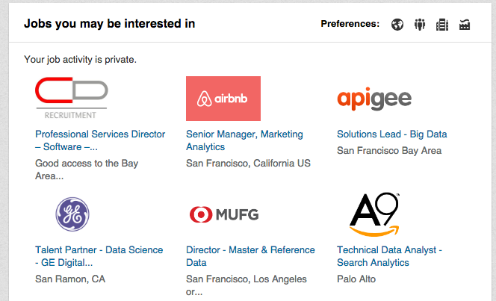
Data Products - An Overview
Benchmarking
& Analytics
The easiest way to create
a Data Product.
Data Science Algorithms
Regression
Classification
courtesy of Andrew Fogg at import.io,

Slide 7
The ASK regarding LinkedIn content
The question?
Ask
The Why?
The need?
50K+ articles posted weekly = lot of content on LinkedIn
BENCHMARK
Understand Content Ecosystem
RECOMMENDATION & PREDICTION
Develop the right content for the right audience

Slide 8
Map the ASK to DATA?
The Data?
Measure
The Algorithm?
The Business ASK
The Data Solution
Topics
Audience / Demographics
Engagement
What
Who
How

Slide 9
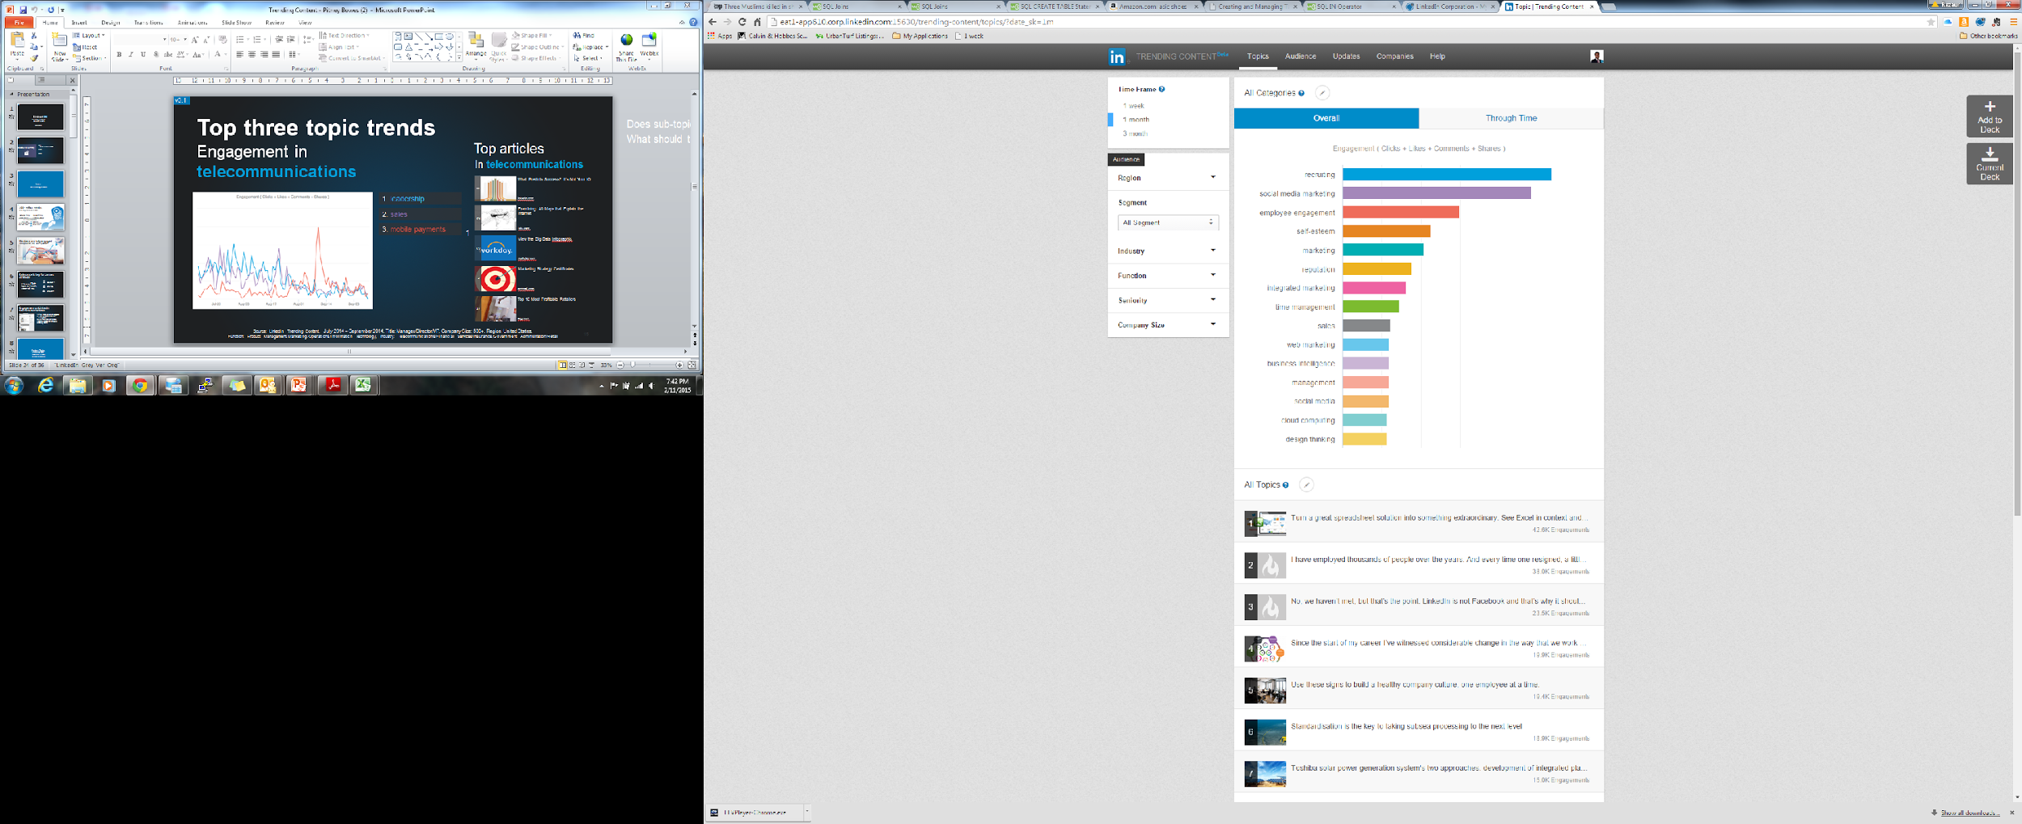
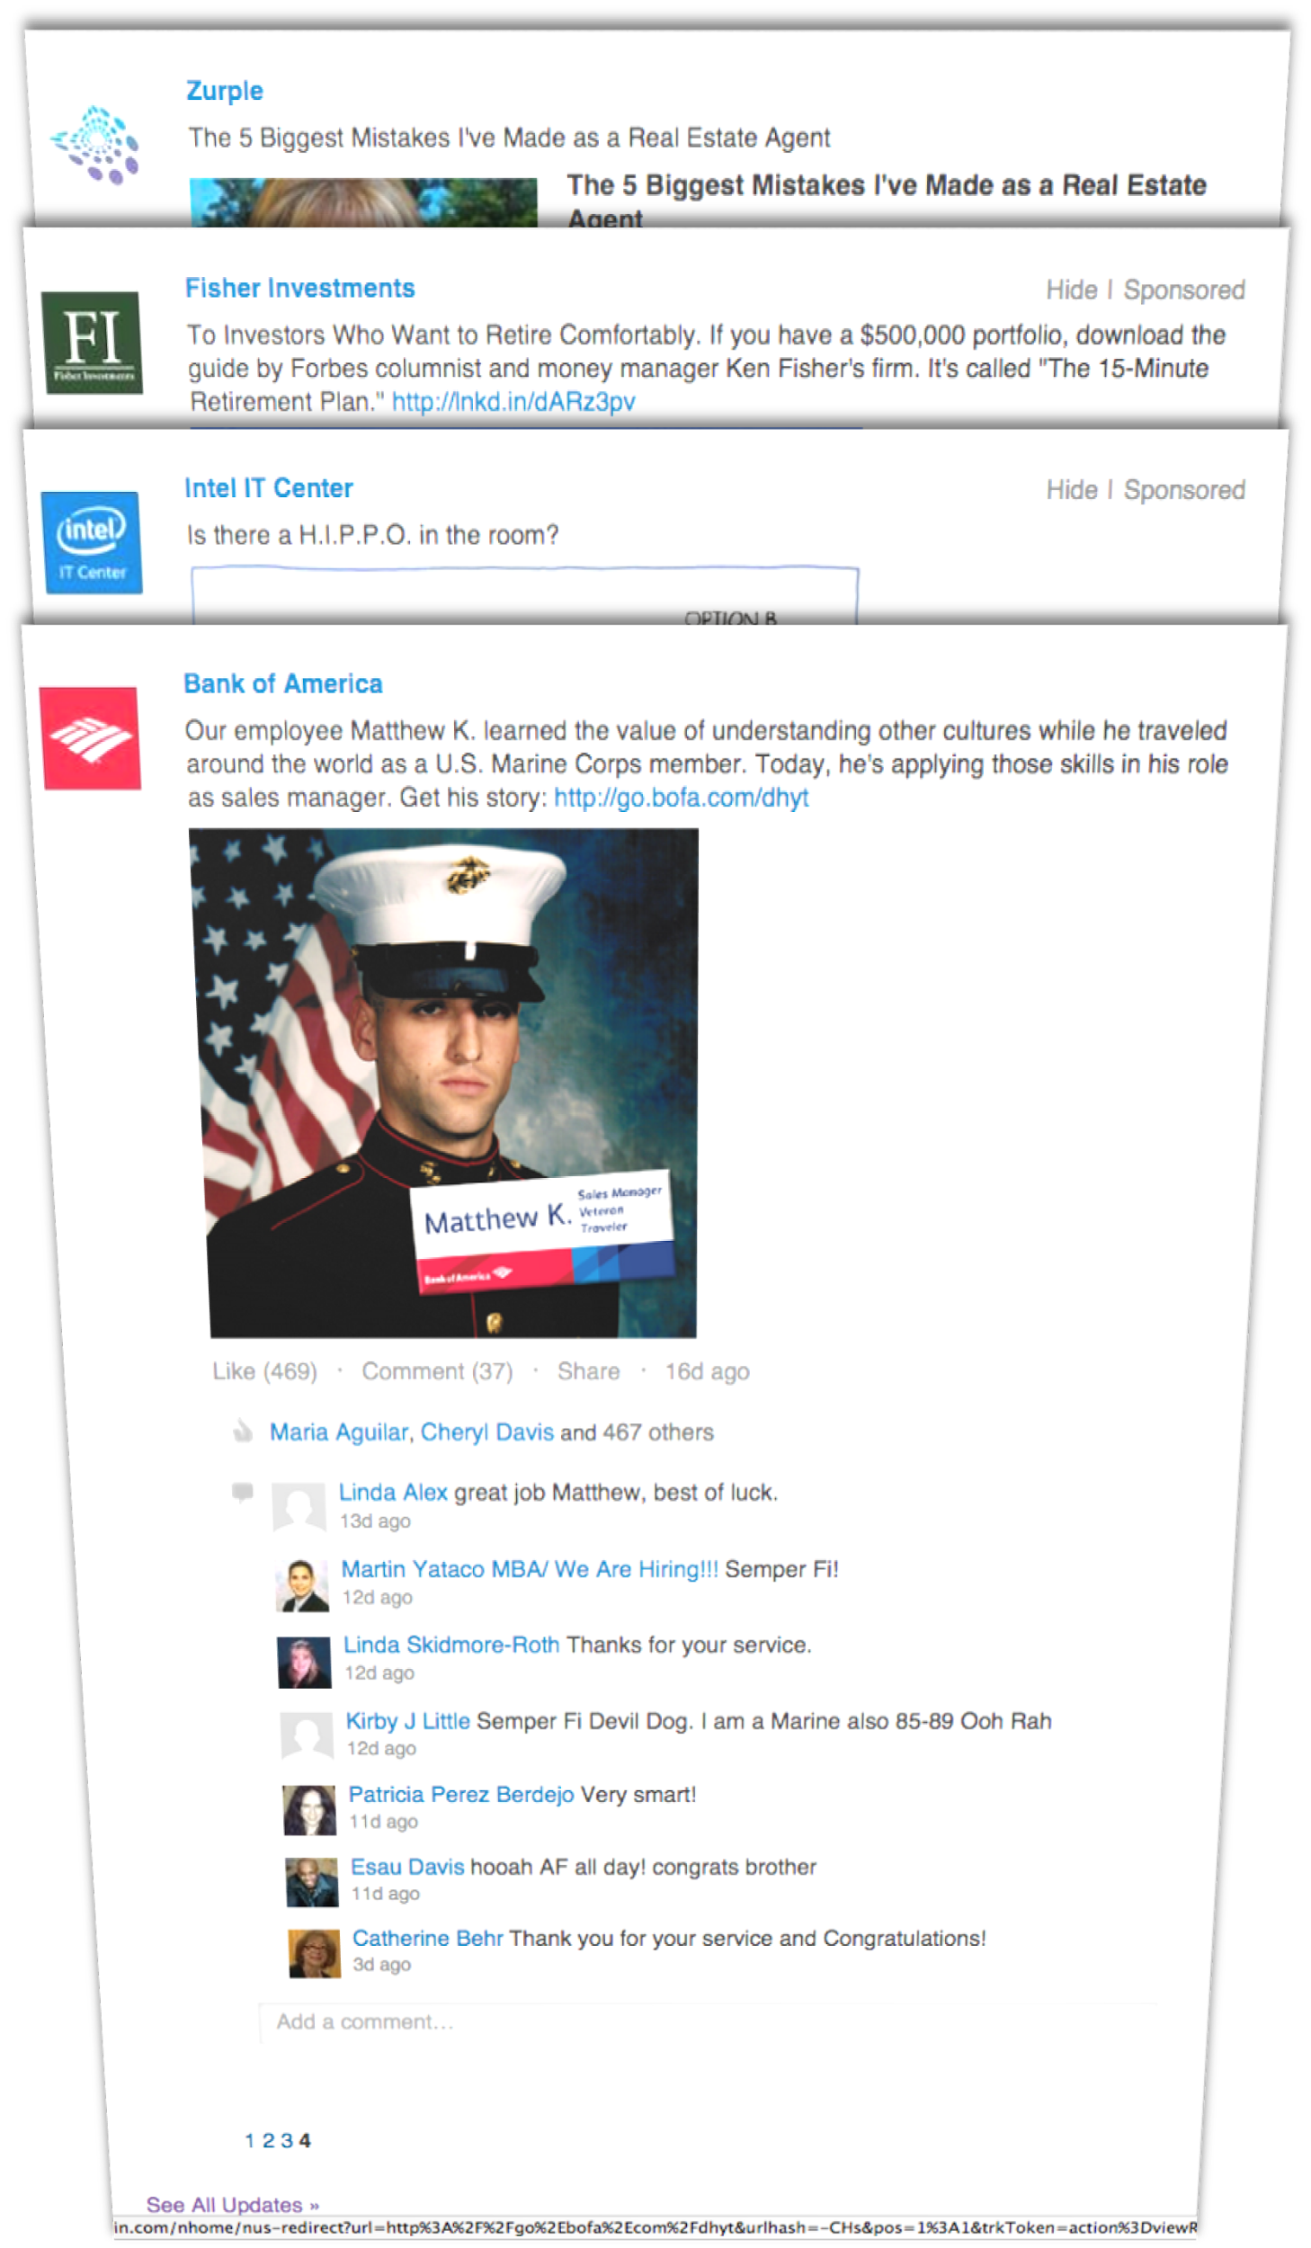
80% of the work is Data Wrangling
The Data?
Measure
The Algorithm?
LinkedIn Content
Front End
Structure
De-Dupe
Clean
Quality Check
DB
Tracking critical metrics is crucial - you can’t measure what you don’t track!

Slide 10
Cross Functional Team
Collaboration
Team
The right Skills?
The right team with the right skills is crucial!
Business
Analytics
Platform
(LMS Insights)
(Business Analytics)
(Data Solutions)
Data Infrastructure
Data Science
(Engineering)

Slide 11
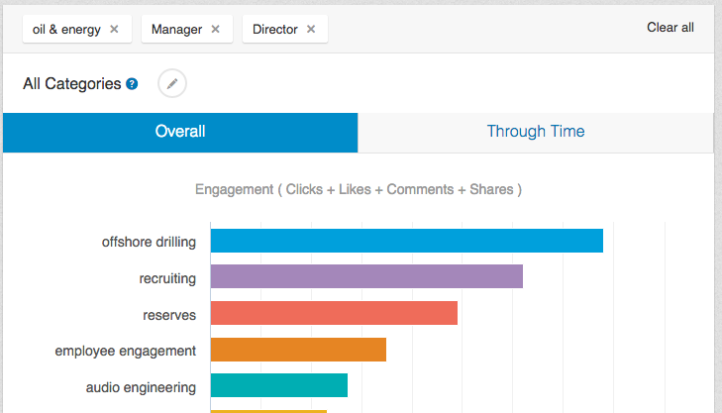
Trending Content
Let’s look at the Oil & Energy Sector

Slide 12
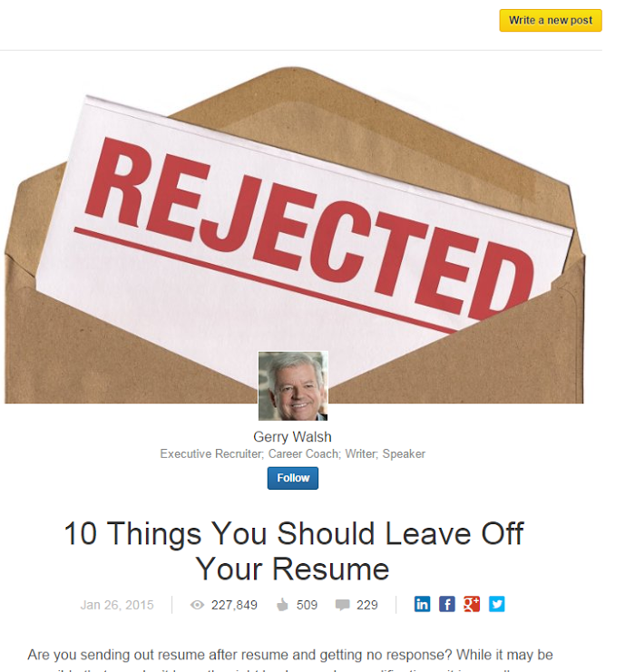
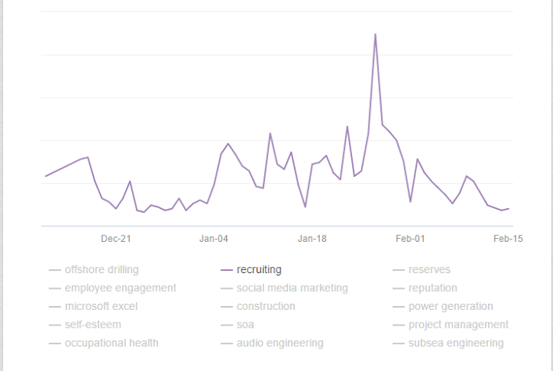

Trending Content
Middle Managers are interested in resumes writing!
Recruiting is the 2nd most popular topic with Oil & Gas professionals…
Development over time
Driven by popular articles related to resumes and recruiting

Slide 13



We’re Hiring!
Come join the most innovative and exciting team
Lutz Finger
lfinger@linkedin.com
Reza Rahman
rrahman@linkedin.com

