Slide 1
Going Real-time
Data Collection and Stream Processing with Apache Kafka
Jay Kreps, Confluent
Notes:
Hi My name is Jay, I’m going to be talking about using Apache Kafka to build a central platform for data streams and stream processing.
5 years of work in 35 mins.

Slide 2

Experience at LinkedIn
Notes:
This story takes place at LinkedIn.
I was on the infra team.
Previously had built a distributed key-value store
Was leading Hadoop adoption effort.

Slide 3

2009: We want all our data in Hadoop!
Notes:
Had done initial prototypes, had some valuable things
Want Data Lake/Hub

Slide 4


What is all our data?
Notes:
XML, CSV dumps, etc.
Translate the nasty data to pretty schemas in Hadoop
XML is super slow and labor intensive to parse
What if the data has a comma?

Slide 5

Initial approach: “gut it out”
Notes:
Various ad hoc load jobs
Manual parsing of each new data we got into target schema
14% of data
Not the kind of team I wanted

Slide 6
Problems
Data coverage
Many source systems
  Relational DBs
  Log files
  Metrics
  Messaging systems
Many data formats
Constant change
  New schemas
  New data sources
Notes:
Data grandfathering
14% of data in Hadoop
N new non-hadoop engineers imply O(N) hadoop engineers

Slide 7
Needed: organizational scalability
Θ(N) => Θ(1)
Notes:
Hadn’t paid much attention to how data flows through the business, more systems and algorithms.
Believe data is what’s important.

Slide 8
How does everything else work?
?
Notes:
Got interested in things like schemas, metadata, dataflow, etc

Slide 9
Relational database changes
Notes:
Real-time, mostly lossless—couldn’t go back in time
Batch, mostly lossless–high latency
Why CSV dumps?

Slide 10
NoSQL

Slide 11
User events
Notes:
Batch aggregation
Lossy, high-latency, only went to data warehouse/Hadoop

Slide 12
Application Logs
Notes:
Splunk

Slide 13

Messaging
Notes:
Low-throughput, lossy, no real scalability story
No central system
No integration with batch wold

Slide 14
Metrics and operational data
Notes:
Real-time
Lossy
Not multi-subscriber

Slide 15
This is a giant mess
Notes:
Reality about 100x more complex
300 services
~100 databases
Multi-datacenter
Trolling: load into Oracle, search, etc

Slide 16
Impossible ideas
Publish data from Hadoop to a search index
Run a SQL query to find the biggest latency bottleneck
Run a SQL query to find common error patterns
Low latency monitoring of database changes or user activity
Incorporate popularity in real-time display and relevance algorithms
Products that incorporate user activity
Notes:
Stop showing the same things
Mark people as interested in jobs
N^2 systems, data types

Slide 17
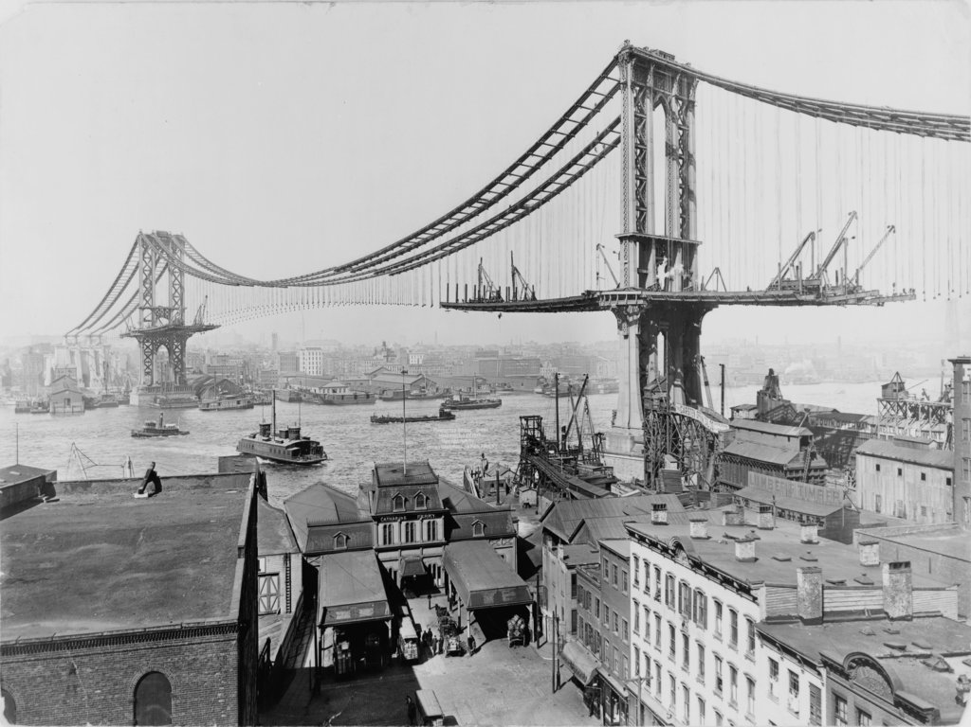
An infrastructure solution?
Notes:
Not tenable—new systems, data being created faster than we integrate them
Not all problems solvable with infrastructure
Extract the common pattern…

Slide 18
Idea: Stream Data Platform
Notes:
Had Hadoop—great that can be our warehouse/archive.
But what about real-time data and real-time processing? All the messed up stuff?
Files are really just a stream of updates stored together

Slide 19

First Attempt: Messaging systems!
Notes:
This problem is solved…don’t reinvent the wheel!

Slide 20
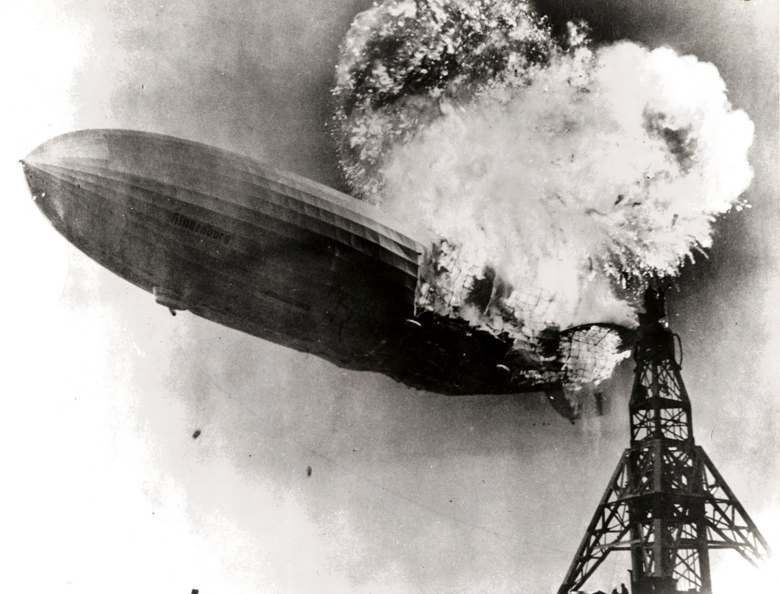
Problems
Throughput
Batch systems
Persistence
Stream Processing
Ordering guarantees
Partitioning
Notes:
Not suitable for ETL
Not suitable for high throughput

Slide 21

Second Attempt: Build Kafka!
Notes:
Reinvent the wheel!
Initial time estimate: 3 months

Slide 22
What does it do?
Notes:
Producers, consumers, topic
Like a messaging system

Slide 23
Commit Log Abstraction
Notes:
Different: Commit log
Stolen from distributed database internals
Key abstraction for systems, real-time processing, data integration

Slide 24
Logs and Publish-Subscribe
Notes:
Very strong, fast publish subscribe mechanism

Slide 25
Kafka: A Modern Distributed System for Streams
Scalability of a filesystem
  Hundreds of MB/sec/server throughput
  Many TB per server
Guarantees of a database
  Messages strictly ordered
  All data persistent
Distributed by default
  Replication
  Partitioning model
Producers, Consumers, and Brokers all fault tolerant and horizontally scalable
Notes:
Built like a modern dist system

Slide 26
Stream Data Platform
Notes:
Let’s dive into the elements of this platform
One of the big things this enables is stream processing…let’s dive into that.
Truviso

Slide 27
Stream Processing a la carte
cat input | grep “foo” | wc -l
Notes:
Like unix pipe, streams data between programs
Distributed, fault-tolerant, elastically scalable

Slide 28



Stream Processing with Frameworks
+
=
Stream Processing
Notes:
Streams + Processing = Stream Processing
HDFS analogy
Most stream processing system use Kafka
Some require it—rollback recovery

Slide 29
Unix Pipes, Modernized
cat /usr/share/dict/words | wc -l
Notes:
Need a uniform data format
Uniform representation of stream
Unix from days of “timesharing”—now we want a distributed version
Services—where a process runs has nothing to do with where you want it’s data
At the data center level
Differences—Distributed (fault tolerant), partitioned parallelism, long running processes

Slide 30
On Schemas
Bad Schemas < No Schemas < Good Schemas

Slide 31

Principled notion of schemas & compatibility
Notes:
Kafka is data format agnostic (like HDFS)
Still need schemas
Used Avro
For database data—capture what you know about the table—don’t throw it all away with CSV
For event data—logs, user activity, metrics, etc the schema is a conversation between the users of the data and the publishers
Explain schema repository

Slide 32
Put it all together
Notes:
Stream Data Platform
Trace data flow

Slide 33
At LinkedIn
Everything in the company is a real-time stream
> 500 billion messages written per day
> 2.5 trillion messages read per day
~ 1 PB of stream data
Tens of thousands of producer processes
Backbone for data stores
  Search
  Social Graph
  Newsfeed
  Primary storage (in progress)
Basis for stream processing
Notes:
Everything that happens in the company is a real-time stream

Slide 34
Best of all:
My data munging team disappeared!
Notes:
Scaled to 1000 data sources
0.5 people staffed it
Lot’s of other munging teams disappeared

Slide 35



















Elsewhere
Notes:
Describe adoption cycle

Slide 36
Why this is the future
System diversity is increasing
Data diversity and volume is increasing
The world is getting faster
The technology exists
Notes:
Basically the three Vs of big data
If you think the world needs to change (and live in silicon valley) there is really only one option

Slide 37
Confluent
Mission: Make this a practical reality everywhere
Product
  Schemas and metadata management
  Connectors for common systems
  Monitor data flow end-to-end
  Stream processing integration
  First release next week
Notes:
Only one thing you can do if you think the world needs to change, you live in Silicon Valley—quit your job and do it.

Slide 38

Questions?
Confluent
  @confluentinc
  http://confluent.io
Apache Kafka
  @apachekafka
  http://kafka.apache.org
  http://linkd.in/199iMwY
Me
  @jaykreps
  Office hours tomorrow at

