Slide 1

Hiding the Elephant
Notes:
How Big Data Apps Make Magic While Hiding Hadoop

Slide 2






Hiding the Elephant - How Big Data Apps Make Magic While Hiding Hadoop
10:40 – 11:20am, Thursday February 19th 2015

Slide 3
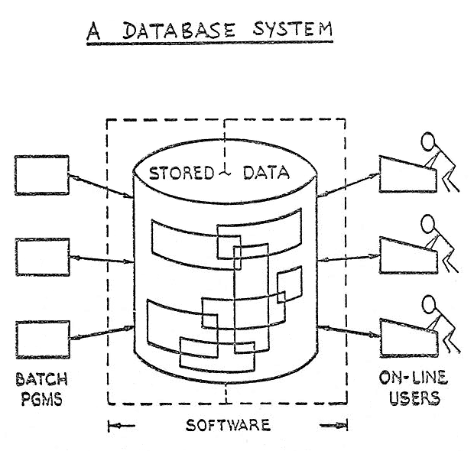
Technology Platform Adoption
Enabling IT
Insights and Analytics
Applications and Workflow
Notes:
Technology teams to solve problems at scale
Srreadsheets
Mini computer
Oracle
NetApps
Time series DB

Slide 5













A Timeline of Me
Past
Present
Future
?
When I was a baby I
could …
When I was a baby I couldn’t
When I grow up I want to
be…
be deployed.
justify an ROI.
used everyday.
But now I can!
‘s
Timeline

Slide 6
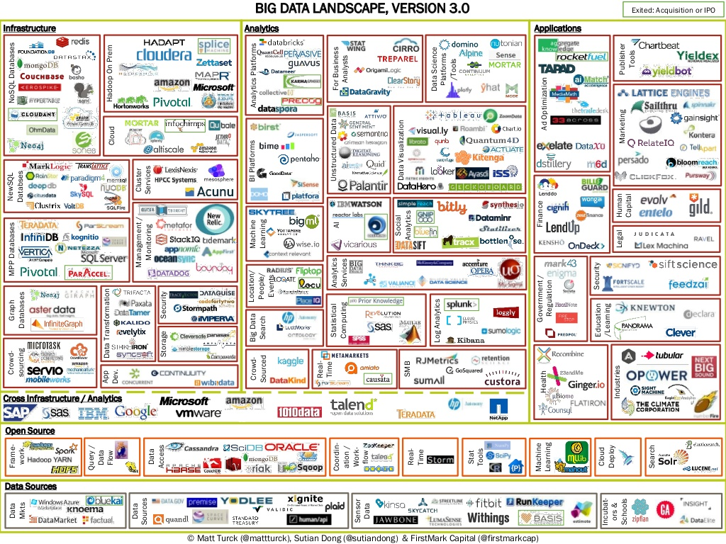
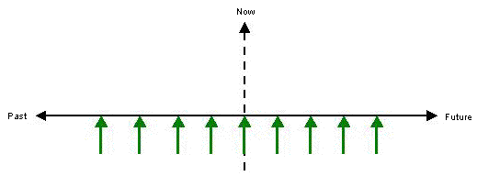
A Venture Capital View
Platform
Analysis
Packaged App
Cost Savings
Value at Scale
Build vs. Buy
Insights
IT Dependent
Business Buyer
Pilot->Deploy
Execution
Role Based
Try->Use

Slide 7




Canaan’s Big Data Investments
Data integration platform built for Big Data environments
Big Data Hadoop platform purpose-built for Retail
Big Data Storage
stealth
Omni-channel marketing optimization platform
Containers are the Future
Data-driven marketing solutions for the online video market
OpenStack-based private cloud as a service
stealth
Notes:
Technology teams to solve problems at scale
Srreadsheets
Mini computer
Oracle
NetApps
Time series DB

Slide 8
Hiding the Elephant - How Big Data Apps Make Magic While Hiding Hadoop
10:40 – 11:20am, Thursday February 19th 2015

Slide 9
Thanks.
Notes:
How Big Data Apps Make Magic While Hiding Hadoop

