Slide 1
Running Hadoop-as-a-Service in the Cloud
Lance Olson
Partner Group Manager
Microsoft

Slide 2

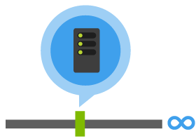



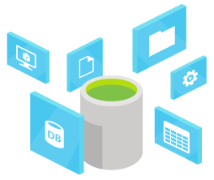
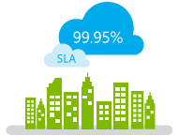
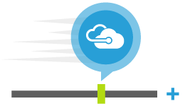
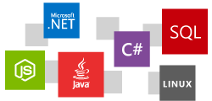
Why Cloud + Big Data?
Data of all Volume
Variety, Velocity
Massive Compute and Storage
Deployment expertise
Speed
Scale
Economics
Time to value
Always Up,
Always On
Open and flexible
Notes:
We’re seeing increasing movement to the cloud due to the economics, time to market, and scaled, and elasticity. The cloud has changed Microsoft’s priorities. We’re interested in running the workloads that matter most to our customers, regardless of the operating system, open source, or otherwise.
Big data makes a lot of sense for the cloud. We operate at hyperscale in the cloud, so the possibilities for expansion are far greater than the limitations of managing your own hardware. The elasticity and ability to use cloud storage and compute enables you to be much more efficient on data processing. It is not uncommon to get an order of magnitude cost savings when moving from on-premises big data to cloud-based. Finally, services are run for you, so they can be optimized such that the deployment and operations of the software far better than installing OSS packages and configuring them manually.
Gartner has increased its sizing and forecast for cloud compute services, reflecting greater interest among our client base than had been expected. We expect the 2013 market to be worth $8 billion (up from $6.8 billion forecast last year) and the 2014 market to be worth $10 billion.

Slide 3



















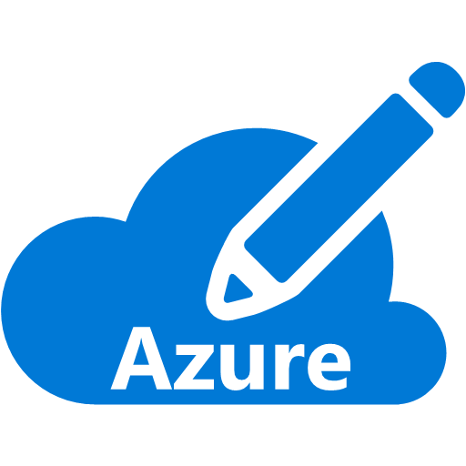
Why Microsoft Azure?
ML
Search
Data Factory
Event Hubs
Database
HDInsight
Stream Analytics
DocumentDB
Azure
Storage
On-premises Hadoop
Azure Facts
>4 trillion objects in Azure
300,000-1M+ requests per second
Double compute and storage every 6 months
Appliances
Software
Notes:
One of the key factors that differentiates Microsoft Azure is our relationship with enterprises around the world with on-premises technologies as well as cloud-based technologies. We understand that doing work in the cloud isn’t an all-or-nothing proposition, and have the ability to support hybrid scenarios connecting cloud and on-premises systems. We have a rich collection of PaaS services for data processing which include machine learning, search, workflow, stream and event processing, document storage, SQL database, and today’s topic, Hadoop-as-a-service. We’ve also developed partnerships with a broad range of colleagues in the industry so you can choose the stack that works best for your business and still get the benefits of being in Azure.
http://www.zdnet.com/article/microsoft-claims-azure-now-used-by-half-of-the-fortune-500/

Slide 4
Introducing Azure HDInsight
Microsoft’s cloud Hadoop offering
100% open source Apache Hadoop
Built on the latest releases across Hadoop (2.6)
Up and running in minutes with no hardware to deploy
Harness existing .NET and Java skills
Utilize familiar BI tools for analysis including Microsoft Excel

Slide 5

Hadoop Is Being Run Everywhere in the World
Notes:
We launched HDInsight in October of 2013, and have spent the last year rolling it out across the globe. We now run Hadoop as a service in 16 regions worldwide including China. We’re not done however. We’ve got additional regions in the works and will continue to add regional coverage wherever you need it. Make point about IOT and sensors and having the infra already in place.

Slide 6

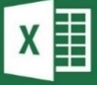




Rockwell Automation is partnered with one of the six oil and gas super majors to build unmanned internet-connected gas dispensers. Each dispenser emits real-time management metrics allowing them to detect anomalies and predict when proactive maintenance needs to occur.
Azure HDInsight
Data
Factory
Power BI for O365
Mobile Device
Hive, Pig,
Real-time notification
Mobile Notification Hub
Azure Blobs
Azure SQL DB
Store sensor data every 5 minutes
    Temperature, pressure, vibration, etc.
    Tens of thousands of data points / second
Notes:
Challenge
Manage sites used for dispensing liquefied natural gas (clean fuel for commercial customers who do heavy-duty road transportation)
Built LNG refueling stations across US interstate highway
Stations are unmanned so they built 24x7 remote management and monitoring to track diagnostics of each station for maintenance or tuning
Built internet-connected sensors embedded in 350 dispenser sites worldwide generating tens of thousands data points per second
Temperature, pressure, vibration, etc.
Data needs outgrew company’s internal datacenter and data warehouse
Solution
Chose Azure HDInsight, Data Factory, SQL Database
Dashboards used to detect anomalies for proactive maintenance
Changes in performance of the components
Energy consumption of components
Component downtime and reliability
Future: Goal is to expand program to hundreds of thousands of dispensers
How They Did It
Collect data from internet-collected sensors
Tens of thousands data points per second
Interpolate time-series prior to analysis
Stored raw sensor data in Blobs every 5 minutes
Use Hadoop to execute scripts and Data Factory to orchestrate
Hive and Pig scripts orchestrated by Data Factory
Data resulting from scripts loaded in SQL Database
Queries detect site anomalies to indicate maintenance/tuning
Produced dashboards with role-based reporting
Azure Machine Learning , SSRS, Power BI for O365
Provide users with customizable interface
View current and historical data (day-to-day operations, asset performance over time, etc.)
Leveraged Azure Mobile Notification Hub for real-time notifications, alarms, or important events

Slide 7
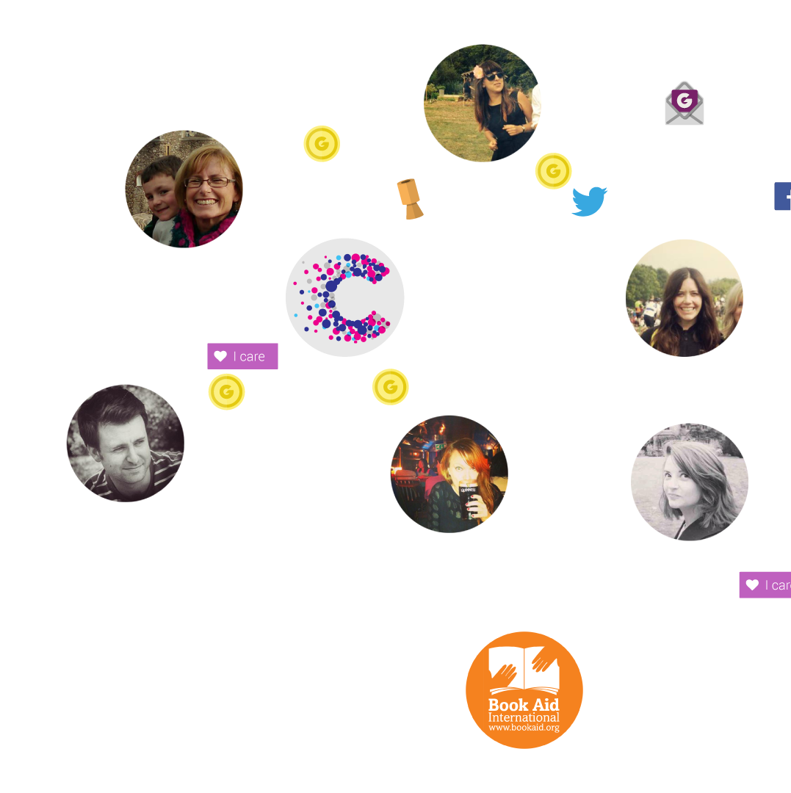

JustGiving wanted to harness the power of their data by using network science to map people’s connections and relationships so that they could connect people with the causes they care about. Based on 15
years of data, the JustGiving GiveGraph is the world’s
largest ecosystem of giving
behavior. It contains more
than 81 million person nodes, thousands of causes and 285 million connections and is the engine that drives JustGiving’s social platform, enabling levels of personalization and engagement that a traditional infrastructure would be unable to deliver.
Give
Graph
Activity
Feeds
Agent
Azure HDInsight
SQL Server
On-premises
Azure Blobs
Real-time Event
Service Bus
Azure Tables
Azure Cache
Website +
Event store
Serves results
Web API
Notes:
JustGiving wanted to identify what was personal and relevant to people and what they cared about, so that they could suggest further causes that may inspire continual involvement. However, with 22 million customers this meant storing and processing huge amounts of data that their existing infrastructure simply couldn’t support. HDInsight, provided the scalable, ‘on-demand’ processing and analysis ability to assist JustGiving with its goal to constantly evolve the personalised experiences it provides to customers.
JustGiving is a global online social platform for giving. It's a financial service (not a charity) that lets you "raise money for a cause you care about" through your network of friends. JustGiving's goal is to become "Facebook of Giving" JG preferred not to refer to Facebook as a way of describing themselves – they are using the term “social giving” and like to refer to themselves as a “tech for good” company. i.e. harness the effect to make charity a group activity which isn't just a onetime event but rather something you stay in touch with on regular basis.
More details on charity goals in a blog post from JustGiving: http://blog.justgiving.com/creating-smart-targets-to-help-fundraisers-raise-more/
Technical Details:
Workflow:
There is one a set of daily HDInsight job that uses the data coming through SQL Server to build out the social graph and provides activity recommendations to the user.
The input data is 20-30 GB/job but the output is in 'hundreds' of GBs as relationships are de-normalized/expanded.
Azure Table Storage is used to serve 'News Feed' to users. The data in Table store come from two main sources:
Real time activity feeds/events coming in from Azure Service Bus. (~50 events/second)
Activity recommendation coming out of the daily HDInsight job
There are several MR processes to create the graph; once that is done, further jobs create the denormalised activity feeds for all users. M/R jobs that do all the graph building.

Slide 8





Storm for Azure HDInsight
Stream analytics for Near-Real Time Processing
Consumes millions of real-time events from a scalable event broker (ie. Apache Kafka, Azure Event Hub)
Performs time-sensitive computation
Output to persistent stores, dashboards or devices
Customizable with Java + .NET
Deeply integrated to Visual Studio
Event producers
Collection
Event Queuing System
Transformation
Long-term storage
Presentation and action
Apache Storm on
HDInsight
Kafka /
RabbitMQ /
ActiveMQ
HBase
Web/thick client
dashboards
Applications
HDFS
Azure DBs
Event Hubs
Azure Stream Analytics
Search and query
Cloud gateways
(web APIs)
Stream
processing
Devices
Azure storage
Live Dashboards
Data analytics (Excel)
Sensors
Field
gateways
Storage
adapters
Devices to take action
Web and Social

Slide 9

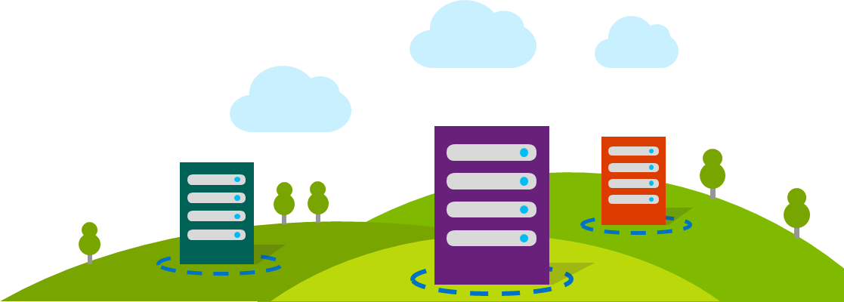
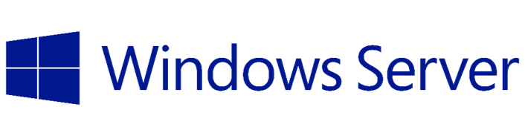
Azure HDInsight running Linux
Choice of Windows or Linux clusters
  Managed & supported by Microsoft
  Re-use common tools, documentation, samples from Hadoop/Linux ecosystem
  Add Hadoop projects that were authored on Linux to HDInsight
  Easier transition from on-premises to cloud

Slide 10
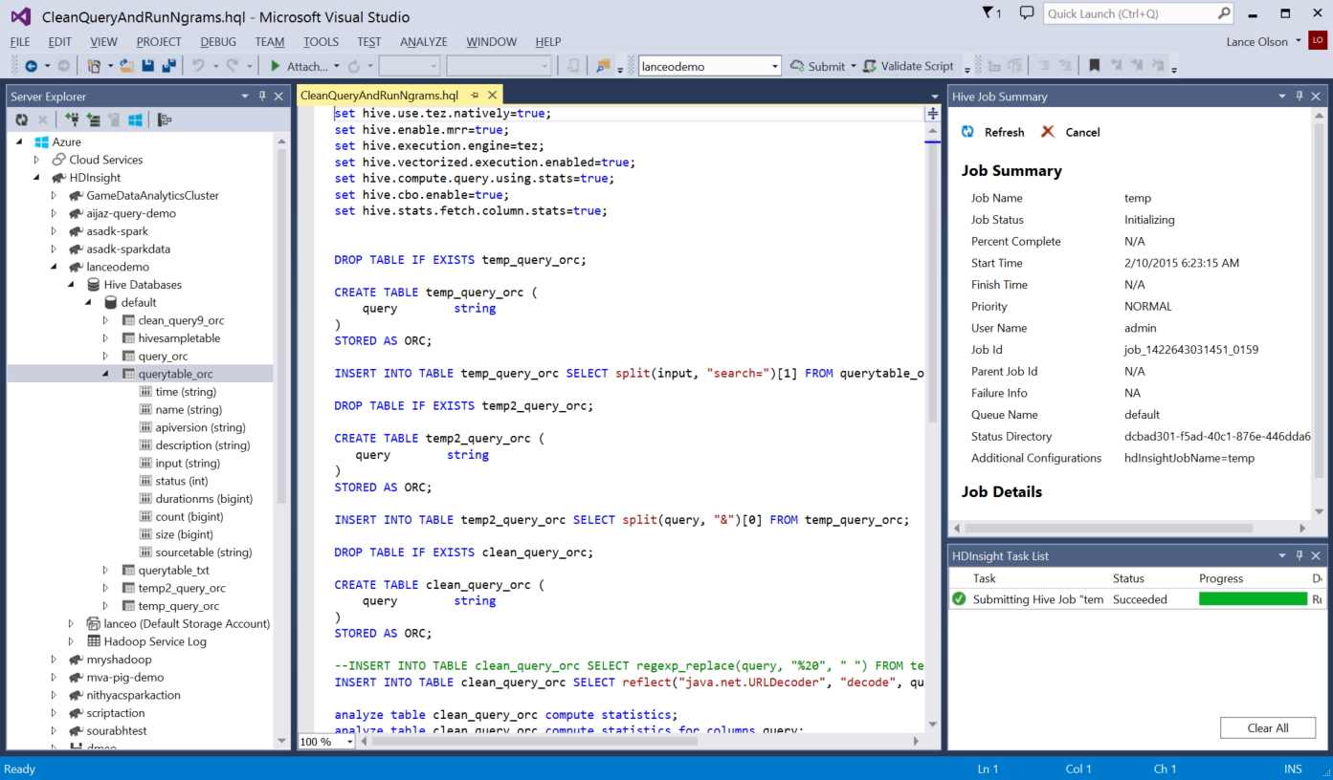
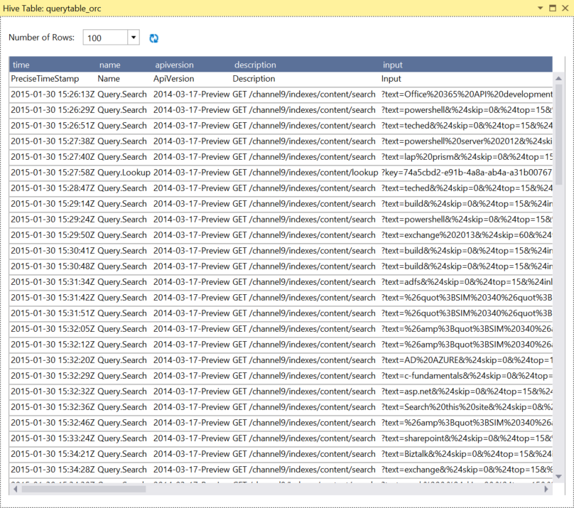
Microsoft Makes Hadoop Easier
Deep Visual Studio Integration
  Debug Hive jobs through Yarn logs or troubleshoot Storm topologies
  Visualize Hadoop clusters, tables, and storage
  Submit Hive queries, Storm topologies (C# or Java spouts/bolts)
  IntelliSense for authoring Hive jobs and Storm business logic

Slide 11


DocumentDB Hadoop Connector
Introducing DocumentDB Hadoop Connector
DocumentDB is a fully-managed, highly-scalable, NoSQL document database on Azure
Schema-less and native JSON
Transactional JavaScript
Rich querying
Tunable consistency
Scalable storage and
throughput
Microsoft Azure DocumentDB can now act as an
input source or output sink for Hive, Pig, and MapReduce jobs.
Store and query schema-less, JSON data and perform analytics with it.
DocumentDB
HDInsight & Hadoop
For more information visit http://aka.ms/documentdb-hdinsight
Notes:
Source: Improve job performance by pushing predicates down to DocumentDB
Sink: Use DocumentDB to store and automatically index your schema-less analytic results
Leverage DocumentDB’s high performance queries to read from your schema-less data

Slide 12
Demo

Slide 13

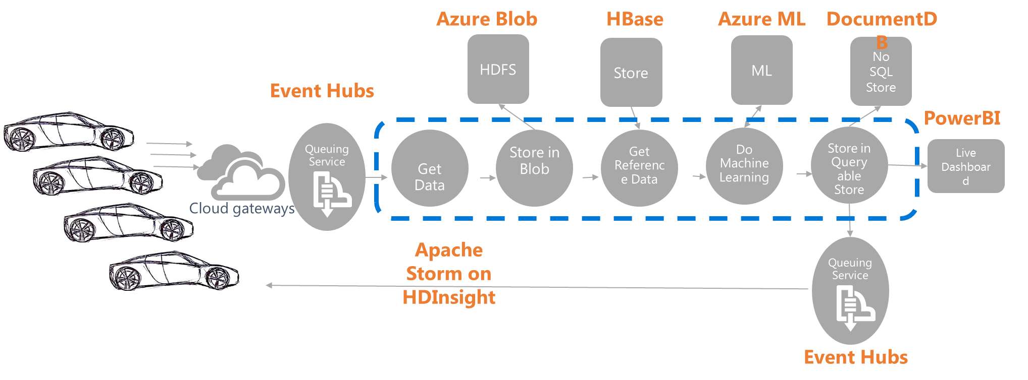
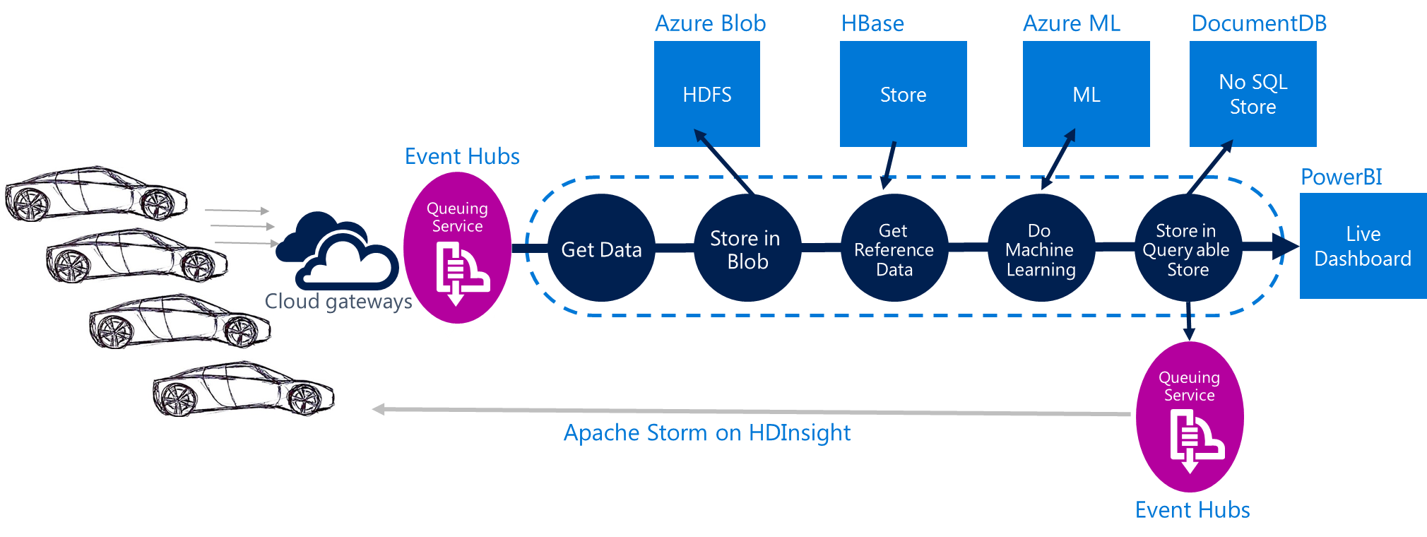

Connected Cars: Build a scalable, reliable, and highly available solution that has the ability to receive and process a large volume of vehicle information and maintenance events
Jay Gopinath – Chief Architect
Information Systems, Toyota USA
Notes:
Challenge
Manage sites used for dispensing liquefied natural gas (clean fuel for commercial customers who do heavy-duty road transportation)
Built LNG refueling stations across US interstate highway
Stations are unmanned so they built 24x7 remote management and monitoring to track diagnostics of each station for maintenance or tuning
Built internet-connected sensors embedded in 350 dispenser sites worldwide generating tens of thousands data points per second
Temperature, pressure, vibration, etc.
Data needs outgrew company’s internal datacenter and data warehouse
Solution
Chose Azure HDInsight, Data Factory, SQL Database
Dashboards used to detect anomalies for proactive maintenance
Changes in performance of the components
Energy consumption of components
Component downtime and reliability
Future: Goal is to expand program to hundreds of thousands of dispensers
How They Did It
Collect data from internet-collected sensors
Tens of thousands data points per second
Interpolate time-series prior to analysis
Stored raw sensor data in Blobs every 5 minutes
Use Hadoop to execute scripts and Data Factory to orchestrate
Hive and Pig scripts orchestrated by Data Factory
Data resulting from scripts loaded in SQL Database
Queries detect site anomalies to indicate maintenance/tuning
Produced dashboards with role-based reporting
Azure Machine Learning , SSRS, Power BI for O365
Provide users with customizable interface
View current and historical data (day-to-day operations, asset performance over time, etc.)
Leveraged Azure Mobile Notification Hub for real-time notifications, alarms, or important events

Slide 14

Toyota USA – Connected Cars
Build a scalable, reliable, and highly available solution that has the ability to receive and process a large volume of vehicle information and maintenance events
Azure Blob
DocumentDB
DocumentDB
HDFS
Store
Persistent Store
Event Hubs
PowerBI
Queuing Service
Get Data
Store in Blob
Get Reference Data
Process and generate artifact
Store in Query able Store
Live Dashboard
Cloud gateways
Apache Storm on HDInsight
Queuing Service
Event Hubs

Slide 15
Key reasons to go with Azure & Storm on HDInsight
Faster time to market when compared to building on-premises data centers
Toyota vehicle services already operates on Azure
Using fully managed HDInsight Storm-as-a-service much more effective than using Storm on IaaS, including SLA’s
Azure platform provides industry standard technologies
All data sits in Azure storage; use compute when needed
Homogenous cloud platform and dev environment for advanced data processing
Full PaaS implementation to reduce operational complexity

Slide 16
Announcing: Azure Big Data ISV & Partner Program
Channel Opportunity:
Rapidly growing enterprise customer channel looking for Big Data applications and services
Get your application and/or solution in front of potential customers via a marketplace listing
Opportunities to get some free marketing via Microsoft blog posts and mentions during conferences
Easy to Participate:
“Lift and shift” to HDInsight (Hadoop, HDP Builds)
Flexible options to support your existing deployment and business models (License per cluster, SaaS subscription, etc)
For more information, please reach out: bigdatapartners@microsoft.com

Slide 17
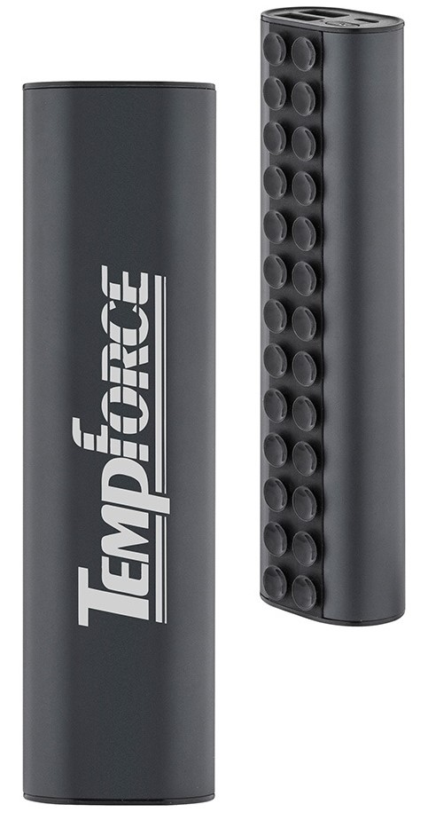
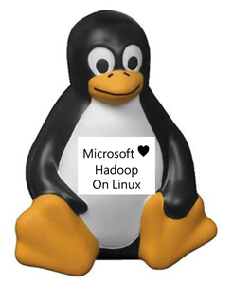

Call to Action
Get $250 of free Azure Credits
Download free Visual Studio Hadoop tooling
Visit us at the Microsoft Booth #1109 HDInsight on Linux Theatre Sessions Thursday 12:15pm, 5:00pm Storm Theatre Sessions Thursday 3:00pm, Friday 3:30pm Machine Learning Thursday 12:45 pm, 6:00 pm, Friday 3:00pm
Go to our other sessions: Connected Cows Keynote with Joseph Sirosh, Grand Ballroom 220, Friday, 9:40am Cloud Machine Learning with Joseph Sirosh, 210 D/H, Friday 10:40am
Chargers
Stress Relievers
T-shirts

Slide 19
Abstract
So you are ready to do a POC, dev/test or deploy a production implementation of Hadoop and want to leverage popular projects like Spark, Storm, or HBase. However, you want to make sure it will scale to the demands of the business while not having a lot of time or hardware to make this case. Come to this session to discover the benefits of deploying Hadoop in the cloud (no hardware to acquire, no hardware maintenance, unlimited elastic scale, and instant time to value). Even if you already deployed Hadoop on-premise, this session will provide best practices for mixing cloud and on-premise implementations together. By the end of this session, we will show you how easy it is to spin up a 32 node Storm cluster and give all attendees a free unlimited 30-day pass to deploy your own Hadoop cluster on Microsoft Azure.

Slide 20
When Hybrid?
Offsite backup
Dev/Test
Burst to Cloud
Cloud
Cloud
Cloud
Cloud
Develop/POC
Bursting
Backup/archive
On-premises Hadoop
Appliances
Software

Slide 21


Virginia Tech is able to capture data from DNA sequencers which are generating 15 PB of genome data each year. Rather than creating a supercomputing center with millions of dollars, Virginia Tech leverages Azure and only paying for compute they use.
“What excites me about what I’m doing with HDInsight is the ability to accelerate discovery to the point that we may be able to find treatments for cancer.”
Wu Feng
Professor of Computer Science
Virginia Tech
Notes:
Case Study: http://www.microsoft.com/casestudies/Windows-Azure/Virginia-Polytechnic-Institute-and-State-University/University-Transforms-Life-Sciences-Research-with-Big-Data-Solution-in-the-Cloud/710000003381
Video: http://www.youtube.com/watch?v=4StwPG0qWT0
Virginia Tech is one of the country’s leading research institutions. The university manages a research portfolio of US$454 million. Virginia Tech began previously used a network of supercomputers to locate undetected genes in a massive genome database. This and related work by other institutions has the potential to lead to exciting medical breakthroughs, including new cancer therapies and antibiotics used to combat the emergence of drug-resistant bugs.
However, as the size of genome databases grows, this no longer became attenable. Of the estimated 2,000 DNA sequencers worldwide, they are generating 15 petabytes of genome data every year. Their existing computational and storage resources required to work with data sets of this size wasn’t keeping up. Rather than getting a grant for millions of dollars to establish their own supercomputing center, Virginia Tech went for Azure HDInsight and only paying for the compute they use.
Benefits include:
Significant cost savings going from a multi-million supercomputer center to paying for only the compute you need in the cloud.
Ability to access the cloud from anywhere and on any device (even outside the laboratory)
Azure is able to elastically scale and keep up with the amount of data being generated
Ultimate benefit: Some day be able to find a treatment for cancer

Slide 22
Microsoft Gets Hadoop
10,000+
engineering hours
Hadoop on Windows
30,000+
code line
contributions
80% data compression with ORC
Hive 100x Query Speed Up
HDFS in Cloud (Azure)
Hadoop 2.2, 2.4, 2.6
Committers
to Hadoop
REEF for Machine Learning
Notes:
MSFT investments and contributions to Hadoop
We are starting at the bottom, in the source code. Making the source base work better not just for Windows, but for everyone
Community Contributions:
10s of thousands of code line contributed (across all deliverables)
6000+ engineering hours contributed (since February 2012)
Others:
Apache Build/Verification Infrastructure: Working with Apache Infrastructure team & Hadoop Core PMC on donation of Azure VM’s to be used as Jenkins Servers for Continuous Integration
Interactive Query: Contributing code and query processing experience to help with Hive query performance (Stinger, ORC & Tez projects)
Hadoop on Windows (1.0 & 2.0): Contributed back our porting efforts for Hadoop on Windows including:
Command-line scripts for the Hadoop surface area
Mapping the HDFS permissions model to Windows
Native Task Controller for Windows
Implementation of Hadoop native libraries for Windows (compression codecs, native I/O)
ASV Driver: Contributed our FileSystem implementation for Azure Storage
Super engaged with contributors and committers
Logged 6k engineering hours in
Committed to the stinger work
Doing work on security integration
Work doing to ensure Hadoop works great on windows

Slide 23
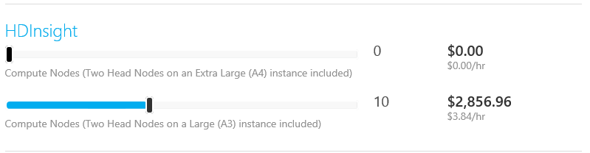
Microsoft Makes Hadoop Low Cost
HDInsight is billed by usage
Billed for usage
Clusters can be deleted when no longer used
No additional price for support
  Azure Support includes Hadoop support
  What usually costs thousands of dollars per node is included
$£€¥

