Slide 1
HADOOP IN DOCKER CONTAINERS
WHAT WORKS AND WHAT DOESN’T -- IN PRODUCTION!
Nasser Manesh

Slide 2
Who Am I?
25 years in Unix infrastructure/SRE/kernel
Startups, architect, VP Engineering/CTO roles.
Petabyte-scale, production, multi-tenant Hadoop clusters
Virtualization, elasticity, container orchestration for Hadoop
Connect with me on LinkedIn: nasser@gmail.com

Slide 3
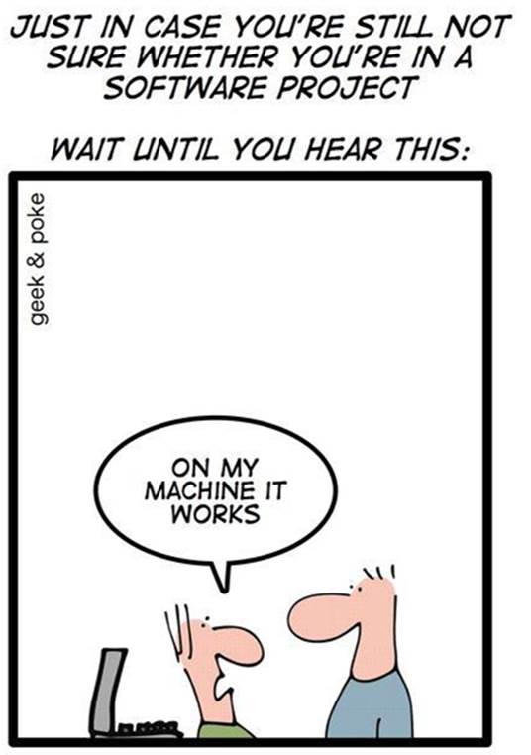
Taking Docker to Production
Getting it to Work for Hadoop
Pitfalls, Solutions

Slide 4

Show of Hands...
Operations, SRE, DevOps?
Developer?
User of Big Data applications / Data Scientist
Management, product managers

Slide 5

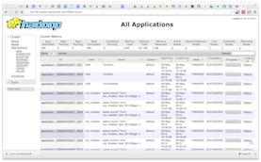
Our Hadoop Clusters at Altiscale
Hadoop Cluster
NodeManagers
+
DataNodes
Workbench
Apache Pig, Hive,
HDFS-NFS
Data Science Apps
Machine Learning Apps
SSH
Name Node
Hadoop Slave
Resource Manager
Hadoop Slave
Hadoop Slave
Secondary Name Node
Hadoop Slave
Browser

Slide 6
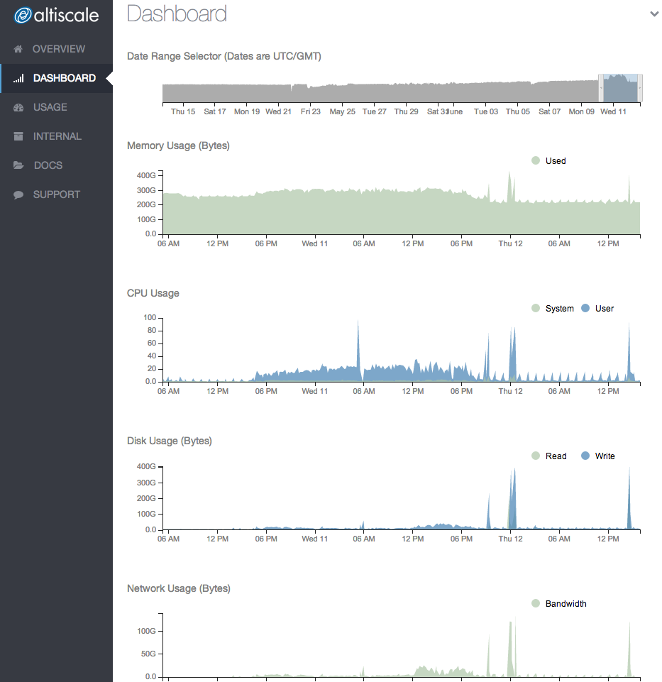
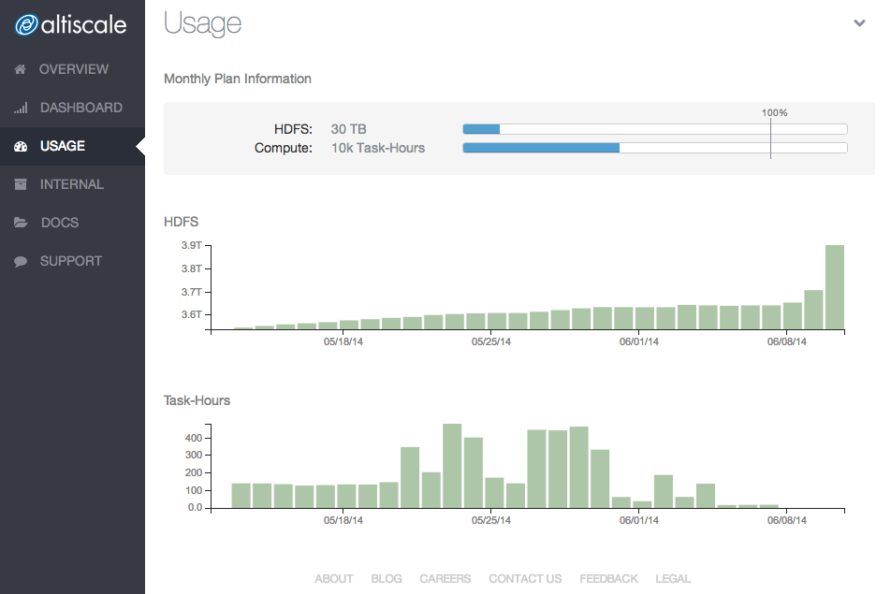
Hadoop as a Service:
It’s not about NODES

Slide 7
Optimization: Business mandate
We run on bare metal
Multiple data centers
Heavily optimized for Hadoop
MARGINS: Optimized resource allocation
How to partition/re-allocate physical machines?

Slide 8
Partition & Re-allocate
Hadoop’s built-in capabilities
Hypervisors: Virtual Machines
Containers: Lightweight Virtualization
Lightweight is important for thousands of very busy cores!

Slide 9

Containers
Isolation (namespaces)
Resource limits (cgroups)

Slide 10
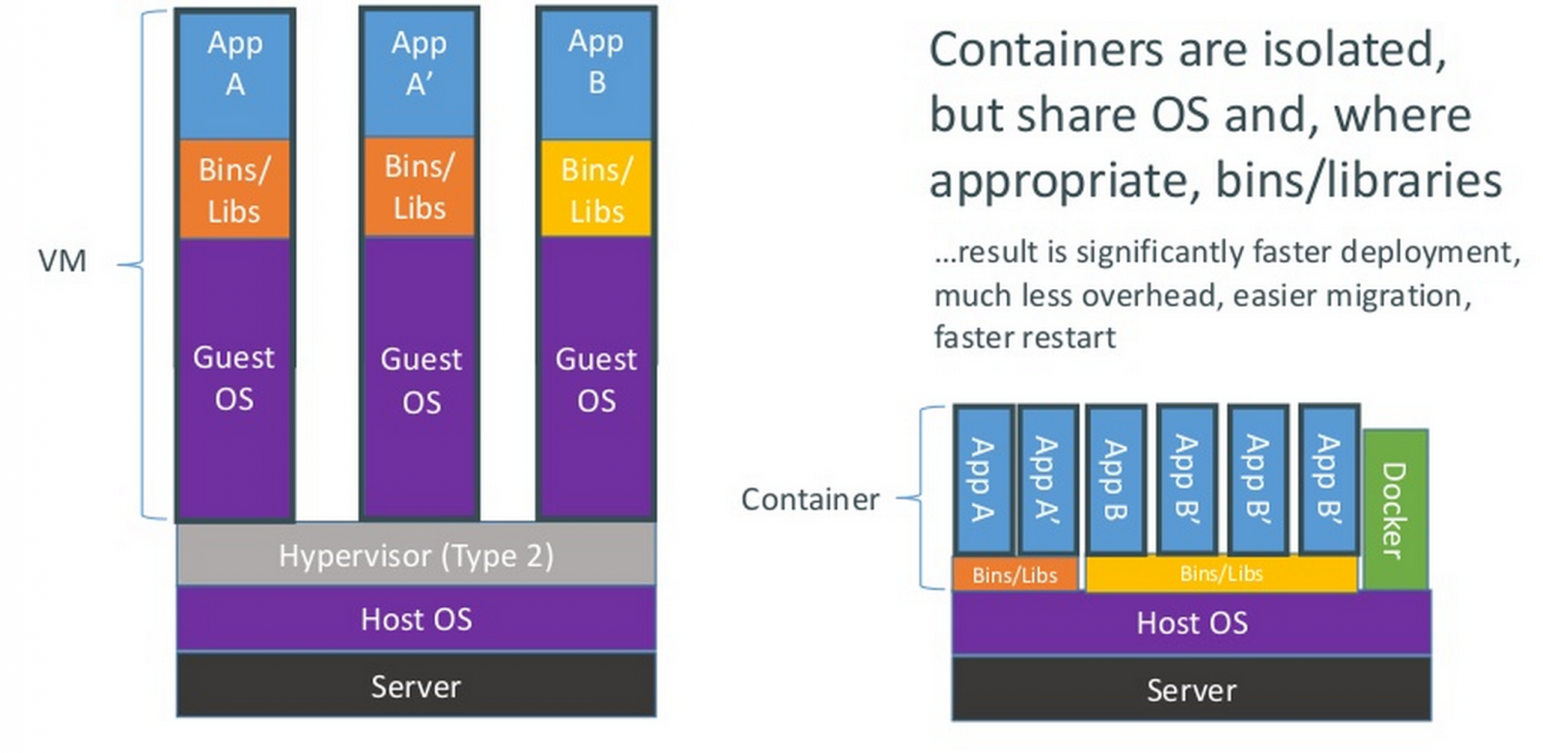
Containers vs. vm’S

Slide 11
From Chroot to Containers
chroot: limiting filesystem view
BSD jail (1995): better sandbox, networking, but limited
Linux-VServer (2001): security
Solaris Zones (2004)
OpenVZ (2005) / Parallels
LXC (2006)
Containers in the kernel (2007)

Slide 12
From Jail to Docker
LXC: robust.
BSD Jails: well-designed.
lmctfy (Let Me Containerize That For You): Google quality.
OpenVZ: active development.
They have been pretty hard to use!
DOCKER IS EASY TO USE. EVERYBODY CAN DO IT.

Slide 13
Docker Is Great For...
Local develop/build/test pipelines
Builds that are “safer” to ship to production
Testing software in different environments
CI slave machines
Creating mini-clusters for development/testing
Packaging and software delivery – can replace RPMs

Slide 14
YES, BUT...

Slide 15
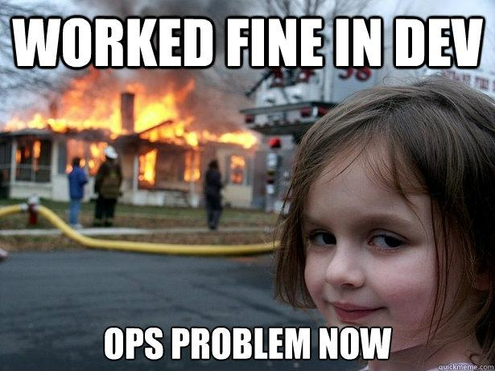

Slide 16
Developers Love Docker, but OPS?
Not operations friendly.
Separate orchestration/provisioning/automation required.
Logging? Are you kidding me?
Docker networking considered harmful… Very simplistic.
Good for single application, not so for “system” containers.
Race conditions, race conditions, race conditions.

Slide 17
Operational Requirements
Stability, reliability, predictability
Performance and security
Enterprise-grade, high throughput networking
Metrics and monitoring
Delivery infrastructure
Troubleshoot-a-bility

Slide 18
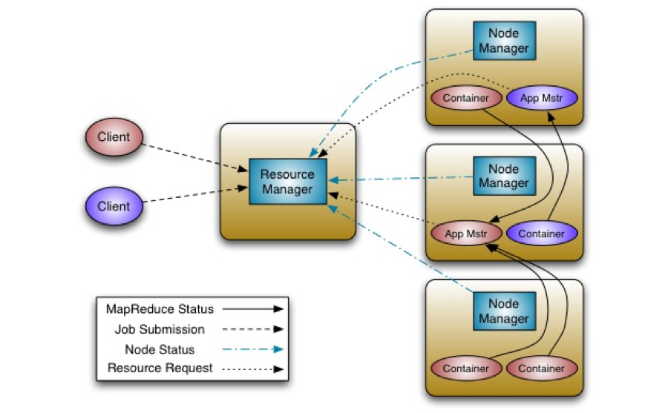
Docker in Hadoop?
YARN’s ApplicationMaster asks the NodeManager to launch containers: LinuxContainerExecutor
Docker can be used not only for fine-grained performance isolation, but for delivering software packages

Slide 19
YES, BUT...

Slide 20
Still Needs Work
Support in both YARN and Docker is needed
Both sets of changes take time
See YARN-1964 for details
Altiscale is working with both communities.

Slide 21
Hadoop in Docker Containers
The bulk of a cluster consists of DataNodes (HDFS) and NodeManagers (YARN)
Traditionally, DN and NM are paired on machines
Put the DN and NM into containers, isolate them, and start moving things around
It’s repeatable, and can be automated

Slide 22
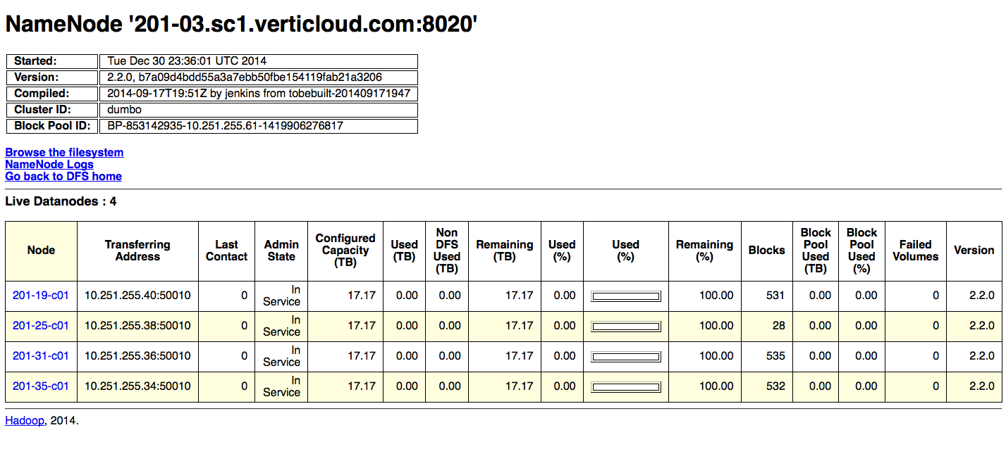

Slide 23
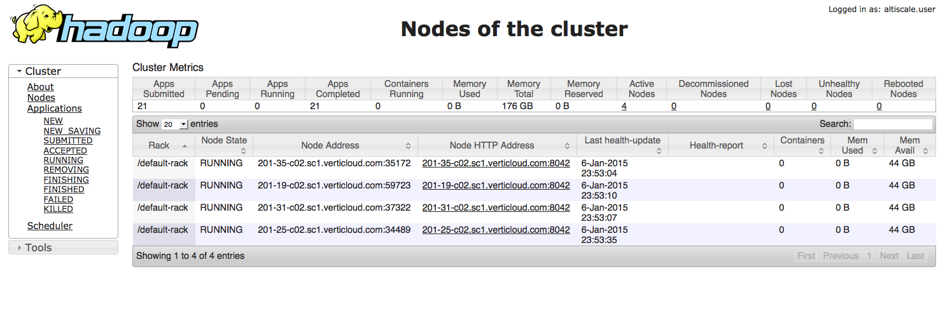

Slide 24
How We Do It
Typical machine: 1 DN container, 1+ NM container
Additional NM containers can float around
NM containers (and the DN container) are isolated
Each container has its own resource limits
  DN uses a lot of disk IO, not many cores or memory
  NMs use most of the cores and memory

Slide 25
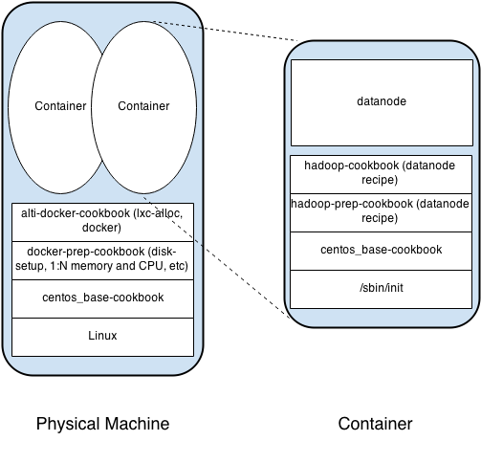

Slide 26
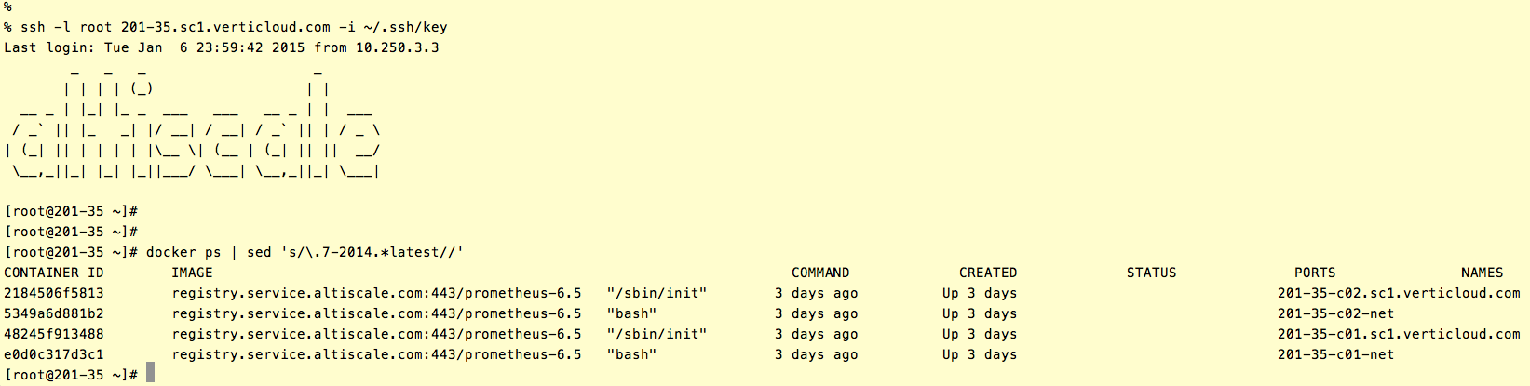

Slide 27
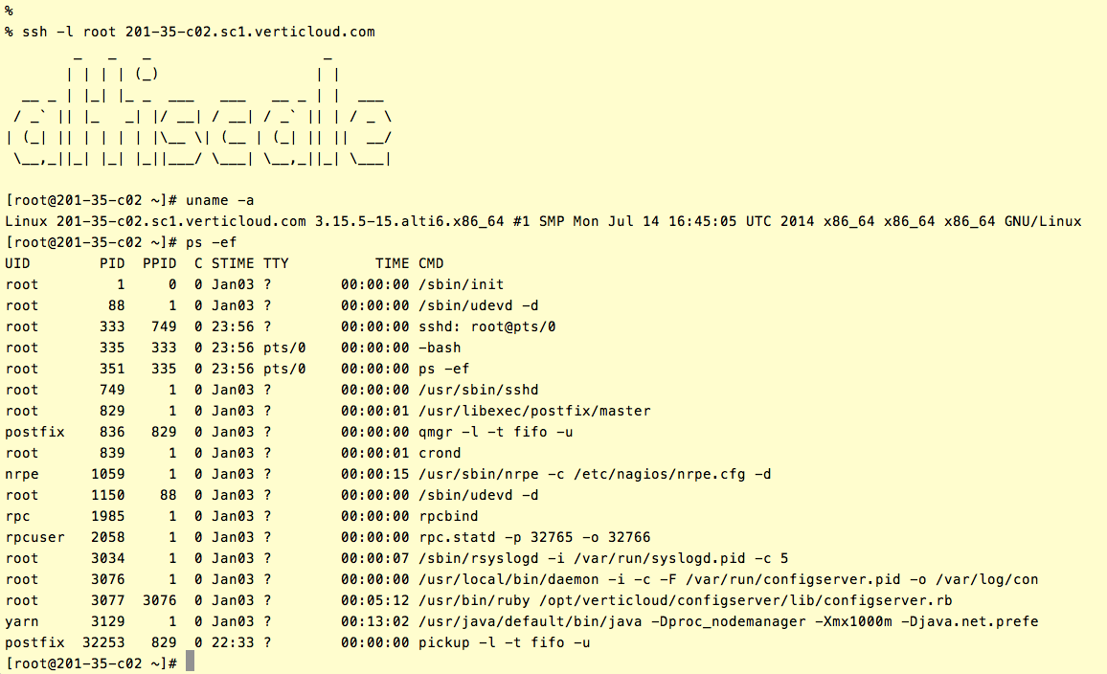
Cs

Slide 28
Disk Allocation
Bulk of the disks go to DNs
But NMs need disks too
Choose a repeatable layout for multiple disks/machine
Think both vertical and horizontal
Volumes: pass directories and not devices to Docker
Make sure Docker does not see these as AUFS

Slide 29
Networking
Docker tries to take over the host
Default networking is simple, for ease of development
Jumbo frames are not supported out of the box - set your own MTU!
Avoid race conditions by serializing Network
Namespace operations

Slide 30
Monitoring and Metrics
You do not necessarily need to monitor the
docker process
How your NM checks the health of the node may need additional mounts in the docker container
Metrics… check out cAdvisor!
Disk metrics in cAdvisor are weak, Altiscale is contributing

Slide 31
Security
Isolation is important, but…
Privileged mode is a big No No
Containers share the same kernel
You have to be on top of Docker and libcontainer/lxc security
Are hypervisors safer?

Slide 32
Delivery Infrastructure
Docker containers are created off of “images”
Docker images are served by a registry, an HTTP server
Has very basic functionality
Images are usually big, and can be proprietary
So you need to add authentication, per-colo caching

Slide 33
Orchestration
Chef or Puppet: node level
Kubernetes, Mesos.
Libswarm? Really?
Rundeck + Chef – take “scheduler” out of the picture.
In-house development/custom work required.

Slide 34
THANK YOU FOR JOINING… QUESTIONS?
visit us at: www.altiscale.com
WE ARE HIRING!

Slide 35
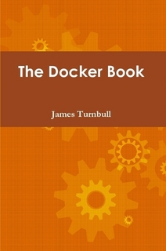
Resources
Docker website
“The Docker Book” by James Turnbull

