Slide 1

SAS Analytic Solutions Running on a Hadoop Cluster using YARN
James Kochuba

Slide 2

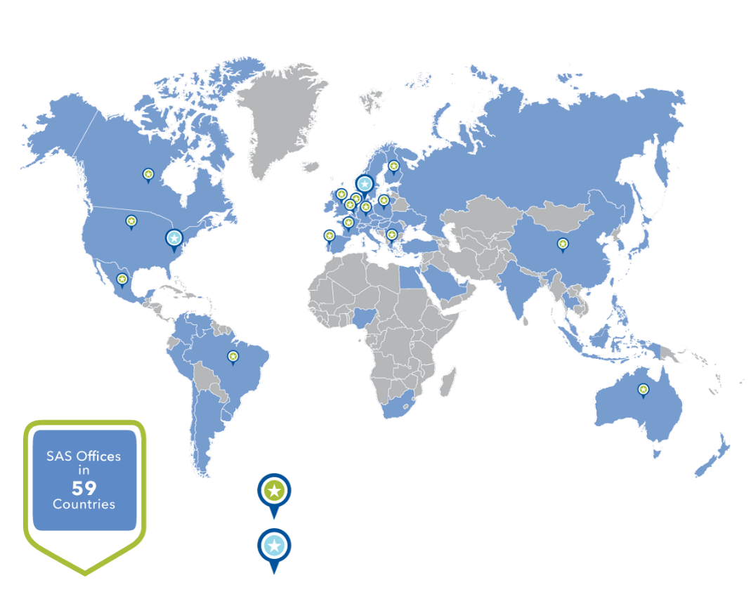
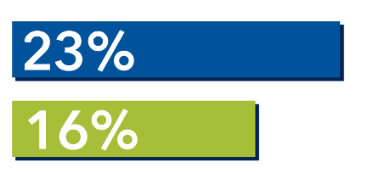
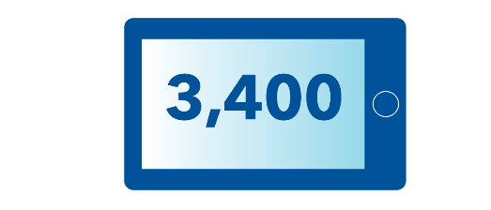
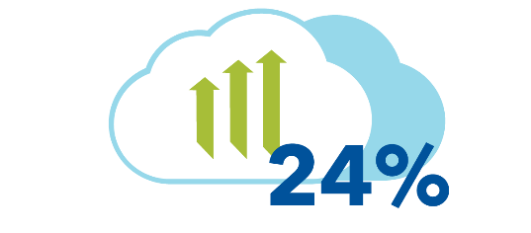

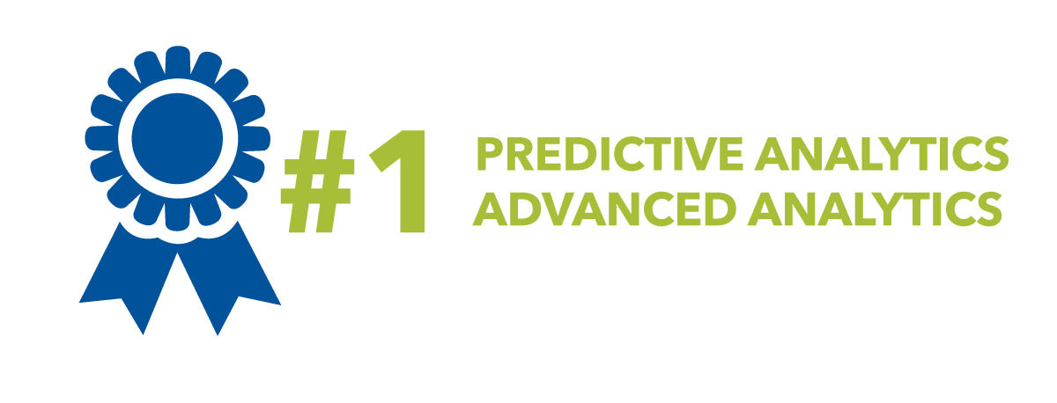
Market Leader in Data & Analytics
Great Places to Work® Awards
SAS
15 COUNTRIES
Industry Average
2 MULTINATIONAL
Revenue Reinvested in R&D
As Ranked by IDC
SAS® Visual Analytics Customer Sites
SAS® Cloud Analytics Revenue Growth
SAS® - Hadoop visualization and analytics solutions

Slide 3

3+ Billion
2014 REVENUE
Customers in 139 countries at 70,000 sites
35% MARKETSHARE
3
DECADES
>
>
SAS customers represent
90% of Fortune Global 500® companies
OF
EXPERIENCE

Slide 4

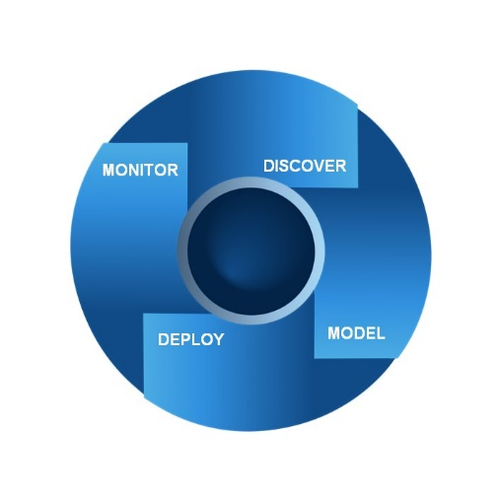

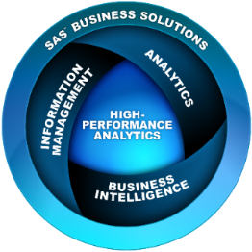
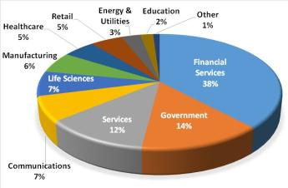


SAS Background
Millions of analytical procedures running at 65,000 sites
Analytics applied to thousands of business issues
41,000 customers in 135 countries
Three-plus decades of experience
$650 million annually in advanced analytics revenue
Total Yearly Revenues $2.8B
IDC ranks SAS No. 1 in advanced analytics with a market share of 36.2%
SAS Advanced Analytics
Statistics
Predictive Modeling
Data Mining
Text analytics
Forecasting & Econometrics
Solution Lines
Analytics
Business Intelligence
Customer Intelligence
Financial Intelligence
Foundation Tools
Fraud & Security Intelligence
Governance, Risk & Compliance
High-Performance Analytics
Information Management
IT & CIO Enablement
OnDemand Solutions
Performance Management
Risk Management
Supply Chain Intelligence
Sustainability Management
Quality Improvement
Operations Research
Data Visualization
Model Management and Deployment
SAS and the Analytic Lifecycle
BUSINESS
MANAGER
BUSINESS
ANALYST
Domain Expert
Makes Decisions
Evaluates Processes and ROI
Data Exploration
Data Visualization
Report Creation
Author Rule Logic
SAS Core Technologies
Industries
Analytic
Lifecycle
IT SYSTEMS /
MANAGEMENT
DATA MINER /
STATISTICIAN
Model Validation
Model Deployment
Model Monitoring
Data Preparation
Exploratory Analysis
Descriptive Segmentation
Predictive Modeling
Notes:
Speaker Notes:
SAS is a global company
We have many joint customers
SAS is a leader in Advanced Analytics
IDC ranks SAS No. 1 in advanced analytics and among top 5 business analytics providers
In July 2013, IDC released its Worldwide Business Analytics Software 2013-2017 Forecast and 2012 Vendor Shares report. Based on 2012 revenue, SAS continues to dominate the advanced analytics market with a market share of 36.2%...up almost a percentage point from the previous year and more than twice the market share of IBM, our next closest competitor.
SAS provides Businesses with ability to manage the analytic (Decisioning) lifecycle
SAS provides tools and business solutions across a wide spectrum of industries
Could also point out that SAS has had a long history of integrating with and complimenting with SAP – since the R2 days. Could refer to slides 22 and 23 if speaking to a more technical audience.

Slide 5


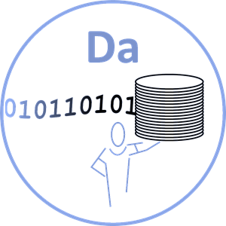
Kickoff 2015
The New Analytics Experience
SAS is uniquely positioned to :
Enable and Empower the new Analytics Culture;
BRIDGE the gaps between Decision Design, Decision Engineering, and the Data.
Decision Design
Decision Engineering
THE NEW ANALYTICS EXPERIENCE
Data

Slide 6



Kickoff 2015
The New Analytics Experience
The “ Art ”
The “ Process ”
DECISION DESIGN | DECISION ENGINEERING
Data is a Raw Material | Data is a finished product
Flexible, ad hoc | Established, documented process
Prototyping | Governance (over data, process, technology)
Data Scientists, Analysts, Smart Creatives | Engineers, DBA, IT
Open Source, “whatever works” | Approved architecture
Departmental, personal | Enterprise
Innovative, Experimental, Groundbreaking | Productionized, Scalable, Repeatable
DATA
No amount or complexity is unsurmountable

Slide 7








ANALYTICS
TEXT ANALYTICS
Finding treasures in unstructured data
like social media or survey tools
that could uncover insights
about consumer sentiment
FORECASTING
Leveraging historical data to drive better insight into decision-making
for the future
INFORMATION
MANAGEMENT
OPTIMIZATION
Analyze massive
amounts of data in
order to accurately
identify areas likely to
produce the most
profitable results
DATA MINING
Mine transaction databases for data of spending patterns that indicate a stolen card
STATISTICS
Copyright © 2015, SAS Institute Inc. All rights reserved.
Notes:
Currently, most organizations use one or more of these techniques to solve a departmental specific business problem. As such, even though valuable, from an enterprise standpoint, the value is somewhat marginalized or not optimized. What we see is that departments, such as Marketing, Finance or Risk are using one technique to solve a problem but not multiple techniques. So, for instance, in a bank, the risk department will use econometric forecasting to manage the treasury portfolio and overall risk…so they think. But they are not proactively looking at text (emails and chat), to see where the bank could be exposed. Or a retailer uses forecasting to predict what will sell, but they are not looking at on line sentiment and customer segmentation to optimize what product they should offer what customer and how to optimize distribution all as part of the same process. These are examples of why these techniques should be pulled together for the greater good.

Slide 8
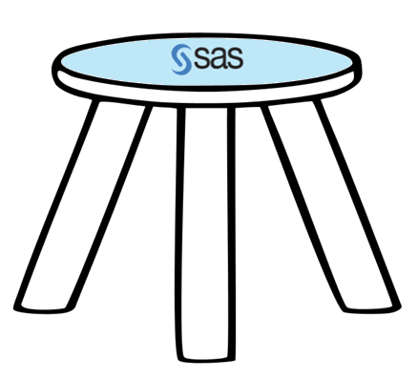



SAS
Critical SAS Components for Hadoop
SAS Access
SAS In-Memory
SAS In-Database

Slide 9


Architecture Review
SAS software with Hadoop
High Speed Network
SAS® Grid/Server
SAS In-memory
(TKGrid / LASR)
In-memory
Private
Public
SAS Access
SAS In-database
(Embedded Process - EP)
SAN
EP
Hadoop Cluster

Slide 10

SAS AND Hadoop
Traditional SAS with Hadoop
SAS® Grid/Server
libname hadoop hdfs (hdmd)
libname hadoop (hive)
libname impala
SAS SQL
Yarn is effecting:
SAS Hive and Impala calls
SAS EP (Mapreduce)
No yarn effect on HDMD since that goes directly to HDFS
SAS ACCESS
Scoring Accel calls
Code Accel calls
Data Quality Accel calls
Impala
HPA procs/LSAR
Hive
HDMD
TKGrid
EP
YARN
Commodity
Hardware
Hadoop
Notes:
Interaction model:
Hive/Impala interaction using SQL though SAS ACCESS
Accelerator calls using Embedded Process in Hadoop
HPA proc calls to HPA rack who then use EP to process (can execute some DS2 code before lifting) and lift data into memory on HPA rack
Note: HPA and LSAR are very similar action, just stay in memory

Slide 11
SAS AND Hadoop
sas on hadoop
SAS® Grid/Server
libname hadoop hdfs (hdmd)
libname hadoop (hive)
libname impala
SAS reporting (SQL)
SAS ACCESS
Scoring Accel calls
Code Accel calls
Data Quality Accel calls
Yarn is effecting:
SAS Hive calls
SAS EP (mapreduce)
SAS In-memory
To start TKGrid process, we will work with YARN
No yarn effect on HDMD since that goes directly to HDFS
Impala
HPA procs/LSAR
Hive
HDMD
Note: resources for SAS rack should be added into Hadoop cluster.
TKGrid
EP
EP
EP
EP
EP
EP
EP
EP
EP
EP
EP
EP
EP
EP
EP
EP
EP
EP
EP
YARN
Hadoop
Notes:
Note: we don’t recommend LSAR currently in this picture

Slide 12

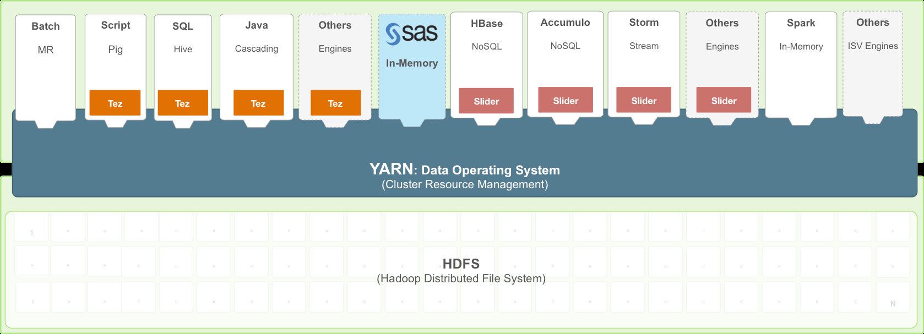
SAS and yarn
WHERE does SAS Fit In?
SAS Access
EP
*Picture Created by Arun Murthy - Hortonworks
http://blogs.sas.com/content/datamanagement/2014/08/20/sas-high-performance-capabilities-with-hadoop-yarn/

Slide 13
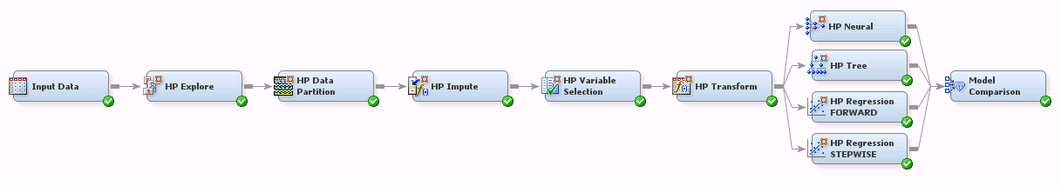
Sas model
Sas HPDM example

Slide 14
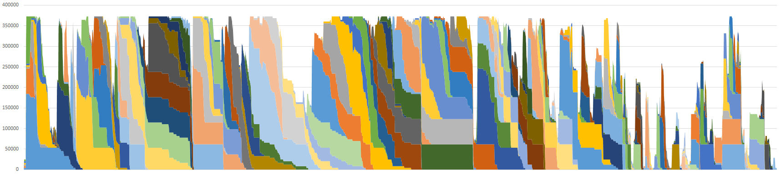
Yarn view
Shared sas and hadoop environment

Slide 15
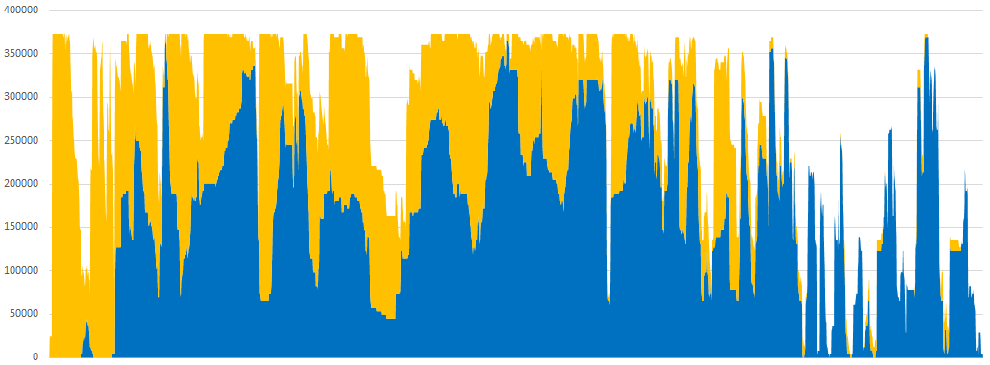
YARN View
SAS vs other work

Slide 16
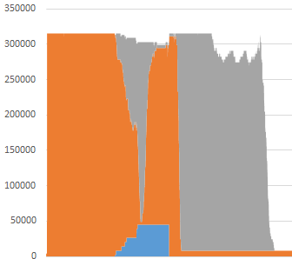
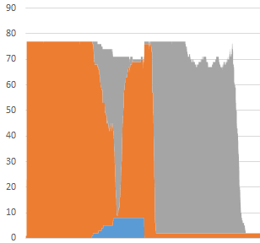
Yarn view
small sas application with background
Memory Usage
Number of Container
Compress data ~31 GB (20,000,000 observations, 50 variables)

Slide 17
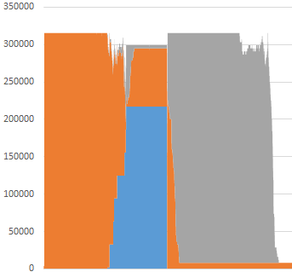
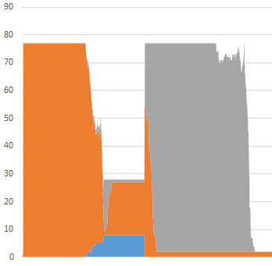
Yarn view
Larger sas application with background
Memory Usage
Number of Container
Compress data ~183 GB (120,000,000 observations, 50 variables)

Slide 18
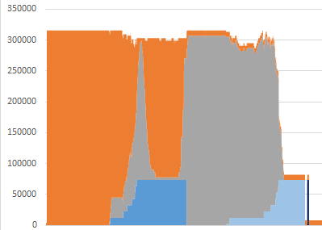
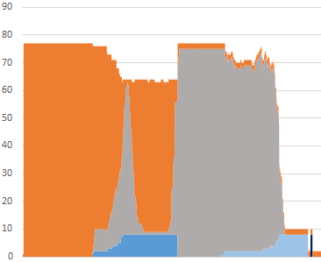
Yarn view
Simple sas model with background
Memory Usage
Number of Container

Slide 19
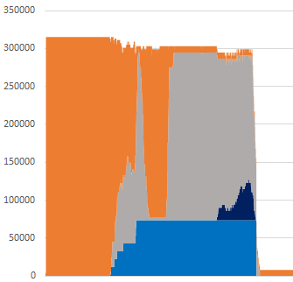
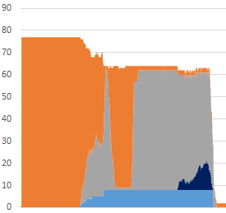
Yarn view
Sas application loading hive with background
Memory Usage
Number of Container

Slide 20
Client issues
Lesson learns
Minimum container memory size can product wasted memory resources
MapReduce application does not use all memory
Smaller applications pushed into large containers (application master to simple applications)
MapReduce tuning
Dependency jobs require queue to help
SAS In-memory using SAS EP to lift data into memory
Queue happy craves up cluster too much
Monitor real resource usage vs containers
Focus on application tuning
SAS YARN workshop

Slide 21






















Notes:
New with 9.4M1 you can use SPDE server to write your SAS datasets to a Hadoop cluster in a distributed fashion. Now eliminating SAN storage cost.

Slide 22

Free Software Trial!
Leading provider for:
Data Preparation
Data Visualization
Data Analysis
sas.com/strata-trial

Slide 23
Enter for a chance to win a GoPro HERO4!
Booth
1022

Slide 24
Questions

Slide 25
Yarn tuning
Basic yarn settings
Property Name | Description
yarn.nodemanager.resource.memory-mb | Amount of physical memory, in MiB, that can be allocated for containers.
yarn.scheduler.minimum-allocation-mb | The minimum allocation for every container request at the RM, in MBs. Memory requests lower than this won't take effect, and the specified value will get allocated at minimum.
yarn.scheduler.maximum-allocation-mb | Largest Container allowed. A Multiple of the minimum-allocation-mb above Depending on your setup you may want to allow the entire node for MR, or restrict it to smaller then a node to prevent potential malicious actions.
yarn.nodemanager.resource.cpu-vcores | Number of virtual CPU cores that can be allocated for containers. This value covers all applications and their containers running on this node and or physical system.
yarn.scheduler.minimum-allocation-vcores | The smallest number of virtual CPU cores that can be requested per container.
yarn.scheduler.maximum-allocation-vcores | The largest number of virtual CPU cores that can be requested per container.
yarn.resourcemanager.scheduler.class | The class used for resource manager (note Hortonworks and Cloudera used different defaults and today, they do prompt writing custom classes)

Slide 26
Yarn tuning
Mapreduce settings
Property Name | Description
mapreduce.map.memory.mb | The size of the container for the Mapper task
mapreduce.map.java.opts | The java opts for the Mapper JVM, make sure that the max heap is less then the size of the container.
mapreduce.reduce.memory.mb | The size of the container for the Reducer task
mapreduce.reduce.java.opts | The java opts for the Reducer JVM, make sure that the max heap is less then the size of the container.
mapreduce.job.reduce.slowstart.completedmaps | Fraction of the number of maps in the job which should be complete before reduces are scheduled for the job.

Slide 27
Yarn tuning
queues
Scheduler queuing
FairScheduler -
CapacityScheduler – queues
Cloudera queuing
Dynamic Pools

