Slide 1
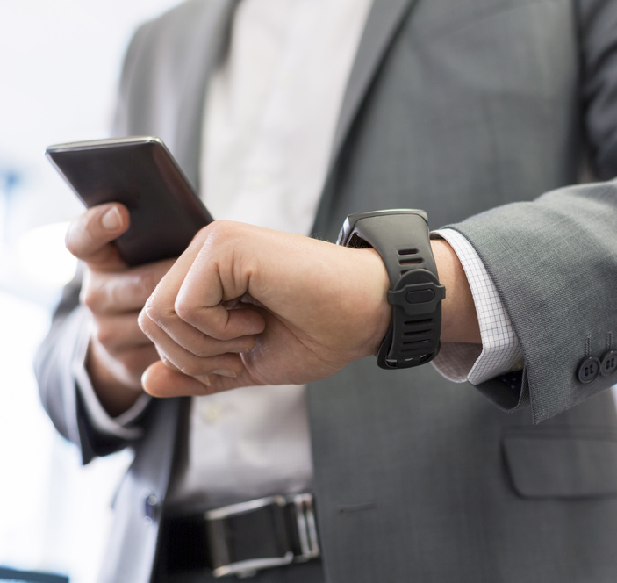
Wearables: Panacea or Pandora’s Box – A Security Perspective
Gary Davis | Chief Consumer Security Evangelist

Slide 2

Why this is important
10 x
Source: Reuters

Slide 3
What’s being collected
Types of data:
Spatial
Physical activity
Physiological statistics
Consumption
Medical symptoms
Bodily functions
Mental health
Risks:
Identity theft or fraud
Insurance fraud
Stalking
Extortion & exploitation
Robbery
Smart glasses
Heart monitor
Fitness wristband
Smart watch
Pain management

Slide 4
Hypergrowth
■ | Smart Clothing
■ | Wearable 3D Motion Trackers
■ | Sports, Fitness, and Wellness Trackers
■ | Healthcare Devices
■ | Smart Watches
■ | Smart Glasses
■ | Wearable Cameras
Units in Millions
780 Million by 2019
GAGR 39%
2014 - 2019
Source: ABi Research

Slide 5


The wild west
IoT
1990
2005
Now
2020

Slide 6
The wild west
Average of 25 vulnerabilities
per device
Source: HP

Slide 7

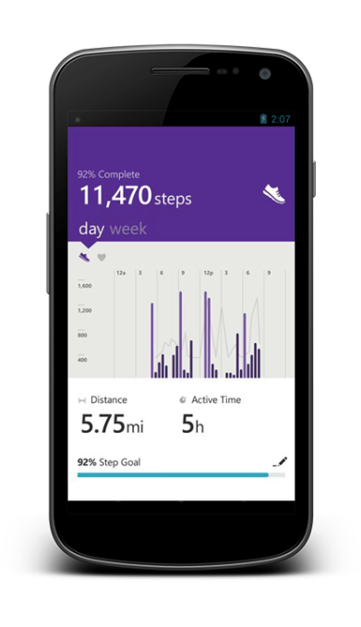

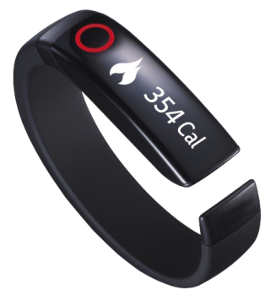

Data flows & what’s at risk
Mobile device
Wearable
Cloud server

Slide 8
The weakest link – your smartphone
36%
36% of mobile devices not PIN protected.
Source: Consumer Reports

Slide 9
The weakest link – your smartphone
36%
22%
22% install software that can find phone when lost.

Slide 10
The weakest link – your smartphone
36%
22%
14%
14% install third party security app.

Slide 11
The weakest link – your smartphone
36%
22%
14%
8%
8% install software that can erase phone’s data.

Slide 12
The weakest link – your smartphone
36%
22%
14%
8%
7%
7% use security features other than screen lock, such as encryption.

Slide 13
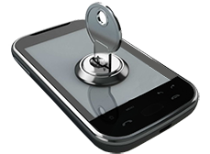
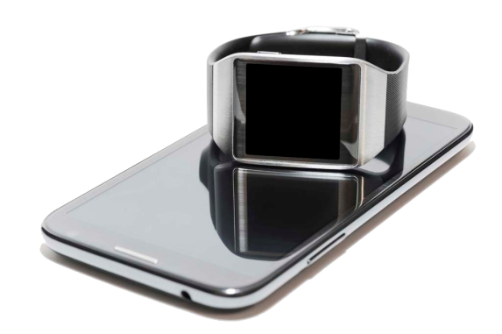
Weakest link exacerbated
40% of robberies in major US cities involve mobile devices
Source: FCC

Slide 14



Attack of the Flappy Bird clones
Making calls without user permission
Installing additional apps
Sending, recording, and receiving SMS messages
Extracting contact data
Tracking geo-location
Establishing root access, allowing uninhibited control of anything on device
The original Flappy Bird game
A malicious Flappy Bird clone
A malicious Flappy Bird clone
79%
Flappy Bird clones contained malware
Source: McAfee Labs Threat Report, Jun 2014

Slide 15
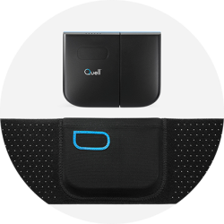
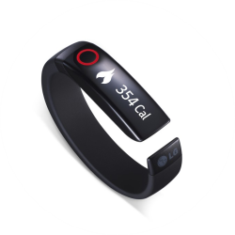
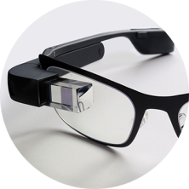
So what do we do…wearables
Do your homework when considering purchase
Change default passwords
Turn Bluetooth off when not required
Limit amount of information to only what’s required
Be careful when using social sharing features
Read and understand privacy policies

Slide 16

So what do we do…mobile devices
PIN or password protect your device
Use biometrics when possible
Be mindful of permissions
Apply OS and app patches
Turn on locate and lock capability
Turn non-essential antennas off
Install security software
Use full device encryption
Stick with trusted app stores

Slide 17
So what do we do…cloud service
Connect using encrypted communications (ie, https://…)
Use multi-factor authentication
Only collect data necessary to deliver service
Require strong passwords
Implement secure session management
Follow best practices for password handling (only store salted hashes and encrypted passwords)

Slide 18
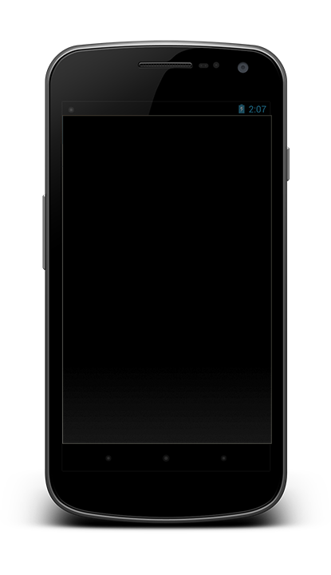
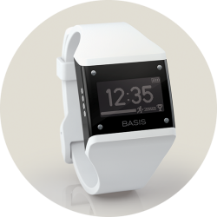
So what do we do…ecosystem
Build security in from start, not as an afterthought
Ensure privacy and security policies are easy to understand, well documented and adhered to

Slide 19
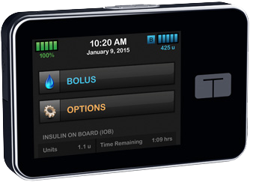
Ultimate wearable hack
Off-the-shelf technology
Total control of device

Slide 20
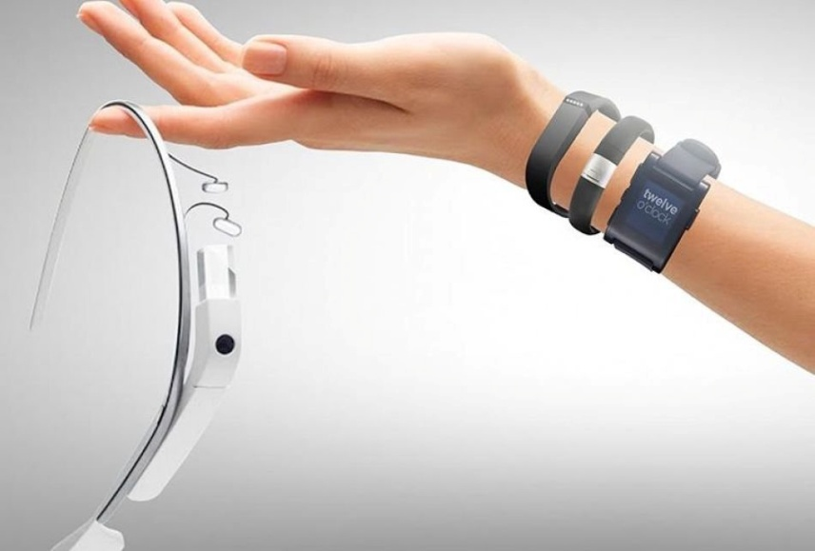
Call to action
Stay engaged and be an evangelist
Focus on education
Develop industry standards that work across ecosystem
Collaborate on ways to ensure security evolves

Slide 21
“It’s time to insure there is a clear set of ground rules for the security of Internet-connected products — before the marketplace and our homes fill with exploitable devices.”
-- Terrell McSweeny, Commissioner, Federal Trade Commission, Jan 28 2015

Slide 22

Follow me on Twitter
@GaryJDavis

