Slide 1
Show Me the Money
The Core Value of Analytics in Organizations and Demonstrating it
Pamela Peele, Ph.D.
Chief Analytics Officer
UPMC Insurance Services Division
February, 2015

Slide 2
Show Me the Money
How to Keep Your Job &
Grow Your Influence
Pamela Peele, Ph.D.
Chief Analytics Officer
UPMC Insurance Services Division
February, 2015

Slide 3
Intellectual Density Quotient: Top 4 Cities
City | IDQ
Rochester, NY | 83.99
San Jose, CA | 73.05
Louisville, KY | 71.92
Pittsburgh, PA | 69.27
San Jose, CA
Percentage of population age 18 and over enrolled in college or grad school
Percentage of population age 25 and older with high school diploma
Patents issued per 1,000 people
Percentage classified as knowledge workforce
Companies/1million pop ranked among the best places to work in the country
Mean annual wage

Slide 4
UPMC Today
One of the nation’s largest Integrated Delivery Systems
6th in NIH funding, affiliated University of Pittsburgh
$12 billion in total operating revenue
> 62,000 employees (1,700 IT FTEs)
> 3,400 employed physicians and 5,000 affiliated physicians
21 hospitals: 4,200 beds and 43 regional cancer centers
400 clinical locations; home care; rehab, urgent care
187,000 admissions per year
2.6 million members in Insurance Division programs
20,000+ contracted network providers

Slide 5
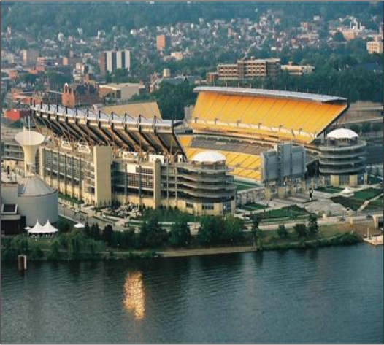
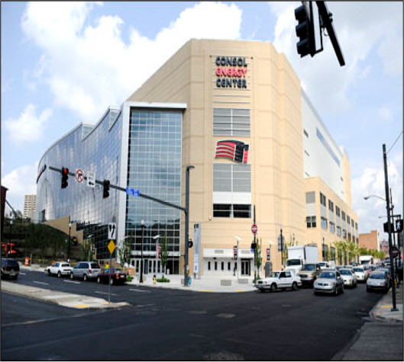

UPMC Invests Heavily in Technology and Leverages the Investment Across the IDFS
$1.6 Billion
over the past 5 years
PNC Park Park
Heinz Field
Consol Energy Center
Total Cost of all 3 Stadiums: $833M
Confidential – Do Not Duplicate

Slide 6
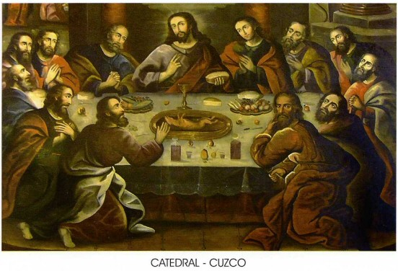
Consuming Something Different

Slide 7

The Kitchen?

Slide 8

Ready to Cook

Slide 9


Now We’re Cooking

Slide 10
Consuming Something Different

Slide 11
Threats to Value
It’s expensive to stand up analytics in an organization
Can’t take baby steps
Big upfront costs
Board of Trustees

Slide 12
Threats to Value
Capacity and team building takes time
Skilled knowledge workers are scarce and expensive

Slide 13
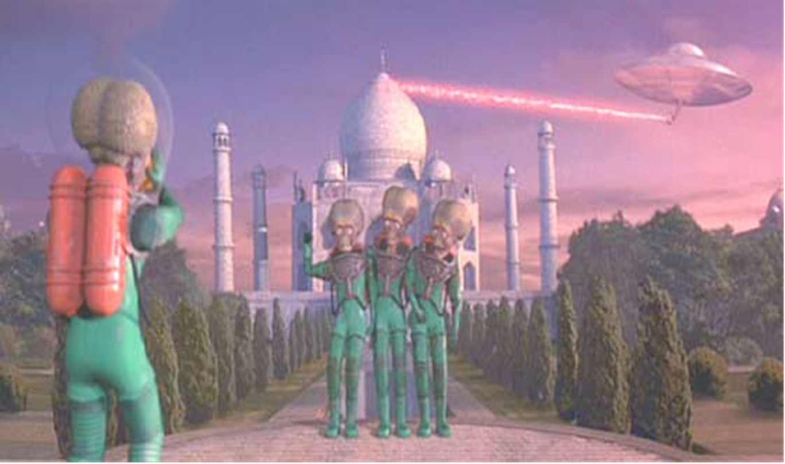
Strangers in a Strange Land

Slide 14

Hiring in Pairs

Slide 15

Threats to Value

Slide 16

Threats to Value

Slide 17

Threats to Value

Slide 18
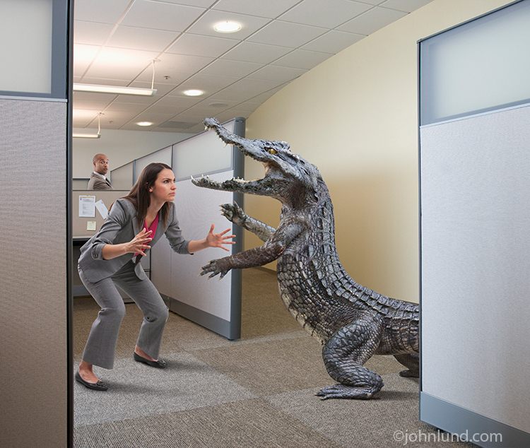
Value Thieves
Why am I wrestling with this everyday?
Ugly Ungroomed Data

Slide 19

Value Thieves

Slide 20
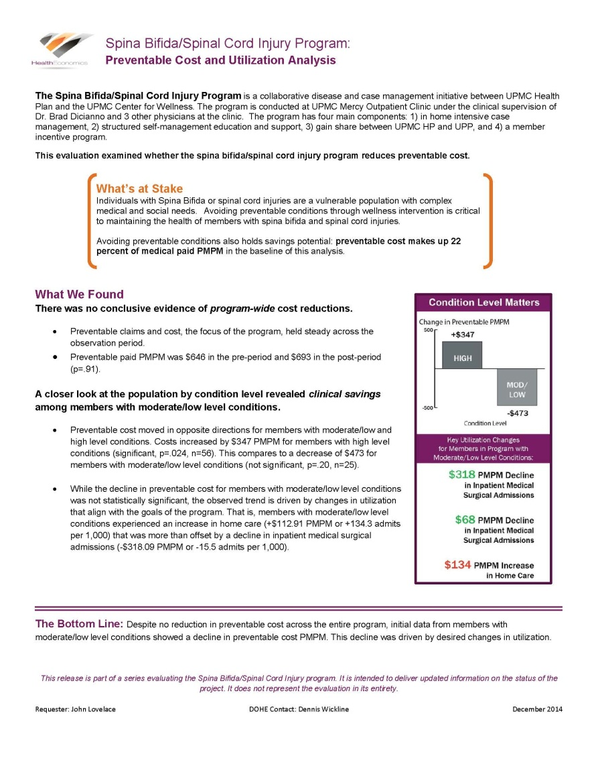

Value Thieves

Slide 21
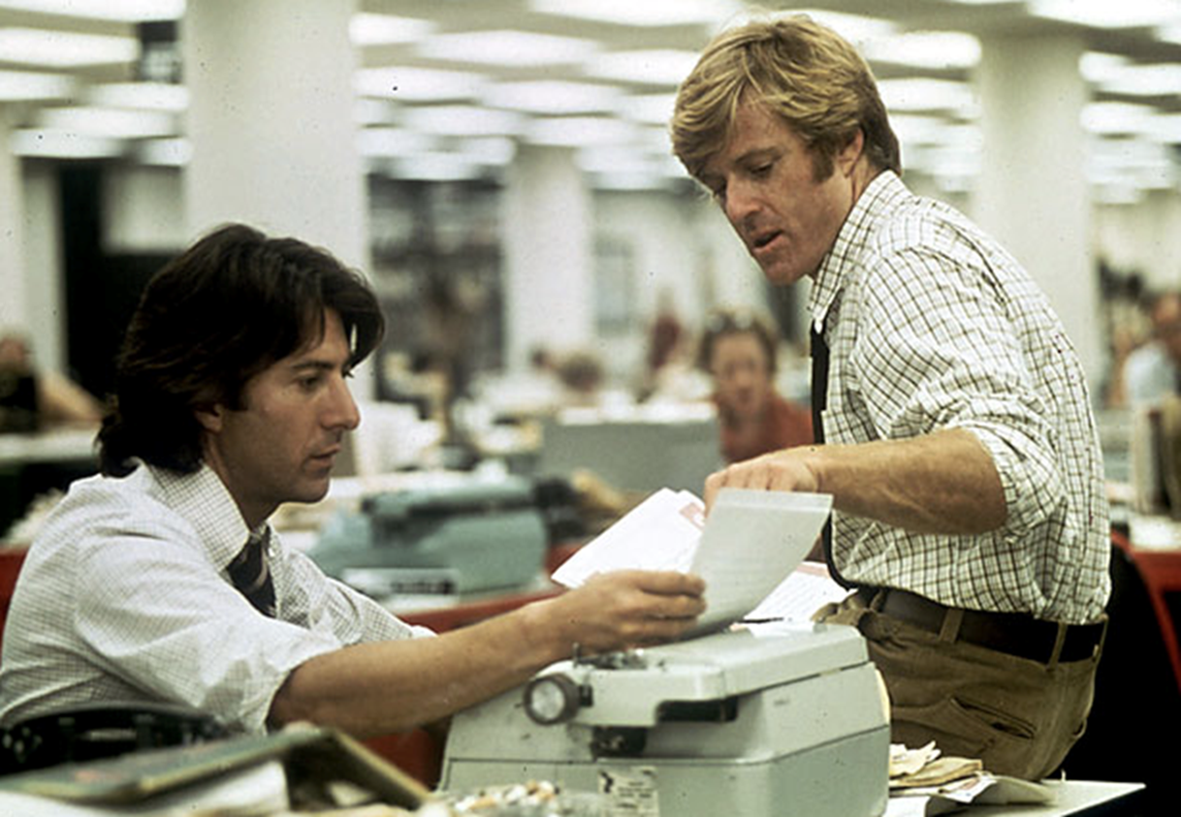
Tell the STORY

Slide 22
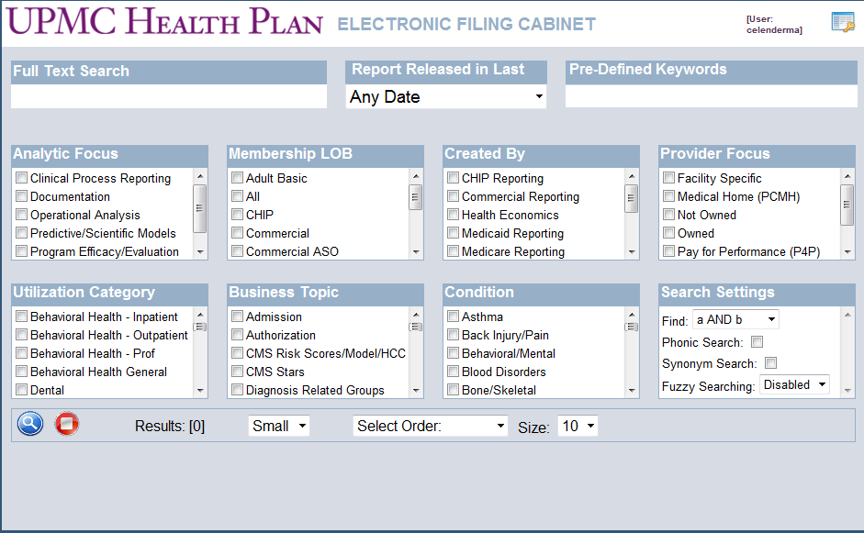
Information/Report Management

Slide 23
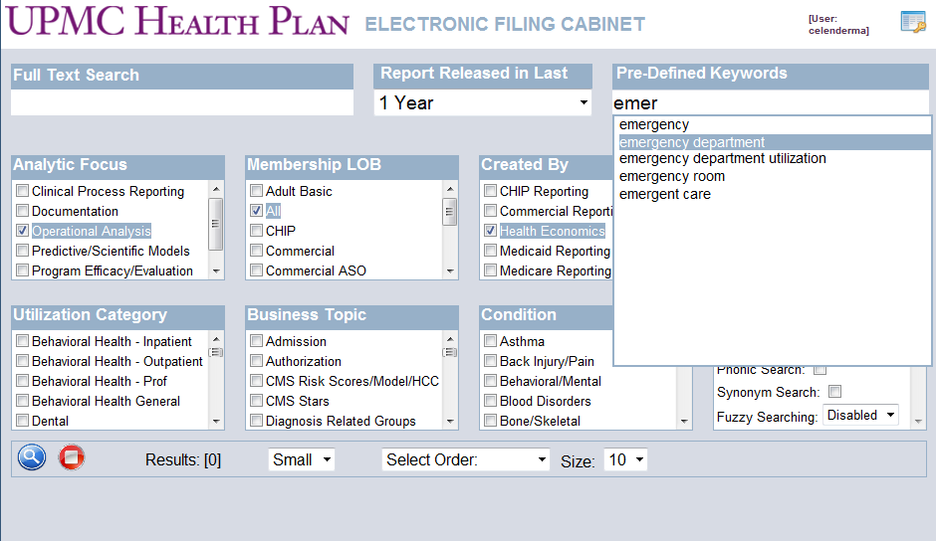

Slide 24
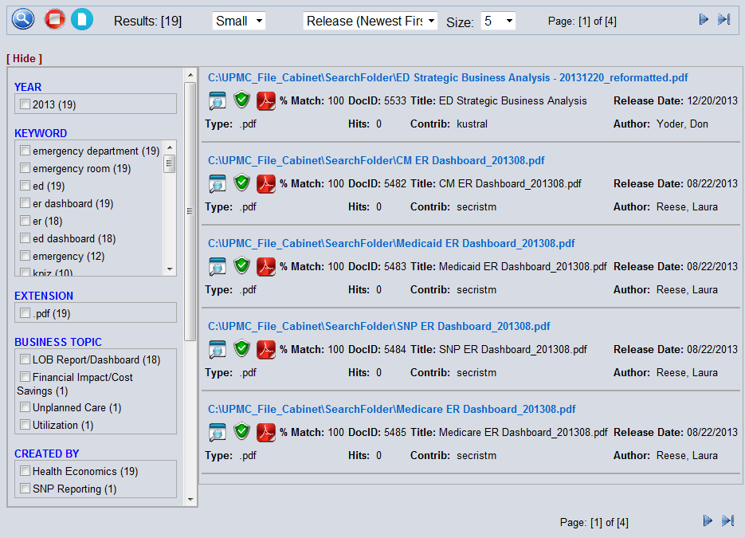

Slide 25
Showing the Value of Data/Analytics
T I M E
Take Credit
Change Organizational Decisions/Processes/Products
Create New Profit
Measure
Consumption of New Knowledge
Change Organizational Decisions/Processes/Products
Storytelling
Distribute New Knowledge
Consumption of New Knowledge
Measure
Produce New Knowledge
Distribute New Knowledge

Slide 26

The Danger of Big Data

Slide 27


Slide 28
The Dangers of Big Data
An information-rich environment creates a scarcity of what it consumes.
Herb Simon (1971)

Slide 29
Thank You
Pamela Peele, Ph.D.
Chief Analytics Officer, UPMC Insurance Services
Associate Professor, Health Policy & Management; Medicine, University of Pittsburgh
peelepb2@upmc.edu
412 454 7952

