Slide 1
Solving Customer Problems with Big Data across Thomson Reuters
Brian Ulicny
@bulicny
Director, David Innovation Lab
Thomson Reuters
STRATA + HADOOP 2015

Slide 2
Who is Thomson Reuters?
Financial & Risk
Legal
Critical news, information & analytics, enables transactions, and connects trading, investing, financial and corporate professionals.
Critical information, decision support tools, software & services to legal, investigation, business and government professionals.
Intellectual Property & Science
Tax & Accounting
Integrated tax compliance and accounting information, software & services for professionals in accounting firms, corporations, law firms and government.
Comprehensive IP & scientific information, decision support tools & services to enable governments, academia, publishers, corporations & law firms.
Reuters News
Powered by more than 2,800 journalists reporting in 20 languages from bureaus around the world, Reuters is the world’s largest international news organization

Slide 3

Data Overview: One company, Boehringer Ingelheim
48269
News
Broker Research
Bonds
Fundamentals
Press Releases
16268
Case Law
Admin Decisions
Public Records
Dockets
Arbitration
180
Editorial Analysis
86753 docs
Scientific Articles
Patents
Trademarks
Domain Names
Clinical Trials
Drugs
Three Vs at TR:
Velocity from fractions of seconds to quarterly filings.
Volume: all the data needed by target professionals
Variety: multiple disparate content, formats, languages.
Notes:
Thomson Reuters acquires, editorially curates and delivers a vast sea of business information, organized around entity categories, such as:
• Organizations • Financial Instruments • Quotes • Estimates • Patents & Trademarks • Briefs, Dockets & Case Law • People, etc.

Slide 4
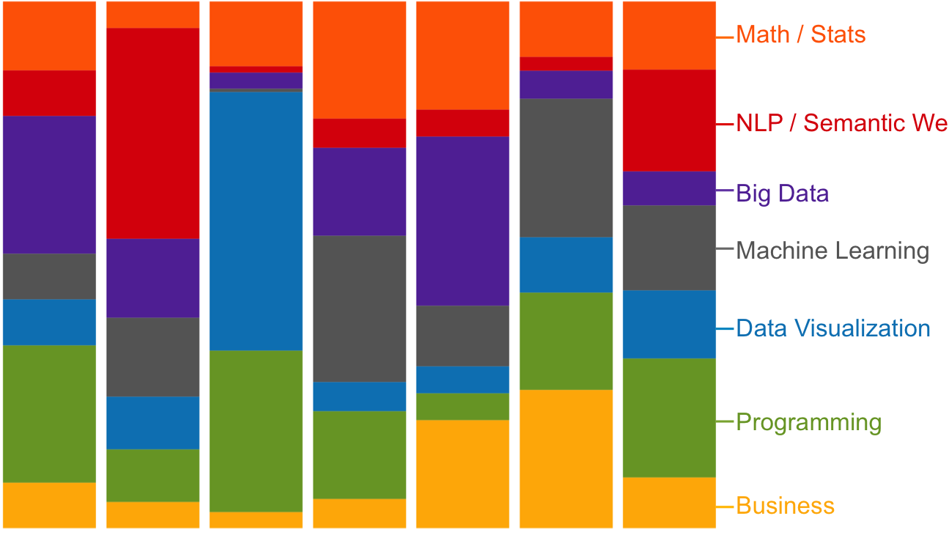
Thomson Reuters Data Innovation Lab
Started in July 2014
PhD and MS from leading universities, MIT, Columbia, UC Berkeley…
Business expertise in Finance, Government, Academia, Software and Hardware Technology and Life Sciences

Slide 5


End User Need: Peer Detection
Peer detection is a common task across customer segments:
Fairness Opinion
Comparable Companies for benchmarking
Buyside and sellside research
M&A practitioners
Supply chain
Transfer Pricing
Notes:
Buyside and sellside research analysts and portfolio managers expect to find ‘peer’ stocks in the same investable universe (e.g. region, exchange, index, currency) with similar characteristics (industry sector, market cap range, revenue range, value stock vs. growth stock).
M&A practitioners need peers for 2 reasons: find a suitable target or potential acquirer, and value a company or a deal.
Supply chain: purchasing managers or corporate supply chain managers will use peer lists to find potential replacement suppliers.
Strategy: corporate strategy teams need peer lists to identify emerging competitors, assess the competitive position of various companies, and assess market share.

Slide 6
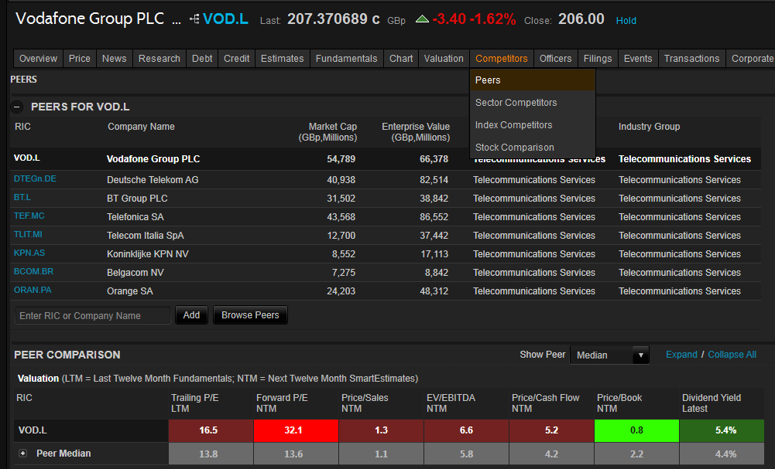
Peers in Eikon (Public Companies)

Slide 7
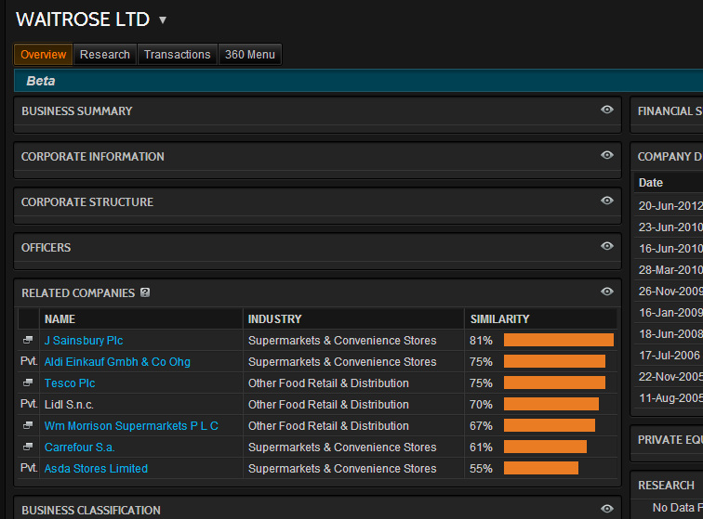
Peers in Eikon (Private Companies)

Slide 8
Use Case: Peer detection
Fundamental workflow: for any given company, which are its most similar companies?
Increase the scope of companies
Improve the quality of peer recommendations
Provide multiple flavors of peer lists
Allow end user control and customization
Provide transparency and explanations for the recommendations

Slide 9
Key tasks in peer detection
Find content sets with potential signals
Classify/ extract and store signals
Clean data
Resolve to authorities
Create a company fingerprint through a list of ranked attributes
Compose a similarity metric based on the different data sources
Provide an interactive user interface to visualize and fine tune the recommendations

Slide 10
Datasets
News
Trademarks
Patents
Wikipedia
Fundamentals
Deals
Starmine Peers
Press Releases
(TR Curated Data)

Slide 11
Patents
Similarity between patent portfolios
Derwent Patent database – approximately 50 million patents
Associate patents with companies
Select a set of attributes that defines a company patent portfolio
Based on these attributes establish a similarity measure
Neighbors of companies in the network can be considered peer candidates
Clustering this network gives technology areas

Slide 12
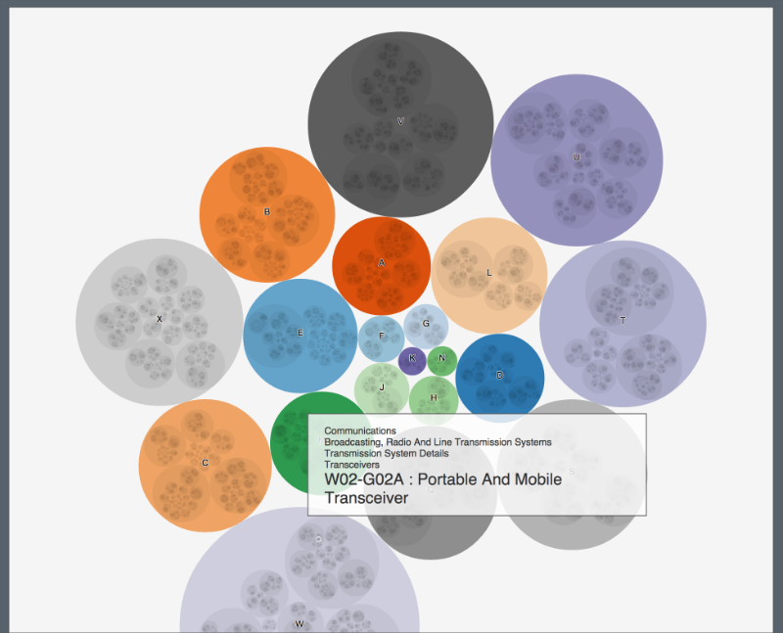
Aside: Visualizing the Derwent Ontology

Slide 13
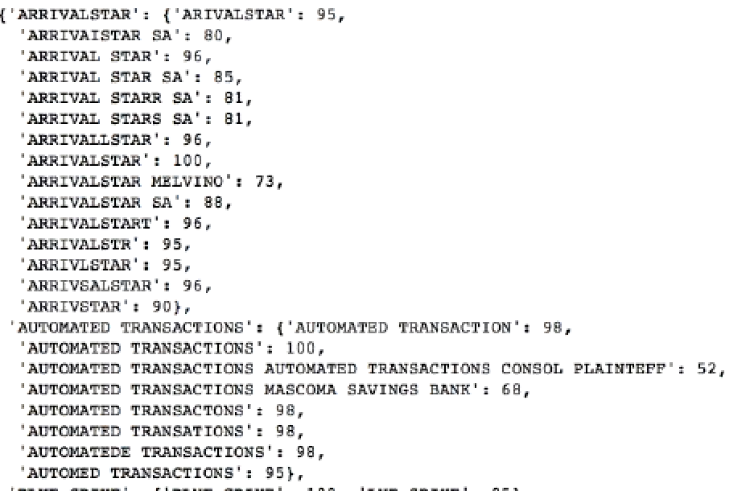
Patent Assignees: Obfuscation and Trolls
Patent “Trolls” often try to hide their status as assignee of patents.
We characterize assignees by ratio of plaintiff to defendant role in patent litigation. Identifying NPE assignees requires de-obfuscating names.

Slide 14
Tools for normalization & access
ENTITY, FACT AND EVENT EXTRACTION , TOPICAL CLASSIFICATION
CONCORDANCE AND RESOLUTION SERVICES
ORGANIZATION AND PEOPLE MASTERS
CENTRALIZED CONTENT ACCESS

Slide 15

Open Calais
http://www.opencalais.com/
A free to use external version of our entity, fact and event extraction engine.
New Calais releases will rely on TR authorities.
Assign Permanent Identifier (PermID) to entities.
Better quality and disambiguation
Leverage the TR identity management of entities
Stay tuned for 2015
Notes:
You can use example of IBM as a company extracted and resolved.
Also what happens when a company is acquired by another company – Calais is fed multiple times a day by all entity updates from TR authorities to ensure the metadata will reflect the new relationships change.

Slide 16
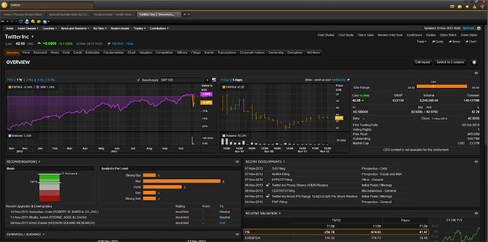
Eikon/Open Eikon
The Open Eikon project is transforming Eikon into a platform for 3rd parties.

Slide 17
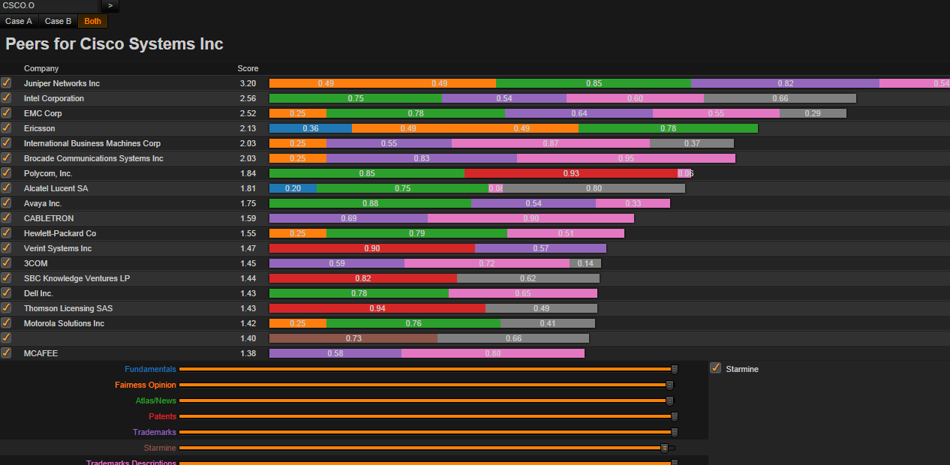
Demo
Front end:
AngularJS
D3
Eikon framework
Aggregation engine:
Java
All communications RESTful with json services

Slide 18
Lessons Learned/Agile Approach
Agree on a deliverable
Extensible architecture
Flexible interaction
Let user determine how they want to drill into information.
One metric doesn’t fit all.
Agree on a contract
Start by integration
Short milestones
Small, self selected teams
In and out of comfort zones

Slide 19
Wish List for the research community
Increased automation for precise information integration
Automated curation upon acquisition or ingest from various formats including pdf, XML into structured forms
Achieving scalable inference on large graphs
Managing rights and permissions
Supporting accessibility and navigation
Provenance tracking
Data visualization at scale, across diverse data sets

Slide 20
Questions?
Yes, we are hiring!

