Slide 1
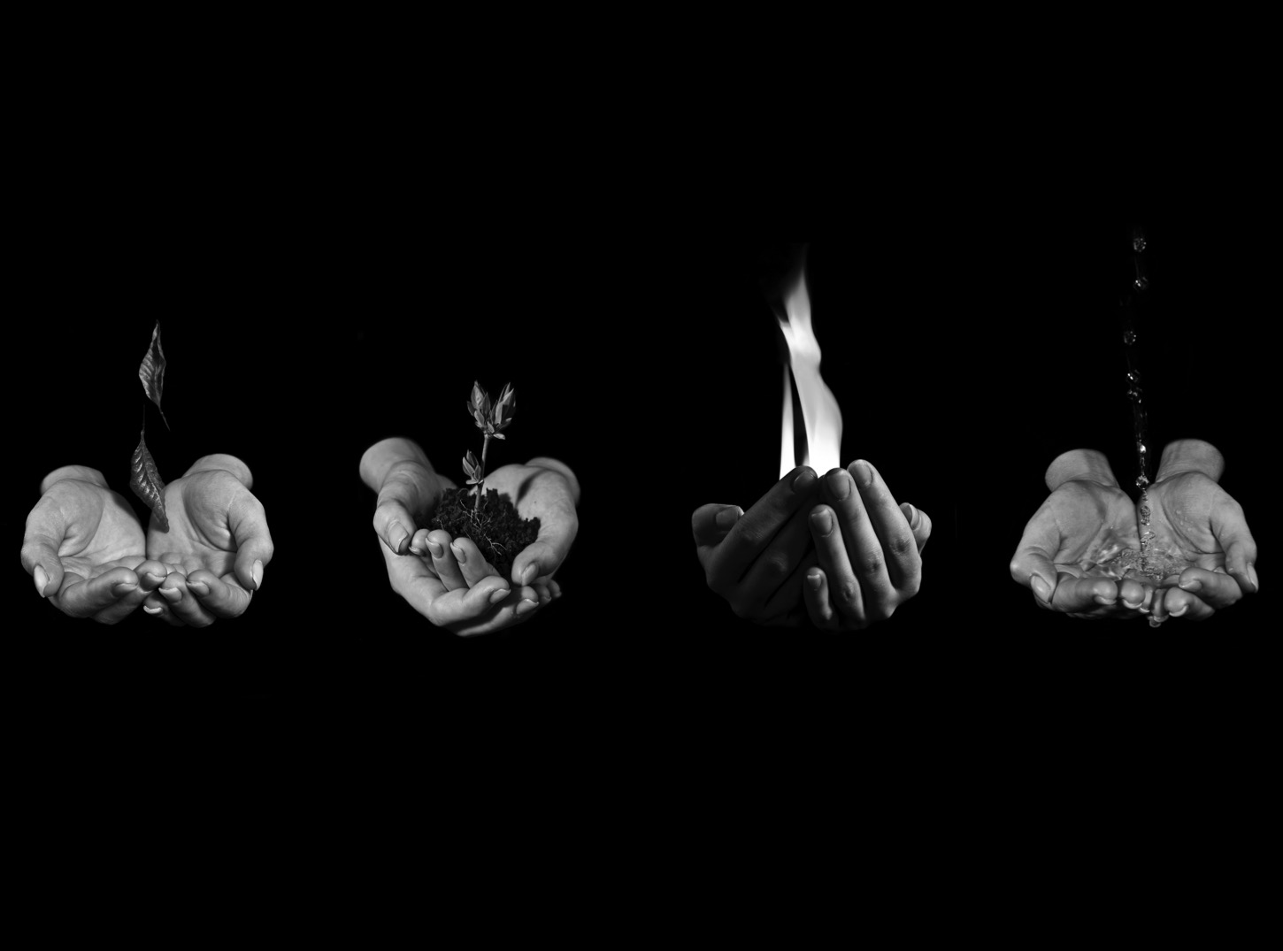
TECH MAGIC
10 Disruptors Shaping The Sensed World
Leah Hunter // @LEAHTHEHUNTER

Slide 2

WHY ME, WHY NOW
Leah writes about the human side of tech for Fast Company. She is also a writer for German magazine "Business Punk."
I am also writing a book entitled “the future” – publishing in September.
@LEAHTHEHUNTER

Slide 3
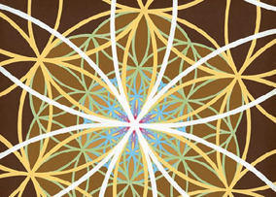
ARTHUR C. CLARKE SAID…
Any sufficiently advanced technology is indistinguishable from magic
@LEAHTHEHUNTER
Notes:
Magic is a different thing altogether. And yet, technology is a tool – magic is too. And yet technology…like anything else…can be a tool that can help us access our higher selves. A guide for our intuition. Our creative spark. You can feel into it, through it to shift energy in the world and quite literally shape the future.
And as these show, there are NO limits to what is possible.
Human subtlety will never devise any inventions more beautiful, more simple or more direct than does nature because in her inventions nothing is lacking and nothing is ever superfluous.

Slide 4

WHO IS SHAPING THE WORLD?
Many companies are making technological advances and surprising intellectual leaps. They are altering the fabric of the world.
But the question is:
Who is doing things worth talking about?
Who is mending the fabric?
The healers. The ones following the principles of sacred geometry. The ones making our world better.
That’s who I will speak to.
@LEAHTHEHUNTER
Notes:
people and startups altering the fabric of the world through hardware, data science and entrepreneurial vision.
The shape and business of IoT is shifting as a result.

Slide 5
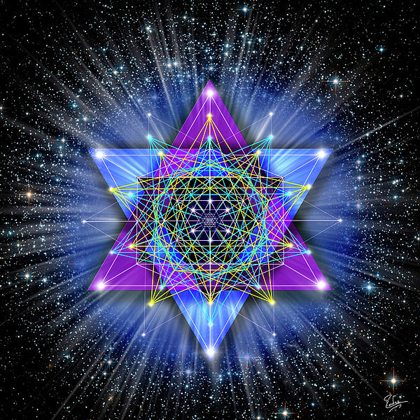
CREATORS OF TECH MAGIC
Data shaping business models
Data creating new lives
Data accelerating learning
Data improving the world
TECH DOESN’T MATTER.
Its positive effect – that does.
@LEAHTHEHUNTER
Notes:
Because here’s the thing: TECH DOESN’T MATTER. Itspositive impact – that’s what does

Slide 6
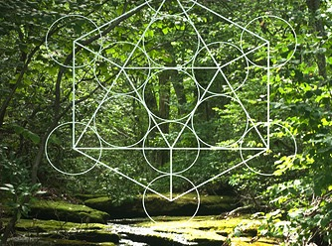
CREATORS OF TECH MAGIC
DATA FOR GOOD
@LEAHTHEHUNTER

Slide 7
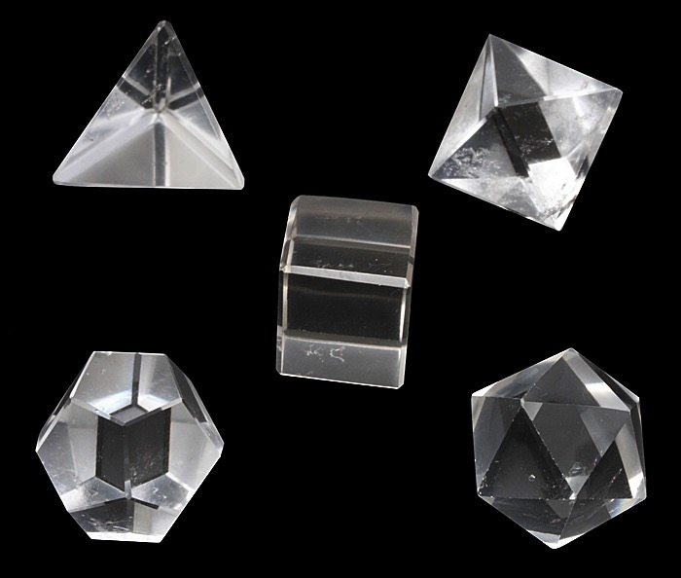
THE MAGIC IS IN THE BACKEND
HOW DO KIDS LEARN?
DUOLINGO
@LEAHTHEHUNTER
Notes:
EmTech. Severin Hacker.

Slide 8
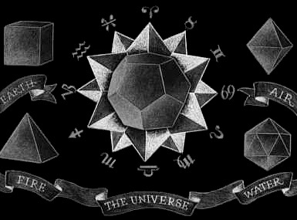
THE MAGIC IS IN THE IMPACT
WHAT IS HAPPENING TO THE RAINFOREST?
INFOAMAZONIA
@LEAHTHEHUNTER
Notes:
Joyce Barnathan. International Center For Journalism

Slide 9
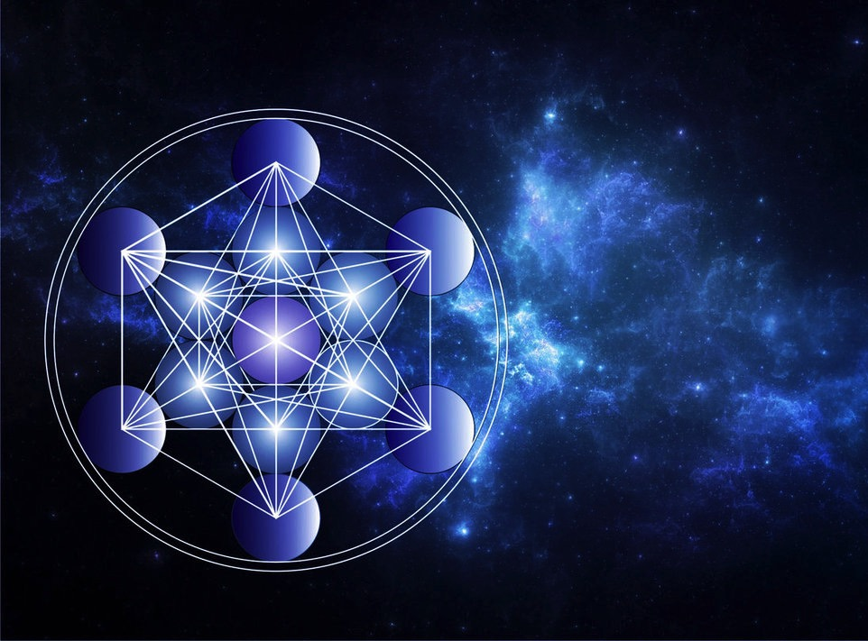
THE MAGIC IS IN THE MANY
HOW DO SMALL BUSINESSES THRIVE?
YELP DATASET CHALLENGE
@LEAHTHEHUNTER
Notes:
Center for Data Innovation

Slide 10
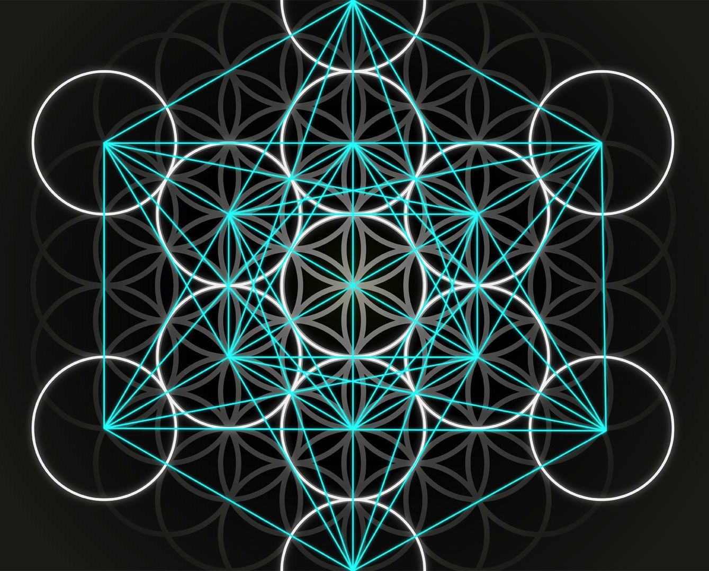
THE MAGIC IS IN THE BEHAVIOR CHANGE
HOW CAN PEOPLE SLEEP BETTER?
JAWBONE
@LEAHTHEHUNTER
Notes:
Travis Bogard

Slide 11
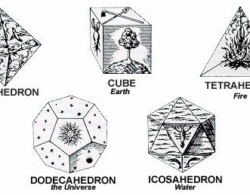
SUMMARY
THE MAGIC IS IN THE UNDERSTANDING
WHY DO I FEEL THIS WAY?
GINGER.IO
@LEAHTHEHUNTER
Notes:
Rachael Kalmar

Slide 12

SUMMARY
THE MAGIC IS IN THE LIVES SAVED
WHO IS AT RISK?
UNIVERSITY OF PENNSYLVANIA
Notes:
GigaOm

Slide 13
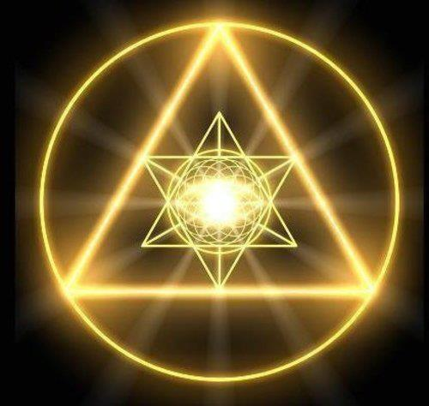
SUMMARY
THE MAGIC IS IN CHANGING THE QUESTION
HOW CAN WE HARNESS CLEAN ENERGY?
XCEL AND NCAR (COLORADO)
@LEAHTHEHUNTER
Notes:
Jason Pontin

Slide 14
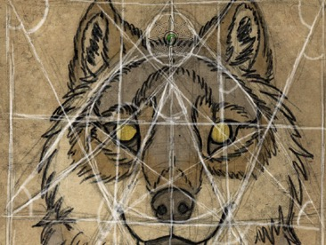
SUMMARY
THE MAGIC IS IN MAKING MORE POSSIBLE
HOW CAN WE SUPPORT MORE PEOPLE?
LENNDO
@LEAHTHEHUNTER
Notes:
Daniella Busse

Slide 15

THE MAGIC IS IN FEEDING THE WORLD
HOW CAN WE END FOOD WASTE?
FOOD TO FORK (TECH M)
@LEAHTHEHUNTER
Notes:
BBC

Slide 16

THE MAGIC IS IN THE EVOLUTION
HOW CAN WE MASTER THIS?
DATA COMPRESSION
@LEAHTHEHUNTER
Notes:
Vinith Misrah

Slide 17
ARTHUR C. CLARKE ALSO SAID…
The only way of discovering the limits of the possible is to venture a little way past them into the impossible
@LEAHTHEHUNTER
Notes:
Practical magic something exemplified by all of these examples that you can put into practice in your work life today…

Slide 18

THANK YOU!!!
:Leah Hunter // @LEAHTHEHUNTER

