Slide 1
The Human-Data Interface:
How to Design for “Irrational” Data Consumers
Cathy Tanimura
Strata
February 19, 2015

Slide 2

I need sales cut by date, product, country, city, segment, rep, margin, campaign source, name, …
For a meeting at 8 tomorrow morning

Slide 3

I don’t need data.
I will tell the customers what they want

Slide 4

I just need some data showing the Cloud campaign outperformed the Ocean campaign…

Slide 5
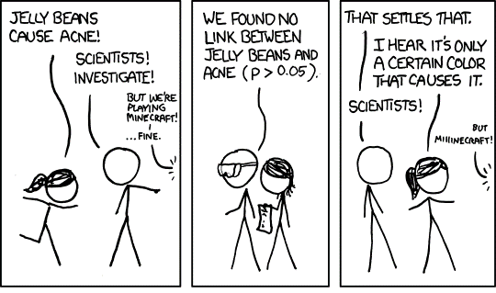
Notes:
http://xkcd.com/882/

Slide 6
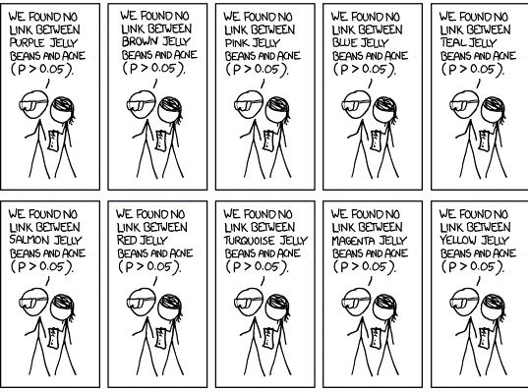
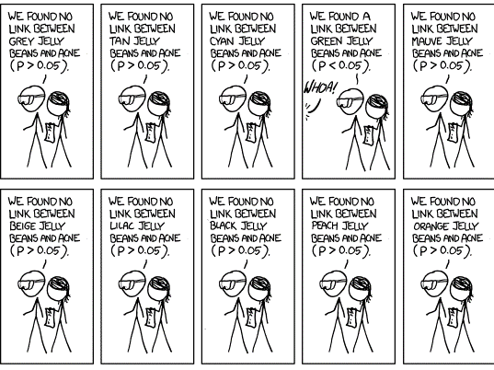
Notes:
http://xkcd.com/882/

Slide 7
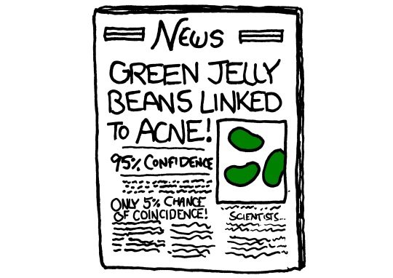
http://xkcd.com/882/
Notes:
http://xkcd.com/882/

Slide 8
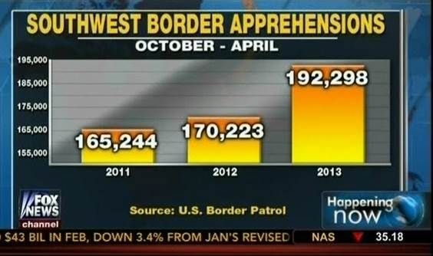

Slide 9
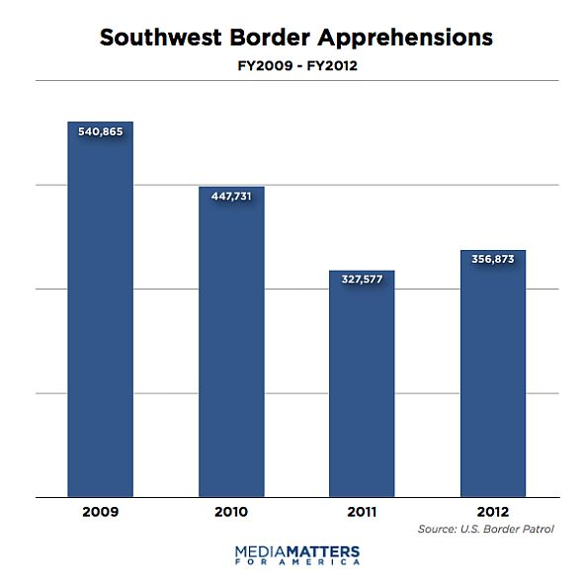

Slide 10

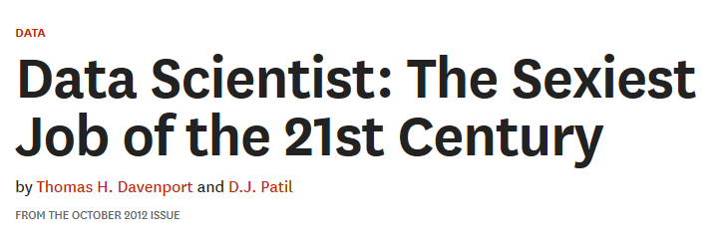

Slide 11
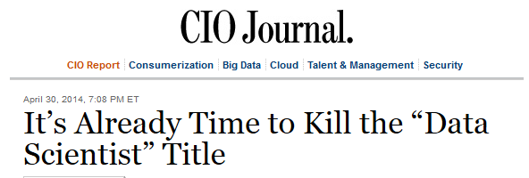

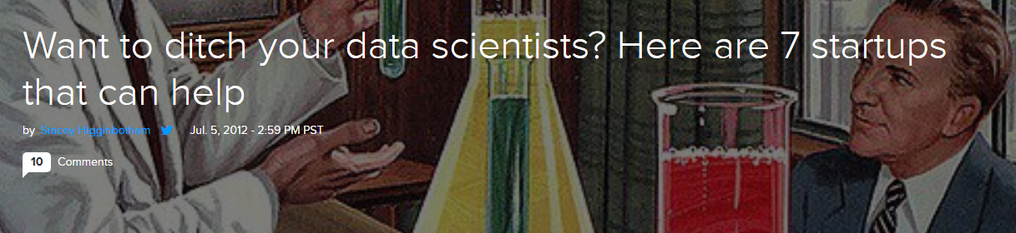



Slide 12
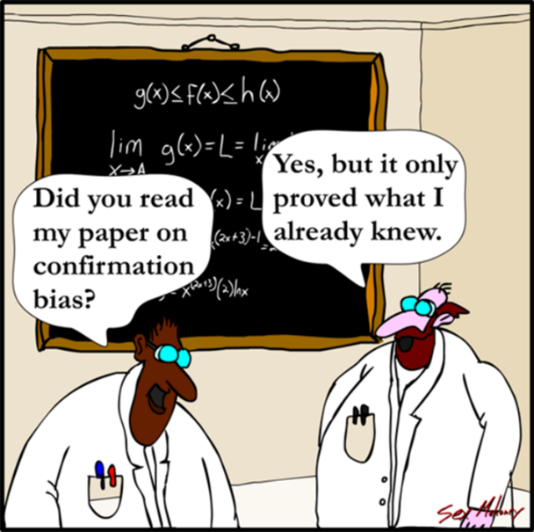
Confirmation bias:
The tendency to search for, interpret, or recall information in a way that confirms one’s beliefs or hypotheses.
(Wikipedia)

Slide 13

Notes:
Daniel Kahneman

Slide 14
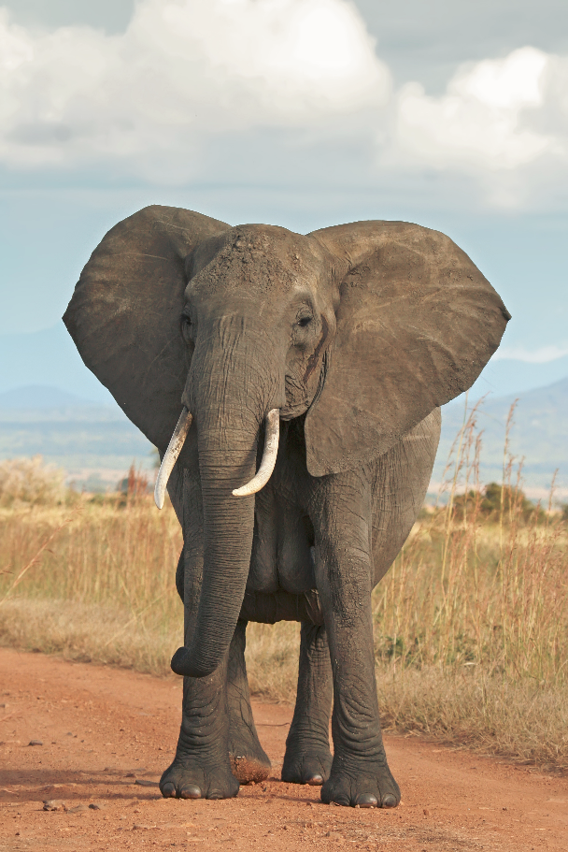
Call out the elephant in the room
Notes:
Image: wikipedia

Slide 15
Belief Persistence:
People to continue to believe, even after presented with information that contradicts or disconfirms the belief

Slide 16
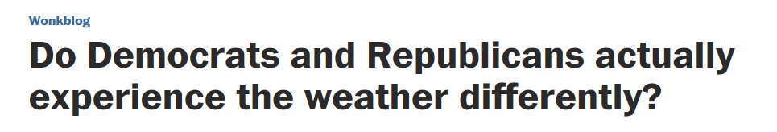
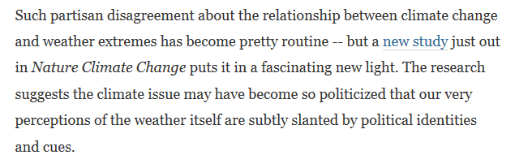
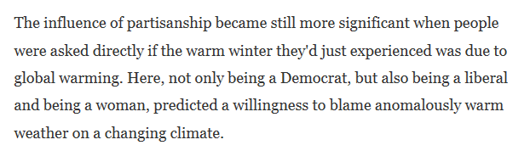

Notes:
http://www.washingtonpost.com/blogs/wonkblog/wp/2014/11/24/do-democrats-and-republicans-actually-experience-the-weather-differently/

Slide 17
Some things that trip humans up:
We tend to give more weight to early evidence
More evidence gives us more confidence in our beliefs, but doesn’t necessarily make us more accurate

Slide 18
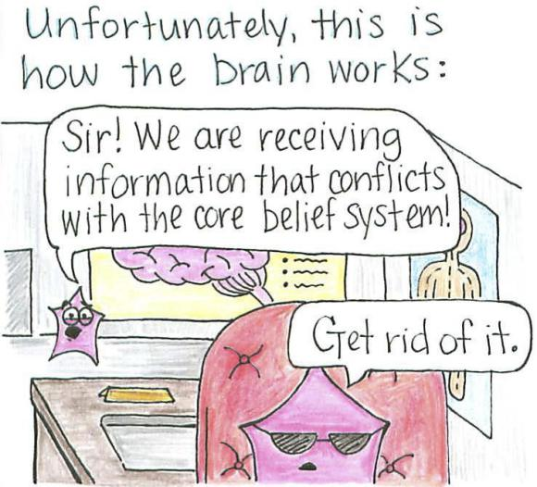

Slide 19


What can we do?

Slide 20
Narrative fallacy:
When we look at a series of data points, our natural tendency is to weave them into a story. This helps us remember and make sense of the data. But can also lead us to tell stories where no stories exist.

Slide 21
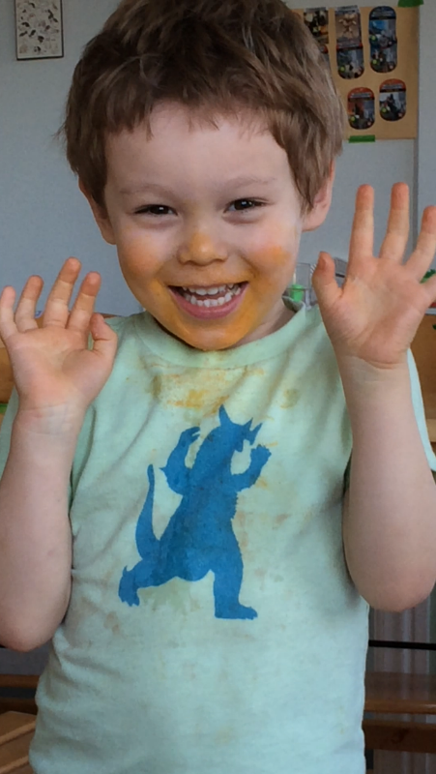
San Francisco:
114 Public Elementary Programs
97 Private Elementary Schools

Slide 22








Small schools movement
$1.7 billion from the Gates Foundation by 2001
Notes:
Evidence That Smaller Schools Do Not Improve Student Achievement
Author(s):
Howard Wainer and
Harris L. Zwerling
Source:
The Phi Delta Kappan,
Vol. 88, No. 4 (Dec., 2006), pp. 300-303
Published by:
Phi Delta Kappa International
Stable URL:
http://www.jstor.org/stable/20442243

Slide 23
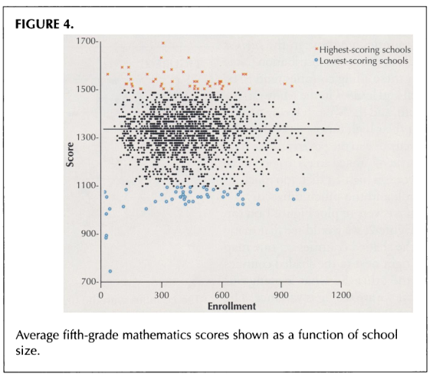
Waine & Zwerling, “Evidence That Smaller Schools Do Not Improve Student Achievement”
Notes:
Evidence That Smaller Schools Do Not Improve Student Achievement
Author(s):
Howard Wainer and
Harris L. Zwerling
Source:
The Phi Delta Kappan,
Vol. 88, No. 4 (Dec., 2006), pp. 300-303
Published by:
Phi Delta Kappa International
Stable URL:
http://www.jstor.org/stable/20442243

Slide 24
Use narrative to advantage
Humans are good at:
Generalizing from a specific example to the general population
Bad at:
Going from the general population to a specific example

Slide 25
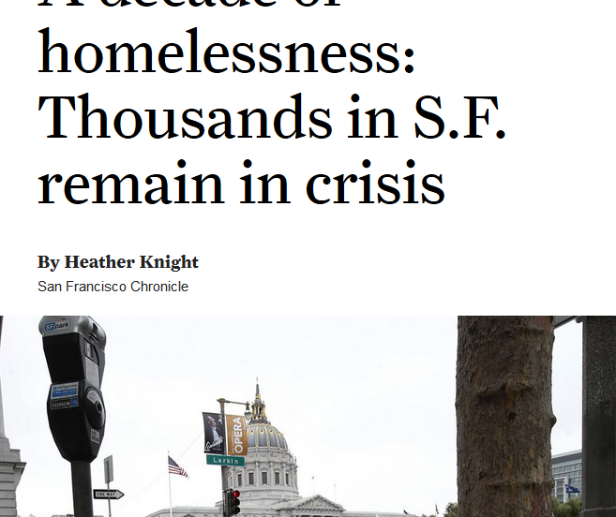

Slide 26
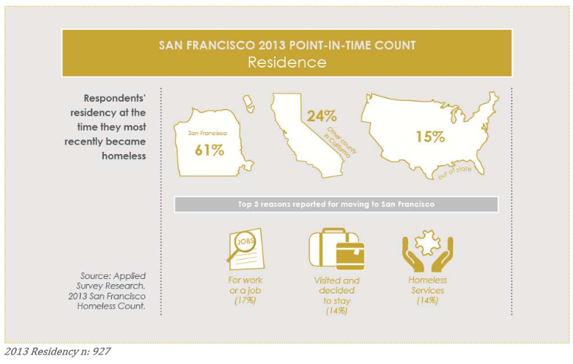
2013 San Francisco Homeless Point-in-Time Count & Survey Comprehensive Report
Notes:
http://www.sfgov3.org/modules/showdocument.aspx?documentid=4819

Slide 27
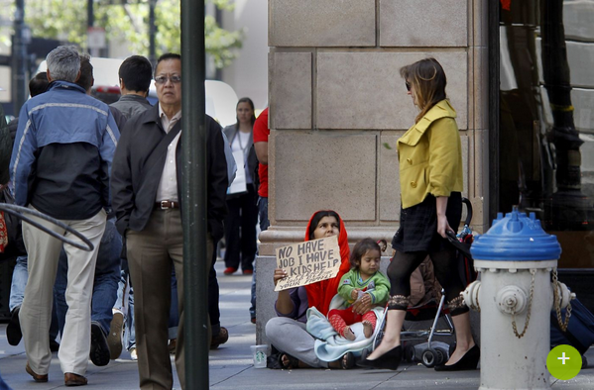
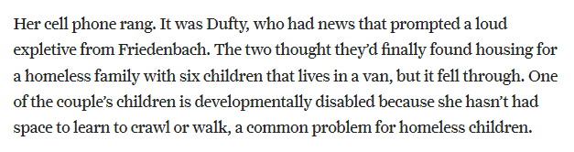
Notes:
http://www.sfchronicle.com/archive/item/A-decade-of-homelessness-Thousands-in-S-F-30431.php

Slide 28
Suggestions
Weave specific stories in with the stats
Point out outliers for what they are (this is an interesting story, but not representative)

Slide 29

People can’t learn boring stuff

Slide 30

Messages that grab your attention
trigger
Memory
Interest
Awareness

Slide 31
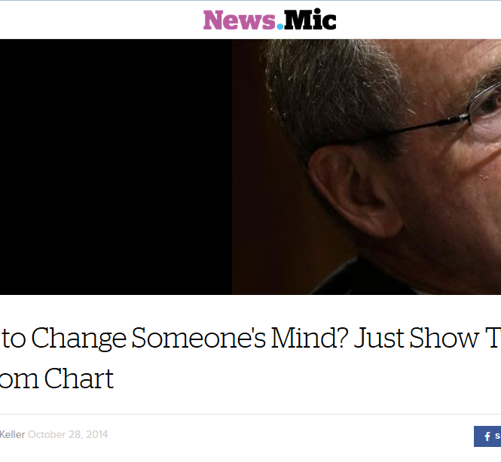
Notes:
And we are in possession of incredibly influential material – when applied in certain ways
http://mic.com/articles/102546/want-to-make-change-someone-s-mind-just-show-them-a-random-chart

Slide 32
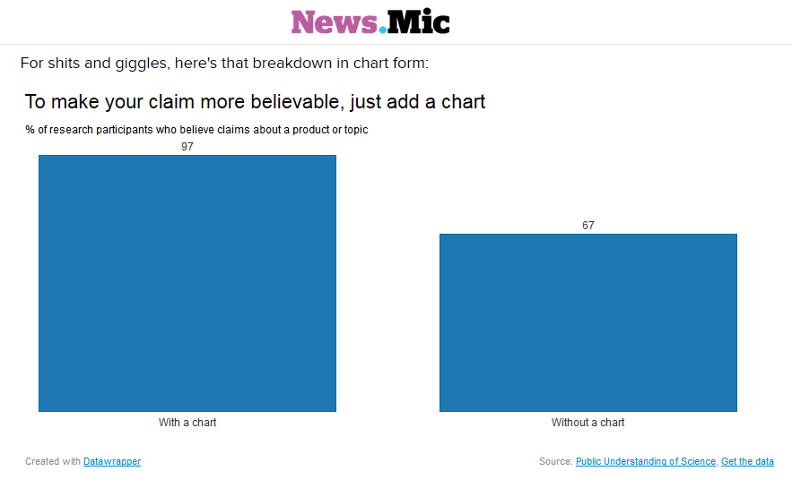

Slide 33
How:
Give the meaning, then details
Visualize, include motion
Involve the senses

Slide 34

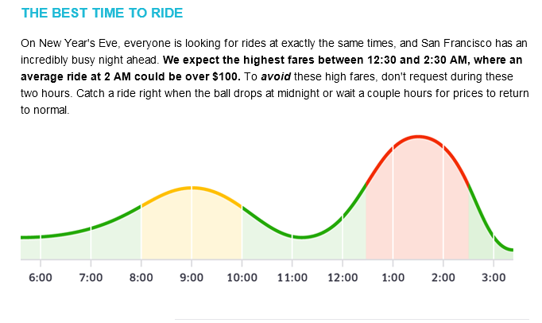

Slide 35

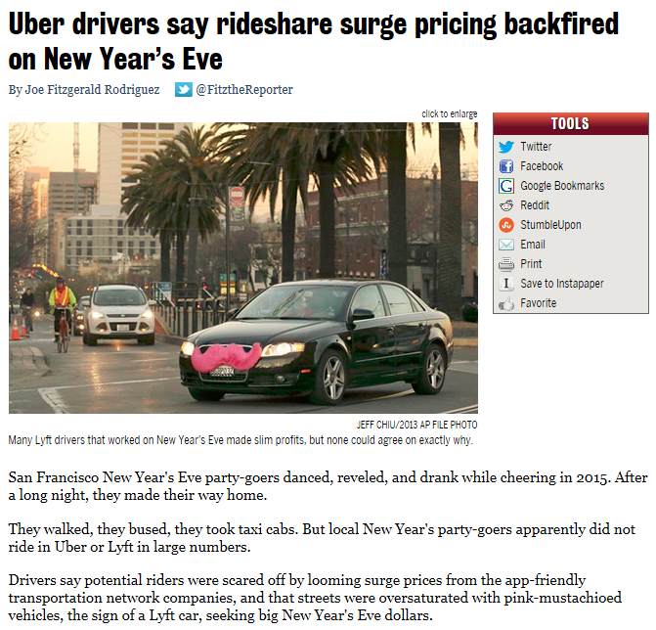

Slide 36
Takeaways:
Confirmation bias affects us all
If you can’t change them, change your attitude
Beware narrative fallacy
But use stories to engage
Help them pay attention!

Slide 37
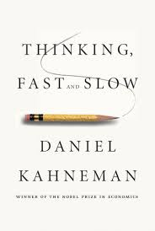
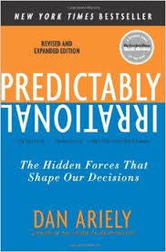
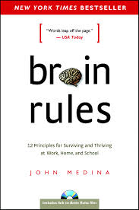

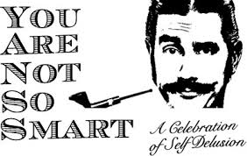
Further reading…

Slide 38
Thank You
Cathy Tanimura

