Slide 1


Top 10 SQL-on-Hadoop Pitfalls
Monte Zweben
CEO, Splice Machine

Slide 2











SQL-on-Hadoop Landscape
A crowded, confusing landscape, full of potential and pitfalls…

Slide 3

Pitfall #1
Individual Record Lookups

Slide 4
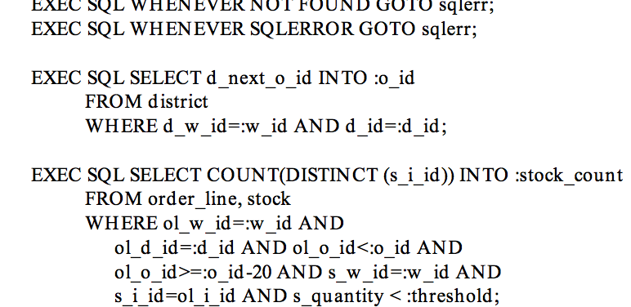

Pitfall #1: Individual Lookups and Range Queries
Issues
Support real-time apps?
Concurrent readers/writers?
e.g., TPC-C A.5:
Impact
Data delays
Inability to support:
many users
many sources
real-time apps
Examples
Affected
Unaffected
Solution
Avoid analytic systems designed for full table scans
Choose systems designed for range queries
Verification: do query <30ms?

Slide 5

Pitfall #2 Dirty Data

Slide 6
Pitfall #2: Fixing Bad Data
Issues
Fix bad data without reloading all data:
UPDATE address
SET state=“CA”
WHERE state=“California”
Impact
Bad reports
Delays to reload entire data set
Examples
Affected
Unaffected
Solution
Ability to update and delete
Transactions for multi-row updates
Verification: update one record in <30ms?

Slide 7

Pitfall #3 Sharding

Slide 8
Pitfall #3: Sharding
Issues
Right key to distribute data
Right shard size
Impact
Slow queries, esp. for large joins or aggregations
Examples
Affected
Unaffected
Solution
Requires design time decisions and/or tuning
Small shards = more parallelization
Fewer shards = less memory and compaction overhead

Slide 9
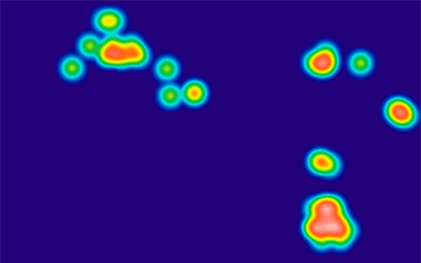
Pitfall #4
Hotspotting

Slide 10
Pitfall #4: Hotspotting
Issues
Data too concentrated in a few nodes
Especially for time series data
e.g., order data
… PRIMARY KEY (order_id, order_line)…
INSERT INTO order_lines (order_id, order_line, create_date, SKU, qty, …)
VALUES (value1, value 2, …);
Impact
Slow queries
Poor parallelization
Examples
Affected
Unaffected
Solution
Key design
Salt keys, if range queries not important

Slide 11
Pitfall #5
SQL Coverage
SELECT
orders.id AS orders_id,
(SELECT COUNT(order_items.id)
FROM order_items
WHERE order_items.order_id = orders.id)
AS orders_total_number_of_items
FROM thelook.orders AS orders
ORDER BY orders_total_number_of_items
LIMIT 500
Splice Machine | Proprietary & Confidential
Notes:
Correlated subquery that Impala has issues with: http://community.cloudera.com/t5/Interactive-Short-cycle-SQL/Plans-for-Impala-to-support-correlated-subqueries/td-p/16620
Subquery restrictions: http://www.cloudera.com/content/cloudera/en/documentation/cloudera-impala/latest/topics/impala_subqueries.html

Slide 12
Pitfall #5: SQL Coverage
Issues
Limited SQL dialects
Why can't I do full join syntax like ON or OR?
Can I do a correlated sub-query?
SELECT employee_number, name
FROM employees AS Person
WHERE salary > (
SELECT AVG(salary)
FROM employees
WHERE department = Person.department);
Impact
Can’t run queries to meet business needs
Examples
Affected
Unaffected
Solution
Do your homework
Compile list of toughest queries and test

Slide 13

Pitfall #6 Concurrency
Splice Machine | Proprietary & Confidential

Slide 14
Pitfall #6: Concurrency
Issues
Power real-time apps
Support 1000s of readers/writers at once
Commit records across tables atomically
Impact
Inability to:
Power real-time apps
Handle many users
Support many input sources
Deliver reports as updates happen
Examples
Affected
Unaffected
Solution
Lockless, high-concurrency transactions
Verification: TPC-C benchmark

Slide 15

Pitfall #7 Columnar
Splice Machine | Proprietary & Confidential

Slide 16
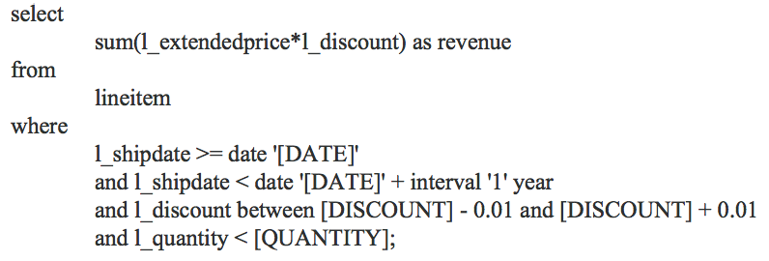
Pitfall #7: Columnar
Issues
OLAP queries slower
Especially large joins or aggregations
e.g., TPC-H Q6
Impact
Poor productivity
Queries may take minutes or hours instead of seconds
Examples
Affected
Unaffected
Solution
Columnar, but not all created equal:
Columnar storage/compression (4x advantage)
Columnar projection (10x)
Columnar engine (e.g., vector processing, pipelining) (50x)
Notes:
http://skylandtech.net/who-is-how-columnar/

Slide 17

Pitfall #8 Node Sizing
Splice Machine | Proprietary & Confidential

Slide 18
Pitfall #8: Node Sizing
Issues
Big boxes vs. pizza boxes?
SSDs?
Memory size?
Impact
Price/performance
Performance bottlenecks
Examples
Affected
Every distributed system
Solution
Default: stick to pizza boxes with moderate memory (32-64 GB) and no SSDs unless a good reason
Do your homework – profile your workload
CPU bound? Memory? I/O? Network?
Notes:
http://skylandtech.net/who-is-how-columnar/

Slide 19

Pitfall #9 Brittle ETL on Hadoop

Slide 20
Pitfall #9: Brittle ETL on Hadoop
Issues
Restart ETL pipeline because of errors
Serialize ETL Pipeline
Impact
Miss ETL window
Delay reports to business users
Examples
Affected
Unaffected
Solution
Incremental updates with transactions to address data quality
Rollback failed ETL steps without restarting entire process
Notes:
http://skylandtech.net/who-is-how-columnar/

Slide 21

Pitfall #10 Cost-Based Optimizer

Slide 22
Pitfall #10: Cost-Based Optimizer
Issues
Choose right join strategy
Choose right index
Choose right ordering
Impact
Poor performance = poor productivity
Manual tuning by DBAs
Examples
Affected
Unaffected
Solution
Cost-based optimizer
However, maturity for OLAP queries may be issue for newer products like Hive, Impala, and Drill
Notes:
http://skylandtech.net/who-is-how-columnar/

Slide 23
Top 10 SQL-on-Hadoop Pitfalls
Individual Lookups and Range Queries
Fixing Bad Data
Sharding
Hotspotting
SQL Coverage
Concurrency
Columnar
Node Sizing
Brittle ETL on Hadoop
Cost-Based Optimizer

Slide 24
Summary
SQL-on-Hadoop Benefits
Excellent price/performance
SQL access
Incredible pace of product advancements
SQL-on-Hadoop Pitfalls
Crowded, confusing market
Relatively immature products
Difficult to determine product differences
Recommendations
Review Top 10 pitfalls
Truly understand your workloads
Do POCs to verify

Slide 25
Questions?
Monte Zweben
mzweben@splicemachine.com

