Slide 1
Tuning and Debugging in Apache Spark
Patrick Wendell @pwendell
February 20, 2015

Slide 2
About Me
Apache Spark committer and PMC, release manager
Worked on Spark at UC Berkeley when the project started
Today, managing Spark efforts at Databricks

Slide 3
About Databricks
Founded by creators of Spark in 2013
Donated Spark to ASF and remain largest contributor
End-to-End hosted service: Databricks Cloud

Slide 4
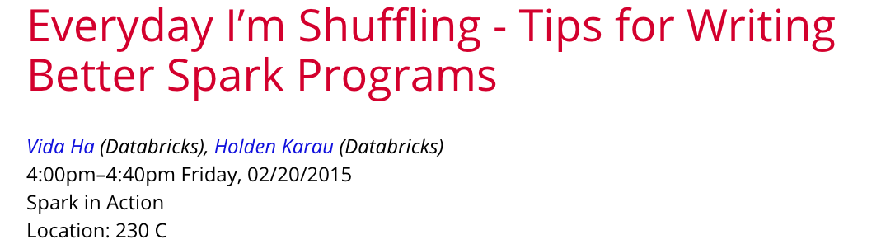
Today’s Talk
Help you understand and debug Spark programs
Related talk this afternoon:
Assumes you know Spark core API concepts, focused on internals

Slide 5
Spark’s Execution Model

Slide 6

The key to tuning Spark apps is a sound grasp of Spark’s internal mechanisms.

Slide 7
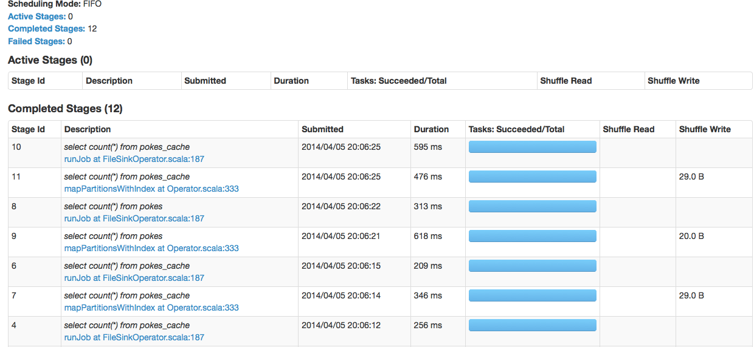
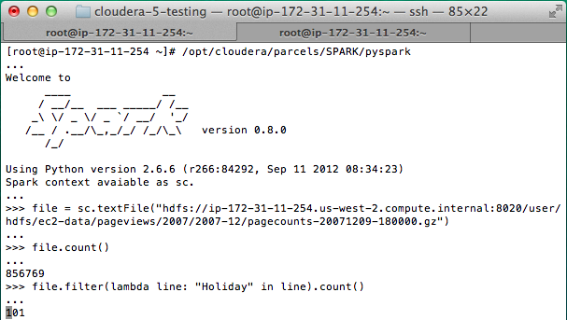
Key Question
How does a user program get translated into units of physical execution: jobs, stages, and tasks:
?

Slide 8
RDD API Refresher
RDDs are a distributed collection of records
rdd = spark.parallelize(range(10000), 10)
Transformations create new RDDs from existing ones
errors = rdd.filter(lambda line: “ERROR” in line)
Actions materialize a value in the user program
size = errors.count()

Slide 9
RDD API Example
// Read input file
val input = sc.textFile("input.txt")
val tokenized = input
.map(line => line.split(" "))
.filter(words => words.size > 0) // remove empty lines
val counts = tokenized // frequency of log levels
.map(words => (words(0), 1)).
.reduceByKey{ (a, b) => a + b, 2 }
input.txt
INFO Server started
INFO Bound to port 8080
WARN Cannot find srv.conf

Slide 10
RDD API Example
// Read input file
val input = sc.textFile( )
val tokenized = input
.map(line => line.split(" "))
.filter(words => words.size > 0) // remove empty lines
val counts = tokenized // frequency of log levels
.map(words => (words(0), 1)).
.reduceByKey{ (a, b) => a + b }

Slide 11
Transformations
sc.textFile().map().filter().map().reduceByKey()

Slide 12
DAG View of RDD’s
textFile() map() filter() map() reduceByKey()
Hadoop RDD
Mapped RDD
Filtered RDD
Mapped RDD
Shuffle RDD
Partition 1
Partition 1
Partition 1
Partition 1
Partition 1
Partition 2
Partition 2
Partition 2
Partition 2
Partition 2
Partition 3
Partition 3
Partition 3
Partition 3
input
tokenized
counts

Slide 13
Transformations build up a DAG, but don’t “do anything”

Slide 14
Evaluation of the DAG
We mentioned “actions” a few slides ago. Let’s forget them for a minute.
DAG’s are materialized through a method sc.runJob:
def runJob[T, U](
rdd: RDD[T], 1. RDD to compute
partitions: Seq[Int], 2. Which partitions
func: (Iterator[T]) => U)) 3. Fn to produce results
: Array[U] → results for each part.

Slide 15
Evaluation of the DAG
We mentioned “actions” a few slides ago. Let’s forget them for a minute.
DAG’s are materialized through a method sc.runJob:
def runJob[T, U](
rdd: RDD[T], 1. RDD to compute
partitions: Seq[Int], 2. Which partitions
func: (Iterator[T]) => U)) 3. Fn to produce results
: Array[U] → results for each part.

Slide 16
Evaluation of the DAG
We mentioned “actions” a few slides ago. Let’s forget them for a minute.
DAG’s are materialized through a method sc.runJob:
def runJob[T, U](
rdd: RDD[T], 1. RDD to compute
partitions: Seq[Int], 2. Which partitions
func: (Iterator[T]) => U)) 3. Fn to produce results
: Array[U] → results for each part.

Slide 17

Evaluation of the DAG
We mentioned “actions” a few slides ago. Let’s forget them for a minute.
DAG’s are materialized through a method sc.runJob:
def runJob[T, U](
rdd: RDD[T], 1. RDD to compute
partitions: Seq[Int], 2. Which partitions
func: (Iterator[T]) => U)) 3. Fn to produce results
: Array[U] → results for each part.

Slide 18
How runJob Works
Needs to compute my parents, parents, parents, etc all the way back to an RDD with no dependencies (e.g. HadoopRDD).
runJob(counts)
Hadoop RDD
Mapped RDD
Filtered RDD
Mapped RDD
Shuffle RDD
Partition 1
Partition 1
Partition 1
Partition 1
Partition 1
Partition 2
Partition 2
Partition 2
Partition 2
Partition 2
Partition 3
Partition 3
Partition 3
Partition 3
input
tokenized
counts

Slide 19
Physical Optimizations
Certain types of transformations can be pipelined.
If dependent RDD’s have already been cached (or persisted in a shuffle) the graph can be truncated.
Once pipelining and truncation occur, Spark produces a a set of stages each stage is composed of tasks

Slide 20
How runJob Works
Needs to compute my parents, parents, parents, etc all the way back to an RDD with no dependencies (e.g. HadoopRDD).
runJob(counts)
Hadoop RDD
Mapped RDD
Filtered RDD
Mapped RDD
Shuffle RDD
Partition 1
Partition 1
Partition 1
Partition 1
Partition 1
Partition 2
Partition 2
Partition 2
Partition 2
Partition 2
Partition 3
Partition 3
Partition 3
Partition 3
input
tokenized
counts

Slide 21
How runJob Works
Needs to compute my parents, parents, parents, etc all the way back to an RDD with no dependencies (e.g. HadoopRDD).
runJob(counts)
Hadoop RDD
Mapped RDD
Filtered RDD
Mapped RDD
Shuffle RDD
Partition 1
Partition 1
Partition 1
Partition 1
Partition 1
Partition 2
Partition 2
Partition 2
Partition 2
Partition 2
Partition 3
Partition 3
Partition 3
Partition 3
input
tokenized
counts

Slide 22
How runJob Works
Needs to compute my parents, parents, parents, etc all the way back to an RDD with no dependencies (e.g. HadoopRDD).
runJob(counts)
Hadoop RDD
Mapped RDD
Filtered RDD
Mapped RDD
Shuffle RDD
Partition 1
Partition 1
Partition 1
Partition 1
Partition 1
Partition 2
Partition 2
Partition 2
Partition 2
Partition 2
Partition 3
Partition 3
Partition 3
Partition 3
input
tokenized
counts

Slide 23
Stage Graph
Each task will:
Read Hadoop input
Perform maps and filters
Write partial sums
Each task will:
Read partial sums
Invoke user function passed to runJob.
Stage 1
Stage 2
Task 1
Task 1
Task 2
Task 2
Task 3
Input read
Shuffle write
Shuffle read

Slide 24
Units of Physical Execution
Jobs: Work required to compute RDD in runJob.
Stages: A wave of work within a job, corresponding to one or more pipelined RDD’s.
Tasks: A unit of work within a stage, corresponding to one RDD partition.
Shuffle: The transfer of data between stages.

Slide 25
Seeing this on your own
scala> counts.toDebugString
res84: String =
(2) ShuffledRDD[296] at reduceByKey at <console>:17
+-(3) MappedRDD[295] at map at <console>:17
| FilteredRDD[294] at filter at <console>:15
| MappedRDD[293] at map at <console>:15
| input.text MappedRDD[292] at textFile at <console>:13
| input.text HadoopRDD[291] at textFile at <console>:13
(indentations indicate a shuffle boundary)

Slide 26
Example: count() action
class RDD {
def count(): Long = {
results = sc.runJob(
this, 1. RDD = self
0 until partitions.size, 2. Partitions = all partitions
it => it.size() 3. Function = size of the partition
)
return results.sum
}
}

Slide 27
Example: take(N) action
class RDD {
def take(n: Int) {
val results = new ArrayBuffer[T]
var partition = 0
while (results.size < n) {
result ++= sc.runJob(this, partition, it => it.toArray)
partition = partition + 1
}
return results.take(n)
}
}

Slide 28
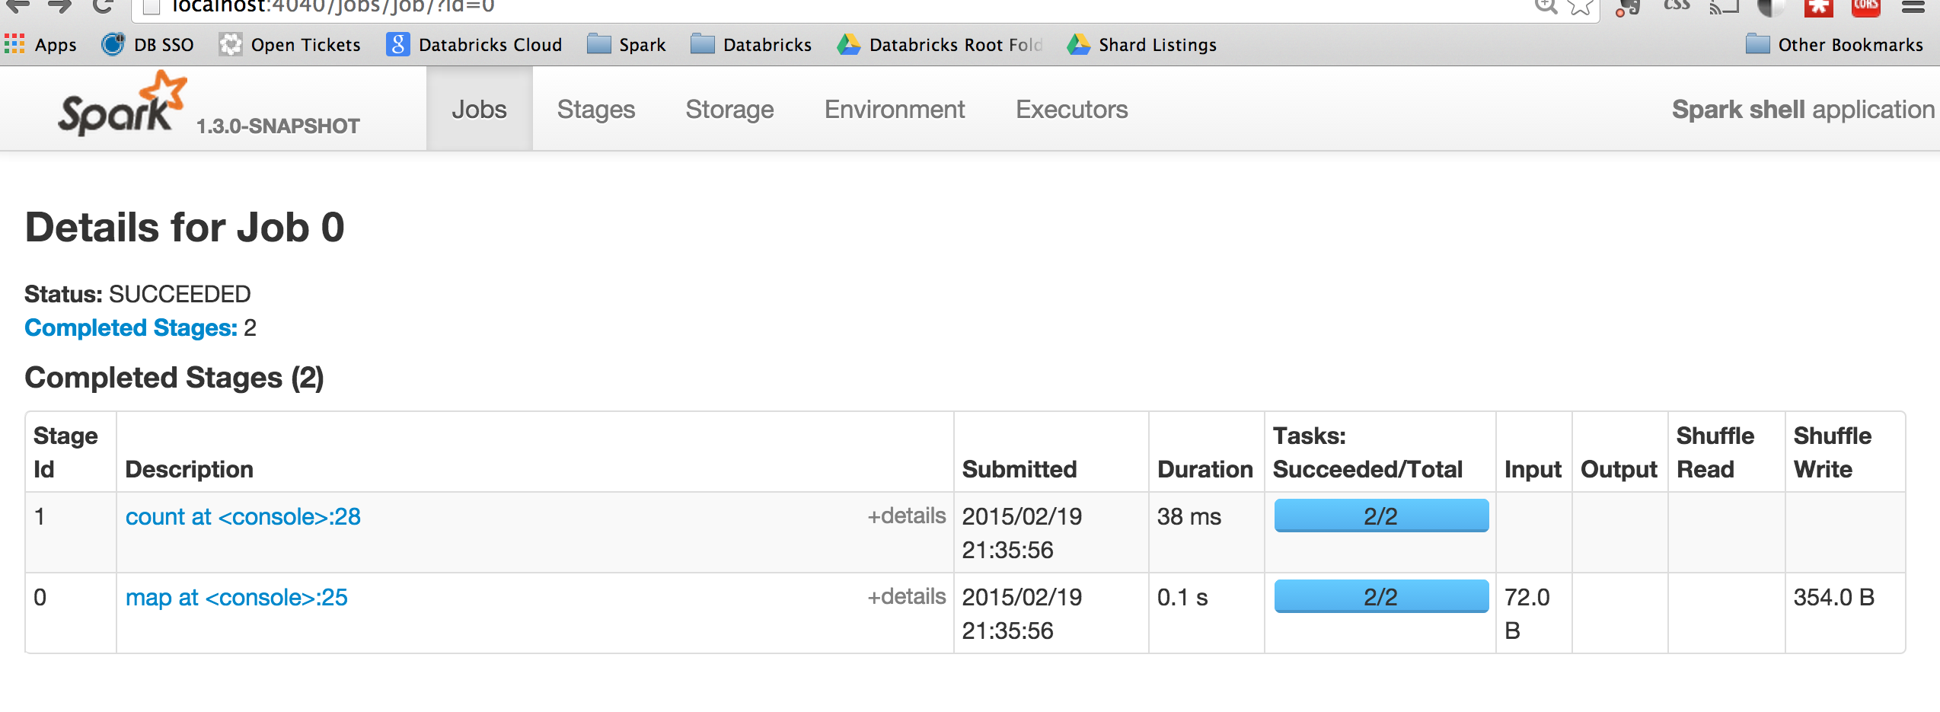
Putting it All Together
Named after action calling runJob
Named after last RDD in pipeline

Slide 29
Determinants of Performance in Spark

Slide 30
Quantity of Data Shuffled
In general, avoiding shuffle will make your program run faster.
Use the built in aggregateByKey() operator instead of writing your own aggregations.
Filter input earlier in the program rather than later.
Go to this afternoon’s talk!

Slide 31
Degree of Parallelism
> input = sc.textFile("s3n://log-files/2014/*.log.gz") #matches thousands of files
> input.getNumPartitions()
35154
> lines = input.filter(lambda line: line.startswith("2014-10-17 08:")) # selective
> lines.getNumPartitions()
35154
> lines = lines.coalesce(5).cache() # We coalesce the lines RDD before caching
> lines.getNumPartitions()
5
>>> lines.count() # occurs on coalesced RDD

Slide 32
Degree of Parallelism
If you have a huge number of mostly idle tasks (e.g. 10’s of thousands), then it’s often good to coalesce.
If you are not using all slots in your cluster, repartition can increase parallelism.

Slide 33
Choice of Serializer
Serialization is sometimes a bottleneck when shuffling and caching data. Using the Kryo serializer is often faster.
val conf = new SparkConf()
conf.set("spark.serializer", "org.apache.spark.serializer.KryoSerializer")
// Be strict about class registration
conf.set("spark.kryo.registrationRequired", "true")
conf.registerKryoClasses(Array(classOf[MyClass], classOf[MyOtherClass]))

Slide 34
Cache Format
By default Spark will cache() data using MEMORY_ONLY level, deserialized JVM objects
MEMORY_ONLY_SER can help cut down on GC
MEMORY_AND_DISK can avoid expensive recompuations

Slide 35
Hardware
Spark scales horizontally, so more is better
Disk/Memory/Network balance depends on workload: CPU intensive ML jobs vs IO intensive ETL jobs
Good to keep executor heap size to 64GB or less (can run multiple on each node)

Slide 36
Other Performance Tweaks
Switching to LZF compression can improve shuffle performance (sacrifices some robustness for massive shuffles):
conf.set(“spark.io.compression.codec”, “lzf”)
Turn on speculative execution to help prevent stragglers
conf.set(“spark.speculation”, “true”)

Slide 37
Other Performance Tweaks
Make sure to give Spark as many disks as possible to allow striping shuffle output
SPARK_LOCAL_DIRS in Mesos/Standalone
In YARN mode, inherits YARN’s local directories

Slide 38
One Weird Trick for Great Performance

Slide 39
Use Higher Level API’s!
DataFrame APIs for core processing
Works across Scala, Java, Python and R
Spark ML for machine learning
Spark SQL for structured query processing

Slide 40
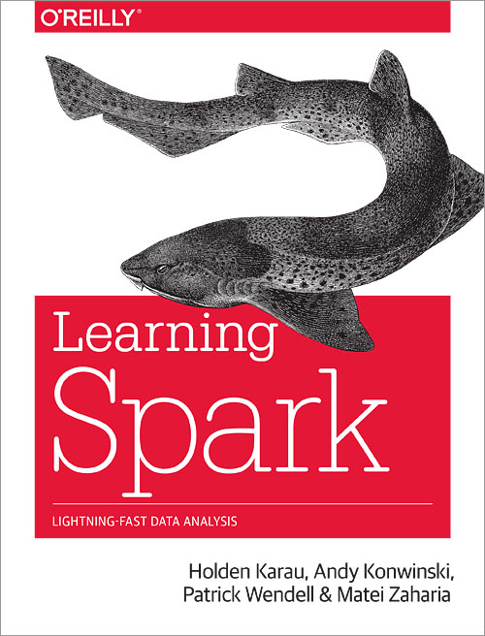
See also
Chapter 8: Tuning and Debugging Spark.

Slide 41

Come to Spark Summit 2015!
June 15-17 in San Francisco

Slide 42
Other Spark Happenings Today
Spark team “Ask Us Anything” at 2:20 in 211 B
Tips for writing better Spark programs at 4:00 in 230C
I’ll be around Databricks booth after this

Slide 43
Thank you. Any questions?

Slide 44
Extra Slides

Slide 45
Internals of the RDD Interface
List of partitions
Set of dependencies on parent RDDs
Function to compute a partition, given parents
Optional partitioning info for k/v RDDs (Partitioner)
RDD
Partition 1
Partition 2
Partition 3
This captures all current Spark operations!

Slide 46
Example: Hadoop RDD
Partitions = 1 per HDFS block
Dependencies = None
compute(partition) = read corresponding HDFS block
Partitioner = None
> rdd = spark.hadoopFile(“hdfs://click_logs/”)
This captures all current Spark operations!

Slide 47
Example: Filtered RDD
Partitions = parent partitions
Dependencies = a single parent
compute(partition) = call parent.compute(partition) and filter
Partitioner = parent partitioner
> filtered = rdd.filter(lambda x: x contains “ERROR”)
This captures all current Spark operations!

Slide 48
Example: Joined RDD
Partitions = number chosen by user or heuristics
Dependencies = ShuffleDependency on two or more parents
compute(partition) = read and join data from all parents
Partitioner = HashPartitioner(# partitions)
This captures all current Spark operations!

Slide 49
A More Complex DAG
Hadoop RDD
Filtered RDD
.count()
Partition 1
Partition 1
Joined RDD
Filtered RDD
Partition 2
Partition 2
Partition 1
Partition 1
Partition 2
Partition 2
JDBC RDD
Mapped RDD
Partition 3
Partition 3
Partition 1
Partition 1
Partition 2
Partition 2

Slide 50
A More Complex DAG
Shuffle Write
Shuffle Read
Stage 1
Task 1
Stage 3
Task 2
Task 1
Task 2
Stage 2
Task 3
Task 1
Task 2

Slide 51
Narrow and Wide Transformations
FilteredRDD
JoinedRDD
Parent
RDD
Parent 1
Partition 1
Partition 1
Partition 1
RDD
Partition 2
Partition 2
Partition 2
Partition 1
Partition 3
Partition 3
Partition 2
Parent 2
Partition 3
Partition 1
Partition 2

