Slide 1
USING MULTIPLE PERSISTENCE LAYERS IN SPARK TO BUILD A SCALABLE PREDICTION ENGINE
Richard Williamson | @SuperHadooper

Slide 2
Some Background
Model Building/Scoring Use Case
Spark Persistence to Parquet via Kafka
Exploratory Analysis with Impala
Spark Persistence to Cassandra
Operational queries via CQL
Impala Model Building/Scoring
Spark Model Building/Scoring
Questions
AGENDA

Slide 3
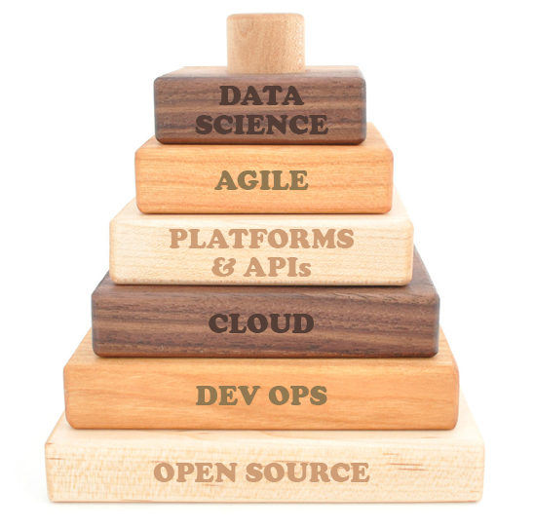
THE EXPERIMENTAL ENTERPRISE
Data science allows us to observe our experiments and respond to the changing environment.
We need to both support investigative work and build a solid layer for production.
The foundation of the experimental enterprise focuses on making infrastructure readily accessible.
Notes:
May not keep this one….

Slide 4
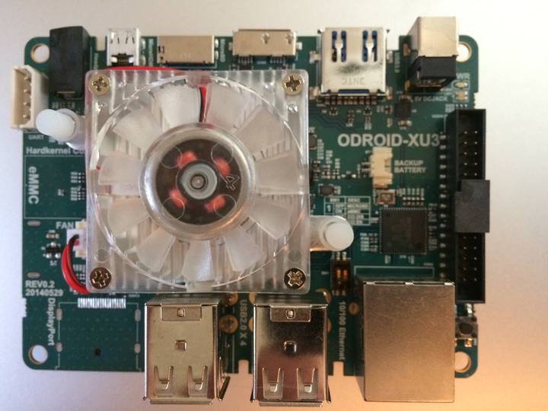
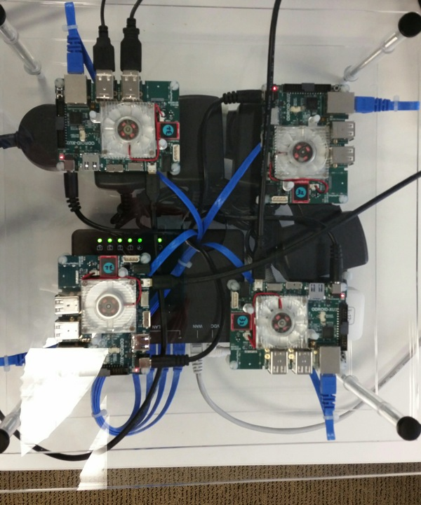

Slide 5
How has
“big data”
changed our ability to better predict the future?
VOLUME: Storing longer periods of history
VELOCITY: Stream processing allows for on the fly forecast adjustments
VARIETY: Data Scientists can use additional features to improve model accuracy
Notes:
Volume – talk about holiday shift impact 5,6 or 11 years back for last time Christmas falls on same day of week and infrequently occurring events (Olympics, World Cup, Tax Incentive)
Velocity – Unplanned events (blizzards,natural disasters,etc) require dynamic model updates
Variety – Promotions, local events, etc

Slide 6
How has
“big data technology”
changed our ability to better predict the future?
Lowered Cost of Storing and Processing Data
Improved data scientist efficiency by having common repository
Improved modeling performance by bringing models to the data versus bringing data to the models
Notes:
10-50X less cost than data warehouse
Talk about story of work before having access to Data Warehouse vs after
Talk about building retail membership acquisition models on client server and taking 24 hours and tax incentive research requiring weeks to get data from over 3 years pulled from tape

Slide 7
Can we predict future RSVPs by consuming Meetup.com streaming API data?
http://stream.meetup.com/2/rsvps
https://github.com/silicon-valley-data-science/strataca-2015/tree/master/Spark-to-Build-a-Scalable-Prediction-Engine
EXAMPLE USE CASE
Notes:
Wanted to find publicstreaming API to work with for streaming predictions
There are very few streaming APIs readily available for consumption

Slide 8
WHERE DO WE START?

Slide 9
BY TAKING A LOOK AT THE DATA…
{"response":"yes","member":{"member_name":"Richard Williamson","photo":"http:\/\/photos3.meetupstatic.com\/photos\/member\/d\/a\/4\/0\/thumb_231595872.jpeg","member_id":29193652},"visibility":"public","event":{"time":1424223000000,"event_url":"http:\/\/www.meetup.com\/Big-Data-Science\/events\/217322312\/","event_id":"fbtgdlytdbbc","event_name":"Big Data Science @Strata Conference, 2015"},"guests":0,"mtime":1424020205391,"rsvp_id":1536654666,"group":{"group_name":"Big Data Science","group_state":"CA","group_city":"Fremont","group_lat":37.52,"group_urlname":"Big-Data-Science","group_id":3168962,"group_country":"us","group_topics":[{"urlkey":"data-visualization","topic_name":"Data Visualization"},{"urlkey":"data-mining","topic_name":"Data Mining"},{"urlkey":"businessintell","topic_name":"Business Intelligence"},{"urlkey":"mapreduce","topic_name":"MapReduce"},{"urlkey":"hadoop","topic_name":"Hadoop"},{"urlkey":"opensource","topic_name":"Open Source"},{"urlkey":"r-project-for-statistical-computing","topic_name":"R Project for Statistical Computing"},{"urlkey":"predictive-analytics","topic_name":"Predictive Analytics"},{"urlkey":"cloud-computing","topic_name":"Cloud Computing"},{"urlkey":"big-data","topic_name":"Big Data"},{"urlkey":"data-science","topic_name":"Data Science"},{"urlkey":"data-analytics","topic_name":"Data Analytics"},{"urlkey":"hbase","topic_name":"HBase"},{"urlkey":"hive","topic_name":"Hive"}],"group_lon":-121.93},"venue":{"lon":-121.889122,"venue_name":"San Jose Convention Center, Room 210AE","venue_id":21805972,"lat":37.330341}}
Notes:
Personalize data to give more meaning (created an RSVP then took a look at the data)
Examine fields that may be interesting to predict for presentation purposes

Slide 10
FROM ONE TO MANY
Now that we know what one record looks like, let’s capture a large dataset.
First we capture stream to Kafka by curling to file and tailing file to Kafka consumer — this will build up some history for us to look at.
Notes:
Spark SQL supports nested JSON data!
Flatten nested columns for Impala

Slide 11
FROM ONE TO MANY
Then use Spark to load to Parquet for interactive exploratory analysis in Impala:
val sqlContext = new org.apache.spark.sql.SQLContext(sc)
val meetup = sqlContext.jsonFile("/home/odroid/meetupstream”)
meetup.registerTempTable("meetup")
val meetup2 = sqlContext.sql("select event.event_id,event.event_name,event.event_url,event.time, guests,member.member_id,member.member_name,member.other_services.facebook.identifier as facebook_identifier, member.other_services.linkedin.identifier as linkedin_identifier, member.other_services.twitter.identifier as twitter_identifier, member.photo,mtime,response, rsvp_id,venue.lat,venue.lon,venue.venue_id,venue.venue_name,visibility from meetup”)
meetup2.saveAsParquetFile("/home/odroid/meetup.parquet")
Notes:
Spark SQL supports nested JSON data!
Flatten nested columns for Impala

Slide 12
INTERACTIVE EXPLORATORY ANALYSIS IN IMPALA
We could have done basic exploratory analysis in Spark SQL, but date logic is not fully supported.
It’s very easy to point Impala to the data and do it there.
Notes:
Should I add slide with chart of hourly trend next?

Slide 13
INTERACTIVE EXPLORATORY ANALYSIS IN IMPALA
Create external Impala table pointing to the data we just created in Spark:
CREATE EXTERNAL TABLE meetup
LIKE PARQUET '/user/odroid/meetup/_metadata'
STORED AS PARQUET
LOCATION '/user/odroid/meetup’;
Notes:
Should I add slide with chart of hourly trend next?

Slide 14
INTERACTIVE EXPLORATORY ANALYSIS IN IMPALA
Now we can query:
select from_unixtime(cast(mtime/1000 as bigint), "yyyy-MM-dd HH”) as data_hr
,count(*) as rsvp_cnt
from meetup group by 1 order by 1;
Notes:
Should I add slide with chart of hourly trend next?

Slide 15
SPARK STREAMING:
Load Cassandra from Kafka
val ssc = new StreamingContext(sc, Seconds(10))
val lines = KafkaUtils.createStream(ssc, ”localhost:2181", "meetupstream", Map("meetupstream" -> 10)).map(_._2)
val sqlContext = new org.apache.spark.sql.SQLContext(sc)
lines.foreachRDD(rdd => {
val lines2 = sqlContext.jsonRDD(rdd)
lines2.registerTempTable("lines2")
val lines3 = sqlContext.sql("select event.event_id,event.event_name,event.event_url,event.time,guests, member.member_id, member.member_name,member.other_services.facebook.identifier as facebook_identifier, member.other_services.linkedin.identifier as linkedin_identifier,member.other_services.twitter.identifier as twitter_identifier,member.photo, mtime,response, rsvp_id,venue.lat,venue.lon,venue.venue_id,venue.venue_name,visibility from lines2")
val lines4 = lines3.map(line => (line(0), line(5), line(13), line(1), line(2), line(3), line(4), line(6), line(7), line(8), line(9), line(10), line(11), line(12), line(14), line(15), line(16), line(17), line(18) ))
lines4.saveToCassandra("meetup","rsvps", SomeColumns("event_id", "member_id","rsvp_id","event_name", "event_url", "time","guests","member_name","facebook_identifier","linkedin_identifier","twitter_identifier","photo","mtime","response","lat","lon","venue_id","venue_name","visibility"))})
ssc.start()

Slide 16
OPERATIONAL QUERIES IN CASSANDRA
When low millisecond queries are needed, Cassandra provides favorable storage.
Now we can perform queries like this one:
select * from meetup.rsvps where event_id=“fbtgdlytdbbc” and member_id=29193652 and rsvp_id=1536654666;

Slide 17
Why do we want to store the same data in two places?
Different access patterns prefer different physical storage.
Large table scans needed for analytical queries require fast sequential access to data, making Parquet format in HDFS a perfect fit. It can then be queried by Impala, Spark, or even Hive.
Fast record lookups require a carefully designed key to allow for direct access to the specific row of data, making Cassandra (or HBase) a very good fit.

Slide 18
START BUILDING MODELS
A quick way to do some exploratory predictions is with Impala, MADlib, or Spark Mllib.
First we need to build some features from the table we created in Impala.

Slide 19
START BUILDING MODELS
A simple way to do this for hourly sales is to create a boolean indicator variable for each hour, and set it to true if the given observation was for the given hour.
We can do the same to indicate whether the observation was taken on a weekend or weekday.

Slide 20
START BUILDING MODELS
The SQL to do this look something like this:
create table rsvps_by_hr_training as (
select
case when mhour=0 then 1 else 0 end as hr0
,case when mhour=1 then 1 else 0 end as hr1
…
,case when mhour=22 then 1 else 0 end as hr22
,case when mhour=23 then 1 else 0 end as hr23
,case when mdate in ("2015-02-14","2015-02-15") then 1 else 0 end as weekend_day
,mdate,mhour,rsvp_cnt from rsvps_by_hour);

Slide 21
Train/score regression model in Impala
Install MADlib for Impala: http://blog.cloudera.com/blog/2013/10/how-to-use-madlib-pre-built-analytic-functions-with-impala/
Train regression model in SQL:
SELECT printarray(linr(toarray(hr0,hr1,hr2,hr3,hr4,hr5,hr6,hr7,hr8,hr9,hr10,hr11,hr12,hr13,hr14, hr15,hr16,hr17,hr18,hr19,hr20,hr21,hr22,hr23,weekend_day), rsvp_cnt))
from meetup.rsvps_by_hr_training;
Which gives us the regression coefficients:
<8037.43, 7883.93, 7007.68, 6851.91, 6307.91, 5468.24, 4792.58, 4336.91, 4330.24, 4360.91, 4373.24, 4711.58, 5649.91, 6752.24, 8056.24, 9042.58, 9761.37, 10205.9, 10365.6, 10048.6, 9946.12, 9538.87, 9984.37, 9115.12, -2323.73>
Which we can then apply to new data:
select mdate,mhour,cast(linrpredict(toarray(8037.43, 7883.93, 7007.68, 6851.91, 6307.91, 5468.24, 4792.58, 4336.91, 4330.24, 4360.91, 4373.24, 4711.58, 5649.91, 6752.24, 8056.24, 9042.58, 9761.37, 10205.9, 10365.6, 10048.6, 9946.12, 9538.87, 9984.37, 9115.12, -2323.73), toarray(hr0, hr1, hr2, hr3, hr4, hr5, hr6, hr7, hr8, hr9, hr10, hr11, hr12, hr13, hr14, hr15, hr16, hr17, hr18, hr19, hr20, hr21, hr22, hr23, weekend_day)) as int) as rsvp_cnt_pred, rsvp_cnt from meetup.rsvps_by_hr_testing

Slide 22
PREDICTED HOURLY RSVPS FROM IMPALA

Slide 23
Prepare data for regression in Spark
val meetup3 = sqlContext.sql("select mtime from meetup2")
val meetup4 = meetup3.map(x => new DateTime(x(0).toString().toLong)).map(x => (x.toString("yyyy-MM-dd HH"),x.toString("yyyy-MM-dd"),x.toString("HH")) )
case class Meetup(mdatehr: String, mdate: String, mhour: String)
val meetup5 = meetup4.map(p => Meetup(p._1, p._2, p._3))
meetup5.registerTempTable("meetup5")
val meetup6 = sqlContext.sql("select mdate,mhour,count(*) as rsvp_cnt from meetup5 where mdatehr >= '2015-02-15 02' group by mdatehr,mdate,mhour")
meetup6.registerTempTable("meetup6")
sqlContext.sql("cache table meetup6”)
val trainingData = meetup7.map { row =>
val features = Array[Double](row(24).toString().toDouble,row(0).toString().toDouble, … LabeledPoint(row(27).toString().toDouble, Vectors.dense(features))}

Slide 24
Train and Score regression model in Spark
val trainingData = meetup7.map { row =>
val features = Array[Double](1.0,row(0).toString().toDouble,row(1).toString().toDouble, … LabeledPoint(row(27).toString().toDouble, Vectors.dense(features))
}
val model = new RidgeRegressionWithSGD().run(trainingData)
val scores = meetup7.map { row =>
val features = Vectors.dense(Array[Double](1.0,row(0).toString().toDouble, … row(23).toString().toDouble))
(row(25),row(26),row(27), model.predict(features))
}
scores.foreach(println)

Slide 25
PREDICTED HOURLY RSVPS FROM SPARK

Slide 26
NEXT STEPS
Include additional features (Holidays, Growth Trend, etc.)
Predict at lower granularity (Event Level, Topic Level, etc.)
Convert Spark regression model to utilize streaming regression
Build ensemble models to leverage strengths of multiple algorithms
Move to pilot, then production

Slide 27
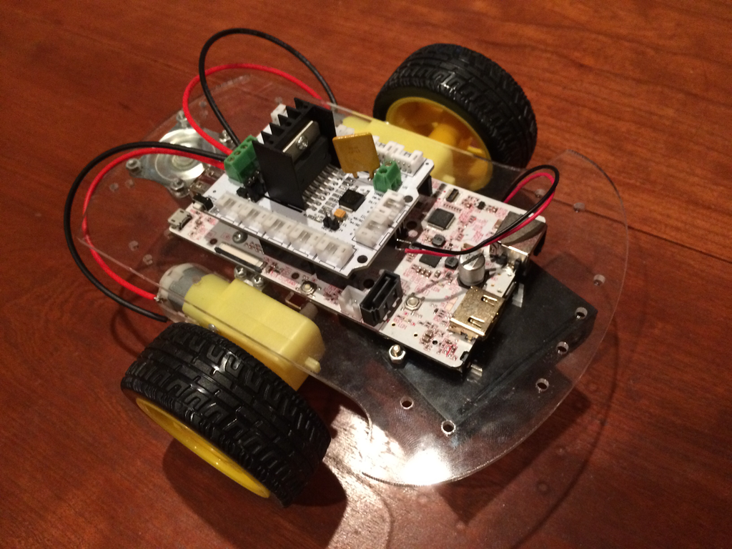

Slide 28
Richard Williamson
richard@svds.com
@superhadooper
Yes, we’re hiring!
info@svds.com

