Slide 1
When 1s and 0s Mean Billions of Dollars at Risk
Credit Suisse Investment Risk

Slide 2
Purpose of this Document
My Background and My Role
Investment Risk is a Strategic Advantage for Credit Suisse and our Clients
All About the Data – Risk Analysis 100% Dependent on Good Data
People, Processes, Changing Ecosystems and the Problem with Optimizing Locally
Solutions: the Big Picture, Empowering the User, Aligning Incentives

Slide 3
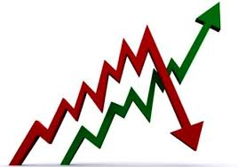

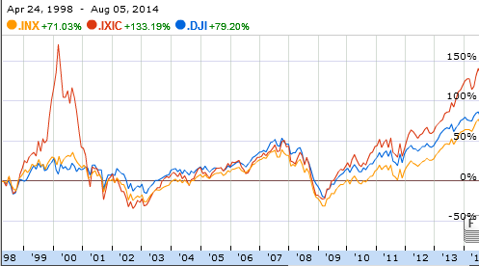
Best-in-Breed Investment Risk for our Clients
Managing the Inevitable Swings of the Market
The market goes up and the market goes down - every investor is painfully aware of the new reality of market cycles
Investors are keen to know the risks of their portfolios and minimize the potential losses in case of a future downturn
Success in asset management and private banking requires the management and transparency of financial risk using the very latest models and analytics
What it Takes to be the Best at Risk Management
Leading models and analytics: leverage the best models available on the market plus proprietary and predictive analytics for further insights
Insights to effectively interpret data: advanced visualization and charting
Real-time, multi-channel distribution: real-time data and insights readily available through every platform, including web services, online and mobile devices (e.g., iPad)
What it Means for Credit Suisse and our Clients
Market-leading funds maximizing performance while minimizing risk
Transparency and Security for our Clients: no matter what the newspaper headlines are for tomorrow, clients know their assets are managed for these risks
Attract Assets from Sophisticated Investors : institutional and large private clients are looking for this type of transparency

Slide 4
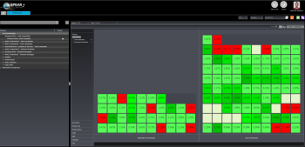
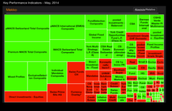
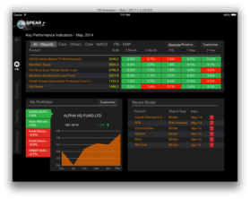
A Robust Investment Risk Platform is All About the Data
Data Sources
Data Warehouse
Cubes
Multi-Channel
Distribution
Portfolios
Loaders
Reporting
Positions
Web Portal
Market Data
Mobile Apps
…
Investment Risk Platform
Risk Models
3rd Party
Proprietary
VaR
Sensitivities
Exposure
Contribution
Stresses
Liquidity
Volatility
Attribution
Performance
Oversee and govern the risk of all of Credit Suisse’s funds
Calculations are complicated, but they are exactly wrong with the wrong inputs, therefore inputs are everything
System was put in place with exactly what it needed – but is that still true today? Seems simple relatively straightforward when viewed in isolation here.....

Slide 5
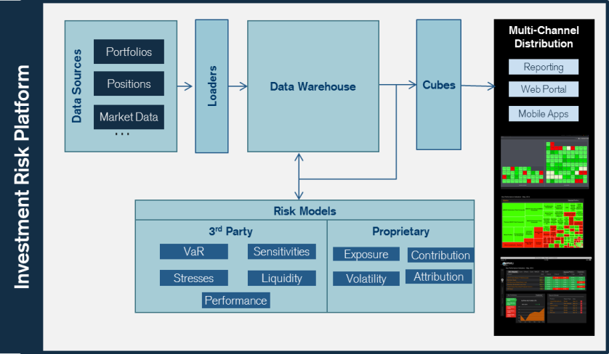
Zoom Out: The Whole Ecosystem
Data ecosystem is complex and not static
Fund Administrator
Upstream system
Upstream system
Upstream system
Data comes from many sources, those sources are ever-changing and evolving. They have their own users
The business is focused on new things, launching new funds, landing new customers
Assumptions change, or were never correct in the first place
People optimize locally – get it done for their own task, get to the rest later
Fund Administrator
Upstream system
Upstream system
Fund Administrator
Upstream system
Fund Administrator
Market
Data Proxy

Slide 6

Solutions for Data Quality in Complex Data Ecosystems
Solve for The Big Picture
End-to-end data flow. Stop solving locally.
Users are where data issues are identified and corrected. Empower the users to raise issues, make changes, and react to them quickly
Issues must be found, raised and solved within a well-defined and understood process, from end to end
Partnership and correct governance. Everyone has a stake in keeping the ecosystem clean, documented and able to respond to the inevitable changes
Empower the User
Create the Correct Processes
Align Incentives

