Slide 1
Talksum Data Stream Router
Next Age of Data Management
November 2013

Slide 2

Who I Am and Where I’m At
Principal Architect at Talksum
Focus on real-time data routing and analytics
Open Source Contributor
ZeroMQ
Rsyslog
Notes:
Other than “Hi, I am Dale” and throw up on the stage…

Slide 3

Where I’ve Been
20
20 Years in “The Industry”
Network engineer
Web application developer
Database administrator
Data architect
Distributed systems architect
years

Slide 4

I Shouldn’t Be Here
By all rights, we shouldn’t even be here!
Samwise Gamgee

Slide 5
So Why Are We Here?
Notes:
Other than “Hi, I am Dale” and throw up on the stage…

Slide 6
What Do We Want?
We want to know who, what, when, where, and why – and we want to know it now!

Slide 7
So What?
Because having accurate information in order to make informed decisions in a timely manner is important.

Slide 8

Why Can’t We Have It?
“I’ve seen things you people wouldn’t believe”…
… except you would; we’re all here because we’ve all been dealing with the same problems.

Slide 9

Data Management
The process(es) of managing generated information according to characteristics of the data to control how the data is stored and used….
… in order to derive useful information from the data to support decisions…
… while being in accordance with regulations and industry mandated best practices

Slide 10

What Do We Need
Systems that…
Operate in “real-time” – keep pace with velocity
Are adaptive – meet changing requirements
Simple to use – avoid specialized skills and custom code
Low overhead – people, time, infrastructure

Slide 11
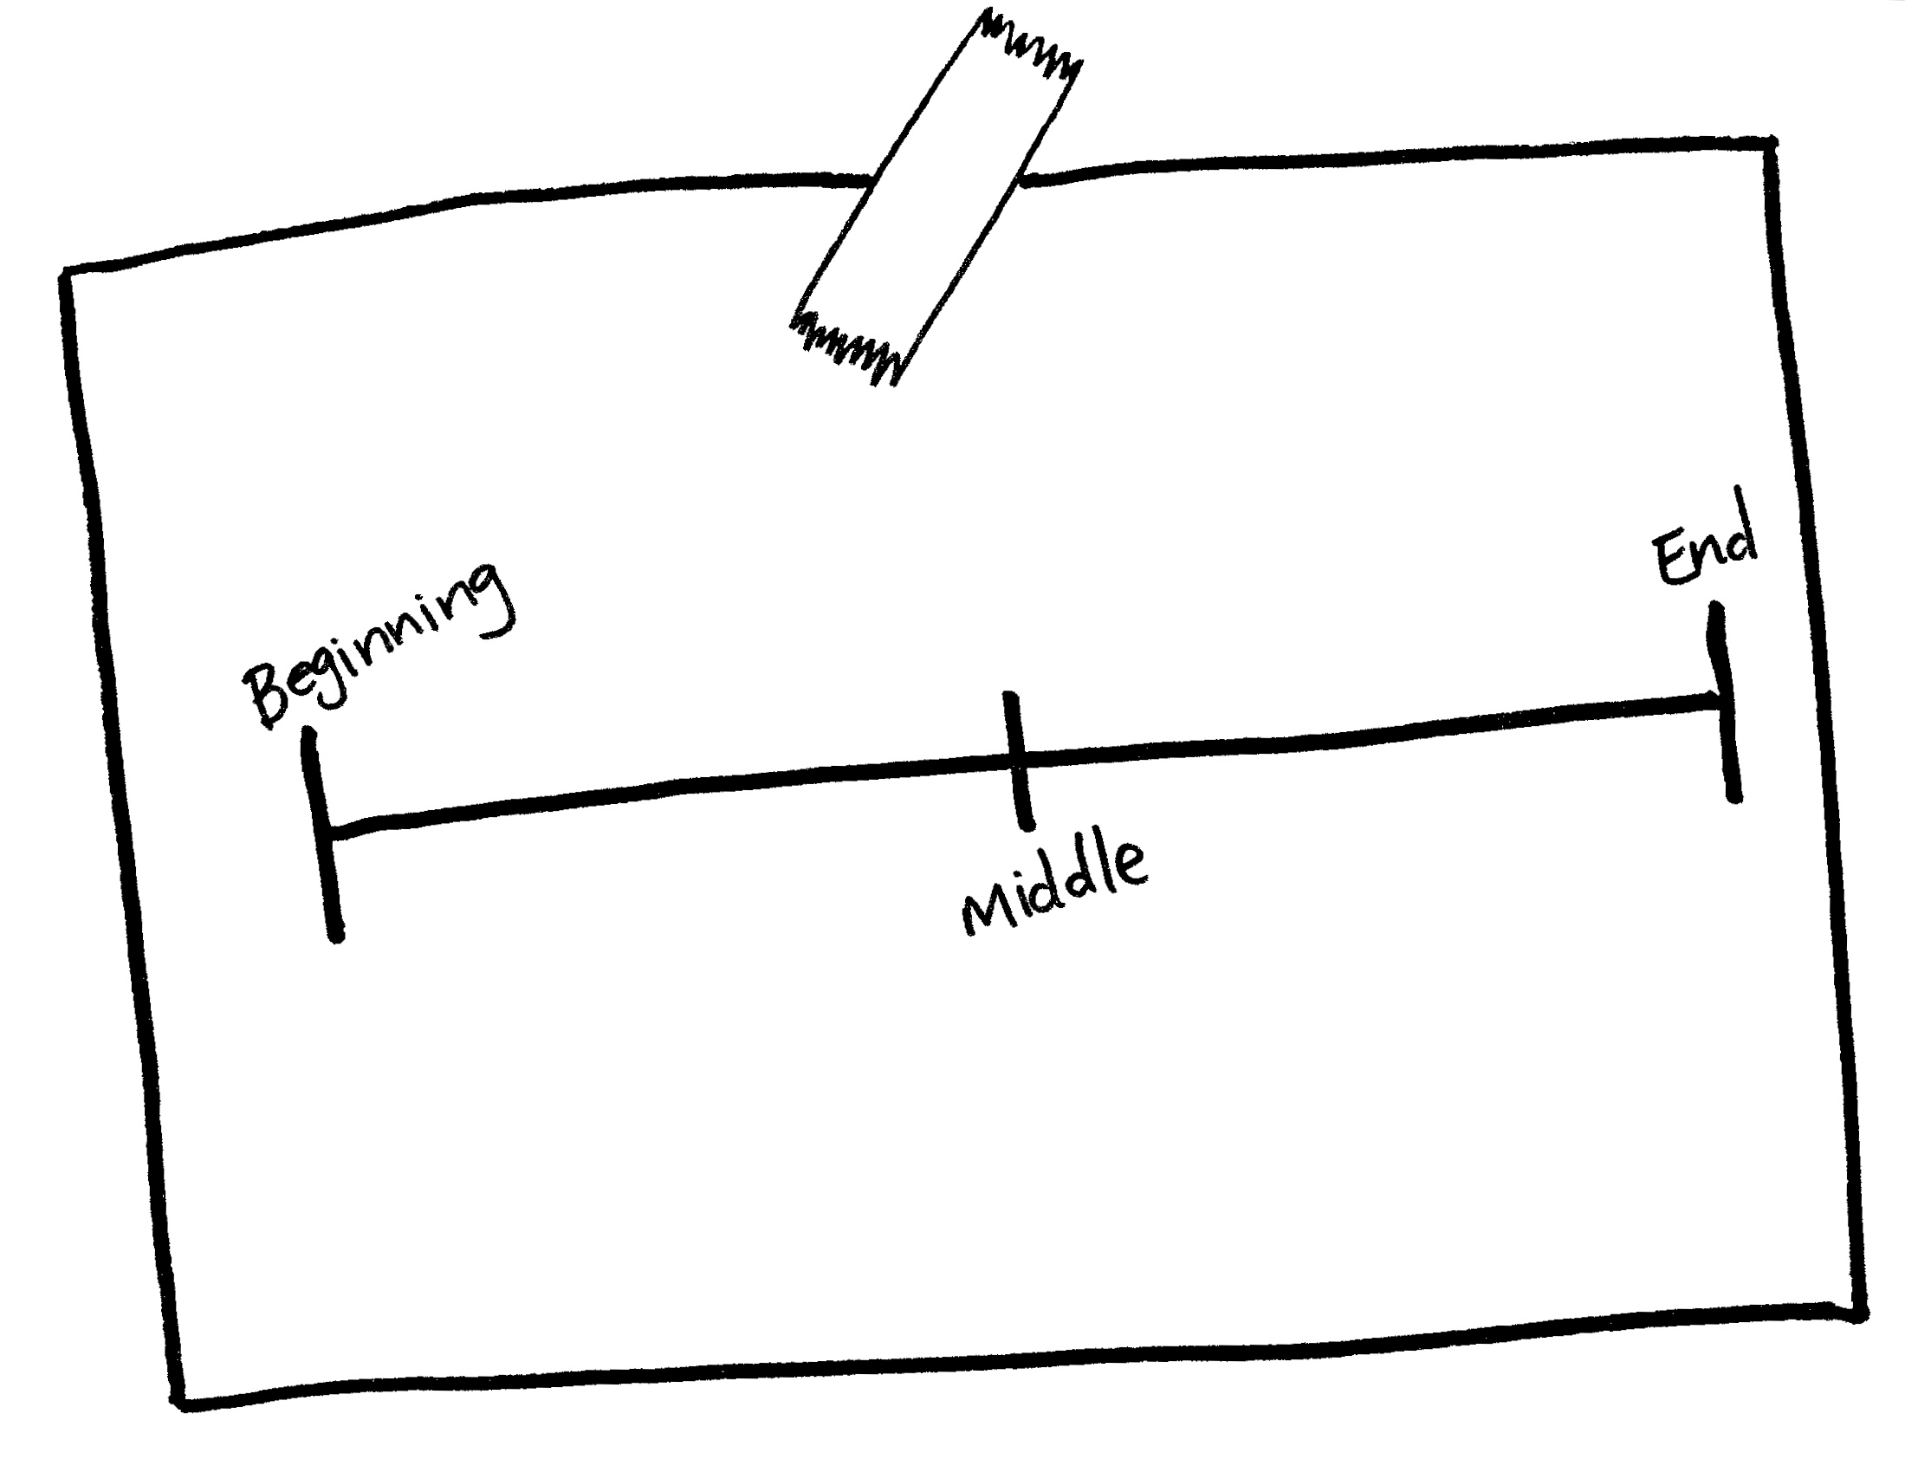
Why Can’t We Have It?
Much of the delay between the creation of data and the derivation of useful information is due to having to collect data to centralized repositories in order to convert it to standardized comparable formats so that we can even start to apply logic to it.

Slide 12

How Do We Get There?
How do we reasonably ingest, transform, route, and analyze data in “real-time”?
How can we apply more logic, earlier in the pipeline, while minimizing ingest performance impact?
How can we begin to create a holistic view of the information in our data, so that we can correlate events from multiple domains?
Every day, more than 2.5 quintillion bytes of data (1 followed by 18 zeros) are created, with 90% of the world’s data created in the last two years alone. As a society, we’re producing and capturing more data each day than was seen by everyone since the beginning of the earth
- Marcia Conner Blog
Notes:
Give quick introduction – detail can be covered on following slides

Slide 13

Common Taxonomy
"If multiple systems observe the same event, their taxonomy description of the event should be identical.”
– MITRE, Common Event Expression, 2008

Slide 14
Common Taxonomy
“If we speak the same language we can actually have a conversation.”
– Me, a couple of hours ago

Slide 15
Common Standards
Speaking the same language allows us to focus on the actual problems we are trying to solve
Having a common taxonomy while still allowing flexibility in expression and transport…
Reduces processing costs by allowing code reuse and reducing the complexity of processing systems
Increases processing ability reduces cost of compliancy efforts
Removes vendor dependencies allowing easier integration of new technology

Slide 16

In A Perfect World …
In an ideal world, we would have an agreed-upon standard for event representation across all domains
There have been numerous attempts, and within specific domains there are successful standards
However, the specific needs of supporting existing systems combined with the specific taxonomies within various domains, along with inertia, has kept a common, cooperative standard from emerging

Slide 17
In The Actual World
2013-11-10
11-10-2013
10/11/2013
2013/11/10
11/10/2013
1384128000
Protobuf
JSON
ASN.1
XML
RFC3164
CSV

Slide 18

Meaning.
How quickly we can draw meaningful correlation between observed events originating from multiple domains determines how intelligent our “intelligent systems” can be

Slide 19
Introducing …
Talksum Data Stream Router™ (TDSR™)

Slide 20
Talksum Data Stream Router
The Talksum Data Stream Router takes a new approach to data management and analytics
Translates incoming data in real time…
…converting it into flexibly managed data streams
…enabling filtering and routing by content
…and the correlation of events from multiple domains
…while still supporting current storage and analytics systems
Notes:
Introduce the router to the world, don’t stutter and “uh uh uh uh”

Slide 21
Input – Protocol Transport Logic
Multiple transport protocols (TCP, UDP, PGM)
Multiple application protocols (HTTP, RFC3164, SNMP, ZeroMQ)
Multiple serialization formats (JSON, BSON, ASN.1, Protobuf, MessagePack)
Goal: convert incoming data in multiple formats on multiple transports into meaningful data streams.

Slide 22
Data Streams
“A sequence of digitally encoded coherent signals (packets of data or data packets) used to transmit or receive information”
– Federal Standard 1037C

Slide 23
Data Streams
Early establishment and encoding of context and intent provides meaning, which supports the ability to deliver critical information in near real-time to interested systems

Slide 24
Context
What time did an event occur?
Where did the event occur?
?
?
?

Slide 25
Intent
Why are we generating information about this event?
Who needs to know?
What’s Going To Happen Next?
How important is it that they know?
?
?
?

Slide 26
Event Transformation
Context and intent is encoded into a standard taxonomy and syntax at the head of a Talksum Protocol message created from the original event
The original unaltered event message may be routed to storage in cases where it is necessary
The encoded message continues in parallel on the Talksum Datastream Router backplane, now ready for efficient filtering, routing, and aggregation

Slide 27
Real-time Insights
Valuable meta information
How many events from each source within a time window
How many events of each type within a time window
How many events meet a specific criteria within a time window
Cardinality approximation

Slide 28
Persistent Streams
Persistent data streams can involve normal operational mode events
Normal systems and security logs from network devices and service delivery daemons
Standard basic safety messages being periodically emitted by vehicles on the highway
Standard logging data concerning energy usage of a house by a smart meter
Notification that a particular vehicle in a fleet has broken down

Slide 29
Dynamic Streams
Dynamic Streams are streams that are derived from the interaction of persistent streams with rules
Heuristics information and aggregates can be the basis of new data streams produced from the original data stream
Streams can be created that contain alerts or API calls to trigger actions based on message content
These new, derived streams can also be inputs into additional routing and filter rules

Slide 30
Output
Hadoop
Elasticsearch
MongoDB
PostgreSQL
MySQL
Remote API Call
Route through parallel channels to maximize throughput
Construct messages from any available message properties
Detailed metrics for each path through the router
Metrics are also routable to any supported back-end system

Slide 31

The Talksum Datastream Router
Refined Data Stream
Customer A:
Summarized Data
Application
Logs
Apache Common Logging – Files
SNMP - UDP
Refined Data Stream
Customer B:
Aggregated Data
System
Logs
Unix Logs – RFC3164 UDP/TCP
Netflow – UDP – NG v.5, 8, 9, 10
Talksum
Data Stream
Router
(TDSR)
Refined Data Stream
Customer C:
Dynamic Stream
Application
Data
Patient Records (HL7) XML/ASN.1
Transportation (BSM) SAE J2735
Data Normalization
Parsers
Filters
Metrics and Counts
Inline ETL/PTL
Asynchronous Outputs
Protocol Verification
Object Data Stores
Indexed Data Caches
NoSQL Data Warehouses
Sensor and
Industrial
Data
Indexed, Mapped, Reduced
Ordered, Sorted Data Streams
I2C, CAN, SNMP, Serial
3rd Party Data
B2B/M2M
XML, JSON, File, HTTP REST
Twitter, RSS,
CAP (Weather Alerts)
Bulk Data Streams
(Lightly Ordered
and Filtered)
SQL Warehouse
Bulk Data Stores
File Storage
Social and
Public Data

Slide 32

Use Cases
Service delivery network monitoring
Automotive and Transportation
Financial tracking and analytics
Scientific research
Use Cases

Slide 33


Network Monitoring & Optimization
Customer: Large European ISP/Email Communications Provider
Use Case: Ingest Netflow data, parse and aggregate in real time, monitors and alerts, optimize network topology
Status: Deploying beta appliance
Refined Data Stream
Existing BI Tools
Talksum
Data Stream
Router
(TDSR)
Refined Data Stream
NOC Alerting
Data Normalization
Parsers
Filters
Metrics and Counts
Inline ETL/PTL
Asynchronous Outputs
Protocol Verification
Object Data Stores
Indexed Data Caches
NoSQL Data Warehouses
System
Logs
Unix Logs – RFC3164 UDP/TCP
Netflow – UDP – NG v.5, 8, 9, 10
Indexed, Mapped, Reduced
Ordered, Sorted Data Streams
Bulk Data Streams
(Lightly Ordered
and Filtered)
SQL Warehouse
Bulk Data Stores
File Storage

Slide 34
Automotive and Transportation
Refined Data Stream
Alerting & Notification
Talksum
Data Stream
Router
(TDSR)
Object Data Stores
Indexed Data Caches
NoSQL Data Warehouses
Vehicle and Road
Infrastructure
Data
Data Normalization
Parsers
Filters
Metrics and Counts
Inline ETL/PTL
Asynchronous Outputs
Protocol Verification
Indexed, Mapped, Reduced
Ordered, Sorted Data Streams
ASN.1
Bulk Data Streams
(Lightly Ordered
and Filtered)
SQL Warehouse
Bulk Data Stores
File Storage

Slide 35

Financial
Customer: Major Financial Stock Exchange
Use Case: Ingest unstructured financial market data, parse and filter for quality, aggregate, integrate with existing data warehouse
Status: Acquiring data sample for POC
Refined Data Stream
Alerting & Notification
Talksum
Data Stream
Router
(TDSR)
Refined Data Stream
Market Dashboard
3rd Party Data
Trading Desks
XML, JSON, File, HTTP REST
Data Normalization
Parsers
Filters
Metrics and Counts
Inline ETL/PTL
Asynchronous Outputs
Protocol Verification
Object Data Stores
Indexed Data Caches
NoSQL Data Warehouses
Indexed, Mapped, Reduced
Ordered, Sorted Data Streams
Social and
Public Data
Twitter, RSS,
CAP (Weather Alerts)
Bulk Data Streams
(Lightly Ordered
and Filtered)
SQL Warehouse
Bulk Data Stores
File Storage

Slide 36

It’s About Speed, Simplicity, and Efficiency
Speed: Exceeding the speed necessary to handle the Big Data initiatives of today, and tomorrow, help optimize any Big Data infrastructure
Simplicity: Making it easy to monitor and analyze data in real time while reducing the cost of acquisition, ETL, and integration
Efficiency: Requiring less resources, which translates into less spend and greater value

Slide 37
What We Do
High-performance data management
Simple to use configuration API
Filters and routes to power real-time monitoring, alerts, analytics, and data reduction
Outputs to any storage, including Hadoop, “NoSQL”, Relational Databases, and message queues
Includes foundational components for regulatory compliance, government standards, and policy control

Slide 38

Questions? Contact:
Brian Knox, Principal Architect
briank@talksum.com

