Slide 1
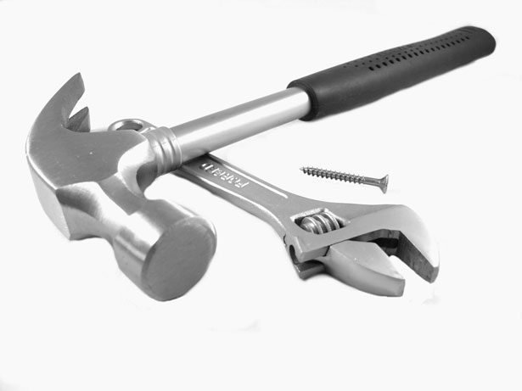
Fixing the economy through data science
Stian Westlake
Hasan Bakhshi
Louise Marston
@stianwestlake
@hasanbakhshi
@louisemarston

Slide 2
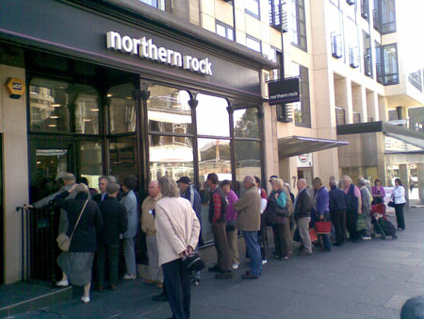

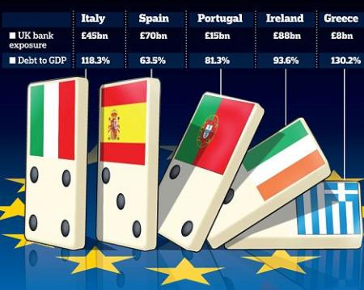

The global economy is still in trouble
Images: The Telegraph
Notes:
STIAN

Slide 3
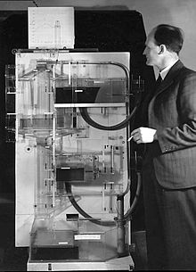
Governments are mostly relying on the old solutions
Top-down economic policy
“Technology? Hedge funds? Housing? It’s all growth as far as we’re concerned.”
Image: Wikimedia/LSE
Notes:
STIAN

Slide 4

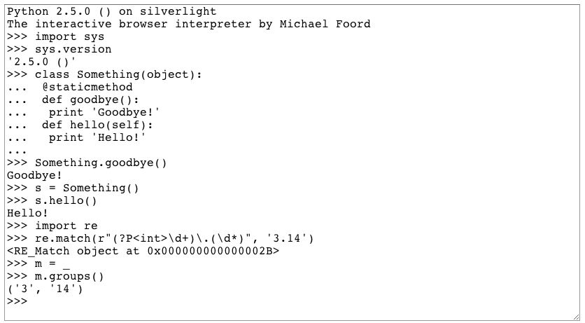

But there’s a growing recognition that we need a different approach to growth
Local growth and clusters
High-growth companies – the “Vital six per cent”
21st century skills – e.g. coding
New technologies
Notes:
It’s a revival of what might once have been called “industrial policy” – but with a greater recognition that it can’t be planned centrally.

Slide 5

However, it’s hard to make economic policy without data
Traditional economic indicators
New economic indicators
National output figures (GDP)
Inflation
Companies’ financial accounts
Standard industry classification codes
?
Cost: £50-£100m/yr
Image: The Day Today
Notes:
Collecting the figures that fill our news bulletins and make the political weather
Is no mean feat: for the US and the UK it costs somewhere between £50 and $200m a year to produce
Relies on decades of intellectual effort: GDP in the 1930s, inflation surveys
Official data is bad at:
Emerging industries and technologies
Networks and relationships between firms and individuals
Knowledge flows

Slide 6

A case in point: tell me about the UK video games industry...
Image: Rockstar
Notes:
Let’s suppose you want to know about an interesting emerging cluster.

Slide 7
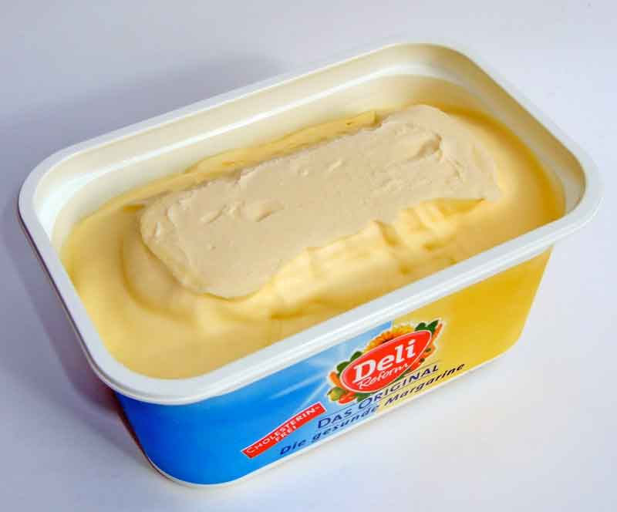

Games companies vs a tub of lard
SIC 10.42: Manufacture of margarine and similar edible fats
SIC 90.03 Artistic creation
SIC 62.02 Computer consultancy
SIC 82.99 Other business support activities
SIC 62.09 Other information technology and computer service activities
SIC 58.21 Publishing of computer games
SIC 58.29 Other software publishing
SIC 62.01/1 Ready-made interactive leisure and entertainment software development
SIC 32.40/9 Manufacture of games and toys not elsewhere classified
Image: Wikimedia
Image: Rockstar
Notes:
First of all, when it comes to new and interesting bits of the economy, the official statistics aren’t much use.
If you’re interested in something like the manufacture of margarine, you’re in luck. All the companies that make it are registered in SIC 10.42.
But if you’re interested in something a little more cutting-edge, you’re in trouble. Some research by the University of Brighton FUSE project found games companies in eight different sectors. Until recently, Rockstar Games, makers of the world-dominating GTA franchise, were classed as miscellaneous toymakers. So looking at the data you would have been forgiven for thinking the UK had an amazing, world-class toymaker in our midst.

Slide 8
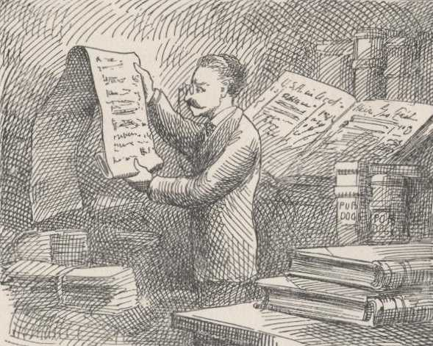
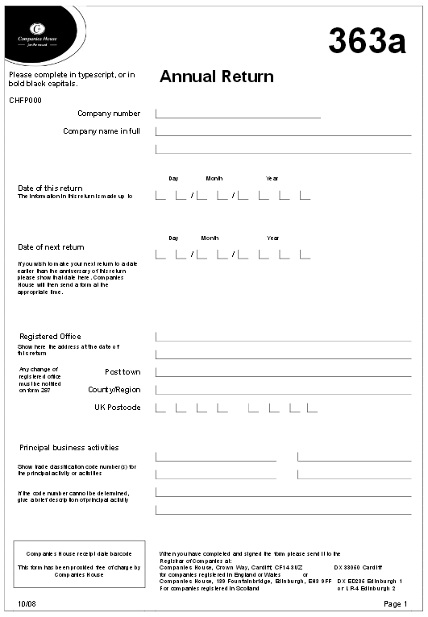
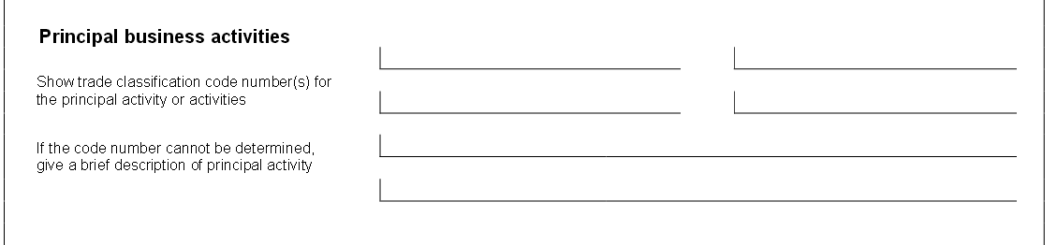
Paperwork for entrepreneurs
10% of companies register as “Other”
Image: Project Gutenberg
Notes:
LOUISE?
Worth noting that our data for “what companies do” is based on a small box in their first annual return.
Anyone in the audience who’s started a business can probably confirm that you have many things going on in your mind in your first year of business, but the integrity of national economic statistics is not high on that list.
One in ten companies is classed as “other”

Slide 9

A lot of un-linked and unsatisfactory data
Things we’d like to know more about
Links between companies
Financial accounts of companies
Locations of companies
Registered intellectual property
Links with universities
Government grants
Skills needs
Image: The Guardian
Notes:
LOUISE?
In the past we’ve had to rely on:
Surveys (one-off, and pretty expensive – eg Next Gen)
Proprietary vendors of business data (eg Experian, Bureau Van Dyke) – expensive, prone to transcription errors when interpreting
Very little of the data are linked or in some cases linkable.
Nesta’s work in the past has relied on closed governmental databases (such as the IDBR) – but these aren’t timely or easy to use.

Slide 10








A quiet data revolution is underway
More open data
Better analysis of social and unstructured data
More linking of data sets
Administrative Data Research Network
Image: The Guardian
Notes:
LOUISE?
More Open Data:
Open financial accounts and beneficial ownership
Platforms making information accessible
Better analysis

Slide 11
Some examples of what can be done
Analysing clusters
Identifying emerging sectors
Looking at links and networks within industries
Understanding skills needs rapidly
Notes:
HASAN?

Slide 12
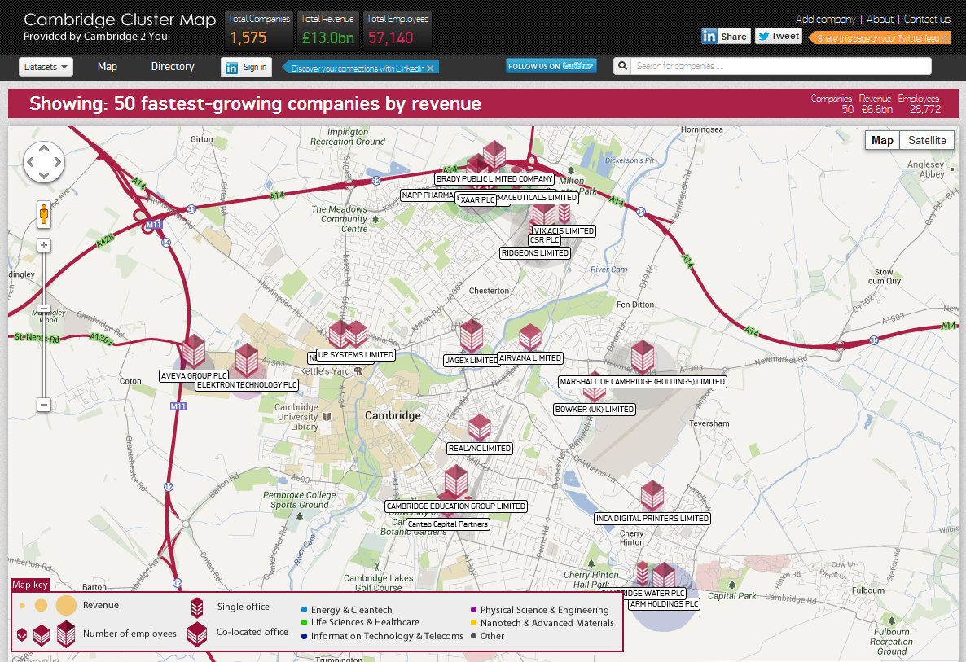
Cambridge Cluster Map /Tech City Map
The first generation: The Cambridge Cluster Map
Notes:
Takes company data (DueDil), and combines with social data (LinkedIn) to show networks.

Slide 13
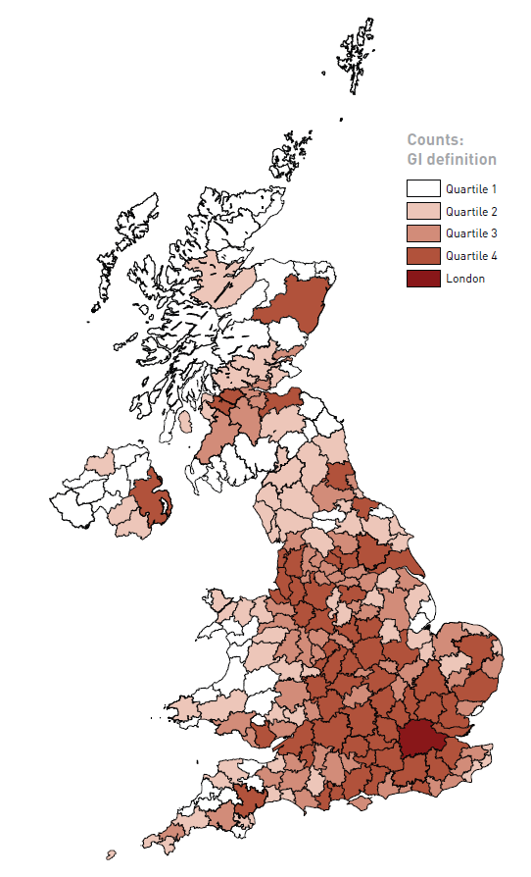
Growth Intelligence/NIESR digital economy map
Where is the UK’s digital economy?
Businesses classified based on online information and links, not SIC codes
Nathan, M. and Rosso, A. (NIESR) with Gatten, T., Majmudar, P. and Mitchell, A. (Growth Intelligence). (2013) ‘Measuring the UK’s Digital Economy with Big Data’
Notes:
LOUISE/HASAN?
Problem = the digital economy is poorly understood, which creates problems for policy design, business investment:
Official definitions – aren’t perfect
Data coverage – public datasets can miss smaller firms
SIC code problems – companies often don’t provide these
From report:
“One in ten companies in the UK are now classified vaguely as ‘other’. One in five have no classification at all.”

Slide 14
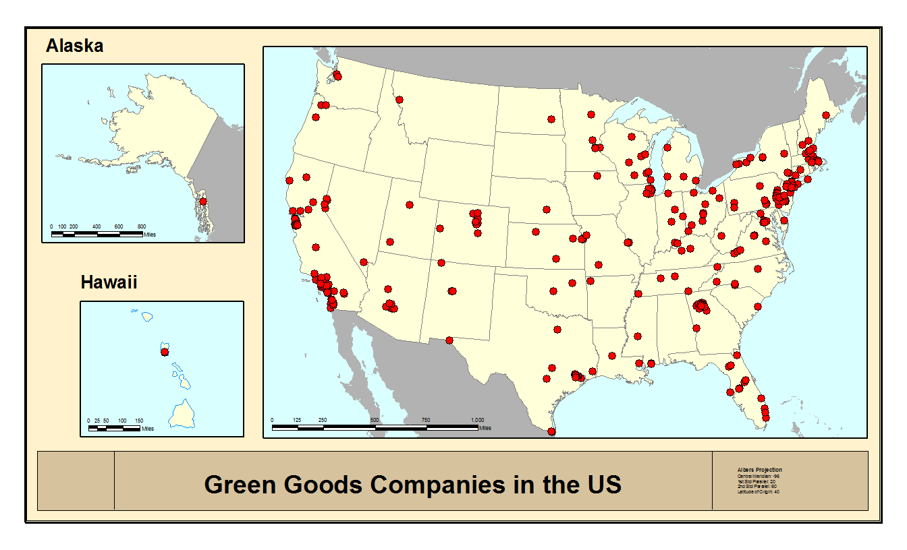
University of Manchester/Georgia Tech: identifying green tech firms
Work by Sanjay Arora, Jan Youtie, Yin Lie – Georgia Institute of Technology – US Green Goods Companies: What can we learn about their growth from web data?
Working with Philip Shapira, Abdullah Gok, Evgeny Klochikin - University of Manchester
Notes:
LOUISE
Data Source: Primarily Company Websites
Many of these measures, for small non-public firms, are not available in patent, publication, and company datasets
US GGCs with Publications:* 10%
US GGCs with Patents:* 19%
Web indicator of R&D* 66%
Not highly correlated with Publications, Patents (r=<0.15)
Surveys are difficult to administer and get a good, representative response rate
We use a combination of business datasets + websites (archived)
*Target years of analysis (2008-10)
We can learn a lot from Web data
Web variables are useful in being able to tease out patterns
Micro-level analyses of GGC do suggest growth patterns
Some financial coordination between government and industry important to GGC growth (but not too much coordination)
Company R&D important to be able to leverage university research into growth
Limits in how far back in time Web variables are useful in Wayback
Not a quick process
Data cleaning and integrity at each phase critical for accurate estimation results
Messy results for people, places, organizations capability – needs a lot of cleaning
More useful with theory v. exploration

Slide 15

How can you build networks in emerging sectors?
1. Attendees and funders want to understand the impact
of events
2. Event organisers want to demonstrate impact
of events
The question of additionality:
What would have
happened without
the
event?
3. Social media data can help
Notes:
LOUISE
Data Source: Primarily Company Websites
Many of these measures, for small non-public firms, are not available in patent, publication, and company datasets
US GGCs with Publications:* 10%
US GGCs with Patents:* 19%
Web indicator of R&D* 66%
Not highly correlated with Publications, Patents (r=<0.15)
Surveys are difficult to administer and get a good, representative response rate
We use a combination of business datasets + websites (archived)
*Target years of analysis (2008-10)
We can learn a lot from Web data
Web variables are useful in being able to tease out patterns
Micro-level analyses of GGC do suggest growth patterns
Some financial coordination between government and industry important to GGC growth (but not too much coordination)
Company R&D important to be able to leverage university research into growth
Limits in how far back in time Web variables are useful in Wayback
Not a quick process
Data cleaning and integrity at each phase critical for accurate estimation results
Messy results for people, places, organizations capability – needs a lot of cleaning
More useful with theory v. exploration

Slide 16

1736 new Twitter follow connections created after LeWeb’12 London
15% ↑ in the total
number of follow connections between attendees
9% ↑ in total number of follow connections involving attendees
Notes:
HASAN
Dark Blue lines: speaker following
speaker Yellow lines: audience following
audience Blue lines: audience following
speaker (& vice versa, but
mostly
the former)

Slide 17

Undertaking text analysis of tweets between participants who connected at LeWeb'12 London
Notes:
HASAN

Slide 18
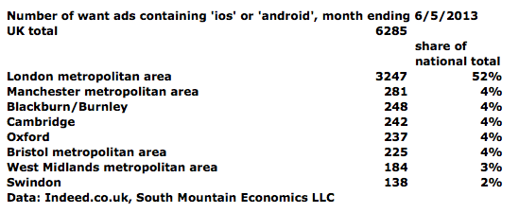
Real-time skills needs dashboard
Ongoing Nesta funded project by Michael Mandel and Judith Scherer, South Mountain Economics
Notes:
Advantages of job ads:
Publicly available, with real-updating
Contain information on job locations and skills required
Are available as universe counts (not samples)
Are available as very detailed geographies and occupation definitions
Disadvantages:
Do not have a one-to-one relationship between want ads and job openings. One job opening may generate multiple ads. Conversely, one ad may correspond to multiple job openings.
Are not used in the same way in different occupations
Don’t necessarily have a stable relationship with hiring and employment (i.e. job boards may open and close)
Are not always available with historical data

Slide 19
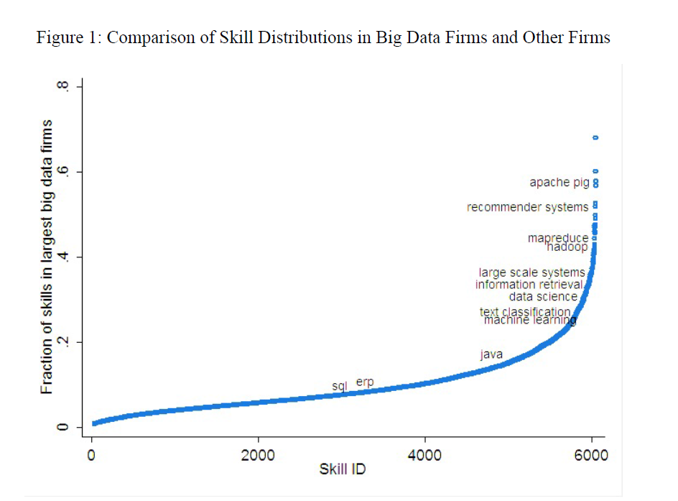
Prasanna Tambe – Big Data Investment, Skills and Firm Value
Using Big Data to map Big Data skills
Reference: Tambe, P. (2013) ‘Big Data Investment, Skills and Firm Value’, forthcoming in Management Science. Accessed at: http://papers.ssrn.com/sol3/papers.cfm?abstract_id=2294077

Slide 20
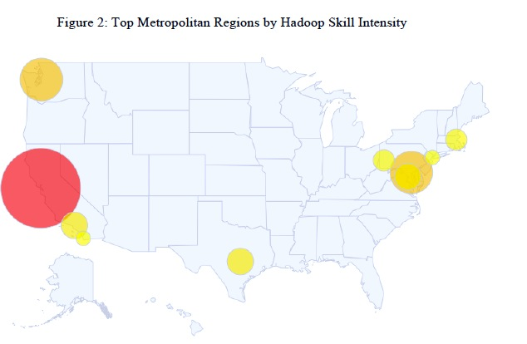

Using Big Data to map Big Data skills
Tambe (forthcoming) uses data from LinkedIn profiles to measure Big Data clustering, and spillovers from firm investments in Big Data skills.
Notes:
HASAN

Slide 21
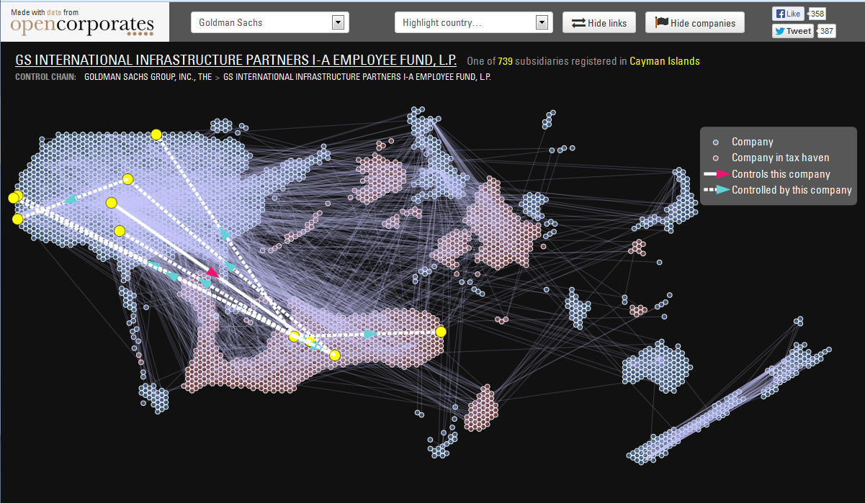
Who owns that company?
Notes:
LOUISE

Slide 22
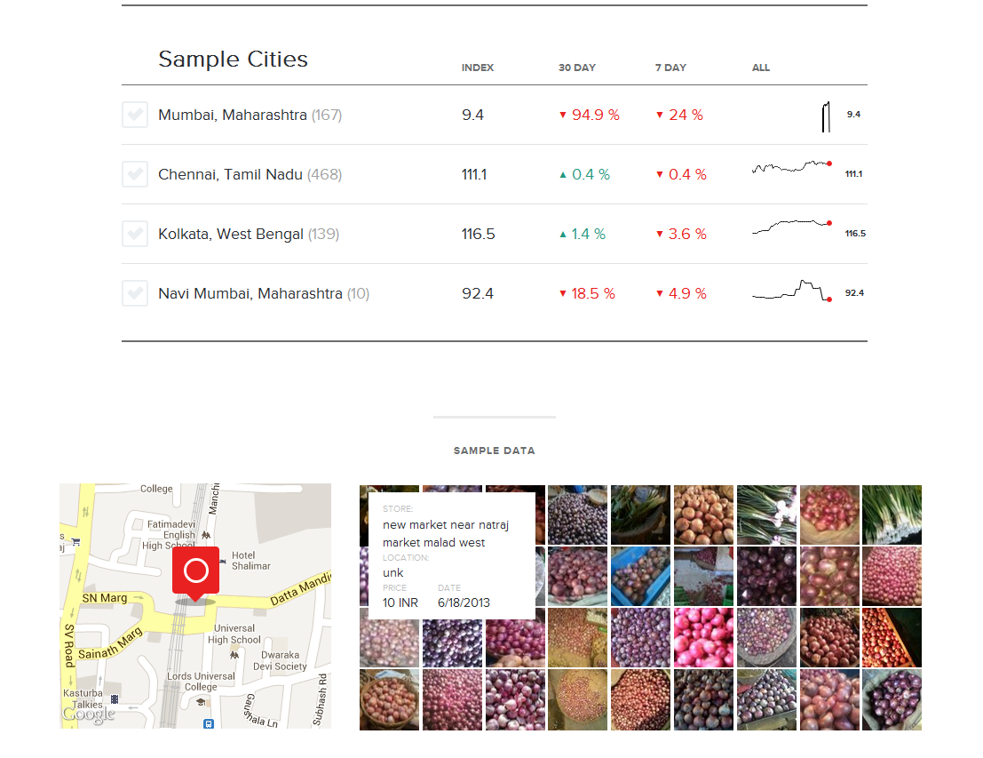
Premise – mobile sourcing of inflation and price data
Notes:
LOUISE
Street teams in 25+ global cities
Online shoppers in 30 countries
Photos as the basis of the information
Create a map of local or country-wide economic activity
--- what this illustrates ----
Real-time data as compared to months old data – especially when prices are so volatile.
Also ability to build custom indices for different citizen experiences e.g. in Mumbai versus Kerala, or for different demographics.
“Government data is a blunter instrument than people need”
http://www.theatlantic.com/business/archive/2013/10/the-price-network/280553/
http://www.premise.com/

Slide 23

What’s next?
Linking together much more government data (IP, research, procurement, grants)
More and better classifications/folksonomies
More open data from governments and businesses (broadband speeds? cellular coverage?)
Better analysis of social media and other online data sources (job ads, media, links)
Notes:
LOUISE

Slide 24
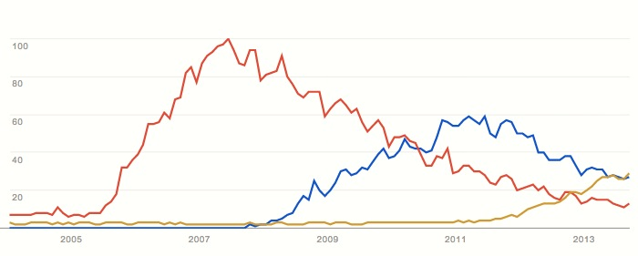
Everyone is talking about data
Web 2.0
Cloud computing
Big Data
Source: Google Trends
…but the discussion is remarkably data-free
Notes:
HASAN

Slide 25
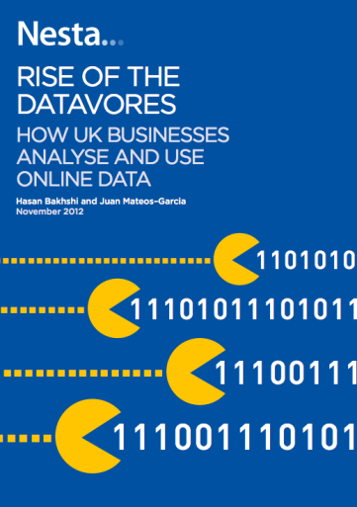
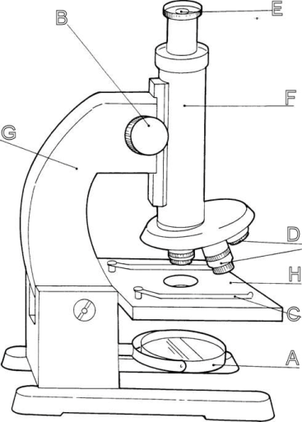

Understanding the “datavores”
1. Rise of the Datavores
(Nov 2012)
2. Growth of the Datavores (forthcoming)
3. Skills of the Datavores
(2014)
…
We create data about use of data in UK businesses
=> 18% of datavores vs 43% of dataphobes
We estimate the links between data use and productivity, and identify synergies between data, employee empowerment & process innovation
We will measure skills and knowledge of productive data talent, and identify good practices to manage & organise it
Notes:
HASAN

Slide 26
What next?
Questions?
How would economic policy look different if this all happens?
We’re looking for new partners with interesting approaches, datasets or puzzles.
hasan.bakhshi@nesta.org.uk
louise.marston@nesta.org.uk
stian.westlake@nesta.org.uk
@hasanbakhshi
@louisemarston
@stianwestlake
Notes:
What can you do? If you know of an interesting set of data that you use or that your company has, that might be useful for research, come and talk to us. And if you can think of a good question about innovation that we could be using this data to answer, tell me that too.

