Slide 1
m
g r a
f t
i
Interactive graphics in Pharma R&D:
The right decision
Francois Mercier, @mgrafit
Strata-EU 2013, London, 12-Nov-2013

Slide 2


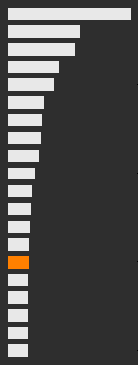
2,500,000
Multiple
Sclerosis
People with MS, in the world
Mainly in western countries
Mainly women 35-45 y.o.
Development of a new drug in MS
300-600 M€
Cost &
Pr(Failure)
#15 in R&D spending (~2 $bn/yr)
7-12 years
Price of a marketed MS treatment
30-45 k€/year/patient
*http://www.imshealth.com/, http://www.nationalmssociety.org/index.aspx
1/12

Slide 3
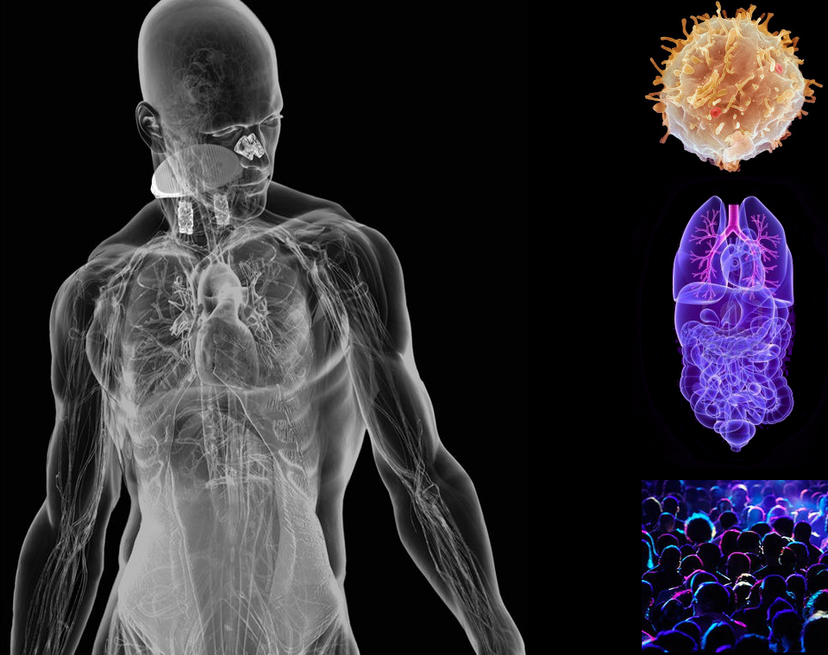
Complex
Systems
2/12

Slide 4

NDA
Review
MA
Pharma
R&D
Roadmap
Phase III (confirmatory)
EOP2
PoC
Phase II
Phase I (FiH, safety profiling)
IND
Pre-clinical ADME
Lead optimization
Lead discovery
Target identification
3/15

Slide 5


Regulatory
Enviro-
nment
IN THE INTEREST OF ALL,
STAY INSIDE THE BOX
Data analyses have to be reproducible
Source data are safely stored and data manipulation are traced
Data analyses are available in the form of programs (no GUI)
4/15

Slide 6
From Patient
To Data
Subject (healthy or ill)
Labs (biofluids, images, other samples)
Nurse
Physician
Mobile devices (cardiac function, vital signs)
Data Warehouse
100 subjects ≈ 1-5 GB
5/15

Slide 7

From
Data To
Decision
Raw data
Data manager
Data scientist
Clinical project leader
Therapeutic area head
Clinical development head
Distillated information
Pharmaceutical division head
6/15

Slide 8

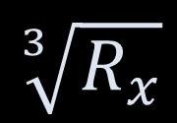
Clinical
Develop.
Strategy
Data manager
$$\sqrt[3]{R_{x}}$$
Data scientist
In clinical projects, a strategy is defined as a compromise between money and science
Clinical project leader
Therapeutic area head
$$€$$
Clinical development head
Pharmaceutical division head
7/15

Slide 9


Decision
Making
Process
?
Collect
Visualize
Refine
Model
Communicate
8/15

Slide 10
Commu-
Nication
Risks
Raw data
RISKS
Loss of information
Mute assumptions
Compromises
Lack of integration
Misinterpretation
How to mitigate these risks?
We use models and graphics
Distillated information
9/15

Slide 11
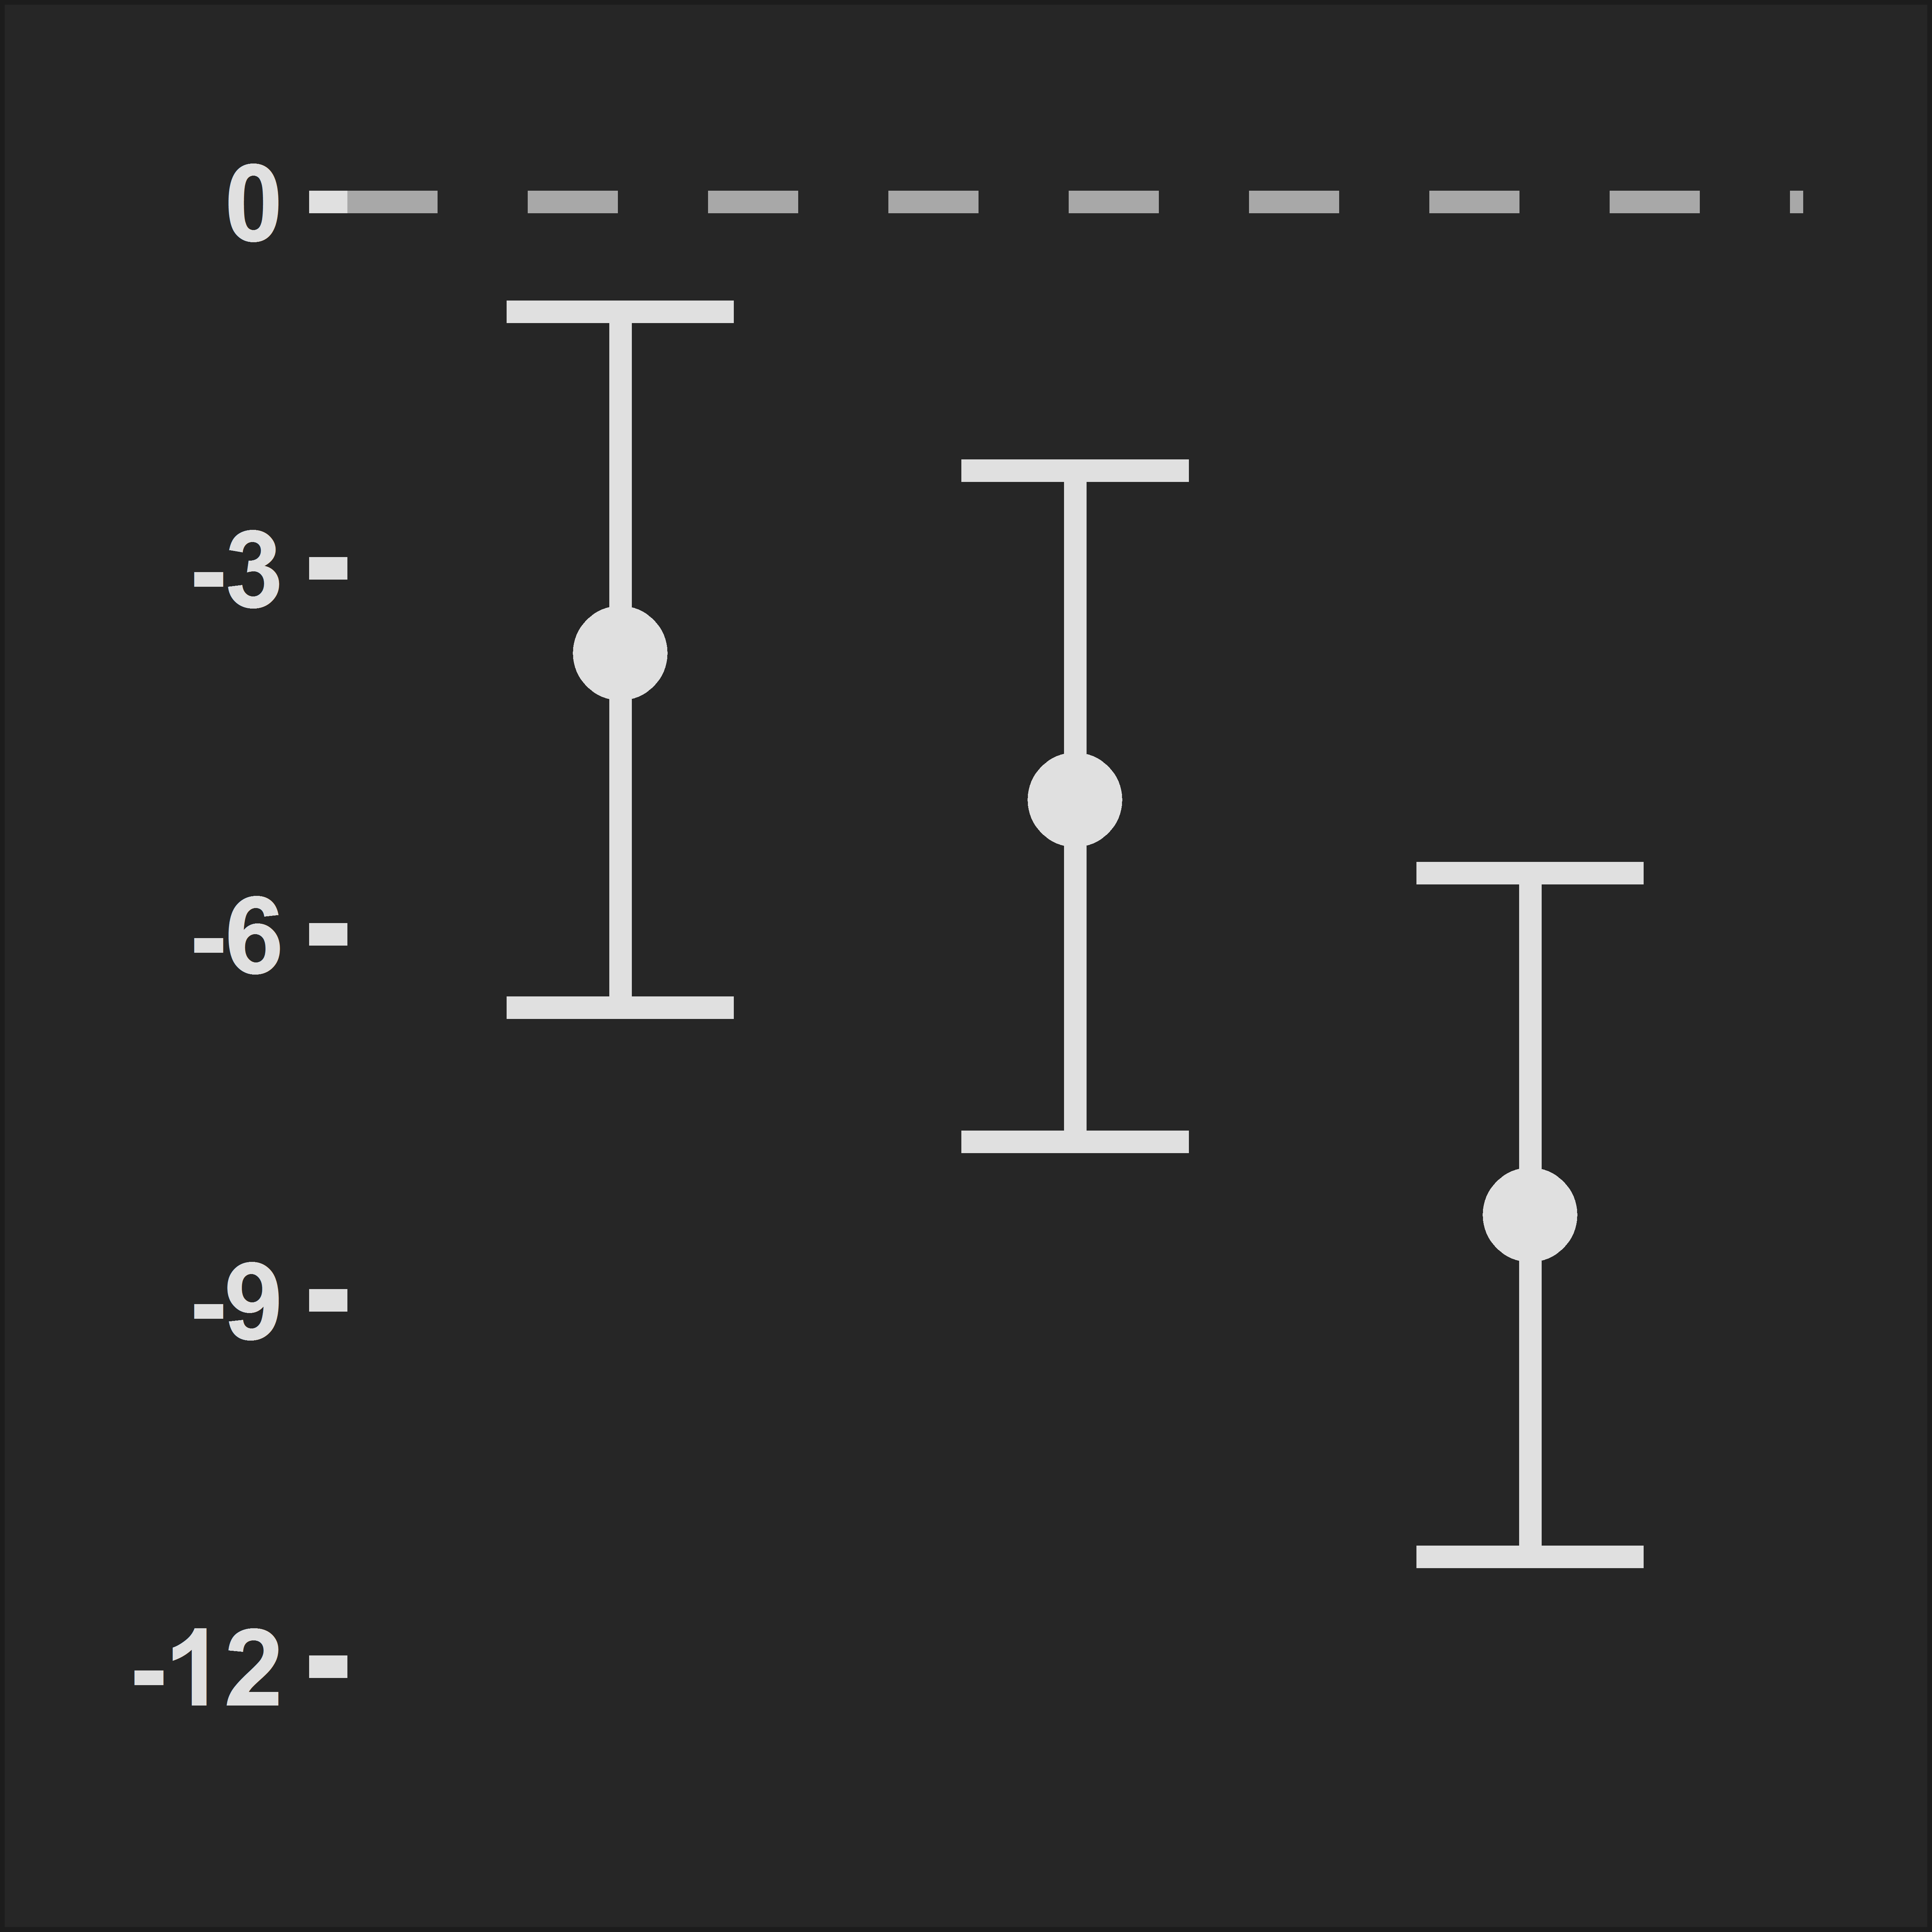

Two sides of the same coin
Models
&
Graphics
Model
Visualize
$${∆SBP}_{ij}=β_{i}+{ε }_{ij}$$
$${ε }_{ij}\sim N\left(0, σ^{2}\right)$$
$$i=\left\{1, 2, 3\right\}$$
$$j=\left\{1, ⋯,N\right\}$$
ΔSBP (mm Hg)
Gaussian distrib⁰
Homoscedasticity
Dose is discrete
10
30
100
Darusentan dose (mg)*
− Mathematical language
+ Assumptions
+ Universal language
− Limited in space and form (2D)
*Data from Nakov et al. Am. J. Hypertension, 2002, 15:583-9.
10/15

Slide 12

Real life
Is
Complex
How many static graphics to depict this model?
$$Y_{ij}={MESOR}_{i}×\left(1+\sum_{k=1}^{K}{{Amp}_{ik}×cos\left(\frac{2π}{24}×k×\left(t_{j}−φ_{ik}\right)\right)}\right)+ε_{ij}$$
$${MESOR}_{i}={AMESOR}_{i}×exp\left(η_{1i}\right)$$
$${Amp}_{ik}={Amp}_{k}×exp\left(η_{2ki}\right)$$
$$φ_{ik}=φ_{k}×exp\left(η_{\left(2k+1\right)i}\right)$$
$${AMESOR}_{i}=θ_{0}×\left(1+\frac{E_{max,i}×{{Dose}_{ij}}^{Hill}}{{{EC}_{50}}^{Hill}+{{Dose}_{ij}}^{Hill}}\right)$$
$$E_{max,i}=θ_{1}×\left(1+γ×{Sex}_{i}=2\right)$$
$${ε }_{ij}\sim N\left(0, σ^{2}\right)$$
11/15

Slide 13
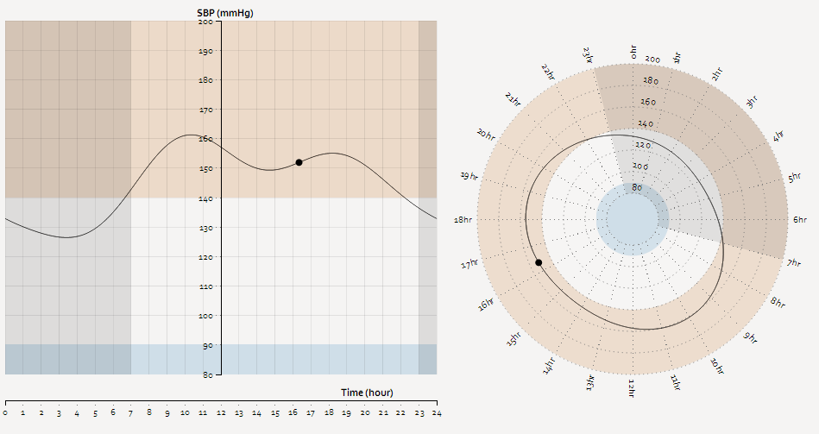
Interactive
Graphics
Use interactive graphics
12/15

Slide 14
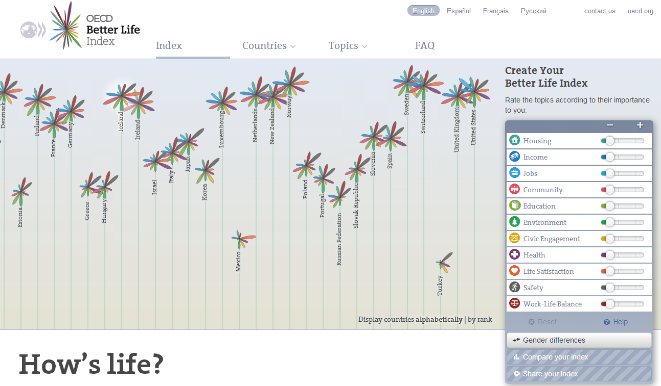
Interactive
Graphics
Use interactive graphics
13/15

Slide 15
Conclusion
Interactive graphics in Pharma R&D:
The right decision
Give control to the end-user
Make scientific discussions an enjoyable experience
Provide context, perspective
Make the assumptions explicit
To take quick and accurate decisions
14/15

Slide 16
Acknow
Ledgments
Jean Mercier (http://www.khawai.com/)
Olivier Luttringer (Novartis)
Hadley Wickham (http://had.co.nz/)
Mike Bostock (http://bost.ocks.org/mike/)
15/15

Slide 17
m
g r a
f t
i
Thank you
Francois MERCIER
francois0mercier@gmail.com
http://www.mgrafit.com

